Slide 1
+
EXORA HEALTH
HOSPITAL GROWTH PROPOSAL
Turn every patient enquiry
into a booked appointment
AI voice receptionist, WhatsApp booking, web booking and one staff workspace
PHASE 1 • PATIENT ACQUISITION
Built to extend into a complete HMS
Director presentation | 19 October 2026
Notes:
Open with the business outcome: more enquiries converted into confirmed appointments.
Position the HMS as the expansion path after the patient acquisition layer is stable.

Slide 2
The patient journey breaks before care begins
Hospitals lose demand when phone, WhatsApp and website enquiries operate as separate queues.
01
Calls arrive when reception is busy
Missed calls and repeated follow-ups
02
WhatsApp conversations stay manual
Slow replies and inconsistent booking
03
Website forms do not see live schedules
Staff must call patients again
04
Channel activity is hard to measure
No shared view of demand and conversion
The first goal is simple: answer faster, show real availability and confirm the booking in the same interaction.
EXORA HEALTH
02
Notes:
Avoid claiming a current loss percentage unless the hospital supplies data.
Ask where most enquiries currently arrive and when reception pressure peaks.

Slide 3
Phase 1: one patient acquisition system
Four entry points connect to the same appointment workflow.
1
2
3
4
AI voice
WhatsApp
Hospital website
Staff desk
Answers enquiries and books
Guided automated booking
Live doctor and slot selection
Manual booking and oversight
Shared booking engine
Doctors • services • schedules • availability • confirmations
Every confirmed appointment appears in the hospital workspace.
EXORA HEALTH
03
Notes:
Stress that the channels do not maintain separate calendars.
A single booking engine reduces double handling and supports consistent reporting.

Slide 4
A shorter path from enquiry to appointment
The system keeps the patient in the same channel while the hospital retains control.
1
2
3
4
5
Patient contacts the hospital
System understands the need
Live slots are offered
Patient confirms
Staff sees the booking
Voice, WhatsApp or web
Speciality, doctor, visit mode
Only current availability
Name, phone and consent
One queue and audit trail
Built-in controls
Slot holds prevent duplicate booking. Tenant isolation separates hospital data. Staff can review channel history and intervene when needed.
EXORA HEALTH
04
Notes:
Walk through one example: a caller asks for a cardiology appointment, hears available slots and confirms without waiting for reception.
Mention that staff remain able to review and correct exceptions.

Slide 5
AI voice receptionist
A dedicated hospital front desk that can answer, check availability and complete bookings.
Answers routine enquiries
Doctors, services, locations and hours
VOICE
Books against live schedules
Holds and confirms the selected slot
Escalates exceptions to staff
Reception handles sensitive or unclear cases
Dedicated number
Call history
Assigned to the hospital tenant
Review outcomes and recordings where consent permits
Keeps every tenant isolated
Separate credentials, database and audit boundary
Activation requires the hospital’s approved phone and provider setup.
EXORA HEALTH
05
Notes:
Demo the assigned number and call history if available.
Do not promise medical advice. Keep the voice agent focused on front desk information and appointments.

Slide 6
WhatsApp automated booking
A guided conversation can turn a message into a confirmed appointment, with staff handoff when needed.
WhatsApp
1
Live availability
Uses the same doctor schedules as voice and web
Patient
I need a skin specialist tomorrow
2
Explicit confirmation
Exora
Collects the details required before booking
Dr Meera has 10:30 AM and 12:00 PM available.
3
Human handoff
Patient
10:30 AM
Stops automation when the patient asks for staff
Exora
Please confirm the patient name and booking consent.
4
Controlled launch
Meta account, number and templates require approval
EXORA HEALTH
06
Notes:
Frame WhatsApp as a guided booking journey, not an open-ended medical chatbot.
Provider activation depends on the hospital’s Meta Business and phone-number readiness.

Slide 7
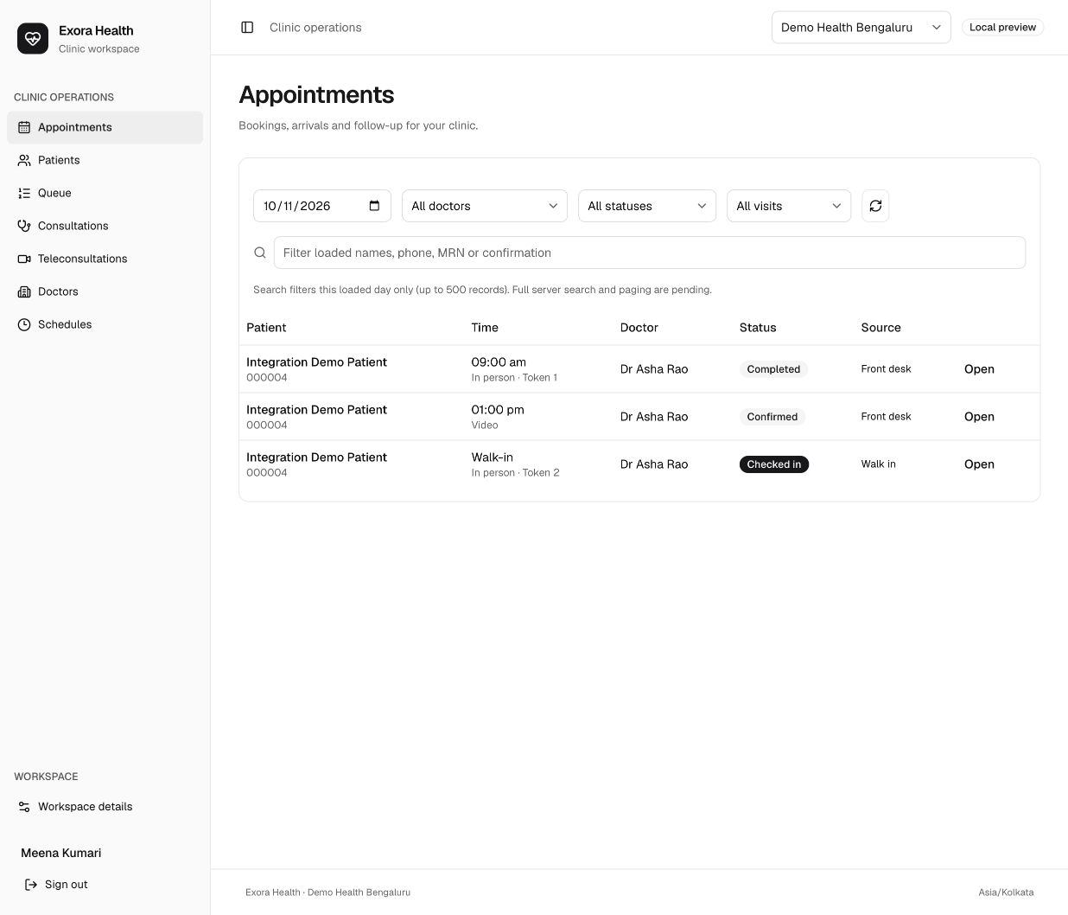
One workspace for reception and management
Bookings from every channel arrive in the same operational view.
Appointments
Book, reschedule, cancel and check in
Patients
Search and register patient details
Queues
Track walk-ins and consultation flow
Channel oversight
Review voice and WhatsApp activity
Designed for hospital roles and permissions
EXORA HEALTH
07
Notes:
The dashboard becomes the hospital’s operational source of truth for appointments.
Role-based access limits what front desk, clinicians and administrators can see or change.

Slide 8
Phase 2: expand into the complete HMS
The acquisition layer becomes the digital front door for a broader hospital operating system.
FOUNDATION AVAILABLE
PLANNED EXPANSION
Patient + OPD core
Hospital-wide modules
Patient registration and records
1
Diagnostics and imaging
Doctor schedules and appointments
2
Pharmacy and inventory
Check-in, queue and encounters
3
Billing, payments and insurance
Clinical notes and Virtual OPD
4
Inpatient, beds and theatre operations
Scope, workflow and rollout sequence will be agreed with hospital leadership before Phase 2.
EXORA HEALTH
08
Notes:
Separate what exists now from what follows later.
Use Phase 1 operating data and staff feedback to prioritise the HMS rollout.

Slide 9
A controlled rollout around one pilot facility
Each stage has a clear operational owner and acceptance check.
01
02
03
04
Discover
Configure
Pilot
Expand
Confirm departments, doctors, schedules, FAQs and escalation rules
Brand the website, connect channels and train the receptionist agent
Launch with selected departments, monitor bookings and support staff
Add departments and channels, then begin the agreed HMS roadmap
Pilot success measures
Enquiries answered • confirmed bookings • time to confirmation • staff interventions • patient drop-off
EXORA HEALTH
09
Notes:
Do not commit dates before confirming integrations, data readiness and approval owners.
Recommend one facility or department first so both teams can validate the patient journey quickly.

Slide 10
RECOMMENDED NEXT STEP
Approve a focused patient acquisition pilot
Launch the channels that matter most, measure conversion, and use the same platform as the foundation for HMS expansion.
1 pilot facility
4 connected entry points
One booking source
Selected departments and doctors
Voice, WhatsApp, web and staff desk
Clear ownership and measurable outcomes
Decision for tomorrow: nominate the pilot facility, operational owner and preferred first channel.
EXORA HEALTH
10
Notes:
Close by asking for a pilot sponsor and a working session with reception and IT.
Offer a short demonstration of voice, web booking and the staff workspace after the discussion.

