Slide 1



RETAIL SALES ANALYSIS
A Data Engineering Case Study
Presented By:
Vishnu Kothapalle
Sai Teja Mudapalli
Chitti Babu
Nirja Gupta

Slide 2

PROJECT INTRODUCTION
This project builds a complete end-to-end retail data pipeline on Snowflake Project Explanation
.
  Ingest raw files from AWS S3 using Snowpipe
  Process through Bronze → Silver → Gold
  Apply cleaning using Snowpark, PySpark, dbt
  Maintain SCD Type-2 dimensions
  Automate with Streams & Tasks
  Power insights through dashboards

Slide 3

Problem Statement
Modern retail companies generate massive volumes of transactional data, which is often:
• Scattered across multiple sources
• Inconsistent and difficult to analyze
• Filled with quality issues
A scalable and structured data pipeline is required to:
• Clean and standardize data
• Maintain data quality
• Support analytics and reporting
• Automate updates and ensure accuracy

Slide 4
Project Objectives
Primary Objective:
To design and implement an end-to-end, scalable retail analytics platform on Snowflake using the Medallion Architecture.
Specific Objectives:
  Raw data is converted into parquet using AWS Glue which internally uses PySpark Script
  Ingest raw data using External Stages + Snowpipe
  Clean and validate data using Snowpark, PySpark, and dbt
  Enforce data quality using dbt tests and custom validations
  Build fact and dimension tables in the Gold layer
  Implement incremental processing with Streams & Tasks
  Apply SCD Type-2 for historical tracking
  Enable analytics for pricing, returns, and customer behavior

Slide 5
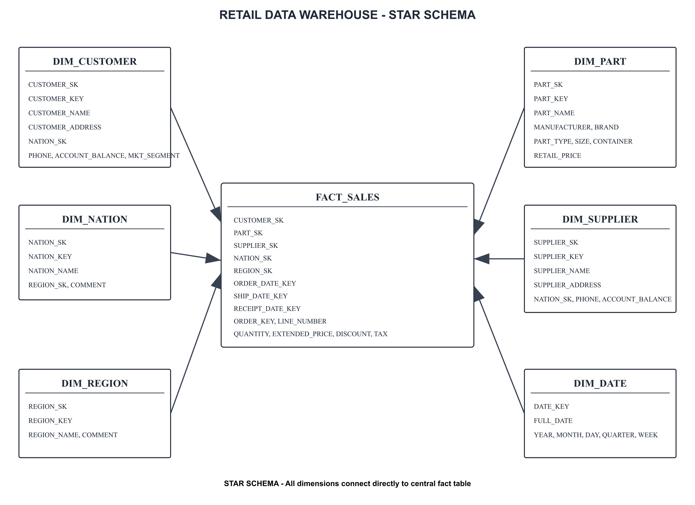
Data Modelling

Slide 6
High-Level Architecture
AWS S3 → Snowpipe → Bronze → Streams → Silver (Snowpark + dbt) → Streams →Gold (SCD2) → Analytical Views → Dashboard
Project Explanation
  Snowpipe auto-loads raw data
  Silver layer uses Snowpark cleaning + dbt modeling
  Gold layer maintains SCD2 dimensions + Fact_Sales
  Tasks automate end-to-end pipeline
  Dashboard analytical views
Tools & Technologies:
Cloud & Storage (AWS S3, Snowflake),
Data Ingestion (External Stage, Parquet Format Snowpipe), Transformations (Snowpark (Python) PySpark ,SQL , dbt Cloud)

Slide 7
Data Processing Approaches
(Batch + Streaming)
Batch Processing
Technologies: AWS Glue, AWS S3, PySpark, Snowflake, dbt
What Happens:
  Large files processed in scheduled batches
  Cleaning & transformations in Snowpark / dbt
  Gold tables refreshed periodically
Real-Time Streaming
Technologies: Snowflake Streams, Tasks, dbt incremental models
What Happens:
  Streams capture new/updated rows
  Tasks merge changes into SCD2 dimensions
  Near real-time analytics enabled

Slide 8
Medallion Architecture (Bronze, Silver, Gold)
Bronze – Raw Data
  Raw Parquet files
  Auto-ingestion via Snowpipe
  No transformations (source of truth) Project Explanation
Silver – Cleaned & Standardized
Includes 3 processing stages:
  Staging Load using Streams (Bronze → STG)
  Snowpark Cleaning: null handling, trimming, date parsing, negative → 0, phone cleaning, NET_PRICE calc, audit logs
  dbt Models: mode/median imputations, deduplication, FK checks, business rules
Gold – Business Layer
  SCD2 Dimensions (Customer, Supplier, Part)
  Fact_Sales built from all Silver tables
  Contains pricing, discount, tax, return info

Slide 9
End-to-End Data Pipeline Flow
1. Data Ingestion:
• Raw files stored in S3
• Loaded using Snowpipe
2. Transformation:
• Bronze → Silver cleaning via Snowpark/dbt
• Silver → Gold modeling via dbt
3. Data Quality:
• dbt tests: not_null, unique, relationships, numeric rules
4. Incremental Processing:
• Streams track changes
• Tasks automate refresh
5. Analytics:
• Pricing, discounts, returns, customer insights

Slide 10
SCD Type-2 & Audit Logging
SCD TYPE-2
Implemented for Customer, Supplier, Product:
  Streams detect changed records
  Procedure expires old row → CURRENT_FLAG = FALSE
  Inserts new row with CURRENT_FLAG = TRUE
  Maintains full historical tracking
Audit Logging
  Snowpark cleansing procedures log all data quality actions (null fixes, type corrections, negative-to-zero conversions, date parsing).
  Audit tables capture metadata such as load time, record counts, source file name, and transformation status.
  dbt tests generate failure logs for invalid values, FK violations, duplicates, and rule breaches.
  Ingestion-level errors (bad rows, parsing failures) are recorded using Snowflake COPY_HISTORY and ERROR views.
  Time Travel enables audit-level traceability, letting us query historical data versions for debugging and compliance.

Slide 11
Time Travel & Orchestration
Time Travel
Used for debugging & audit:
  Query past versions of tables
  Validate SCD2 behavior
  Restore accidental updates
Examples:
AT (TIMESTAMP => DATEADD(MINUTE,-10,CURRENT_TIMESTAMP()))
BEFORE (OFFSET => -3*60*60)
Tasks & Job Orchestration
  Snowpipe auto-ingests raw Parquet files from AWS S3 into the Bronze layer.
  Streams capture incremental CDC changes from Bronze → Silver → Gold.
  Snowflake Tasks orchestrate the ELT workflow, triggering:
    Bronze → Silver staging load
    Snowpark cleansing procedures
    dbt model execution (staging → marts)
    SCD Type-2 dimension updates in Gold
  Pipeline runs on a scheduled DAG of Tasks, ensuring continuous, fully automated data refresh.

Slide 12
Data Quality
Applied at Silver layer using dbt + custom logic:
  Schema Tests: not-null, unique, FK
  Cleaning Rules: null fill, trimming, date parsing
  Business Rules:
    discount (0–1)
    tax ≥ 0
    non-negative price/quantity
  Custom Tests: digits_only (phone), non_negative, string cleanliness
  Audit Logs after every dbt model run

Slide 13
Dashboard Highlights
Metrics shown:
  Total revenue, quantity, avg discount
  Missing value summary
  Outlier detection & distribution
  Campaign performance (success vs failure)
  Monthly/Quarterly pricing charts
  Discount vs Sales impact
  Return rate heatmaps
  Line-item performance comparisons

Slide 14

THANK YOU
For Your Attention

