Slide 1
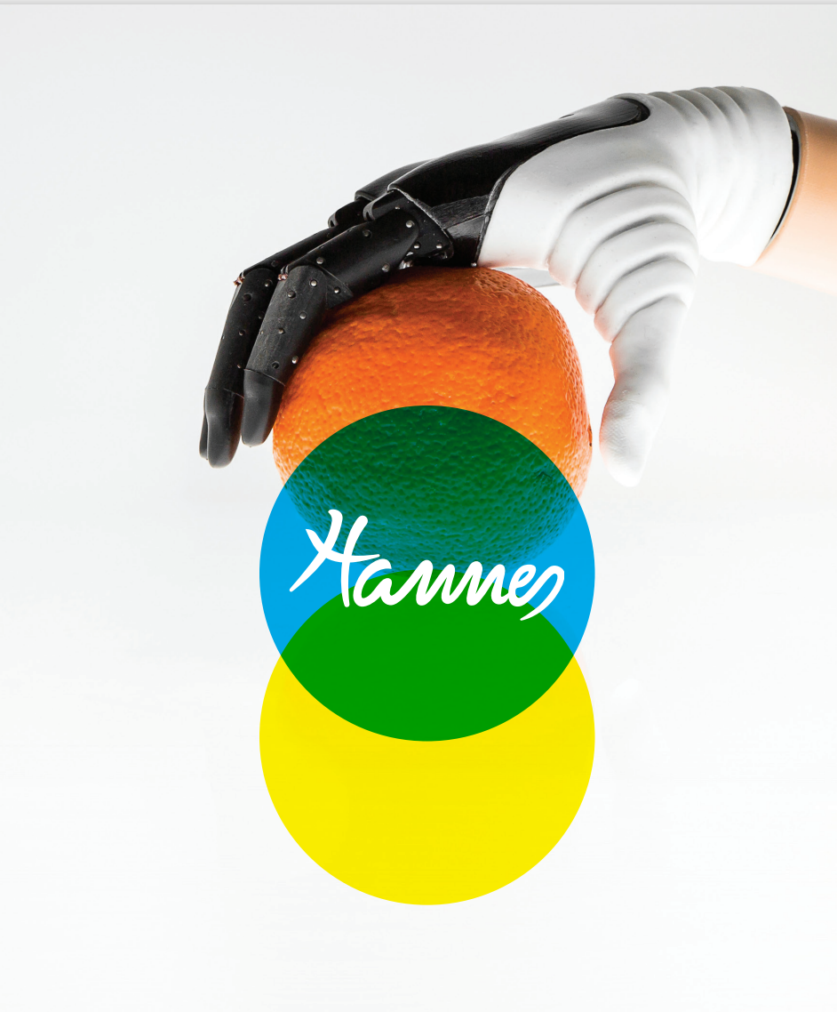
HANNES transradial HAND PROSTHESIS
Yeshwanth Guru Krishnakumar
Koushikmani Maskalmatti Lakshman
Anderson Siqueira De Andrade
Suraj Deshini
BIOMEDICAL ROBOTICS
GROUP-8

Slide 2
CONTENT
Hannes hand Prosthesis
Mechanical Model
Materials and methods
Hanne's system with electronic part
System components
User analysis during the rehabilitation Training
Features of Hannes hand prosthesis with further Development
References

Slide 3
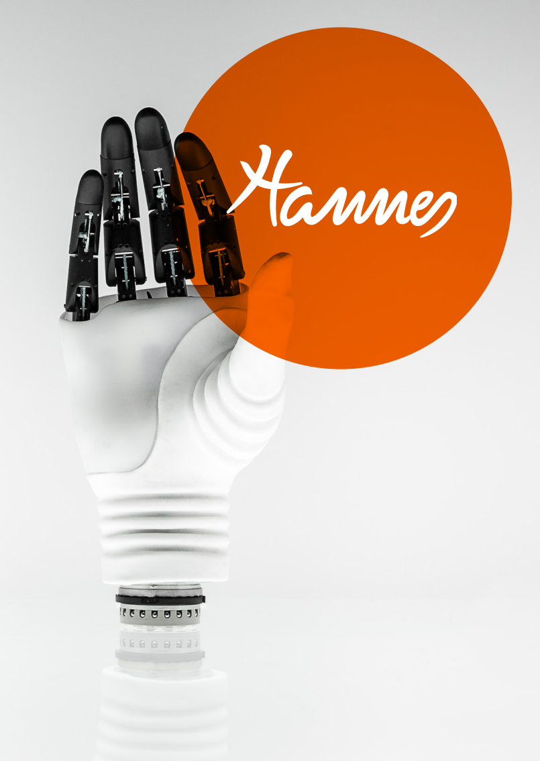
Hannes Hand Prosthesis
Hannes, is the myo-electric controlled, polyarticulated, robotic hand prosthesis made by the joint laboratory Rehab Technologies IIT – INAIL. This is the result of the collaboration between the Instituto Italiano di Technologia and the INAIL Prosthesis Centre in Budrio. The prosthetic hand, designed inspired by nature, is able for people who suffered the amputation of the upper limb to return more than 90% of the lost functionality and is characterized by extreme versatility, no invasiveness, ease of use, robustness and a weight similar to that of a human hand.

Slide 4
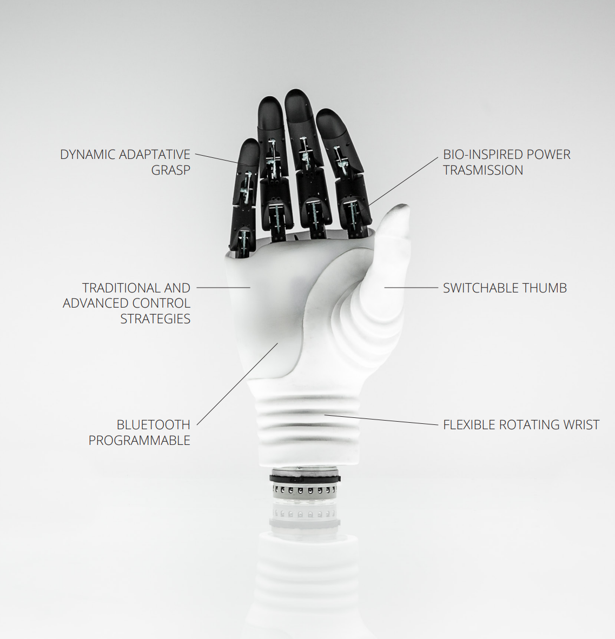
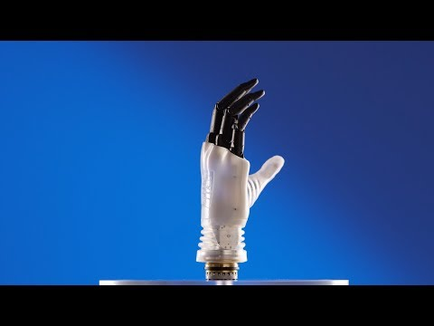
Mechanical model of prosthesis hand

Slide 5
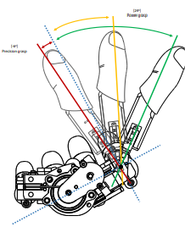
three stable rotation positions of the thumb
Fingers can be positioned in abduction/adduction in three equally spaced stable positions along an ROM of approximately 60°.
These positions are stabilized by using a custom spring-based mechanical plunger integrated in the metacarpal phalanx of the robotic thumb.
The tip of the mechanical plunger has an appropriate shape in order to engage with its female counterpart that is machined in the palm frame.

Slide 6
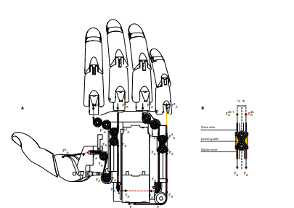
Forces acting in the palm mechanism
The schematic shows the distribution of forces, which results from the tension applied by the leader and follower wires, and detail of the custom-made bush bearing.

Slide 7
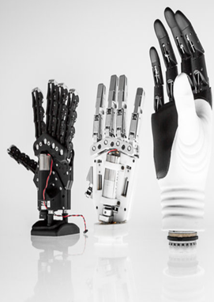
Material'S and methods
The main idea of the innovations is the achievement of naturalness of forms, movements and orientation of the rotation axes and hand posture
Hannes incorporates key biometric properties that make this prosthesis uniquely similar to a human hand. The anthropometry of the real hand has guided the prosthetic design, from aesthetic to structural features, allowing the user to perceive the prosthesis not as an external tool but rather as an integral part of the body

Slide 8
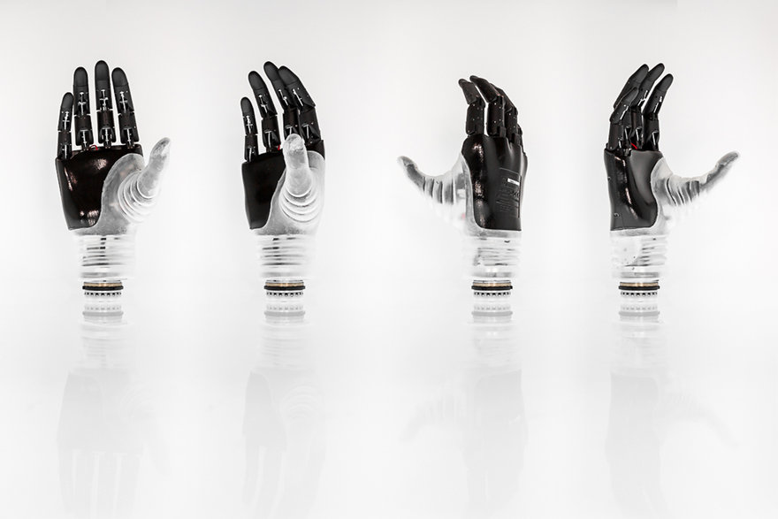
Technical features
SIZES: 7¾ L, 7 ¾ R, 8 ¼ L, 8 ¼ R
GRIP STRENGTH: 150N
GRASP TIME: 1.1 s
WEIGHT: 480 g (SIZE 7¾)
LENGTH: 174 mm (SIZE 7¾)
AUTONOMY: 1 DAY

Slide 9
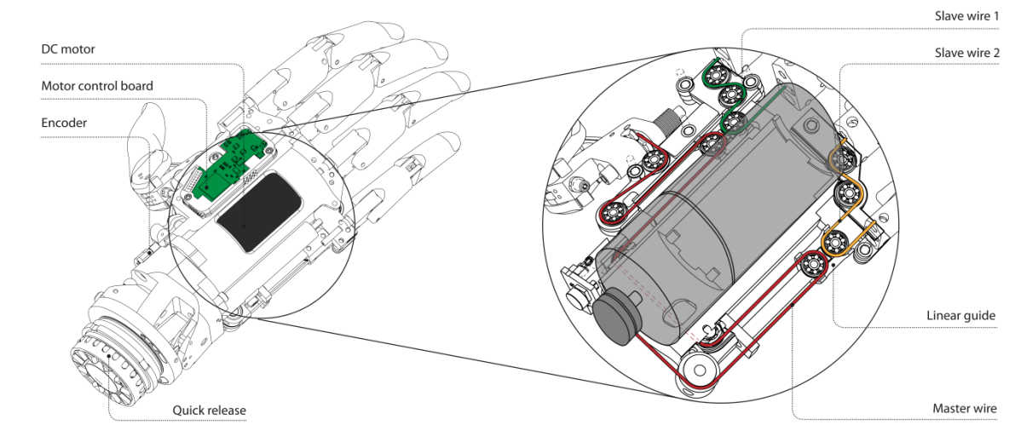
Transmission mechanism based on dag system

Slide 10
TRANSMISSION MECHANISM BASED ON DAG SYSTEM CONTINUE
The prosthetic hand, called Hannes, incorporates high levels of biomimicry through the concurrence of anthropomorphism, performance, and functionality, which lead to better performance compared with other existing research and commercial prosthetic devices
The motor drive actuates the leader wire, thus transmitting the force to the cable-based mechanism accommodated in the palm.

Slide 11
TRANSMISSION MECHANISM BASED ON DAG SYSTEM
CONTINUE
There are two follower wires the first one is moves the index and middle finger, while the second follower wire is used to actuate the ring and little finger.
The thumb can assume three different positions to reproduce different grasping movements: pinch, power and lateral configurations
Hannes hand is available in two different sizes (small and large) to realize a prosthetic device with anthropometric dimensions as similar as those of the amputee.

Slide 12
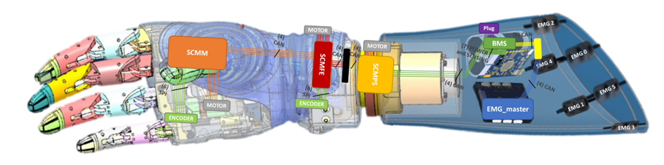
Hannes system with electronic part(Electrode)
The interaction between the three main components of Hannes system is implemented through CAN bus and Slip Rings.
The six EMG sensors send information through wires-connection to the EMG-Master.
This electronic board contains the firmware responsible for translating the electromyographic signals into the class related to the movement that the amputee wants to perform.
The EMG-Master is the core board of the whole Hannes system and it is intended for multiple functionalities.

Slide 13
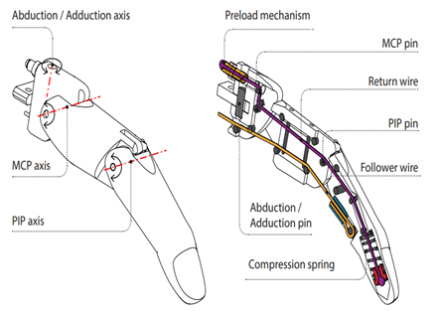
Hannes Mechatronics
Fingers
The mechanism depends on dowel pins to guide the wires in the fingers and to maximize the integration density and robustness.
The wire which is located at the top is used for the extension of the finger.
When the motor applies torque, follower and return wires both get tensioned, which results in a compression of the extension spring. Therefore, the tensioned return wire produces torque on the MCP and PIP joints that is an antagonist to the torque generated by the follower wire.

Slide 14
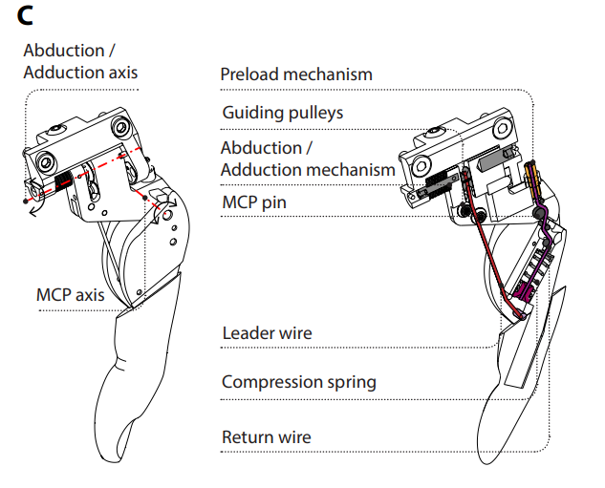
CONTINUE
Thumb
The thumb comprises an active abduction/adduction joint that operates similarly to the MCP joint of the fingers, whereas the IP and DIP joints are locked.
The thumb rotation is implemented by a custom-made spring-based plunger mechanism.
The closure timing of the thumb can be synchronized with the fingers by means of a screw-based mechanism that acts on the preload of the corresponding return wire. This is crucial to perform precision grasps correctly.

Slide 15
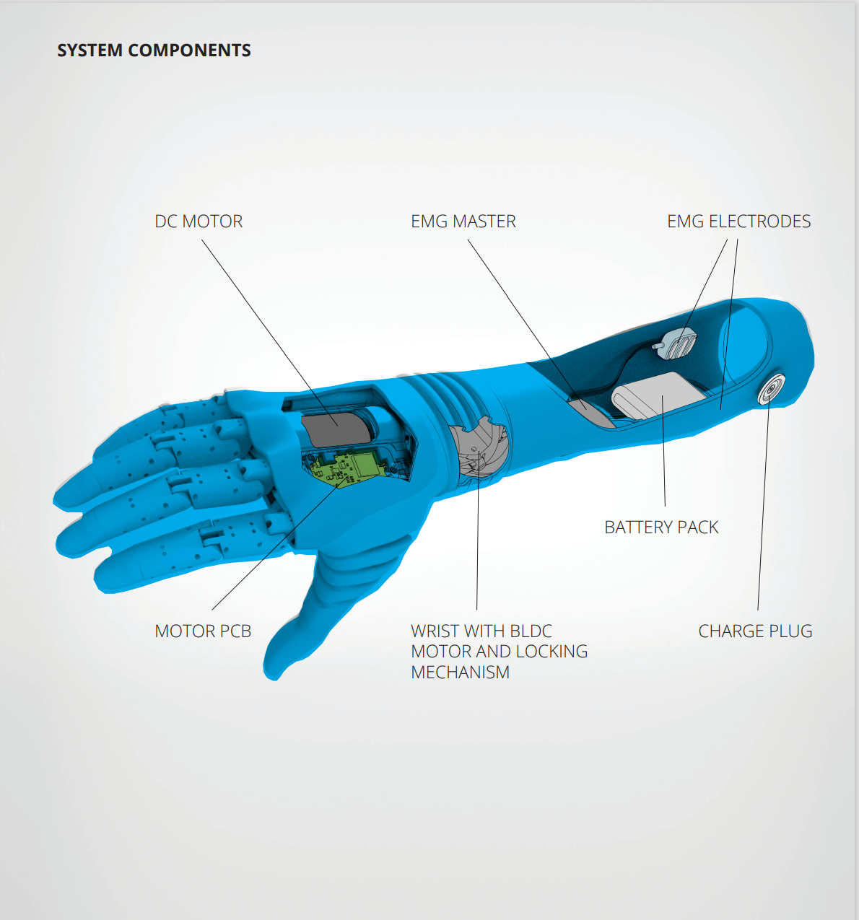
System components
The Hannes Prosthetic arm is composed of three main components, which are:
A myoelectric polyarticulated prosthetic arm
A passive Flexion Extension wrist module, and
A myoelectric interface/controller that includes two surface electromyographic sensors, a battery pack and control electronics.

Slide 16
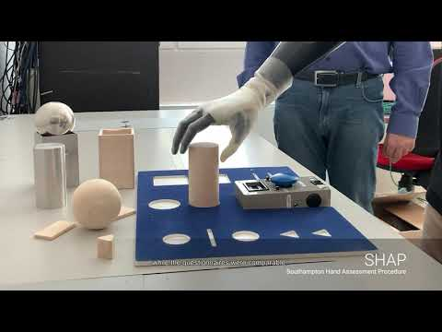
analysis executed during the rehabilitative training with Hannes.
Full and partial opening/closing of the prosthetic hand
Grasping and manipulating wooden objects of different shape (cubes, cylinders, etc.)
Grasping and manipulating small objects such as buttons or coins
Grasping, manipulating and releasing cups made of different materials (i.e., plastic or glass)
Laying and clearing a table
Tidying up a room
Utilizing cutlery
Cutting an apple and spreading butter on toast
Utilizing a toothbrush and toothpaste
Opening and closing doors using handles and locking/unlocking doors
Simulated driving (turn the steering wheel, shifting gears)
Utilizing occupational therapy panels with zips and strings
Tying laces
Dressing (shirts, jackets)
Writing with a pen on a sheet of paper
Using a computer keyboard

Slide 17
Features of Hannes hand prosthesis with further Development
Analysis and optimization of Hannes prosthetic :a multibody approach
Improved pattern recognition control of Hannes
Miniature EMG Sensors for Prosthetic Applications

Slide 18
References
R. Vinet, Y. Lozac’h, N. Beaudry, G. Drouin, Design methodology for a multifunctional hand prosthesis. J. Rehabil. Res. Dev. 32, 316–324 (1995).
C. Pylatiuk, A. Kargov, S. Schulz, Design and evaluation of a low-cost force feedback system for myoelectric prosthetic hands. JPO J. Prosthet. Orthot. 18, 57–61 (2006).
H. Bouwsema, C. K. van der Sluis, R. M. Bongers, Learning to control opening and closing a myoelectric hand. Arch. Phys. Med. Rehabil. 91, 1442–1446 (2010).
J. T. Belter, J. L. Segil, A. M. Dollar, R. F. Weir, Mechanical design and performance specifications of anthropomorphic prosthetic hands: A review. JRRD. 50, 599–618 (2013).
R. F. Weir, in Standard Handbook of Biomedical Engineering and Design (McGraw-Hill, New York, USA, 2004), p. 32.1–32.61.
G. K. Patel, C. Castellini, J. M. Hahne, D. Farina, S. Dosen, A Classification Method for Myoelectric Control of Hand Prostheses Inspired by Muscle Coordination. IEEE Trans. Neural Syst. Rehabil. Eng. 26, 1745–1755 (2018).
M. Zecca, S. Micera, M. C. Carrozza, P. Dario, Control of Multifunctional Prosthetic Hands by Processing the Electromyographic Signal. Crit. Rev. Biomed. Eng. 45, 383–410 (2017).

Slide 19
Thank you

