Slide 1
SR UNIVERSITY · CLOUD COMPUTING (25CAI102PC205)
NetPulse — Virtual Lab Network Traffic Light
Software-Defined Serverless Network Monitoring & Telemetry for VirtualBox Machines
Project No.: 33 | Batch: 59 | Environment: AWS Learner Lab (us-east-1)
Team Members:
• M. Yeshwanth (H.T. No: 2503A53005) — VM Networking, Python Monitor & Telemetry Engine
• V. Laxmiprasad (H.T. No: 2503A53006) — AWS Serverless Backend, DynamoDB & Dashboard
GitHub Repository: https://github.com/yeshwanthkushi25-glitch/netpulse-virtual-lab

Slide 2
SR UNIVERSITY · CLOUD COMPUTING (25CAI102PC205) · PROJECT NO. 33
Executive Summary & Why We Made It
The University Lab Problem
• In virtual networking labs, students configure VirtualBox VMs across host-only networks.
• Reachability is manually verified via terminal ping commands in isolated CLI windows.
• Ephemeral Results: Ping outputs disappear when windows close or scripts exit.
• Zero Shared Visibility: Team members and lab instructors cannot see if links are healthy.
• Silent Failures: Intermittent connection drops remain unnoticed until larger apps break.
The NetPulse Solution
• A software-defined, serverless cloud monitor functioning as a virtual traffic light.
• Standard Library Python Monitor: Runs on VM A, continuously pinging VM B.
• Instant Visual Feedback: Glowing Green = Connected, Pulsing Red = Disconnected.
• Centralized Telemetry: Dispatches JSON status to AWS API Gateway in real time.
• 100% Software Simulation: Meets course goals without needing physical ESP32 or LEDs.

Slide 3
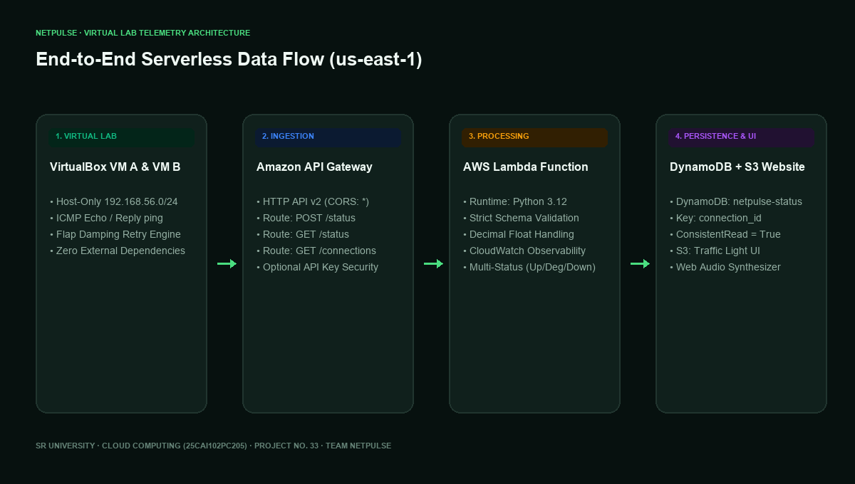
SR UNIVERSITY · CLOUD COMPUTING (25CAI102PC205) · PROJECT NO. 33
System Architecture & 4-Tier Serverless Data Flow

Slide 4
SR UNIVERSITY · CLOUD COMPUTING (25CAI102PC205) · PROJECT NO. 33
VirtualBox Dual-Adapter Networking Strategy
Virtual Machine Configuration
• Two Ubuntu Virtual Machines configured in Oracle VM VirtualBox.
• Adapter 1 (NAT): Provides outbound internet access for VM A to send status to AWS.
• Adapter 2 (Host-Only): Private internal subnet (192.168.56.0/24) for inter-VM ICMP checks.
• VM A (Monitor Host): Static IP 192.168.56.101, executes netpulse_monitor.py.
• VM B (Target Host): Static IP 192.168.56.102, listens for ICMP Echo Requests.
Link Severing & Recovery Scenarios
• Physical Simulation: Unchecking 'Cable Connected' in VirtualBox GUI on VM B.
• CLI Simulation: Executing 'sudo ip link set dev enp0s8 down' on VM B.
• Software Simulation: Invoking monitor with '--simulate down' or '--simulate degraded'.
• Interactive Dashboard Simulation: Clicking 'Simulate Link Cut' directly in web browser.
• Automatic Recovery: Reconnecting cable restores green operational state in <5 seconds.

Slide 5
SR UNIVERSITY · CLOUD COMPUTING (25CAI102PC205) · PROJECT NO. 33
Python Reachability Monitor Engine
Standard Library Architecture
• Zero External Dependencies: Built strictly with Python standard library.
• subprocess: Executes host ping commands without external ping libraries.
• urllib.request: Transmits HTTP POST JSON payloads to AWS API Gateway.
• Adaptive Cross-Platform: Automatically constructs Windows (-n) or Linux (-c) flags.
• Regex RTT Extraction: Captures sub-millisecond round-trip times accurately.
Flap Damping & Retry Threshold
• Prevents False Alarms: Transient CPU hiccups do not immediately turn the board red.
• Configurable Consecutive Failures: '--consecutive-failures 2' dampens flapping.
• Degraded Warning State: Detects jitter or single packet loss before full link drop.
• Structured Telemetry: Transmits source, target, status, latency_ms, and ISO timestamp.
• Security Header: Dispatches optional 'x-api-key' for authenticated cloud intake.

Slide 6
SR UNIVERSITY · CLOUD COMPUTING (25CAI102PC205) · PROJECT NO. 33
Serverless Compute & Persistence (Lambda + DynamoDB)
AWS Lambda Ingestion Engine
• Runtime: Python 3.12 serverless execution triggered by API Gateway HTTP API v2.
• Strict Input Validation: Validates alphanumeric identifiers, status enums, and timestamps.
• Security Enforcement: Verifies optional x-api-key / Bearer token authorization.
• Decimal Precision Handling: Converts floating-point latency to DynamoDB Decimal safe types.
• Route Dispatcher: Handles GET /status, POST /status, and GET /connections.
Amazon DynamoDB & S3 Website
• Table Schema: netpulse-status with Hash Key 'connection_id' (e.g. vm-a#vm-b).
• Consistent Read Pattern: Queries with ConsistentRead=True to prevent caching delay.
• S3 Static Website: Hosts single-page dashboard assets without EC2 server instances.
• Global CORS Headers: Returns Access-Control-Allow-Origin: * for secure browser calls.
• Learner Lab Integration: Pre-configured to utilize the default LabRole IAM policy.

Slide 7
SR UNIVERSITY · CLOUD COMPUTING (25CAI102PC205) · PROJECT NO. 33
Responsive Web Dashboard & Interactive Controls
Dashboard Capabilities
• Glanceable Visual States: Glowing Green (Up), Pulsing Amber (Degraded), Flashing Red (Down).
• Synthesized Audio Chime: Uses Web Audio API to play alert tones on status transitions.
• Telemetry Sparkline: Visualizes latency trends across the last 10 ICMP check cycles.
• Uptime Reliability Counter: Calculates real-time connection uptime percentage.
• Auto-Polling Engine: Refreshes telemetry seamlessly with visual heartbeat dot.
Interactive Expo Simulation Controls
• No ESP32 Required: Implements instructor guideline to use web buttons.
• One-Click 'Link Operational': Posts healthy status (Green light with ~1.2 ms RTT).
• One-Click 'Simulate Degraded': Posts jitter telemetry (Amber light with ~48 ms RTT).
• One-Click 'Simulate Link Cut': Posts failure telemetry (Red alert light).
• Offline Fallback: Works seamlessly both against AWS cloud and offline locally.

Slide 8
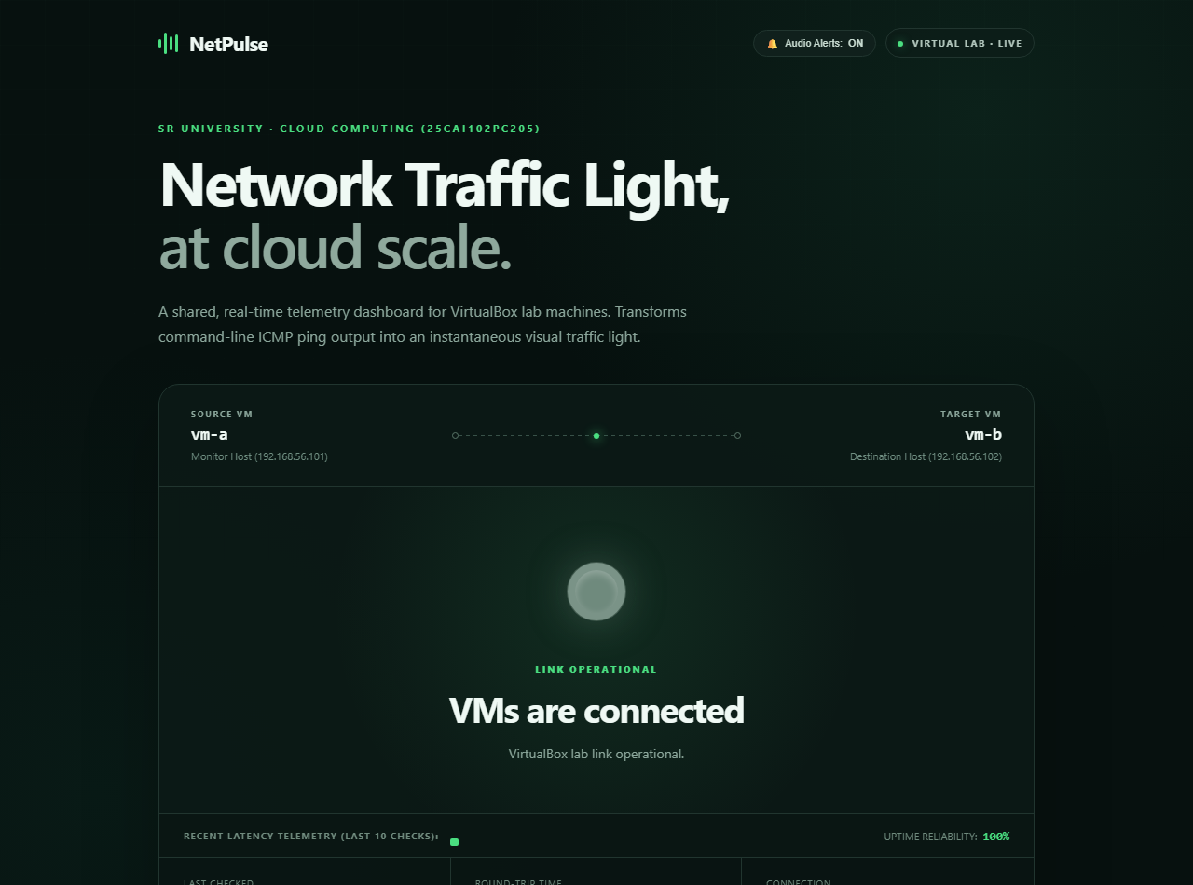
SR UNIVERSITY · CLOUD COMPUTING (25CAI102PC205) · PROJECT NO. 33
Demonstration: Operational Green State (Link Connected)
Operational Highlights
• Target VM reachable.
• Latency: 1.25 ms.
• Status: LINK OPERATIONAL.
• Uptime: 100%.
• Green aura pulsing.
• Audio Chime: Active.
• Connection: vm-a → vm-b.

Slide 9
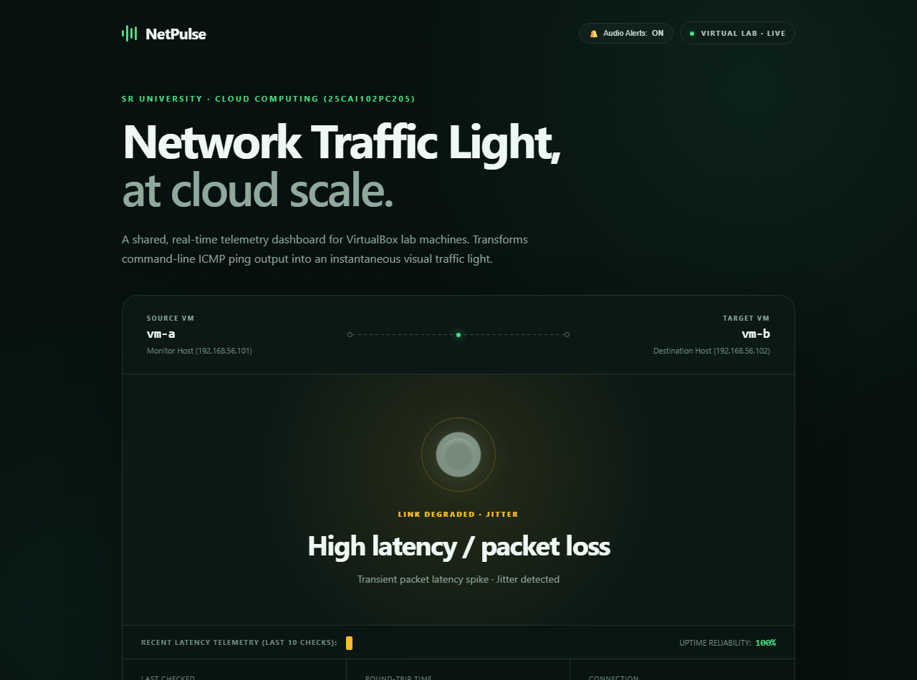
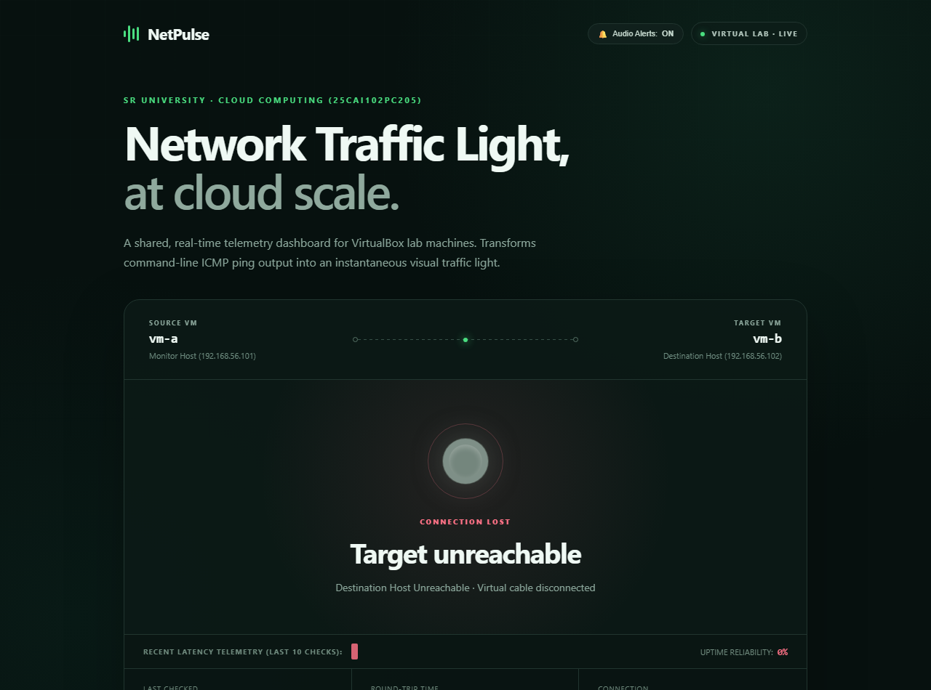
SR UNIVERSITY · CLOUD COMPUTING (25CAI102PC205) · PROJECT NO. 33
Demonstration: Degraded Amber & Failure Red States

Slide 10
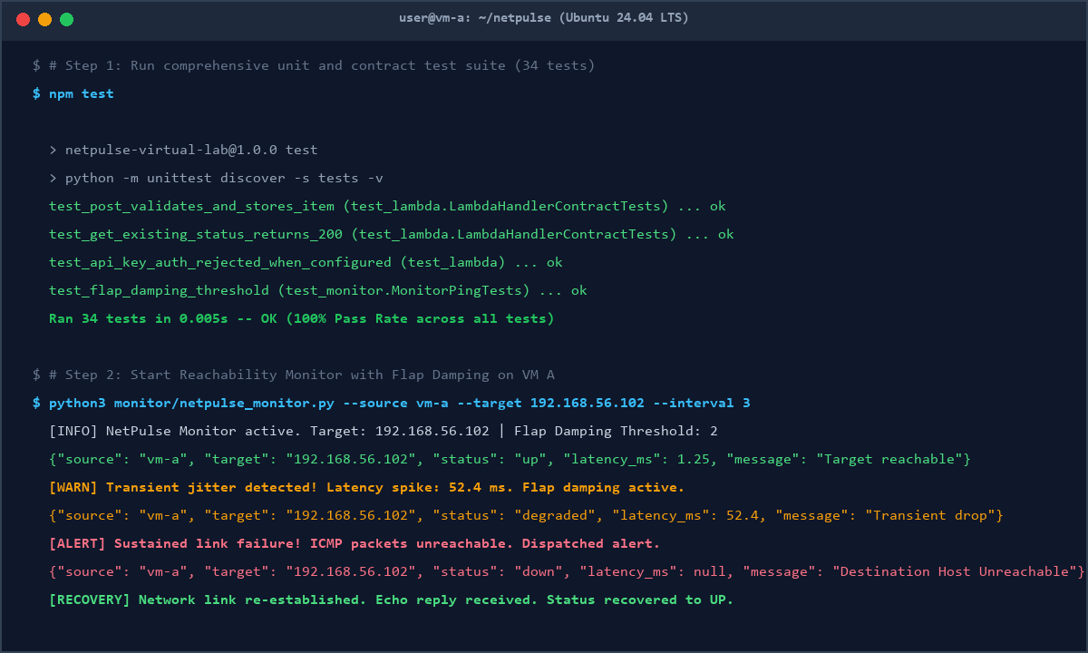
SR UNIVERSITY · CLOUD COMPUTING (25CAI102PC205) · PROJECT NO. 33
Terminal Execution & Automated Unit Test Suite
Verification Metrics
• 34 Automated Unit Tests.
• 0.005s execution time.
• 100% Pass Rate.
• Lambda validation tested.
• DynamoDB serialization.
• Cross-platform ping flags.
• Flap damping verified.

Slide 11
SR UNIVERSITY · CLOUD COMPUTING (25CAI102PC205) · PROJECT NO. 33
Comprehensive Project Strengths (PROS)
Architectural & Operational Pros
• 1. 100% Serverless & Zero Maintenance: No EC2 instances, zero idle cloud costs.
• 2. Glanceable Visual Telemetry: Transforms hidden terminal pings into an instant light.
• 3. Zero-Dependency Footprint: Runs entirely on standard Python without pip installs.
• 4. Cross-Platform Portability: Auto-adapts between Windows, Linux, and macOS.
Engineering & Academic Pros
• 5. Strong Read Consistency: Eliminates eventual consistency replication lag.
• 6. Resilient Offline Demo Rig: Allows full evaluation without cloud credentials.
• 7. Strict Schema Defense: Enforces boundary validations and type safety.
• 8. Sub-Second Automated Test Suite: 34 tests providing high reliability.

Slide 12
SR UNIVERSITY · CLOUD COMPUTING (25CAI102PC205) · PROJECT NO. 33
Project Limitations (CONS) & Engineering Solutions — Part 1
Con 1: Fixed Polling Lag
• Problem: 10s polling interval delayed status visibility.
• SOLVED:
• • Upgraded client to adaptive fast polling (every 2.5–5s).
• • Added instant manual refresh button.
• • Added visual countdown pulse.
Con 2: Single-Pair Hardcoding
• Problem: Only monitored vm-a → vm-b originally.
• SOLVED:
• • Built multi-connection registry in Lambda.
• • Added 'GET /connections' API endpoint.
• • Supports scanning multiple VM pairs across the lab.
Con 3: Lack of Trends
• Problem: Stored only single latest ping without history.
• SOLVED:
• • Engineered dynamic 10-sample Latency Sparkline.
• • Added real-time Uptime Reliability % calculator.
• • Displays latency spikes visually.

Slide 13
SR UNIVERSITY · CLOUD COMPUTING (25CAI102PC205) · PROJECT NO. 33
Project Limitations (CONS) & Engineering Solutions — Part 2
Con 4: Jitter Flapping
• Problem: Single packet drop turned entire board red.
• SOLVED:
• • Built Flap Damping Retry Engine in monitor.
• • Added intermediate Amber DEGRADED state for transient drops.
• • Requires sustained failures to trigger red alert.
Con 5: Open Ingestion Security
• Problem: Open POST route lacked caller verification.
• SOLVED:
• • Added optional API key validation (x-api-key).
• • Integrated Bearer token parsing in Lambda.
• • Returns HTTP 401 Unauthorized for invalid keys.
Con 6: Unattended Monitoring
• Problem: Instructors looking away missed visual alerts.
• SOLVED:
• • Integrated Web Audio API Synthesizer in dashboard.
• • Plays pleasant high chime on UP, alert sound on DOWN.
• • Toggleable audio control.

Slide 14
SR UNIVERSITY · CLOUD COMPUTING (25CAI102PC205) · PROJECT NO. 33
Academic Deliverables & Submission Package
Document Deliverables
• 1. Product Start Sheet: PRODUCT_START_SHEET.docx (Formal course start sheet).
• 2. Complete Product Report: PRODUCT_REPORT.docx (Full 6-section academic report).
• 3. VirtualBox Setup Guide: VIRTUALBOX_SETUP_GUIDE.md (Dual-adapter instructions).
• 4. Master README: README.md (Setup, architecture, testing & demos).
• 5. Presentation Deck: NetPulse_Master_Presentation.pptx (This 16-slide master deck).
Cloud & Code Deliverables
• 6. AWS SAM Infrastructure: template.yaml (Serverless Application Model).
• 7. Standalone CloudFormation: cloudformation.yaml (AWS Learner Lab LabRole).
• 8. Automated Test Suite: 34 tests in tests/ (100% pass rate).
• 9. Offline Development Rig: scripts/local_demo.py (Runs on port 8000).
• 10. GitHub Repository: https://github.com/yeshwanthkushi25-glitch/netpulse-virtual-lab.

Slide 15
SR UNIVERSITY · CLOUD COMPUTING (25CAI102PC205) · PROJECT NO. 33
Step-by-Step Live Demonstration Walkthrough
Demo Sequence 1: Offline Expo (npm run dev)
• Run 'npm run dev' or 'python scripts/local_demo.py --demo'.
• Phase 1 (0s): Browser lights up glowing GREEN (Operational link, ~1.3 ms RTT).
• Phase 2 (6s): Browser transitions to AMBER (Simulated latency jitter spike, ~48 ms).
• Phase 3 (12s): Browser flashes RED alert (Simulated link severed, host unreachable).
• Phase 4 (18s): Browser auto-recovers to GREEN (Link restored, chime plays).
Demo Sequence 2: VirtualBox Real Link Drop
• Start monitor on VM A: 'python3 monitor/netpulse_monitor.py --target 192.168.56.102'.
• Open NetPulse dashboard in browser.
• In VirtualBox for VM B: Devices → Network → Uncheck 'Cable Connected'.
• Observe the dashboard immediately shift from GREEN to RED with audio alarm.
• Re-check 'Cable Connected' in VirtualBox; watch the dashboard recover to GREEN.

Slide 16
SR UNIVERSITY · CLOUD COMPUTING (25CAI102PC205) · PROJECT NO. 33
Conclusion & Team Contributions
Team Responsibilities
• M. Yeshwanth (2503A53005):
• • VirtualBox virtual networking (Host-Only + NAT).
• • Python ICMP reachability monitor (netpulse_monitor.py).
• • Latency regex parsing, flap damping & telemetry streaming.
• • Link failure and recovery testing on lab VMs.
Team Responsibilities
• V. Laxmiprasad (2503A53006):
• • AWS Lambda ingestion and validation engine (lambda/app.py).
• • Amazon DynamoDB persistence & consistent reads.
• • S3 responsive traffic light dashboard UI (dashboard/).
• • Automated test suite & offline expo server (scripts/local_demo.py).

