Slide 1
Sentiment Analysis and Quality Metrics in Amazon Product Reviews
DS606:Capstone
Professor: Dr. Chaojie Wang
By
Yeshwanth Rayankula(PS07211)

Slide 2
Outline
Introduction
Dataset Description
Data Preprocessing
Imbalanced Dataset
Exploratory Data Analysis
Techniques and Models Used
Topic Modeling
Aspect Based Sentiment Analysis
Challenges
Conclusion and Future Work
Introduction
Dataset Description
Data Preprocessing Imbalanced Dataset Exploratory Data Analysis Techniques and Models Used Topic Modeling
Aspect Based Sentiment Analysis Challenges
Conclusion and Future Work

Slide 3
Introduction
Objective
To perform Sentiment Analysis to classify reviews as positive, neutral, or negative.
To implement Topic Modeling and Aspect-Based Sentiment Analysis to focus on specific features such as quality, delivery, price, and customer service.
Data Source
The dataset is sourced from Amazon and contains customer reviews for various products.
Data size: 301 MB
Data shape: 567,092 rows and 10 columns
Link: https://www.kaggle.com/datasets/saurav9786/amazon-product-reviews

Slide 4
Dataset Description
Id: This is just an index and not useful for analysis. It can be dropped.
ProductId: Important to identify reviews related to specific products. Useful for analyzing sentiment per product and performing product-specific aggregations.
UserId: This helps analyze behavior patterns across users, understand review frequency, or detect repeat users.
HelpfulnessNumerator & HelpfulnessDenominator: These indicate how helpful other users found the review. It could be useful for weighting reviews (i.e., reviews with more helpful votes could be considered more reliable).
Score: The product rating (1–5). It is essential for analyzing review sentiment correlations and can be a feature to predict or a label for classification.
Time: This is useful for time-based analysis, trends, and seasonality (after conversion to a readable format). Keep this column.
Summary: A brief version of the review. You can use this as an additional text field for sentiment analysis, though it might overlap with the Text.
Text: The full review text is the most critical feature for sentiment analysis

Slide 5
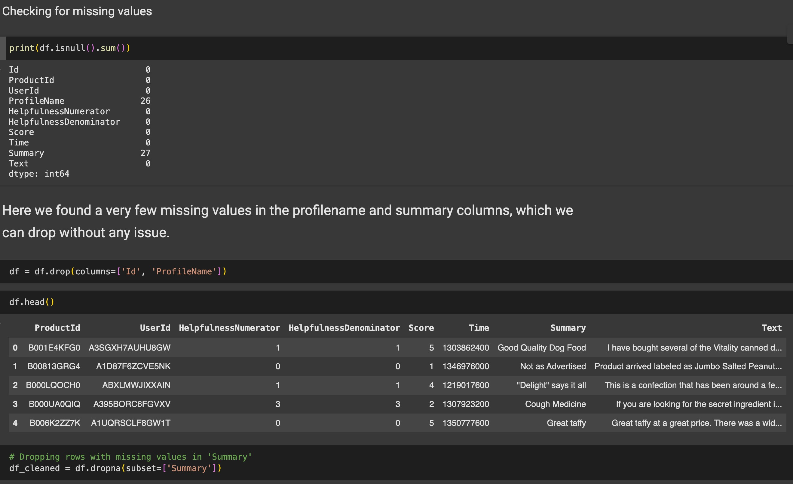
Data Preprocessing
The dataset is checked for null values
Removed columns having null values
Removed duplicates from the dataset
Converted time data type to datetime format

Slide 6
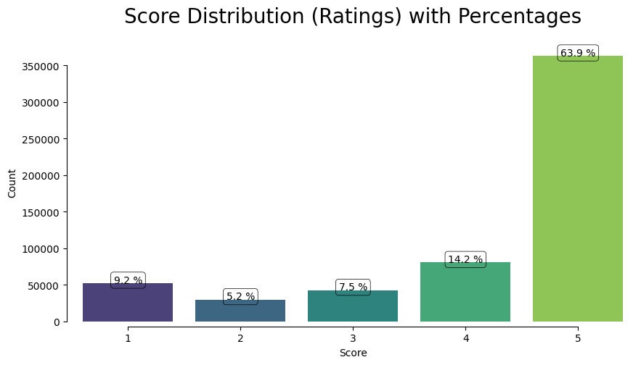
Imbalanced Dataset
From the plot, it is clear that the majority of the reviews are skewed towards positive reviews (with a Score of 5, representing 63.9% of the total), while lower scores are much less frequent.
This imbalance in the distribution of scores can indeed introduce bias in your sentiment analysis model.

Slide 7
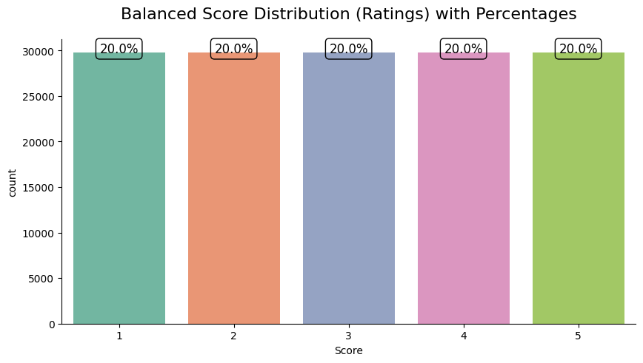
Imbalanced Dataset
Balanced Subset for Analysis
It is used when conducting aspect-based sentiment analysis where balance is critical, and it takes a balanced subset of the data with an equal number of reviews from each score.
However, this could result in data loss and reduced diversity, so it should be done cautiously.

Slide 8
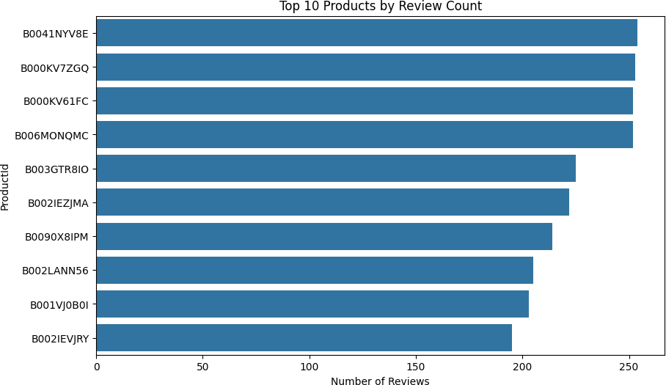
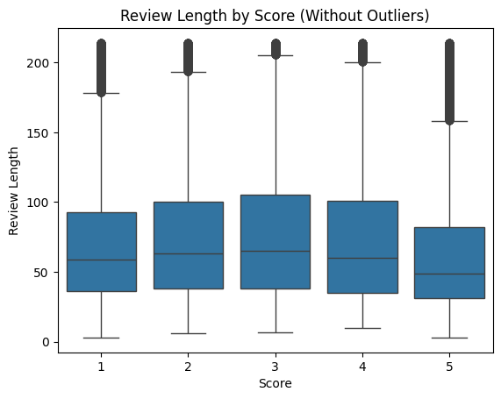
Exploratory Data Analysis

Slide 9
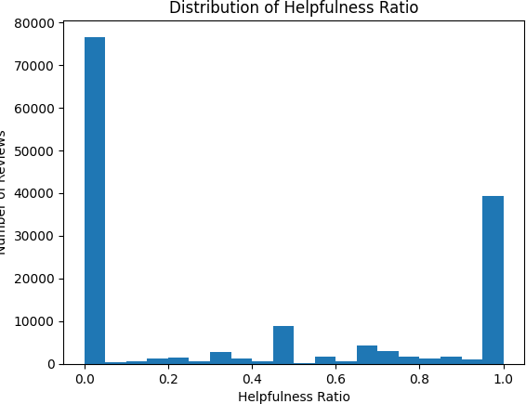
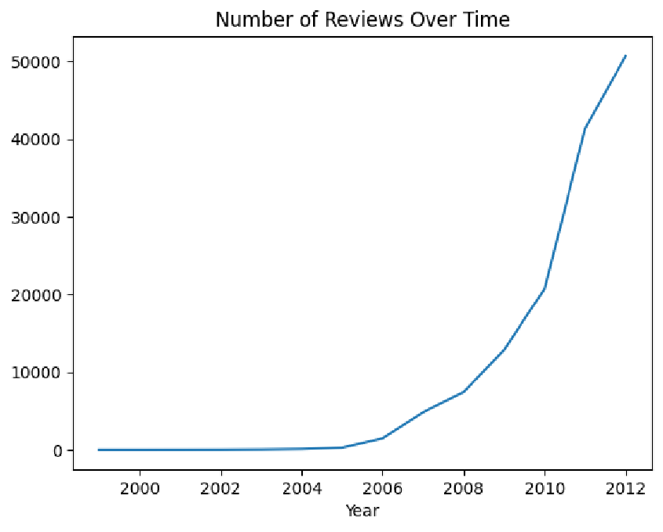
Exploratory Data Analysis

Slide 10
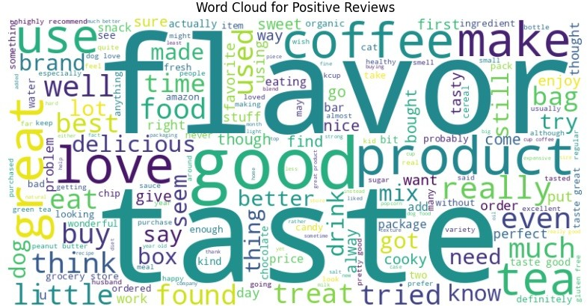
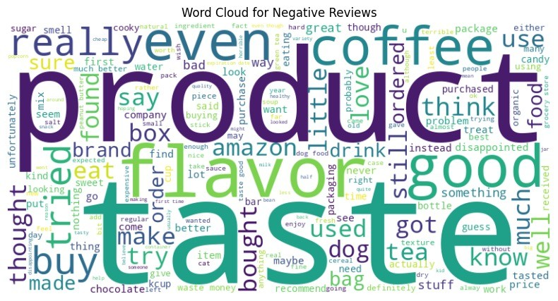
Exploratory Data Analysis

Slide 11


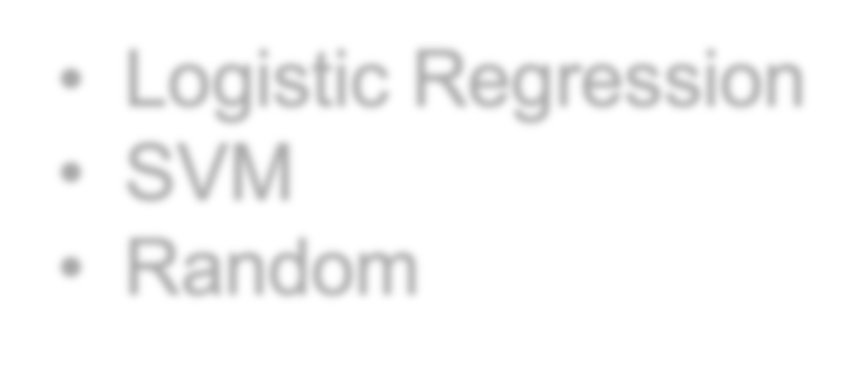

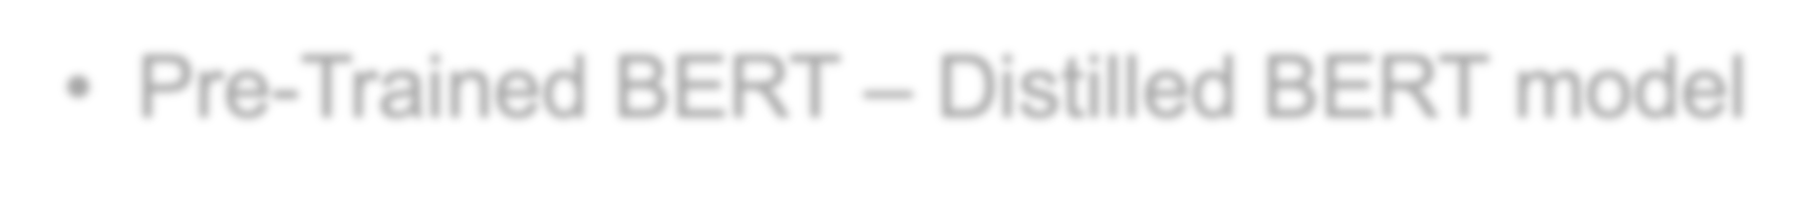
Techniques and Models Used:
Traditional Machine Learning Models:
Logistic Regression
SVM
Random
NLP Transformer
Pre-Trained BERT – Distilled BERT model

Slide 12
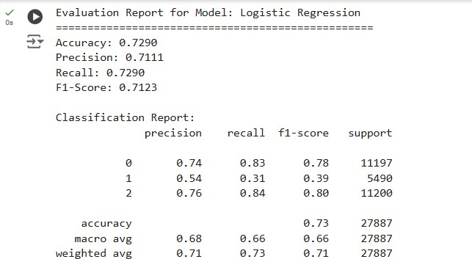
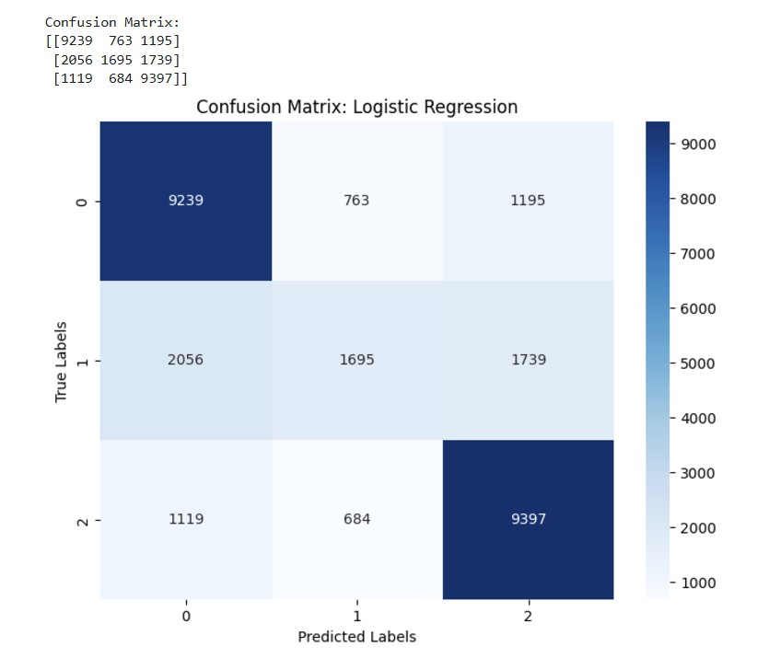
Traditional ML Models Logistic Regression

Slide 13
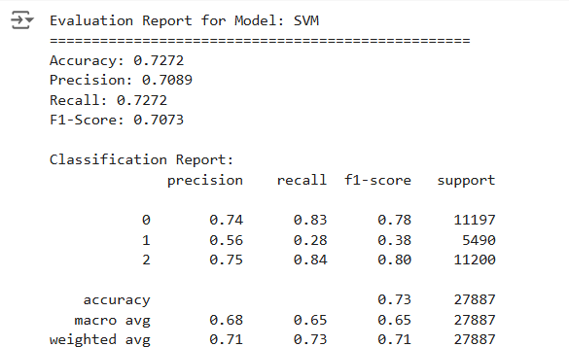
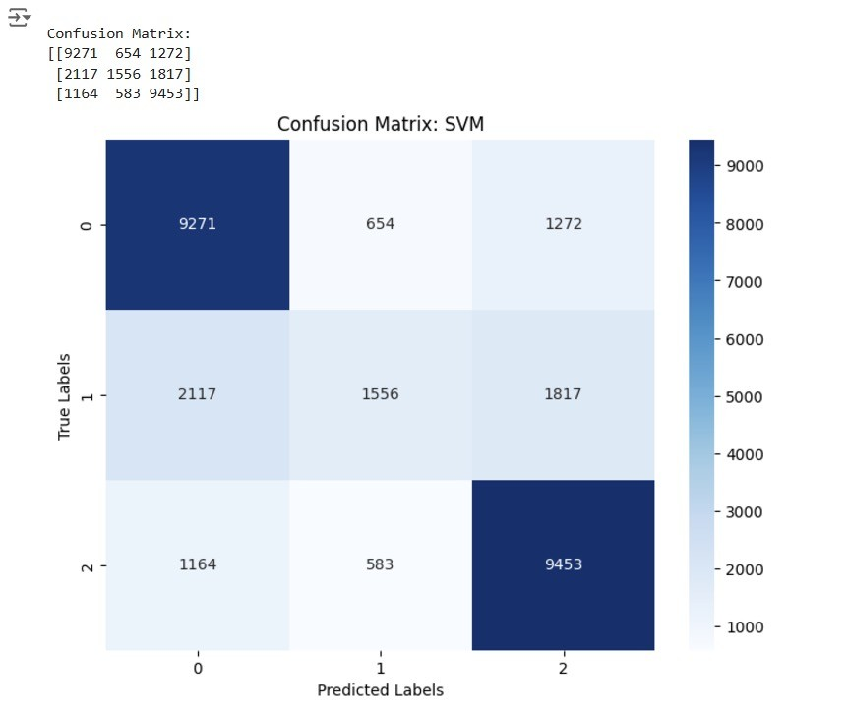
Support Vector Machine (SVM)

Slide 14
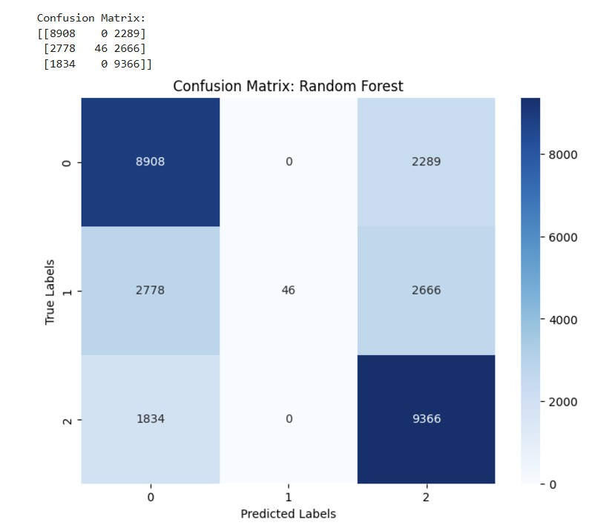
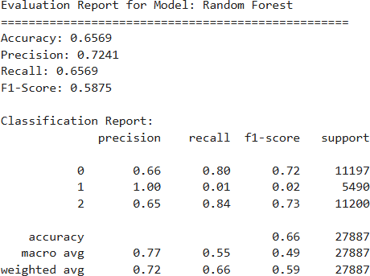
Random Forest

Slide 15
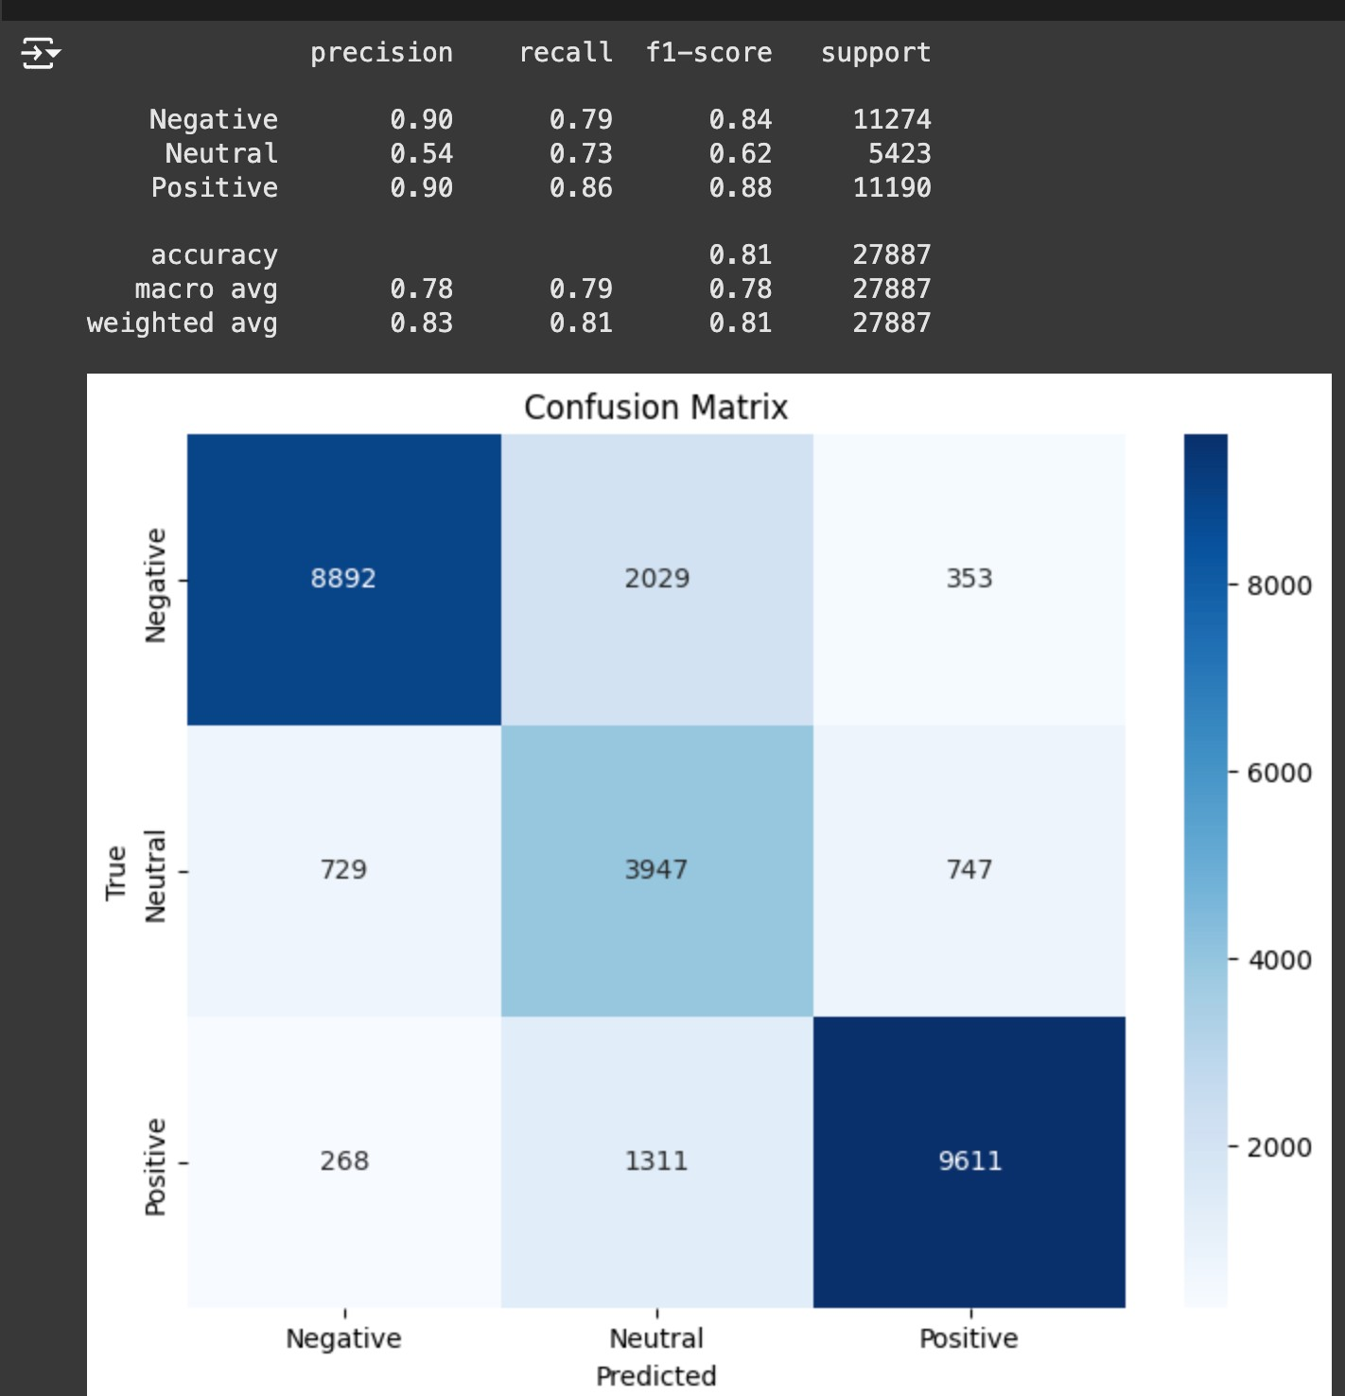
Pre-Trained BERT – Distilled BERT model
BERT (Bidirectional Encoder Representations from Transformers) is a pre-trained deep learning model that uses bidirectional context to understand the meaning of words in a sentence.
Used the distillery-base-uncased model to classify customer reviews into Positive, Neutral, and Negative sentiments.
BERT's contextual understanding and pre-trained knowledge
enabled it to outperform traditional machine learning models like Logistic Regression, SVM, and Random Forest. This demonstrates its superior ability to handle complex and nuanced sentiment analysis tasks.

Slide 16
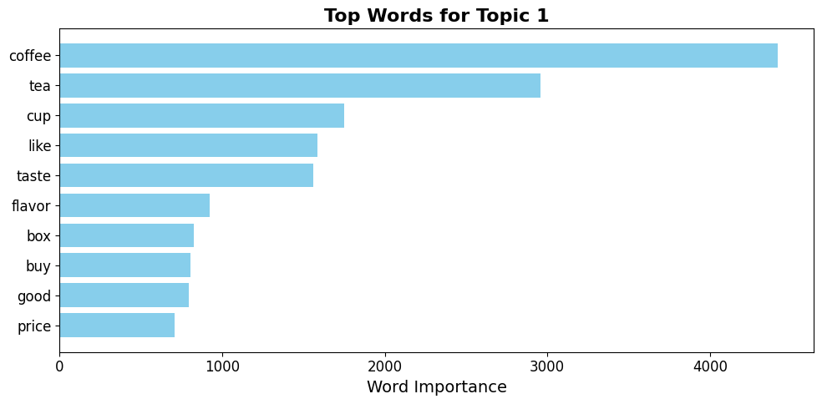
Topic Modeling
Applied topic modeling
on the
Cleaned_Text column to identify hidden themes and patterns in customer reviews.
Used Latent Dirichlet Allocation
(LDA) to group reviews into 5 distinct topics due to the large dataset.
Removed stopwords, tokenized text,
and vectorized data using CountVectorizer to create a Document-Term Matrix (DTM).
Created word clouds to display the most significant terms for each topic, aiding in interpretation and insights.

Slide 17
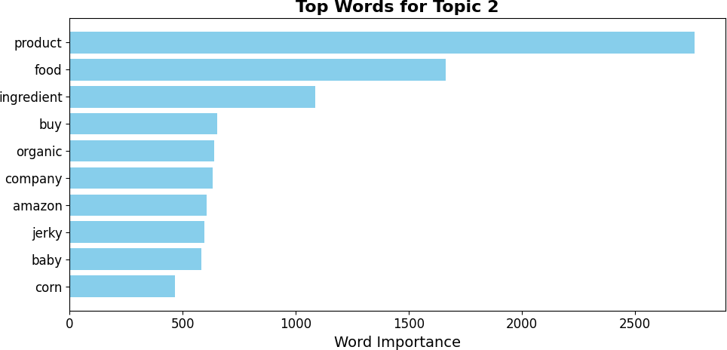
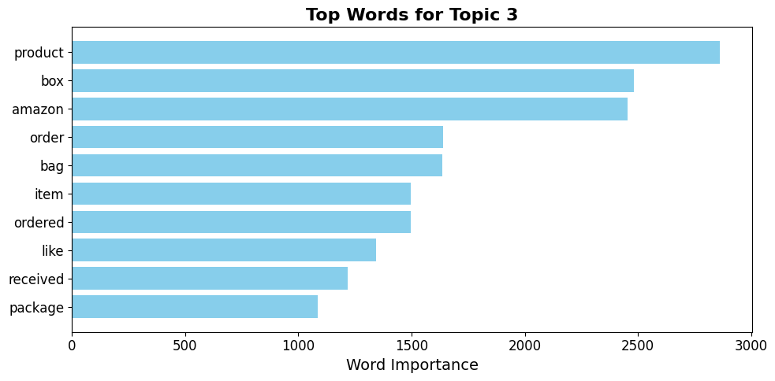
Topic Modeling

Slide 18
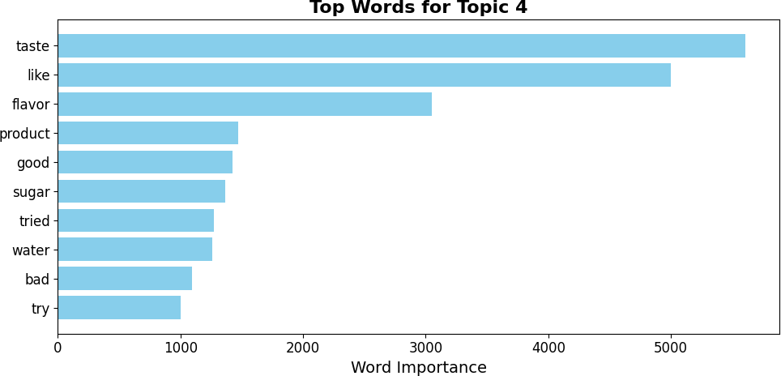
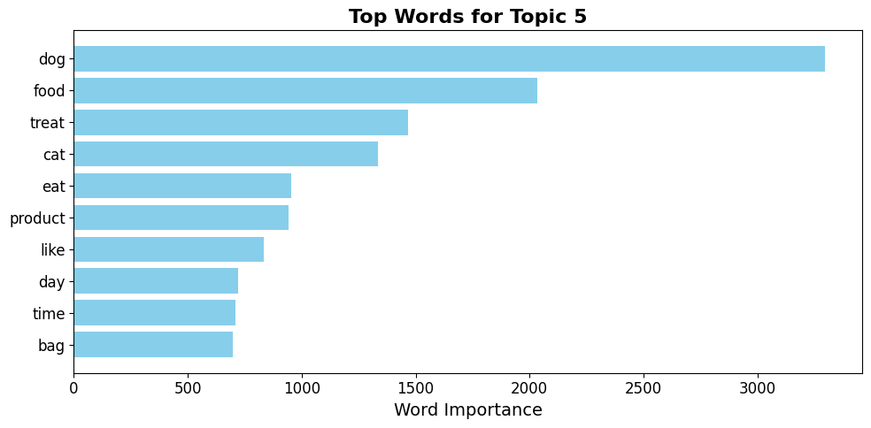
Topic Modeling

Slide 19
Aspect Based Sentiment Analysis
Analyzed customer reviews from the Cleaned_Text column to identify specific aspects and determine the sentiment (positive, negative, or neutral) associated with each aspect.
Extracted aspects using Spacy by identifying noun phrases.
Used VADER Sentiment Analyzer to calculate sentiment scores for each aspect.
Aggregated sentiment scores to compute overall positive, neutral, and negative sentiment for each aspect.
Identified the top 10 positive and negative aspects based on sentiment polarity.
Used word clouds to highlight the most frequently discussed aspects and their polarity.

Slide 20
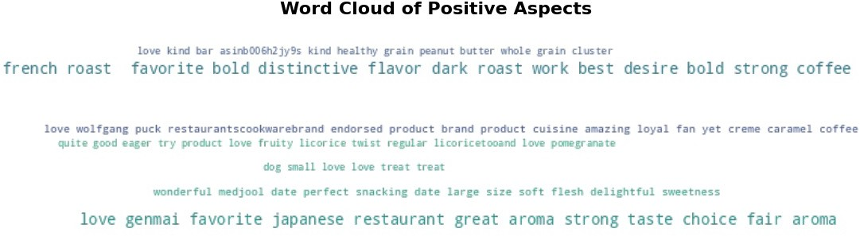
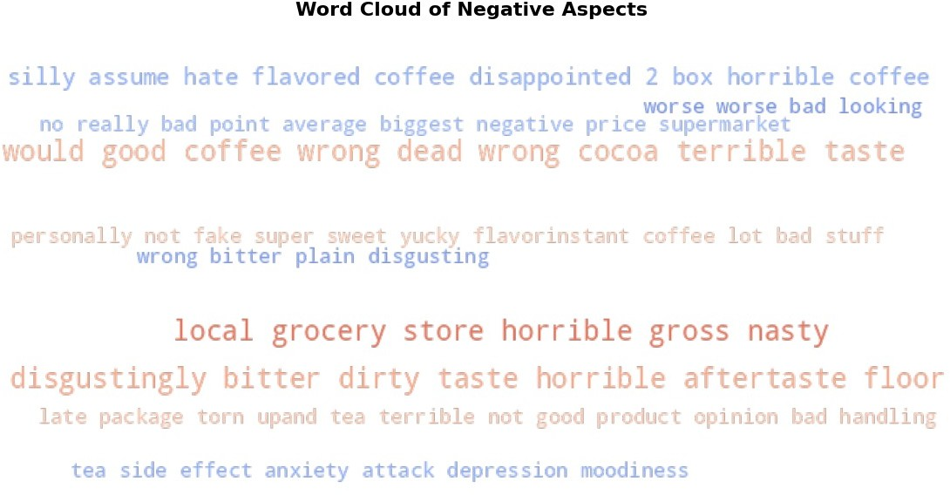
Aspect Based Sentiment Analysis

Slide 21





Challenges
Faced difficulty with running the BERT model several times.
Computing was a major challenge during the project- Purchased collab pro for computing.
Class Imbalance

Slide 22
Conclusion and Future Work
Best Performing Models:
Logistic Regression: Achieved an accuracy of 72.90%.
SVM: Achieved an accuracy of 72.72%.
Random forest: Achieved an accuracy of 65.69%
BERT model: Outperformed other models with an accuracy of around 90%
Future Work:
Use the Pre-trained BERT and fine-tune the BERT model for better performance.
Explore additional techniques such as using RoBERTa.

Slide 23


