Slide 1
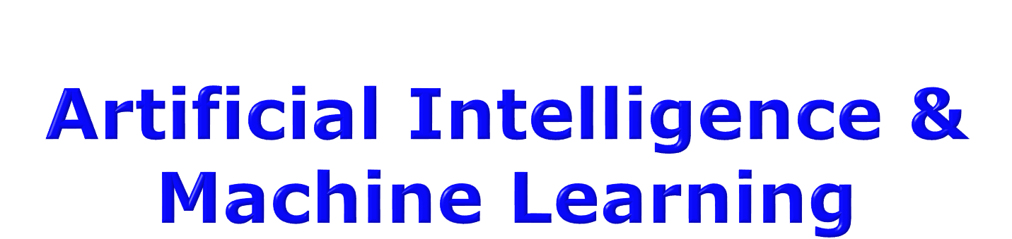
Adversarial Search
Meaning: involving or characterized by conflict or opposition

Slide 2

Multi-Agent Environment(MEA): every agent needs to consider the actions of the other agents, in order to optimize its own welfare
Normally considered in terms of economies
Cooperative: Agents act collectively to achieve a common goal
Competitive:
Agents compete against each other
Their goals are in conflict
Gives rise to the concept of adversarial search problems – often known as games.

Slide 3
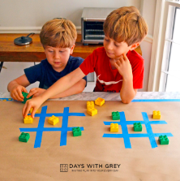
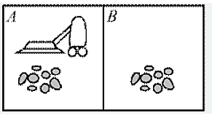
Example
Single agent
Multiple agent

Slide 4
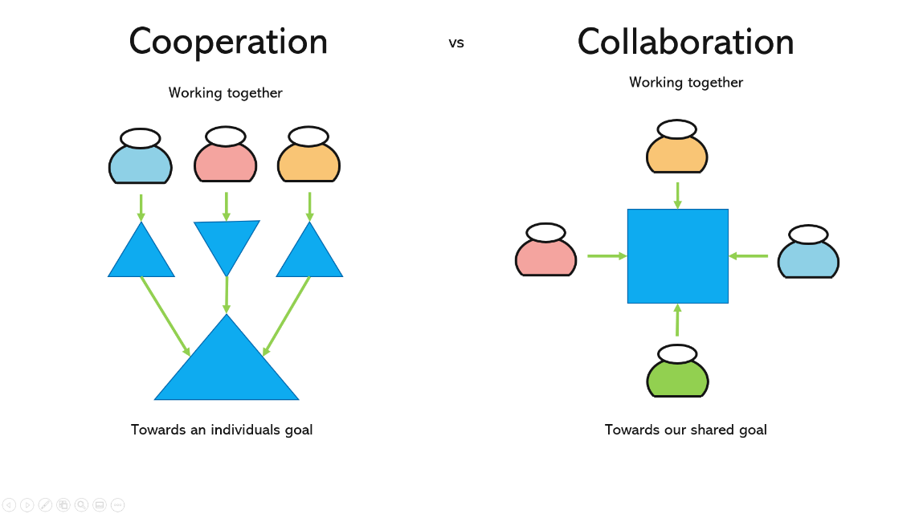

Slide 5

It’s a branch of economics
Views any MAE as a game provided that the impact of each agent on the other is “significant”, i.e., able to affect the actions of the other agent(s)
In AI, “game” is a specialized concept:
Deterministic, fully-observable environments
Two agents whose actions must alternate
Utility values at the end of the game are always equal and opposite
+1 = Chess winner
-1 = Chess looser.

Slide 6

Tackled by Konrad Zuse, Claude Shannon, Norbert Wiener, Alan Turing
Have seen lot of successes recently, e.g., DeepBlue
Game states are easy to represent:
Agents restricted by a limited action rules
Outcomes defined by precise rules
Games: interesting because they are hard to solve:
Chess: average branching factor of 35
If 50 moves by each player, search tree has 35¹⁰⁰ nodes!

Slide 7
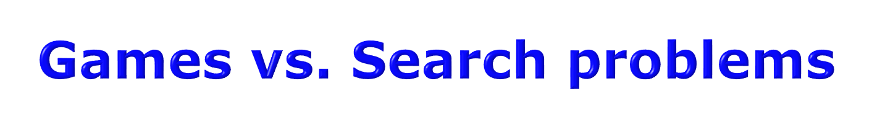
In typical search problems, we optimize a measure to acquire the goal: there is no opponent
In games, there is an "Unpredictable" opponent
Need to specify a move for every possible opponent reply Strict penalty on an inefficient move
Stringent time constraints
Unlikely to find goal, must approximate
Requires some type of a decision to move the search forward.

Slide 8

Initial state
Successor function
Terminal state test
Utility function: defining the usefulness of the terminal states from the point of view of one of the players.
Imagine 2 players of tic-tac-toe: MAX and MIN
MAX moves first: We can generate a game tree
The terminal states are at the leaves
MAX should play in order to maximize its utility, which will minimize the utility for MIN
This is called a Zero-Sum Game.

Slide 9
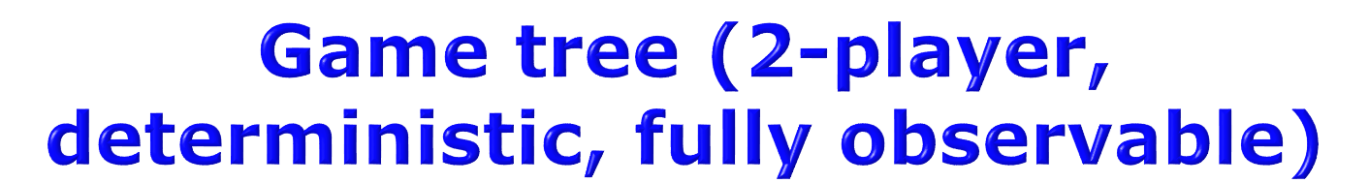
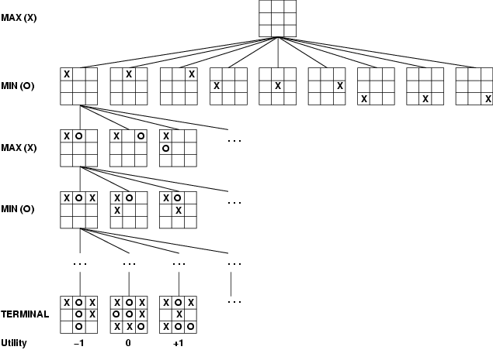
This terminal state is one of the worst for MAX and one of the best for MIN
This terminal state is one of the best for MAX and one of the worst for MIN

Slide 10
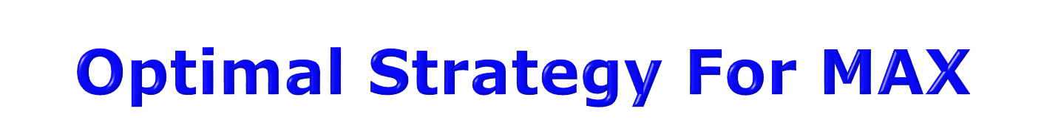
This is a MAE
In discovering the sequence of optimal moves by MAX, we have to consider that MIN is taking moves as well
So, the optimal strategy will tell how should MAX play against MIN (by considering the moves of the latter), in order to win the game
Let us consider a shortened game tree of TIC-TAC-TOE
Numbers are the utilities
Ply: a move by MAX followed by a move from MIN.

Slide 11

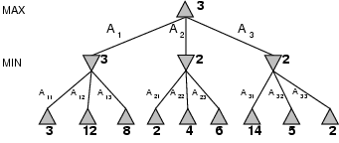
Move of MAX
Move of MIN

Slide 12

When it is the turn of MAX, it will always take an action in order to maximize its utility, because it’s winning configurations have high utilities
When it is the turn of MIN, it will always take an action in order to minimize its utility, because it’s winning configurations have low utilities
In order to implement this, we need to define a measure in each state that takes the move of the opponent into account:
This measure is called Minimax.

Slide 13
Minimax represents the utility of a state, given that both MAX and MIN will play optimally till the end of the game
In any state s, one or more actions are possible
For every possible new state that can be transited into from s, we compute the minimax value
The term “Minimax” is used because:
the opponent is always trying to minimize the utility of the player, and
the player is always trying to maximize this minimized selection of the opponent.
Confused? See next slide…

Slide 14
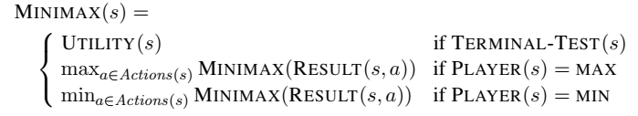
(In game phrasing, we say that a tree is one move deep, consisting of two half-moves, each of which PLY is called a ply.)

Slide 15

Consider “3” at Level 1: MIN selects an action (A11) that leads to a state of minimum utility for MAX, i.e., minimum{3,12,8}
Consider “3” at Level 0: MAX selects an action (A1) that leads to a state of maximum utility for MIN, i.e., maximum{3,2,2}
Both are opposing what is best for the other.

Slide 16
At each node, MAX will always select the action with highest minimax value (it wants to reach states with higher utilities)
At each node, MIN will always select the action with lowest minimax value (it wants to reach states with lower utilities).

Slide 17

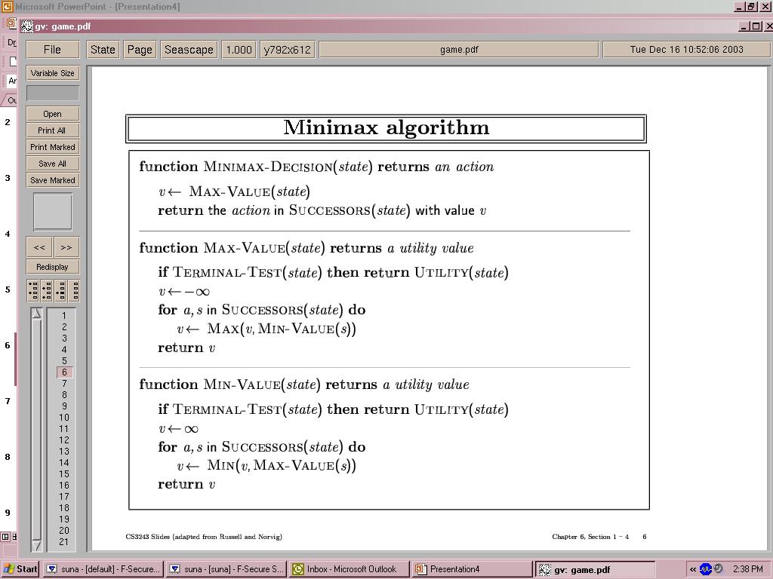
Depth-First Exploration
Recursion: Winds all the way to the terminal nodes, and then unwinds back by backing up the values
Min(minimax) for MIN moves
Max(minimax) for MAX moves

Slide 18

Complete? Yes (if tree is finite)
Optimal? Yes (against an optimal opponent)
Time complexity? O(b^{m})
Space complexity? O(bm) (depth-first exploration)
For chess, b ≈ 35, m ≈100 for "reasonable" games → exact solution completely infeasible
We need to think of a way to cut down the number of search paths.

Slide 19
Limitation of the mini-max Algorithm
The main drawback of the mini-max algorithm is that it gets really slow for complex games such as Chess, go, etc.
This type of games has a huge branching factor, and the player has lots of choices to decide.
This limitation of the minimax algorithm can be improved from alpha-beta pruning.

Slide 20
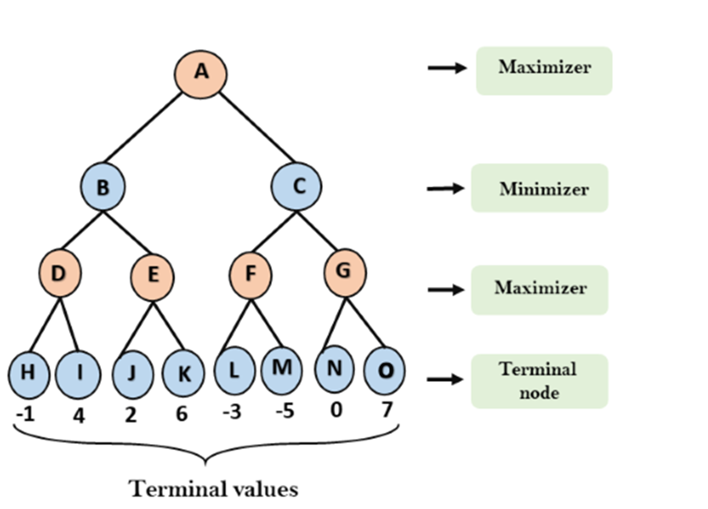
Other Examples

Slide 21
Step 1
In the first step, the algorithm generates the entire game-tree and apply the utility function to get the utility values for the terminal states.
In the below tree diagram, let's take A is the initial state of the tree.
Suppose maximizer takes first turn which has worst-case initial value = -∞, and minimizer will take next turn which has worst-case initial value = +∞.

Slide 22
Step 2
Now, first we find the utilities value for the Maximizer, its initial value is -∞, so we will compare each value in terminal state with initial value of Maximizer and determines the higher nodes values. It will find the maximum among the all.
For node D max(-1,-∞) => max(-1,4)= 4
For Node E max(2, -∞) => max(2, 6)= 6
For Node F max(-3, -∞) => max(-3,-5) = -3
For node G max(0, -∞) = max(0, 7) = 7

Slide 23
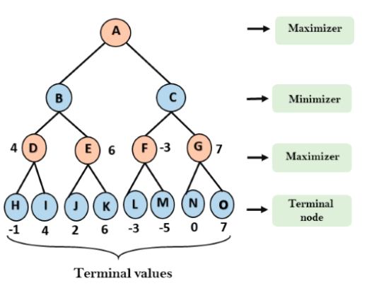

Slide 24
Step 3
In the next step, it's a turn for minimizer, so it will compare all nodes value with +∞ and will find the 3rd layer node values.
For node B= min(4,6) = 4
For node C= min (-3, 7) = -3

Slide 25
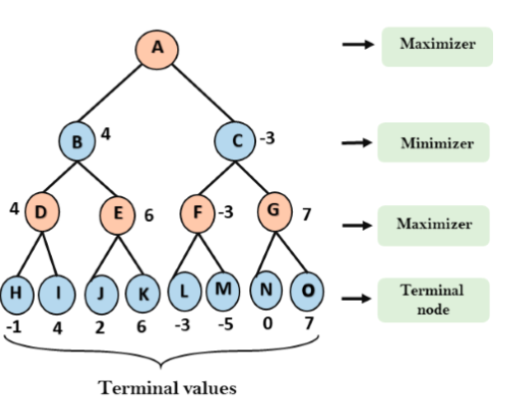

Slide 26
Step 4
Now it's a turn for Maximizer, and it will again choose the maximum of all nodes value and find the maximum value for the root node.
In this game tree, there are only 4 layers, hence we reach immediately to the root node, but in real games, there will be more than 4 layers.
For node A max(4, -3)= 4

Slide 27
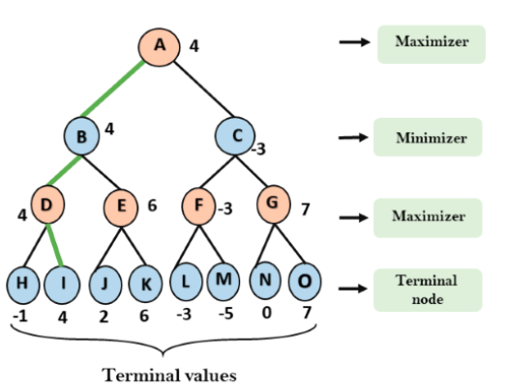

Slide 28
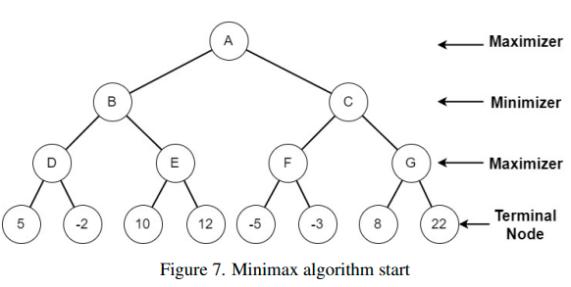
Example 2

Slide 29
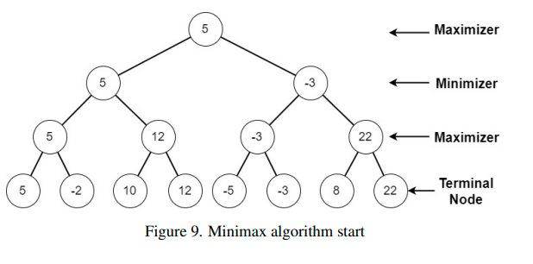
Solution

Slide 30

A modified variant of the minimax method is alpha-beta pruning. It's a way for improving the minimax algorithm.
As a result, there is a technique known as Pruning that allows us to compute the correct minimax choice without having to inspect each node of the game tree.
It's named alpha-beta pruning/ alpha-beta cut-off because it involves two threshold parameters, Alpha and beta, for future expansion.
Alpha-beta pruning can be done at any depth in a tree, and it can sometimes prune the entire sub-tree as well as the tree leaves.

Slide 31
Parameters for Alpha-Beta Pruning
The two-parameter can be written as follows: a) Alpha: At any point along the Maximizer path, Alpha is the best (highest-value) option we've uncovered so far. The value of alpha starts at -∞. b) Beta: At every point along the route of Minimizer. Beta is the best (lowest-value) option we've found so far. Minimizer. The initial value of beta is +∞.
Condition for Alpha-Beta Pruning
α >= β

Slide 32
Key points about alpha-beta pruning
Only the value of alpha α will be updated by the Max player.
Only the beta β value will be updated by the Min player.
Instead of alpha and beta values, node values will be sent to upper nodes while retracing the tree.
Only the alpha and beta values will be passed to the child nodes.

Slide 33
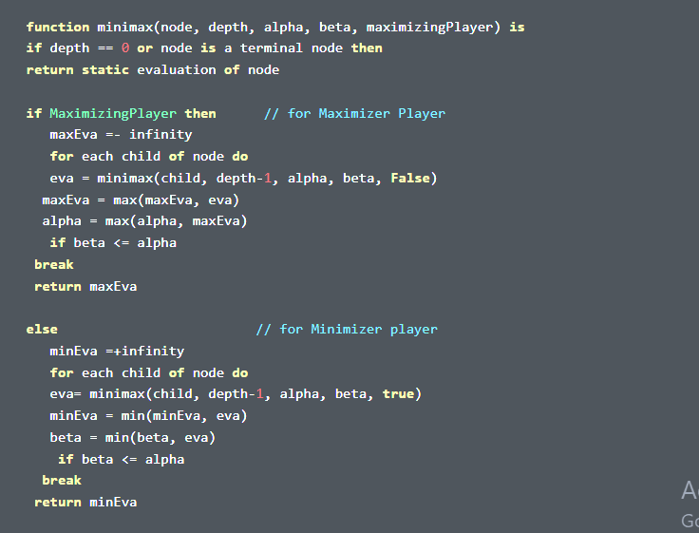
Pseudo-code for Alpha-beta Pruning

Slide 34
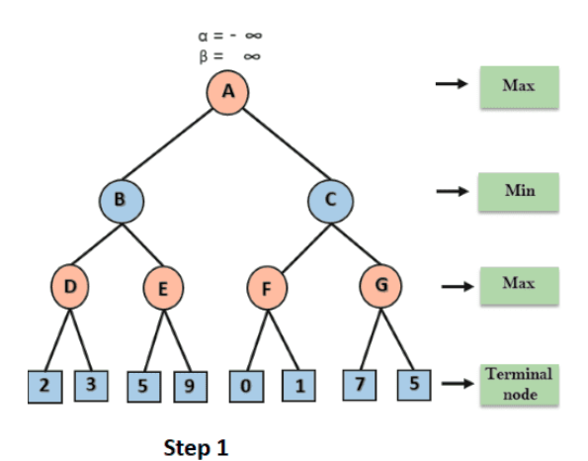
Working of Alpha(α)-Beta (β) Pruning
Step 1: At the first step the, Max player will start first move from node A where α= -∞ and β= +∞, these value of alpha and beta passed down to node B where again α= -∞ and β= +∞, and Node B passes the same value to its child D.

Slide 35
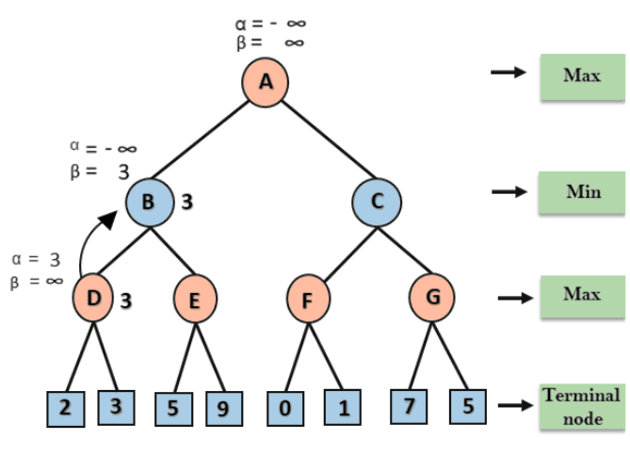
Step 2: At Node D, the value of α will be calculated as its turn for Max. The value of α is compared with firstly 2 and then 3, and the max (2, 3) = 3 will be the value of α at node D and node value will also 3.
Step 3: Now algorithm backtrack to node B, where the value of β will change as this is a turn of Min, Now β=+∞, will compare with the available subsequent nodes value, i.e. min (∞, 3) = 3, hence at node B now α= -∞, and β= 3.
In the next step, algorithm traverse the next successor of Node B which is node E, and the values of α= -∞, and β= 3 will also be passed.

Slide 36
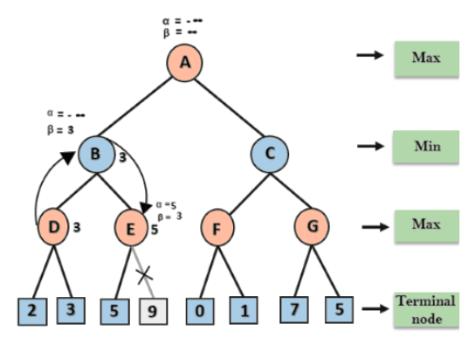
Step 4: At node E, Max will take its turn, and the value of alpha will change. The current value of alpha will be compared with 5, so max (-∞, 5) = 5, hence at node E α= 5 and β= 3, where α>=β, (Since condition achieved) so the right successor of E will be pruned, and algorithm will not traverse it, and the value at node E will be 5.

Slide 37
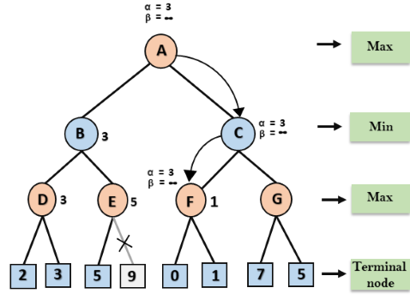
Step 5: At next step, algorithm again backtrack the tree, from node B to node A. At node A, the value of alpha will be changed the maximum available value is 3 as max (-∞, 3)= 3, and β= +∞, these two values now passes to right successor of A which is Node C.
At node C, α=3 and β= +∞, and the same values will be passed on to node F.
Step 6: At node F, again the value of α will be compared with left child which is 0, and max(3,0)= 3, and then compared with right child which is 1, and max(3,1)= 3 still α remains 3, but the node value of F will become 1.

Slide 38
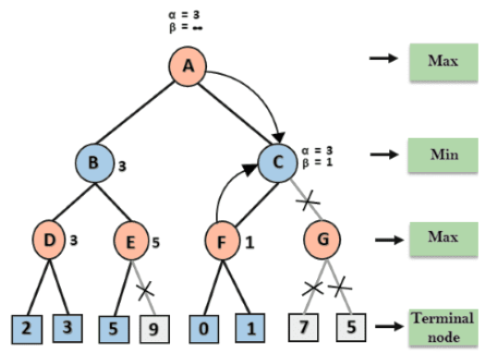
Step 7: Node F returns the node value 1 to node C, at C α= 3 and β= +∞, here the value of beta will be changed, it will compare with 1 so min (∞, 1) = 1. Now at C, α=3 and β= 1, and again it satisfies the condition α >= β, so the next child of C which is G will be pruned, and the algorithm will not compute the entire sub-tree G.

Slide 39
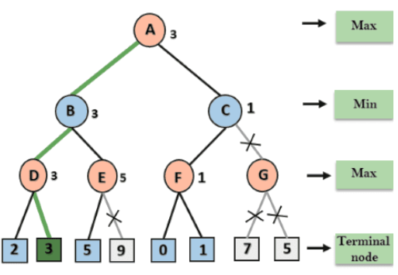
Step 8: C now returns the value of 1 to A here the best value for A is max (3, 1) = 3.
Following is the final game tree which is the showing the nodes which are computed and nodes which has never computed. Hence the optimal value for the maximizer is 3 for this example.

Slide 40
Move Ordering in Alpha-Beta pruning
The effectiveness of alpha-beta pruning is highly dependent on the order in which each node is examined. Move order is an important aspect of alpha-beta pruning.
It can be of two types:
Worst ordering: In some cases, alpha-beta pruning algorithm does not prune any of the leaves of the tree, and works exactly as minimax algorithm. In this case, it also consumes more time because of alpha-beta factors, such a move of pruning is called worst ordering. In this case, the best move occurs on the right side of the tree. The time complexity for such an order is O(b^{m}).
Ideal ordering: The ideal ordering for alpha-beta pruning occurs when lots of pruning happens in the tree, and best moves occur at the left side of the tree. We apply DFS, hence it first search left of the tree and go deep twice as minimax algorithm in the same amount of time. Complexity in ideal ordering is O(b^{m/2}).

Slide 41
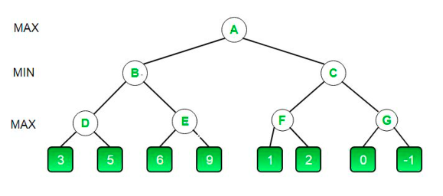
Example 2

Slide 42
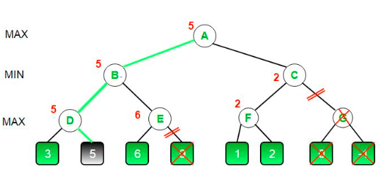
Solution

Slide 43
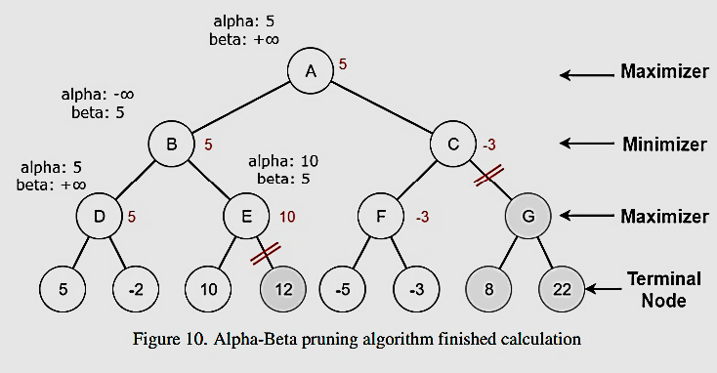
Example 3

Slide 44
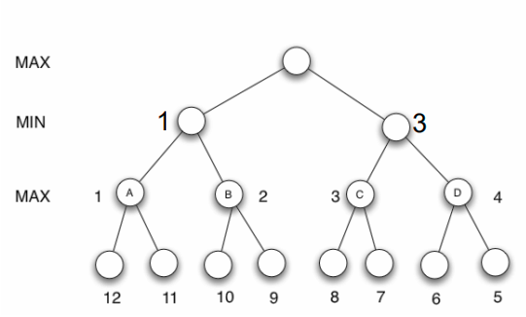
Example 4

Slide 45
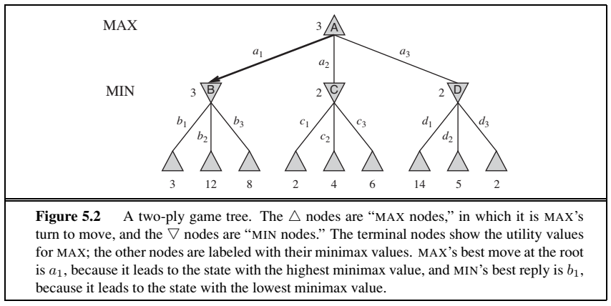
Example 5

Slide 46
Figure 5.5 Stages in the calculation of the optimal decision for the game tree in Figure 5.2. At each point, we show the range of possible values for each node. (a) The first leaf below B has the value 3. Hence, B, which is a MIN node, has a value of at most 3.
(b) The second leaf below B has a value of 12; MIN would avoid this move, so the value of B is still at most 3.
(c) The third leaf below B has a value of 8; we have seen all B’s successor states, so the value of B is exactly 3. Now, we can infer that the value of the root is at least 3, because MAX has a choice worth 3 at the root.
(d) The first leaf below C has the value 2. Hence, C, which is a MIN node, has a value of at most 2. But we know that B is worth 3, so MAX would never choose C. Therefore, there is no point in looking at the other successor states of C. This is an example of alpha–beta pruning.
(e) The first leaf below D has the value 14, so D is worth at most 14. This is still higher than MAX’s best alternative (i.e., 3), so we need to keep exploring D’s successor states. Notice also that we now have bounds on all of the successors of the root, so the root’s value is also at most 14.
(f) The second successor of D is worth 5, so again we need to keep exploring. The third successor is worth 2, so now D is worth exactly 2. MAX’s decision at the root is to move to B, giving a value of 3.

Slide 47

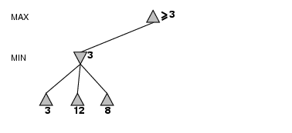

Slide 48
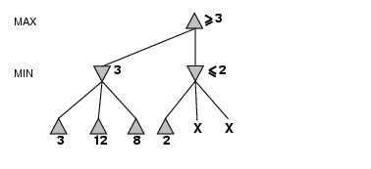

Slide 49
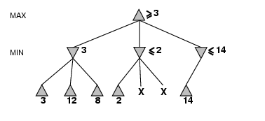

Slide 50
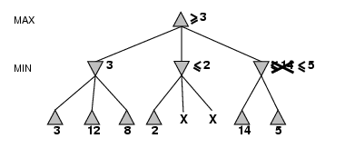

Slide 51
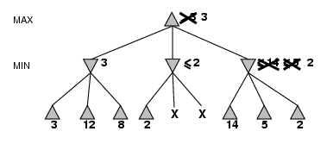

Slide 52

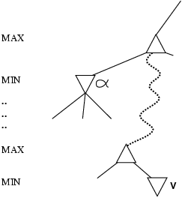
α is the value of the best (i.e., highest-value) choice found so far at any choice point along the path for MAX
If v is worse than α, MAX will avoid it
→ prune that branch
Define β similarly for MIN.

Slide 53

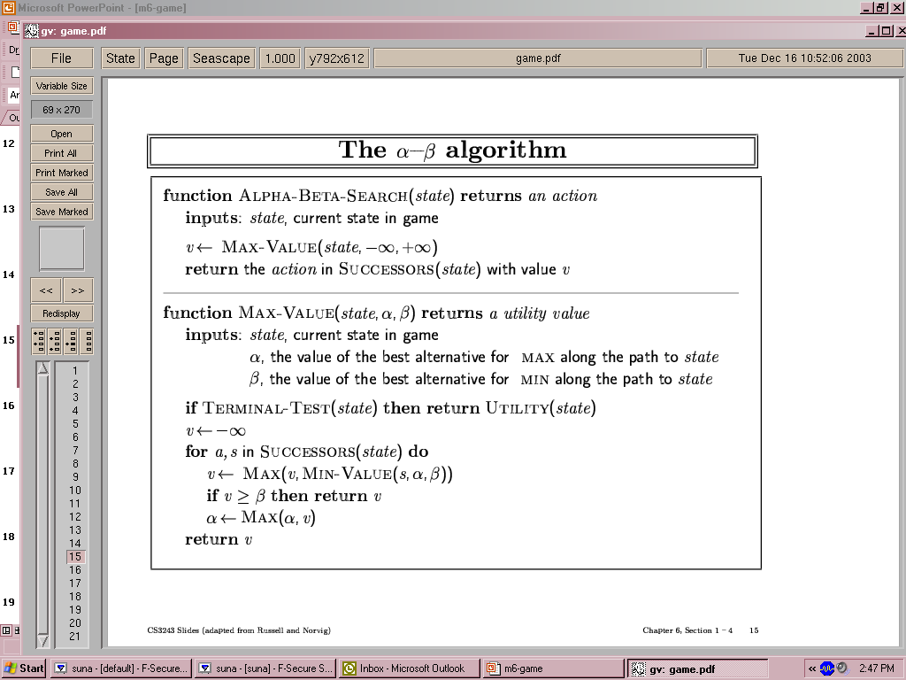
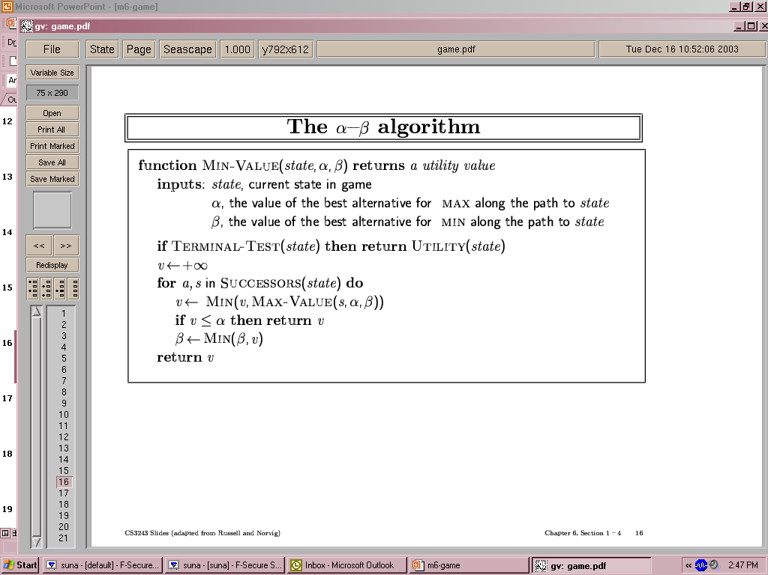

Slide 54

Pruning does not affect final result
Good move ordering improves effectiveness of pruning
With "perfect ordering," time complexity = O(b^{m/2})
→ doubles depth of search
A simple example of the value of reasoning about which computations are relevant (a form of meta-reasoning)

Slide 55
Rules to find good ordering
Occur the best move from the shallowest node.
Order the nodes in the tree such that the best nodes are checked first.
Use domain knowledge while finding the best move.
Ex: for Chess, try order: captures first, then threats, then forward moves, backward moves.
We can book keep the states, as there is a possibility that states may repeat.

