Slide 1
Chapter 28
Network Management:
SNMP
28.<number>

Slide 2
28-1 NETWORK MANAGEMENT SYSTEM
We can say that the functions performed by a network management system can be divided into five broad categories: configuration management, fault management, performance management, security management, and accounting management.
Topics discussed in this section:
Configuration Management
Fault Management
Performance Management
Security Management
Accounting Management
28.<number>

Slide 3
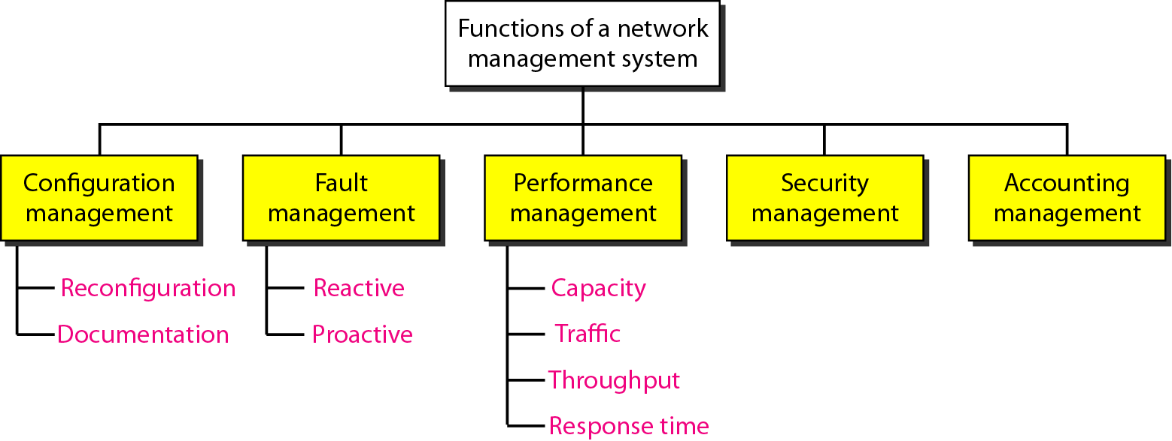
Figure 28.1 Functions of a network management system
28.<number>

Slide 4
28-2 SIMPLE NETWORK MANAGEMENT
PROTOCOL (SNMP)
The Simple Network Management Protocol (SNMP) is a framework for managing devices in an internet using the TCP/IP protocol suite. It provides a set of fundamental operations for monitoring and maintaining an internet.
Topics discussed in this section:
Concept
Management Components
Structure of Management Information (SMI)
Management Information Base (MIB)
SNMP
28.<number>

Slide 5
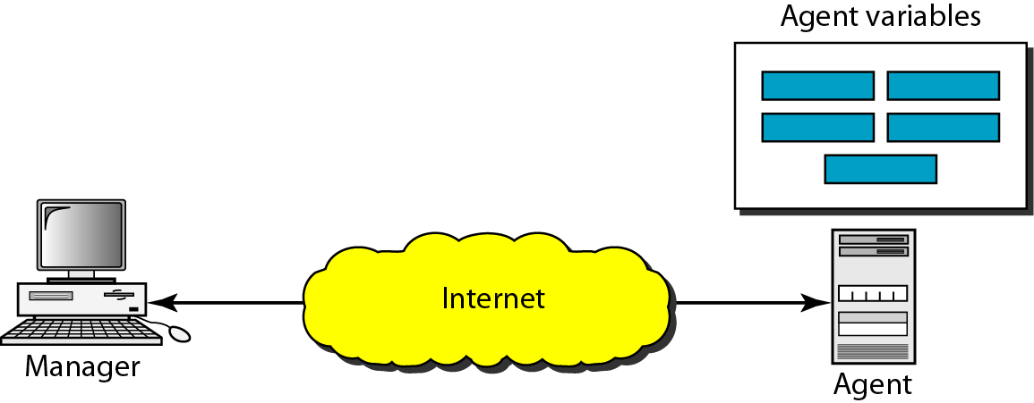
Figure 28.2 SNMP concept
28.<number>

Slide 6
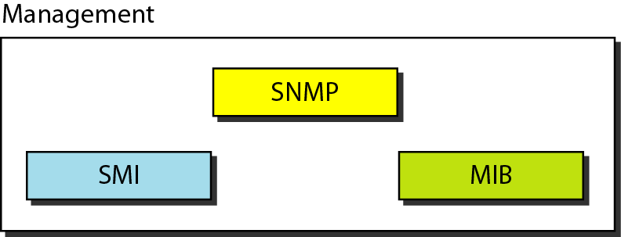
Figure 28.3 Components of network management on the Internet
28.<number>

Slide 7

Note
SNMP defines the format of packets exchanged between a manager and
an agent. It reads and changes the status (values) of objects (variables)
in SNMP packets.
28.<number>

Slide 8
Note
SMI defines the general rules for naming objects, defining object types (including
range and length), and showing how to encode objects and values. SMI does not define the number of objects an entity should manage or name the objects to be managed or define the association between the objects and their values.
28.<number>

Slide 9
Note
MIB creates a collection of named objects, their types, and their relationships to each other
in an entity to be managed.
28.<number>

Slide 10
Note
We can compare the task of network management to the task of writing a program.
❏ Both tasks need rules. In network
management this is handled by SMI.
❏ Both tasks need variable declarations. In
network management this is handled by MIB.
❏ Both tasks have actions performed by
statements. In network management this is
handled by SNMP.
28.<number>

Slide 11
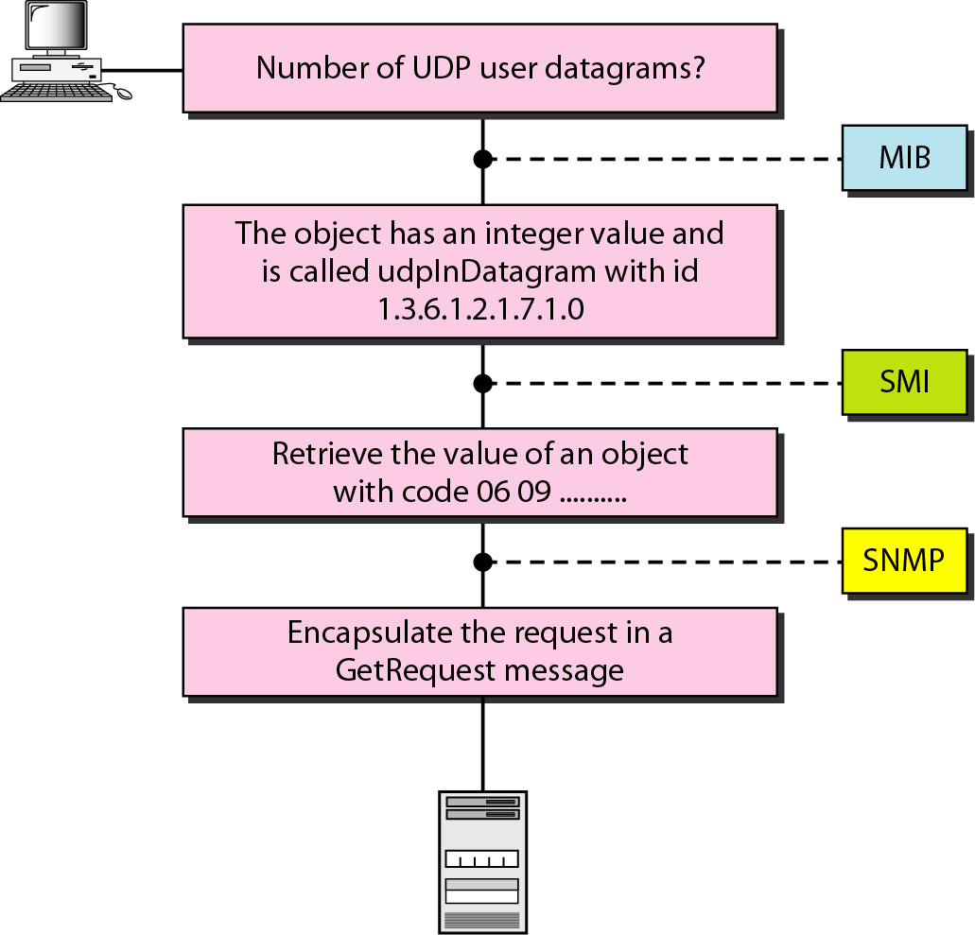
Figure 28.4 Management overview
28.<number>

Slide 12
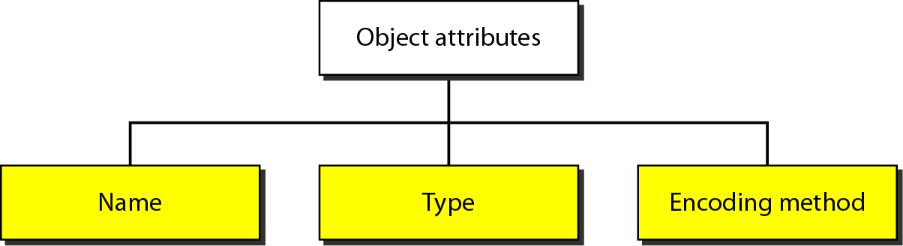
Figure 28.5 Object attributes
28.<number>

Slide 13
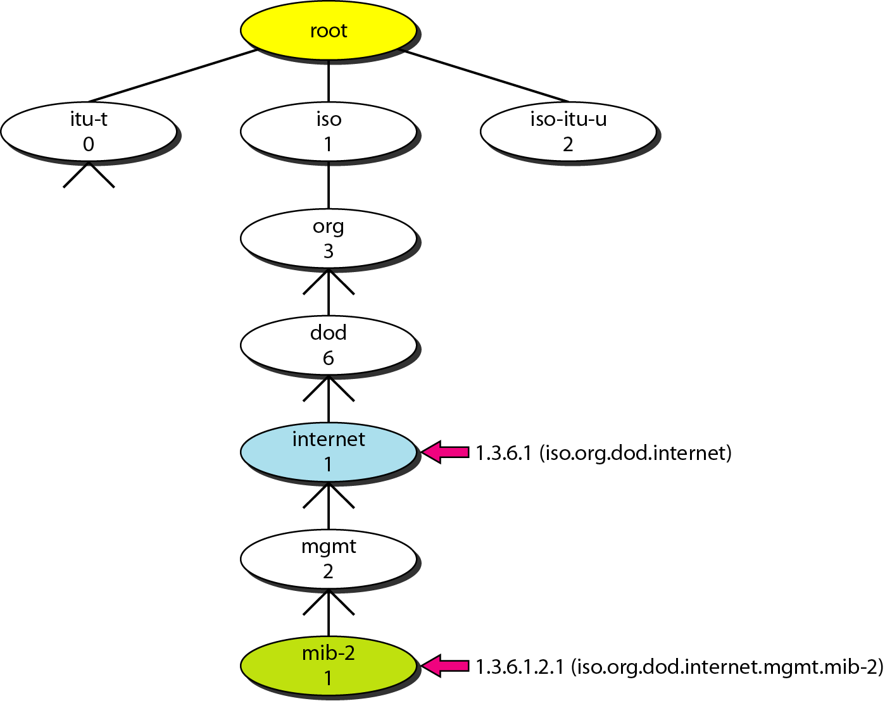
Figure 28.6 Object identifier
28.<number>

Slide 14
Note
All objects managed by SNMP are given an object identifier.
The object identifier always starts with 1.3.6.1.2.1.
28.<number>

Slide 15
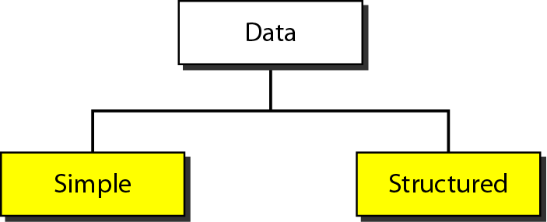
Figure 28.7 Data type
28.<number>

Slide 16
Table 28.1 Data types
28.<number>

Slide 17
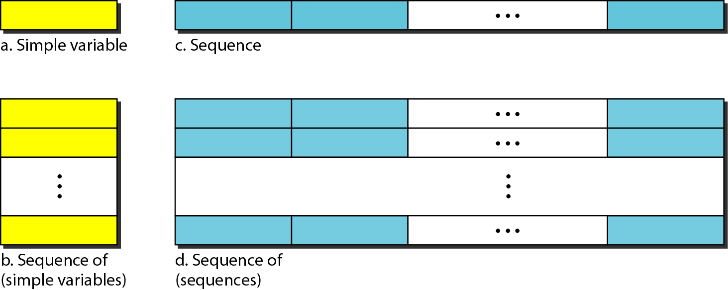
Figure 28.8 Conceptual data types
28.<number>

Slide 18
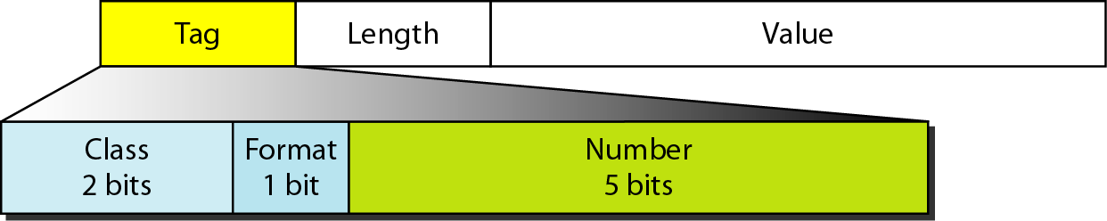
Figure 28.9 Encoding format
28.<number>

Slide 19
Table 28.2 Codes for data types
28.<number>

Slide 20
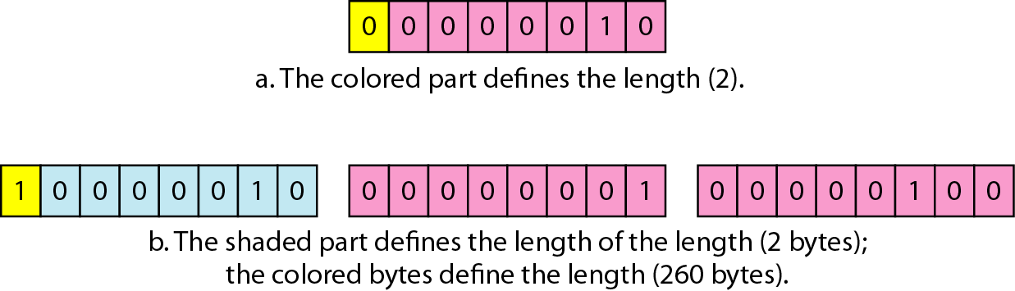
Figure 28.10 Length format
28.<number>

Slide 21
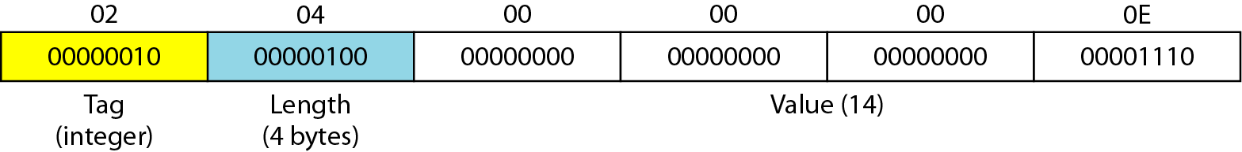
Example 28.1
Figure 28.11 shows how to define INTEGER 14.
Figure 28.11 Example 28.1, INTEGER 14
28.<number>

Slide 22
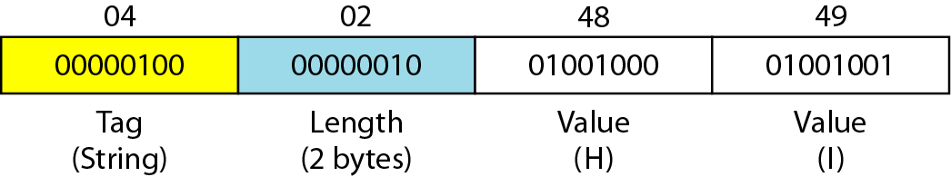
Example 28.2
Figure 28.12 shows how to define the OCTET STRING “HI”.
Figure 28.12 Example 28.2, OCTET STRING “HI”
28.<number>

Slide 23
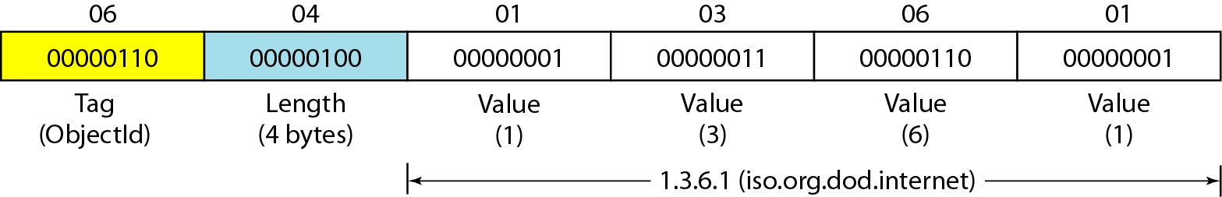
Example 28.3
Figure 28.13 shows how to define ObjectIdentifier
1.3.6.1 (iso.org.dod.internet).
Figure 28.13 Example 28.3, ObjectIdentifier 1.3.6.1
28.<number>

Slide 24
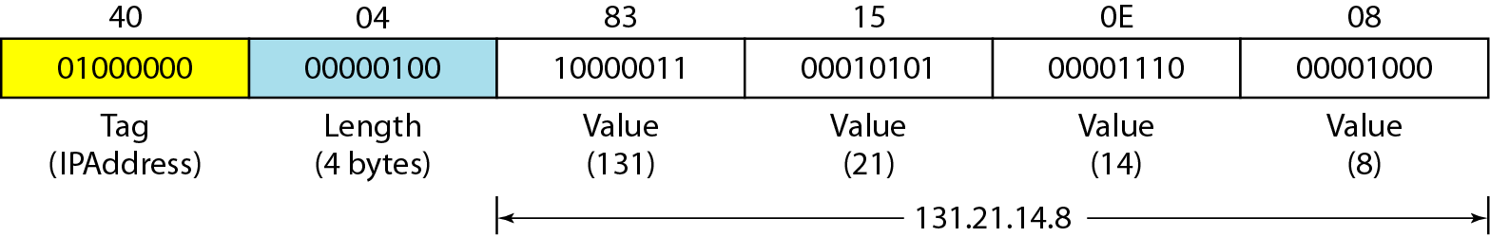
Example 28.4
Figure 28.14 shows how to define IPAddress 131.21.14.8..
Figure 28.14 Example 28.4, IPAddress 131.21.14.8.
28.<number>

Slide 25
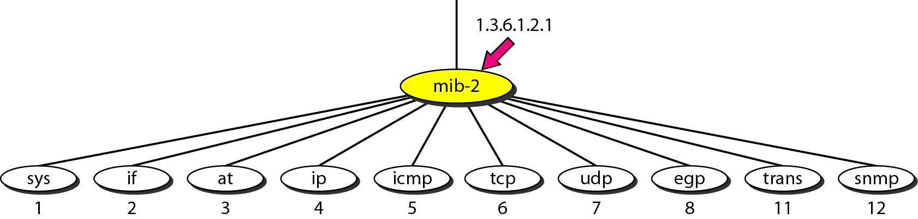
Figure 28.15 mib-2
28.<number>

Slide 26
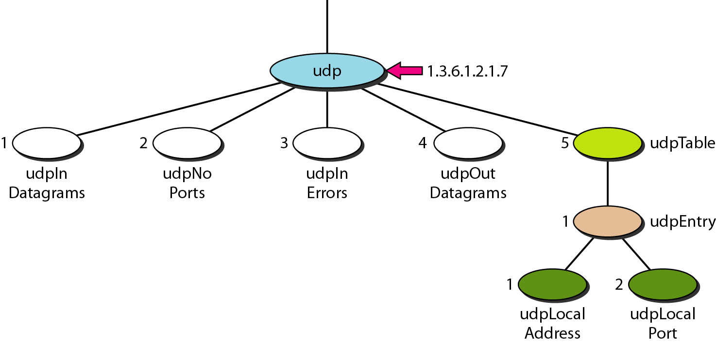
Figure 28.16 udp group
28.<number>

Slide 27
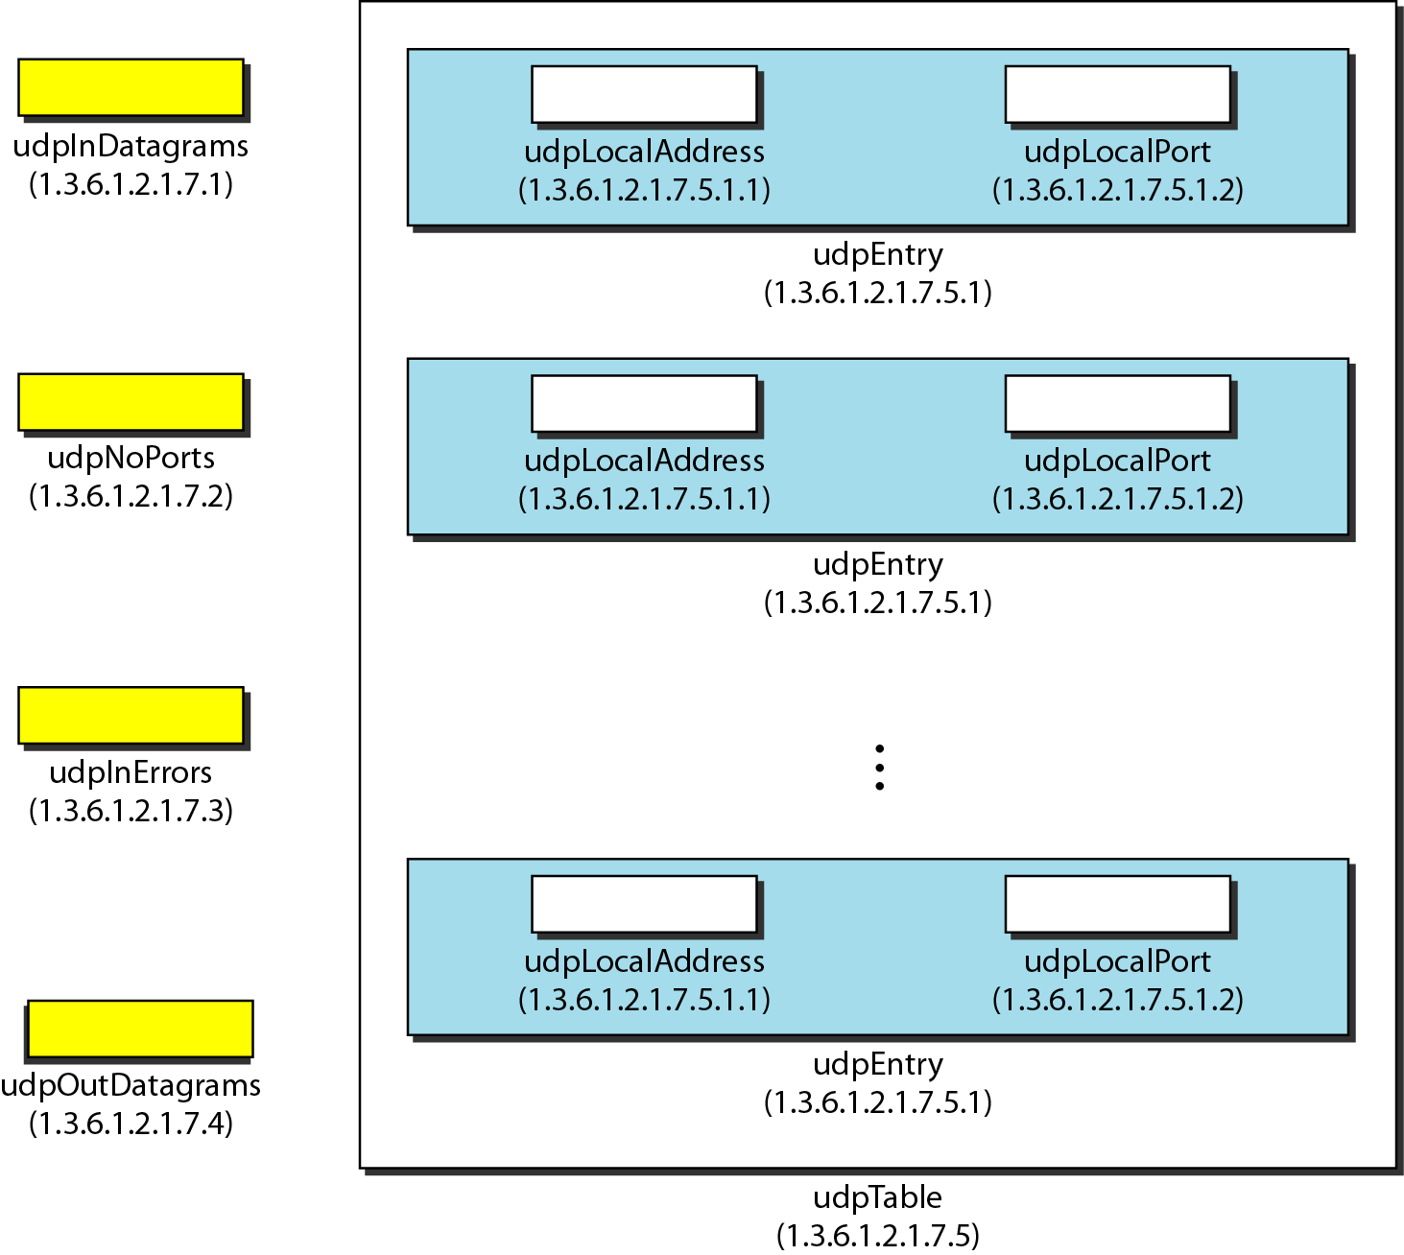
Figure 28.17 udp variables and tables
28.<number>

Slide 28
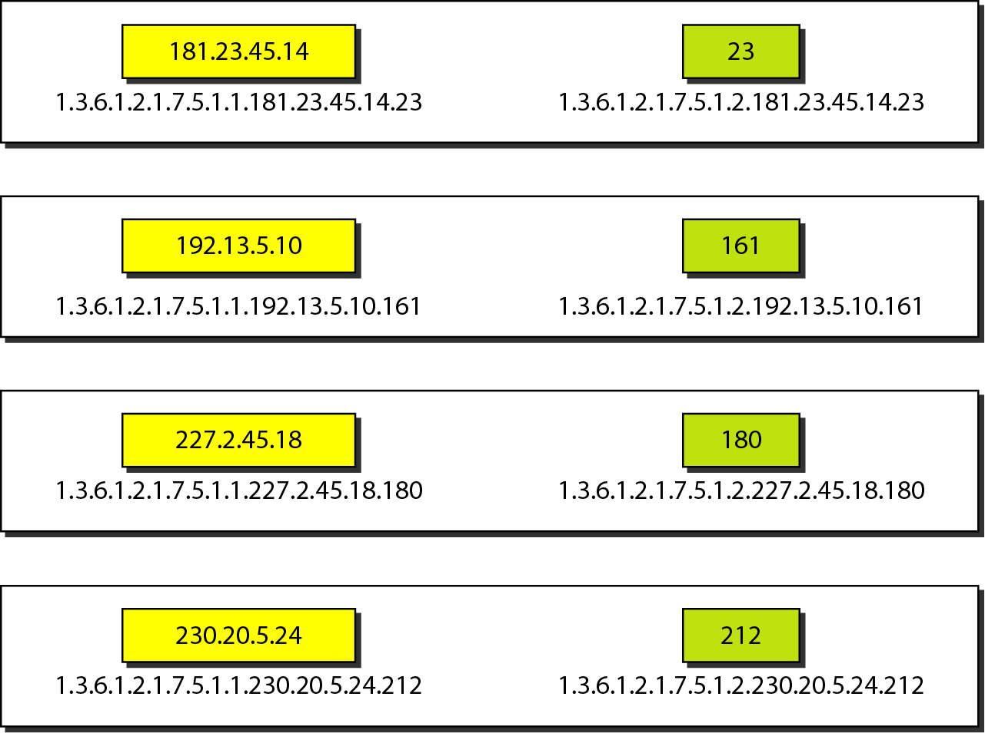
Figure 28.18 Indexes for udpTable
28.<number>

Slide 29
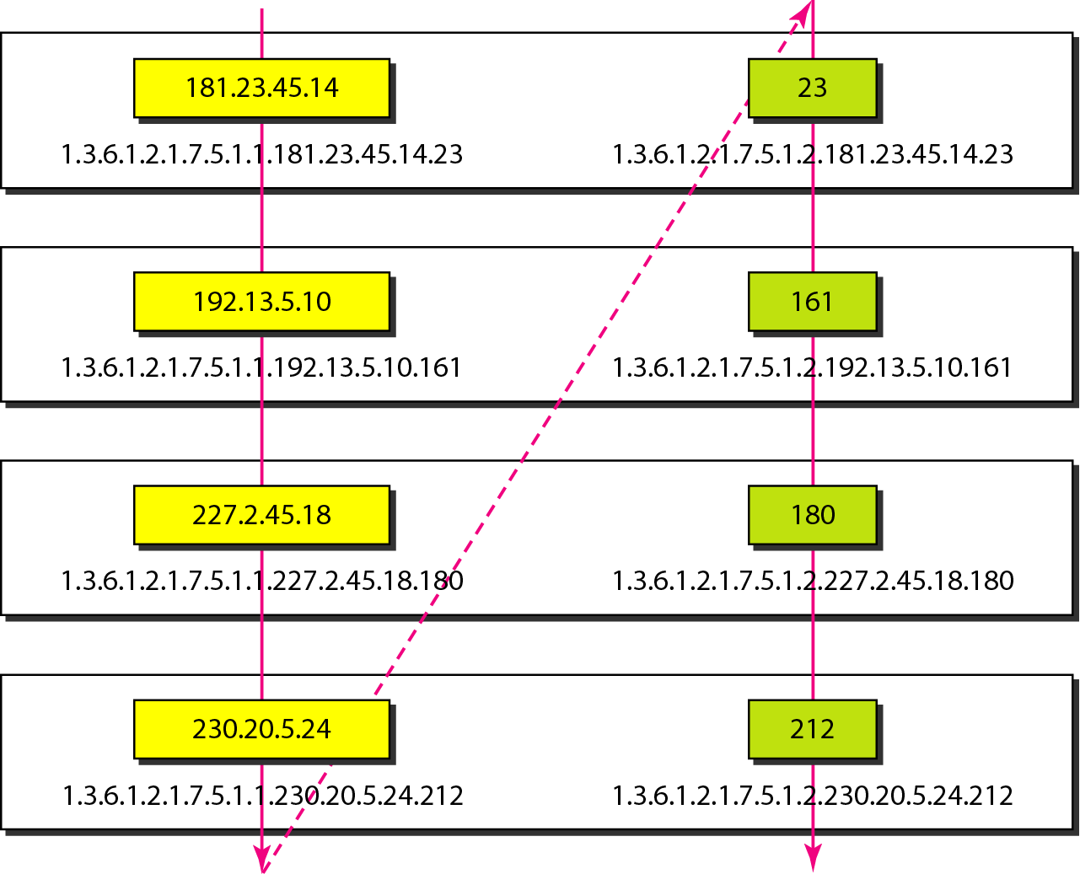
Figure 28.19 Lexicographic ordering
28.<number>

Slide 30
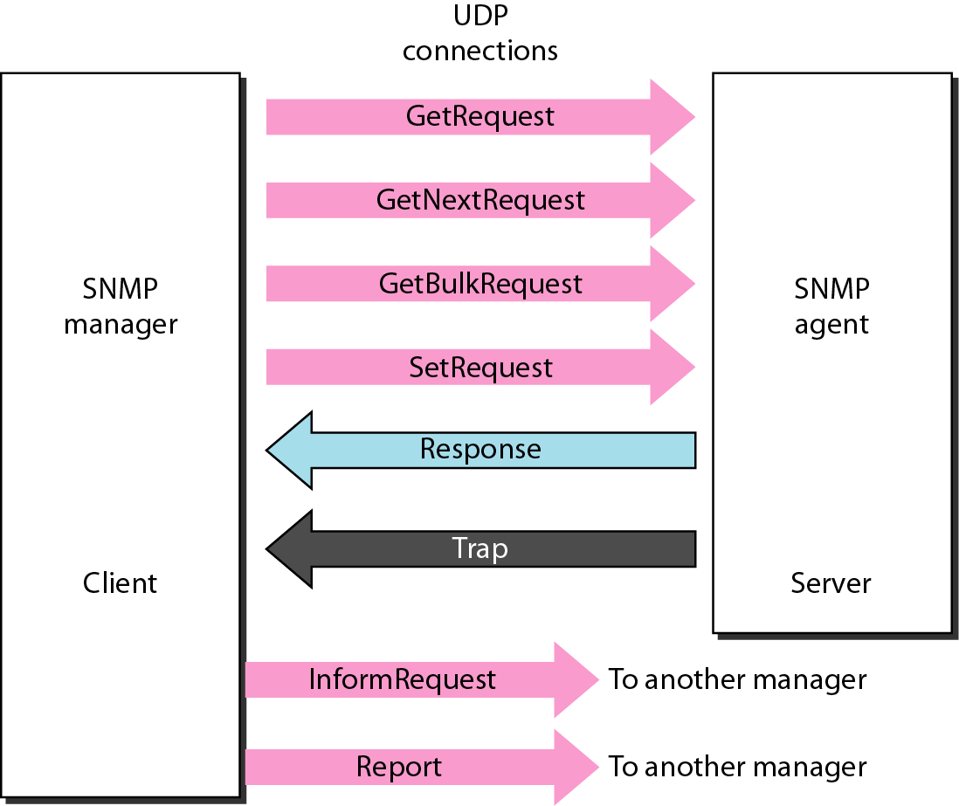
Figure 28.20 SNMP PDUs
28.<number>

Slide 31
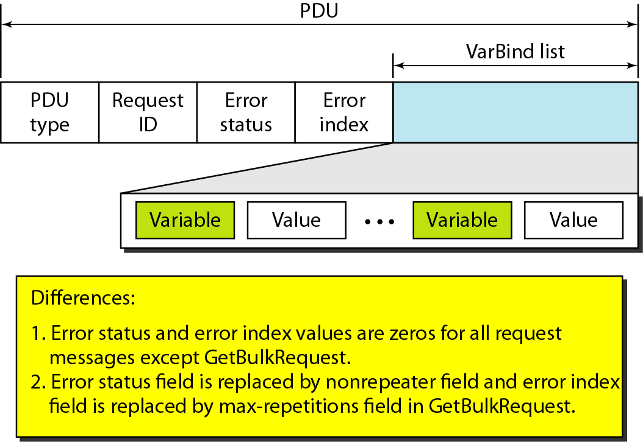
Figure 28.21 SNMP PDU format
28.<number>

Slide 32
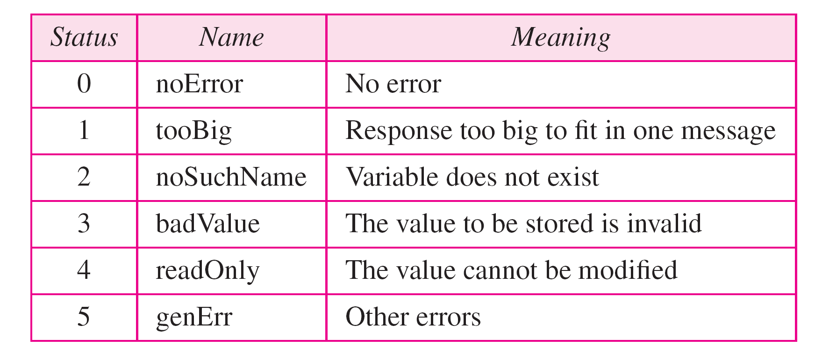
Table 28.3 Types of errors
28.<number>

Slide 33
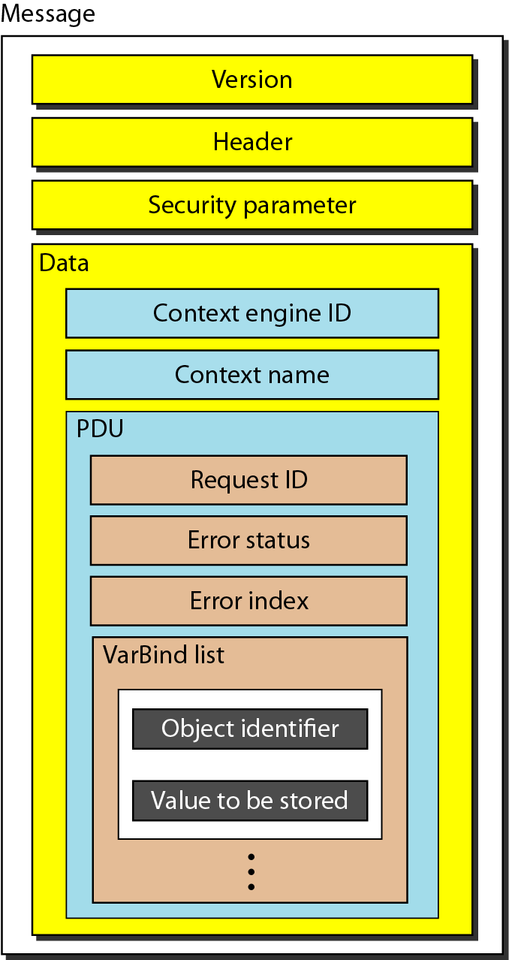
Figure 28.22 SNMP message
28.<number>

Slide 34
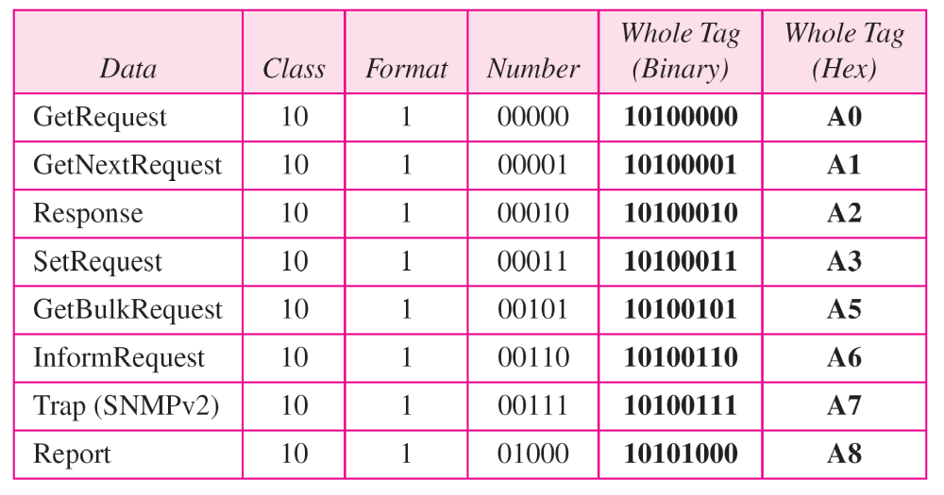
Table 28.4 Codes for SNMP messages
28.<number>

Slide 35
Example 28.5
In this example, a manager station (SNMP client) uses the GetRequest message to retrieve the number of UDP datagrams that a router has received. There is only one VarBind entity. The corresponding MIB variable related to this information is udpInDatagrams with the object identifier 1.3.6.1.2.1.7.1.0. The manager wants to retrieve a value (not to store a value), so the value defines a null entity. Figure 28.23 shows the conceptual view of the packet and the hierarchical nature of sequences. We have used white and colored boxes for the sequences and a gray one for the PDU. The VarBind list has only one VarBind.
28.<number>

Slide 36
Example 28.5 (continued)
The variable is of type 06 and length 09. The value is of type 05 and length 00. The whole VarBind is a sequence of length 0D (13). The VarBind list is also a sequence of length 0F (15). The GetRequest PDU is of length ID (29). Now we have three OCTET STRINGs related to the security parameter, security model, and flags. Then we have two integers defining maximum size (1024) and message ID (64). The header is a sequence of length 12, which we left blank for simplicity. There is one integer, version (version 3). The whole message is a sequence of 52 bytes. Figure 28.24 shows the actual message sent by the manager station (client) to the agent (server).
28.<number>

Slide 37
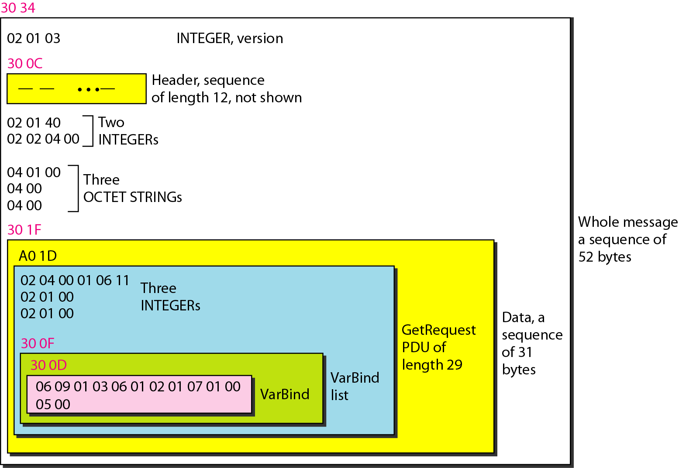
Figure 28.23 Example 28.5
28.<number>

Slide 38
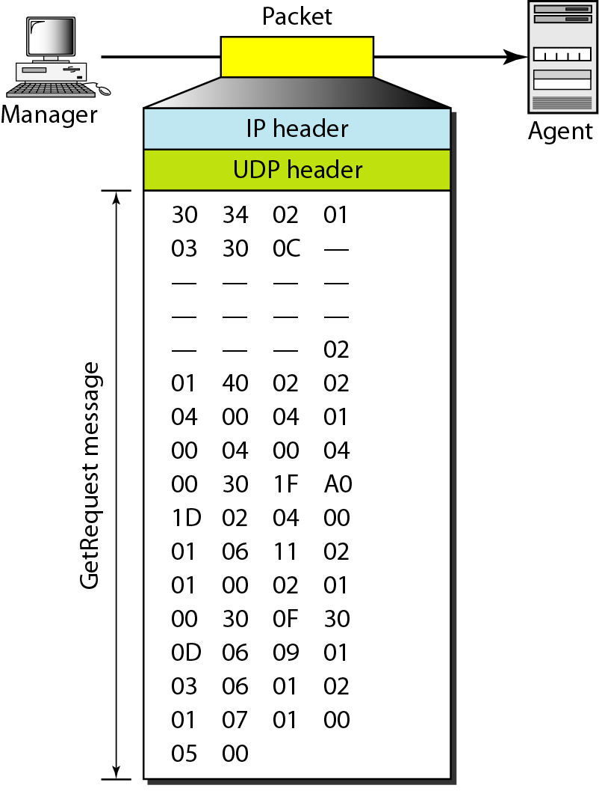
Figure 28.24 GetRequest message
28.<number>

Slide 39
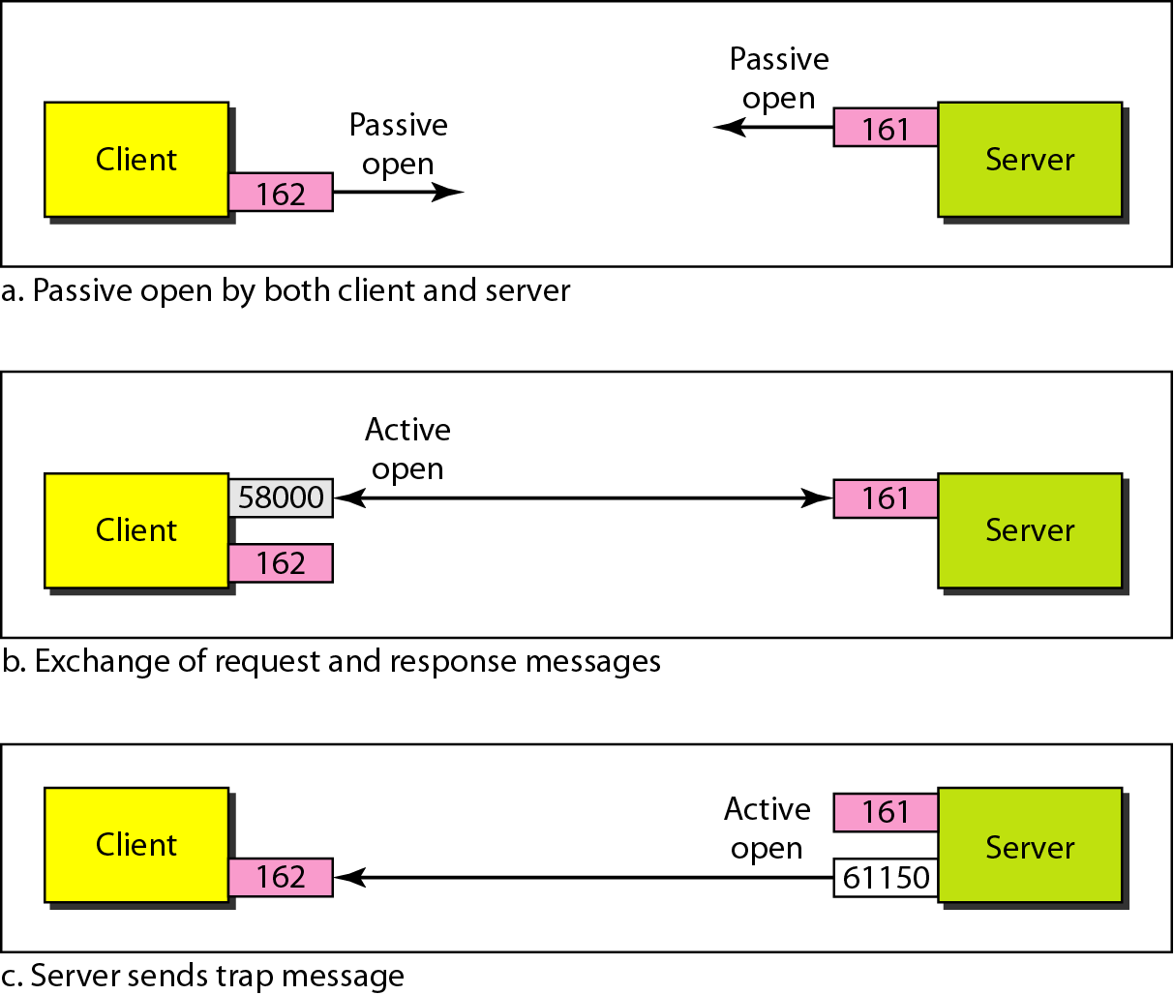
Figure 28.25 Port numbers for SNMP
28.<number>

