Slide 1
Chapter 29
Multimedia
29.<number>

Slide 2
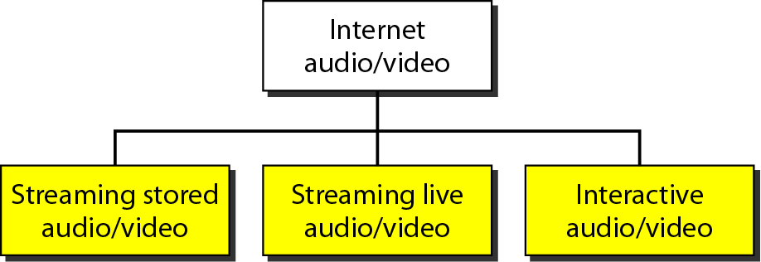
Figure 29.1 Internet audio/video
29.<number>

Slide 3

Note
Streaming stored audio/video refers to on-demand requests for compressed audio/video files.
29.<number>

Slide 4
Note
Streaming live audio/video refers to the broadcasting of radio and TV programs through the Internet.
29.<number>

Slide 5
Note
Interactive audio/video refers to the use of the Internet for interactive audio/video applications.
29.<number>

Slide 6
29-1 DIGITIZING AUDIO AND VIDEO
Before audio or video signals can be sent on the Internet, they need to be digitized. We discuss audio and video separately.
Topics discussed in this section:
Digitizing Audio
Digitizing Video
29.<number>

Slide 7
Note
Compression is needed to send video over the Internet.
29.<number>

Slide 8
29-2 AUDIO AND VIDEO COMPRESSION
To send audio or video over the Internet requires compression. In this section, we discuss audio compression first and then video compression.
Topics discussed in this section:
Audio Compression
Video Compression
29.<number>

Slide 9
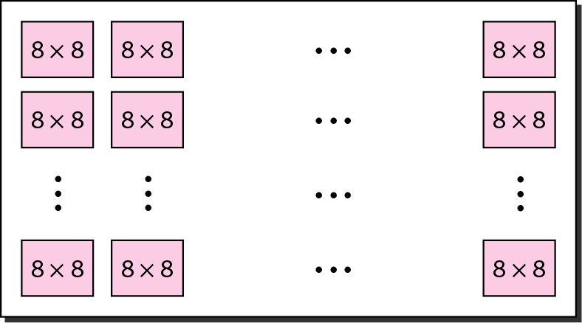
Figure 29.2 JPEG gray scale
29.<number>

Slide 10
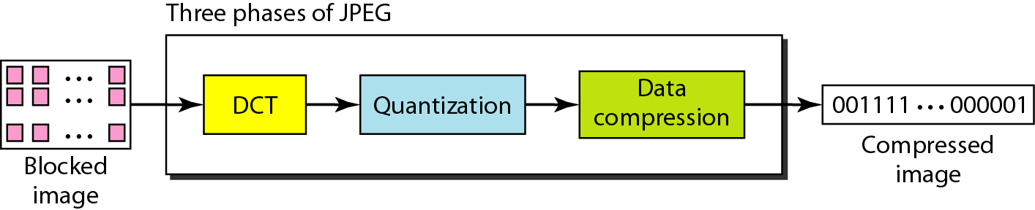
Figure 29.3 JPEG process
29.<number>

Slide 11
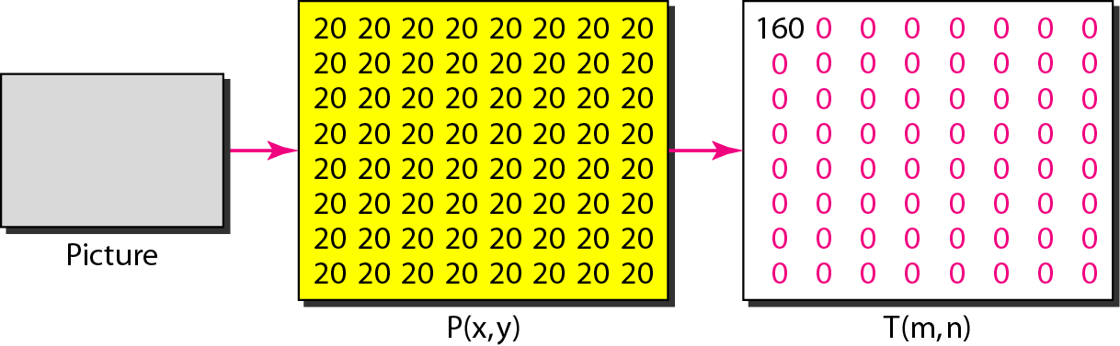
Figure 29.4 Case 1: uniform gray scale
29.<number>

Slide 12
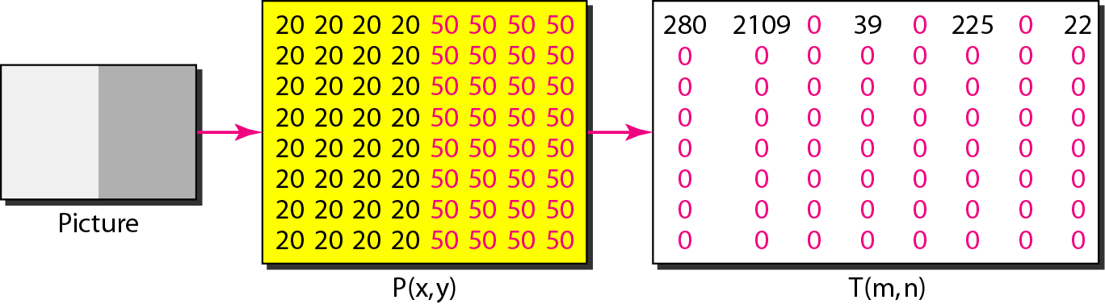
Figure 29.5 Case 2: two sections
29.<number>

Slide 13
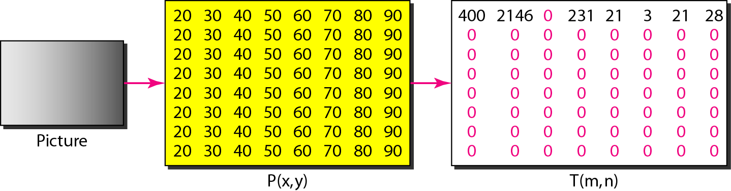
Figure 29.6 Case 3: gradient gray scale
29.<number>

Slide 14
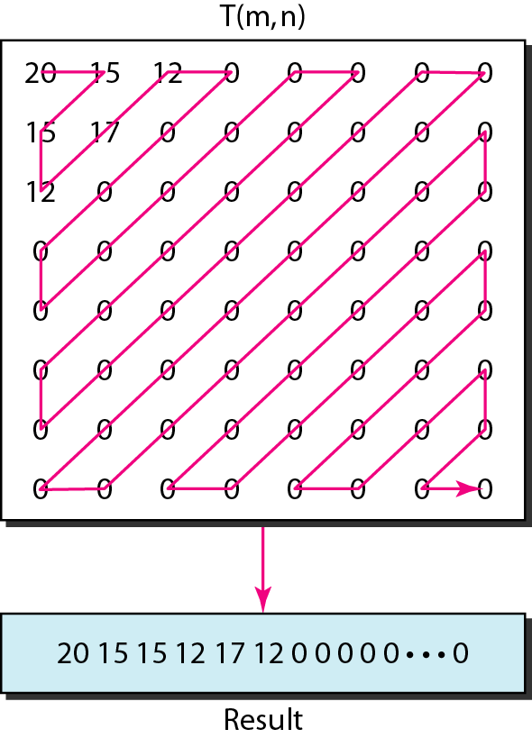
Figure 29.7 Reading the table
29.<number>

Slide 15

Figure 29.8 MPEG frames
29.<number>

Slide 16
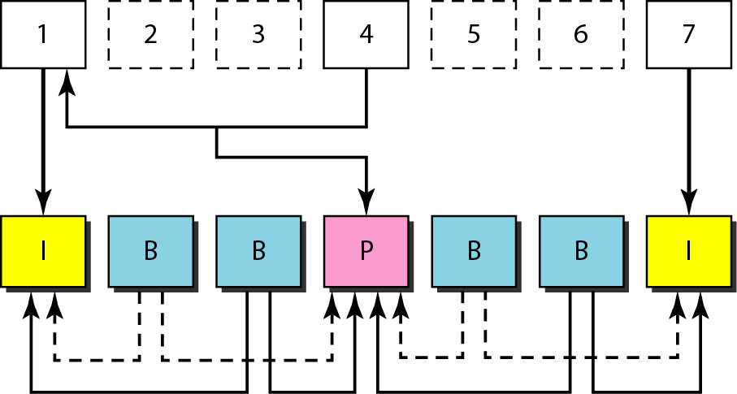
Figure 29.9 MPEG frame construction
29.<number>

Slide 17
29-3 STREAMING STORED AUDIO/VIDEO
Now that we have discussed digitizing and compressing audio/video, we turn our attention to specific applications. The first is streaming stored audio and video.
Topics discussed in this section:
First Approach: Using a Web Server
Second Approach: Using a Web Server with a Metafile
Third Approach: Using a Media Server
Fourth Approach: Using a Media Server and RTSP
29.<number>

Slide 18
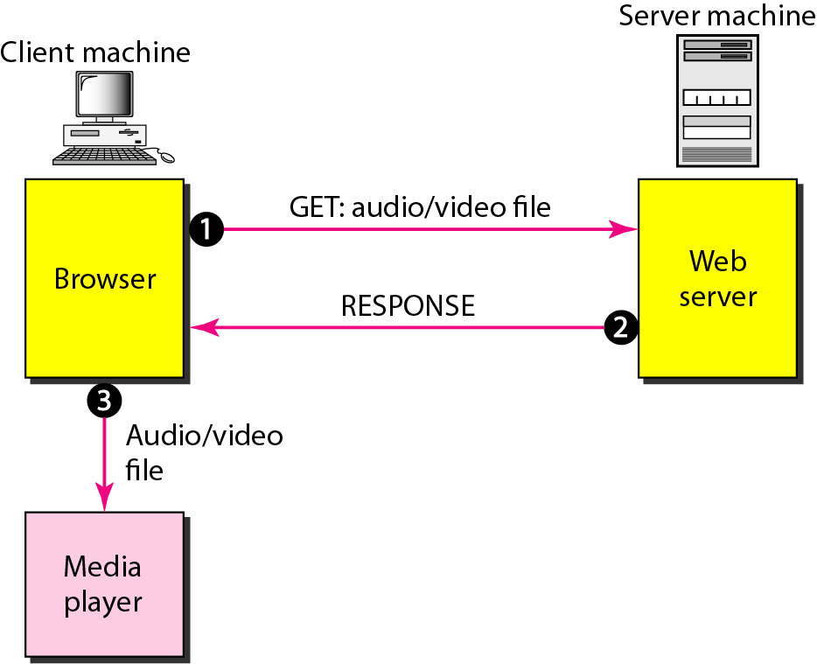
Figure 29.10 Using a Web server
29.<number>

Slide 19
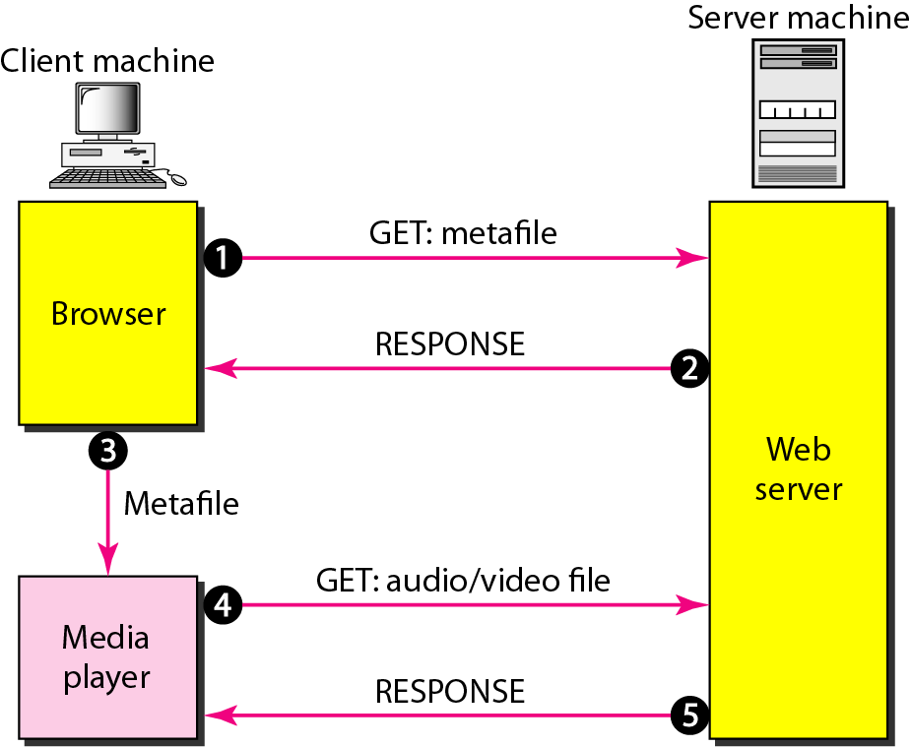
Figure 29.11 Using a Web server with a metafile
29.<number>

Slide 20
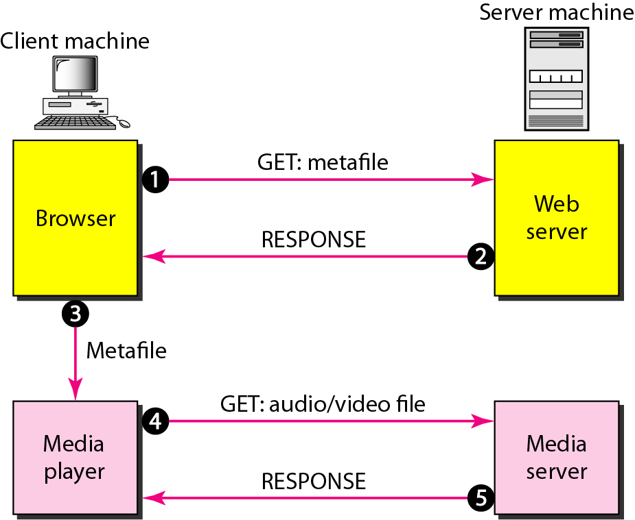
Figure 29.12 Using a media server
29.<number>

Slide 21
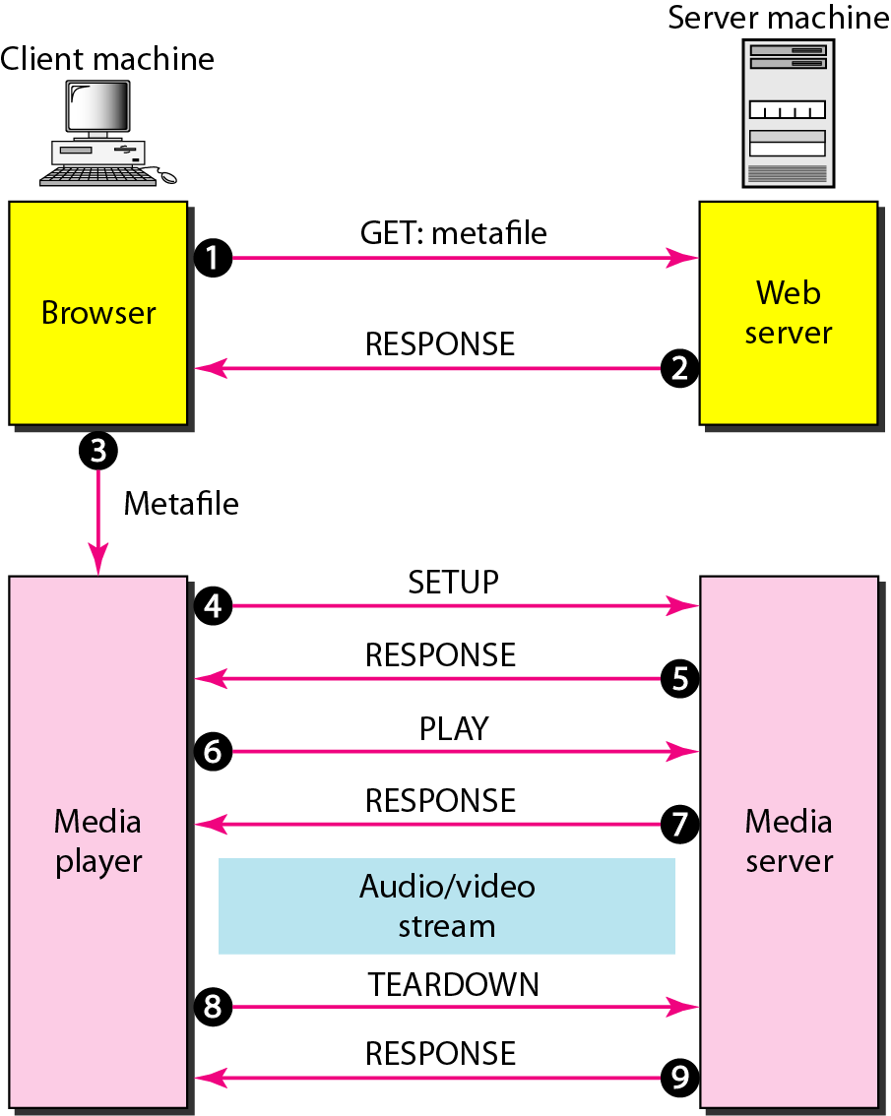
Figure 29.13 Using a media server and RTSP
29.<number>

Slide 22
29-4 STREAMING LIVE AUDIO/VIDEO
Streaming live audio/video is similar to the broadcasting of audio and video by radio and TV stations. Instead of broadcasting to the air, the stations broadcast through the Internet. There are several similarities between streaming stored audio/video and
streaming live audio/video. They are both sensitive to delay; neither can accept retransmission. However, there is a difference. In the first application, the communication is unicast and on-demand. In the second, the communication is multicast and live.
29.<number>

Slide 23
29-5 REAL-TIME INTERACTIVE
AUDIO/VIDEO
In real-time interactive audio/video, people communicate with one another in real time. The Internet phone or voice over IP is an example of this type of application. Video conferencing is another example that allows people to communicate visually and orally.
Topics discussed in this section:
Characteristics
29.<number>

Slide 24
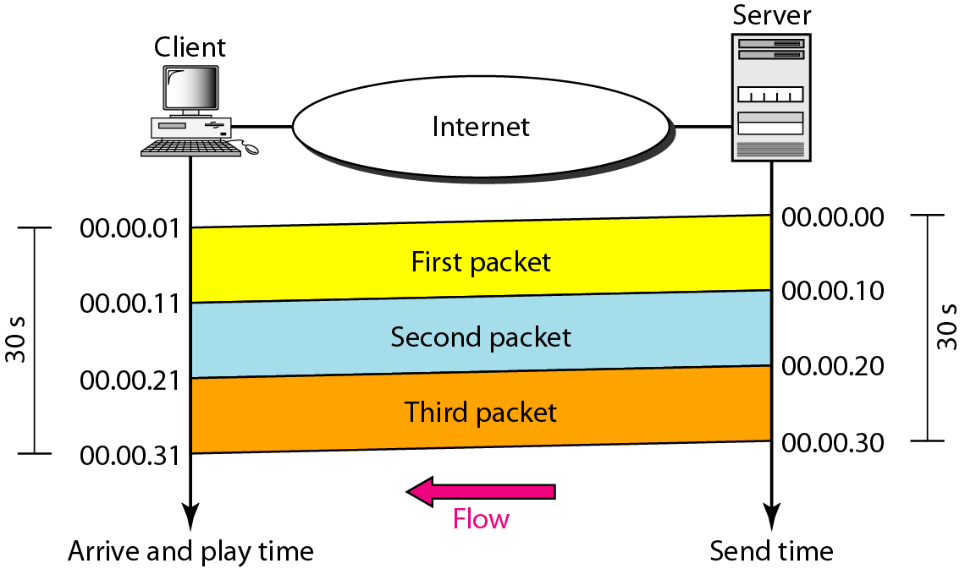
Figure 29.14 Time relationship
29.<number>

Slide 25
Note
Jitter is introduced in real-time data by the delay between packets.
29.<number>

Slide 26
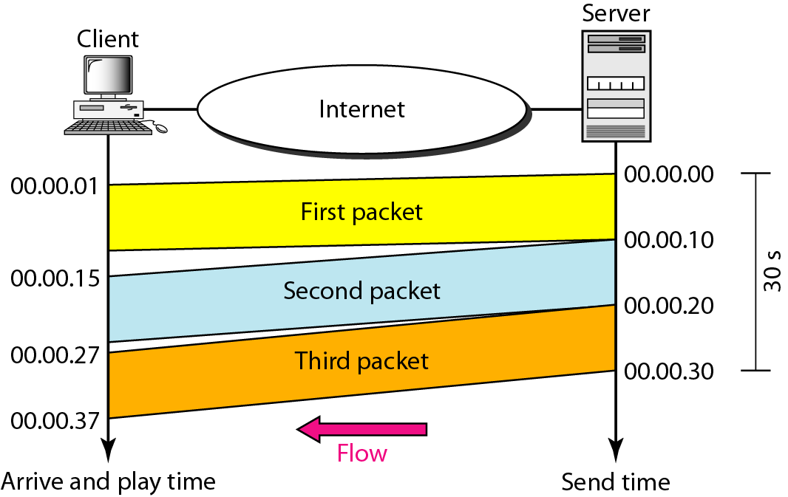
Figure 29.15 Jitter
29.<number>

Slide 27
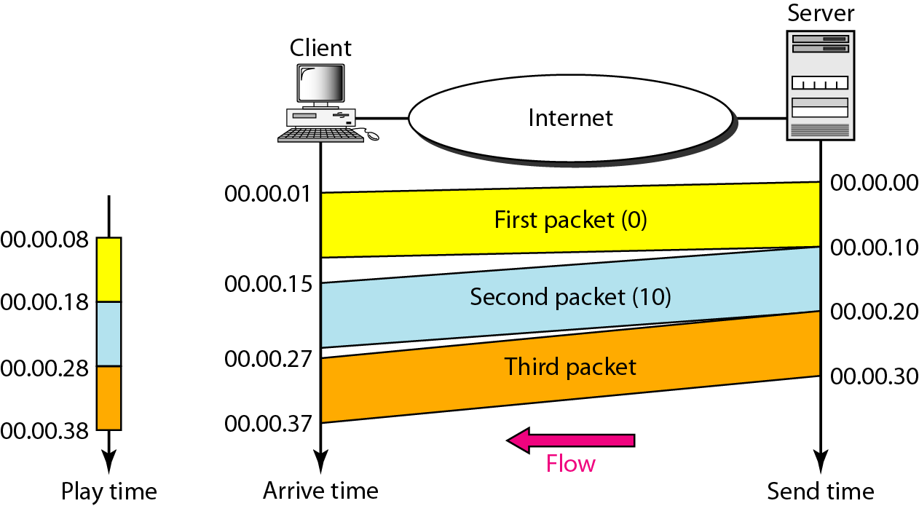
Figure 29.16 Timestamp
29.<number>

Slide 28
Note
To prevent jitter, we can time-stamp the packets and separate the arrival time from the playback time.
29.<number>

Slide 29
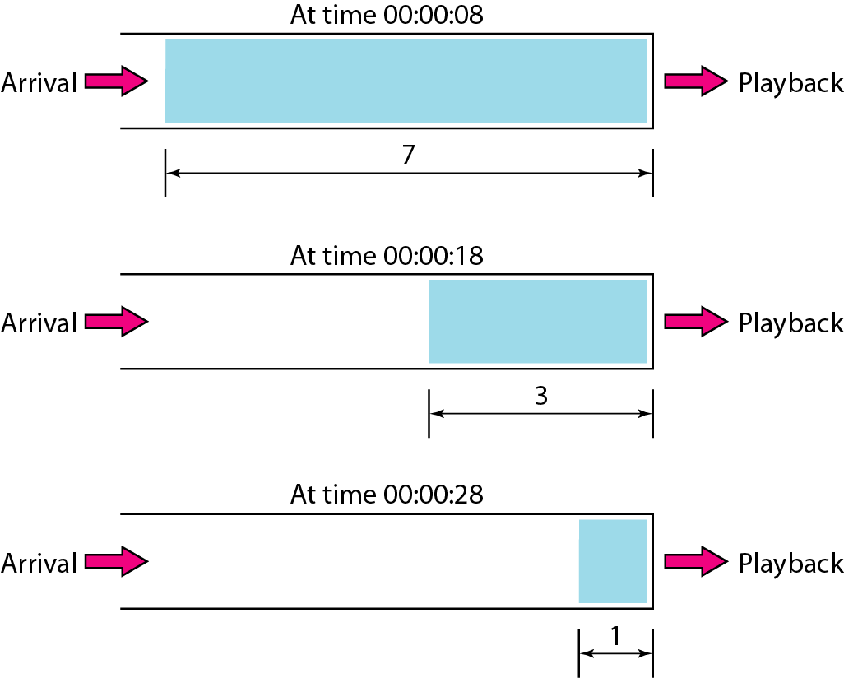
Figure 29.17 Playback buffer
29.<number>

Slide 30
Note
A playback buffer is required for real-time traffic.
29.<number>

Slide 31
Note
A sequence number on each packet is required for real-time traffic.
29.<number>

Slide 32
Note
Real-time traffic needs the support of multicasting.
29.<number>

Slide 33
Note
Translation means changing the encoding of a payload to a lower
quality to match the bandwidth
of the receiving network.
29.<number>

Slide 34
Note
Mixing means combining several streams of traffic into one stream.
29.<number>

Slide 35
Note
TCP, with all its sophistication, is not suitable for interactive multimedia
traffic because we cannot allow retransmission of packets.
29.<number>

Slide 36
Note
UDP is more suitable than TCP for interactive traffic. However, we
need the services of RTP,
another transport layer
protocol, to make up
for the deficiencies
of UDP.
29.<number>

Slide 37
29-6 RTP
Real-time Transport Protocol (RTP) is the protocol designed to handle real-time traffic on the Internet. RTP does not have a delivery mechanism; it must be used with UDP. RTP stands between UDP and the application program. The main contributions of RTP are time-stamping, sequencing, and mixing facilities.
Topics discussed in this section:
RTP Packet Format
UDP Port
29.<number>

Slide 38
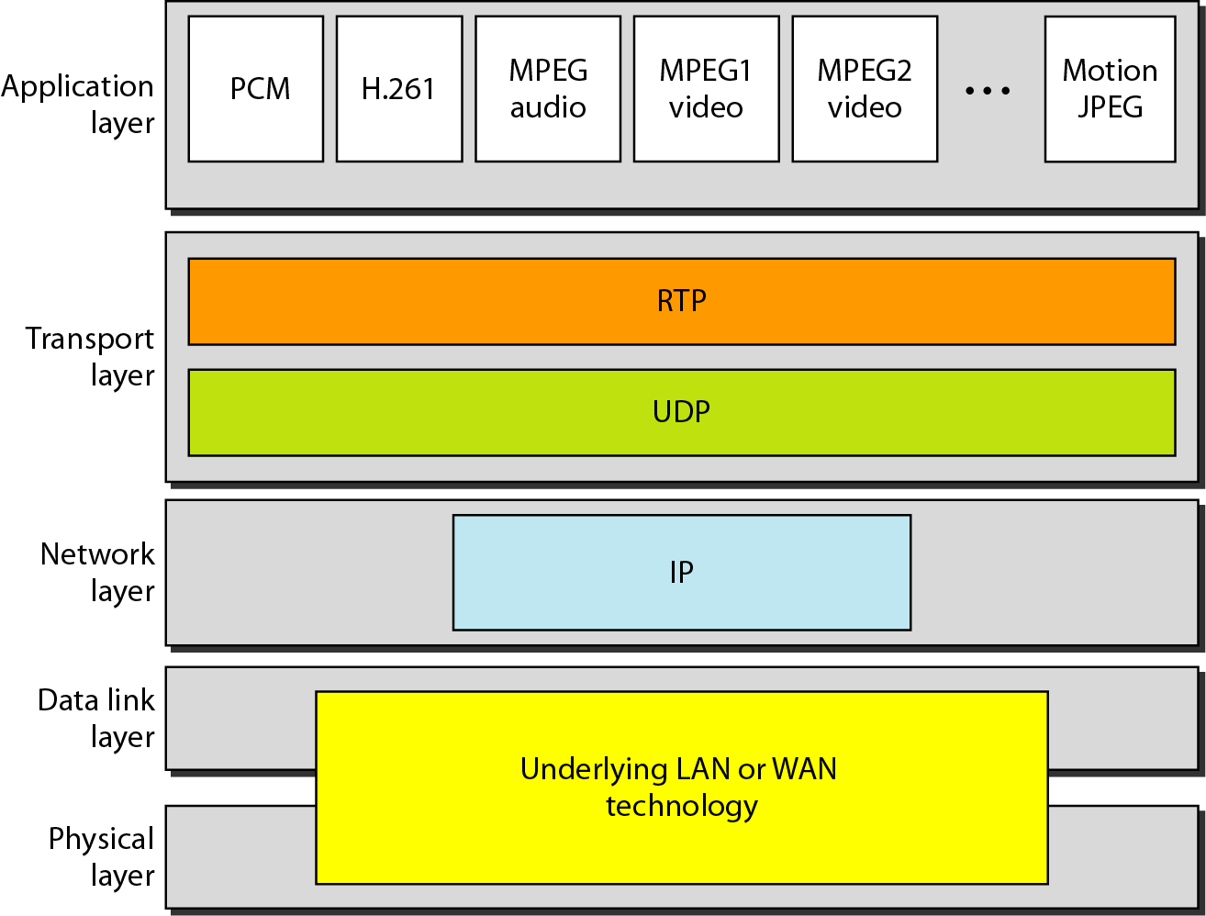
Figure 29.18 RTP
29.<number>

Slide 39
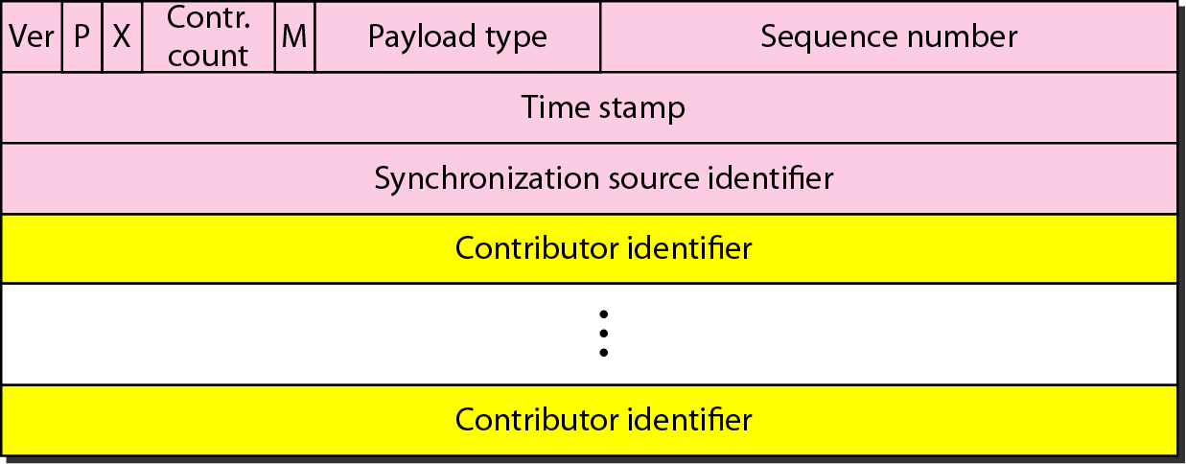
Figure 29.19 RTP packet header format
29.<number>

Slide 40
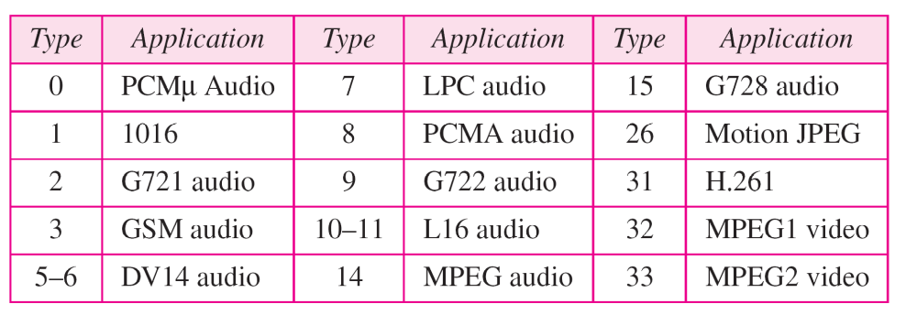
Table 20.1 Payload types
29.<number>

Slide 41
Note
RTP uses a temporary even-numbered UDP port.
29.<number>

Slide 42
29-7 RTCP
RTP allows only one type of message, one that carries data from the source to the destination. In many cases, there is a need for other messages in a session. These messages control the flow and quality of data and allow the recipient to send feedback to the source
or sources. Real-time Transport Control Protocol (RTCP) is a protocol designed for this purpose.
Topics discussed in this section:
Sender Report and Receiver Report
Messages
UDP Port
29.<number>

Slide 43
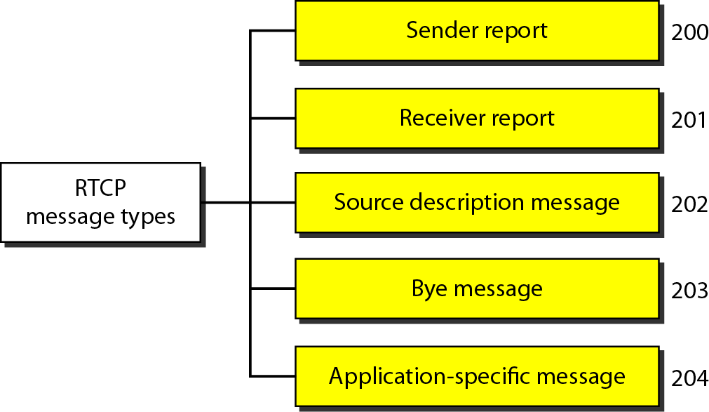
Figure 29.20 RTCP message types
29.<number>

Slide 44
Note
RTCP uses an odd-numbered UDP port number that follows the port number selected for RTP.
29.<number>

Slide 45
29-8 VOICE OVER IP
Let us concentrate on one real-time interactive audio/video application: voice over IP, or Internet telephony. The idea is to use the Internet as a telephone network with some additional capabilities. Two protocols have been designed to handle this type of communication: SIP and H.323.
Topics discussed in this section:
SIP
H.323
29.<number>

Slide 46
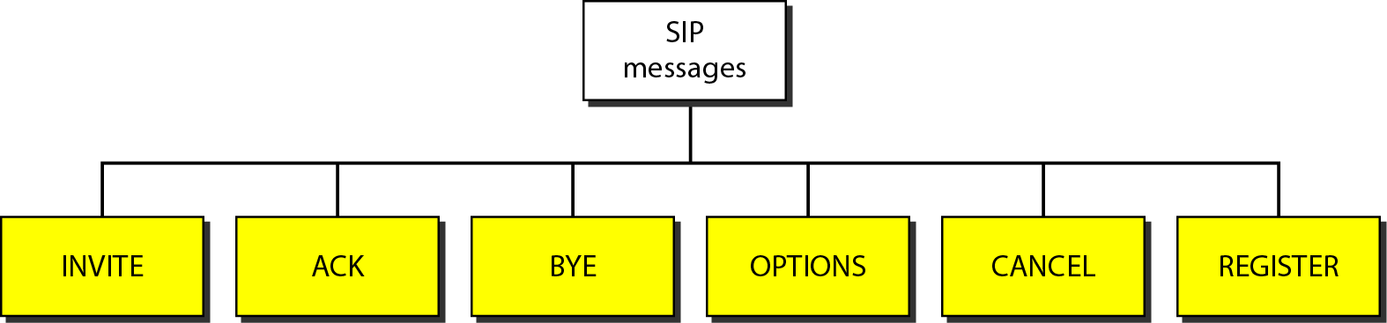
Figure 29.21 SIP messages
29.<number>

Slide 47
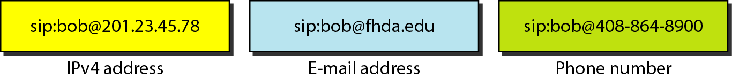
Figure 29.22 SIP formats
29.<number>

Slide 48
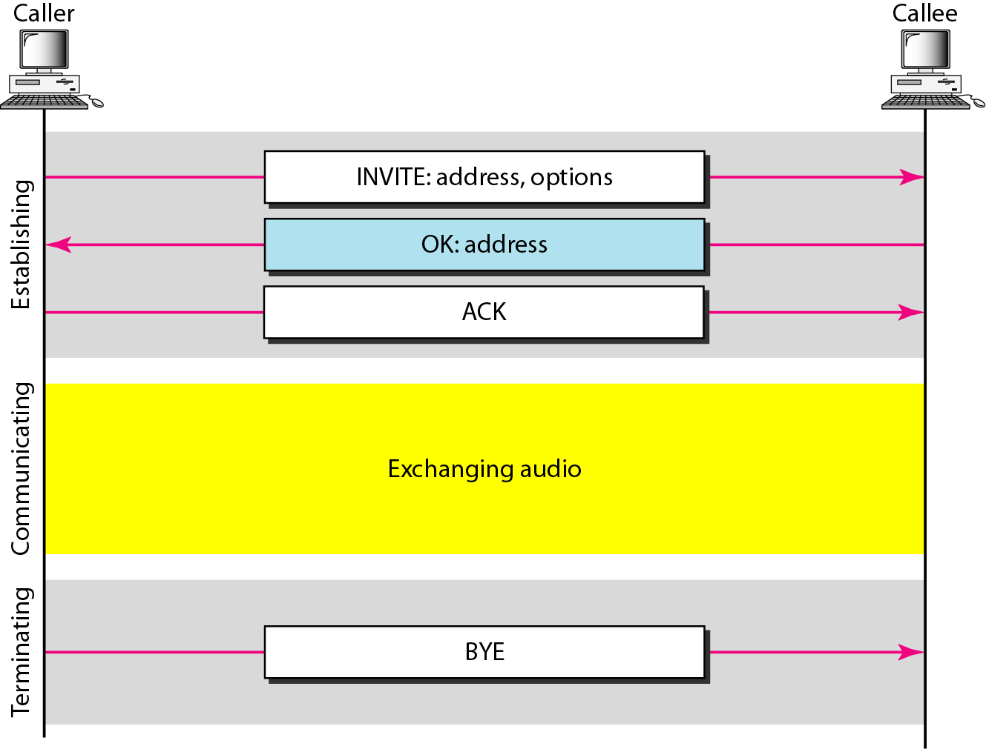
Figure 29.23 SIP simple session
29.<number>

Slide 49
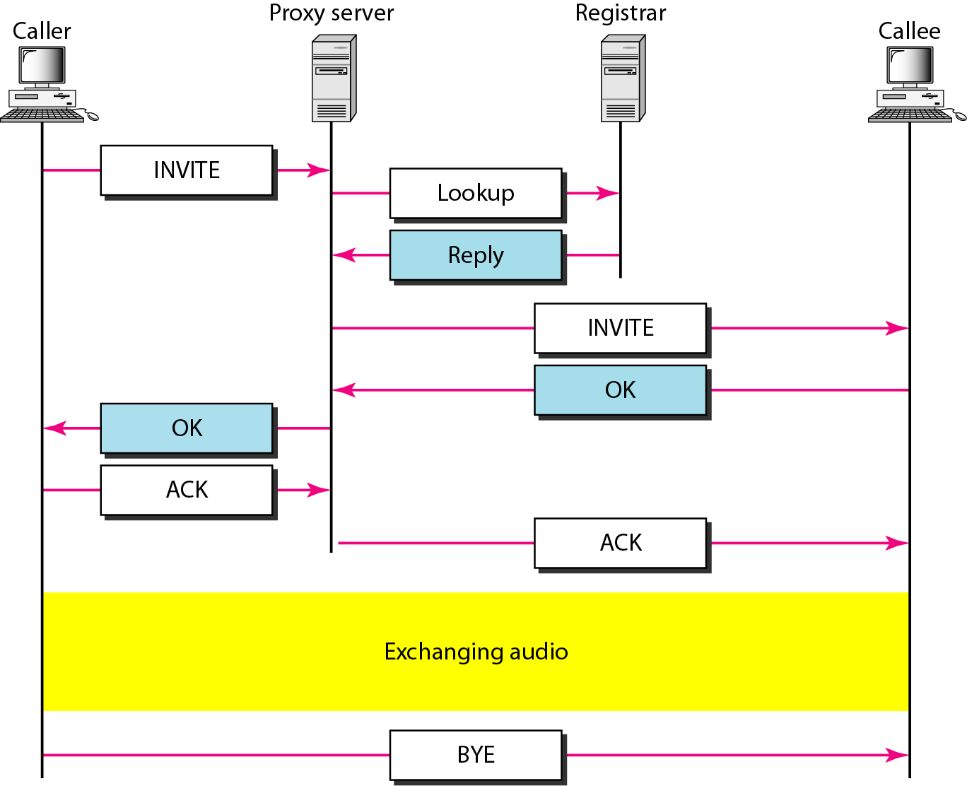
Figure 29.24 Tracking the callee
29.<number>

Slide 50
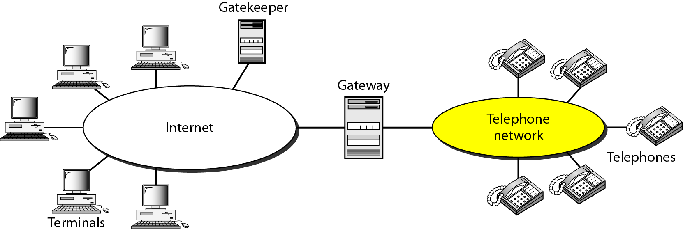
Figure 29.25 H.323 architecture
29.<number>

Slide 51
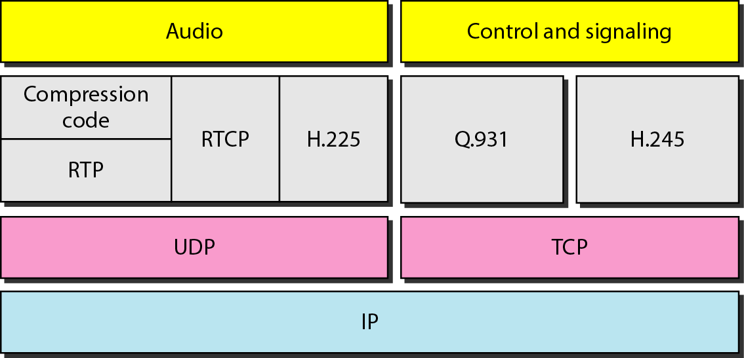
Figure 29.26 H.323 protocols
29.<number>

Slide 52
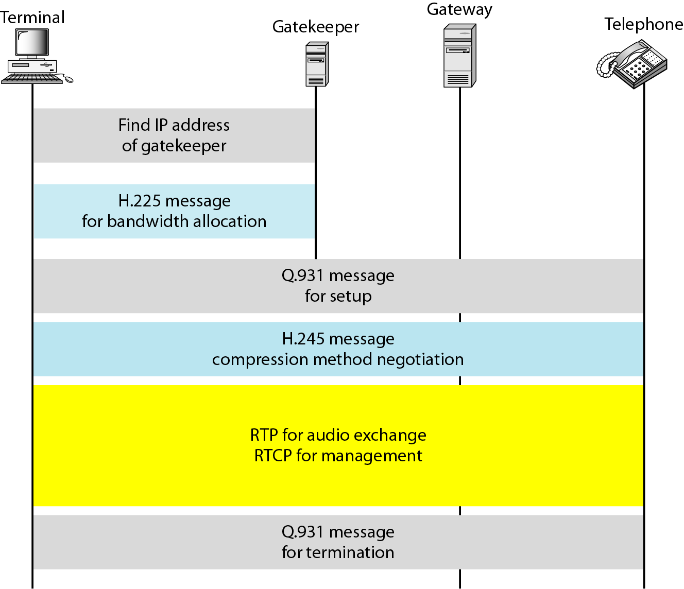
Figure 29.27 H.323 example
29.<number>

