Slide 1

Chapter 2 – Foundation I
Yeshwant Singh
yeshwant.singh@ddn.upes.ac.in
SoCS, UPES, Dehradun

Slide 2
Outline
Basic Probability Theory
Univariate Models
Multivariate Models
Statistic

Slide 3
Probability
Probability theory is nothing but common sense reduced to calculation.
— Pierre Laplace, 1812

Slide 4
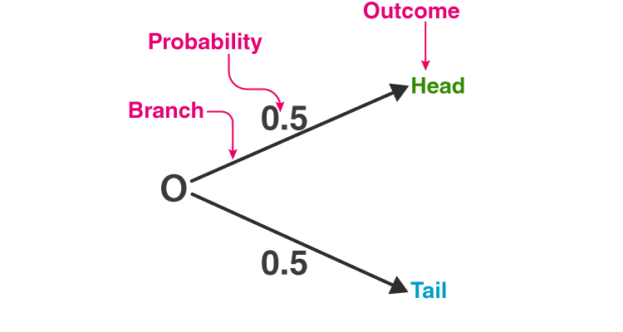
Probability
Frequentist Interpretation.
Bayesian Interpretation.
Flip the coin many times, we expect it to land heads about half the time.
Quantify our uncertainty or belief about something
Notes:
We belief that the coin is equally likely to land heads or tails on the next toss

Slide 5
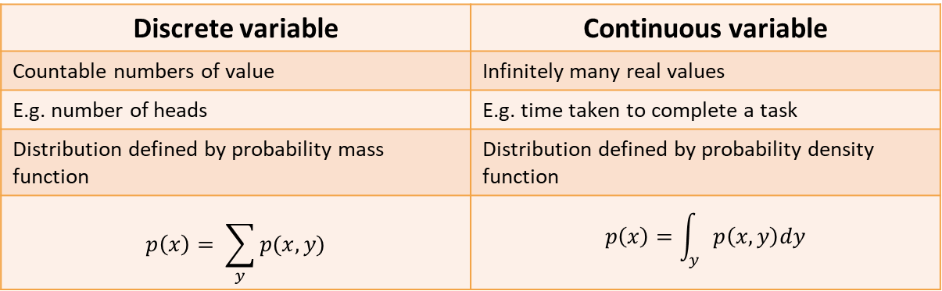
Random Variable
Is a mathematical formalization of a quantity or object which depends on random events.
It is a mapping or a function from possible outcomes in a sample space to a measurable space, often the real numbers.
Discrete variable | Continuous variable
Countable numbers of value | Infinitely many real values
E.g. number of heads | E.g. time taken to complete a task
Distribution defined by probability mass function | Distribution defined by probability density function
$$p\left(x\right)= \sum_{y}{p(x,y)}$$ | $$p\left(x\right)=\int_{y}{p\left(x,y\right)dy}$$

Slide 6
Bayes’ rule
“Bayesian” is used to refer to inference methods that represent “degrees of certainty” using probability theory, and which leverage Bayes’ rule, to update the degree of certainty given data.
Layman term: Update our belief based on prior belief and data so that we infer something with a certain degree of uncertainty.

Slide 7

Bayes’ rule
Math term:
Posterior Probability
Prior Probability
Likelihood
Layman term:
Updated belief
Prior belief
Data

Slide 8
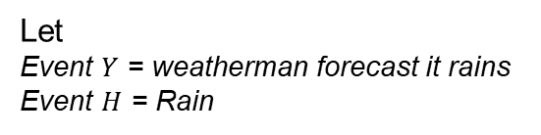




Bayes’ rule - Example
Marie is getting married tomorrow at an outdoor ceremony in the desert.
In recent years, it has rained only 5 days each year.
When it actually rains, the weatherman has forecast rain 90% of the time.
When it doesn't rain, he has forecast rain 10% of the time.
Unfortunately, the weatherman is forecasting rain for tomorrow.
What is the probability it will rain on the day of Marie's wedding?
Let
Event $Y$ = weatherman forecast it rains
Event $H$ = Rain
Prior Probability
$$P\left(H\right)=\frac{5}{365}=0.0137$$
Likelihood
$$P(Y|H) = 0.9$$
$$P(Y|\sim H) = 0.1$$
Posterior Probability
$$P(H|Y) = ??$$

Slide 9

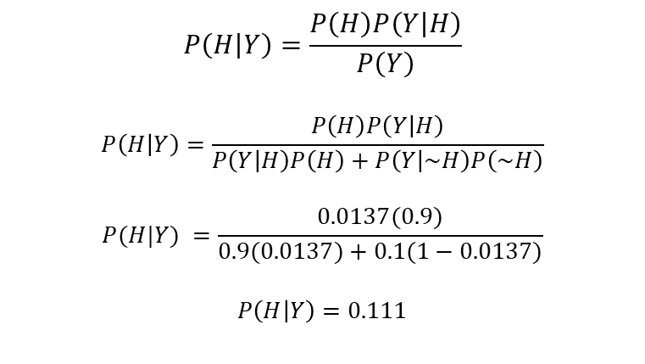



Bayes’ rule - Example
We know
$$P\left(H | Y\right)=\frac{P\left(H\right)P\left(Y | H\right)}{P\left(Y\right)}$$
$$P\left(H | Y\right)=\frac{P\left(H\right)P\left(Y | H\right)}{P\left(Y | H\right)P\left(H\right)+P\left(Y | \sim H\right)P\left(\sim H\right)}$$
$$P(H|Y) =\frac{0.0137(0.9)}{0.9(0.0137)+0.1(1−0.0137)}$$
$$P\left(H | Y\right)=0.111$$
$$P\left(H\right)=\frac{5}{365}=0.0137$$
$$P(Y|H) = 0.9$$
$$P(Y|\sim H) = 0.1$$
$$P(H|Y) = ??$$
The probability it will rain on the day of Marie's wedding, given the weatherman is forecasting rain for tomorrow is 0.111

Slide 10
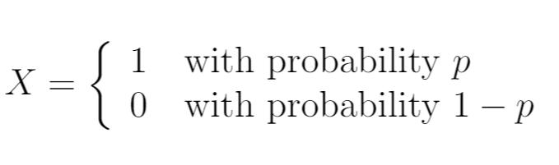
Bernoulli Distributions
A random variable follows a Bernoulli distribution if it only has two possible outcomes: 0 or 1.
For example, suppose we flip a coin one time. Let the probability that it lands on heads be p. This means the probability that it lands on tails is 1-p.
Thus, we could write:
In this case, random variable X follows a Bernoulli distribution. It can only take on two possible values.
Now, if we flip a coin multiple times then the sum of the Bernoulli random variables will follow a Binomial distribution.
https://www.statology.org/bernoulli-vs-binomial/

Slide 11
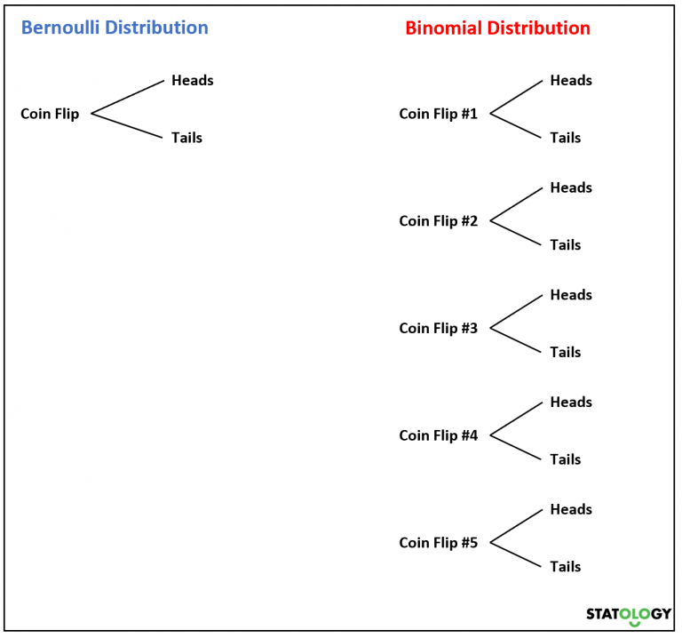
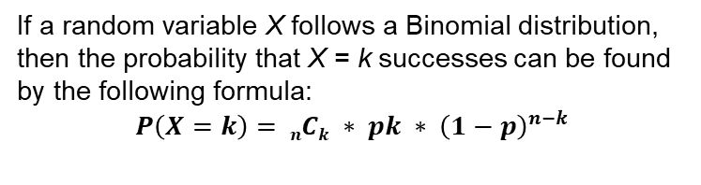
Binomial Distributions
If a random variable X follows a Binomial distribution, then the probability that X = k successes can be found by the following formula:
$$P\left(X=k\right)= nCk ∗ pk ∗ {\left(1−p\right)}^{n−k}$$
n: number of trials
k: number of successes
p: probability of success on a given trial
_{n}C_{k}: the number of ways to obtain k successes in n trials
https://www.statology.org/bernoulli-vs-binomial/

Slide 12

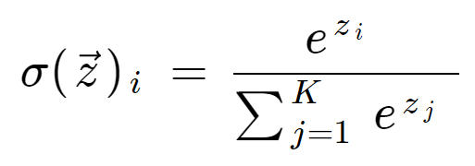
Multinomial Distributions
Bernoulli distribution: K = 2 outcomes, n = 1 trial
Binomial distribution: K = 2 outcomes, n ≥ 1 trial
Multinomial distribution: K ≥ 2 outcomes, n ≥ trials
Binomial | Multinomial
E.g. Coin Toss (H/T) | E.g. weather (sunny/windy/gloomy)
Sigmoid function | Softmax function – ensure total probability across all class equal to 1
https://deepai.org/machine-learning-glossary-and-terms/softmax-layer

Slide 13
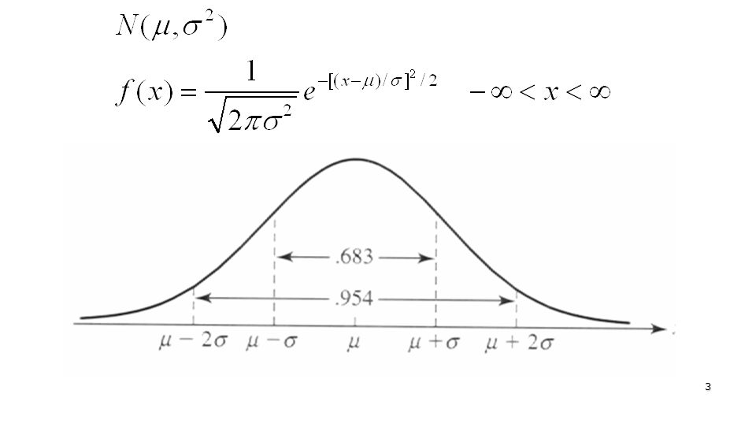
Univariate Gaussian Distribution
Univariate
Multivariate
Statistic
Defined by two parameters, mean μ, which is expected value of the distribution and standard deviation σ which corresponds to the expected squared deviation from the mean.

Slide 14
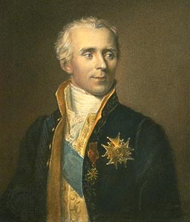
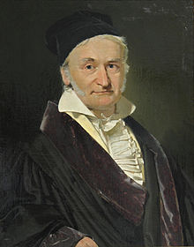
Fun Facts of Gaussian
Univariate
Multivariate
Statistic
The fundamental nature of this distribution and its main properties were noted by Laplace when Gauss was six years old.
Gauss popularized the use of the distribution in the 1800s, and the term “Gaussian” is now widely used in science and engineering
Laplace
Gauss
Image taken from Wikipedia

Slide 15





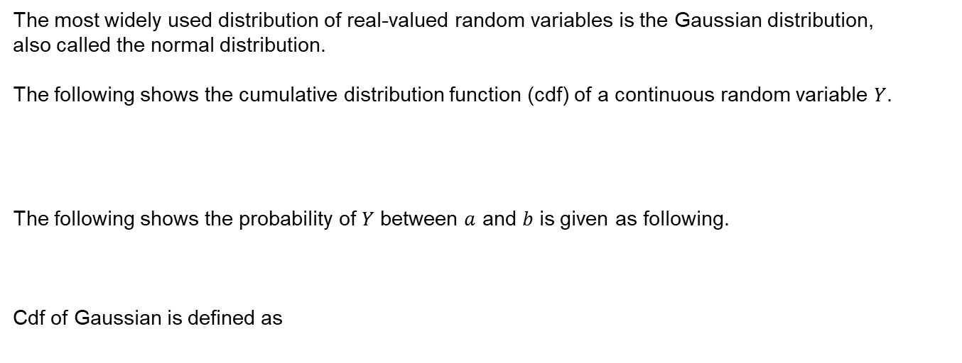
Univariate Gaussian Distribution
Univariate
Multivariate
Statistic
The most widely used distribution of real-valued random variables is the Gaussian distribution,
also called the normal distribution.
The following shows the cumulative distribution function (cdf) of a continuous random variable $Y$.
The following shows the probability of $Y$ between $a$ and $b$ is given as following.
Cdf of Gaussian is defined as
,
mean
variance

Slide 16
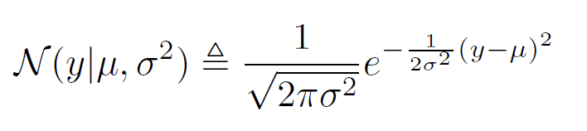
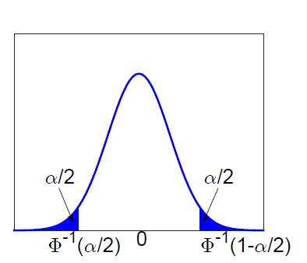
Gaussian Distribution
Univariate
Multivariate
Statistic
The most widely used distribution of real-valued random variables is the Gaussian distribution,
also called the normal distribution.
Probability distribution function (pdf) of Gaussian is
mean
variance
Normalization – ensure area under curve = 1

Slide 17
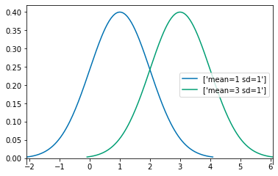
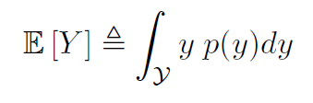
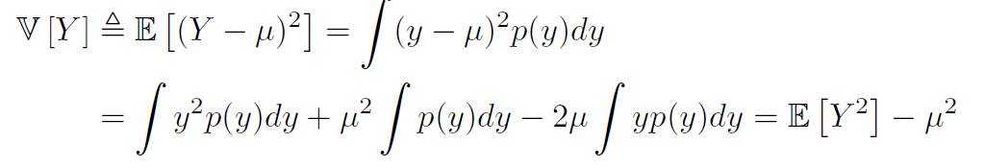
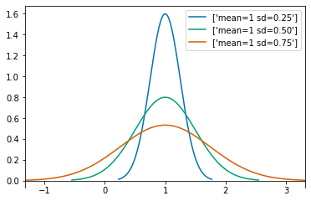

Gaussian Distribution
Univariate
Multivariate
Statistic
Mean of pdf of Gaussian is = 0
Variance of pdf of Gaussian is = Spread

Slide 18
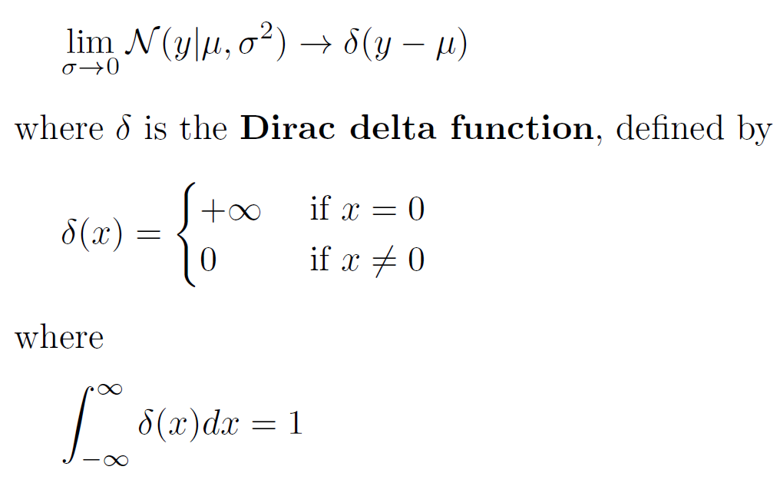
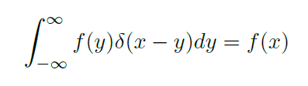
Dirac delta function
Univariate
Multivariate
Statistic
When variance of Gaussian goes to zero, the distribution becomes narrower.
Sifting Property

Slide 19
Other Univariate Distributions
Univariate
Multivariate
Statistic
Student t-distribution – hypothesis testing
Cauchy distribution – useful for Bayesian modelling (heavy tails)
Laplace distribution – has heavy tails, used in robust linear regression and sparse linear regression
Beta distribution
Gamma distribution
Exponential distribution
Chi-square distribution – used in hypothesis testing
Inverse gamma distribution
Empirical distribution

Slide 20
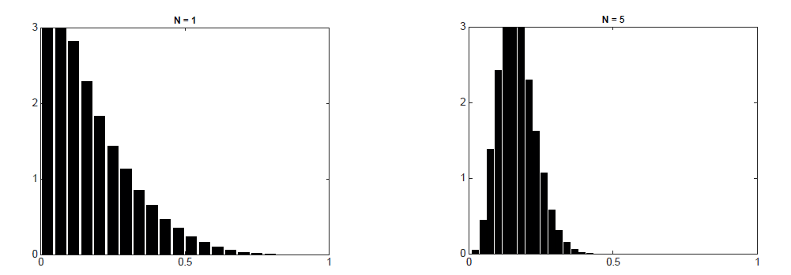
Central Limit Theorem
Univariate
Multivariate
Statistic
When independent random variables are summed up, the distribution converges to a normal distribution even if the original distribution themselves are not normally distributed.
sims = RV(Beta(a=2, b=3)).sim(1000000)
Notes:
This function wants to stretch and shift the probability distribution

Slide 21
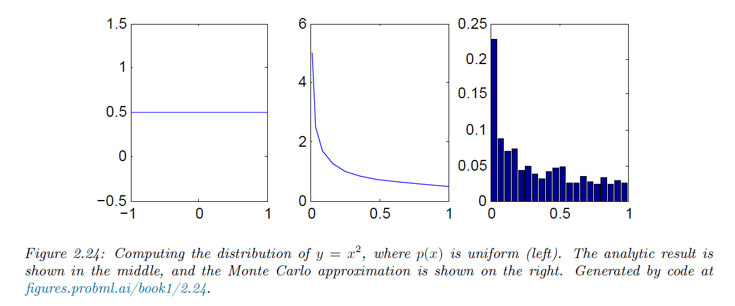
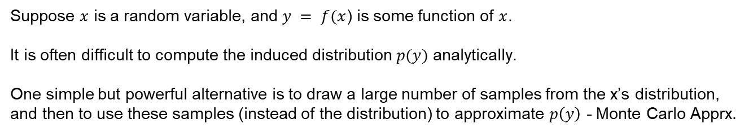
Monte Carlo Approximation
Univariate
Multivariate
Statistic
Suppose $x$ is a random variable, and $y = f(x$) is some function of $x$.
It is often difficult to compute the induced distribution $p(y)$ analytically.
One simple but powerful alternative is to draw a large number of samples from the x’s distribution, and then to use these samples (instead of the distribution) to approximate $p\left(y\right)$ - Monte Carlo Apprx.
Notes:
P(H) – probability of raining.

Slide 22
Multivariate
Univariate
Multivariate
Statistic
When we have more than one variable → multivariate
Univariate → Variance
Multivariate → Covariance
Describing how much data deviate from mean
Compute the average deviation

Slide 23
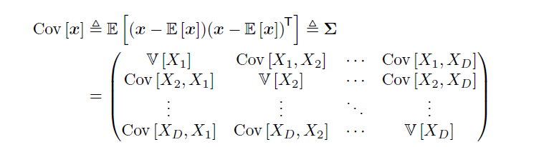
Multivariate
Univariate
Multivariate
Statistic
If x is a D-dimensional random vector, its covariance matrix is defined to be the following symmetric, positive semi definite matrix:
Notes:
positive semi definite matrix – all eigenvalues are non-negative

Slide 24





Multivariate Gaussian Distribution
Univariate
Multivariate
Statistic
The most widely used joint probability distribution for continuous random variable is the multivariate Gaussian or multivariate normal (MVN).
MVN density is
Mean vector, $E[y]$
Covariance matrix, $Cov[y]$
Normalization – ensure area under curve = 1
D = Dimension
Notes:
D = di

Slide 25


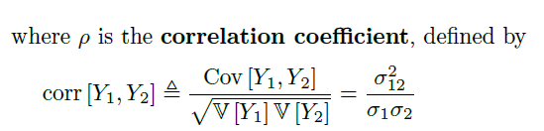
Multivariate Gaussian Distribution
Univariate
Multivariate
Statistic
Pdf of MVN is represent by
Notes:
D = di

Slide 26
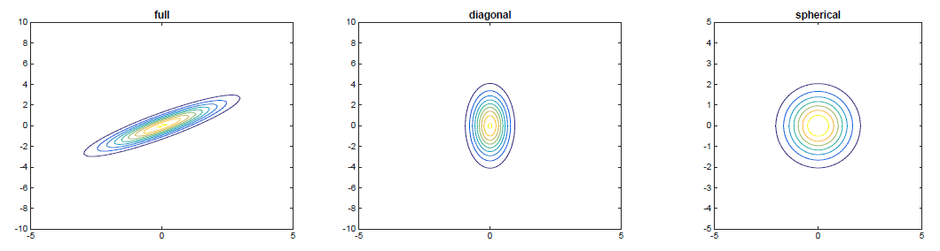
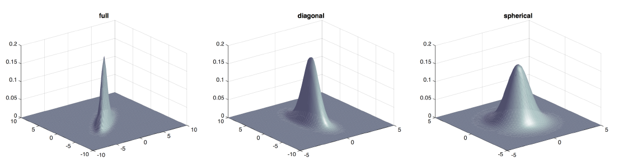
Multivariate Gaussian Distribution
Univariate
Multivariate
Statistic
Notes:
Full covariance matrix, diagonal CM

Slide 27
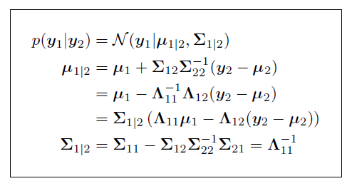

Example: Imputate missing value from MVN
Univariate
Multivariate
Statistic
Guess the probability at $y1=0, y2=−1$
$$p(y1=0|y2=−1)$$
Posterior Conditional Formula
x
x
x
x
x
x
x
x
x
x
x
x
x
x
x
x
x
x
y₁
y₂

Slide 28
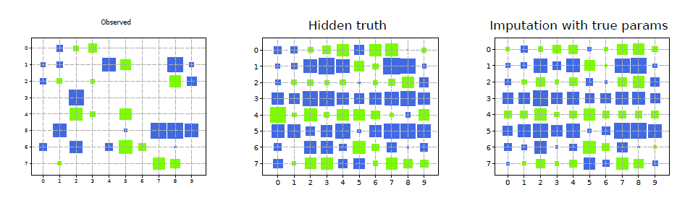
Multivariate - Gaussian
Univariate
Multivariate
Statistic

Slide 29
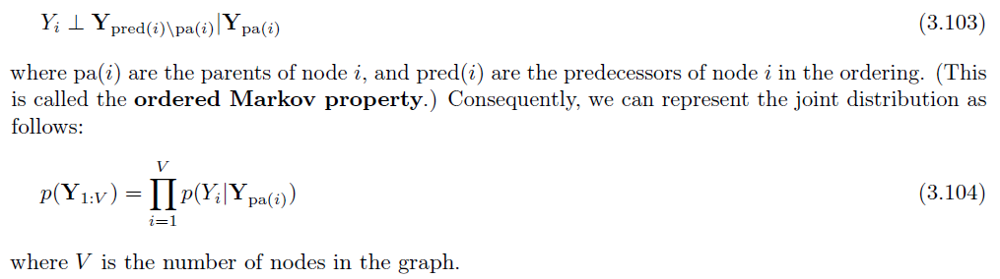
Probabilistic graphical models
Univariate
Multivariate
Statistic
A probabilistic graphical model or PGM is a joint probability distribution that uses a graph
structure to encode conditional independence assumptions.
Node = Random variable
Edge = Direct dependency
Connect them such that each node is conditionally independent of all its predecessors given its parents
Notes:
This function wants to stretch and shift the probability distribution

Slide 30
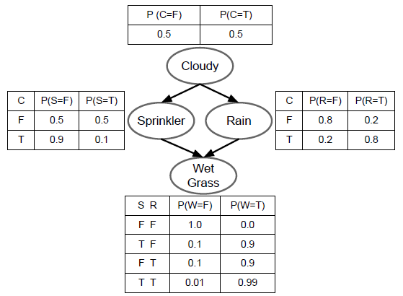
Example PGM: Water sprinkler network
Univariate
Multivariate
Statistic
Suppose we want to model the dependencies between 4 random variables:
C (whether it is cloudy season or not),
R (whether it is raining or not),
S (whether the water sprinkler is on or not), and
W (whether the grass is wet or not).
Joint distribution
Conditional probability distribution (CPD) for node i
Notes:
This function wants to stretch and shift the probability distribution

Slide 31
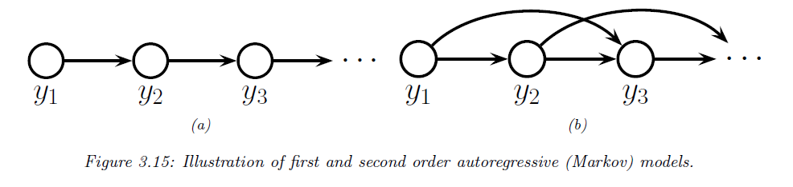


Example PGM: Markov Chain Network
Univariate
Multivariate
Statistic
Suppose we want to create a joint probability distribution over variable-length sequences, p(y1:T ). MC model is a stochastic model describing a sequence of possible events in which the probability of each event depends only on the state attained in the previous event.
First order Markov Model
Mth order Markov Model
Notes:
This function wants to stretch and shift the probability distribution

Slide 32
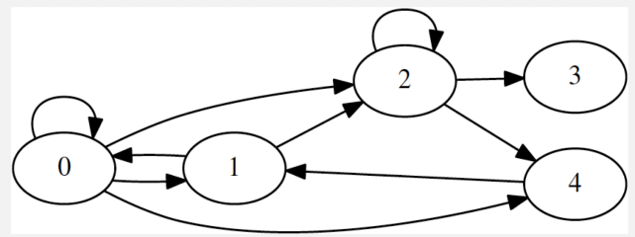
Example
Univariate
Multivariate
Statistic
Given this PGM, the adjacent matrix is
 | 0 | 1 | 2 | 3 | 4
0 | 1 | 1 | 0 | 0 | 0
1 | 1 | 0 | 0 | 0 | 1
2 | 1 | 1 | 1 | 0 | 0
3 | 0 | 0 | 1 | 0 | 0
4 | 1 | 0 | 1 | 0 | 0
Notes:
This function wants to stretch and shift the probability distribution

Slide 33
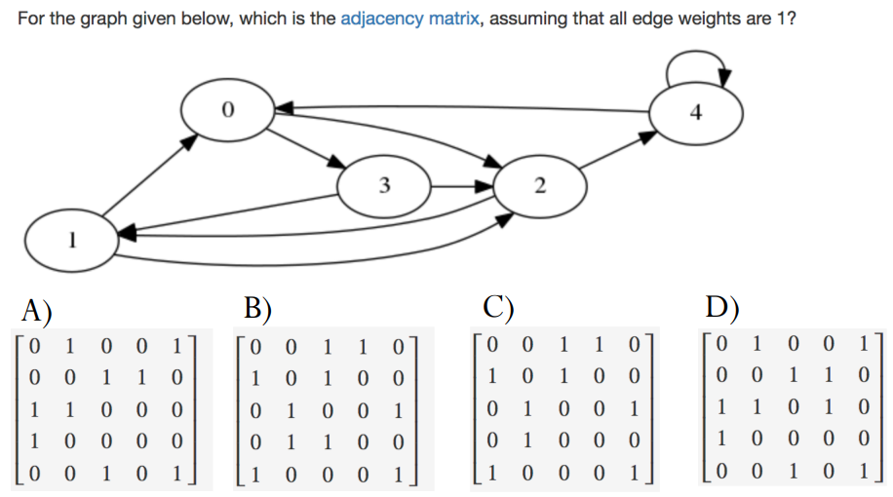
Example
Univariate
Multivariate
Statistic
Notes:
Answer: A

Slide 34

Model Fitting / Training
Univariate
Multivariate
Statistic
Loss function / objective function

Slide 35
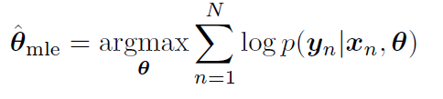

Maximum likelihood estimation
Univariate
Multivariate
Statistic
Estimated Parameter
Probability
Model
Since most optimization algorithms are designed to minimize cost functions, we redefine the objective function to be the (conditional) negative log likelihood or NLL and we minimize NLL

Slide 36
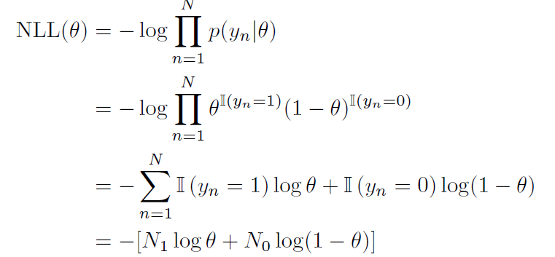
MLE for the Bernoulli distribution
Univariate
Multivariate
Statistic
Suppose Y is a random variable representing a coin toss, where the event Y = 1 corresponds to heads and Y = 0 corresponds to tails.
Let θ = p(Y = 1) be the probability of heads. The probability distribution for this rv is the Bernoulli.
The NLL for the Bernoulli distribution is given by
Notes:
Capital pi notation
N – number of throw

Slide 37
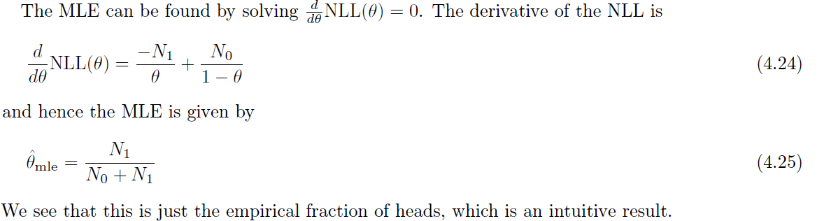
MLE for the Bernoulli distribution
Univariate
Multivariate
Statistic

Slide 38
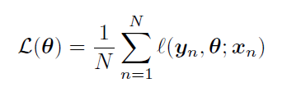
Empirical Risk Minimization
Univariate
Multivariate
Statistic
We can generalize MLE by replacing the (conditional) log loss term, with any other loss function.
This is known as empirical risk minimization or ERM, since it is the expected loss where the
expectation is taken wrt the empirical distribution.
See Decision Theory Section for more details.

Slide 39
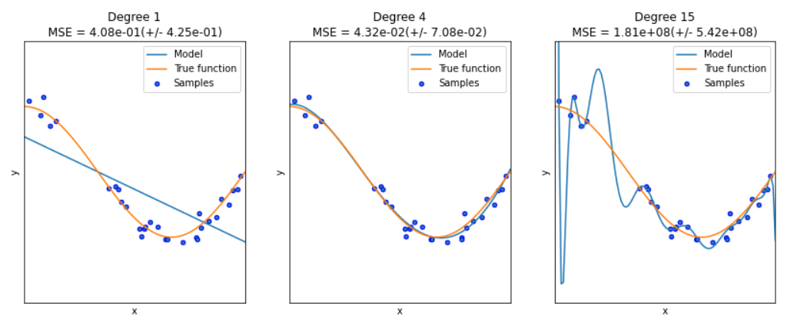
Regularization
Univariate
Multivariate
Statistic
Enough parameters to perfectly fit the training data.
Most of the time, empirical distribution ≠ true distribution
Model unable to predict novel future data → Overfitting

Slide 40
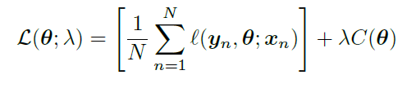
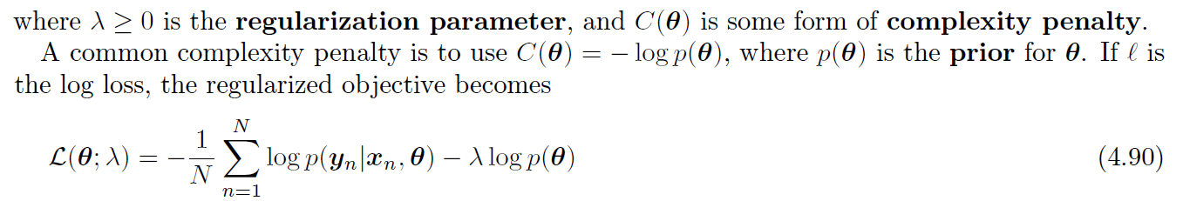
Regularization
Univariate
Multivariate
Statistic
Add penalty term to loss function

Slide 41
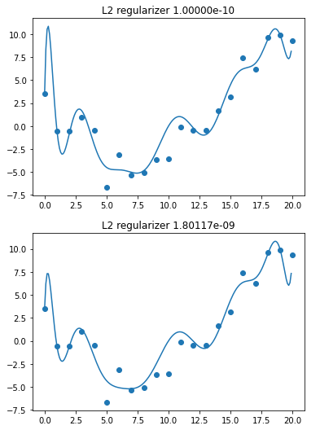
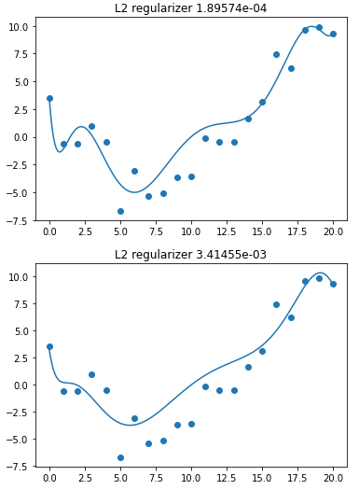
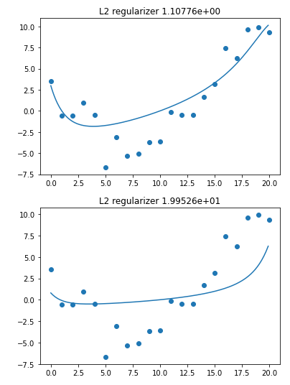
Regularization - How to choose?
Univariate
Multivariate
Statistic
C
E
A
B
D
F

Slide 42
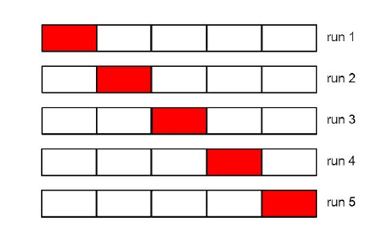





Regularization – Validation Set
Univariate
Multivariate
Statistic
Fit the model on D_{train} (for each setting of λ) with loss function
For each λ, we compute parameter estimate
Then evaluate its performance on D_{valid} using validation data.
We then pick the value of λ that results in the best validation performance.
Fit the model on with D_{train} and D_{valid} using λ*
If training data sample size is very small, will have problem.

Slide 43
Regularization – Validation Set
Univariate
Multivariate
Statistic
For first CV,
Fit the model on D_{train} (for each setting of λ) with loss function
For each λ, we compute parameter estimate, θ
Then evaluate its performance on D_{valid} (red) using validation data.
We then pick the value of λ that results in the best validation performance.
We have λ₁
6. Repeat five times.
We will have
CV1: λ_{1,} Loss₁; CV2: λ_{2,} Loss₂; CV3: λ_{3,} Loss₃ ; CV4: λ_{4,} Loss₄;
CV5: λ_{5,} Loss₅
7. We then pick the value of λ* that results in the best validation performance (lowest loss).
8. Fit the model on with D_{train} and D_{valid} using λ*

Slide 44
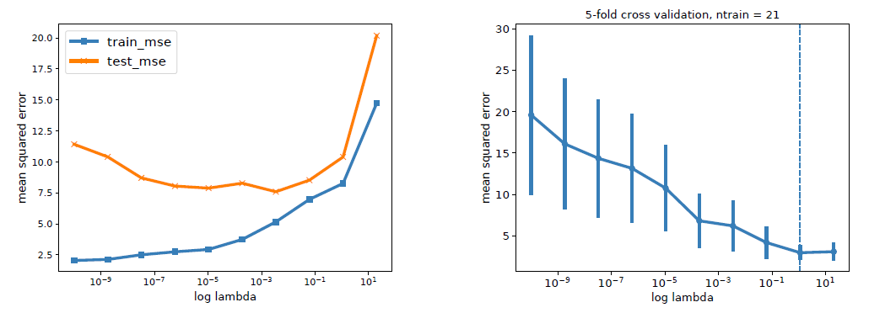
Regularization – Validation Set
Univariate
Multivariate
Statistic
Vertical line is the point chosen by the one standard error rule

Slide 45
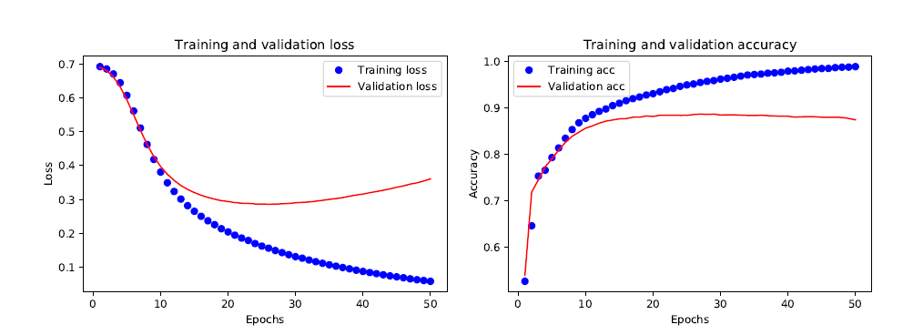
Regularization – Early Stopping
Univariate
Multivariate
Statistic

Slide 46
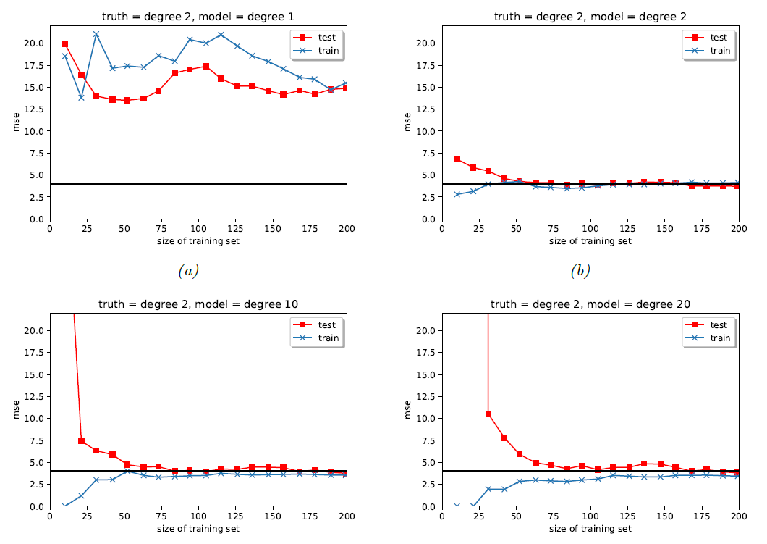
Regularization – More Data
Univariate
Multivariate
Statistic
Simple model → underfitting
Model complexity increases, train and test approaches true error (black line)
Complex model → overfitting (big gap between train and test), but gap reduces as N increases
Optimal model (degree 2) – best → converges fastest

