Slide 1

Job Connect
Asansol Engineering College
Final Year Project by Group 14
Mentored By: Dr. Anup Kumar Mukhopadhyay
Branch: Information Technology Session: [ 2020 - 2024 ]
Paper Code: PROJ - CS881
Priyanshu Burman - 10800220058 Sathi Ruidas - 10800220069 Abhijit Shaw - 10800220081 Joy Chakraborty - 10800220083

Slide 2
Introduction
Overview: Job Connect is a comprehensive platform designed to seamlessly connect job seekers with employers, facilitating efficient job searching, applications, and recruitment processes.
Goals:
Provide a user-friendly interface for job seekers to easily find and apply for jobs.
Enable employers to post job vacancies and manage applications efficiently.
Purpose: Bridge the gap between job seekers and employers through a streamlined and intuitive online portal.

Slide 3
Technology Stack
Frontend: React.js, Material-UI, Axios
Backend: Node.js, Express.js, MongoDB Atlas (Mongoose)
Authentication: bcrypt, JWT, Passport.js
Middleware & Utilities: body-parser, cors, express-session, Multer, crypto, uuid

Slide 4
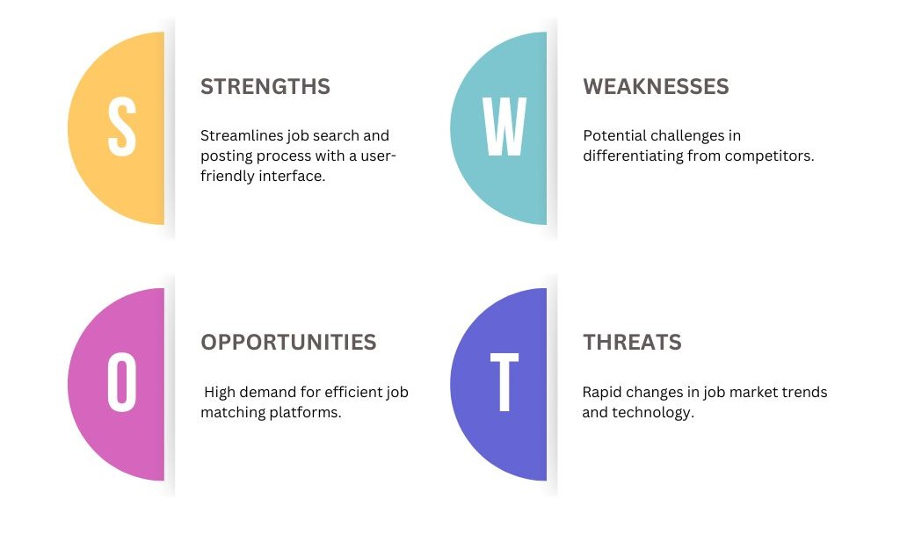
SWOT Analysis

Slide 5
System Architecture
Frontend: React.js components structured for modularity and reusability.
Backend: Node.js and Express.js powering the server-side logic and API endpoints.
Database: MongoDB Atlas for persistent data storage.

Slide 6
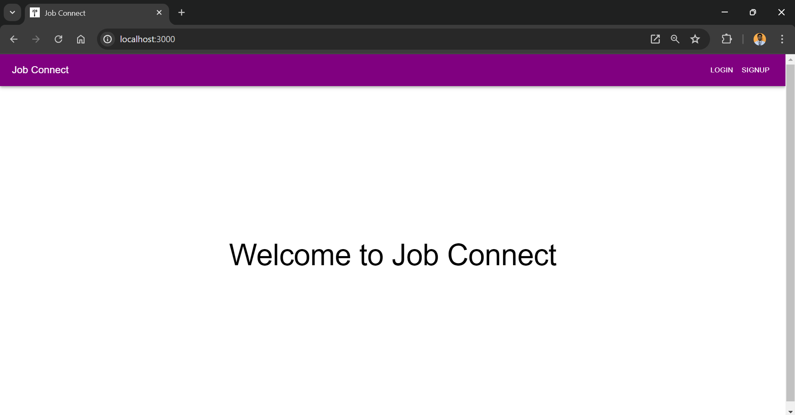
Client Side
< Initiating the “clientHello” />

Slide 7
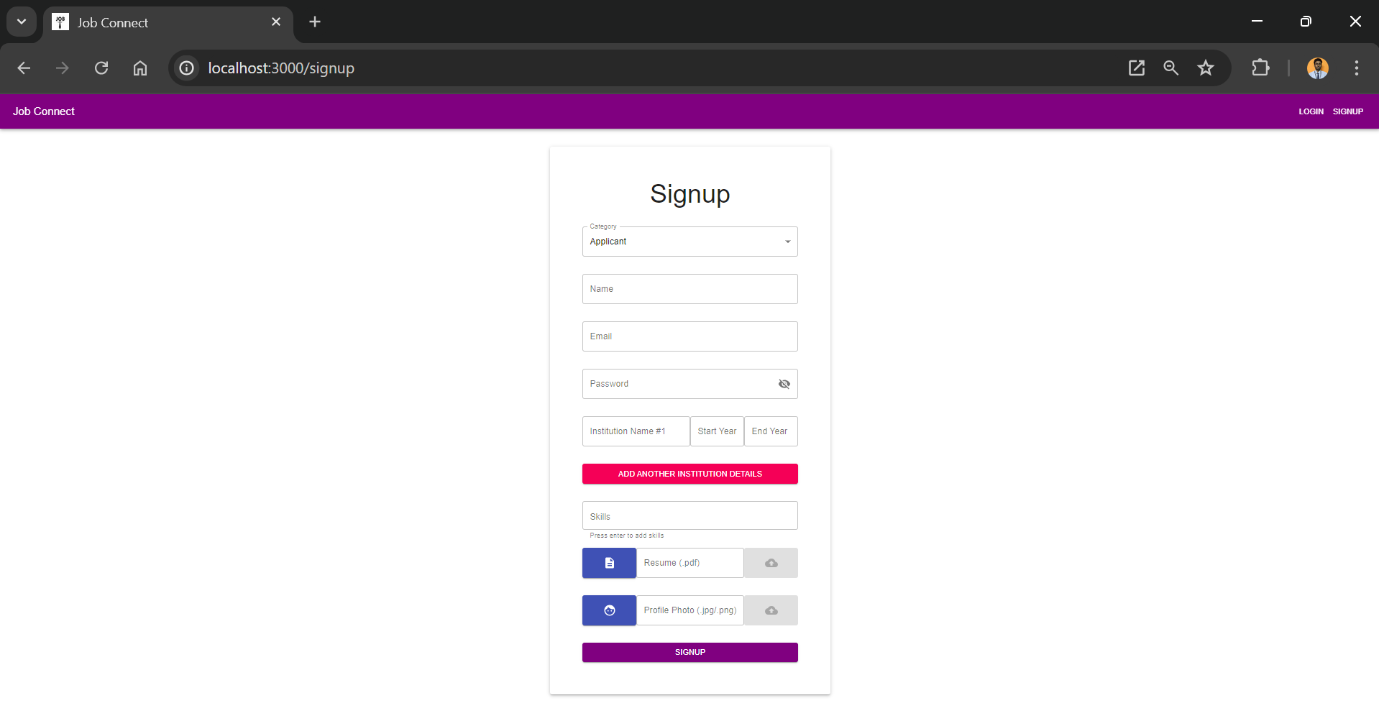
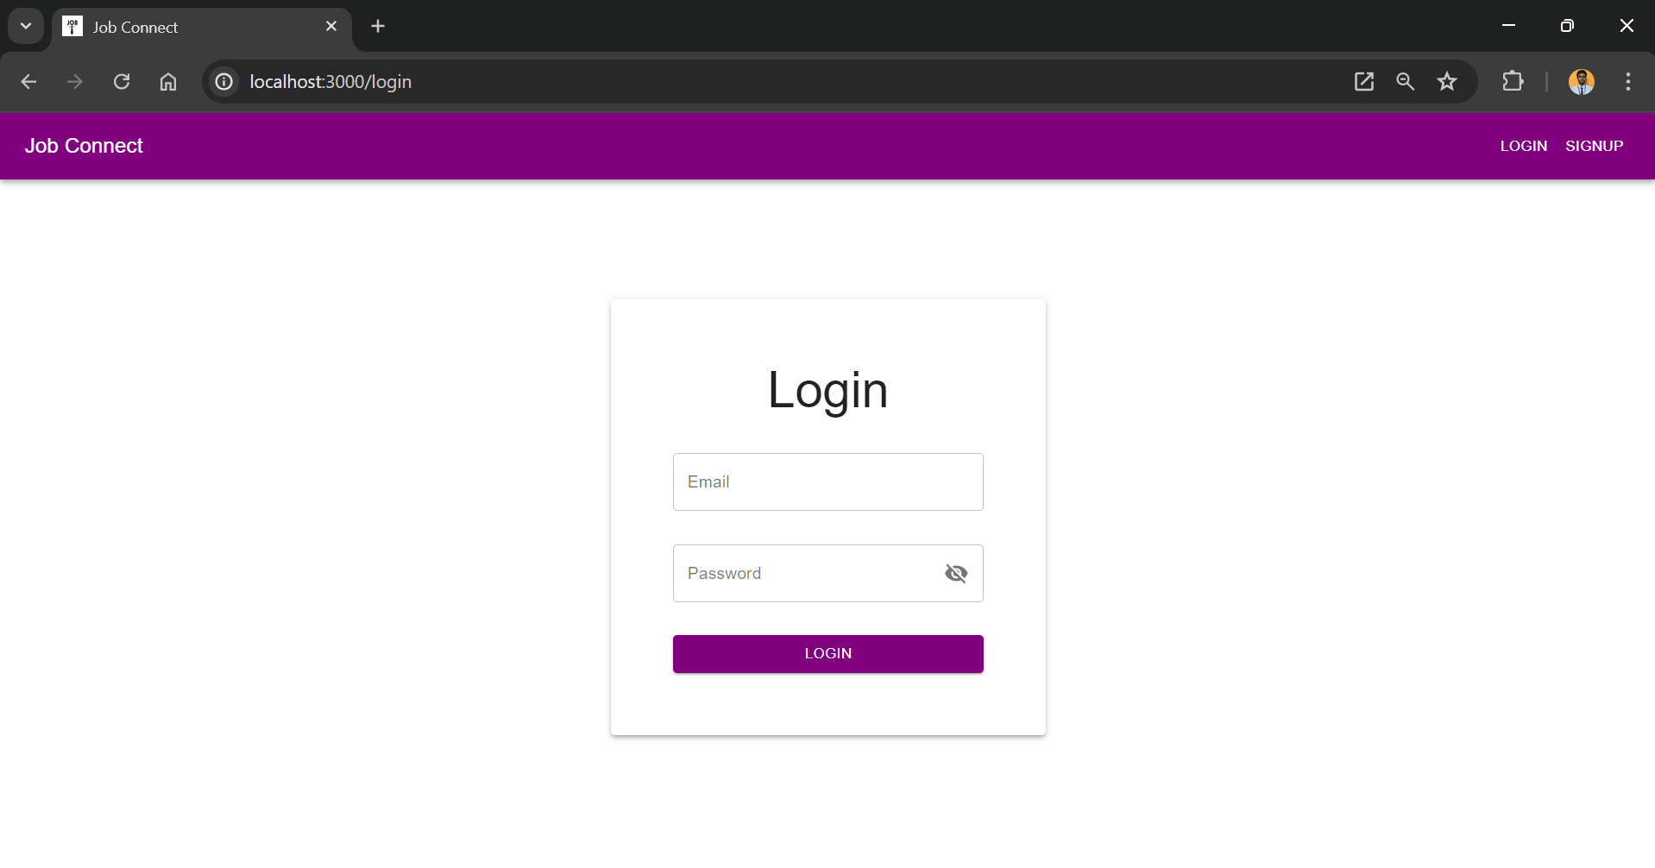
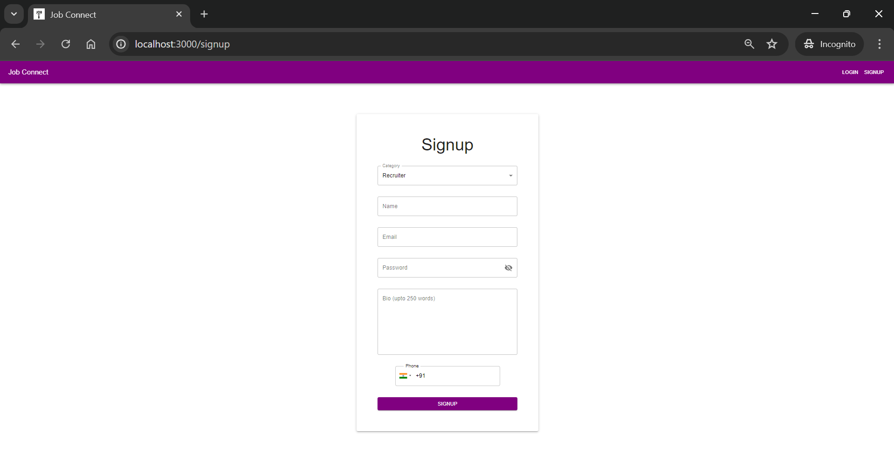
Sign Up & Sign In User Interfaces
Sign Up Sign In
Applicant
Recruiter

Slide 8
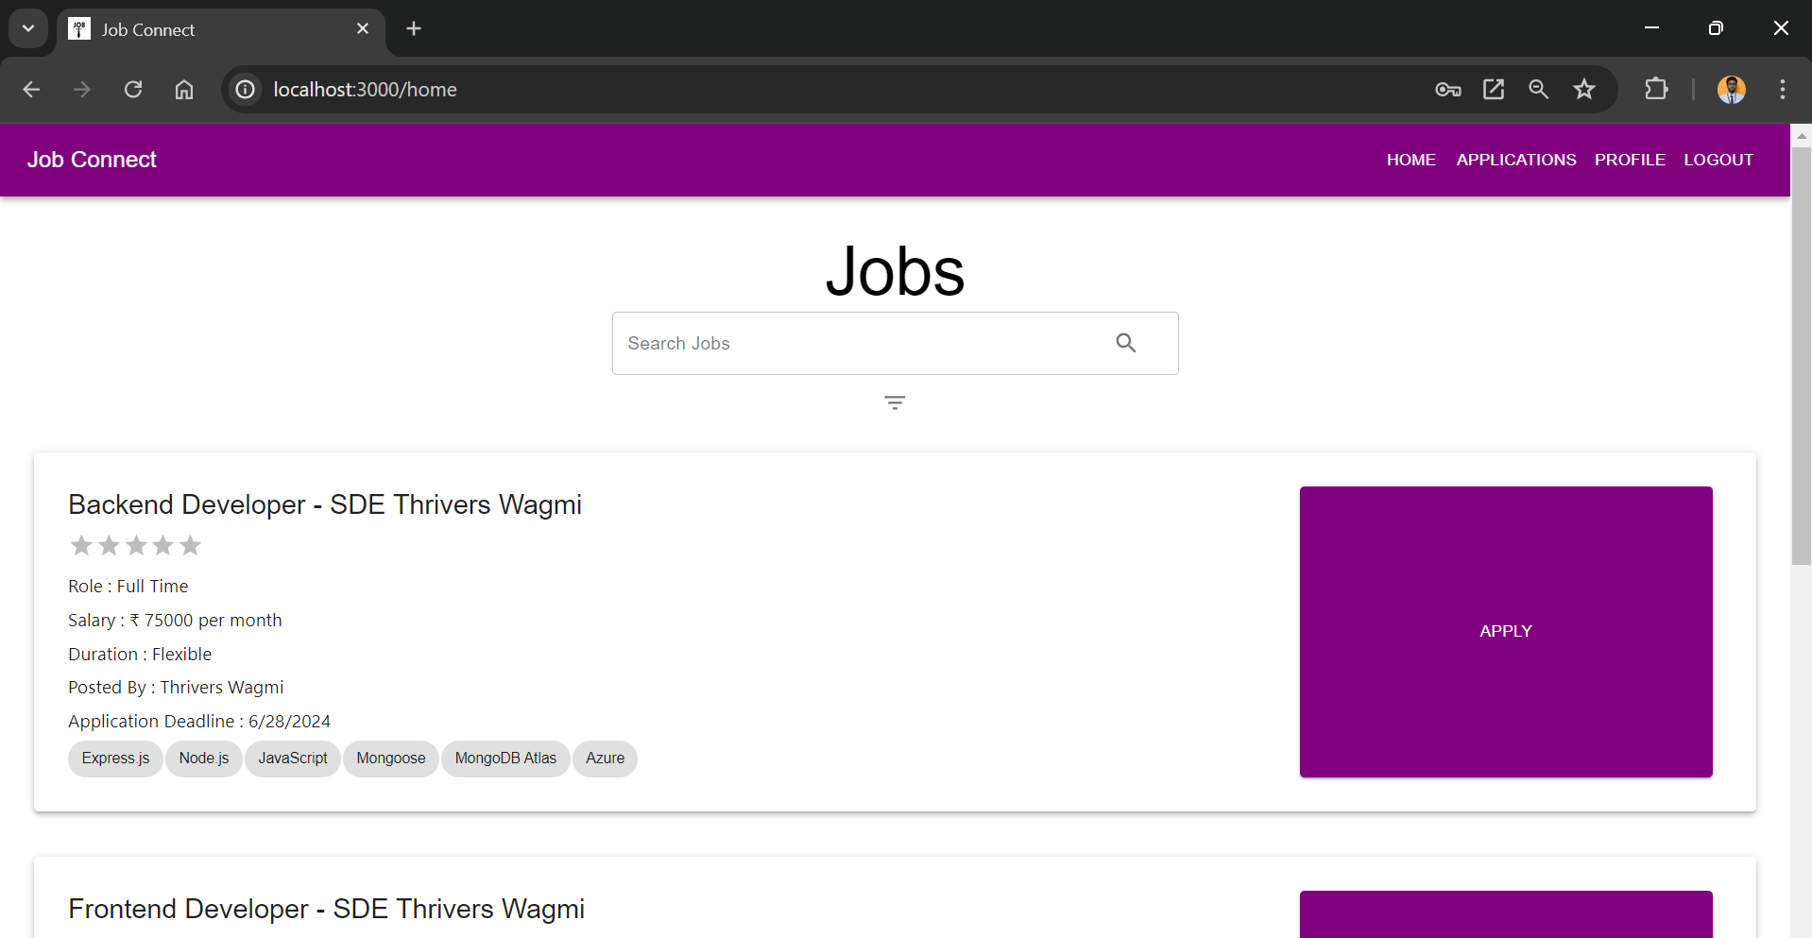
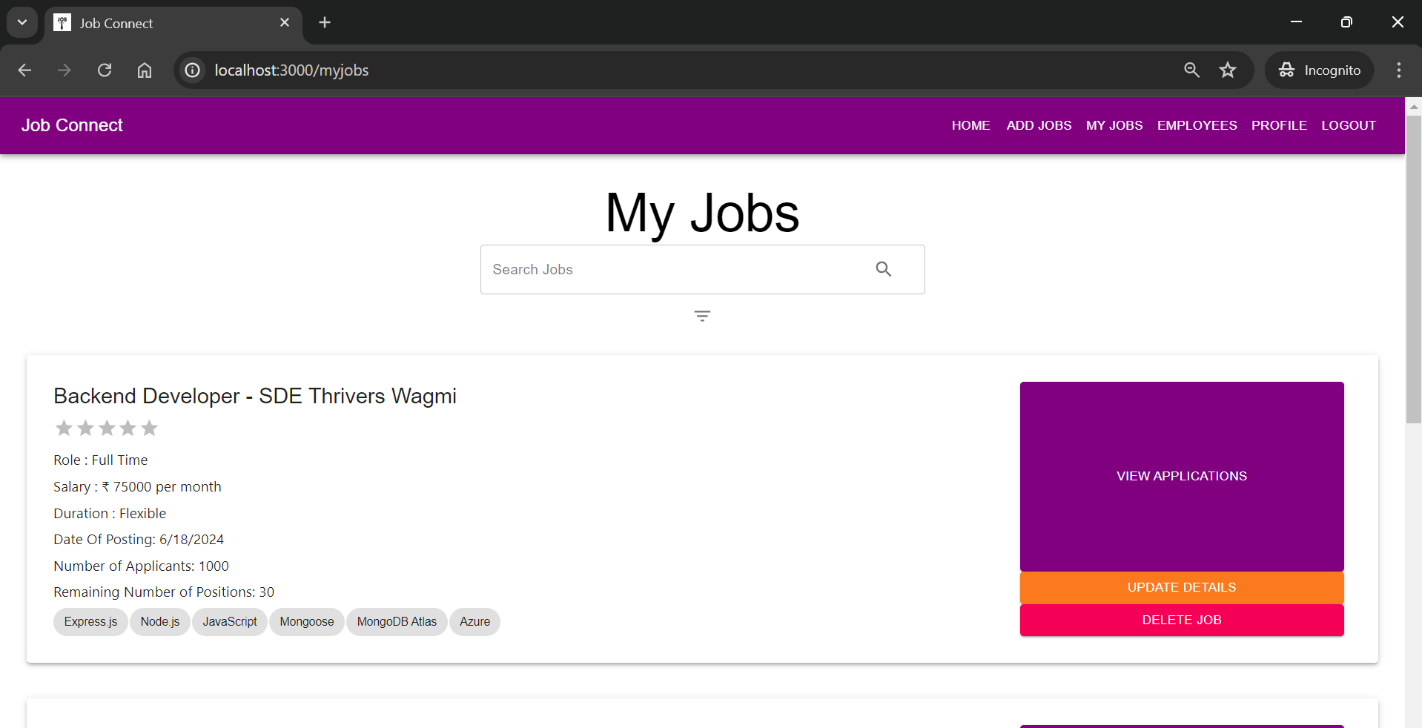
Jobs UI Implementation
Applicant Recruiter

Slide 9
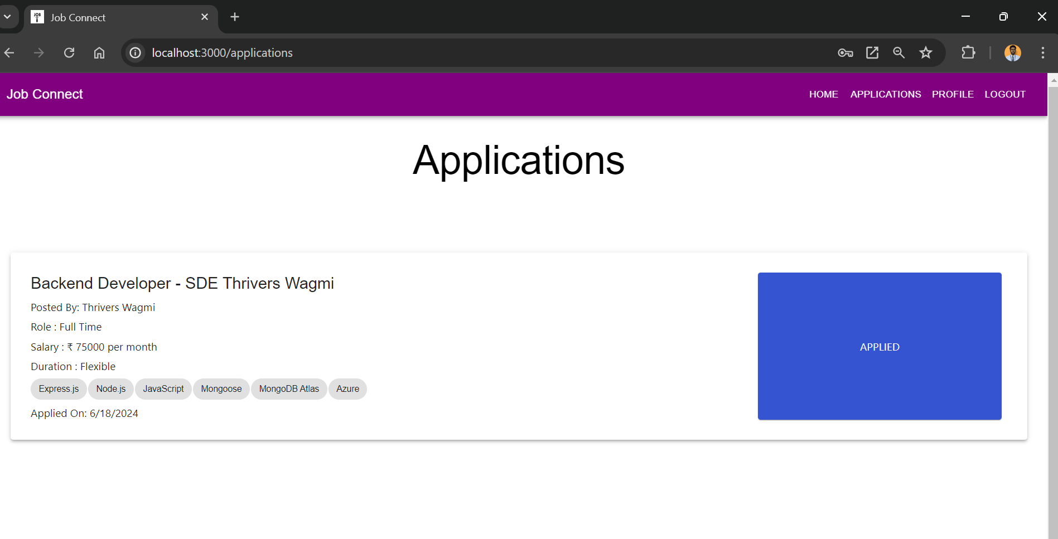
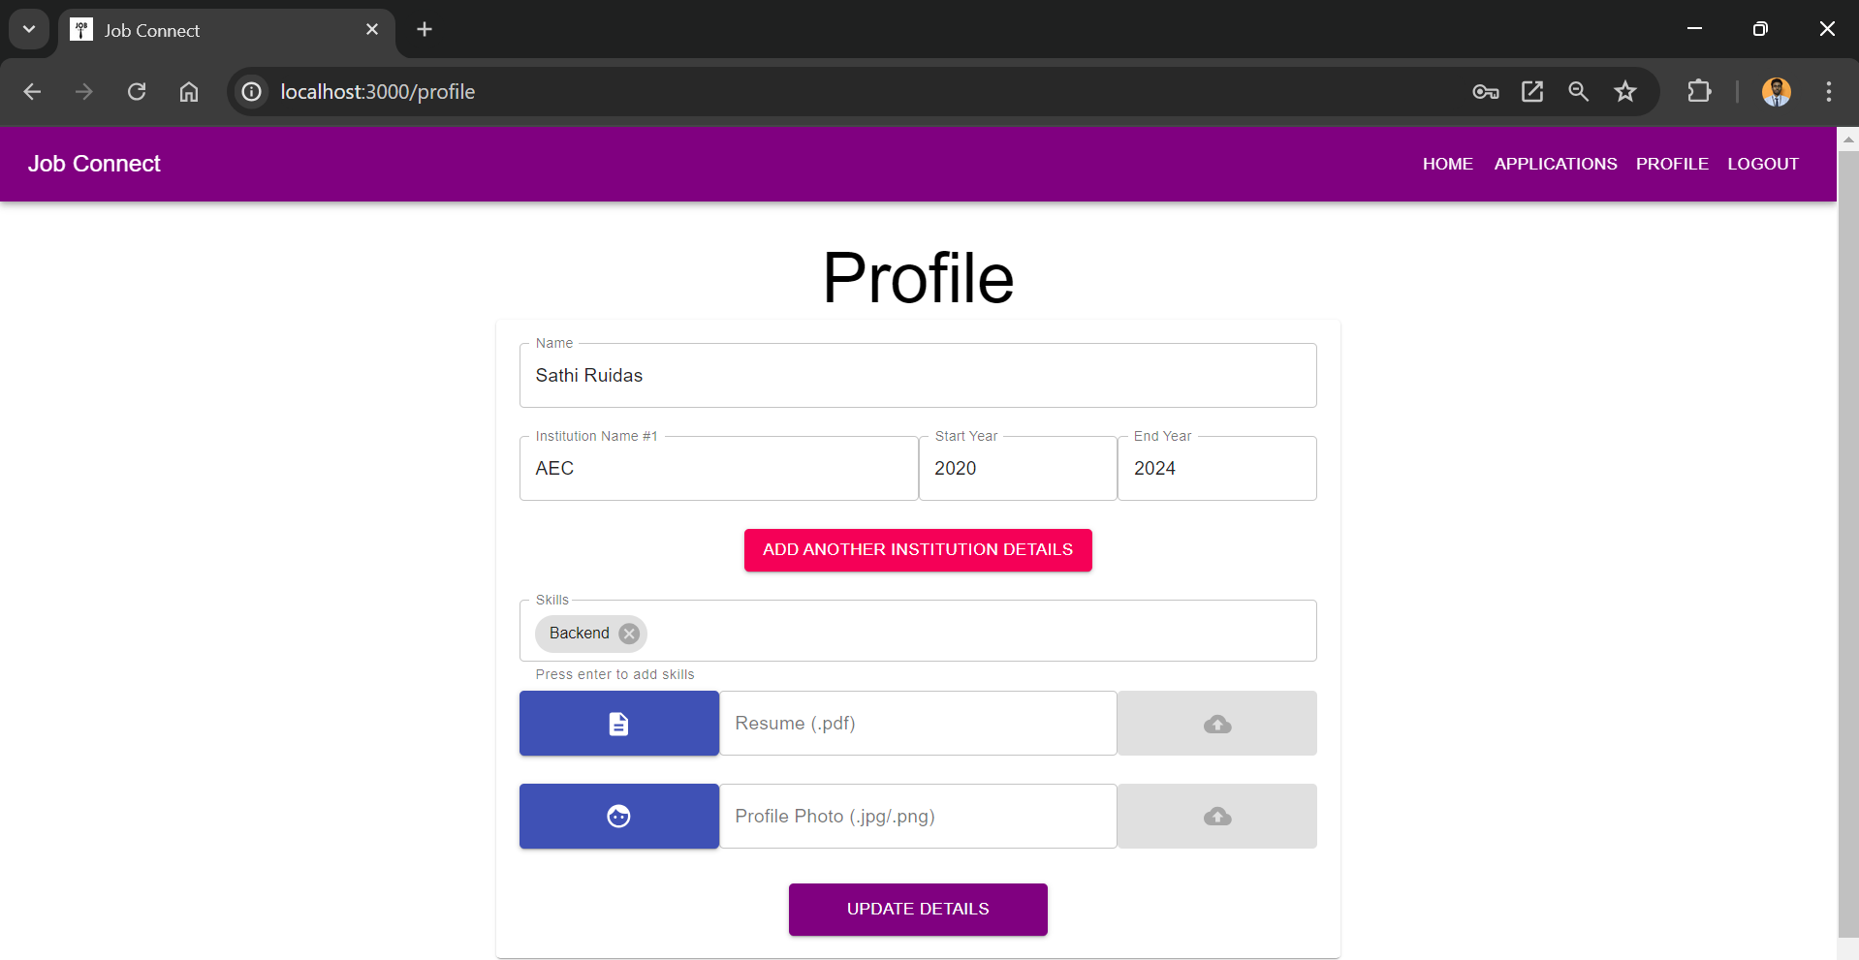
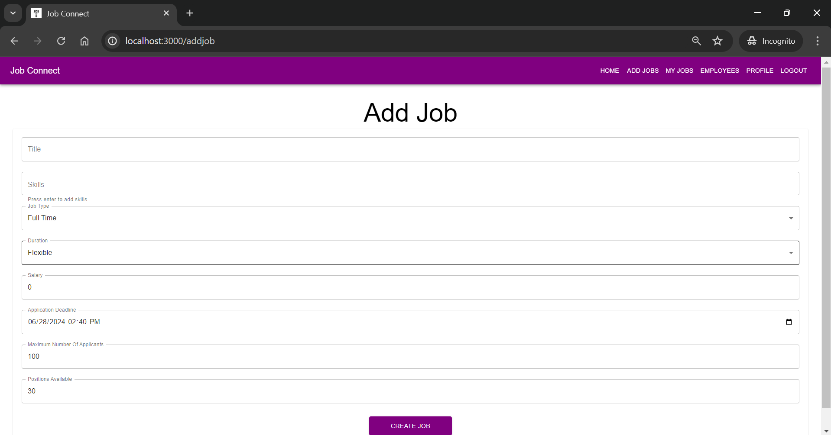
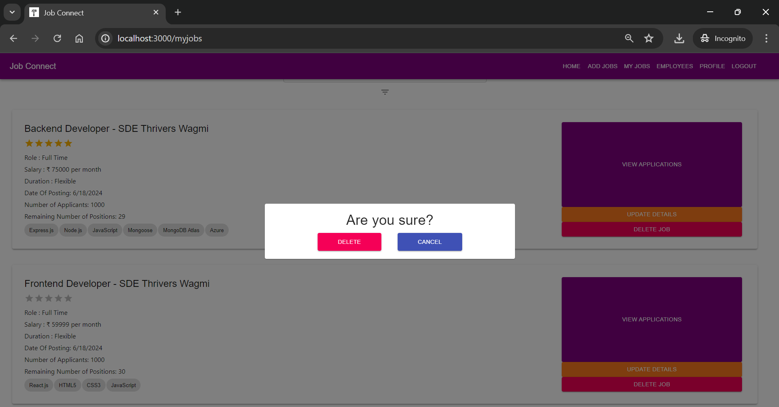
Key Components
Applicant
Recruiter

Slide 10
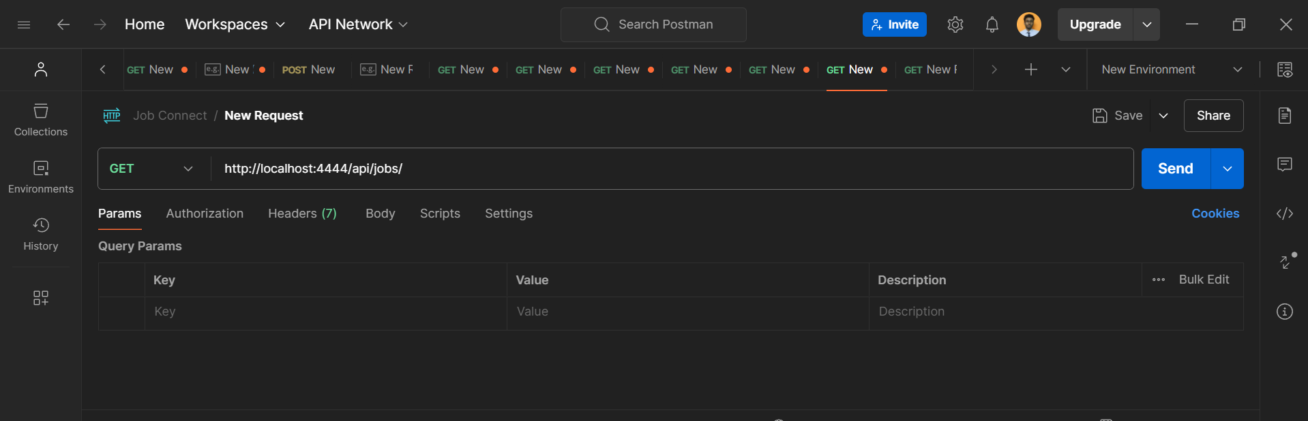
Server Side
${ Initiating “serverHello” }

Slide 11
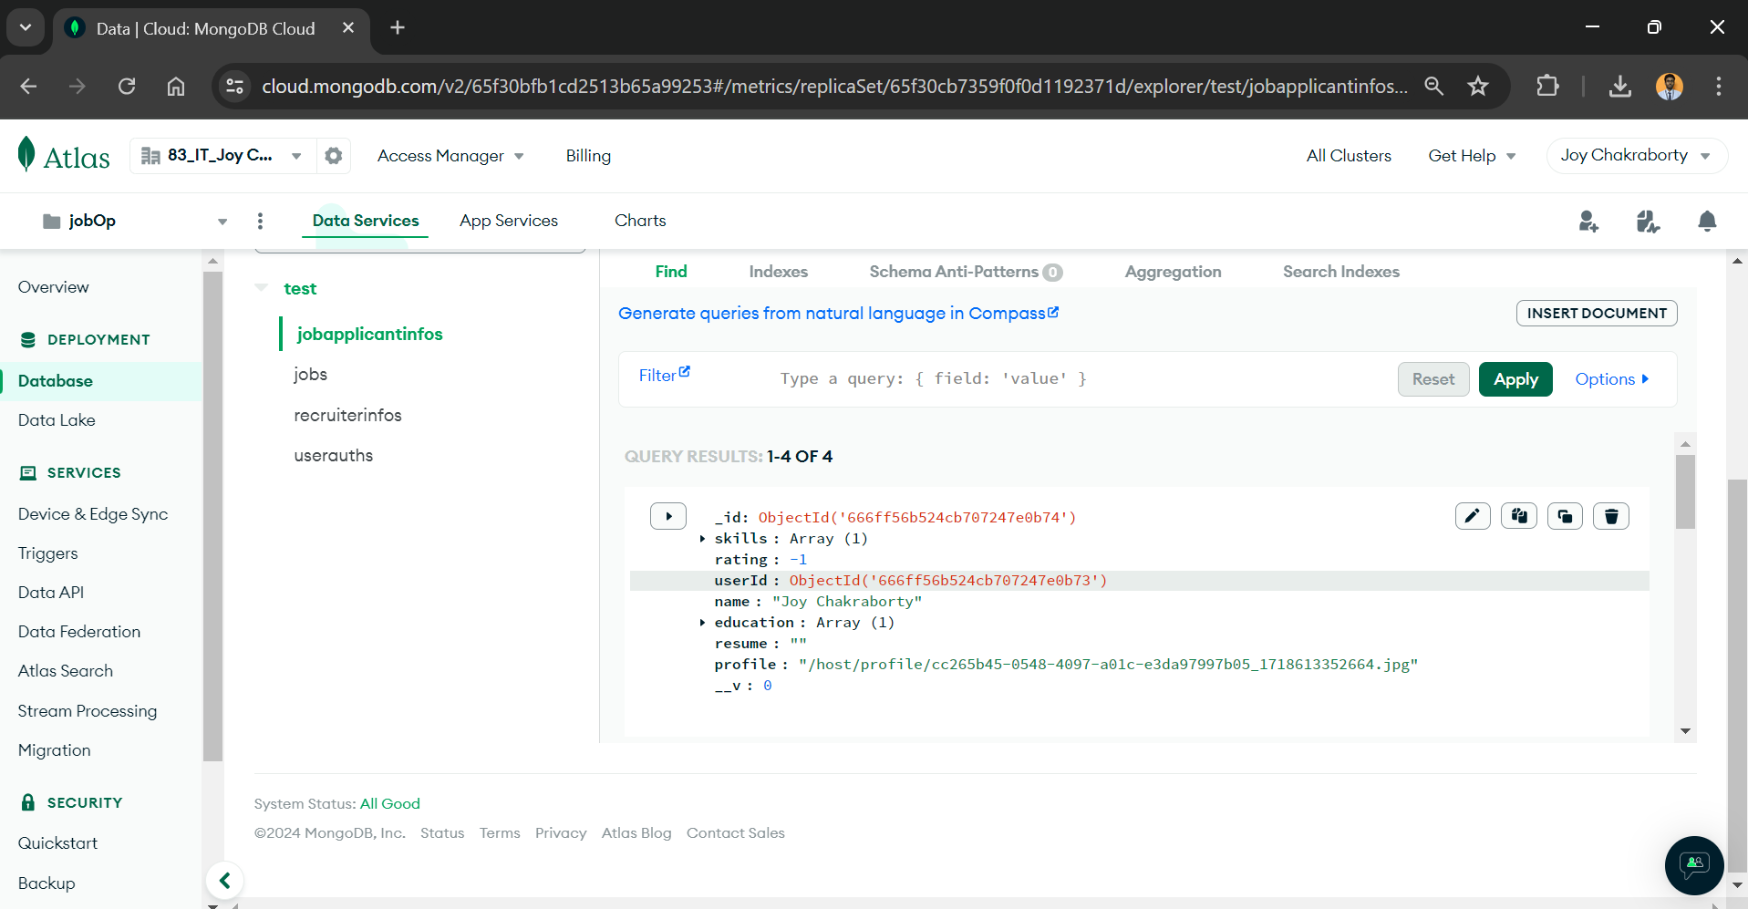
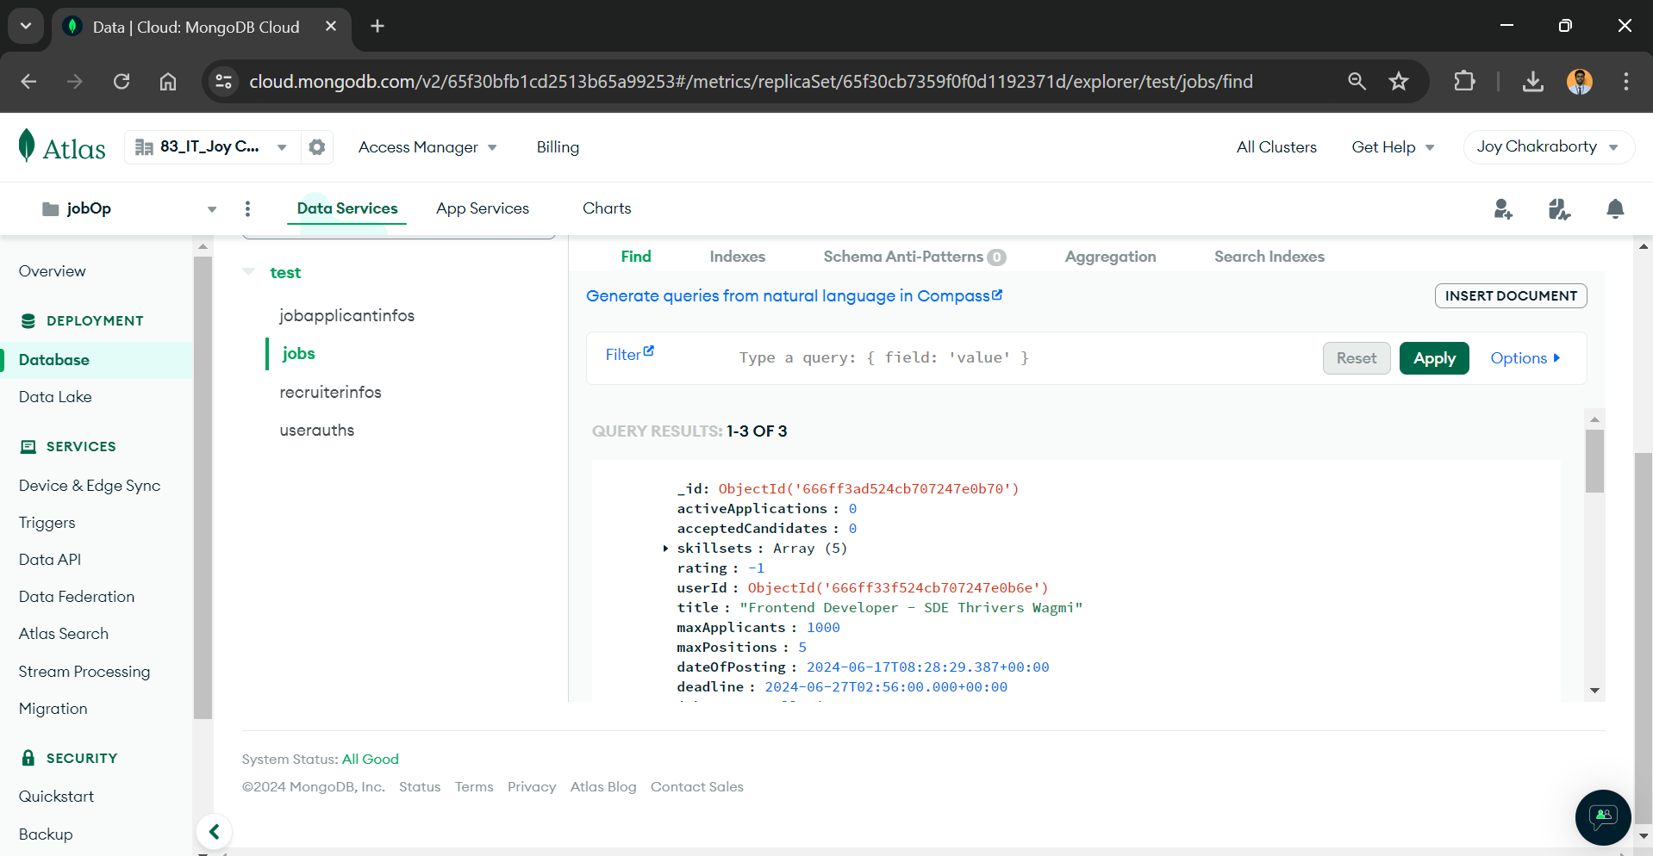
Applicant Data Models
Applicant Data Model Jobs Data Model
> Work: Stores all attributes related to applicants >Work: Stores data related to jobs > Collection name: jobapplicantinfos >Collection name: jobs

Slide 12
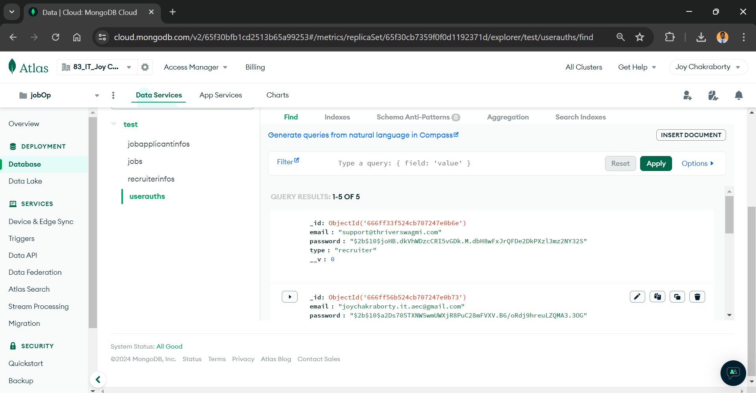
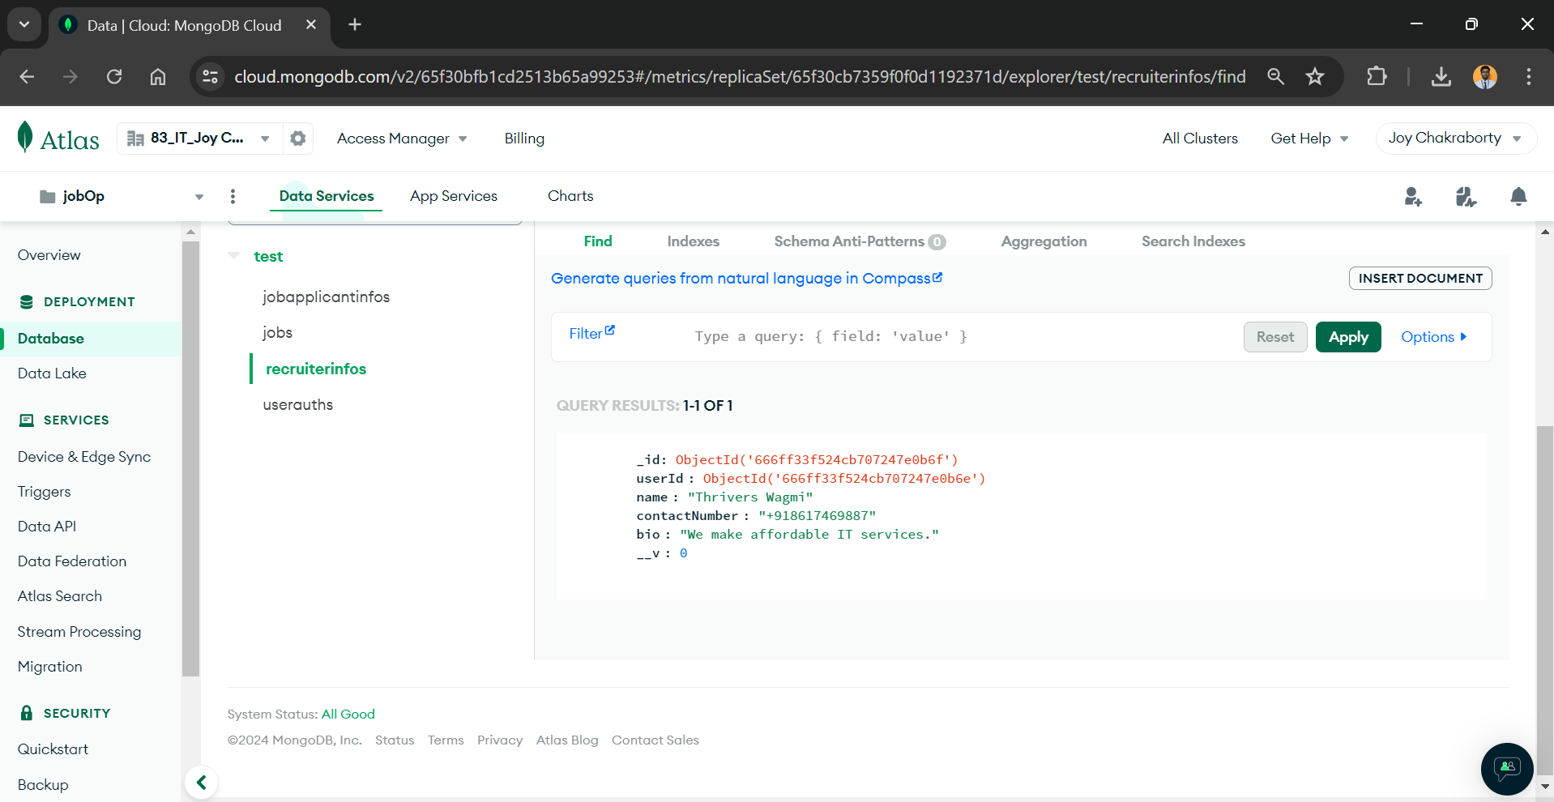
Company Data Models
Authentication Data Model Company Data Model
> Work: Stores all attributes related to authentication >Work: Stores data related to componies > Collection name: userauths >Collection name: recruiterinfos

Slide 13
Server Side Routes
Authentication and User Management
Base Route: /api/auth
Endpoints:
POST /signup
POST /login
File Handling (Resume and Profile)
Base Route: /api/files
Endpoints:
POST /resume
POST /profile
GET /resume/:file
GET /profile/:file

Slide 14
Project Work Through
Let’s quickly have brief demo of our product. The Job Connect!

Slide 15
Challenges
Integration Issues: Faced challenges integrating frontend with backend; sought help from YouTube tutorials.
Authentication: Struggled with custom authentication; learned and solved via YouTube tutorials.
Styling: Difficulties in achieving simple yet appealing styles; utilized W3Schools resources.

Slide 16
Future Scope
> Peer-to-Peer Interview Portal:
One-on-One Interviews:
Facilitate real-time interviews using WebRTC technology.
Enable seamless interaction between employers and candidates.
> Integrated Code Editor:
Support for Multiple Languages:
Provide an integrated code editor.
Languages supported: C++, Java, Python.
> Enhanced User Experience:
Smooth and Intuitive Interface:
Ensure a user-friendly design.
Focus on enhancing the overall user experience.

Slide 17
Conclusion
Job Connect offers a robust platform for job seekers and employers, streamlining the job search and recruitment processes.
The use of the MERN stack ensures a scalable and maintainable solution, capable of handling a growing user base and evolving requirements.

Slide 18
QnA

Slide 19
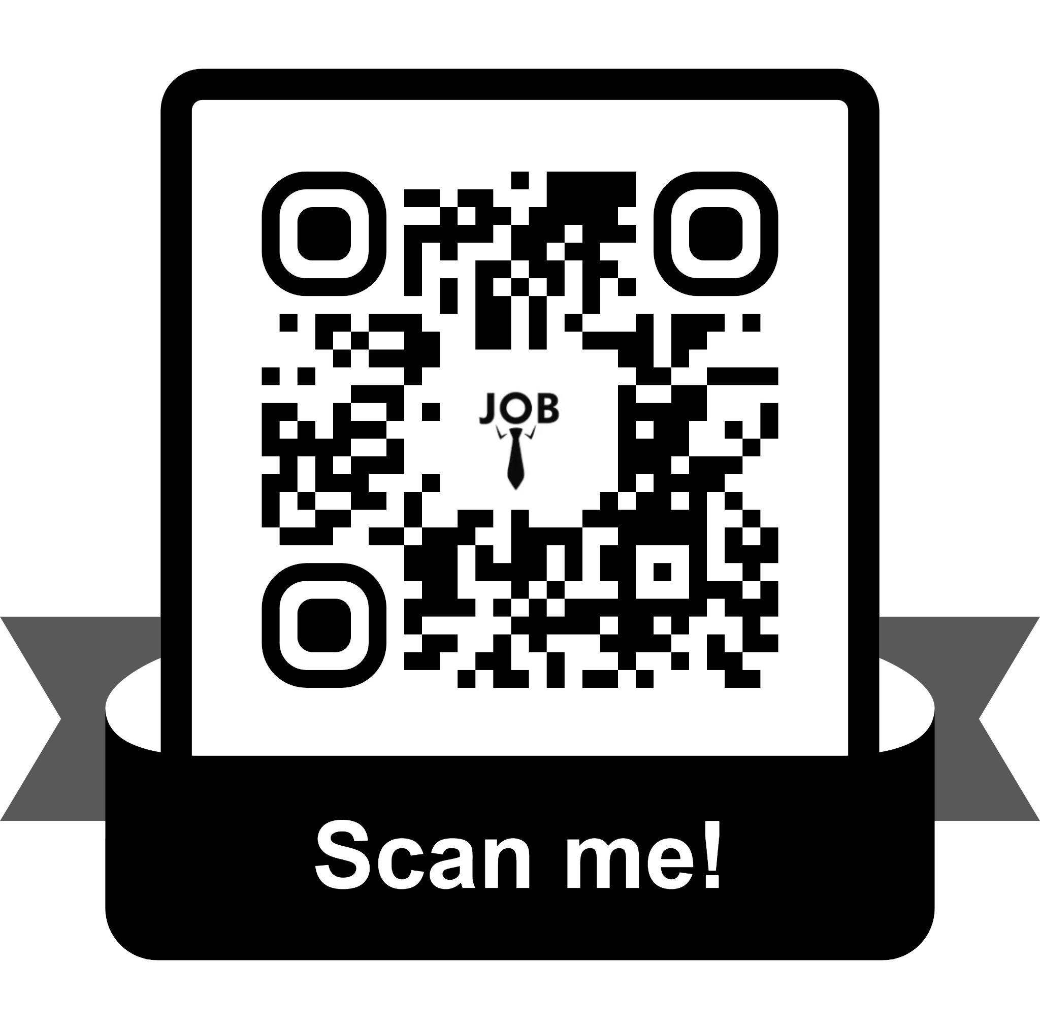
Thank You!
For giving us an opportunity to present :)

