Slide 1
CSE 575 Class Project Presentation Weather Forecasting
Team Members:
Balaji Sankar – 1209346459 - bsankar@asu.edu – 20% contribution
Karthik Subramanian – 1209360876 - ksubra19@asu.edu – 20% contribution
Aarti Rao Manjeshwar – 1209163211 - amanjesh@asu.edu – 20% contribution
Shwetha Narayanan – 1209166097 - snaray36@asu.edu – 20% contribution
Ramanathan Nachiappan – 1210822532 – rnachiap@asu.edu - 20% contribution

Slide 2
Overview
Introduction
Data Sets
Time Series Data modelling
Forecasting
Proposed approaches
PCA and Feature Selection
Baseline - Naïve Persistence model
ARIMA Modeling
Time Series Linear Modeling
Nearest Neighbor Modeling
Experiment and Results
Future Prospects

Slide 3
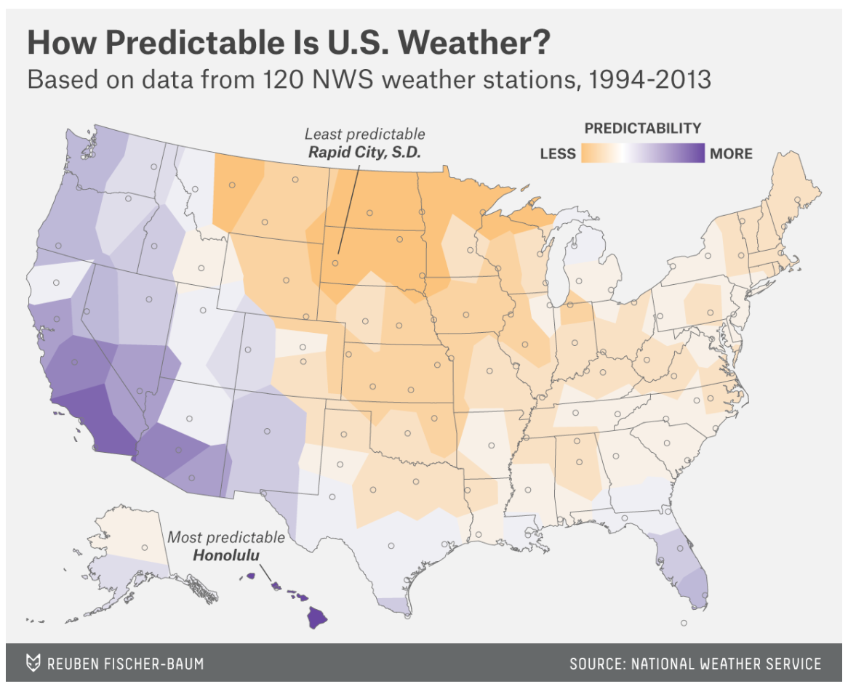

Slide 4
Data Sets
Source: http://www.noaa.gov/
National Oceanic and Atmospheric Administration by the U.S Department of Commerce
Data Set Sample:
Seattle, Dallas and Cincinnati Weather data
Parameters – Sunrise, sunset, wind speed, precipitation, dew point, wet bulb temperature, pressure change, sky conditions etc. (92 features)

Slide 5
Time Series Data Modeling
Time Series Data is a series of data points equally spaced in time
Characteristics
Modeling time series data often used in
Signal processing
Pattern recognition
Weather forecasting
Mathematical finance
Core Concept of Time Series Analysis involves
Extracting statistics
Extracting characteristics
Core Concept of Time Series Forecasting involves
predicting future values based on the previously observed values
Data Types applicable
Real valued, continuous data, discrete numeric data or discrete data

Slide 6
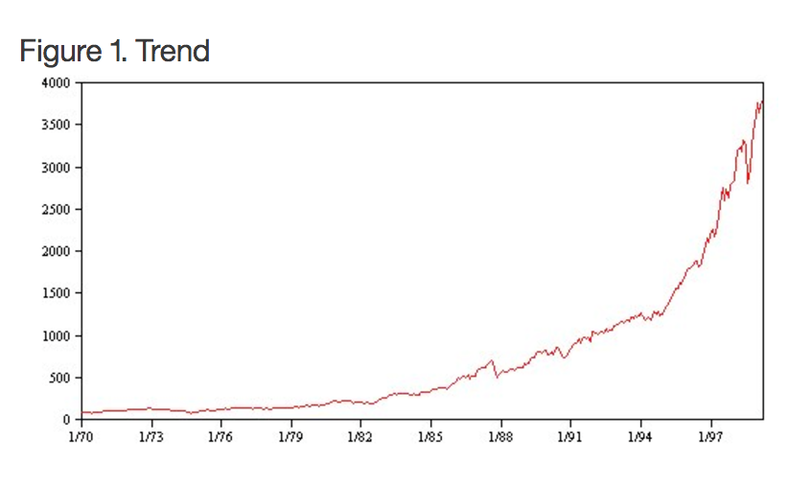
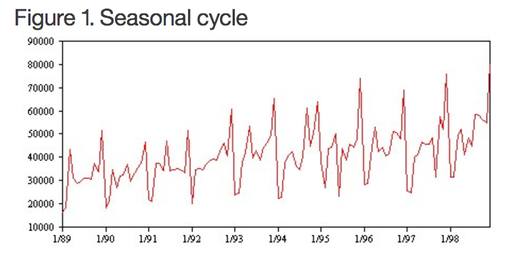
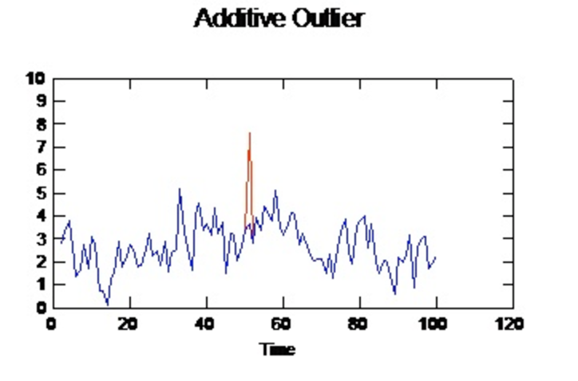
Time Series

Slide 7
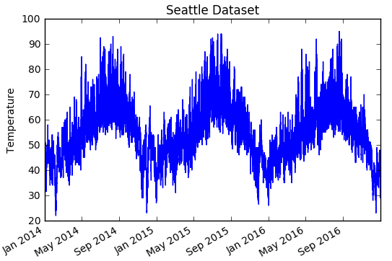
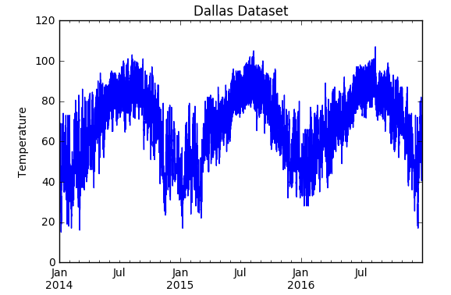
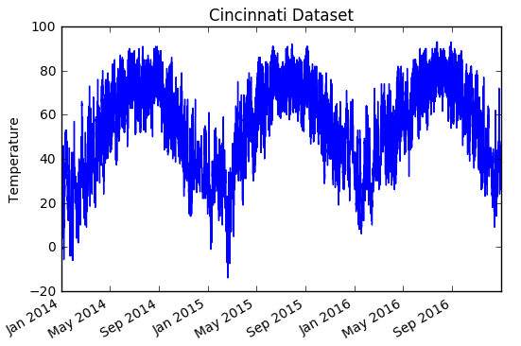
Weather is seasonal!

Slide 8
Forecasting
Forecasting: Process of predicting a future event from the current model (data mapped against time points)
In the realm of Machine Learning, forecasting finds its applications in analyzing trend and seasonality for future predictions
Weather Forecasting
Seasonal forecasting using quantitative methods
Quantitative Method ?
Stable historical data
Involves mathematical techniques

Slide 9
Proposed Approaches
Data Set Feature Reduction using PCA
Base model using Naïve Persistence
ARIMA Modeling
Time Series Linear Modeling
K Nearest Neighbor Modeling

Slide 10
Preprocessing
Original number of features: 50
Cleaned the data and reduced the number of features to 19
Aggregated the data and collapsed it to hourly time series data
We mapped each unique sky conditions to a corresponding integer and since a particular hour might have multiple sky conditions, we took a voting and assigned the maximum
Original features – 92
Reduced manually to 19
Aggregated data – collapsed into hourly

Slide 11
Feature Extraction using PCA
Find variance of each column
Sort by variance of each column
Find the number of columns which have positive variance
This represents the ideal number of features
Positive variance indicates that the feature is not closely related to other features
Apply dimensionality reduction for these number of features

Slide 12
Step-wise regression for feature selection
Selected Features
Cincinnati | Precipitation, Pressure and Visibility
Dallas | Humidity, Wind Direction and visibility
Seattle | Wet bulb temperature, precipitation, pressure change

Slide 13
Baseline Prediction for Time Series
A baseline prediction is a starting point helps us in time series to determine how well our model performs on time series
We used the persistence algorithm in establishing the baseline performance
Persistence Algorithm:
Also called “Naïve” Forecast which is equivalent to the ‘Zero Rule’ algorithm
This algorithm uses the value at the previous time step t-1 (input) to predict the outcome in the next time step t+1 (output)
Dataset split – Training -2/3rd and Testing – 1/3rd
This assumes nothing about the specifics about the time series to which it is applied, thus making it naïve and establishing a baseline performance

Slide 14
Experiments
<MSE for SEA, DAL, CIN along with the graph and a zoomed version>

Slide 15
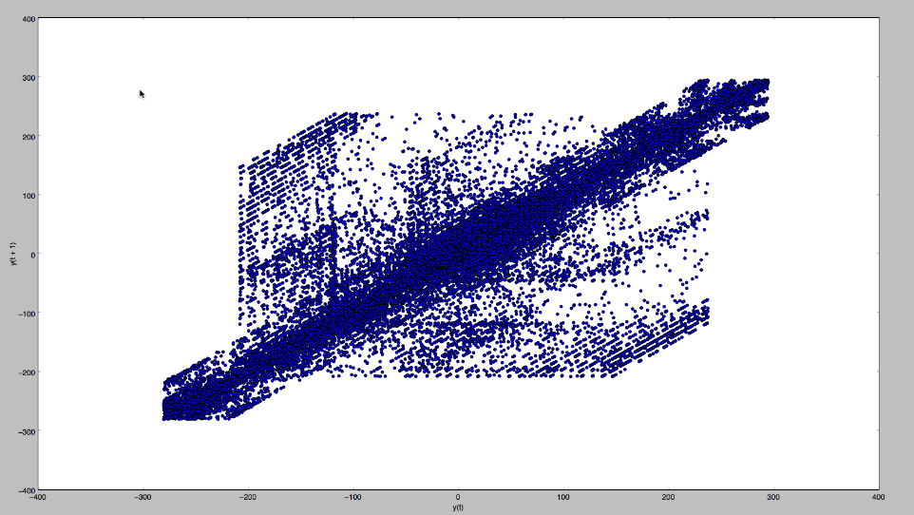
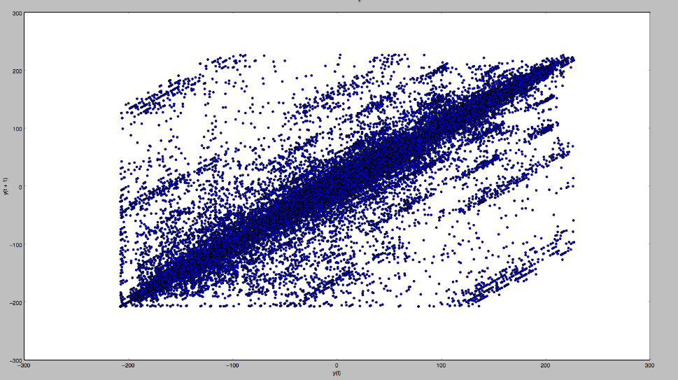
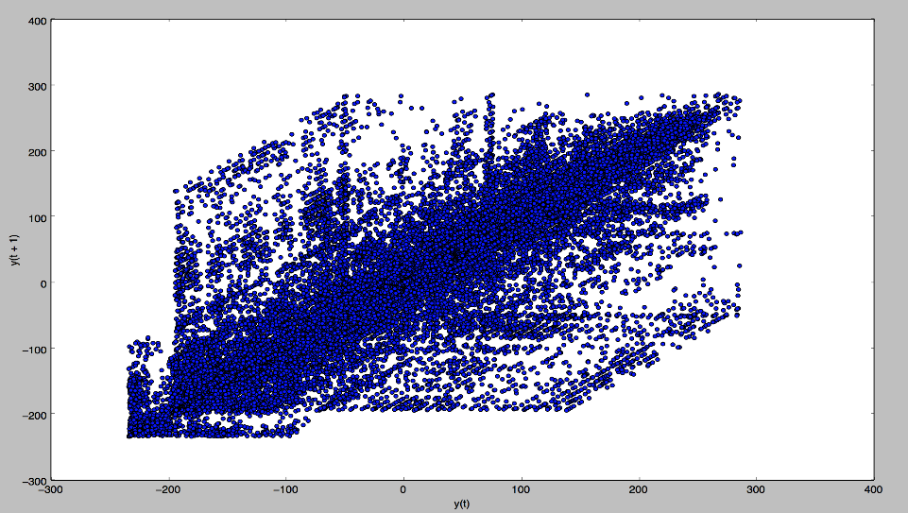
Correlation Check
Seattle
Dallas
Cincinnati

Slide 16
AR Modeling
AR model is similar to the baseline prediction model in terms of predicting outcome using the observation of the previous time step
However the approach is not naïve, but based upon linear regression model (a linear combination of input values)
For example X(t+1) = w0 + w1*X(t-1)
This relationship between variables is called correlation and we performed a correlation check for the two variables t+1 and t-1

Slide 17
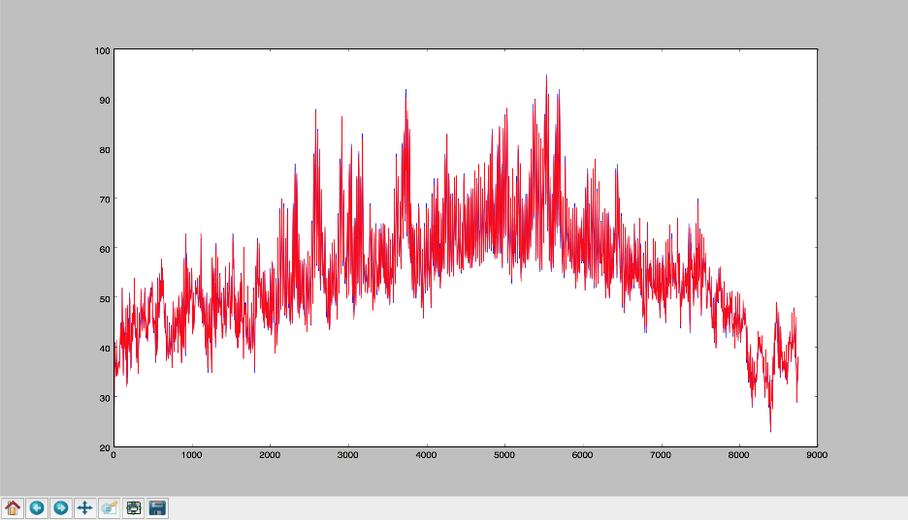
AR Modelling
Lagged values of Temperature as predictors
X(t+1) = w0 + w1*X(t-1)

Slide 18
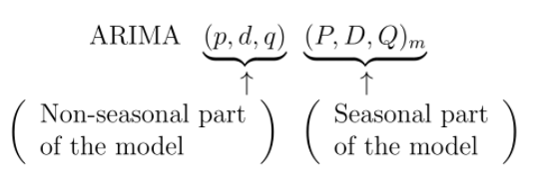
ARIMA
Combination of autoregressive (AR), integration (I) - and moving average (MA) operations.

Slide 19
Nearest Neighbor Modeling
Case 1:
Created a lagged dataset (by 1 day)
Mapped attributes to next day’s temperature
Split data into train and test (random sampling)
Trained model with selected features
Results:
Test MSE:

Slide 20
Time Series Linear Modeling

Slide 21
Experiments

Slide 22
Results

Slide 23
Future Prospects
“All the team members agree on the team members’ contributions in terms of both (a) what s/he did and (b) the percentage”

Slide 24
Team Members
Balaji Sankar – 1209346459 - bsankar@asu.edu – 20% contribution
<contribution>
Karthik Subramanian – 1209360876 - ksubra19@asu.edu – 20% contribution
<contribution>
Aarti Rao Manjeshwar – 1209163211 - amanjesh@asu.edu – 20% contribution
<contribution>
Shwetha Narayanan – 1209166097 - snaray36@asu.edu – 20% contribution
<contribution>
Ramanathan Nachiappan – 1210822532 – rnachiap@asu.edu - 20% contribution
<contribution>
“All the team members agree on the team members’ contributions in terms of both (a) what s/he did and (b) the percentage”

Slide 25
Thank You!
“All the team members agree on the team members’ contributions in terms of both (a) what s/he did and (b) the percentage”

