Slide 1

Continuos Integration Automated work-Flow

Slide 2
Continuous Integration?
CI workflow
Continuous Integration (CI) is a development practice that requires developers to integrate code into a shared repository several times a day. Each check-in is then verified by an automated build, allowing teams to detect problems early.
By integrating regularly, you can detect errors quickly, and locate them more easily.
Continuous Integration is cheap. Not continuously integrating is costly. If you don’t follow a continuous approach, you’ll have longer periods between integrations. This makes it exponentially more difficult to find and fix problems. Such integration problems can easily knock a project off-schedule, or cause it to fail altogether.
2
Thangharaj J M | 11/29/2016
© Robert Bosch Engineering and Business Solutions Private Limited 2016. All rights reserved, also regarding any disposal, exploitation, reproduction, editing, distribution, as well as in the event of applications for industrial property rights.

Slide 3
Benefits of Implementing CI
CI workflow
Continuous Integration brings multiple benefits to your organization:
Say goodbye to long and tense integrations
Increase visibility which enables greater communication
Catch issues fast and nip them in the bud
Spend less time debugging and more time adding features
Proceed in the confidence you’re building on a solid foundation
Stop waiting to find out if your code’s going to work
Reduce integration problems allowing you to deliver software more rapidly
3
Thangharaj J M | 11/29/2016
© Robert Bosch Engineering and Business Solutions Private Limited 2016. All rights reserved, also regarding any disposal, exploitation, reproduction, editing, distribution, as well as in the event of applications for industrial property rights.

Slide 4
Jenkins Introduction:
CI workflow
Jenkins is an open source automation tool written in Java with plugins built for Continuous Integration purpose. Jenkins is used to build and test your software projects continuously making it easier for developers to integrate changes to the project, and making it easier for users to obtain a fresh build. It also allows you to continuously deliver your software by integrating with a large number of testing and deployment technologies.
With Jenkins, organizations can accelerate the software development process through automation. Jenkins integrates development life-cycle processes of all kinds, including build, document, test, package, stage, deploy, static analysis and much more.
4
Thangharaj J M | 11/29/2016
© Robert Bosch Engineering and Business Solutions Private Limited 2016. All rights reserved, also regarding any disposal, exploitation, reproduction, editing, distribution, as well as in the event of applications for industrial property rights.

Slide 5
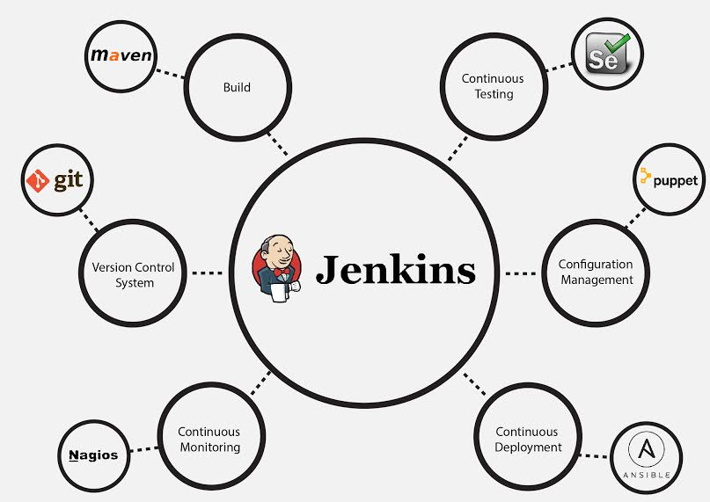
Over-View
CI workflow
5
Thangharaj J M | 11/29/2016
© Robert Bosch Engineering and Business Solutions Private Limited 2016. All rights reserved, also regarding any disposal, exploitation, reproduction, editing, distribution, as well as in the event of applications for industrial property rights.

Slide 6
Overall CI-Flow in JLR-NGI
Wait for Int labels
PDC check Script
Un approved labels are not picked
Merging and Build
Merge Checks
Checking and apply label
Picks only approved labels
System Binary generation
BVT at Integrator Desk
Consolidated Mail
Rejected

Slide 7
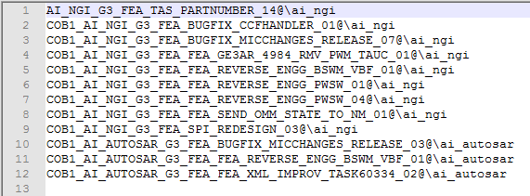
Job – 1: Wait for integration labels
CI workflow
This job is scheduled to run once in every 4 hours.
This job will collect all labels that have been DEV released by developers into a text file called “JenkinsLabelMaster.txt”
7
Thangharaj J M | 11/29/2016
© Robert Bosch Engineering and Business Solutions Private Limited 2016. All rights reserved, also regarding any disposal, exploitation, reproduction, editing, distribution, as well as in the event of applications for industrial property rights.

Slide 8
Job – 2: PDC approved label check
CI workflow
This PDC check script ensures, before merging only the PDC approved labels go for merging and build job.
This script is triggered downstream after “wait for integration” job is complete.
Script workflow is as below:
Wait for Int labels
pdc_check.data
Compare_script
Sent to merging and build job
Approved Labels alone
8
Thangharaj J M | 11/29/2016
© Robert Bosch Engineering and Business Solutions Private Limited 2016. All rights reserved, also regarding any disposal, exploitation, reproduction, editing, distribution, as well as in the event of applications for industrial property rights.

Slide 9
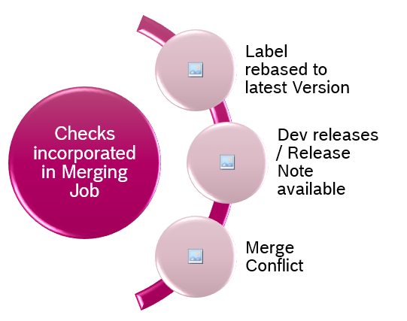
Job – 3: Merging
CI workflow
Only the approved labels are taken for merging and build.
We have few checks incorporated in merging before it proceeds to build.
What are the checks incorporated?
9
Thangharaj J M | 11/29/2016
© Robert Bosch Engineering and Business Solutions Private Limited 2016. All rights reserved, also regarding any disposal, exploitation, reproduction, editing, distribution, as well as in the event of applications for industrial property rights.

Slide 10
Job – 3: Merging and Build job
CI workflow
5 different Builds executed
Changed files are checked in
New Label applied
Totally there are 5 – Build’s that take place
Release build
Lint build
Unit Test build
UTRun
Debug Build
The changed files are checked in.
Lastly new label is applied on all the three vobs
10
Thangharaj J M | 11/29/2016
© Robert Bosch Engineering and Business Solutions Private Limited 2016. All rights reserved, also regarding any disposal, exploitation, reproduction, editing, distribution, as well as in the event of applications for industrial property rights.

Slide 11
Job – 4: V850_System Binary generation
CI workflow
System Binaries for V850 is created by this job.
There is a script incorporated by us, which picks up the part number version from inside the file and renames it to the required convention.
This acts as a part number check , to see if the V850 / System binaries are generated correctly for
IMC
IMC-Flexray
ISC
11
Thangharaj J M | 11/29/2016
© Robert Bosch Engineering and Business Solutions Private Limited 2016. All rights reserved, also regarding any disposal, exploitation, reproduction, editing, distribution, as well as in the event of applications for industrial property rights.

Slide 12
Job – 5: BVT @Integrators desk
CI workflow
Initially BVT (Basic verification test) took place in test PC.
Now this set up is implemented @Integrator Desk.
The below diagram shows the BVT purpose:
Automated Part Number check
System stability check
Manual test cases
BVT Checks
12
Thangharaj J M | 11/29/2016
© Robert Bosch Engineering and Business Solutions Private Limited 2016. All rights reserved, also regarding any disposal, exploitation, reproduction, editing, distribution, as well as in the event of applications for industrial property rights.

Slide 13
Job – 6: Consolidated Mail:
CI workflow
Once all the jobs have been successfully completed , we have a consolidated mail getting triggered.
This mail contains the below info:
Labels integrated
New label applied on each of the vob
Latest Binaries path
Auto-Flashing logs
BVT report.
13
Thangharaj J M | 11/29/2016
© Robert Bosch Engineering and Business Solutions Private Limited 2016. All rights reserved, also regarding any disposal, exploitation, reproduction, editing, distribution, as well as in the event of applications for industrial property rights.

Slide 14

Job – 7: Dashboard
CI workflow
The dashboard is displayed as below:
Its has :
Unit Test
Lint / Compiler Warnings
Logiscope
CCR metrics
BVT report and Warnings details
14
Thangharaj J M | 11/29/2016
© Robert Bosch Engineering and Business Solutions Private Limited 2016. All rights reserved, also regarding any disposal, exploitation, reproduction, editing, distribution, as well as in the event of applications for industrial property rights.

