Slide 1

Git Basic Training
Installation
  Prerequisites / where is …
  Configure and clone
Git terms
  Comparison to ClearCase
  Git tools compared to CC
Git basic work steps
  Changing files
  Branching
  Remote for collaboration
  Merge / Rebase
HMI SW-Dev Workflow
  _int for all
  _stabi (-lization)
Import / Export Git <-> CC
  How does this work
Experienced git
  Clubbing commits
  Git review with gerrit
  Cherry pick
Car Multimedia
Confidential | RBCN/EO -Vinoth | 20/10/2016 | © Robert Bosch Car Multimedia GmbH 2016. All rights reserved, also regarding any disposal, exploitation, reproduction, editing, distribution, as well as in the event of applications for industrial property rights.

Slide 2
Installation Prerequisites
Git Basic Training
Reading Wiki to get the latest news
  https://inside-docupedia.bosch.com/confluence/display/gen3generic/Using+git
GitManual as handbook
  https://hi-dms.de.bosch.com/docushare/dsweb/Get/Document-648274/GitManual.docx
Setup your config and adjust setting (GitManual – Section 3)
Start your clone
  Git clone is intended to be a “one time command”
Car Multimedia
Confidential | RBCN/EO -Vinoth | 20/10/2016 | © Robert Bosch Car Multimedia GmbH 2016. All rights reserved, also regarding any disposal, exploitation, reproduction, editing, distribution, as well as in the event of applications for industrial property rights.

Slide 3
Gitolite Server Network
Git Basic Training
Backup server
- slave system
Gitolite server RBEI mirror
slave system
Gitolite server
- master system
Push to master
Mirror syncs instantly
Forward
Forward
APAC
Forward
EMEA
Pull from local
near site
Build server
Pull
Push
Pull
Push
Developer
offline work
sync to server
Car Multimedia
Confidential | RBCN/EO -Vinoth | 20/10/2016 | © Robert Bosch Car Multimedia GmbH 2016. All rights reserved, also regarding any disposal, exploitation, reproduction, editing, distribution, as well as in the event of applications for industrial property rights.

Slide 4
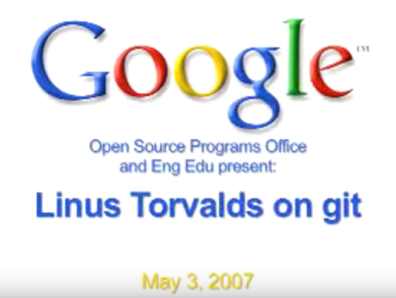

Why Git
Git Basic Training
Some talk about core implementation from Linus Torvalds
  http://www.linux.com/news/featured-blogs/185-jennifer-cloer/821541-10-years-of-git-an-interview-with-git-creator-linus-torvalds
Car Multimedia
Confidential | RBCN/EO -Vinoth | 20/10/2016 | © Robert Bosch Car Multimedia GmbH 2016. All rights reserved, also regarding any disposal, exploitation, reproduction, editing, distribution, as well as in the event of applications for industrial property rights.

Slide 5
Git Terms
Git Basic Training
Car Multimedia
Confidential | RBCN/EO -Vinoth | 20/10/2016 | © Robert Bosch Car Multimedia GmbH 2016. All rights reserved, also regarding any disposal, exploitation, reproduction, editing, distribution, as well as in the event of applications for industrial property rights.

Slide 6
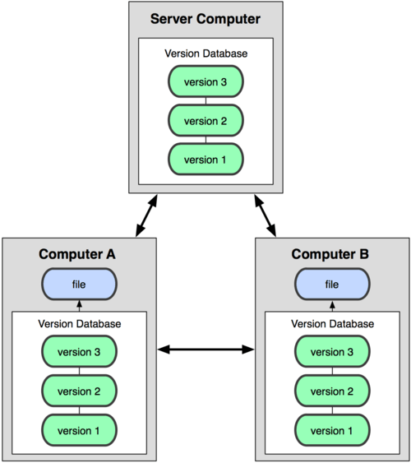
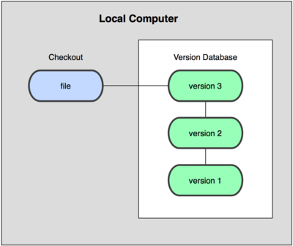
The basic Git Concept
Source code management at HMI
All is local (http://git-scm.com/book)
Car Multimedia
Confidential | RBCN/EO -Vinoth | 20/10/2016 | © Robert Bosch Car Multimedia GmbH 2016. All rights reserved, also regarding any disposal, exploitation, reproduction, editing, distribution, as well as in the event of applications for industrial property rights.

Slide 7
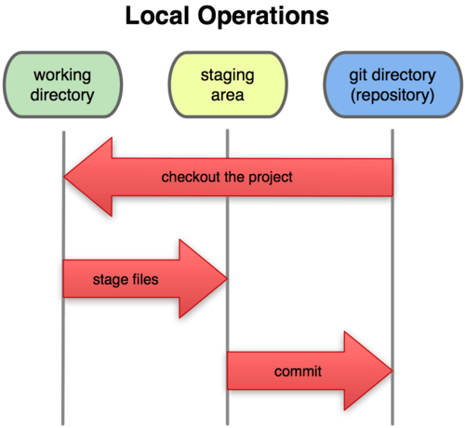
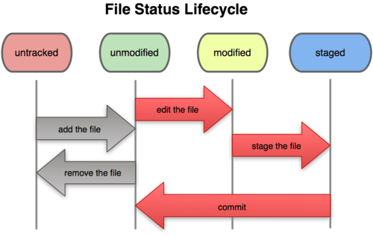
Git on Files
Source code management at HMI
Main states for your files: unstaged, modified, staged, committed
Car Multimedia
Confidential | RBCN/EO -Vinoth | 20/10/2016 | © Robert Bosch Car Multimedia GmbH 2016. All rights reserved, also regarding any disposal, exploitation, reproduction, editing, distribution, as well as in the event of applications for industrial property rights.

Slide 8
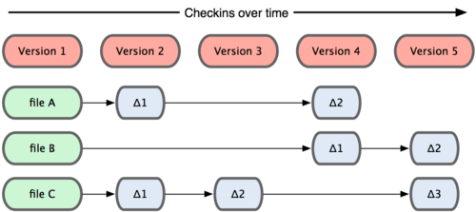
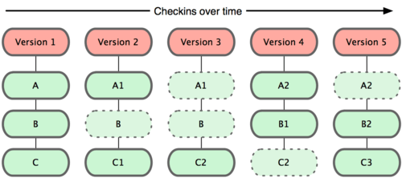
Git Version Data are Snapshots
Source code management at HMI
Only differences to previous versions are stored
Car Multimedia
Confidential | RBCN/EO -Vinoth | 20/10/2016 | © Robert Bosch Car Multimedia GmbH 2016. All rights reserved, also regarding any disposal, exploitation, reproduction, editing, distribution, as well as in the event of applications for industrial property rights.

Slide 9
Git and Version Numbers
Source code management at HMI
Git uses check summing with SHA-1.
  40-character hexadecimal string
  24b9da6552252987aa493b52f8696cd6d3b00373
Shortened 24b9da6
You will see these hash values all over the place in Git because it uses them so much. In fact, Git stores everything by the hash value of its contents and not by file name.
Git uses hashes to be consistent over the world
  Main focus is to be unique even if not connected to others
  Avoid time loss by waiting for others to get ready!
Car Multimedia
Confidential | RBCN/EO -Vinoth | 20/10/2016 | © Robert Bosch Car Multimedia GmbH 2016. All rights reserved, also regarding any disposal, exploitation, reproduction, editing, distribution, as well as in the event of applications for industrial property rights.

Slide 10
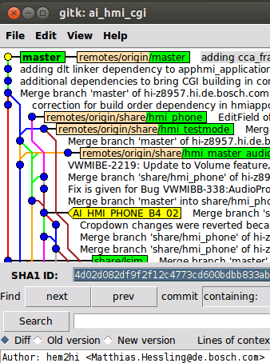
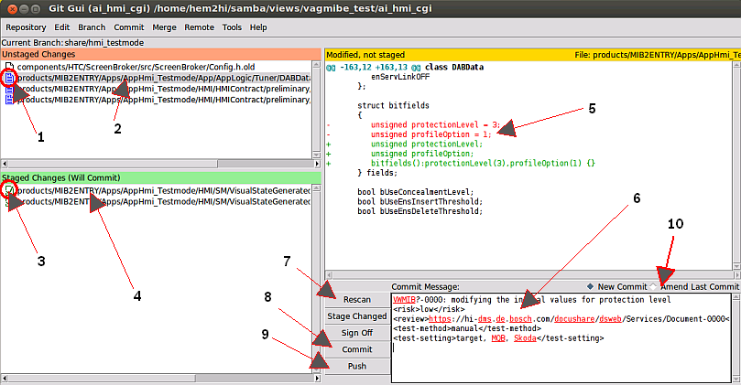
Git Tools
Source code management at HMI
There are many different graphical tools around
  Graphical tools as standalone
    SmartGit, GitCola, SourceTree
  Eclipse embedded tools
    E.g. E-git
With core git two of them are shipped and they express best the core
  gitk git gui
Car Multimedia
Confidential | RBCN/EO -Vinoth | 20/10/2016 | © Robert Bosch Car Multimedia GmbH 2016. All rights reserved, also regarding any disposal, exploitation, reproduction, editing, distribution, as well as in the event of applications for industrial property rights.

Slide 11
Guidelines for commit contents
Git Basic Training
Commit often on your local repository
  Your commits only get published by a push operation to some public server.
Be sure you have a story worth telling when you push
  Don't push all commits being understandable for the rest of the world.
  To come from many commits to only one being for the delivery this chapter will explain how to do this.
Keep changes as atomic as possible
  Developers usually get carried away while writing code.
  This makes merging of functional code much easier later on.
Keep changes as complete as possible
  Half a bug fix is not worth publishing, nor is a non functioning feature part.
  If a local commit doesn't even compile, you should not publish it. Combine all necessary commits that are needed to make a compliable and useful commit.
Prepare for cherry pick
  A very good reason for having atomic commits is the cherry pick feature. Git allows you to pick the changes from a single commit and apply them to some other branch. Of course if the commit contains more than just the bug fix, things get more complicated.
Car Multimedia
Confidential | RBCN/EO -Vinoth | 20/10/2016 | © Robert Bosch Car Multimedia GmbH 2016. All rights reserved, also regarding any disposal, exploitation, reproduction, editing, distribution, as well as in the event of applications for industrial property rights.

Slide 12
CM-AI commit message guidelines
Git Basic Training
Lines in the message:
1. Line: Useful comment! - not only “bug fixed”
  Explain the result of the commit
    not the state before
  Write your commit message in the present tense
  First line should be short summary (50 chars or less)
  Use always references to work package if available
  Examples:
    XYZ-8843: Fix speech problem after dataset change
    UVW-929: Add POI list handling. Writing the list into flash.
2. Line: Blank line separating the summary from the body is critical
3++ Line: Body if necessary contains more detailed explanatory text
  if necessary. Wrap it to 72 characters.
Car Multimedia
Confidential | RBCN/EO -Vinoth | 20/10/2016 | © Robert Bosch Car Multimedia GmbH 2016. All rights reserved, also regarding any disposal, exploitation, reproduction, editing, distribution, as well as in the event of applications for industrial property rights.

Slide 13
Branching
Git Basic Training
A branch is for stacking commits
Branches are cheap pointers,
keeping track on the development Head
Create a branch and do some new work on it
  List branches: git branch
  New branch: git branch <new_branch_name>
  Switching between branches: git checkout <branch_name>
  Create new branch and check out: git checkout –b <new_branch_name>
  Delete a branch: git branch –D <branch_name>
  Rename branch name:
      git branch -m <oldname> <newname>
      git branch –m <newname>
Car Multimedia
Confidential | RBCN/EO -Vinoth | 20/10/2016 | © Robert Bosch Car Multimedia GmbH 2016. All rights reserved, also regarding any disposal, exploitation, reproduction, editing, distribution, as well as in the event of applications for industrial property rights.

Slide 14
Basic commands used before start development
Git Basic Training
Git fetch
Git rebase
git submodule update --init
Git status
Git add(move file local from working repo to staging area)
Git Commit(move file local from staging to Git repository)
Git push(local git repo to remote repo)
Car Multimedia
Confidential | RBCN/EO -Vinoth | 20/10/2016 | © Robert Bosch Car Multimedia GmbH 2016. All rights reserved, also regarding any disposal, exploitation, reproduction, editing, distribution, as well as in the event of applications for industrial property rights.

Slide 15
Remote for collaboration
Git Basic Training
If you’re done then push.
  Developer is
  becoming integrator
Car Multimedia
Confidential | RBCN/EO -Vinoth | 20/10/2016 | © Robert Bosch Car Multimedia GmbH 2016. All rights reserved, also regarding any disposal, exploitation, reproduction, editing, distribution, as well as in the event of applications for industrial property rights.

Slide 16
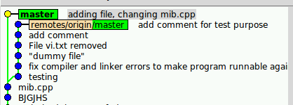
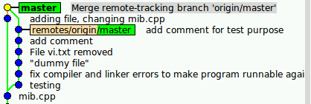
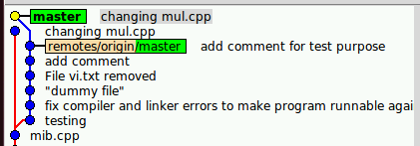
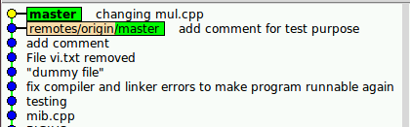
Merge / Rebase
Git Basic Training
Merge and rebase are the commands to bring the things together
  While merge preserves the branches
  Rebase cleans up to one string
merge
rebase
Car Multimedia
Confidential | RBCN/EO -Vinoth | 20/10/2016 | © Robert Bosch Car Multimedia GmbH 2016. All rights reserved, also regarding any disposal, exploitation, reproduction, editing, distribution, as well as in the event of applications for industrial property rights.

Slide 17
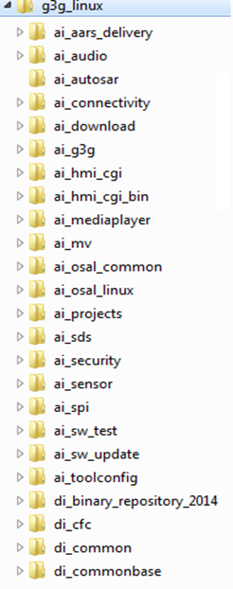
Using Git Super Repository
Git Basic Training
g3g_linux
ai_audio
ai_hmi_cgi
ai_projects
v1
v2
v3
g3g_int
v4
g3g_int
g3g_int
git submodule update –init
gitall checkout g3g_int
alias gitall=‘git submodule foreach git'
g3g_int
Car Multimedia
Confidential | RBCN/EO -Vinoth | 20/10/2016 | © Robert Bosch Car Multimedia GmbH 2016. All rights reserved, also regarding any disposal, exploitation, reproduction, editing, distribution, as well as in the event of applications for industrial property rights.

Slide 18
Branch Naming wrt. ClearCase
Git Basic Training
View / Function | Branch names in ClearCase ai_projects | Branch names in other vobs e.g. di_middleware_server | Branch names in Git applied in all sub- modules the same
Main feature branch for Nissan NCG3 (A-IVI) | ai_prj_nissan_ncg3_int | di_midw_g3g_int, di_middleware_nissan_int, di_midw_g3g_audio_int, ... | nissan_ncg3_int
Stabilization branch 1 for Nissan NCG3 (A-IVI) | ai_prj_ nissan_ncg3_14.1_int | di_midw_g3g_int, di_middleware_nissan_14.1_int, di_midw_g3g_audio_14.3_int, ... | nissan_ncg3_14.1_stabi
Main feature branch for AID | ai_g3g_int | di_midw_g3g_int, dia_common_gen3_int, di_midw_g3g_fea_reception_preint, ... | g3g_int
Stabilization branch 1 in AID | ai_g3g_14.01_int | di_midw_g3g_int, dia_common_gen3_int, di_midw_g3g_fea_reception_preint, ... | g3g_14.01_stabi
Car Multimedia
Confidential | RBCN/EO -Vinoth | 20/10/2016 | © Robert Bosch Car Multimedia GmbH 2016. All rights reserved, also regarding any disposal, exploitation, reproduction, editing, distribution, as well as in the event of applications for industrial property rights.

Slide 19
Remote Branches – Collaboration Model
Git Basic Training
Main development branch
  origin/<pj_name>_int
    For main work. All together!
    No excuse – what you do matters ☺
User branches
  origin/usr/<userid>/<branchname>
    Personal work or self organized teams
    Review actions
Stabilization branches
  origin/<pj_name>_<numbering>_stabi
    Pull request mode enabled!
    The master decides
Share (team) branches
  origin/share/branchname
    Currently NOT used
Car Multimedia
Confidential | RBCN/EO -Vinoth | 20/10/2016 | © Robert Bosch Car Multimedia GmbH 2016. All rights reserved, also regarding any disposal, exploitation, reproduction, editing, distribution, as well as in the event of applications for industrial property rights.

Slide 20
Deliver Software
Git Basic Training
You want to do a devRelease?
  What you would do in ClearCase
    Branch, code, label, devReleaseNote, e-mail, wait for a week…
  What you do in Git
    Code, commit, rebase, push
Git deliver in multiple submodules
  Make sure developers know about your change via root commit
  1. push in submodules
  2. push in root (superrepo)
Car Multimedia
Confidential | RBCN/EO -Vinoth | 20/10/2016 | © Robert Bosch Car Multimedia GmbH 2016. All rights reserved, also regarding any disposal, exploitation, reproduction, editing, distribution, as well as in the event of applications for industrial property rights.

Slide 21
Import / Export CC <-> Git
Git Basic Training
Import: ai_hmi_cgi/tools/Cc2Git/ impLabelFiles.bat for CC -> Git
Export: <vob>/tools/ClearCaseImport/ import_git.bat Git -> CC
Import
Export
Git _int _import
CC
Git _int _import
CC
copy
export
copy
merge
copy
export
copy
merge
copy
export
copy
merge
Car Multimedia
Confidential | RBCN/EO -Vinoth | 20/10/2016 | © Robert Bosch Car Multimedia GmbH 2016. All rights reserved, also regarding any disposal, exploitation, reproduction, editing, distribution, as well as in the event of applications for industrial property rights.

Slide 22
More git
Git Basic Training
Git resetting
  Back to normal / forward to new version
    git reset --hard
    git clean –xdf
Stashing
  Git stash save “message”
  Git stash pop
Git reflog / log
  What records git? (git log, git log –n 2,git log --stat, git log --pretty=oneline, git log –n 2 --reverse, git log <br_name>)
  Undo things?
Cherry pick
  Cherry pick is a rebase of one commit(copy content from a commit)
PRACTICE
Car Multimedia
Confidential | RBCN/EO -Vinoth | 20/10/2016 | © Robert Bosch Car Multimedia GmbH 2016. All rights reserved, also regarding any disposal, exploitation, reproduction, editing, distribution, as well as in the event of applications for industrial property rights.

Slide 23
Modifying the history (clubbing commits)
Git Basic Training
Amend the one last commit
  Stage the changes you want to add to the last commit. Use the command.
  git --commit --amend
Squash several commits to only one to push
  This is the fastest and easiest way to go if you want to club (or sum up) all of your commits in question into one, and to rewrite a new commit message.
  Ensure local working copy is the clean and current HEAD is the final status
  git reset --soft <commit>
  Squashing a “sleve made film” of commits to a new history:
  git rebase –i HEAD~<countofcommits>
PRACTICE
Car Multimedia
Confidential | RBCN/EO -Vinoth | 20/10/2016 | © Robert Bosch Car Multimedia GmbH 2016. All rights reserved, also regarding any disposal, exploitation, reproduction, editing, distribution, as well as in the event of applications for industrial property rights.

Slide 24
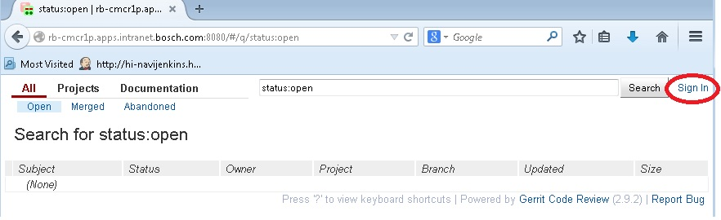
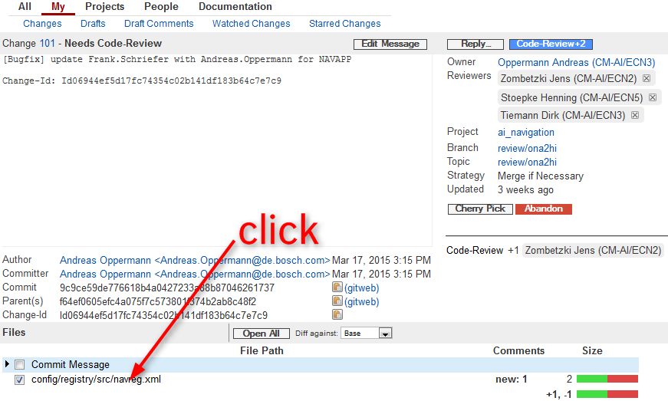
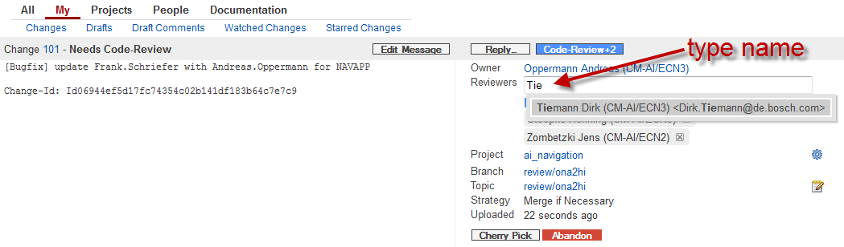
Git review with Gerrit
Git Basic Training
https://inside-docupedia.bosch.com/confluence/display/cmaicfnavi/Gerrit@ESN
  Command line git review and go ahead…
Car Multimedia
Confidential | RBCN/EO -Vinoth | 20/10/2016 | © Robert Bosch Car Multimedia GmbH 2016. All rights reserved, also regarding any disposal, exploitation, reproduction, editing, distribution, as well as in the event of applications for industrial property rights.

Slide 25
Other Stuff
Git Basic Training
Tagging in git?
  Capital letters, use a good name,
  don’t move or delete after pushing to remote
  Git tag <TAG_NAME>
  Git push –tags <TAG_NAME>
History Logs
git log --no-merges --pretty=format:"' %h; %aD; %an; %s" <from>..<until>
PRACTICE
Car Multimedia
Confidential | RBCN/EO -Vinoth | 20/10/2016 | © Robert Bosch Car Multimedia GmbH 2016. All rights reserved, also regarding any disposal, exploitation, reproduction, editing, distribution, as well as in the event of applications for industrial property rights.

