Slide 1
GIT
1
Internal | Sabareesh SS (ECA36) | 23/08/2016 | © Robert Bosch Engineering and Business Solutions Limited 2011. All rights reserved, also regarding any disposal, exploitation, reproduction, editing, distribution, as well as in the event of applications for industrial property rights.

Slide 2
Getting Started
Under My IT services Order for the Bosch available Git version - Git-1.8.5.2-preview20131230
Home -> Standard Desktop Software -> Approved Client Software ->
Order Non-Peacy software install/Uninstall
Recommended GUI tool from Bosch is SourceTree, which is fast and friendly.
2
Internal | Sabareesh SS (ECA36) | 23/08/2016 | © Robert Bosch Engineering and Business Solutions Limited 2011. All rights reserved, also regarding any disposal, exploitation, reproduction, editing, distribution, as well as in the event of applications for industrial property rights.

Slide 3
Obstacles
When coming from another SCM system to Git you need to shift how you think about how version control works.
In a more classic SCM you think of it as a system that versions files in a tree or directory structure.
Git is better thought of as a system that versions trees of files.
Internal | Sabareesh SS (ECA36) | 23/08/2016 | © Robert Bosch Engineering and Business Solutions Limited 2011. All rights reserved, also regarding any disposal, exploitation, reproduction, editing, distribution, as well as in the event of applications for industrial property rights.
Notes:
3

Slide 4
GIT, A different Clearcase
Create and go to a folder for Git repository initialization.
There are No Check-in and Check-out commands in Git.
There are No Views and Configuration specifications in Git.
There is No file based access control in Git.
Internal | Sabareesh SS (ECA36) | 23/08/2016 | © Robert Bosch Engineering and Business Solutions Limited 2011. All rights reserved, also regarding any disposal, exploitation, reproduction, editing, distribution, as well as in the event of applications for industrial property rights.
Notes:
4

Slide 5
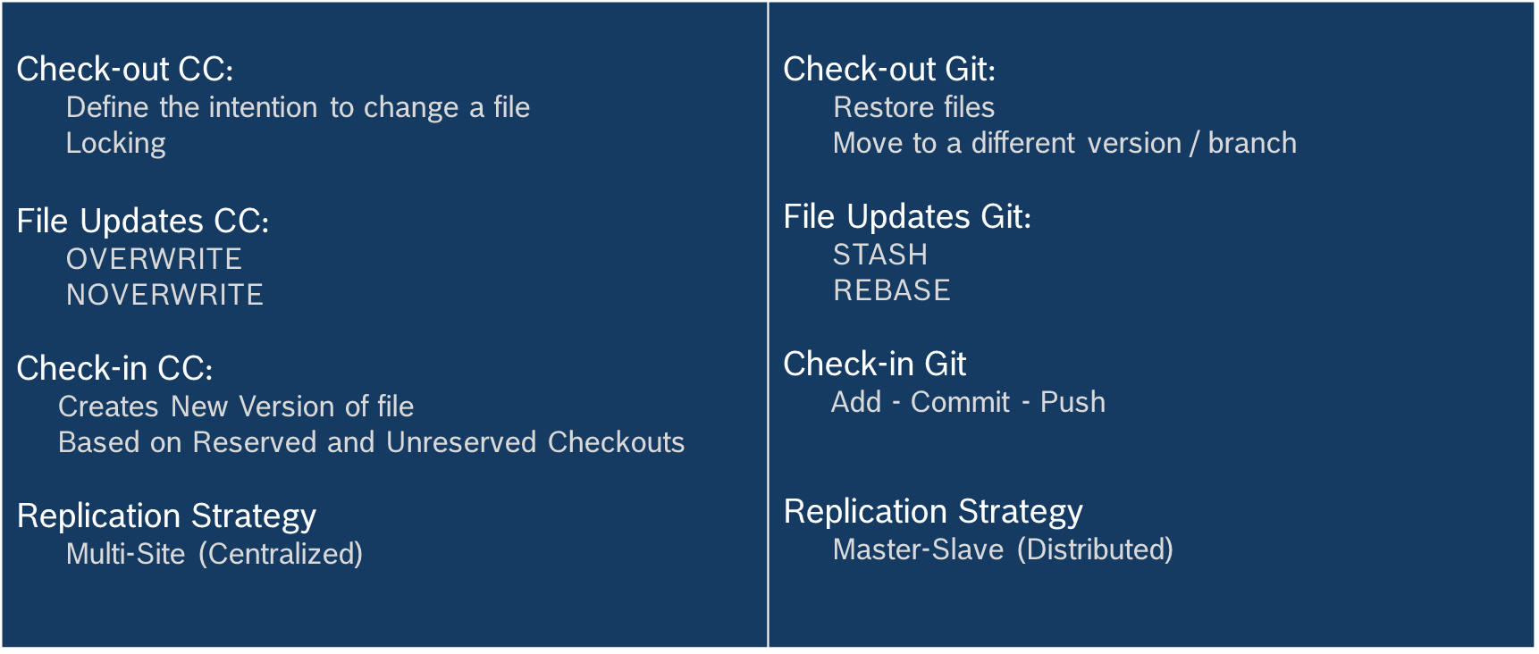
Clearcase Vs GIT
Internal | Sabareesh SS (ECA36) | 23/08/2016 | © Robert Bosch Engineering and Business Solutions Limited 2011. All rights reserved, also regarding any disposal, exploitation, reproduction, editing, distribution, as well as in the event of applications for industrial property rights.
Notes:
5

Slide 6
How Git Works?
Stores whole copies of the repo
No file deltas
Entire tree is captured at each commit not just the files that changed, a snapshot of the repo
Branches and tags
Are pointers to commits
Very fast and light weight
Internal | Sabareesh SS (ECA36) | 23/08/2016 | © Robert Bosch Engineering and Business Solutions Limited 2011. All rights reserved, also regarding any disposal, exploitation, reproduction, editing, distribution, as well as in the event of applications for industrial property rights.
Notes:
6

Slide 7
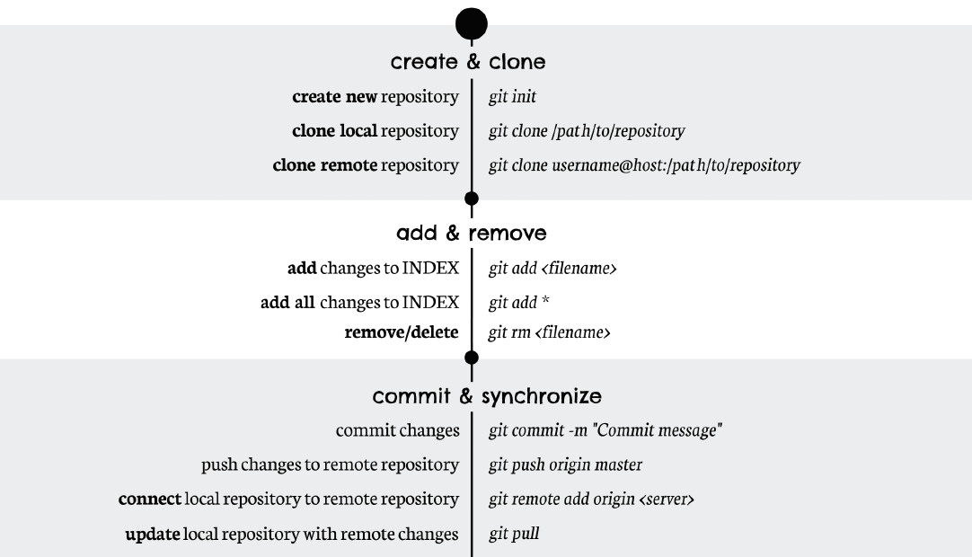
GIT Cheat Sheet
Internal | Sabareesh SS (ECA36) | 23/08/2016 | © Robert Bosch Engineering and Business Solutions Limited 2011. All rights reserved, also regarding any disposal, exploitation, reproduction, editing, distribution, as well as in the event of applications for industrial property rights.
Notes:
7

Slide 8
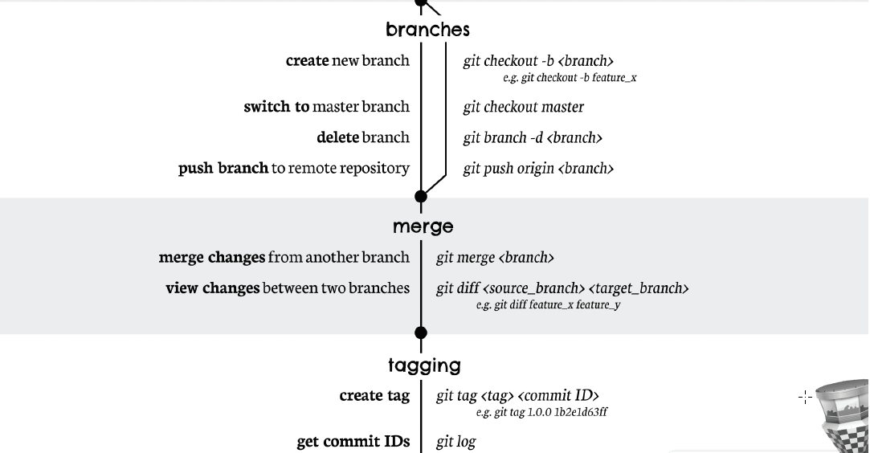
GIT Cheat Sheet
Internal | Sabareesh SS (ECA36) | 23/08/2016 | © Robert Bosch Engineering and Business Solutions Limited 2011. All rights reserved, also regarding any disposal, exploitation, reproduction, editing, distribution, as well as in the event of applications for industrial property rights.
Notes:
8

Slide 9
GIT Branching Approach
master
sprint-1
sprint-2
bugfix
Bugfixes happens here
hotfix
.
Emergency hotfixes happens here
feature
.
A feature specific to the branch Sprint-1
.
push
branch-out
merge
branch-out
pull

Slide 10
Learn GIT - References
Tutorials
Code School https://try.github.io/levels/1/challenges/1
Everyday Git https://www.kernel.org/pub/software/scm/git/docs/giteveryday.html
Wiki
https://git.wiki.kernel.org/index.php/Main_Page
Internal | Sabareesh SS (ECA36) | 23/08/2016 | © Robert Bosch Engineering and Business Solutions Limited 2011. All rights reserved, also regarding any disposal, exploitation, reproduction, editing, distribution, as well as in the event of applications for industrial property rights.
Notes:
10

