Slide 1

Department of CSE(AI-ML)
Industrial Oriented Mini Project
on
TITLE: PREDICTIVE LEARNING FOR CHILI VARIETIES FROM MULTI-SOURCE IMAGE AND SENSOR DATA
Presented By : Batch no-06
K. Kusuma (23UJ1A6673)
M. Sravanthi (23UJ1A6678)
P. Yes Kumar (23UJ1A6687)
R. Gandhi Naik (23UJ1A6693)
Under the Guidance of :
Mrs. P. ASHWINI, M.Tech.
Assistant Professor,
CSE(AI&ML), MREM

Slide 2
Table of Content
1) Abstract
2) Introduction
3) Motivation
4) Problem Definition
5) Literature surveys
6) Existing Methodology
7) Drawbacks of existing system
8) Software Details
9) Research Gaps
10) Proposed Methodology
11) Sample Code
12) Packages / Libraries
13) Data Sets
14) Result Analysis
15) Advantages and Application
16) Conclusion
17) Future Scope
18) Reference

Slide 3
Abstract
Chili cultivation includes many varieties with different appearances and environmental needs. Correct identification is important for better crop planning and yield estimation. Traditional methods depend on manual observation and expert knowledge, which are time-consuming, subjective, and not reliable in early stages. Many existing digital systems use only image data or only sensor data. Because of this, they cannot give accurate results or work well for large-scale farming.

Slide 4
Introduction
Chili cultivation plays a crucial role in the global agricultural economy, requiring rigorous quality control and variety identification to meet processing and export standards. In recent years, the integration of digital imaging devices across farms, markets, and storage units has generated vast amounts of multi-source visual data. However, translating this raw data into actionable agricultural intelligence remains a complex challenge. This project proposes a predictive learning system designed to automate the classification of distinct chili varieties and assess their physical health. By leveraging advanced machine learning algorithms and image processing techniques, the system aims to replace subjective manual inspections with a highly accurate, data-driven framework, ultimately enhancing decision-making in modern agricultural systems.

Slide 5
Motivation
Economic Impact: Accurate sorting of chilies by variety and health ensures better market pricing and reduces post-harvest losses.
Technological Advancement: The increasing availability of digital sensors and cameras on farms provides an untapped resource for automated crop monitoring.
Empowering Farmers: Providing an accessible, automated tool reduces the reliance on scarce human experts for quality control.
Efficiency at Scale: Modern Agri-based industries require high-throughput processing systems that manual labor simply cannot sustain.

Slide 6
Problem Definition
The core problem lies in the inability to accurately, consistently, and rapidly classify different chili varieties and quality states from multi-source digital images, which often suffer from varying lighting conditions, backgrounds, and angles. To solve this, the project aims to develop a robust predictive machine learning model capable of automatically extracting complex morphological features—such as texture, shape, and color—to classify these images with high precision and minimal computational overhead, replacing subjective manual methods.

Slide 7
Literature surveys
Year | Author | Title | Existing System | Proposed System | Key Contribution | Drawbacks/Limitations
2018 | Jiang, et al. | Postharvest Biology and Technology Nondestructive quality assessment of chili | Binary classification logic and manual morphological inspection. | Fuzzy logic combined with K-Nearest Neighbor (KNN). | Extracted morphological features (area, diameter) to classify seeds, handling uncertainty using Mamdani Fuzzy rules. | Relies on manual, hand-crafted feature extraction, which is not scalable for high-throughput industrial pipelines.
2019 | Arsenovic, et al. | Solving Current Limitations of Deep Learning Based Approaches for Plant Disease | Standard CNNs trained on lab-controlled datasets (like Plant Village) with uniform backgrounds. | Two-stage neural network architecture utilizing style Generative Adversarial Networks (GANs). | Augmented data using GANs to mimic complex, real-world backgrounds; achieved 93.67% accuracy in real-life conditions. | GAN-based data augmentation is highly computationally expensive and can introduce synthetic artifacts that confuse the model.
2024 | Ma, et al. | Chili Object Detection Method Based on Improved YOLOv8n | Standard YOLOv5, YOLOv7-tiny, and baseline YOLOv8n networks. | Improved YOLOv8n utilizing HGNetV2, SEAM attention, and CARAFE upsampling. | Enhanced feature extraction under heavy leaf occlusion; reduced parameters by 29.5% while improving mAP. | Spatial attention modules (SEAM) can struggle to generalize if the testing environment's lighting significantly differs from the training set.
2025 | Tai, et al. | Intelligent Recognition and Automated Production of Chili: A Review... | Fragmented literature on either purely deep learning or purely mechanical harvesting. | Comprehensive review framework analyzing the intersection of perception and robotics. | Systematically mapped the transition from traditional CV to deep learning for fine-grained cultivar identification and robotic picking. | As a review paper, it does not propose a novel algorithmic architecture or provide new empirical dataset testing.

Slide 8
Existing Methodology
Manual Visual Inspection: Farmers or quality experts manually inspect harvested batches.
Subjective Assessment: Classification is based entirely on human experience, evaluating visible traits such as color gradient, physical shape, texture, and visible defects.
Basic Automated Systems: Some existing technological solutions rely on rudimentary computer vision (like basic color thresholding) or simple linear classifiers that do not learn complex feature hierarchies.

Slide 9
Drawbacks of existing system
Judgments vary significantly between different human inspectors, leading to a complete lack of standardization.
Manual sorting is highly time-consuming and labor-intensive, creating bottlenecks in high-throughput processing.
The process is prone to human error and fatigue, especially when distinguishing between visually similar chili varieties.
It is completely ineffective and unscalable for handling large datasets or industrial-level agricultural requirements.
Human inspection and basic optical systems suffer reduced reliability under varying environmental and lighting conditions.

Slide 10
Software Details
Programming Language: Python 3.12.0
Data Manipulation & Analysis: Pandas, NumPy
Image Processing: OpenCV (cv2), Scikit-image
Machine Learning Framework: Scikit-learn (for model implementation, train-test splitting, and evaluation metrics)
Model Serialization: Joblib / Pickle (for saving trained models)
Graphical User Interface (GUI): Tkinter (for seamless user interaction and real-time predictions)
Visualization: Matplotlib, Seaborn (for performance graphs and confusion matrices)

Slide 11
Research Gaps
Most existing research focuses either on disease detection or simple variety classification, lacking a unified multi-class framework that handles both (Variety + Health states).
Advanced hyperspectral or deep learning models require massive computational power, making them difficult to deploy on standard, low-cost agricultural hardware.
Traditional machine learning approaches often fail to capture the subtle, non-linear spatial texture variations in chili surfaces, necessitating optimized models like LGBM.

Slide 12
Proposed Methodology
Multi-Source Data Acquisition: Automated collection of chili images organized into specific categories.
Image Preprocessing Pipeline: Standardizing images by resizing them to 64x64 pixels, normalizing colors, and flattening them into 1D numerical feature vectors.
Dataset Splitting: Randomly partitioning the preprocessed data into a 80% Training set and a 20% Testing set to ensure an unbiased evaluation.
Multi-Model Training: Training four distinct supervised machine learning classifiers simultaneously: LGBM, LDA, AdaBoost, and SVM.
Evaluation & Model Persistence: Validating all trained models and saving the best-performing LGBM Classifier for real-time, automated inference.

Slide 13
Sample code
# Load Dataset
path = "Chili Multi-Source"
categories = os.listdir(path)
# Image Visualization
for category in categories:
folder = os.path.join(path, category)
images = os.listdir(folder)[:4]
for img in images:
image = cv2.imread(os.path.join(folder, img))

Slide 14
image = cv2.cvtColor(image, cv2.COLOR_BGR2RGB)
plt.imshow(image)
# Preprocessing
X, Y = [], []
for root, dirs, files in os.walk(path):
for file in files:
img = cv2.imread(os.path.join(root, file))
img = resize(img, (64,64,3))
X.append(img.flatten()) Y.append(categories.index(os.path.basename(root)))
X = np.array(X)
Y = np.array(Y)
# Train-Test Split
x_train, x_test, y_train, y_test = train_test_split(X, Y, test_size=0.3)

Slide 15
# Model Training
models = {
"LGBM": LGBMClassifier(),
"LDA": LinearDiscriminantAnalysis(),
"AdaBoost": AdaBoostClassifier(),
"SVM": SVC()
}
for name, model in models.items():
model.fit(x_train, y_train)
preds = model.predict(x_test)
# Prediction
img = load_img("test_image.jpg", target_size=(64,64))
img = img_to_array(img)/255.0
img = img.flatten().reshape(1,-1)
prediction = model.predict(img)

Slide 16
Packages/Libraries
## Importing Libraries
import pandas as pd
import os
import numpy as np
import matplotlib.pyplot as plt
from sklearn.model_selection import train_test_split
from sklearn.metrics import accuracy_score
from sklearn.metrics import precision_score
from sklearn.metrics import recall_score
from sklearn.metrics import f1_score
from sklearn.metrics import classification_report
from sklearn.metrics import confusion_matrix

Slide 17
import seaborn as sns
from skimage import io, transform
from sklearn import preprocessing
import joblib
import cv2
import warnings
warnings.filterwarnings('ignore')
from sklearn.preprocessing import StandardScaler, LabelEncoder
from sklearn.svm import SVC
from lightgbm import LGBMClassifier
from sklearn.discriminant_analysis import LinearDiscriminantAnalysis
from sklearn.linear_model import PassiveAggressiveClassifier
from tensorflow.keras.preprocessing.image import ImageDataGenerator
from skimage.transform import resize
from skimage.io import imread

Slide 18
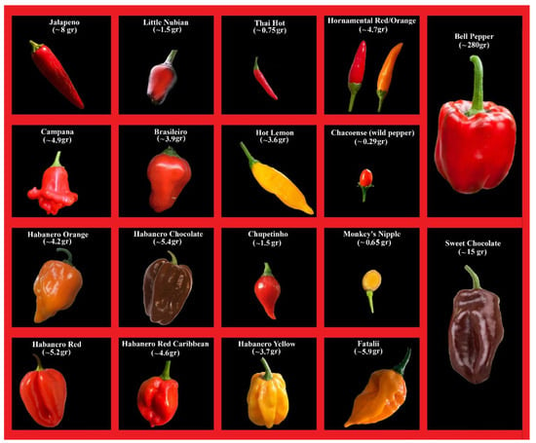
Data Sets
Dataset of chili varities

Slide 19
Result Analysis
Four models (LGBM, LDA, AdaBoost, SVM) were evaluated using Accuracy, Precision, Recall, and F1-score.
The dataset is balanced across five chili classes, enabling fair model training and testing.
LGBM achieved the best performance with 98.93% accuracy, showing strong ability to classify different chili varieties.
SVM (95.20%) and LDA (96.00%) also produced good results, while AdaBoost (80.80%) showed lower performance.
Overall comparison confirms LGBM as the most effective model for chili image classification.

Slide 20
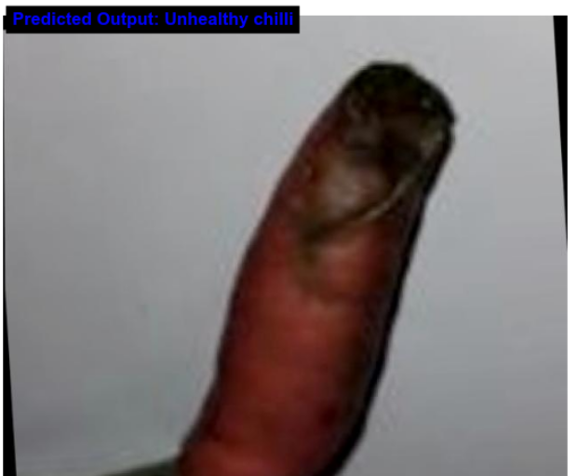
Model | Accuracy (%) | Precision (%) | Recall (%) | F1-Score (%)
LGBM Classifier | 98.93 | 98.94 | 98.94 | 98.94
LDA Classifier | 96.00 | 96.40 | 96.16 | 96.16
AdaBoost Classifier | 80.80 | 81.53 | 81.59 | 81.34
SVM Classifier | 95.20 | 95.21 | 95.67 | 95.30
Comparative Performance Analysis of Machine Learning Models.
Single Image Prediction Result.

Slide 21
Advantages and Application
Applications
Automated chili sorting and grading in food processing industries.
Quality inspection systems for exporters and spice manufacturers.
Smart farming and digital agriculture platforms for crop monitoring.
Post-harvest quality assessment in warehouses and storage units.
IoT-based agricultural monitoring systems for real-time crop analysis.
Advantages
Enables automated and consistent chili classification, reducing human error.
Reduces inspection time and labor costs in agricultural industries.
Handles large multi-source image datasets efficiently.
Provides reliable classification under different lighting and conditions.
Supports scalable deployment for real-world agricultural applications.

Slide 22
Conclusion
This project developed an automated chili image classification system using machine learning techniques to identify different chili varieties and quality conditions. The system processes raw images through preprocessing and feature extraction to improve classification performance. Among the tested models, LightGBM achieved the best result with an accuracy of 98.93%, outperforming LDA, SVM, and AdaBoost. Overall, the system demonstrates reliable and efficient classification, making it useful for practical agricultural quality assessment.

Slide 23
Future Scope
In the future, the proposed chili image classification system can be enhanced by integrating advanced deep learning models such as Convolutional Neural Networks (CNNs) to automatically extract richer and more complex image features. The system can also be extended to support real-time deployment through mobile or web-based applications, allowing farmers and agricultural experts to classify chili varieties instantly using a camera. Additionally, the dataset can be expanded to include more chili varieties, crop types, and disease conditions, improving the robustness and practical usability of the system for broader agricultural quality monitoring and decision support.

Slide 24
Reference
J. Jiang, et al. [20] Postharvest Biology and Technology Nondestructive quality assessment of chili s using near-infrared hyperspectral imaging combined with multivariate analysis,‖ Postharvest Biol. Technol., vol. 146, no. May, pp. 147–154, 2018.
Arsenovic, et al. [22] Solving Current Limitations of Deep Learning Based Approaches for Plant Disease Detection. Symmetry 2019, 11, 939
Ma, et al. [12] Chili Object Detection Method Based on Improved YOLOv8n. Plants 2024, 13, 2402.
Tai, et al. [10] Intelligent Recognition and Automated Production of Chili s: A Review Addressing Varietal Diversity and Technological Requirements. Agriculture 2025, 15, 1200.

Slide 25
THANK YOU

