Slide 1
IronGate QVR Service Discussion
AR&VR Team

Slide 2
HW Architecture w/ EPU Design
HMD
EPU
IMU BMW055
SPI
SD835
Dual Display
SD835
WIFI I/Q..
BT&WIFI&4G
Depth Camera
MIPI
QLink
GPS
DP Bridge
6Dof Camera
MIPI
DP
DP over USB-C
Type C
SPI
IMU BMW055
RGB Camera
MIPI
USB3.0
SLIMBUS
HDMI out
Audio Codec
Mic & Speaker
Voice Wakeup
I2S/INT
Sub Battery
Main Battery

Slide 3
Software Architecture
Settings
Other Apps
Games
APP
Game Engine Plugin
Launcher
EPU
SDK
Android Standard SDK
AR SDK
Air Interaction
AR NDK
QVR service
Decode 6DoF Data
USBH Audio
USBH Camera
USBH HID
OS
DP Out
IMU(BMW055)
USB Host
DP In
QVR service(with 6DoF)
USB HUB / Composite device
HMD
6DoF Data
Dual Display
Dual 6DoF Sensor
IMU
BMW055
USB HID
USB Audio
USB Camera
HMD has one IMU sensor and stereo 6DoF camera, these sensors data fusion by QVR service in HMD, then sending the 6DoF information to EPU via USB HID, there is a IMU sensor in EPU also, data fusion by QVR service in EPU, application can alternative use these two kinds of pose data which produced by EPU(output by QVR service in EPU) and HMD(output by QVR service in HMD).
HMD system no display out, dual display video frames comes from EPU directly via DP.

Slide 4
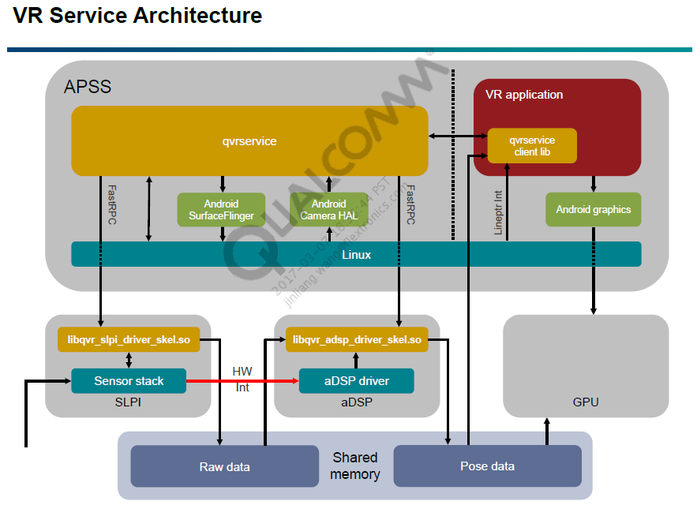
QCT QVR service

Slide 5
Question
Q1: Can QVR service in HMD supports system without display?
Q2: Pose output by HMD QVR service, transmit to EPU, and application in EPU uses this pose data for rending, is there a risk of sensor latency?
HMD sends the following data to EPU at the same time:
USB camera data stream, 1080P @ 30fps.
USB audio data stream, e.g., 44.1khz @ 2ch.
USB HID data stream, including 3DoF/6DoF information.

