Slide 1
Hardware Architecture
Flex AR&VR Team

Slide 2
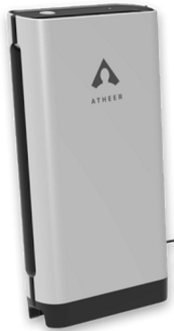
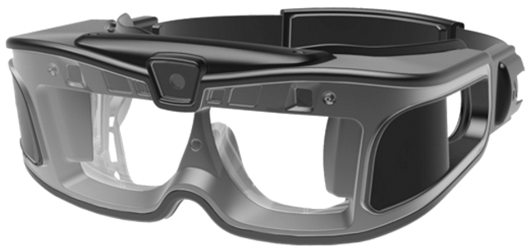
Hardware solution(HMD+EPU)
USBC Cable
Belt Pack (External Processor Unit embedded)
Head Mounted Display
Solution: One SD835 (Android) in HMD(Head Mounted Device), another SD835 (Android) in Belt Pack. Belt Pack SD835 serves as application processor, and HMD SD835 serves as co-processor for audio, image, video, CV, IMU sensors, etc, like HPU in HoloLens.

Slide 3
IronGate Hardware Description
 | HMD | EPU
CPU | APQ8098 | APQ8098
DDR Memory | LPDDR4X 4GB(may use 2GB to make cost effective) | LPDDR4X 4GB
UFS/EMMC | UFS 32GB | UFS 64GB(Extensible to 128GB)
RGB Camera | Still capture 12M, Auto Focus; Video 1080p@30fps
Depth Camera | TOF
6DOF Camera | Stereo,720p
IMU | 9-Axis | 9-Axis
Ambient Light Sensor | Yes
Proximity Sensor | Yes
Display | top-down projection, binoculars, 720p@60fps
Audio | 4Mics+2Spks
Voice wakeup | Yes
3.5mm Phone Jack | Yes
GPS |  | Yes
BT+WiFi |  | BT 4.0 above; WIFI (802.11 b/g/a/n/ac 2.4G/5G)
4G LTE |  | Yes
USBC | Yes | Yes
HDMI2.0 |  | Yes
Battery | 500mAh | 10000mAh
Charging |  | QC3.0

Slide 4
Hardware Architecture Solution - HMD
HMD
2xSpk
SPI/I2C
Mic1/2/3/4
2xWSA8815
Opt Engine+ DMD
Opt Engine+ DMD
DLP Board
9-Axis Sensor
ALS/PS Sensor
MIPI-4Lane
RGB Camera
SLIMBUS
WCD9341
Voice Activation
DLPA2005
dlp3433
dlp3433
DLPA2005
Flash LED
APQ8098Lite
MIPI-2Lane
Headphone
DP Bridge
Depth Camera
LPDDR4X-PoP
DP
MIPI-1Lane
USB3.1 Gen1
USBC Switch and CC logic
USBC
6DOF Left Camera
EPU
MIPI-1Lane
I2C
6DOF Right Camera
PMI8998/PM8998/PM8005
UFS
USB_5V
UFS-32GB
PWR
Status LED
Sub_Battery
button
PCIe
USB 3.0 To PCIe Bridge
USBC

Slide 5

Hardware Architecture Solution – EPU
EPU
T-Flash
9-Axis IMU
Status LED
Button
4G LTE Module(option)
USB2.0/3.0
HDMI OUT
HDMI
UFS 64GB
UFS
VPH_PW
5V Boost
Current limit Reverse block
5V
DP2Lane
ANX7426 USBC Switch and CC logic
USBC1
Chain1
WiFi/BT
I/Q
USB 3.0 To PCIe Bridge
Usb3.0+2.0
HMD
PCIe
DP-2lane+ USB3.1Gen1
BT UART
Usb2.0/3.0
Chain0
Usb2.0
USBC2
Slimbus
USB2.0
USB2.0
Micro USB2.0 OTG
Diplexer
GPS LNA
WTR 5975
I2C
5V
QC3.0 charger /USB2.0 expansion
Qlink
PMIC
APQ8098
LPDDR4X PoP
PWR
Main_Battery

Slide 6
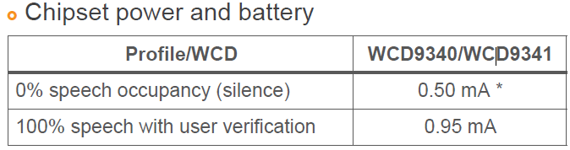

Voice Wake up and Recognition
APQ8098
Apps Processor
Audio subsystem LPASS (QDSP6)
OEM Application
WCD9341
Initial audio detection
Sound Classification, Keyword detection & user validation
SVA Framework
Support two methods:
voice activation algorithm runs on AP
voice activation algorithm runs on the codec to minimize power

Slide 7
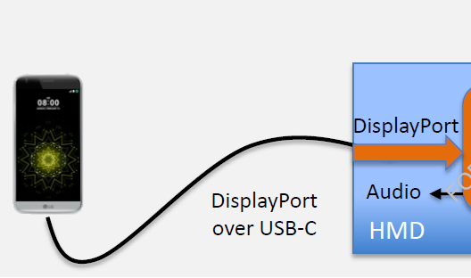
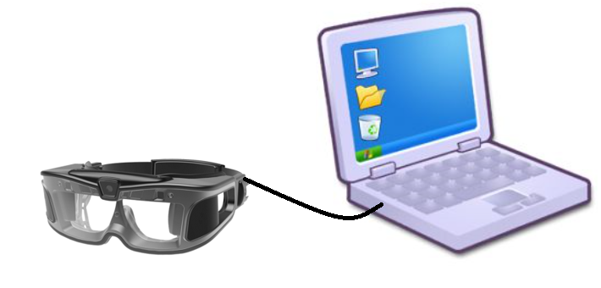

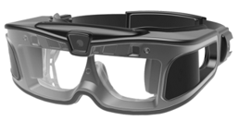
Expansion in future
2. Mobile +HMD
3. PC/Laptop+HMD

Slide 8
The End

