Slide 1
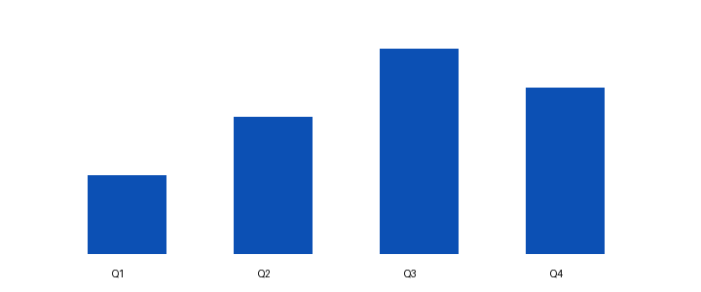
Quarter report
Authorized PNG picture
Aspect ratio and geometry preserved
Notes:
Image inserted through the independent bounded module.

Slide 2
Editable chart

