Slide 1
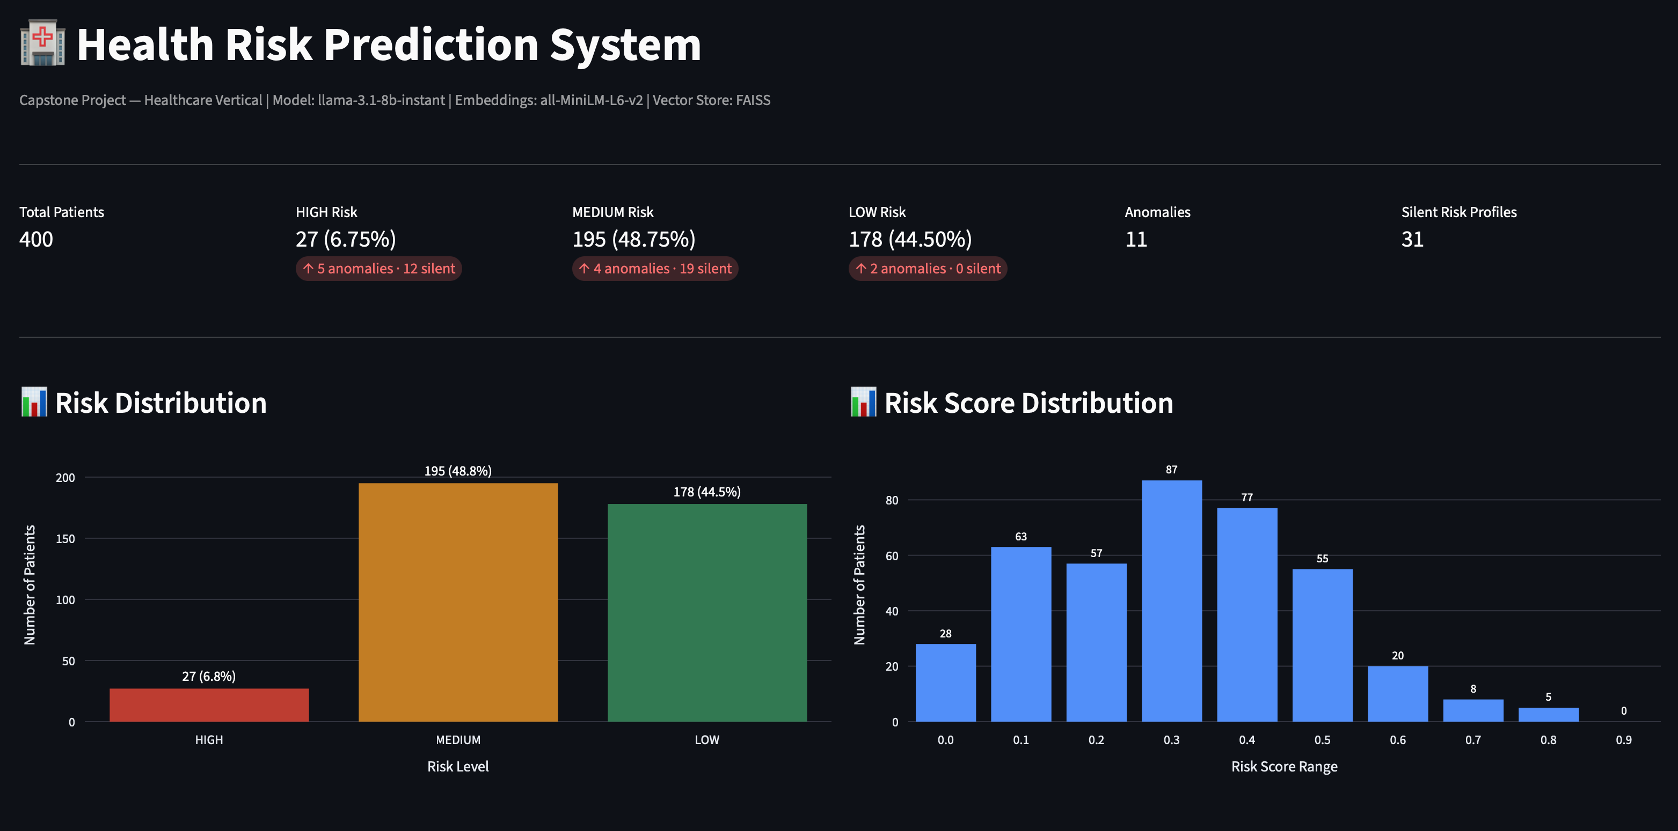
April 12, 2026
Capstone Project — Generative AI Advanced | Healthcare Vertical
Saravanan Shanmugam (207681)
Notes:
Hi, my name is Saravanan Shanmugam. This is my capstone project for the Generative AI Advanced program. I built a Health Risk Prediction System for the Healthcare vertical. The goal is to help underwriters and clinical operations teams identify high-risk patients early using AI — without needing any data science expertise.

Slide 2
Project Overview
PROJECT TITLE
Health Risk Prediction System
DOMAIN
TEAM MEMBER
GOAL
Healthcare
Saravanan Shanmugam
Emp ID: 207681
Predict patient health risk levels using
embeddings, RAG & Llama 3.1
Project Goal
Predict patient health risk levels using embeddings, RAG, and Llama 3.1, and generate plain-language risk summaries for underwriters and clinical operations teams.
Combines structured patient data with unstructured clinical notes into a unified AI pipeline — enabling early detection of silent risk profiles that traditional rule-based systems miss.
Notes:
The project title is Health Risk Prediction System, built for the Healthcare domain as part of the Generative AI Advanced program. The goal is to predict patient health risk levels using embeddings, retrieval-augmented generation, and Llama 3.1, and to surface those insights as plain-language summaries that a business team can act on immediately without needing data science expertise.

Slide 3
Business Problem & Motivation
Business Context
Stakeholders Affected
Healthcare providers and life insurance underwriters struggle to identify high-risk patients early, leading to delayed interventions and increased claim costs.
Underwriters making risk decisions
Clinical operations teams managing patient care
Patient care coordinators ensuring timely interventions
Pain Points
Expected Business Impact
Manual review of patient records is time-consuming
Unstructured clinical notes are underutilized
Silent risk profiles go undetected until a health event occurs
Early identification of high-risk patients
Reduction in claim costs
Faster underwriting decisions
Automated risk reporting replacing manual review
Notes:
Healthcare providers and life insurance underwriters struggle to identify high-risk patients early. Patient records are large, clinical notes are unstructured, and traditional rule-based systems miss patients who have dangerous risk combinations but no obvious diagnosis code — what we call silent risk profiles. This system addresses that gap by combining structured patient data with unstructured clinical notes, running them through an AI pipeline, and surfacing the highest-risk cases automatically.

Slide 4
Solution Concept
Patient Data & Clinical Notes
Embeddings & Vector Search
Risk Scoring
RAG Retrieval
LLM Summaries
Business Output
Structured + Unstructured
MiniLM-L6-v2 + FAISS
Z-score + Rule-based
Context-aware Search
Llama 3.1 8B via Groq API
Plain English for Underwriters
DATA INGESTION
AI / ML PROCESSING
GENERATIVE AI LAYER
OUTPUT
AI/ML Components
Sentence Transformer (MiniLM-L6-v2)
FAISS IndexFlatL2 vector store
Scipy Z-score anomaly detection
Rule-based risk classification
GenAI Enhancement
Groq API + Llama 3.1 8B Instant
Converts risk scores to plain English
3-sentence actionable summaries
For non-technical underwriters
Key Innovation
Combines structured + unstructured data
Single embedding input
Detects silent risk profiles
Catches what rule-based systems miss
Notes:
Our solution is an end-to-end AI pipeline. We start by combining structured patient fields like age, BMI, smoking status, and diabetes with unstructured clinical notes into a single text per patient. We then generate 384-dimensional embeddings using a Sentence Transformer model and store them in a FAISS vector store. Risk scores are calculated using a rule-based scoring system grounded in clinical risk factors. For each patient, we retrieve the three most similar historical cases from FAISS and pass them along with the patient data to Llama 3.1, which generates a plain-language business summary. The key innovation is detecting silent risk profiles — patients with high risk scores but no obvious clinical diagnosis — which traditional systems miss entirely.

Slide 5
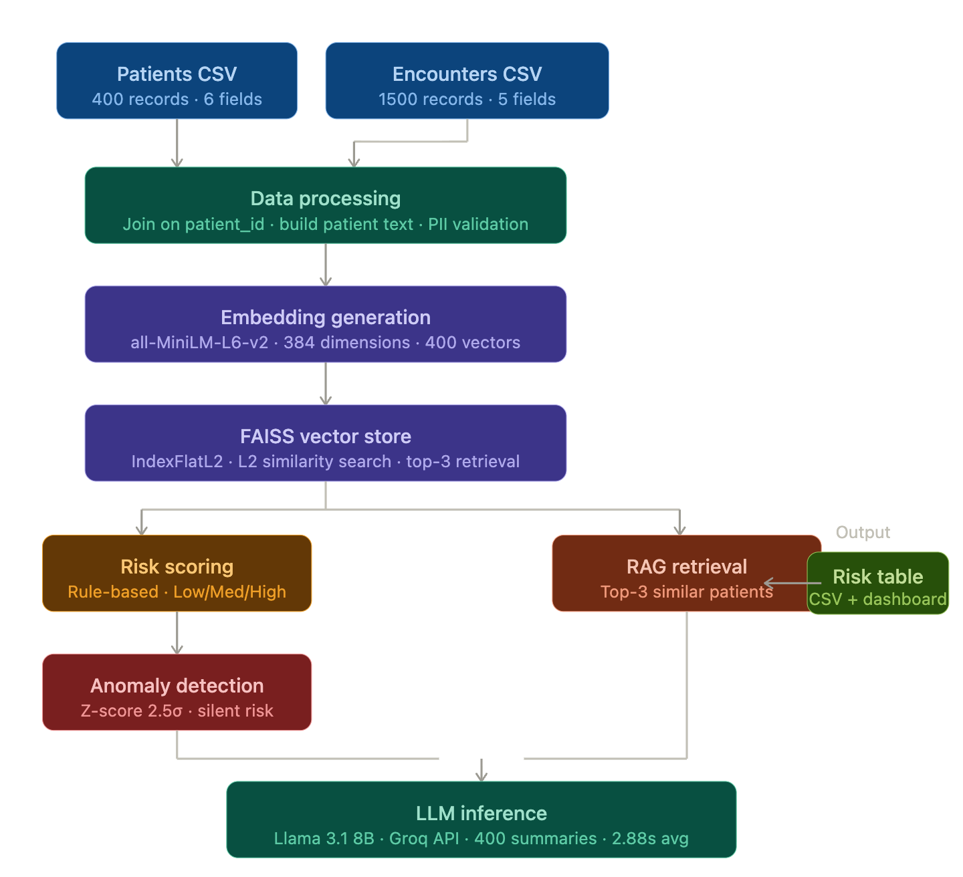
Architecture & Data Pipeline
Platform
Vector Database
VS Code + Jupyter Notebook
Groq Cloud API for LLM
No GPU required
Local Python execution
FAISS IndexFlatL2
400 vectors stored
384 dimensions per vector
L2 distance similarity
Model Orchestration
Security / Governance
Custom Python RAG pipeline
FAISS retrieval + Groq generation
No external framework
Full end-to-end control
Anonymized patient IDs
No PII in dataset (validated)
API key via env variable
LLM = decision-support only
Notes:
The architecture follows a linear pipeline from data ingestion to output. Two CSV files are ingested and joined on patient ID. The combined patient text is embedded using the all-MiniLM-L6-v2 model producing 384-dimensional vectors stored in a FAISS IndexFlatL2 index. Risk scoring runs in parallel with RAG retrieval — FAISS finds the top three similar patients which are passed as context to the LLM. Anomaly detection runs on BMI and risk score using z-score statistics. The LLM generates summaries for all 400 patients. The entire pipeline runs locally in VS Code with Groq cloud API for LLM inference — no GPU required. See the architecture diagram on this slide for the full end-to-end flow.

Slide 6
Dataset Description
Patients Dataset
Merged Dataset
400 rows
6 fields
400 rows
10 fields
patient_id, age, sex, bmi, smoker, diabetic
Course material — confirmed anonymized
5 patients with no encounter (filled defaults)
Combined into single patient text for embeddings
JOIN on patient_id
Data Preparation
Data Quality
Encounters Dataset
No missing values
PII scan: zero emails, phones, names
Top Dx Codes:
F41 Anxiety | I25 CAD
E78 Cholesterol | G47 Sleep
I10 Hypertension
Structured fields + clinical notes combined
Single text string per patient record
Input for embedding generation
1,500 rows
5 fields
encounter_id, patient_id, date, dx_code, note
395 unique patients — latest encounter only
Notes:
We used two datasets provided as course material. The patients dataset has 400 records with six fields — patient ID, age, sex, BMI, smoker, and diabetic. The encounters dataset has 1500 records across 395 unique patients covering clinical visits from January to July 2024. Since patients had multiple visits, we retained only the most recent encounter per patient, collapsing 1500 records to one per patient. The five patients with no encounter record were filled with a default note. A full PII scan confirmed no emails, phone numbers, or name patterns across all 400 records.

Slide 7
Model Design & Training
ML / LLM MODELS USED
Sentence Transformer (all-MiniLM-L6-v2)
Llama 3.1 8B Instant (Groq API)
Embedding
384 dims
No GPU
Summarization
Free tier
Zero-shot
Lightweight embedding model for text similarity
Stored in FAISS IndexFlatL2 (L2 / Euclidean distance)
Fast inference via Groq Cloud API
Prompt-engineered: role, audience, output format
Training / Fine-tuning
Embedding Logic
Anomaly Scoring
No training or fine-tuning performed
No labeled outcome column in dataset
Supervised training not possible
LLM uses zero-shot prompt engineering
Future: LoRA/QLoRA when outcome labels available
Structured fields + clinical notes combined
Single text string per patient
Stored in FAISS IndexFlatL2
L2 (Euclidean) distance for similarity
All 400 patients processed
Z-score on BMI + risk score fields
Threshold: 2.5 standard deviations
Flags top ~1.2% extreme values
Silent risk: score ≥0.60, no high-risk dx
LLM summaries for all 400 patients
Notes:
We selected two models. The Sentence Transformer all-MiniLM-L6-v2 was chosen for embedding generation because it is lightweight, runs on CPU, and produces strong 384-dimensional vector representations. Llama 3.1 8B Instant via Groq API was chosen for LLM summarization because it is fast, available on a free tier, and produces strong plain-language output. No model training or fine-tuning was performed because the dataset has no labeled outcome column — without knowing which patients actually had cardiac events or which claims were approved, there is no ground truth to train against. Llama 3.1 was used zero-shot, meaning it was guided purely through prompt engineering specifying the role, audience, output format, and patient context. The anomaly detection threshold of 2.5 standard deviations was chosen based on standard statistical outlier detection convention.

Slide 8
Evaluation & Results
Evaluation Approach: Traditional metrics (Accuracy, Precision, Recall, AUC) not applicable — no labeled outcome column. LLMOps metrics used instead.
27
HIGH Risk (6.75%)
195
MEDIUM Risk (48.75%)
178
LOW Risk (44.50%)
400 PATIENTS SCORED | KEY FINDINGS
11
Anomalies
31
Silent Risk
400
LLM Summaries
2.88s
Avg Latency
0.12
Embed Drift (STABLE)
Key Output Example
Fairness & Notes
Patient H10012 | Age 72 | Smoker | Diabetic | Dx: J45 (Asthma)
Risk Score: HIGH (0.85)
Flagged as both anomaly and silent risk
LLM recommended further investigation due to silent risk pattern detected via embedding similarity
Anomaly detection operates independently of risk scoring — 2 LOW-risk patients flagged H10315 (age 41, BMI 14.8 — severely underweight) and H10329 (age 23, BMI 40.0 — severely obese)
Decision-support only
Human review mandatory
No PII to external API
Avg tokens/call: 91
Logprobs: not supported
Future: llama-3.3-70b for confidence
Notes:
Traditional classification metrics like accuracy, precision, recall, and AUC cannot be calculated because the dataset has no labeled outcome column. Instead we evaluated using LLMOps metrics. Out of 400 patients, 27 were classified HIGH risk, 195 MEDIUM, and 178 LOW. 11 anomalies were detected — including 2 within LOW risk patients flagged on extreme BMI values, demonstrating anomaly detection operates independently of risk scoring. 31 silent risk profiles were identified — patients with high risk scores but no high-risk diagnosis code. All 400 patients received LLM-generated summaries with an average real inference latency of 2.88 seconds and 91 tokens per call. Model confidence scoring was not available because the llama-3.1-8b-instant model on Groq does not support logprobs.

Slide 9
Demonstration / Prototype
Patient Records
Embedding + Vector Store
Risk Scoring + Anomaly Detection
RAG + LLM Inference
Business Action
STREAMLIT DASHBOARD | LIVE DEMO FEATURES
KPI Overview
Risk Distribution
Patient Risk Table
400 patients processed
27 HIGH / 195 MED / 178 LOW
11 anomalies detected
31 silent risk profiles
Interactive bar + pie charts
Risk level counts with labels
Visual breakdown by category
Color-coded severity bands
Filterable by risk level, sex, age
Anomaly + silent risk flags
Sortable columns
Export-ready dataset view
LLM Summary Panel
Anomaly Report
LLMOps Pipeline
Select patient ID to view summary
Plain-language risk narrative
RAG-grounded with 3 similar cases
E.g. H10012: anomaly + silent risk
All 11 flagged patients listed
2 LOW-risk caught on extreme BMI
Z-score details per patient
Independent of risk scoring
Real latency: avg 2.88s
Real tokens: avg 91 per call
Drift chart with 0.25 threshold
Current drift: 0.12 (STABLE)
Platform: VS Code + Jupyter | Groq Cloud API | Local FAISS | Streamlit Dashboard
Notes:
The pipeline flow starts with raw patient and encounter CSV files, combines them into a single patient text per record, generates embeddings, stores them in FAISS, scores risk, detects anomalies, retrieves similar cases, and produces plain-language LLM summaries. The Streamlit dashboard provides a business-team-friendly interface showing risk distribution charts, a filterable patient risk table, individual LLM summaries searchable by patient ID, an anomaly report, a silent risk profiles report, and LLMOps metrics including real latency, token count, and embedding drift monitoring. Screenshots in this slide show the actual outputs from our pipeline run on all 400 patients.

Slide 10
Responsible AI & LLMOps Practices
NIST AI RMF ALIGNMENT
1
GOVERN
2
MAP
3
MEASURE
4
MANAGE
LLM outputs treated as decision-support only. Human review mandatory before clinical or underwriting action.
Use case scoped to healthcare risk prediction. Business audience: underwriters and clinical ops teams.
Real latency: 2.88s avg. Token count: 91 avg. Embedding drift: 0.12 (STABLE, threshold 0.25).
Anomalies flagged automatically. Silent risk surfaced for human review. Retrain if drift exceeds 0.25 for 2 consecutive runs.
Guardrails
Monitoring
Explainability
All 400 patients analyzed — none excluded
RAG-grounded summaries (3 similar cases) reduce hallucination risk
API key via env variable, not hardcoded
Full PII scan: zero emails, phones, names detected. Dataset pre-anonymized.
Prod: Presidio / AWS Comprehend Medical for runtime PII scrubbing
Latency: avg 2.88s per inference (real API time)
Tokens: avg 91 per call (Groq API usage)
Embedding drift: 0.12 via KL-divergence (threshold 0.25)
Confidence: N/A — logprobs not supported by llama-3.1-8b-instant
Future: llama-3.3-70b-versatile for logprob-based scoring
Every LLM summary references specific risk factors
Similar historical cases via FAISS provide transparency
Anomaly + silent risk flags documented in output
Prod: clinical guidelines KB as additional RAG grounding source
Notes:
We aligned the project design with NIST AI RMF principles across all four functions — Govern, Map, Measure, and Manage. Full organizational compliance is beyond the scope of a capstone but the spirit of each function is implemented. Key guardrails include generating summaries for all patients with no exclusions, grounding every LLM output in retrieved FAISS context to reduce hallucination, managing the API key via environment variable, and conducting a full PII scan across all 400 records before any data was sent to an external API. LLMOps monitoring tracks real latency and token count per inference. Embedding drift is monitored using KL-divergence with a retraining threshold of 0.25. Model confidence scoring was explored via logprobs but is not supported by the current model — this is documented as a future enhancement.

Slide 11
Business Value & Future Enhancements
QUANTIFIED BUSINESS BENEFITS
27
High Risk Identified
31
Silent Risk Detected
11
Anomalies Flagged
400
LLM Summaries
2.88s
Avg Inference Time
1
Streamlit Dashboard
Key Learnings
Limitations
Future Enhancements
Combining structured + unstructured data produces richer risk signals
Silent risk via embeddings is more powerful than dx code matching alone
PII validation should be evidence-based: full dataset scan, not assumption
LLM summaries for all patients ensures no borderline case is missed
No labeled outcome data — risk scores are rule-based, not learned from actual health events
Silent risk threshold (0.60) may miss borderline LOW risk patients
Model confidence unavailable — logprobs not supported on Groq
Collect labeled outcomes for LoRA/QLoRA fine-tuning
Switch to llama-3.3-70b for logprob confidence scoring
Microsoft Presidio for runtime PII scrubbing
Feature-based silent risk detection (beyond threshold)
Expand to life insurance underwriting domain
Add clinical guidelines KB as RAG grounding source
Notes:
The system delivers measurable business value — 27 high-risk patients identified for proactive intervention, 31 silent risk profiles surfaced that traditional systems would miss, 11 anomalies flagged including 2 in low-risk patients caught purely on extreme BMI, and 400 plain-language summaries generated at 2.88 seconds per patient. Key learnings include the value of combining structured and unstructured data into a single embedding, the power of FAISS similarity search for silent risk detection, and the importance of evidence-based PII validation. The main limitation is the absence of labeled outcome data which prevents supervised model training. Future enhancements include collecting labeled outcome data for LoRA fine-tuning, switching to a logprobs-compatible model for real confidence scoring, implementing Microsoft Presidio for production PII scrubbing, and expanding the same pipeline to the life insurance underwriting domain.

