Slide 1


Web Programming and Problem Solving
JavaScript Basics
Date: 10.10.2022
Instructor: Zhandos Yessenbayev

Slide 2
Content
Introduction
Variables
Types
Operators
Arrays
Objects

Slide 3
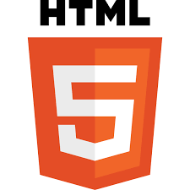
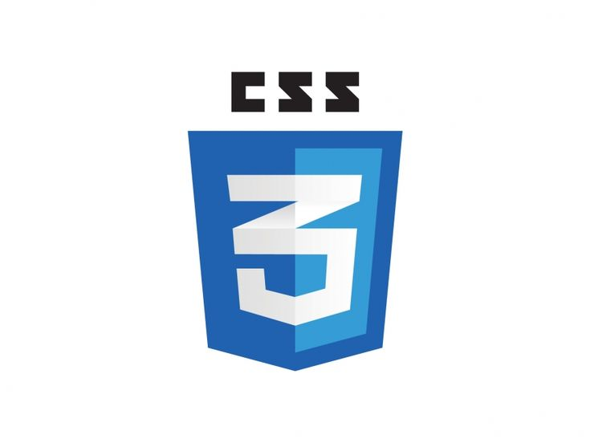

HTML, CSS, Javascript
Hyper-Text Markup Language (HTML) is the standard markup language for documents designed to be displayed in a web browser.
It describes the structure of the web page
Cascading Style Sheets (CSS) is a stylesheet language used to describe the presentation of a document written in HTML.
It describes the style of the web page
JavaScript (JS) is a lightweight and interpreted programming (or scripting) language for Web pages.
It adds behavior to the web page

Slide 4

Brief History
Brendan Eich (/ˈaɪk/), born July 4, 1961, co-founder of the Mozilla project, CEO of Brave Software, created the JavaScript programming language in 1995.
ECMAScript (ES) is a JavaScript standard intended to ensure the interoperability of web pages across different browsers.
ECMA 262, …, ES5, ES6, …, ES2022

Slide 5
What is JS used to?
JavaScript can be used to:
Change the behavior of the web application
Change HTML content
Change HTML attribute values
Change HTML styles (CSS)
Hide/Show HTML elements
Do other computations

Slide 6
How to use JS?
Browsers understand JavaScript by default, so there is no need to install anything
To incorporate your JavaScript program in your web page,
wrap it with <script> tag in the <head> or <body> sections
link it as an external file in the <head> section
<script src=“myprogram.js”></script>

Slide 7
How to see the output?
Programs can output the intermediate results or other information to users (e.g. debugging):
Directly into HTML, using innerHTML property
document.getElementById("demo").innerHTML = “Hello, World!”
In pop up message using alert() function
alert(“Hello, World!”))
To the browser’s console using console.log() function
console.log(“Hello, World!”)

Slide 8
Variables
Variables are containers (pointers) that store data values of the program
They can be declared using var, let, or const
They must have unique names (identifiers)
Names can contain letters, digits, underscores, and dollar signs.
Names must begin with a letter.
Names can also begin with $ and _ (but we will not use it in this tutorial).
Names are case sensitive (y and Y are different variables).
Reserved words (like JavaScript keywords) cannot be used as names.

Slide 9
Variables
Variable declarations:
var x = 3 + 2; // x is 5
let y = 10; // y is 10
const PI = 3.14; // PI is “3.14”
msg = ”Hello!”; // z is 15
Variables declared with let and const cannot be redeclared.

Slide 10
Types
There are six primitive data types:
Number: integer or decimal numbers – a = 20, b = 3.5
String: some text – s = “Hello, World!” or empty string - t = “”
Boolean: true or false – y = true
undefined: a variable which is declared but doesn’t contain value – let x;
null: a variable with no value assigned to it – p = null
Symbol: unique symbolic value (not covering here)

Slide 11
Operators
There are different types of operators:
Assignment Operators
let name = “Tom”; x = 3; y = name;
Arithmetic Operators
a = 2 + 3; b = 4 * 5 / 2 - 1; x = “Hello”; y = “World”; z = x + y;
Comparison Operators
a > 0; a < 0; a == 0;

Slide 12
Arrays
Array is a data type to store ordered values (possibly different).
To create an array, use square brackets: const A = [”Tom”, 25, 30]
Elements in the array are indexed by numbers (starting from 0): let x = A[0] // x stores “Tom”
Changing values in the array: A[1] = 20 // A = [”Tom”, 20, 3]
Adding new element: A.push(“John”); A[10] = 100;
The number of elements: let n = A.length; let k = A[n-1];

Slide 13
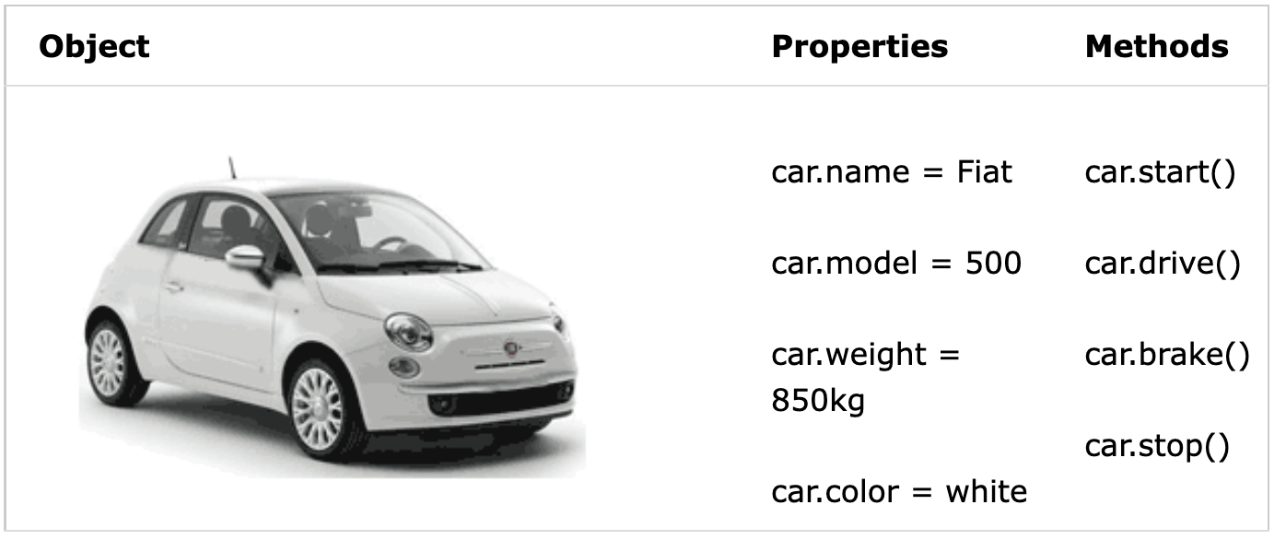
Objects
Object is a complex data type which stores values by their keys. The objects may have properties and methods.

Slide 14
Objects
Working with objects
To create an object, use curly brackets and key:value pairs: const car = { name: “Fiat”, // note ending comma color: “white”, }
To access properties, use dot notation or square brackets: let x = car.name; car[“color”] = “black”;

Slide 15
Summary
Key takeaways:
There are several ways to output data and info
Variables are used to store values in program
There are six primitive data types
Operators can be used to manipulate data
Arrays can store ordered list of values
Objects can store values by their keys

Slide 16
Thanks for Attention!

