Slide 1


Web Programming and Problem Solving
Responsive Web Design
Date: 19.09.2022
Instructor: Zhandos Yessenbayev

Slide 2
Content
Responsive Web Design
What is RWD?
Main Strategies
Media Queries
Flexible Layouts
Grid View
Responsive Images
Relative Units
Viewport

Slide 3
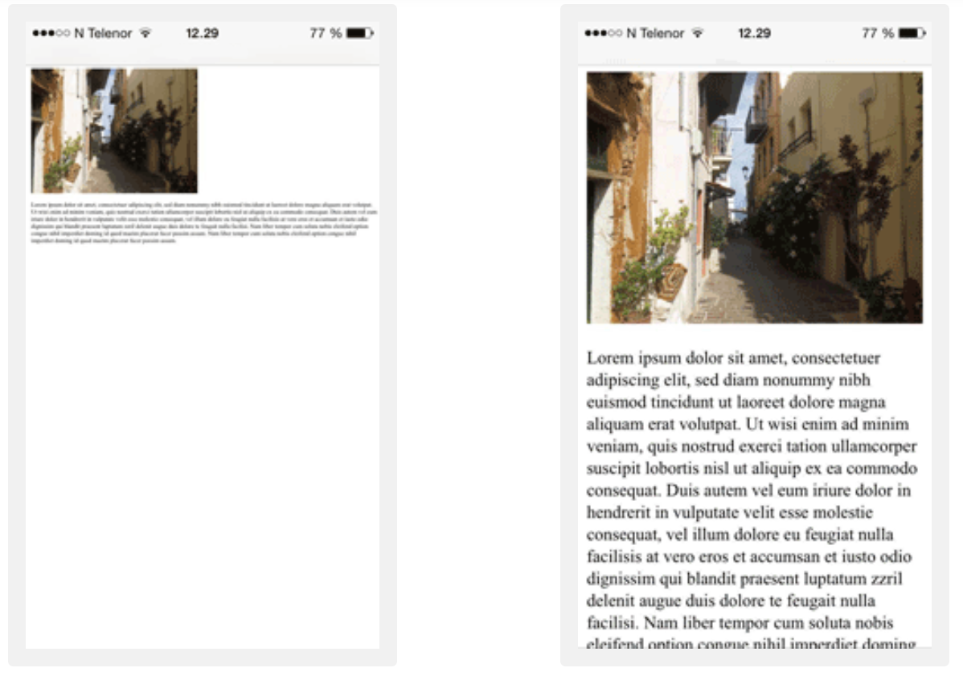
What is Responsive Web Design?

Slide 4
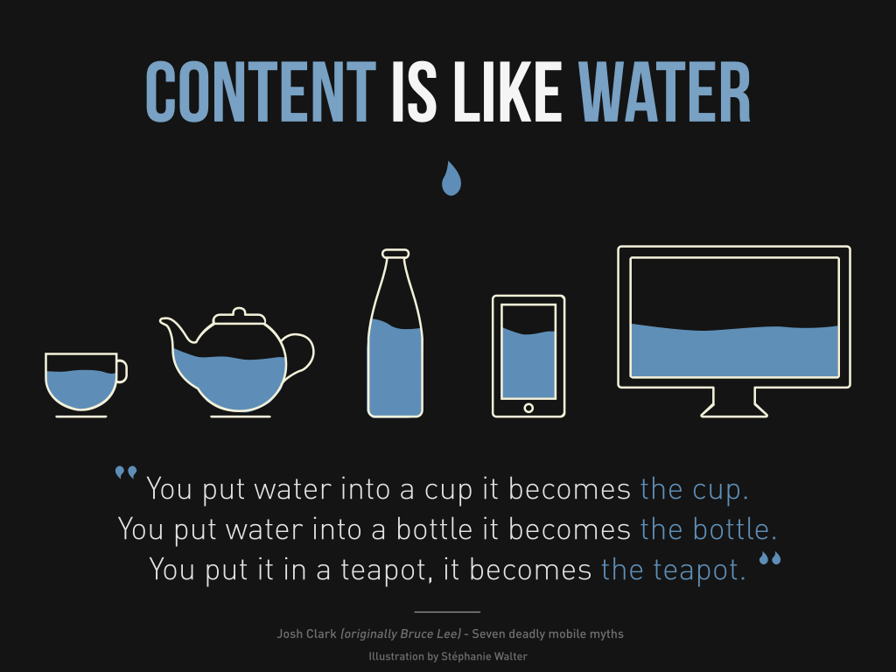
What is Responsive Design?
Responsive web design refers to a design strategy to make websites render correctly for various devices (mobile, tablet, and desktop).

Slide 5
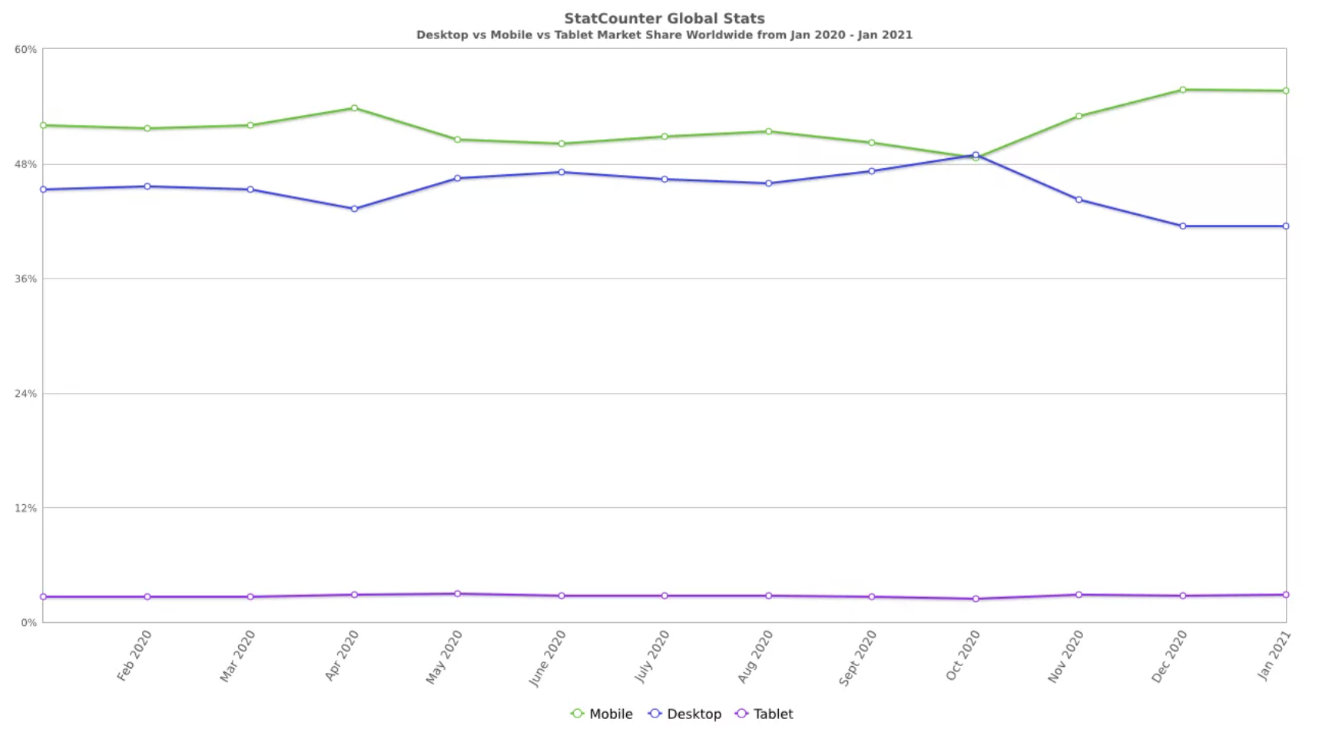
Device Statistics

Slide 6
Main Strategies
Here are some main strategies:
Media queries
Flexible layouts
Grid View
Responsive images
Relative units
Viewport

Slide 7
Media queries
Media queries are @media rules used to change CSS properties if some conditions are true
@media not|only mediatype and
(mediafeature and|or|not mediafeature) { CSS-Code; }
mediatype: all, print, screen, speech
mediafeature: max-width, min-width, orientation, etc.

Slide 8
Media queries
Media queries use breakpoints (screen sizes) to decide how content needs to be rendered
Common breakpoints (in pixels):
Mobile: up to 767
Tablet: 768 – 1023
Desktop: 1024 – 1179
Desktop (extra): 1200 +
@media screen and (min-width: 768px) { p {
width: 100%; background-color: lightblue; } }

Slide 9
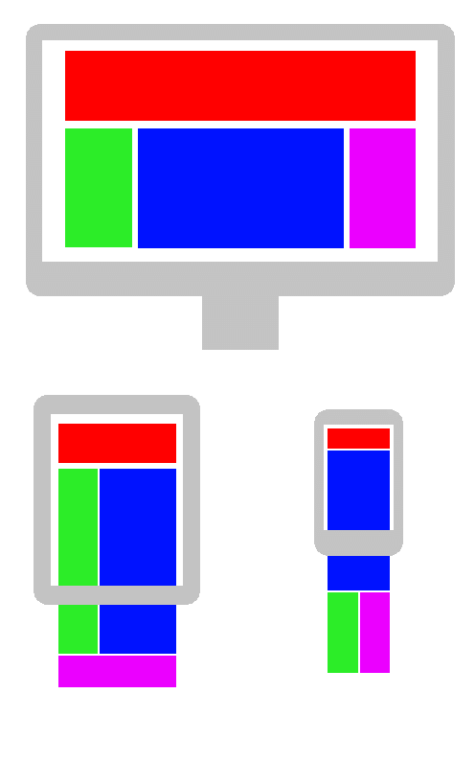
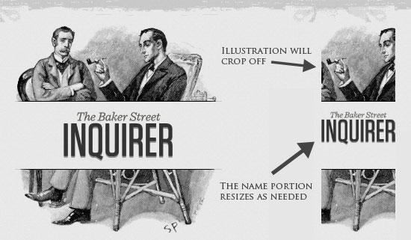
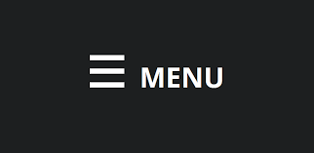
Flexible layouts
Website layout can be optimized for a a device’s screen size:
reposition elements
resize elements (images)
hide or partially show elements

Slide 10
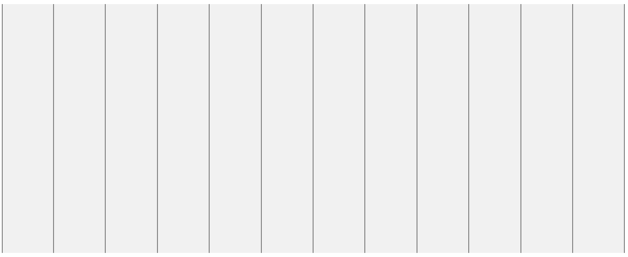
Grid View
Many web pages are based on a grid-view, which means that the page is divided into columns:
a responsive grid-view often has 12 columns
the percentage for one column: 100% / 12 columns = 8.33%
the columns should be floating to the left and other elements cleared
make one class for each of the 12 columns: .col-1 {width: 8.33%;}, etc.
The columns should be wrapped with a row, where they add up to 12

Slide 11
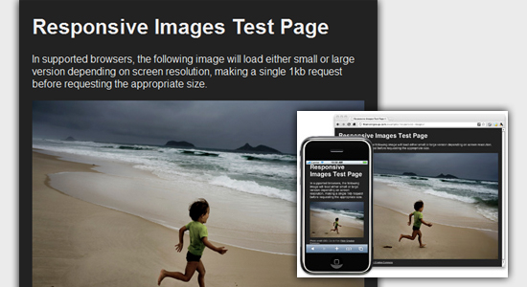
Responsive images
Some techniques to make images responsive:
Set max-width and height
Use picture and srcset
Vectors (svg) vs Bitmap (jpg)
img {
max-width: 100%;
height: auto
}
<picture> <source srcset="small.jpg" media="(max-width: 768px)"> <source srcset=”medium.jpg" media="(max-width: 1024px)"> <source srcset=”large.jpg"> <img src=”medium.jpg" alt=”Medium image"> </picture>

Slide 12
Relative units
Use relative units for width/height, font size, etc.
percentage (width: 100%)
em (font size: 1 em)
vw, vh, vmin, vmax (height: 100vh)

Slide 13
Viewport
One more important addition to RWD strategy is to add the following magic line in HTML code:
<meta name="viewport"
content="width=device-width, initial-scale=1.0">
The viewport is the user's visible area of a web page.
Content is sized to the viewport and the scaling factor set to 1

Slide 14
Summary
Key takeaways:
Content is like water, so target all types of devices (mobile, tablet, dektop)
To make your website responsive, use:
Media queries
Flexible layouts
Grid view
Responsive images
Relative units
Viewport

Slide 15
Thanks for Attention!

