Slide 1


Web Programming and Problem Solving
DOM Manipulation
Date: 09.11.2022
Instructor: Zhandos Yessenbayev

Slide 2
Content
Introduction
Finding Elements
Element Manipulation
Content Manipulation
Attribute Manipulation
Style Manipulation
Class Manipulation

Slide 3
What is DOM?
The HTML DOM is a standard object model and programming interface for HTML document.
DOM defines:
The HTML elements as objects
The properties of all HTML elements
The methods to access all HTML elements
The events for all HTML elements

Slide 4
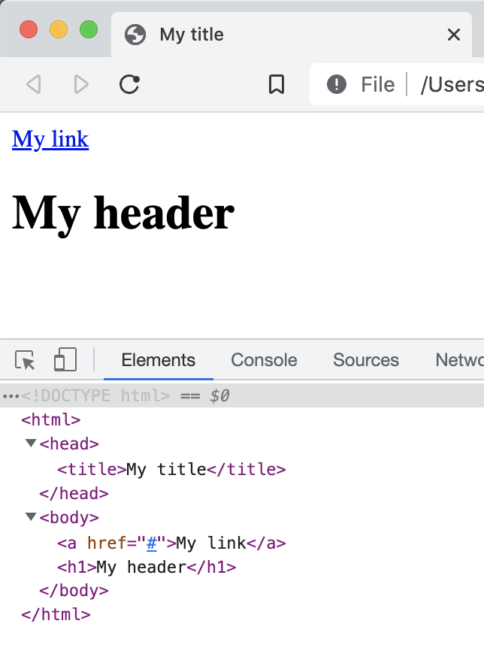

What is DOM?
<!DOCTYPE html>
<html>
<head>
<title>My title</title>
</head>
<body>
<a href="#">My link</a>
<h1>My header</h1>
</body>
</html>
Browser View
Graphical View
HTML View

Slide 5
Document Object
The main object in the DOM is document. All the elements are accessible via document.
Main methods to access elements:
Finding elements
Creating elements
Adding elements
Deleting elements

Slide 6
Finding elements
The elements in DOM can be found by element’s ID, tag and class names, CSS selector:
document.getElementById( <element_id> )
document.getElementsByTagName( <tag_name> )
document.getElementsByClassName( <class_name> )
document.querySelectorAll( <CSS selector> );
Note that the last three methods return an array of elements

Slide 7
Element Manipulation
The main methods to work with elements are:
document.createElement( <element> )
document.removeChild( <element> )
document.appendChild( <element> )
document.replaceChild( <new_element>, <old_element>)

Slide 8
Element Manipulation
Example: Adding a header element to the body
// print the initial document object
console.log(document);
// create an HTML element - h1
let h1 = document.createElement("h1");
// append the h1-element to the body-element
document.body.appendChild(h1);
// print the final document object
console.log(document);
Note that the header element has no text, i.e. it is empty

Slide 9
Content Manipulation
There are two basic properties to manipulate content
of the elements (add, clear):
innerText
innerHTML
// print the initial document object
console.log(document);
// create an HTML element - h1
let h1 = document.createElement("h1");
// create an HTML element - h1
h1.innerText = ”<i>Header Text</i>"
// append the h1-element to the body-element
document.body.appendChild(h1);
// print the final document object
console.log(document);
NOTE:
With innerHTML, the content is treated
as an HTML content, i.e.properly
decoding HTML tags.
With innerText, the content is treated
as pure text.

Slide 10
Attribute Manipulation
The attributes of an HTML element can be accessed and manipulated using:
getAttribute( <attribute_name> )
setAttribute(<attribute_name>, <attribute_value> )
// create an HTML element - a
let a1 = document.createElement("a");
a1.setAttribute("href", "https://w3schools.com");
a1.innerText = "W3Schools";
document.body.appendChild(a1);
Note: getAttribute() method returns null if there is no requested attribute

Slide 11
Style Manipulation
To change CSS style of an element, style property (attribute) can be used.
Note: CSS property with dash are converted to camel case:
Ex: background-color -> backgroundColor
let p1 = document.createElement("p");
p1.innerText = "This is the first paragraph!";
p1.style.color = "red";
p1.style.backgroundColor = "yellow";
document.body.appendChild(p1);

Slide 12
Class Manipulation
The elements might define several classes which can be accessed using classList property
classList returns a list of all the classes
classList itself has methods to add(), remove() and toggle() a class
// add and remove a class to the element
let btn1 = document.getElementById("btn1");
console.log(btn1.classList);
btn1.classList.add("btn");
console.log(btn1.classList);
btn1.classList.remove("btn");
console.log(btn1.classList);

Slide 13
Summary
Key takeaways:
DOM is a standard way to work with HTML document
document object is used to access other elements
With JavaScript all the elements, their content, attributes, styles and classes can be accesses and manipulated.

Slide 14
Thanks for Attention!

