Slide 1


Web Programming and Problem Solving
CSS (part 2)
Date: 12.09.2022
Instructor: Zhandos Yessenbayev

Slide 2
Content
CSS selectors
DOM-based
Pseudo-class
Pseudo-elements
Conflict Resolution

Slide 3
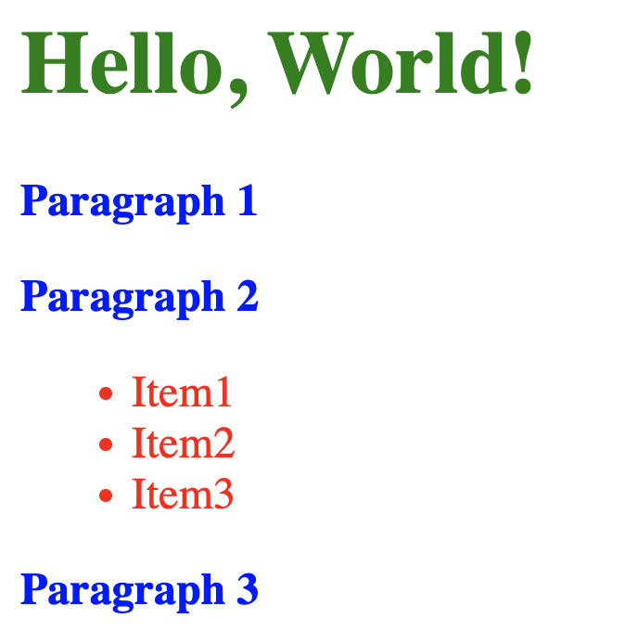
CSS Selectors
What if we want to change a particular paragraph?
How do we select a specific element?
What if one element is changed in several places?
How to resolve the conflicts?

Slide 4
CSS Selectors
To distinguish between elements, we use selectors:
Element Types (Tags)
Element Classes
Element Attributes
Element IDs
DOM-based
Pseudo-class
Pseudo-elements

Slide 5
Element Selectors
Selection of one or more elements:
body {
margin: 0;
padding: 0;
}
h1, p {
color: blue;
font-size: 12pt;
}
Selects and changes the properties of body element
Selects and changes the properties of h1 and p elements
(Note the comma in between)

Slide 6
Class Selectors
Class is an identifier that can group together multiple elements
<p class="second"> … </p>
<li class="second item"> … </li>
Definition of the class second
for two elements. Elements can
belong to several classes.
.second {
color: red;
}
li.item {
color: purple;
}
Selects the elements with
the specified class
(second or item)
Note a dot before class name

Slide 7
Attribute Selectors
Selection of the elements by their attributes
h1[style] {
text-align: center;
}
li[name] {
color: gray;
}
li[name="item1"] {
color: orange;
}
Selects all h1 tags with their
style attribute defined
Selects all li elements with
their name attribute defined
as well as those which have
specific value for name attribute

Slide 8
ID Selectors
ID is an identifier of an element unique within the document
<p id=”last"> … </p>
Assignment of ID to the element
#last {
color: red;
font-size: 15pt;
}
Selects the elements by its ID
Note a hash before the ID

Slide 9
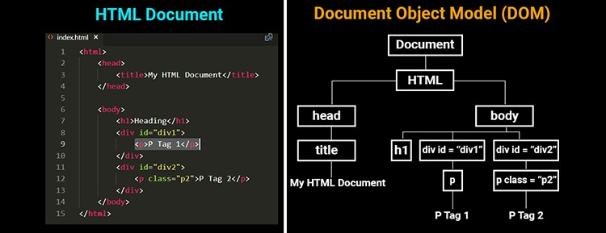
DOM
HTML document can be viewed as a tree-like structure.
This structure is represented as Document Object Model (DOM) in memory
Elements are called nodes, such as:
Root (Document)
Parent
Child/Children
Siblings (head, body)

Slide 10
Children Selectors
To select direct children of some element, use > :
ul > li {
color: red;
}
Selects only the direct li elements of ul
To select any other direct child of some element:
body li {
color: green;
}
Selects all li elements of body

Slide 11
Pseudo-Class Selectors
A pseudo-class is used to define a special state of an element.
/* unvisited link */ a:link { color: red; } /* visited link */ a:visited { color: green; } /* mouse over link */ a:hover { color: hotpink; } /* selected link */ a:active { color: blue; }
The syntax:
a tag’s states
selector:pseudo-class { property: value; }

Slide 12
Pseudo-Class Selectors
To select the first child of an element:
ul li:first-child { color: blue; }
To select the n-th child of an element:
ul li:nth-child(3) { color: green; }

Slide 13
Pseudo-Element Selectors
A pseudo-element is used to style specified parts of an element.
p::first-letter { color: red; } p::first-line { color: black; } p::selection { color: red; background: yellow; }
::marker { color: orange; }
The syntax:
selector::pseudo-element { property: value; }
Note double colon in syntax

Slide 14
Conflict Resolution
Application of CSS rules depends on three main concepts:
Cascade
Inheritance
Specificity
To resolve the conflicts, we need to understand them well.

Slide 15
Cascade
Cascade is a concept which means that the origin and the order of CSS rules matter, i.e. the latest rules is applied
h1 { color: blue; }
/* this rule overrides
the previous rule */
h1 { color: green; }
Source order only matters
when the specificity weights
of the rules are the same!

Slide 16
Specificity
Specificity is the weight that the browser uses to decide which property value is applied to an element.
Weight is composed of 4 numbers based on
the location of a rule and the number of appearance of the selectors
Inline style | ID selector | Class, pseudo-class, attribute selectors | Element, pseudo-element selectors
More important
Less important

Slide 17
Specificity
Selector | Inline | ID | Class | Element | Specificity
h1 | 1 | 0 | 0 | 1 | [1,0,0,1]
p | 0 | 0 | 0 | 1 | [0,0,0,1]
p.second | 0 | 0 | 1 | 1 | [0,0,1,1]
ul li:first-child | 0 | 0 | 1 | 2 | [0,0,1,2]
#last | 0 | 1 | 0 | 0 | [0,1,0,0]
#last{ color: blue; }
body p:last-child{ color: green; }
vs

Slide 18
Inheritance
Inheritance means that elements can inherit the properties defined in their parents or ancestors.
Some properties can’t be inherited like weight or margin.
CSS provides five special property values for elements:
inherit – turn on inheritance
initial – property’s default
revert – browser's default
revert-layer – previous layer
unset – set to inherit or initial
body { color: blue; }
/* revert to browser’s
default value*/
h1 { color: revert; }

Slide 19
!important
Importance is the mechanism to apply a rule no matter what the order, specificity or inheritance of other rules
h1 { color: blue !important; }
/* this rule is not applied */
h1 { color: green; }
However, it is not recommended
to use it unless really necessary

Slide 20
Summary
Key takeaways:
The selection can be done:
using element’s type, class, attributes and ID
based on DOM (structure of HTML)
Using psedo-classes and pseudo-elements
Three concepts are important in conflct resolution
Cascade
Specificity
Inheritance
Use important keyword only when really necessary

Slide 21
Thanks for Attention!

