Slide 1


Web Programming and Problem Solving
CSS (part 3)
Date: 14.09.2022
Instructor: Zhandos Yessenbayev

Slide 2
Content
Box Model
Box anatomy
Overflow
Box sizing
Positioning the Elements
Display
Float
Position
Website Layout
Multi column pages

Slide 3
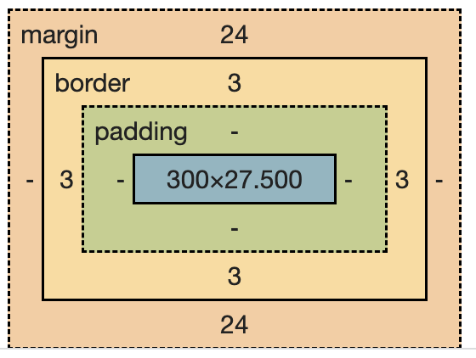
Box Model
The CSS Box Model is a box that wraps around every HTML element.
Components of Box Model:
Content - actual content of the box.
Padding – transparent area around the content.
Border – a border around the padding and content
Margin – transparent rea outside the border.

Slide 4
Box Model
Some properties of Box Model:
For margin, padding and border, we can define values separately for the properties such as top, right, bottom and left or use the shorthand notations
margin-top: 20px;
margin: 50px 30px 50px 30px;
If two elements have facing margins, the maximum of two gets applied
If the content is not fitting the box, use overflow property
auto value adds a scrolling
hidden value hides the extra part of content

Slide 5
Box Sizing
Some properties of Box Model:
The width and height properties depend on box-sizing property
content-box includes only content and not borders and padding
border-box includes borders, padding and content (recommended way)
By default, box-sizing is not inherited by children
Use the universal selector * to set box-sizing for each element
* {
box-sizing: border-box;
margin: 0;
padding: 0;
}
Applied to all elements

Slide 6
Positioning the Elements
Normal Document Flow defines the positions of elements on the screen depending on their place in HTML document.
We can change this flow using positioning properties such as:
display
flow
position

Slide 7
Display
Display property defines how the box model is displayed:
block starts from the new line and occupies it all
inline is placed on the same line where defined (some box properties are ignored like margin-top)
inline-block behaves like a block and inline elements
flex makes the elements inside it to line up (float)

Slide 8
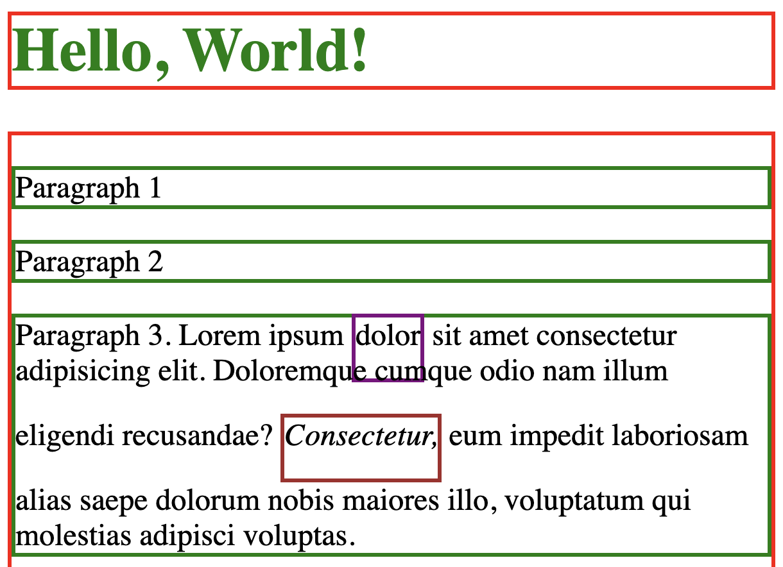
Display
Block elements
Inline element
Inline-block element

Slide 9
Float
The float property specifies how an element should float:
Elements can float to the right or left (none is default)
Floated elements are removed from the Normal flow
The next element occupies the free space of the floated element
The clear property prevents the next element from occupying free space of the floating element

Slide 10
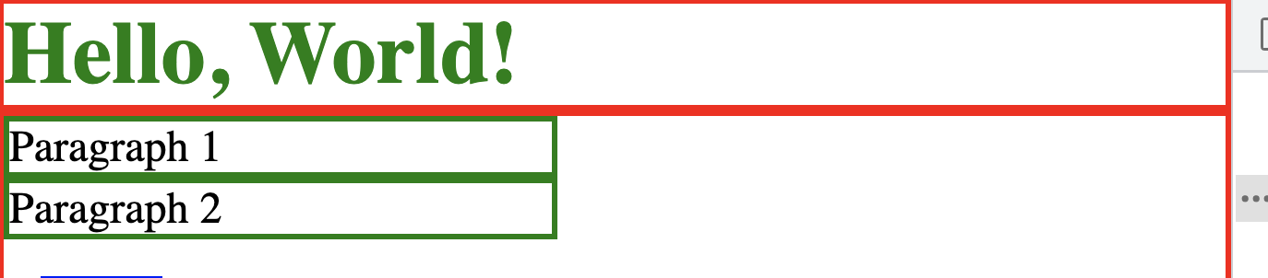
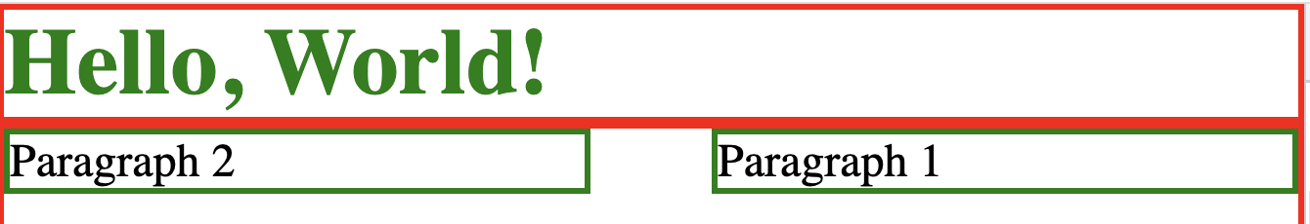
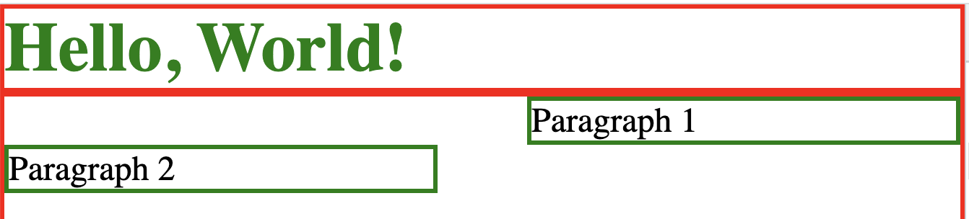
Float
Elements in Normal flow,
not floated
Paragraph 1 is floated to the right
Paragraph 1 is floated to the right,
Paragraph 2 is cleared

Slide 11
Position
Position property specifies the type of positioning method used for an element:
static - positioned according to the normal flow (default)
relative - positioned relative to its normal position (preserves space)
absolute - positioned relative to the nearest positioned ancestor (removes space)
fixed - positioned relative to the viewport (removes space)
sticky - positioned based on the user's scroll position (as relative or fixed)
Elements are positioned using the top, bottom, left, and right properties.

Slide 12
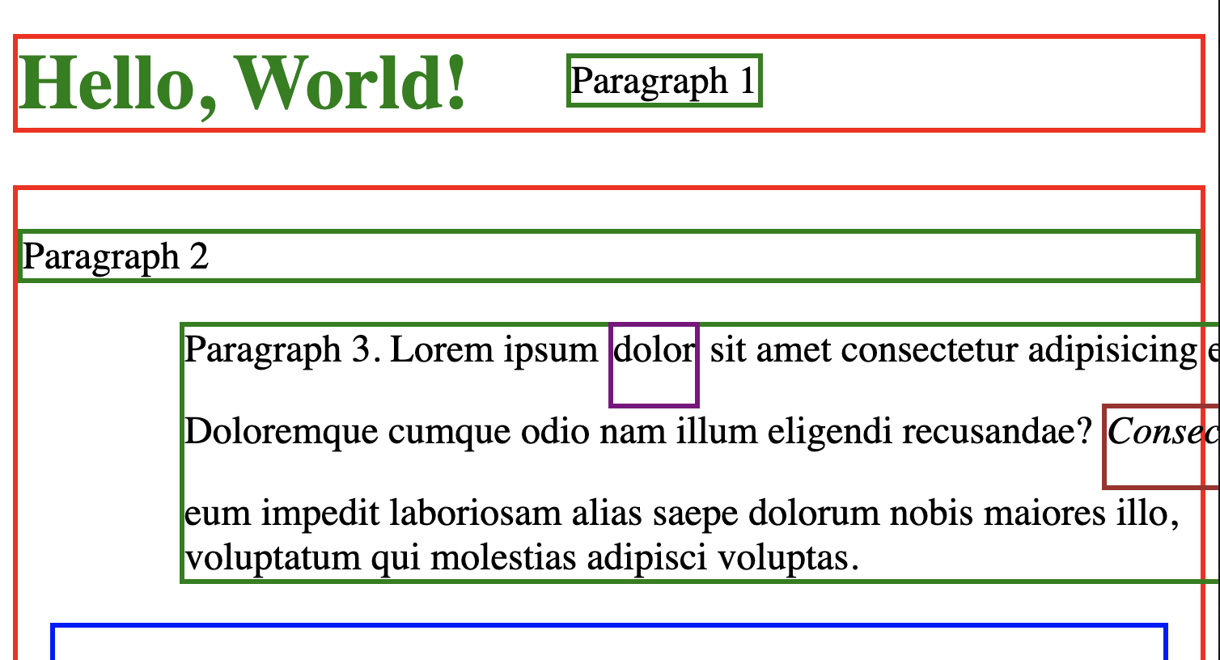
Position
Paragraph 1 is absolute
Paragraph 2 is static
Paragraph 3 is relative
Notes:
To use absolute position, you need to define position property on some ancestor
html element by default defines position relative

Slide 13
Website Layout
We can restructure our HTML document to have different layouts depending on:
content (primary, secondary)
semantics (header, navigation, content, footer)
screen size (desktop, tablet, mobile)
Let’s have a look at a typical desktop layout

Slide 14
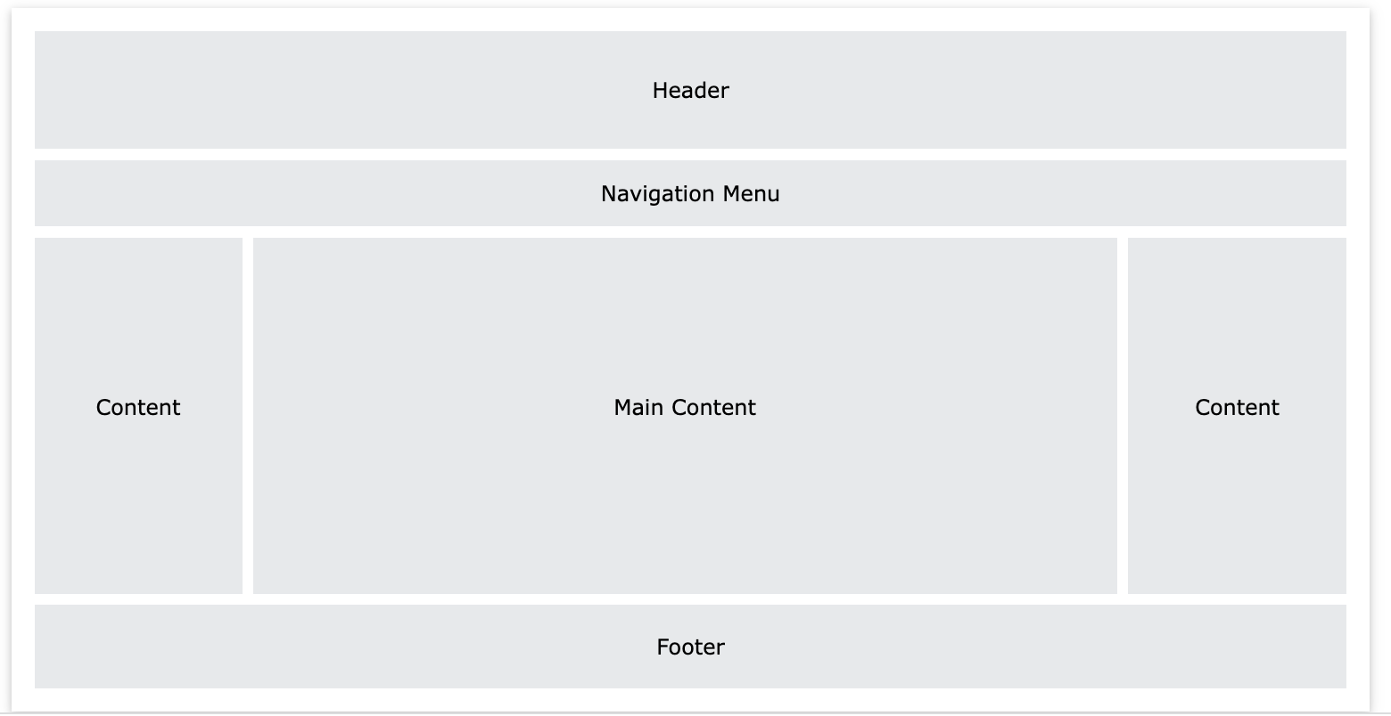
Website Layout
One of the typical layouts for big screen

Slide 15
Website Layout
Several ideas to mention:
Use semantic elements (header, nav, footer, section)
Header,, nav and footer are block elements, i.e. take all line
To make multi-column page:
use flex property on the containing element (section)
define column width in percentage (e.g.: 25%-50%-25%)
See the code (index_layout.html, style3.css)
Note: there are other solutions as well

Slide 16
Summary
Key takeaways:
The Box Model :
Understand the structure of Box
Use overflow property to take care of extra content
Use box-sizing property carefully
Positioning elements on the page can be done using:
Display
Float
Position
Website layouts depend on several factors (content, screen)

Slide 17
Thanks for Attention!

