Slide 1
Prediction of High Poverty-Stricken Schools
Derek Nguyen, Yessica Gaona, Ian Roquebert, James Helgren

Slide 2
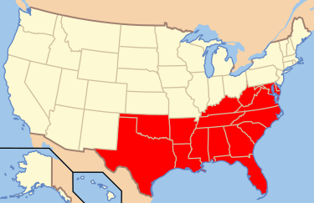
Introduction
We are interested in answering if the number of students that qualify for Free/Reduced school lunches is a better indicator than Title I designation for predicting high poverty in schools.
We gathered data from the Common Core of Data (CDD) which is the Department of Education's primary database on public elementary and secondary education in the US.
Focus on South region of the U.S:
  Alabama, Arkansas, Delaware, Florida, Georgia, Kentucky, Luisiana, Maryland, Mississipi, North Carolina, Oklahoma, South Carolina, Tennessee, Texas, Virginia, and West Virginia.

Slide 3
Questions
What states have the highest percentage of strict poverty schools?
What features are the best indication of poverty?
How is the distribution of poverty with respect to state?

Slide 4
Brief Overview of the Data
Table generator made gathering data more efficient than working with raw data files, however not as many features were available.
Title 1 designation was not available for school years before 1998.
  "Indicators of charter, magnet, Title I, and schoolwide Title I schools were added to CCD in 1998-99, and they are presented without further editing or imputation in the Longitudinal Database"
We gathered data year by year then concatenated years for each section:
Ground Truth Labeling | Feature Selection | Modeling | Model Selection | Testing
1998-2003 | 2003-2006 | 2006-2015 | 2015-2018 | 2018-2020

Slide 5
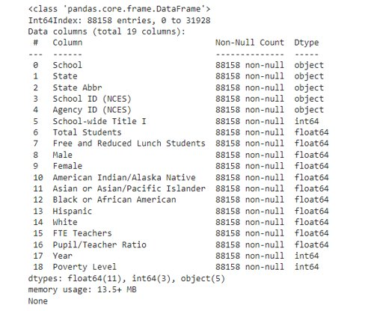
Data Cleaning
19 columns before data cleaning and normalization
Removed rows with missing values; non-numeric and not applicable data represented by:
† indicates that the data are not applicable.
– indicates that the data are missing.
‡ indicates that the data do not meet NCES data quality standards.

Slide 6
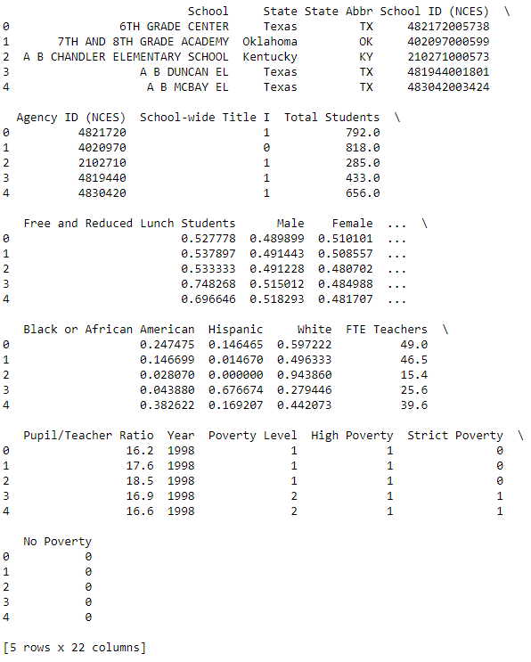
Normalization
Normalized Features
  Free and Reduced Lunch Students
  Male
  Female
  American Indian/Alaska Native
  Asian or Asian/Pacific Islander
  Black or African American
  Hispanic
  White
To normalize these features, we divided by 'Total Students' column, then we deleted it.
Eliminated 'FTE Teachers' because we will use 'Pupil/Teacher Ratio' instead.

Slide 7
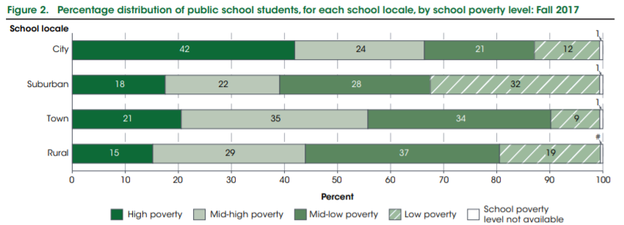
Poverty Level Threshold
Poverty Level (CCD) is determined by percentage of students that qualify for Free/Reduced Lunch.
  High (>75%)
  Mid-high (50.1% - 75%)
  Mid-low (25.1% - 50%)
  Low (<25%)
For our model we will take a similar approach:
  Strict (>=66%)
  High (>=33%)
  No poverty (<33%)

Slide 8
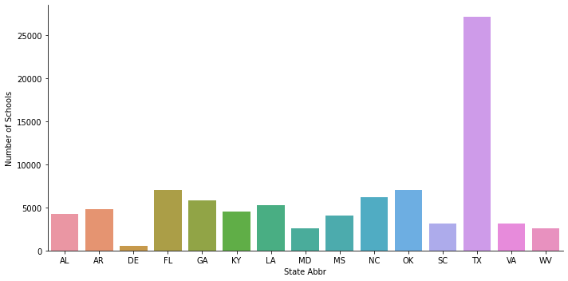
School Distribution Per State
State​ | # Schools​
AL​ | 4282
AR ​ | 4827
DE​ | 531
FL​ | 7045
GA​ | 5813
KY​ | 4542
LA​ | 5302
State​ | # Schools​
MD | 2559
MS | 4023​
NC | 6212
OK | 7026
SC | 3098
TX | 27177
VA | 3156
WV | 2565

Slide 9
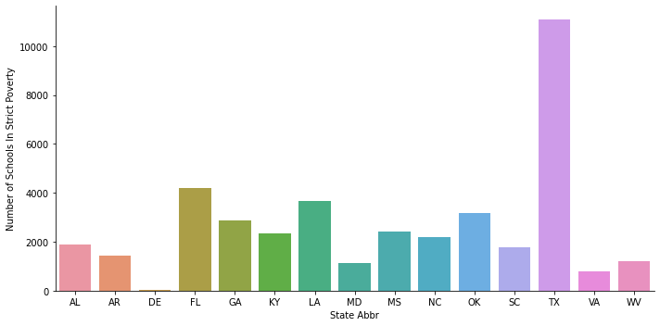
Strict Poverty Per State
State​ | # Schools​
AL​ | 1904​
AR ​ | 1436​
DE​ | 31​
FL​ | 4214​
GA​ | 2858​
KY​ | 2331​
LA​ | 3676​
State​ | # Schools​
MD | 1112
MS | 2411
NC | 2186
OK | 3185
SC | 1767
TX | 11088
VA | 791
WV | 1198

Slide 10
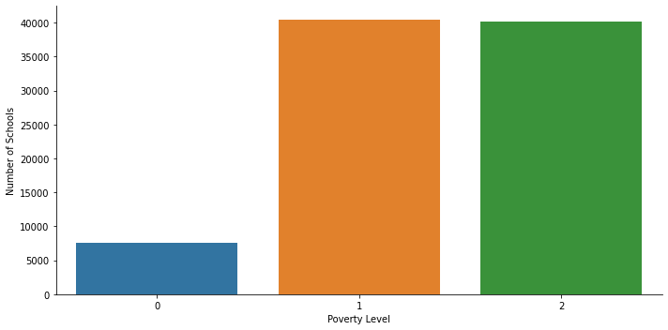
Poverty Level vs Schools
Poverty Level | Number Of Schools
No Poverty | 7551
High Poverty | 40419
Strict Poverty | 40188

Slide 11
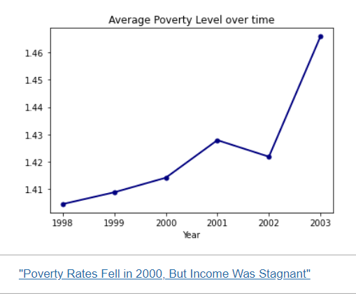
Average Poverty vs Time

Slide 12
Feature Selection
Years: 2004-2006
Before Feature Selection begins, we can already eliminate the following columns:
  School
  State
  State Abbr
  School ID
  Agency ID
From our Poverty Level Threshold, we have added 4 new columns:
  No Poverty Level (0, 1)
  High Poverty Level (0, 1)
  Strict Poverty Level (0, 1)
  Poverty Level (0, 1, 2)

Slide 13
Feature Selection
First, we will determine which features are most relevant for determining Poverty Level:
  For this we used a 'chi2' test on all features. The higher the score, the best the feature is at predicting poverty level.
    - Nominal 2-class target variable
    - Multiple dependent variables
  We also looked at our Correlation Matrix.
Then, we establish the optimal number of features.
  To do this we used Forward Selection using a tree-based model ('ExtraTreesClassifier') to determine the ideal number of features to predict Poverty Level.
  3 is the optimal number of features

Slide 14
Chi Square Scores(with Y = 'strict')
Specs | Chi square score
School-wide Title I | 520.878645
Male | 0.194143
Female | 0.036934
American Indian/Alaska Native | 57.565779
Asian or Asian/Pacific Islander | 22.946501
Black or African American | 3236.796141
Hispanic | 988.992489
White | 3146.773986
Pupil/Teacher Ratio | 86.134895

Slide 15
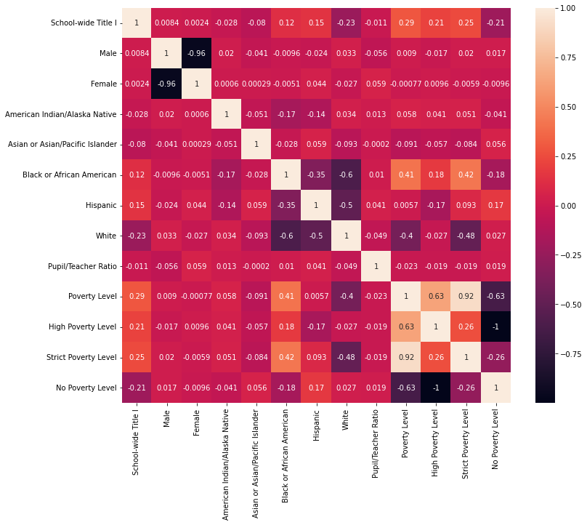
Correlation
Matrix
Based on the Correlation Matrix, the most significant features for both Title I and Poverty Levels are:
Black or African American
White
Hispanic

Slide 16
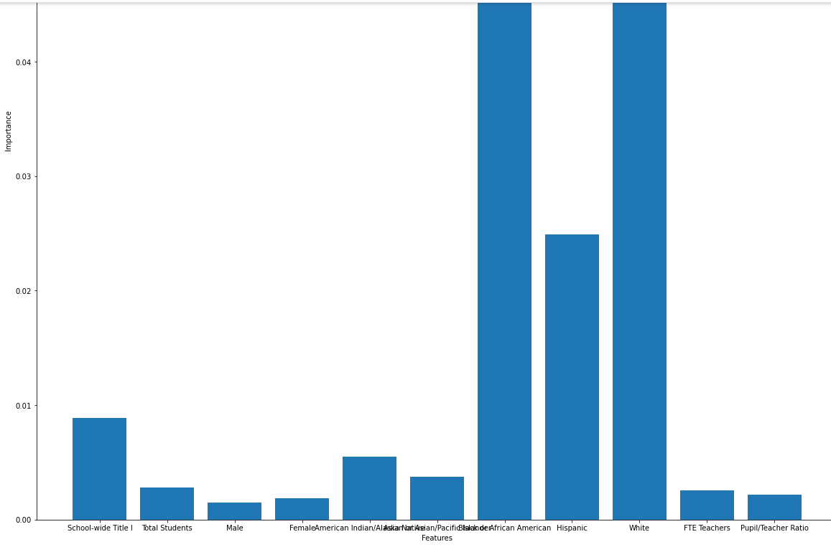
Feature Selection Results
Based on our results for ExtraTreesClassifier, Correlation Matrix, and Chi Square Scores, we determine that the 3 features we will use for modeling are:
Black or African American
White
Hispanic

Slide 17
Modeling
Years: 2007-2015
LOGISTIC REGRESSION
KNN CLASSIFIER
SVM CLASSIFIER
RANDOM FOREST
Compatible with classification problems
Simple
We need to make binary prediction
Compatible with classification problems
No assumptions about data
Compatible with classification problems
Linear SVC can be used for large sets of data
Compatible with classification problems
Works efficiently on large datasets
Better accuracy than other classification models but more complex

Slide 18
Modeling Results
We made models for each of 'Title I', 'High Poverty Level', and 'Strict Poverty Level'. We evaluated each model by checking for accuracy and used 5-fold Cross Validation. These are the accuracy results on the Modeling dataset using the average 5-fold CV score.
LOGISTIC REGRESSION
KNN CLASSIFIER (K=[1,2,…,10])
SVM CLASSIFIER (kernel=linear)
RANDOM FOREST (n=100)
Title I : 92.13%
High Poverty: 95.19%
Strict Poverty: 72.68%
Best Results: K=10
Title I : 92.26%
High Poverty: 95.37%
Strict Poverty: 77.63%
Title I : 92.13%
High Poverty: 95.19%
Strict Poverty: 72.66%
Title I : 99.87%
High Poverty: 99.67%
Strict Poverty: 99.24%

Slide 19
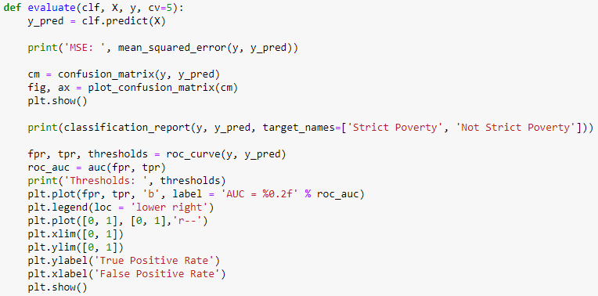
Model Selection
Years 2015-2018
For Model Selection we used the models that we built on the Modeling section and ran them with the Model Selection dataset.
To evaluate our results, made a function evaluate(). This function automated the evaluation process of our model.
The metrics used to evaluate are:
  Mean Squared Error
  Accuracy, Precision, Recall, F1 Score
  Confusion Matrix
  ROC-AUC Curve

Slide 20
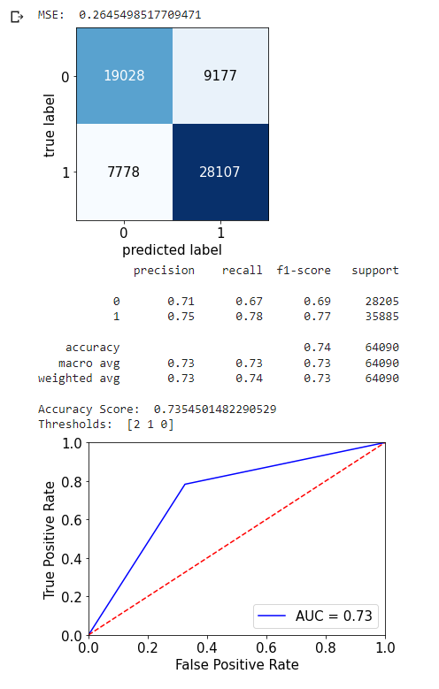
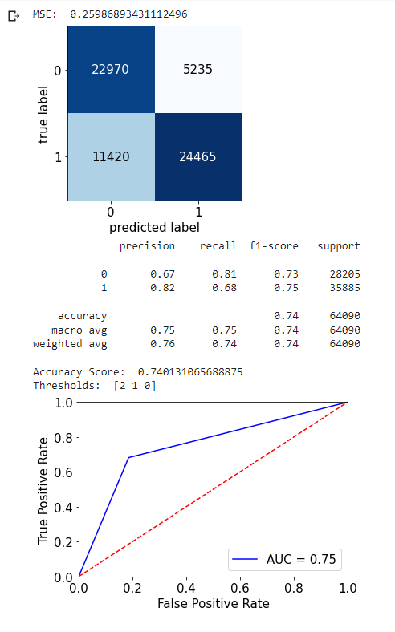
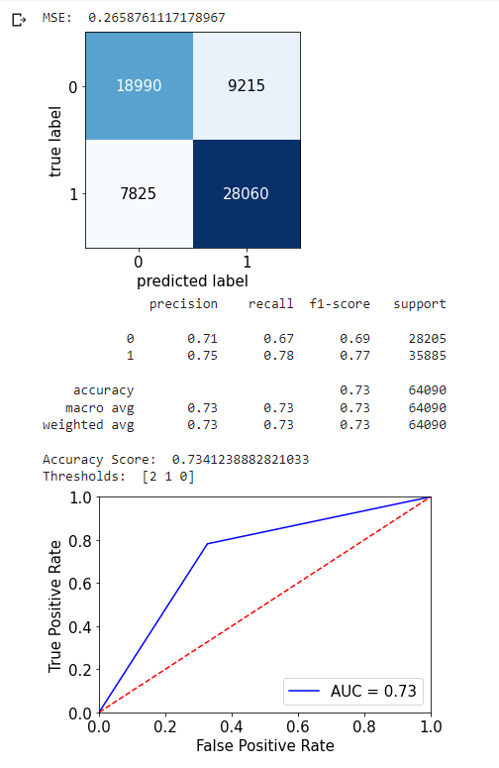
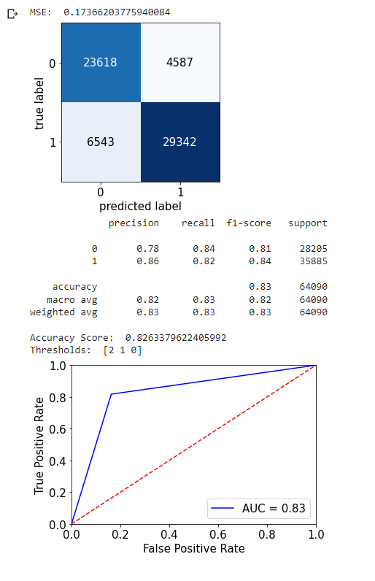
Model Selection Results (Strict Poverty)
LOGISTIC REGRESSION
KNN CLASSIFIER
SVM CLASSIFIER
RANDOM FOREST

Slide 21
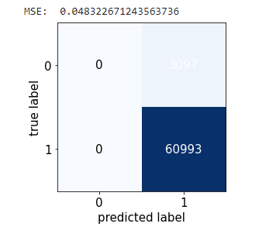
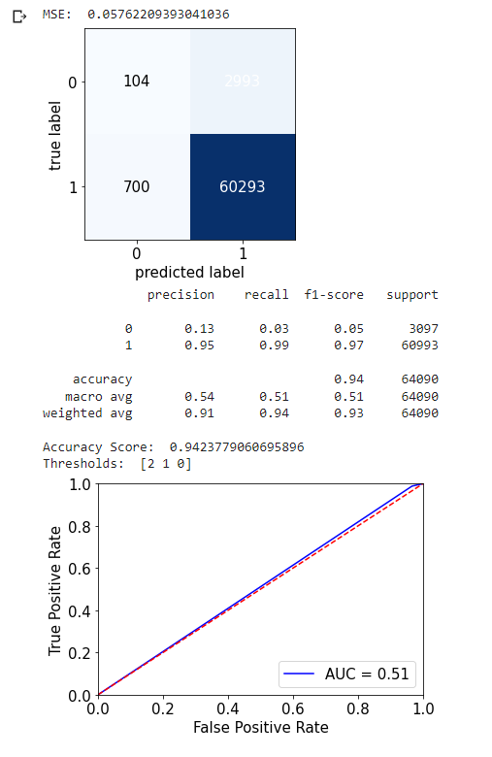
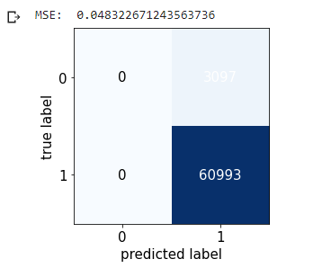
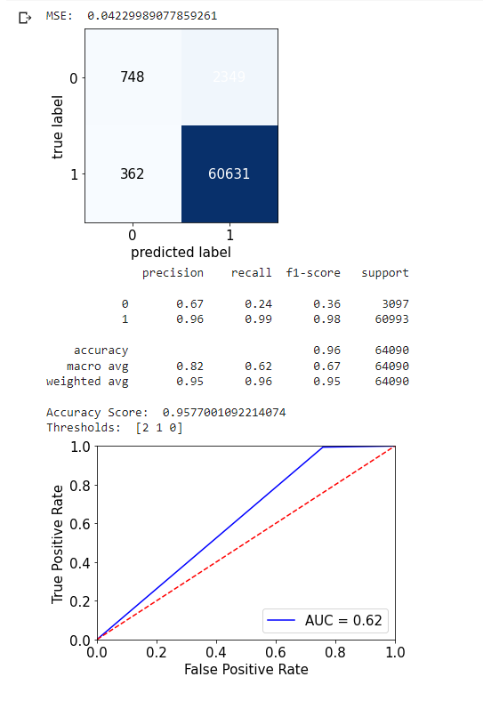
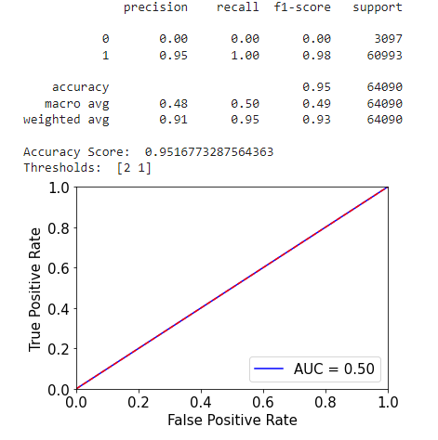
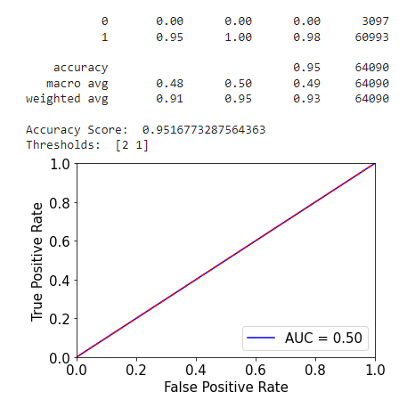
Model Selection Results
(High Poverty)
LOGISTIC REGRESSION
KNN CLASSIFIER
SVM CLASSIFIER
RANDOM FOREST

Slide 22
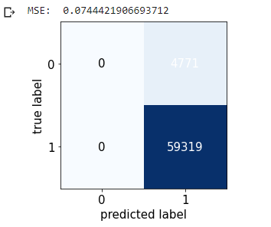
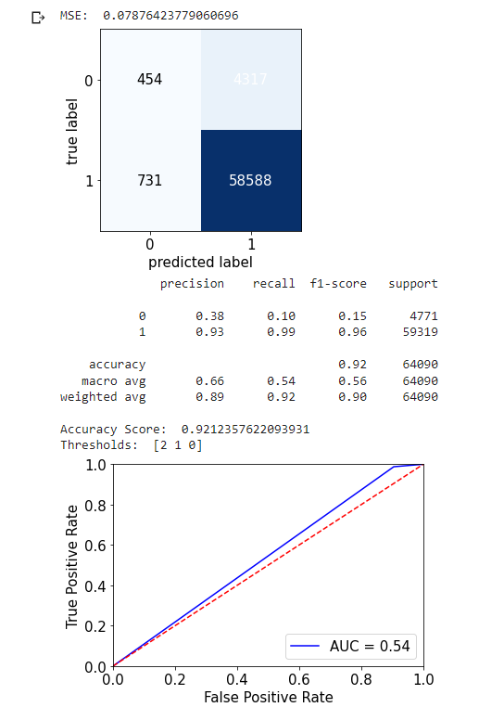
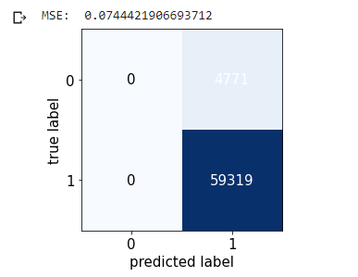
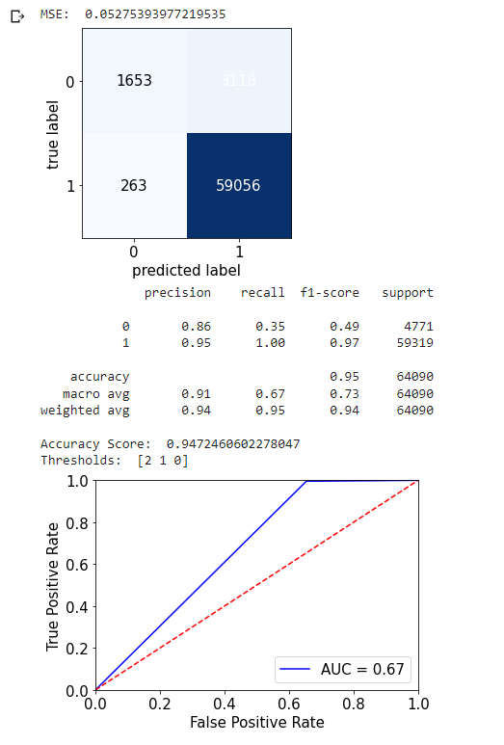
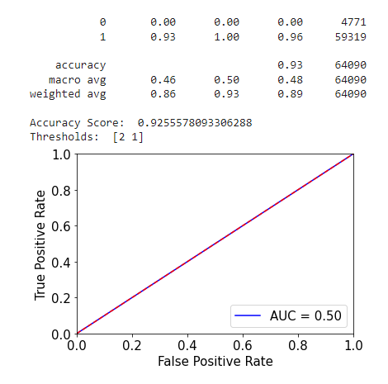
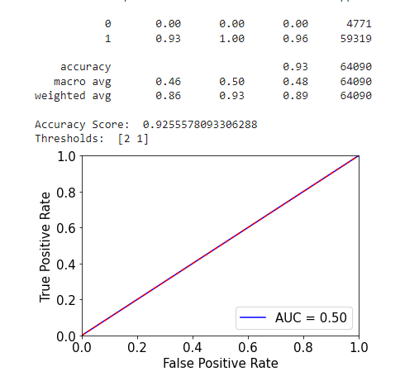
Model Selection Results
(School-wide Title I)
LOGISTIC REGRESSION
KNN CLASSIFIER
SVM CLASSIFIER
RANDOM FOREST

Slide 23
Testing Results
Years 2018-2020
We have selected Random Forest to be the best classifier for our data.
The Mean Squared Error for Random Forest is:
To further improve our model, we will look for ways to reduce overfitting, improve regularization, and revisit the threshold we established for poverty level.
Strict Poverty Prediction Errors | High Poverty Prediction Errors | School-wide Title I Prediction Errors
27.21% | 4.40% | 5.56%

