Slide 1
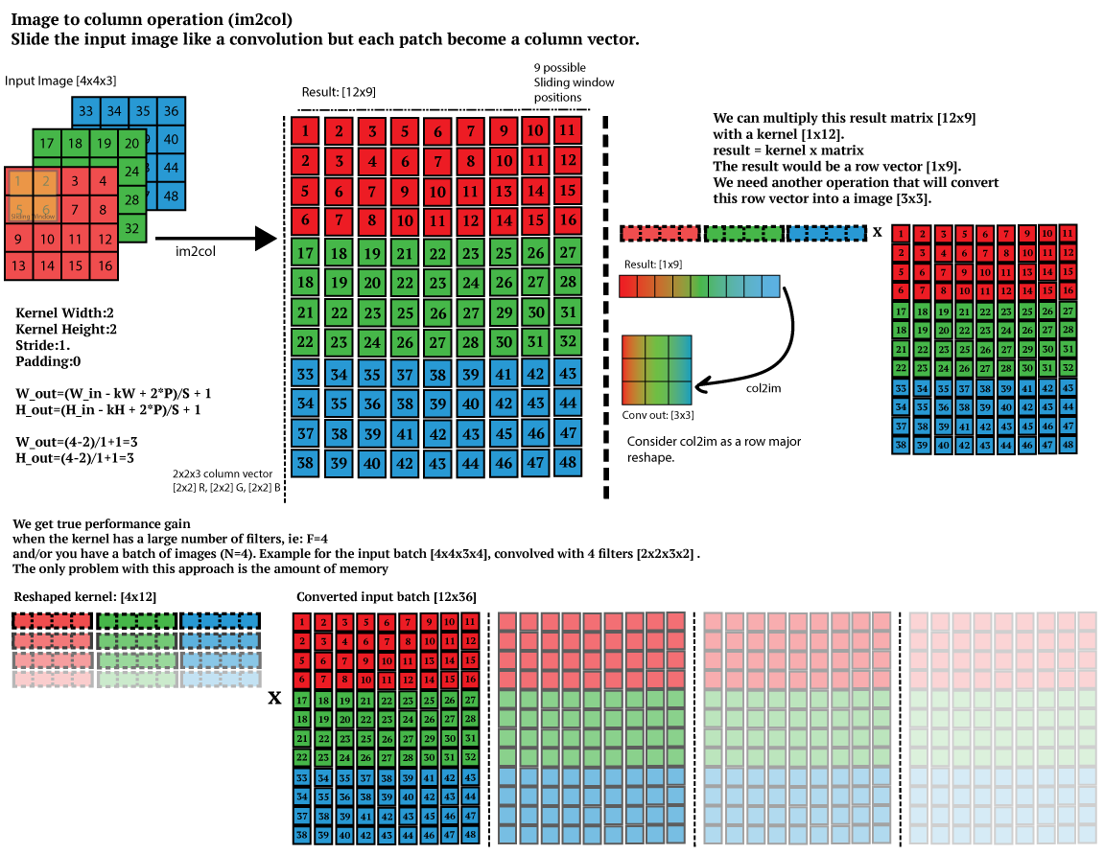

Slide 2
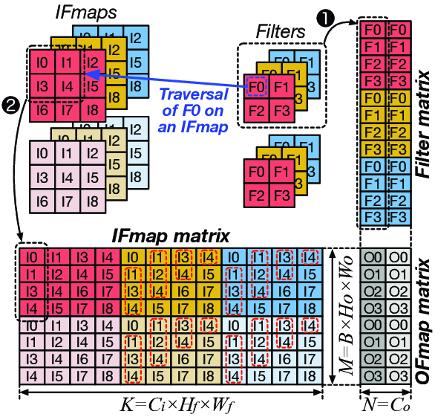

Slide 3
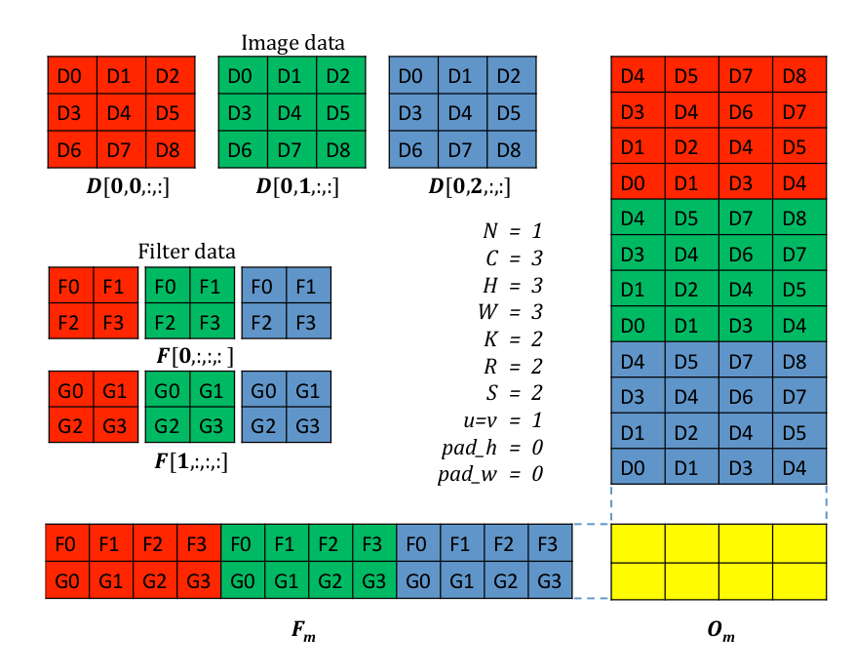

Slide 4
1. im2col
x N
kh
P x Q
kw
KH x KW
N
x C
C
W
H

Slide 5
2. Reshaped kernel
x C
KH x KW
K
K
C
KW
KH

Slide 6
3. Matrix multiplication
P x Q x N
KH x KW x C
K
P x Q x N
KH x KW x C
K

Slide 7
4. col2im
OH x OW x N
K
N
K
Q
P
P x Q x N
K

Slide 8
kernel_winograd_BtdB
BlockIdx.z
K
threadIdx.z
C
BlockIdx.x
threadIdx.x
threadIdx.y
KW
KH
if (C <= 170)
{
threadX = C;
blockZ = 1;
}
else if (C == 224 || C == 256)
{
threadX = C / 2;
blockZ = 2;
}
BlockIdx.y
1 or 2

Slide 9
kernel_winograd_BtdB
BlockIdx.z
KH * KW
threadIdx.z
C
BlockIdx.x
N
threadIdx.x
threadIdx.y
P
Q
if (C <= 170)
{
threadX = C;
blockZ = 1;
}
else if (C == 224 || C == 256)
{
threadX = C / 2;
blockZ = 2;
}
BlockIdx.y
1 or 2

Slide 10
After Point wize matrix multiplication
gridDim.z = k
gridDim.x = TileH * TileW
36
K
TileH * TileW

Slide 11
im2col
OC
3
6
OC
IC
IC
G
Gg
g

Slide 12
kernel_winograd_BtdB
BlockIdx.z
Tile_W * Tile_H
threadIdx.z
BlockIdx.x
N
threadIdx.x
threadIdx.y
6
C
if (C <= 170)
{
threadX = C;
blockZ = 1;
}
else if (C == 224 || C == 256)
{
threadX = C / 2;
blockZ = 2;
}
BlockIdx.y
1 or 2

Slide 13

1D Winograd 3
N
6
OC
6
N
6
OC
IC
IC
TileW * TileH
TileW * TileH
Gg
Btd
[(Gg)ʘ(Btd)]
OC
TileW * H * N

Slide 14
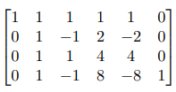
1D Winograd 4
N
N
6
OC
OC
OW
TileW * TileH
OH
[(Gg)ʘ(Btd)]
At

Slide 15

Winograd Convolution
1. Input transform
4. result
Transform
d2
3. Element-wise multiplication
4
8
12
16
2. Filter transform
ic
4
h
oc
8
h
ic
12
3x1
oc
ic
input
output

Slide 16
6
1
[K, C, 1, 6]
C
K

Slide 17
K
C
[6, 1, C, K]
6

Slide 18
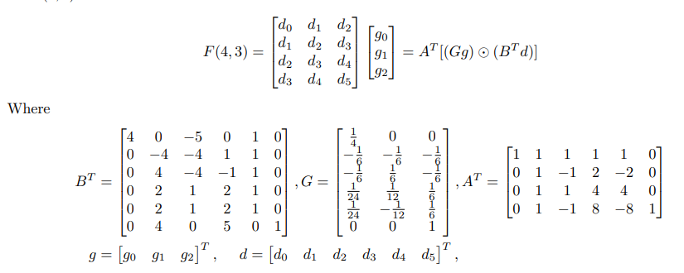
C
W
H

