Slide 1

Visualizing the Sudoku Puzzle

Slide 2

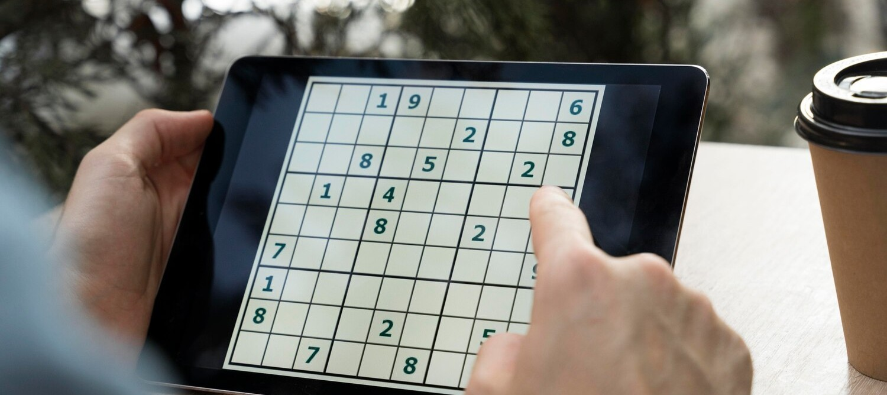
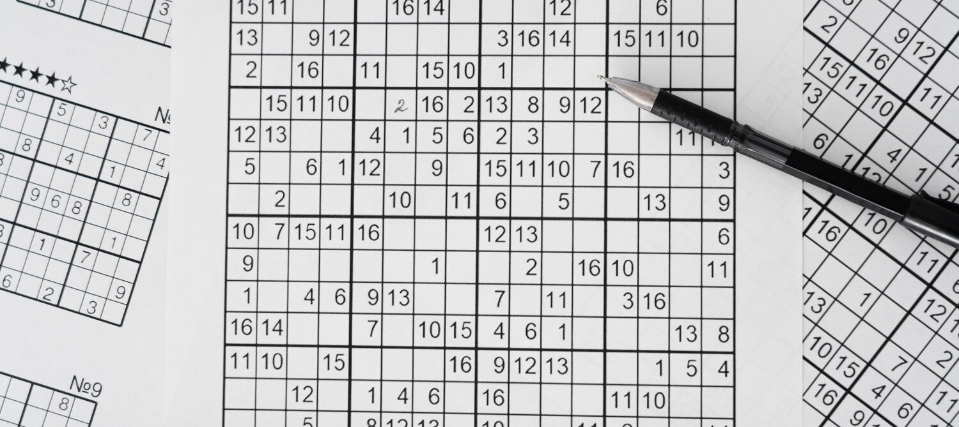
UNLOCKING THE SUDOKU PUZZLE
Sudoku is a number placement puzzle that challenges the mind. In this presentation, we will explore the visual aspects of solving Sudoku puzzles, highlighting the strategies and techniques that make this game both engaging and rewarding.

Slide 3


Understanding the Sudoku Grid
The Sudoku grid is a square divided into
. The objective is to ﬁll the grid with digits from 1 to 9, ensuring that each digit appears
only once in each row, column, and 3x3 grid.

Slide 4
Overview
Backtracking is a general algorithmic technique used for solving problems by incrementally building candidates to the solutions, and abandoning a candidate (backtracking) as soon as it determines that the candidate cannot possibly lead to a valid solution.

Slide 5

How to Apply BackTracking ?

Slide 6


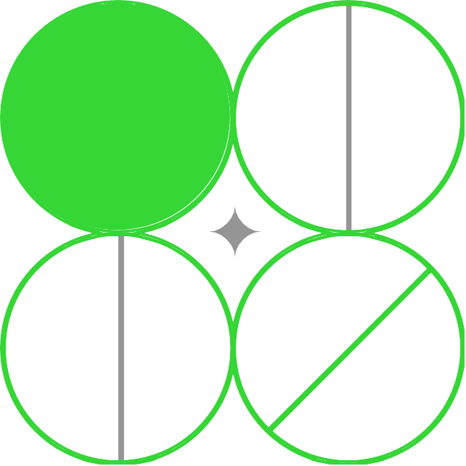
Identifying Empty Cells
The ﬁrst step in solving a Sudoku puzzle is to
that need to be ﬁlled. Visualizing the empty cells and their potential
values is crucial for making informed decisions throughout the solving process.

Slide 7


Applying Logical Reasoning
Sudoku relies heavily on to determine the correct placement of digits. By analyzing the rows, columns, and 3x3 grids, players can eliminate possible values and narrow down the options for each empty cell.

Slide 8


Visualizing Possible Values
Keeping track of the for each empty cell is essential. Visualizing these possibilities can help players identify patterns, ﬁnd hidden singles, and make strategic decisions to progress through the puzzle.

Slide 9

Identifying Hidden Singles
A is a digit that appears only once in a row, column, or 3x3 grid. Identifying these hidden singles can be a powerful technique for solving Sudoku puzzles, as they provide a clear and deﬁnitive placement for a digit.

Slide 10

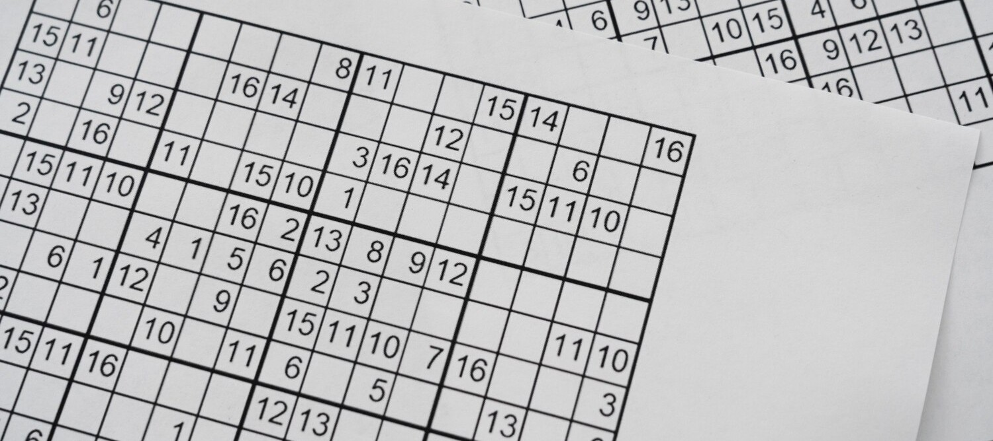

APPLYING ELIMINATION TECHNIQUES
Sudoku puzzles often require the use of to narrow down the possible values for each empty cell. By systematically eliminating options, players can progress towards the solution and uncover new insights.

Slide 11

Recognizing Patterns and Strategies
Experienced Sudoku players develop the ability to recognize patterns and apply various solving strategies to tackle even the most challenging puzzles. These visual cues and techniques can make the solving process more efﬁcient and enjoyable.

Slide 12

Validating the Solution
Once the Sudoku grid is ﬁlled, it's crucial to validate the solution by ensuring that each row, column, and 3x3 grid contains all the digits from 1 to 9 without any repeats. This ﬁnal step ensures the integrity of the solved puzzle.

Slide 13
CONCLUSION: MASTERING BACKTRACKING VISUALLY
In this presentation, we have explored the visual aspects of solving Sudoku puzzles, from understanding the grid structure to applying logical reasoning and elimination techniques. By mastering these visual strategies, players can enhance their Sudoku solving experience and unlock the full potential of this captivating logic-based game.

Slide 14

Thanks!

