Slide 1
Breast Cancer Prediction and Comparative Analysis
GROUP 12
YESWANTH SIRIPURAPU

Slide 2
INTRODUCTION
Breast cancer is a major public health concern that affects millions of people globally. Female breast cancer is currently the most often diagnosed cancer globally, surpassing lung cancer.
In 2020, an expected 2,261,419 new breast cancer cases were identified in women worldwide. Breast cancer tumors can be classed as benign or malignant. Fibroadenomas are solid, smooth, hard, non-cancerous (benign) lumps that do not spread throughout the body.
The difference between benign and malignant breast cancers is critical because it influences the best course of therapy. Machine Learning (ML) can reliably determine the kind of tumor by analyzing massive volumes of data and extremely complicated patterns.
In this article, we classified the topic as a Binary Classification problem and used four distinct classification algorithms, including support vector machines and random forests, to predict breast cancer based on patient data and imaging findings.

Slide 3
OBJECTIVE
Breast cancer is a condition that is frequently discussed these days. It is one of the most widely distributed disorders.
It is critical to detect the illness so that women may begin treatment as soon as possible. It is preferable to have an accurate and timely diagnosis.
The major purpose of this research is to assist pathologists in predicting cancer types more quickly.

Slide 4
DATASET ACQUISITION
We conducted our research using the dataset from the University of Wisconsin Hospitals Madison Breast Cancer Database. The dataset's characteristics are calculated using a digitised picture of a breast cancer sample obtained by fine-needle aspiration.
These qualities enable us to deduce the properties of the cell nuclei shown in the picture. Breast Cancer Wisconsin Diagnostic includes 569 occurrences (Benign: 357, Malignant: 212), two classes (62.74% benign and 37.26% malignant), and 11 integer valued features (-Id, Diagnosis, Radius, Texture, Area, Perimeter, Smoothness, Compactness, Concavity, Concave points). -Symmetry (fractal dimension).

Slide 5
DATA PRE PROCESSING
When it comes to developing a machine learning model, data pre-processing is the first step that signals the start of the process.
Typically, real-world data is imprecise, inconsistent, and erroneous (including mistakes and outliers), and it frequently lacks particular attribute values and trends.
This is where data pre-processing comes into play: it helps to calm, format, and organize raw data, making it ready to use in machine learning models.

Slide 6
PROPOSED SYSTEM
Breast cancer detection is incredibly crucial in today's medical environment. Breast cancer is one of the most serious cancers that may affect women. Breast cancer (BC) has two types: benign (noncancerous) and malignant.
Malignant cancer is described as a curable kind of cancer, but benign cancer is listed as an incurable condition. Changes in genes, intense pain, size and form, fluctuations in breast color (redness), and skin texture are all indications of breast cancer.
Machine learning is used to make predictions. To diagnose breast cancer, many classification approaches are applied, such as Support Vector Machine (SVM) and Random Forest.
These methods belong to the domain of supervised machine learning. These methods are used to predict the development of breast cancer. These algorithms' accuracy results are assessed.

Slide 7
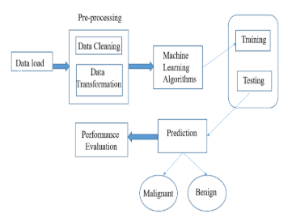
PROPOSED SYSTEM ARCHITECTURE

Slide 8
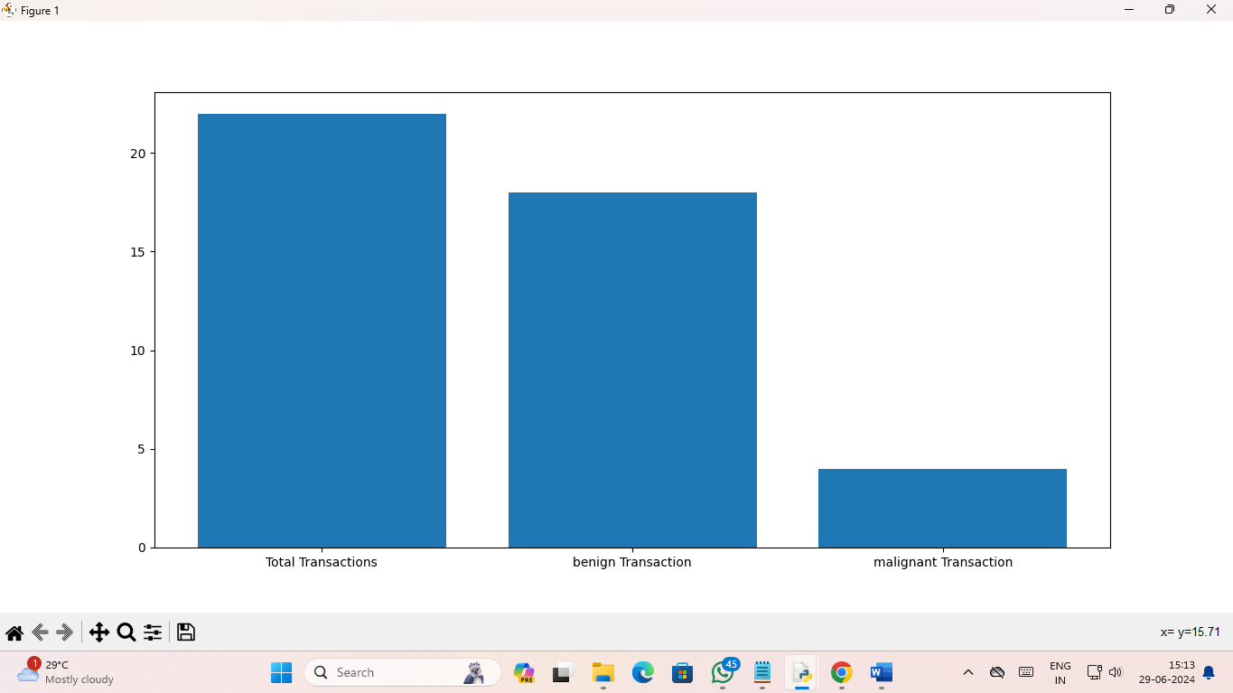
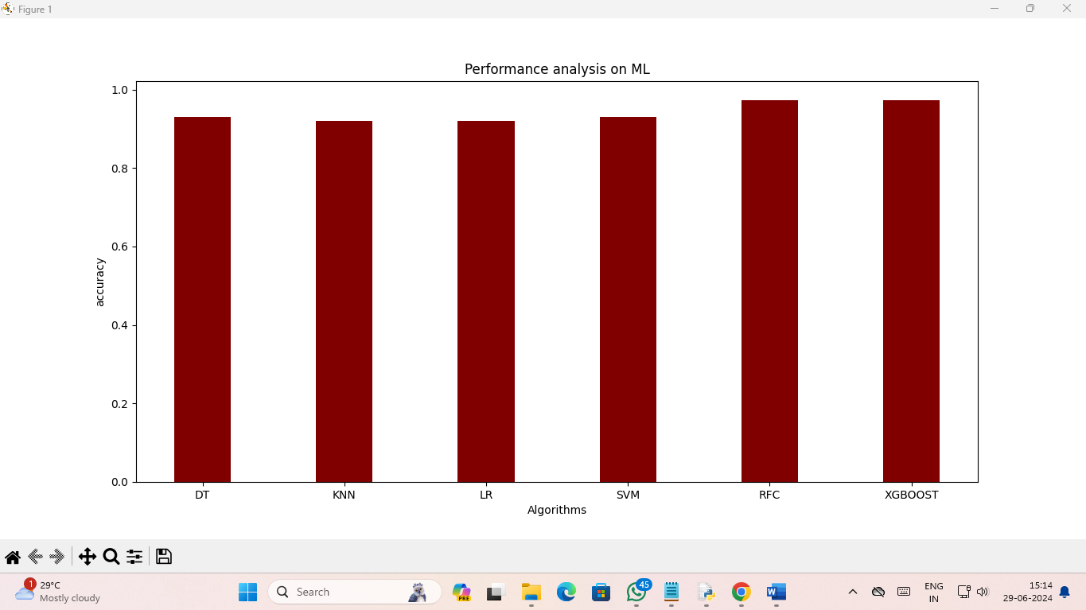
TEST RESULTS AND OUTPUT

Slide 9
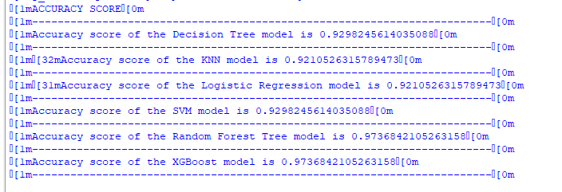
ACCURACY

