Slide 1

Centralized organ donation secured system using blockchain
BATCH MEMBERS
1) DINESHKUMAR M (511320205008)
2) JEEVARATHINAM R (511320205012)
3) KATHIR SELVAM V (511320205302)
Name of the SUPERVISOR
Mrs.M.Menaka,
HOD/IT

Slide 2
LITERATURE SURVEY
TITLE | AUTHOR | YEAR | ADVANTAGE | DISADVANTAGE
Organ Donation Decentralized Application Using Blockchain Technology | Lama Abdulwahab Dajim, Sara Ahmed Al-Farras | 2019 |  | organ donation decentralised app Operate on a first-in, first-out basis
Blockchain Based Auditable Medical Transaction Scheme for Organ Transplant Services | Gasim Alandjani | 2019 |  | Machine-to-machine (M2M) communication These duties include services that make life easier for device owners
Creating Organ Donation System with Blockchain Technology | Anmol Soni, Dr. S. Ganesh Kumar | 2021 |  | Web-based application First-in, first-out (FIFO) method Foundational technology is blockchain
Conceptual framework for general traceability solution: description and bases | Abdesselam Bougdira, Abdelaziz Ahaitouf | 2019 |  | Offer a suggested framework for traceability-related purposes Framework: processes, procedures, data classification, specifications, and goals.
Improving the Robustness and Accuracy of Crime Prediction with the Self-Exciting Point Process through Isotropic Triggering | Gabriel Rosser & Tao Cheng | 2019 |  | Self-exciting point process (SEPP) Decline in predicted accuracy

Slide 3
ABSTRACT
Today’s organ donation and transplantation systems pose different requirements and challenges in terms of registration,donor-recipient matching,organ removal,organ delivery,and transplantation with legal,clinical,ethical,and technical constraints.
A Private ethereum blockchain-based solution to enable organ donation and transplanation management in a manner that is fully decentralized,secure,traceable,auditable,private,and trustworthy.
Smart contracts have been developed and six algorithms have been presented along with their implementation, testing, and validation details.
The performance of the proposed solution has been evaluated through privacy, security, and confidentiality analyses.
The solution has been compared with existing solutions to assess its effectiveness.

Slide 4
EXISTING SYSTEM
Organ donation and transplantation systems pose different requirements and challenges in terms of registration, donor-recipient matching, organ removal, organ delivery, and transplantation with legal, clinical, ethical, and technical constraints.
Accessing the organ donation waiting list is a basic requirement for organ allocation.
Referral for transplantation can be affected by both geographical and socioeconomic factors.
The organ must be in acceptable working conditions with donor-recipient matching, and its removal should not pose a life-threatening risk to the donor.

Slide 5
PROPOSED SYSTEM
We propose a private Ethereum blockchain-based solution that ensures organ donation and transplantation management in a manner that is decentralized, secure, reliable, traceable, auditable, and trustworthy.
We develop smart contracts that register actors and ensure data provenance through producing events for all the necessary actions that occur during the organ donation and transplantation stages.
We develop an auto-matching process between the donor and recipient through a smart contract based on certain criteria.

Slide 6
MODULES
Private Permissioned Ethernum Network
Blockchain Integration
Participants Interactions
Organ Donation
Organ Transplantation

Slide 7
ARCHITECTURAL DIAGRAM
patient
donor
View patient history
Sign up
Request organ
donor request
Make a reques
View history

Slide 8
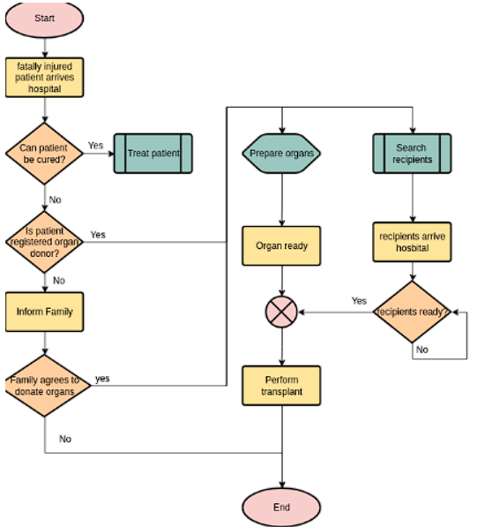
UML DIAGRAMS

Slide 9
UML DIAGRAMS

Slide 10
ALGORITHMS
STEP 1: Patients from Various Hospital Request for Organ
STEP2: Donar will Send the Data Securely with the help of Block chain Technology
STEP3:Then Matching will be Done to Check the Donar is Capable to Donate the Organ
STEP4:Finally Organ will be Sent for Delivery
STEP5:It is also Possible to Edit the Details at any Time

Slide 11
REFERENCES
[1] L. A. Dajim, S. A. Al-Farras, B. S. Al-Shahrani, A. A. Al-Zuraib, and R. Merlin Mathew, ‘‘Organ donation decentralized application using blockchain technology,’’ in Proc. 2nd Int. Conf. Comput. Appl. Inf. Secur. (ICCAIS), May 2019, pp. 1–4, doi: 10.1109/cais.2019.8769459.
[2] A. Powell. (Mar. 18, 2019). A Transplant Makes History. Harvard Gazette. [Online]. Available: https://news.harvard.edu/gazette/story/2011/09/atransplant-makes-history
[3] Organ Donation Facts and Info: Organ Transplants. Accessed: Apr. 18, 2021. [Online]. Available: https://my.clevelandclinic.org/health/ articles/11750-organ-donation-and-transplantation
[4] (Mar. 21, 2019). Facts and Myths About Transplant. Accessed: Apr. 21, 2021. [Online]. Available: https://www.americantransplant foundation.org/about-transplant/facts-and-myths/
[5] Organ Procurement and Transplantation Network. Accessed: Apr. 18, 2021. [Online]. Available: https://optn.transplant.hrsa.gov/ resources/ethics/ethical-principles-in-the-allocation-of-humanorgans/

Slide 12
THANK YOU

