Slide 1

Tic-Tac-Toe Using Alpha-Beta Pruning
Presented By
Yeswanth

Slide 2
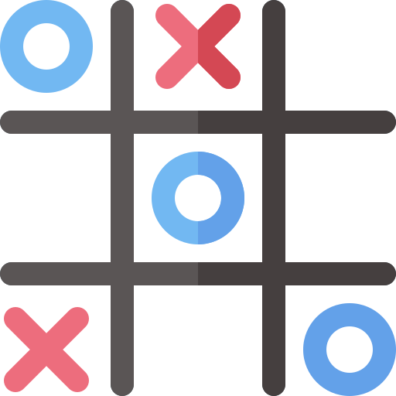
PROJECT
TIC-TAC-TOE using Alpha Beta Pruning

Slide 3
PROJECT
Sequential Alpha-Beta Pruning for Small Grids:
For smaller grids such as 3x3 and 4x4, the game will continue to use the standard sequential Alpha-Beta Pruning.
This is optimal for smaller search spaces, ensuring fast and efficient decision-making.
Parallel Alpha-Beta Pruning for Large Grids:
For larger grids such as 7x7 and 10x10, the game will utilize a parallelized version of Alpha-Beta Pruning.
This parallel approach will leverage multiple cores to handle the increased search complexity and improve performance.
The implementation will be based on research findings on parallelizing Alpha-Beta Pruning to ensure efficient execution even with large board sizes.

Slide 4


PROJECT APPROACH
APPROACHES
ANALYTICAL APPROACH

Slide 5
PROJECT
APPROACH

Slide 6
OVERVIEW
Purpose: Develop a GUI Tic-Tac-Toe game with an AI opponent using Alpha-Beta Pruning.
Key Features:
Dynamic board size selection (3x3 to 10x10).
Choice of sequential or parallel pruning.
Google Sheets integration for tracking AI performance.
AI optimizations to manage complexity on larger boards.

Slide 7
ARCHITECTURE

Slide 8
ARCHITECTURE
TicTacToe Class
Manages game logic and Alpha-Beta Pruning AI.
TicTacToeGUI Class
Creates and manages the user interface.
Integration Modules
gspread and Google Sheets: Logs AI performance metrics.
Tkinter: Provides GUI functionality.

Slide 9
TIC|TAC|TOE
OVERVIEW
Core game logic and AI functionality.
Includes:
Dynamic depth adjustment for Alpha-Beta pruning.
Winner checking.
AI move evaluation and metrics tracking.
KEY METHODS
get_depth_limit(size): Adjusts search depth based on board size.
alpha_beta(): Alpha-Beta Pruning algorithm for optimal AI decisions.
get_best_move(): Determines the best move for AI within a time limit.
check_winner(): Checks rows, columns, and diagonals for a win.
OUTCOMES
Time taken for each move.
Peak memory usage.
Game outcome (win, draw, lose).

Slide 10
TIC|TAC|TOE GUI
OVERVIEW
Builds GUI with Tkinter.
Handles:
Menu navigation.
Human and AI moves.
Game outcomes (win, draw, lose).
KEY METHODS
Menu: Allows user selection of board size and pruning type.
Game Board: Dynamically generates buttons for board cells.
Move Handling:
Human: Updates the board and checks the result.
AI: Calls get_best_move() and updates the board.
OUTCOMES
Fields Saved:
Session ID, board size, pruning type.
Time taken, memory usage, game result.

Slide 11
INTEGRATION
OVERVIEW
gspread and Google Sheets: Logs AI performance metrics.
Tkinter: Provides GUI functionality.
KEY METHODS
Purpose: Log AI performance metrics for analysis.
Implementation:
Uses gspread to interact with Google Sheets.
Appends each move's data as a row in the sheet.
OUTCOMES
Fields Saved:
Session ID, board size, pruning type.
Time taken, memory usage, game result.

Slide 12
PROJECT
DEMO

Slide 13
ANALYTICAL
APPROACH

Slide 14



APPROACH
DATA
Getting data from game. Data include type of board, type of pruning, type of player, move, time taken.
VISULIZATION
STORAGE
+
ANALYTICS

Slide 15
ARCHITECTURE
Game Status
Google Sheet
Dashboard
True
True
Code
Game
Interface
True
Start
No Status
False

Slide 16
DASHBOARD

Slide 17
THANK
YOU

