Slide 1
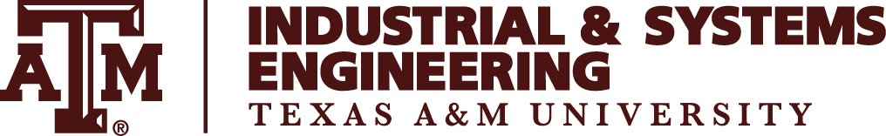
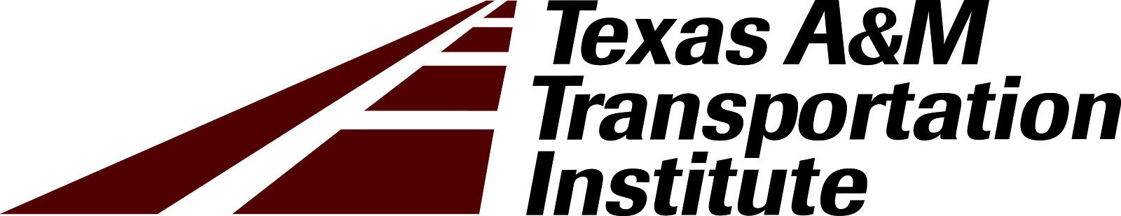
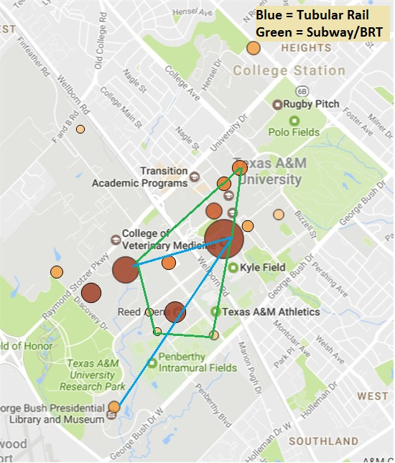
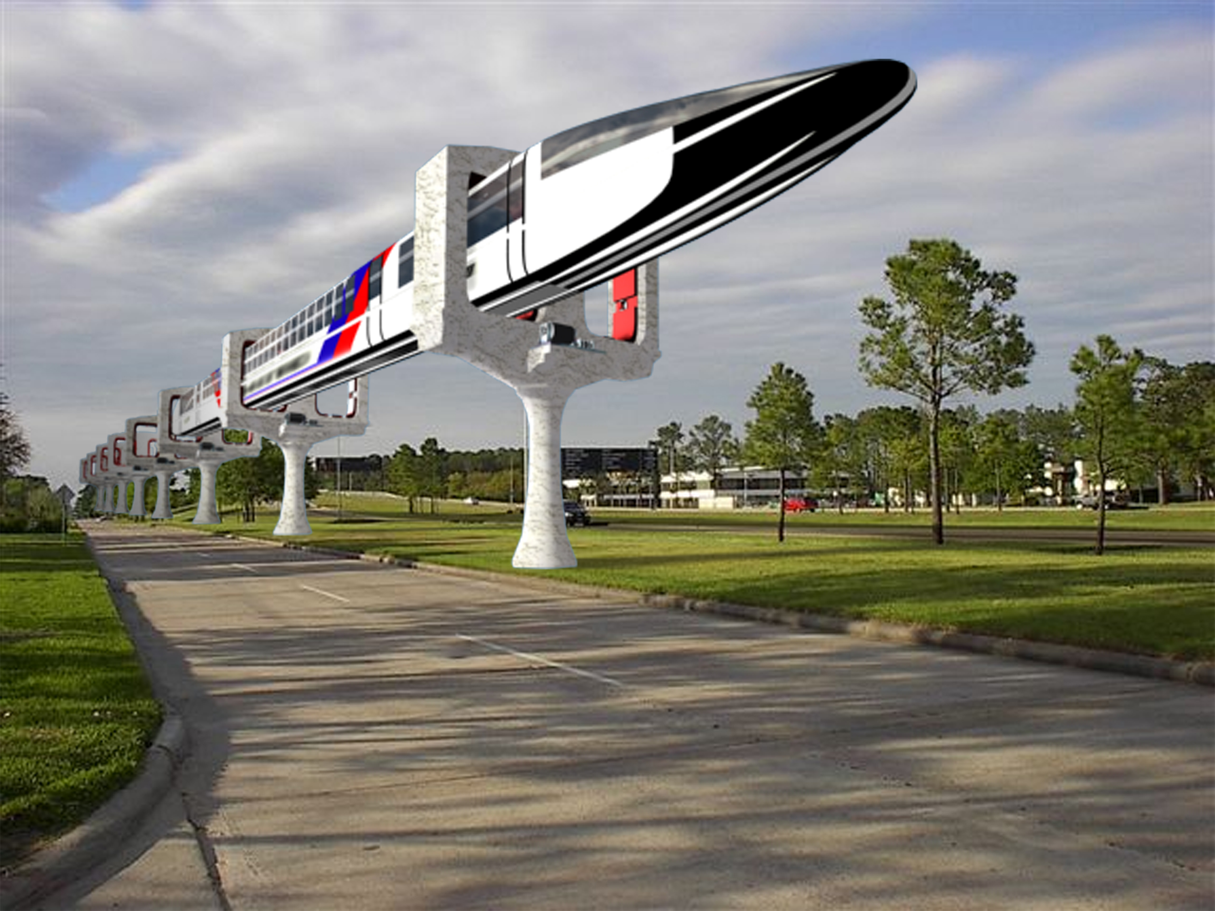
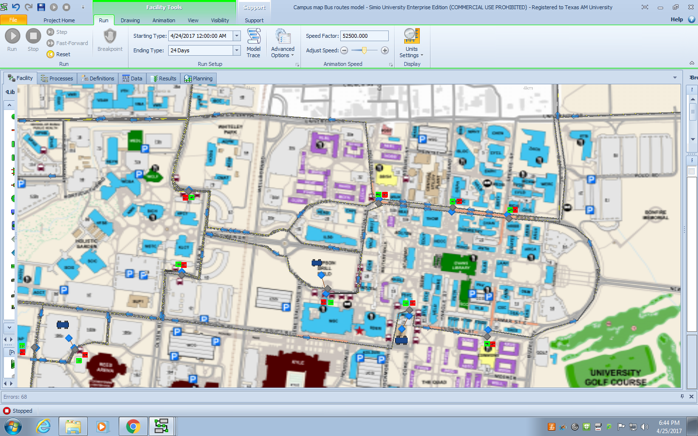
Team 29: Mass Transit Options at Texas A&M University
Members: Aidan Casey, Blake Jones, Imran Khan, Hogan Sullins
Satish Bukkapatnam (Advisor, ISEN), David Sparks (Sponsor, TTI), Jose Vazquez (Professor, ISEN)
Abstract
Methodology
Optimized Routes
TTI has proactively identified a future problem stemming from Texas A&M’s continued student body growth. To combat this issue, TTI has asked the team to devise the optimal route for three methods of transportation: Tubular Rail, dedicated lane bus rapid transit (BRT), and subways. Using a combination of linear programming and Simio modeling, the team developed optimized routes for alleviating congestion. From a ridership perspective, the subway proved to alleviate the most pressure from the current bus system, but from a cost-benefit perspective the Tubular Rail technology is by far the most cost friendly.
Data Preparation
The team began by calculating the distances between every combination of the major bus stops to the nearest thousandth of a mile. Ridership data was obtained from TTI and included the boarding passenger count at each stop. We aggregated this data to determine the ridership metric.
Linear Program
The objective function in the linear program minimized the product of the distance between two potential stops and the inverse ridership metric. The program constrains the total distance of the route to under 2.5 miles. It also constrains the route so that the distance between any two stops is kept to over half of a mile. Finally, it ensures that the turning angle between two stops is plausible given the modality being evaluated. For instance, the Tubular Rail technology has certain mechanical properties that make it unable to turn as quickly as other modalities or to adjust to elevation.
Figure 3. Optimized Route for Tubular Rail, Subway, and BRT
Conclusions
The linear program found that a looped subway/BRT route consisting of stops at Ross & Spence, Ross & Ireland, Wehner, PEAP/Reed Arena, Blue Bell Park, and the MSC alleviated the most stress from the current bus system. The Simio simulation demonstrated a XX% reduction in traffic and XXXXX riders per month if the subway route were to be implemented. Similarly, the linear program found that the optimal route for Tubular Rail would contain one line from Wehner to the MSC, and one line from the MSC to PEAP/Reed Arena to the Bush School. Tubular Rail would result in a XX% decrease in traffic to the current system, and ridership would be projected at XXXXX per month. While ridership is lower for Tubular Rail, the projected full cost of implementation is $0.63B - $2.56B cheaper than that of a subway, and $105M - $197M cheaper than that of BRT.
Simio
Simio was used to project ridership of the ideal route for each modality. First, we modeled the current bus system. We received time series data of passenger arrivals from TTI and used this to model the passenger arrival rates at each station. Once we had the current system modeled, we added our proposed routes on top of the system in order to get an estimate of projected ridership and cost per passenger mile for each modality.
Taken from http://joshedwards.com/tag/tubular-rail/
Figure 1. Tubular Rail Concept Visualization
Problem Identification
As Texas A&M continues to expand, the current transportation infrastructure must expand in a similar manner in order to accommodate the school’s growth in a healthy, sustainable way. The team was tasked with evaluating the feasibility of three different modalities of transportation – subway, dedicated lane BRT, and tubular rail – based on their feasibility of implementation and cost effectiveness.
Acknowledgements
Robert Brydia, James Flores, Mark Lawley, Robert King, Robert Pulliam, Andrew Rihani
Figure 2. Simio Screencap

