Slide 1
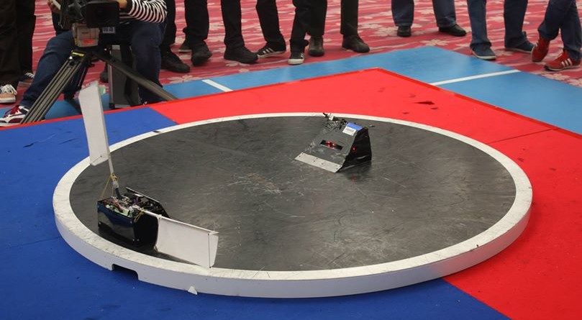
Project Introduction
Two Robot
Black background of the ring
Objective: Push the enemy out of the ring

Slide 2
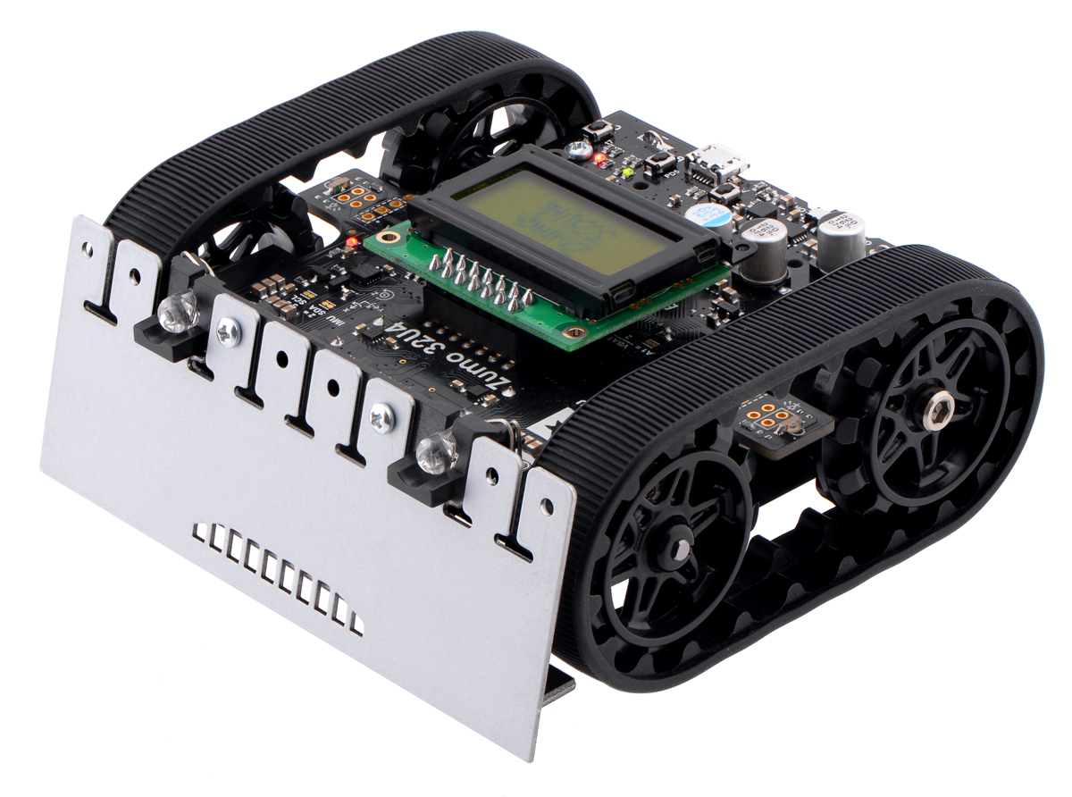
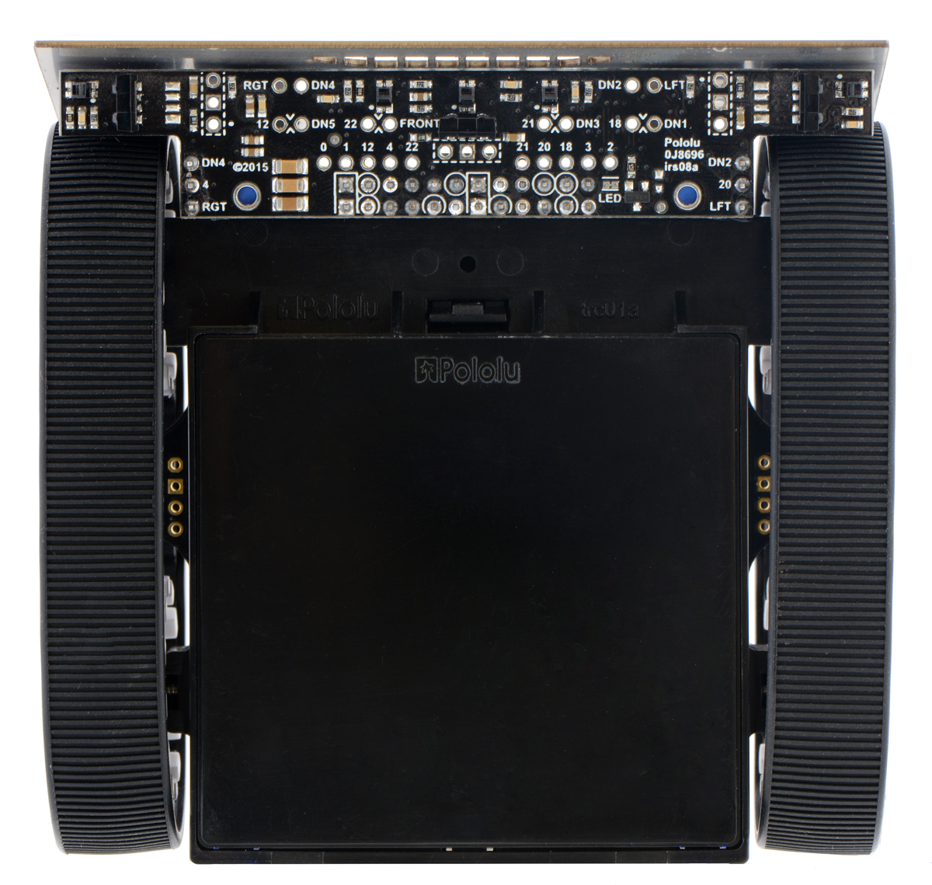
Two side proximity sensors.
(Detect opponent)
Two front proximity sensors. (Detect opponent)
LSM303 module, which is the accelerometer
(Detect collision)
Three line sensors.
(Detect the black background)

Slide 3
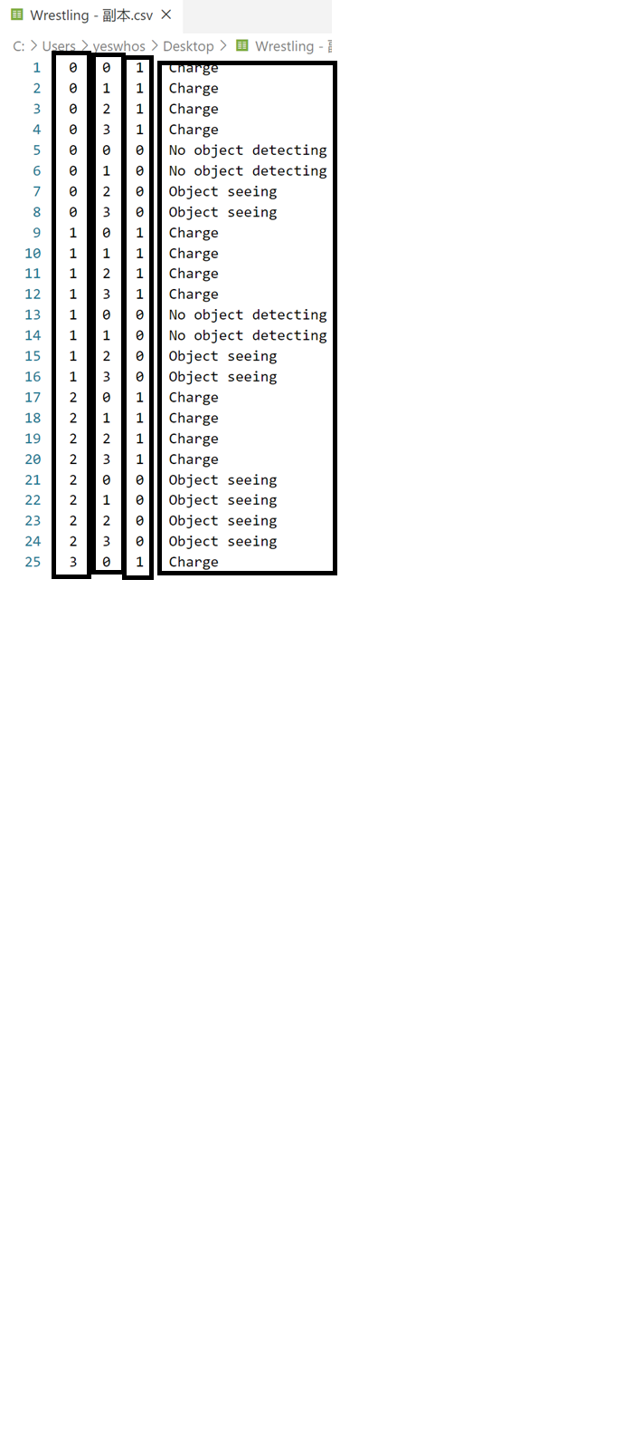
What I have done so far
Decision Tree
1. Prepare the dataset
ProxSensor 1
ProxSensor 2
Label
Accelerometer

Slide 4
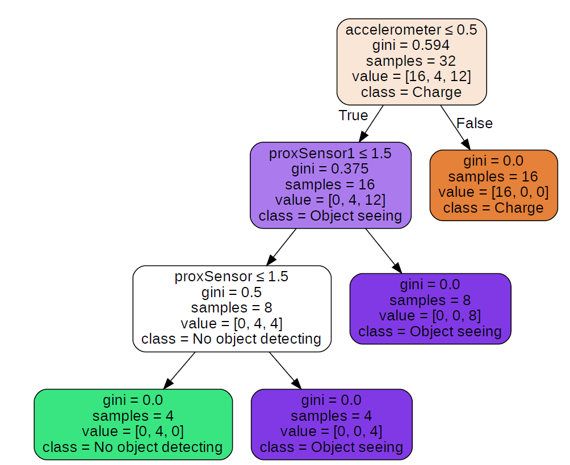
What I have done so far
2. Choose algorithm
ID3
C4.5
CART
3. Generated decision tree
Choosen Feature or attributes
Gini number
Sample of this node
Number of samples in each label
e.g. 16 samples in ‘charge’,
4 in ‘no object seeing’,
12 in ‘object seeing’
The label of most number of sample in this node

Slide 5
What I have done so far
4. Apply the tree into the Arduino code
Use JSON to store the tree, and apply it in the Arduino code

Slide 6
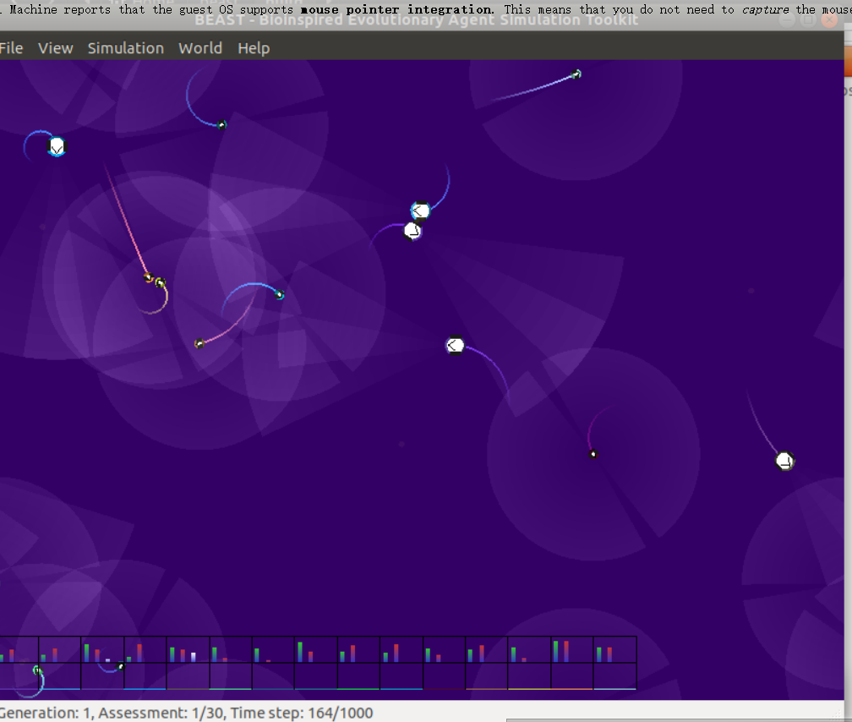
What am I plan to do next.
Genetic Algorithm (GA) or Genetic Programming (GP)
Use BEAST (Bio-inspired Evolutionary Agent Simulation Toolkit) to simulate the evolution process
VS.
VS.
Winner
Winner
Crossover and mutations
VS.
VS.
Winner
Winner
………………….

Slide 7
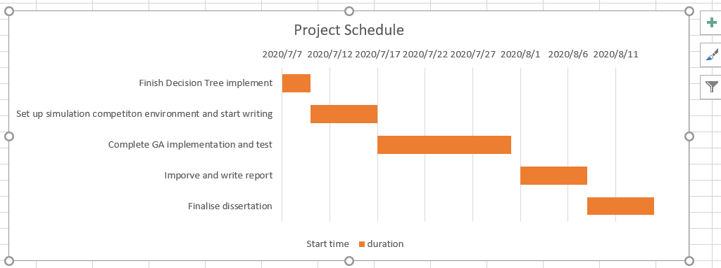
Schedule

