Slide 1
AYU SYSTEMS
ENGINEERING FOR PUBLIC INFRASTRUCTURE
APIC ProtoHub
4
APIC CENTRES
live in the network today
Prototyping-as-a-Service for Andhra Pradesh
11
MACHINES
published with full capability specs
Andhra Pradesh has built the machines.
It has not built the way in.
6
PROCESSES
FDM · SLA · SLS · CNC · laser · PCB
ProtoHub turns scattered prototyping centres into one bookable network — so idle machines find innovators, and ideas stop dying for lack of access.
APIC PROTOHUB INNOVATION CHALLENGE · RTIH × ANDHRA PRADESH INNOVATION SOCIETY
CONCEPT NOTE · 01
Notes:
Andhra Pradesh funded the machines but not the way in. Four centres are live, eleven machines published. The single insight: users know their part, not our equipment list — so search by what you are making, not by machine name.

Slide 2
The gap, and what closes it
WHAT BREAKS TODAY
WHAT CLOSES IT
Zero demand visibility
Machines idle because nobody knows they exist
FIT — the capability engine
Users know their part, not our equipment list. Every other feature assumes you already know which machine to book. Fit removes that assumption.
Manual scheduling & quoting
Registers, WhatsApp, staff memory. Pricing depends on who you ask
RANK: AVAILABLE → DISTANCE → FIT
Islands, not a network
Kakinada's printer breaks; nobody routes the job to Vijayawada
Build envelope
Rotation-aware — a 320×330×500 part fits a 340×340×600 machine
No utilization data
Achievable tolerance
APIS cannot measure return on crores of capex
Only machines that can actually hold the spec
Live material stock
Never book a machine that will run out mid-job
Availability & distance
Nearest working machine first; small parts spare big ones
ALREADY BUILT AND TESTED
Schema, matcher, and booking flow run against live PostgreSQL 16. Matcher implemented twice — SQL and JavaScript — identical results across six scenarios.
CONCEPT NOTE · 02
Notes:
Left: the four failures, all of which trace to one root — the network is invisible. Right: Fit, the capability engine. Key proof point: double-booking is rejected by a Postgres exclusion constraint, not application code, so it is structurally impossible rather than merely handled.

Slide 3
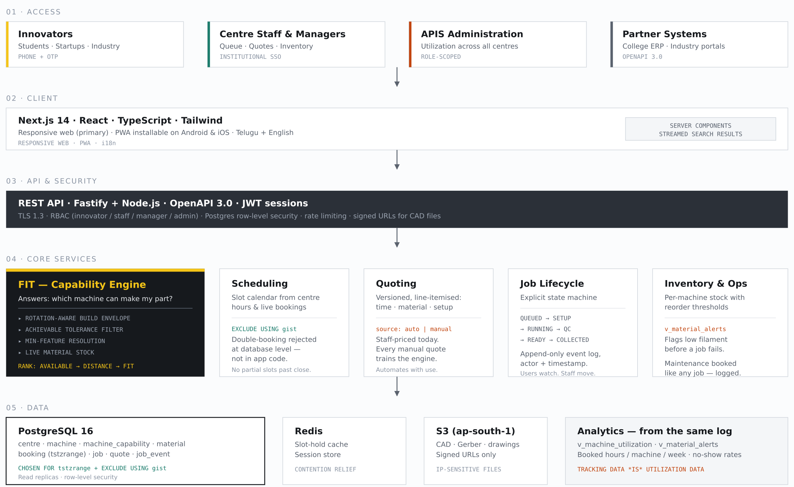
Architecture
Next.js · Fastify · PostgreSQL 16 · AWS ap-south-1 (data residency in India)
SCALE & EXPANSION
Capability is data,
not code
A waterjet and an SLS printer are the same row shape. Adding a centre is an INSERT — Anantapur goes live by flipping one boolean.
The network
outgrows APICs
The schema hardcodes no "APIC". College workshops, ITI labs, and industry spare capacity join the same network. Public capex is the seed, not the ceiling.
It improves
with use
Every quote records auto or manual. Each manual quote is a labelled training example — the engine gets cheaper the more the network is used.
The honest constraint: technical scale is solved; organisational scale is not. Every feature must make the centre manager's first morning easier — not only the innovator's.
CONCEPT NOTE · 03
Notes:
Five layers: access, client, API/security, core services, data. Postgres 16 was chosen specifically for tstzrange plus EXCLUDE USING gist. The right rail is the expansion story — capability lives in data, so growth is data entry rather than development.

