Slide 1
TRADE SHOW 2026 · PROJECT PROPOSAL
Learning Journey Assistant
An AI system that turns every student's marked assessments and feedback into a clear, personalised path to improve.
Ask us for a live demo
Booth
12
· La Trobe University
Notes:
Welcome visitors; introduce the team and the one-line pitch.

Slide 2
THE PROBLEM
Students get feedback. They rarely get a next step.
Mastery is unclear
Moodle data sits idle
Everyone studies blind
Students can't tell how close they are to genuinely understanding a topic, only their last grade.
Learning outcomes, rubrics and results already exist — but nothing connects them into guidance.
Without a structured feedback loop, students re-study everything instead of what actually needs work.
Notes:
Set up the gap: rich feedback exists but students can't act on it.

Slide 3
OUR APPROACH
A dynamic AI model of each student's academic profile — built from real subject data.
Moodle Data
Competency Model
Personalised Guidance
Subjects, rubrics, assessment results, feedback
Mastery mapped to learning outcomes, per student
Plans, adaptive quizzes, study strategies, resources
Notes:
Introduce the AI model as the core idea: a living academic profile per student.

Slide 4
HOW IT WORKS
From marked assessment to next study step
01 · Integrate
02 · Model mastery
03 · Detect gaps
04 · Guide
Securely connect to Moodle subject data, rubrics and results.
Build a competency model aligned to each subject's learning outcomes.
Analyse marked work and feedback to pinpoint exactly what's weak.
Recommend study strategies, resources and adaptive quizzes.
Notes:
Walk through the four-step pipeline behind the model.

Slide 5
WHAT STUDENTS GET
Four tools, one continuous loop
Mastery Dashboard
Personalised Learning Plans
Understanding level, strengths, gaps and progress trends at a glance.
Concrete next steps generated directly from each student's own gaps.
Adaptive Quizzes
Study Strategy Guidance
Practice generated against the exact learning outcomes still at risk.
Evidence-based recommendations tailored to how each student is performing.
Notes:
Show the four concrete deliverables students would actually use.

Slide 6
WHY IT WORKS
Every mistake becomes something a student can learn from — not just a mark.
Grounded in each subject's own rubrics and outcomes, so recommendations are accurate, explainable, and never a substitute for the grade a student actually earned.
Notes:
This is the emotional hook slide -- lean on it.

Slide 7
RESPONSIBLE BY DESIGN
Built for a university, not around one
Formative signal only — never overrides official academic grading.
Outputs grounded in structured subject data, to keep recommendations accurate.
Access requires proper permission and student consent, aligned to Moodle governance.
Designed to meet institutional IT security and privacy policy from day one.
Notes:
Address the compliance-minded audience directly: privacy, ethics, human oversight.

Slide 8
ROADMAP
What ships first, what comes next
Must-Haves
Nice-to-Haves
Secure Moodle integration Rubric & feedback parsing engine Competency model per subject Visual mastery dashboard Learning plan & adaptive quiz generation
Longitudinal skill tracking across subjects Early academic-risk analytics Conversational reflective AI interface Gamified mastery milestones
Notes:
Distinguish what ships first from what's exploratory.

Slide 9
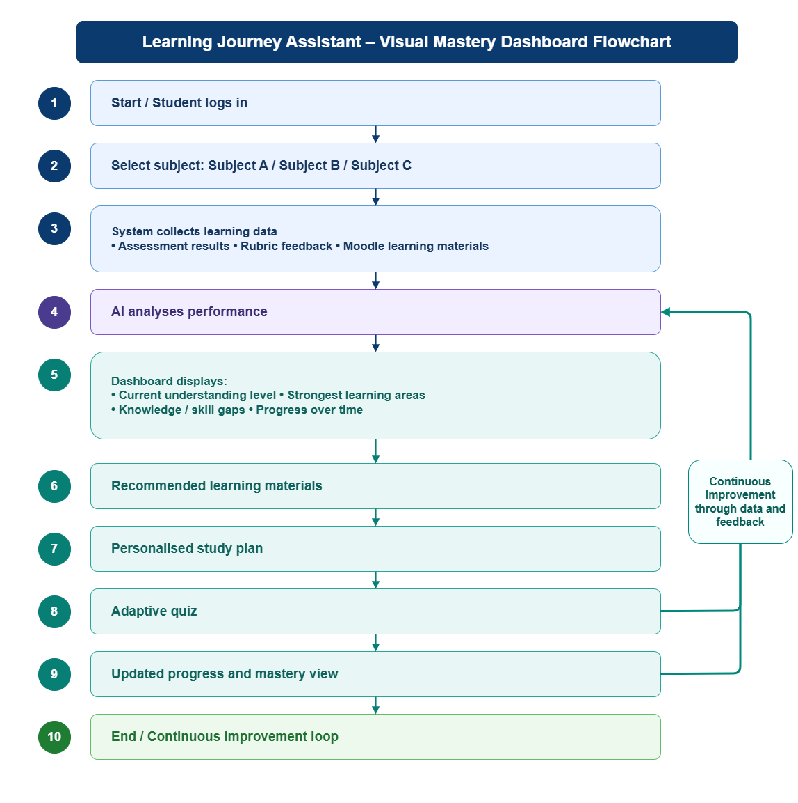
ROADMAP
Mastery Dashboard Flow Chart
Notes:
Distinguish what ships first from what's exploratory.

Slide 10
THE TEAM
Six roles, one shared mission
Business Analyst Requirements, governance & compliance
Engineering Manager Architecture, delivery & risk management
SWE-1 (Backend/Integration) Moodle integration, auth & security
SWE-2 (Data/ML) Competency engine & synthetic data
SWE-3 (AI/NLP) Feedback parsing & recommendations
SWE-4 (Frontend) Dashboard, quiz UI & student UX
Agile/Scrum methodology with rotating Scrum Master 12-week semester delivery (Jul–Oct 2026)
Notes:
Distinguish what ships first from what's exploratory.

Slide 11
TECGNOLOGY STACK
Enterprise-grade, proven technologies
LMS Integration:
Moodle (Docker, MariaDB, REST API)
Backend:
Python + FastAPI
PostgreSQL database
pgvector for semantic search
AI/ML:
Provider-agnostic LLM (Azure OpenAI recommended)
Vector embeddings for competency matching
Frontend:
React + TypeScript
Recharts for visualization
Platform:
GitHub + GitHub Actions CI
Docker Compose deployment
pytest + jest testing
Notes:
Distinguish what ships first from what's exploratory.

Slide 12
DELIVERY TIMELINE
12 weeks, 5 sprints, disciplined delivery
LMS Integration:
Moodle (Docker, MariaDB, REST API)
Backend:
Python + FastAPI
PostgreSQL database
pgvector for semantic search
AI/ML:
Provider-agnostic LLM (Azure OpenAI recommended)
Vector embeddings for competency matching
Frontend:
React + TypeScript
Recharts for visualization
Platform:
GitHub + GitHub Actions CI
Docker Compose deployment
pytest + jest testing
Notes:
Distinguish what ships first from what's exploratory.

Slide 13
LET'S TALK
Learn from every mistake — that's the whole idea.
Visit our booth for a live walkthrough of the mastery dashboard, or scan the QR code below to book a demo.
Learning Journey Assistant Team La Trobe University · Booth 12
Notes:
End on the CTA -- direct people to the demo / booth conversation.

