Slide 1
Agentic Public Records Compliance Assistant
CMU · Building Agentic AI Systems · Capstone (Research Assistant track)
Evidence-grounded redaction recommendations for New Jersey OPRA requests, with a human in charge
4 deterministic agents on LangGraph
MCP tool server (4 tools)
Policy RAG over 5 nj.gov documents
Selective Tree of Thought
Mandatory human authorization
Final presentation · November 2026 · all records are synthetic; policy sources are public nj.gov documents
Notes:
Introduce the project: a research-assistant agent that helps public-records staff prepare redactions under New Jersey's Open Public Records Act. Four agents coordinate on a LangGraph workflow, call tools through an MCP server, retrieve official policy text, use Tree of Thought only for ambiguous cases, and stop for a human to authorize every output. Say up front: the agents are deterministic and rule-based; no LLM is called in the workflow; all records are synthetic.

Slide 2
Redaction is manual, and every one needs a legal basis
Before releasing a record under New Jersey's Open Public Records Act (OPRA), a custodian must:
Intended users
1
Public-records custodians and review staff at New Jersey agencies
find personal information: phone numbers, licence numbers, home addresses, IP addresses
decide whether the statute or GRC guidance requires redaction, and cite it
redact consistently and record why
2
What the assistant does
Finds candidate personal information, retrieves the governing OPRA/GRC text, recommends with citations, escalates when unsure
Manual, repetitive, and easy to get wrong. A missed number is a privacy breach; an unsupported redaction wrongly withholds public information.
3
What it never does
Decide disclosure. A named human approves every redaction, and nothing is published
Prototype scope: synthetic text records · public nj.gov policy documents · no real records or personal data
Agentic Public Records Compliance Assistant · CMU Building Agentic AI Systems capstone
2
Notes:
The users are records custodians. The hard part is not spotting a phone number; it is establishing that a specific provision requires redaction, applying it consistently, and keeping a record. Errors go both ways: missing personal data is a breach, redacting without a basis wrongly withholds public information. The assistant prepares evidence and recommendations; the custodian decides.

Slide 3
Why a standalone LLM is not enough
A single LLM prompt
This agentic system
Can invent a plausible statute or section
Cites only retrieved chunk ids; validate_citations checks each exists and is verbatim
Knows only its training data
Retrieves current text from 5 official nj.gov documents
Cannot act on the record
Calls detection, retrieval and validation tools through MCP
One pass, no recovery
Bounded multi-step loops with retries, timeouts and a step limit
May follow instructions hidden in documents
Retrieved text is evidence only; non-official sources cannot be cited
No audit trail; may imply a decision
Hash-chained audit log; a named human authorizes every output
Agentic Public Records Compliance Assistant · CMU Building Agentic AI Systems capstone
3
Notes:
A compliance answer needs evidence, actions and accountability that one prompt cannot provide. The agentic design separates detection, retrieval, validation and review; constrains citations to retrieved, validated chunks; recovers from tool failures within limits; and records everything for audit. The final decision stays with a person.

Slide 4
Final architecture (as implemented)
Four deterministic agents on one LangGraph workflow; ToT is a conditional subgraph, not a fifth agent; a human authorizes every output
LangGraph StateGraph workflow (app/workflows/graph.py)
Synthetic inputs
OPRA-style request + synthetic record
(data/, 'Synthetic: yes' header)
Orchestrator Agent: plans, routes, merges evidence, bounded retries, step limit, escalation
Reviewer-requested re-evaluation
≤ 2 per finding: Policy Research, QA and ToT run again
feedback
Record Analysis Agent
detect_pii · ≤ 2 attempts
Policy Research Agent
search_policy · ≤ 2 queries per category
Compliance & QA Agent
propose_redactions · validate_citations · missed-PII sweep
Conditional ToT subgraph
only for AMBIGUOUS / CONFLICTING
branching 3 · depth 3 · beam 2 · min 70
Human review (mandatory)
LangGraph interrupt() → Streamlit review session
approve · reject · modify · re-evaluate · add missed redaction
generate
evaluate
QA critic
Legend
→ workflow control
⇢ tool call / feedback
dashed box: conditional
grey box: future
MISSING → one targeted retrieval, then re-check
Evidence
decision
prune
reject · beam
select or
escalate
Final authorization
named reviewer · every finding resolved
Shared typed WorkflowState: findings · evidence · QA report · ToT result · tool_calls · audit (append-only)
CLEAR → standard ReAct path
(rule tool + validated citations)
Finalize recommendations
every tool call (ToolCaller with timeout)
Deterministic span redaction
derivative in outputs/ · original unchanged
Future architecture (not implemented)
LLM planner and critic in the workflow
Audio / video transcription and redaction
Multi-user access control
Persistent cross-process checkpoints
MCP tool layer: official MCP Python SDK, stdio server (app/mcp_server.py), 4 read-only tools
search_policy
validate_citations
detect_pii
propose_redactions
Audit report
hash-chained review events · tool calls · ToT branches
Policy RAG knowledge base
Hybrid BM25 + ChromaDB (all-MiniLM-L6-v2) · 5 official nj.gov documents · 496 chunks · provenance guard
Presidio + spaCy
PII detector
Deterministic redaction rules
Notes:
Walk the diagram left to right. The Orchestrator owns the workflow state and routing. Record Analysis detects candidate personal data, Policy Research retrieves official text, and Compliance & QA proposes redactions, validates every citation and classifies the evidence. CLEAR evidence takes the standard ReAct path; MISSING evidence gets one targeted retrieval and then escalates; only AMBIGUOUS or CONFLICTING evidence enters the Tree of Thought subgraph, which is part of the workflow, not a fifth agent. Every path stops at human review (a LangGraph interrupt). All tool calls go through the MCP server. The grey box lists future work that is not implemented.

Slide 5
ReAct tool use through MCP: decide, call a tool, observe, repeat
Decide
MCP server official MCP Python SDK 2.3.0 · stdio · 4 read-only tools
1
The agent's rules pick the next tool from the current state
detect_pii
Presidio + spaCy: spans, category, confidence
Act
called by Record Analysis
2
Call the tool through MCP; inputs validated, call timed out and logged
search_policy
Hybrid retrieval with an evidence status
called by Policy Research
3
Observe
The structured result is written to the shared workflow state
Deterministic rules; accepts chunk ids only
propose_redactions
called by Compliance & QA
4
Repeat or stop
Bounded: ≤ 2 attempts, ≤ 2 queries per category, step limit 30
validate_citations
Chunk exists, excerpt verbatim, source official
called by QA and the ToT critic
Rule-based, not LLM-driven. A Claude planner exists (Milestone 3) but was tested only with a fake client. No LLM runs in the workflow.
Recorded trace, Scenario A: detect_pii → search_policy → propose_redactions → validate_citations (5/5 valid). No ToT call.
Agentic Public Records Compliance Assistant · CMU Building Agentic AI Systems capstone
5
Notes:
Each agent runs a bounded ReAct-style loop: decide on a tool, call it, observe the structured result, then decide again or stop. The decisions are made by rules, which makes the behaviour reproducible and testable; it is not LLM tool selection. The four tools are exposed by an MCP server built with the official Python SDK over stdio; all are read-only. The Scenario A trace shows the four calls of the standard path.

Slide 6
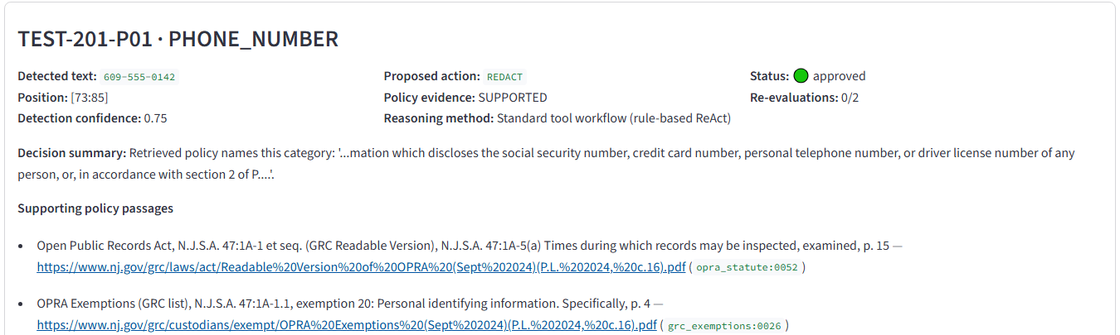
Policy retrieval grounds every recommendation in official text
5 official nj.gov documents: OPRA statute, GRC exemptions, GRC redaction guidance, Custodian's Handbook, AG Directive 2022-1
Executed query (Checkpoint 3.1, reproduced in Milestone 7)
“What New Jersey law applies when a public record contains someone's personal telephone number?”
Rank 2 · N.J.S.A. 47:1A-5(a) · p. 15 · chunk opra_statute:0052 · cosine 0.654
496 section-aware chunks with title, section (e.g. 47:1A-5(a)), page and source URL
Hybrid search: BM25 + ChromaDB (all-MiniLM-L6-v2), top 4 passages
Evidence thresholds: SUFFICIENT or INSUFFICIENT
Screenshot: the running reviewer app, Scenario A finding card with real citations and URLs
Provenance guard: only nj.gov sources can be cited
No passage names the category → MISSING → “Human review required”. Never an invented citation (Scenario C: IP address).
Agentic Public Records Compliance Assistant · CMU Building Agentic AI Systems capstone
6
Notes:
The knowledge base is five official New Jersey documents chunked by section, so every passage carries its title, section, page and URL. Retrieval is hybrid: keyword BM25 plus semantic search in ChromaDB. For the phone-number question, the operative statute 47:1A-5(a) is returned at rank 2. The screenshot is from the real app. If no passage names the category, the evidence is MISSING and the item goes to human review; the system never writes a citation of its own.

Slide 7
Selective Tree of Thought: only when the evidence is ambiguous
CLEAR
standard path · 14 of 14 straightforward cases bypassed ToT
Real run: Scenario B, a retired judge's home address
Branch | Depth | Action | Rel | Cit | Cons | Expl | Total | Status
d1.1 | 1 | REDACT | 20 | 15 | 13 | 15 | 63 | unverified
d1.2 | 1 | HUMAN REVIEW | 15 | 30 | 25 | 15 | 85 | evaluated
d1.1>2 | 2 | REDACT | 30 | 30 | 25 | 15 | 100 | selected
AMBIGUOUS / CONFLICTING
ToT subgraph · 7 of 7 activated
MISSING
one targeted retrieval, then escalate
branching ≤ 3
depth ≤ 3
beam 2
select ≥ 70
Depth 2 checked “covered person” against the record (“retired Superior Court judge”) and spent the one targeted retrieval, adding the operative 47:1A-5(a) text.
The reviewer then answered covered status = unconfirmed. ToT re-ran and the case escalated (d1.2, 85).
Across the evaluation: 8 ToT runs, 25 branches, 2 rejected, 13 kept as uncertain, 0 limit violations.
Critic rubric (deterministic Compliance & QA)
Policy relevance
30
Citation validity
30
Consistency with facts
25
Explanation & uncertainty
15
Rejected outright: fabricated or altered citation · unsupported factual assumption · REDACT with no evidence.
REDACT selectable only if every assumption is SUPPORTED and an operative provision is cited.
Implemented: a LangGraph subgraph run by the Orchestrator, not a fifth agent.
Changed from proposal: CrewAI/LangChain critic agent → deterministic QA critic.
Agentic Public Records Compliance Assistant · CMU Building Agentic AI Systems capstone
7
Notes:
ToT runs only when the QA agent classifies the evidence as ambiguous or conflicting, for example a provision that protects home addresses only for certain classes of people. It is a beam search: up to three candidate interpretations, depth three, keep the best two, and a branch must score at least 70. Scores use the 30/30/25/15 rubric from Checkpoint 4.1, but scores alone never authorize a redaction: every factual assumption must be supported and an operative provision cited. The table is the real Scenario B run. Be clear that the critic is deterministic, not an LLM agent as originally proposed.

Slide 8
Evaluation: 22 scenarios, ReAct-only vs ReAct + ToT
0
+1
unsupported redactions in either configuration
preferred decision with ToT (S12, retired judge's address)
21/21
+13
correct ToT activation or bypass decisions
extra tool calls; +0.11 s per ToT case; $0 (no LLM)
Recall 17/19: the detector misses a spelled-out and a 7-digit phone number; QA flags both for the reviewer.
Live demo: A clear → approved and redacted · B ambiguous → ToT 100 → reviewer feedback → escalated · C missing evidence → finalization blocked
Source: docs/milestone_6/evaluation_results.json (commit 7a1a875), recomputed from 44 raw traces (33/33 match). Deterministic agents, simulated reviewer, self-authored scenarios: not a general accuracy claim.
8
Notes:
Same 22 scenarios in both configurations; only enable_tot differs. Most metrics are identical: precision 1.00, recall 0.895, every action acceptable, all escalations correct, 22 of 22 end-to-end. ToT changed one decision: S12, where it found a fully verified redaction instead of abstaining, so the preferred-action rate rose from 0.88 to 0.94. It cost 13 extra tool calls and about a tenth of a second per ToT case. Importantly, before the evaluation-driven fixes ToT made two unsupported redactions; they are fixed and covered by regression tests. With 7 ToT cases this is evidence of no harm and one gain, not a general accuracy claim. Then run the live demo: scenarios A, B and C.

Slide 9
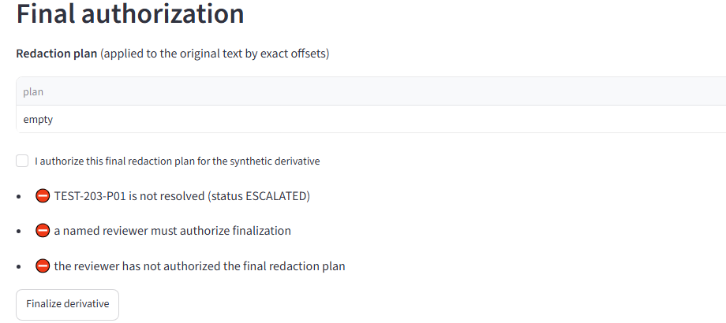
Guardrails keep a human in charge
1
No invented law
Only retrieved chunk ids can be cited; QA vetoes any invalid citation
2
Provenance
Non-nj.gov text is never cited; the injected document in S20 was blocked
3
Bounded
Retries, step limit 30, ToT depth/beam/tool budgets, ≤ 2 re-evaluations
4
Originals untouched
Derivative written separately; source hash re-checked at finalization
Real UI, Scenario C: finalization blocked for an escalated, unsupported finding
5
Human authorization
Limitations
LangGraph interrupt; named reviewer; every finding resolved first
Rule-based agents; no LLM in the loop
Detector misses spelled-out and 7-digit numbers
22 self-authored scenarios; simulated reviewer
Text only; single local reviewer, no access control
6
Audit
Append-only, hash-chained review events and full tool-call history
16/16 safety checks over 44 runs · 40/40 guardrail tests · 314/314 tests
Agentic Public Records Compliance Assistant · CMU Building Agentic AI Systems capstone
9
Notes:
These controls are enforced in code and covered by tests, not just described. The screenshot is the real app refusing to finalize Scenario C: the finding is escalated, so the reviewer must reject or modify it as their own decision. Be direct about limitations: the agents are rule-based, the detector has known gaps that QA flags for the reviewer, and the dataset is small and self-written.

Slide 10
Lessons learned, conclusion and roadmap
Lessons learned
Conclusion
Roadmap
future work; none of it is implemented
Comparing A with B exposed 4 defects that unit tests missed
A high rubric score is not legal correctness
Provenance checks mattered more than extra branches
Deterministic agents made every result reproducible
Every course concept implemented, with tests and traces
Selective ToT helps a narrow class of ambiguous cases at small cost
The human reviewer remains the decision maker
LLM planner and critic behind the same guardrails
Better detection of spelled-out numbers
More policy sources with provenance checks
Synthetic audio and video
Multi-user review and a study with records staff
Thank you. Questions?
Agentic Public Records Compliance Assistant · CMU Building Agentic AI Systems capstone
10
Notes:
Close with three lessons. First, evaluation against a baseline found real defects, including two that only appeared with ToT. Second, a confident score is not correctness, which is why redaction needs verified facts, official citations and a human. Third, controlling what counts as evidence mattered more than generating more reasoning paths. The roadmap items are future work, not implemented.

