Slide 1
GLOBOWAX
PLATFORM
Operations System and Globowax Club Loyalty Program — Partner Presentation
From paper tickets to a digital system: a structure running in real use today.

Slide 2
THE PROBLEM
Customers come once and leave
And most never come back.
5–25×
%25–95
0
How much more expensive it can be to win a new customer than to retain an existing one
The profit increase a 5% rise in customer retention can create
Systems we've had, until now, tracking customer loyalty and visit history
Harvard Business Review
Bain & Company
2

Slide 3
THE SOLUTION
One platform, two powerful parts
Check-In and Operations App
Globowax Club Loyalty Platform
Tracks every step from vehicle intake to delivery, and takes payment (cash / card / split).
Automatically manages points, gift cards, campaigns, and customer messaging in the background.
Together: turns one-time customers into regulars, without adding work for staff.
3

Slide 4
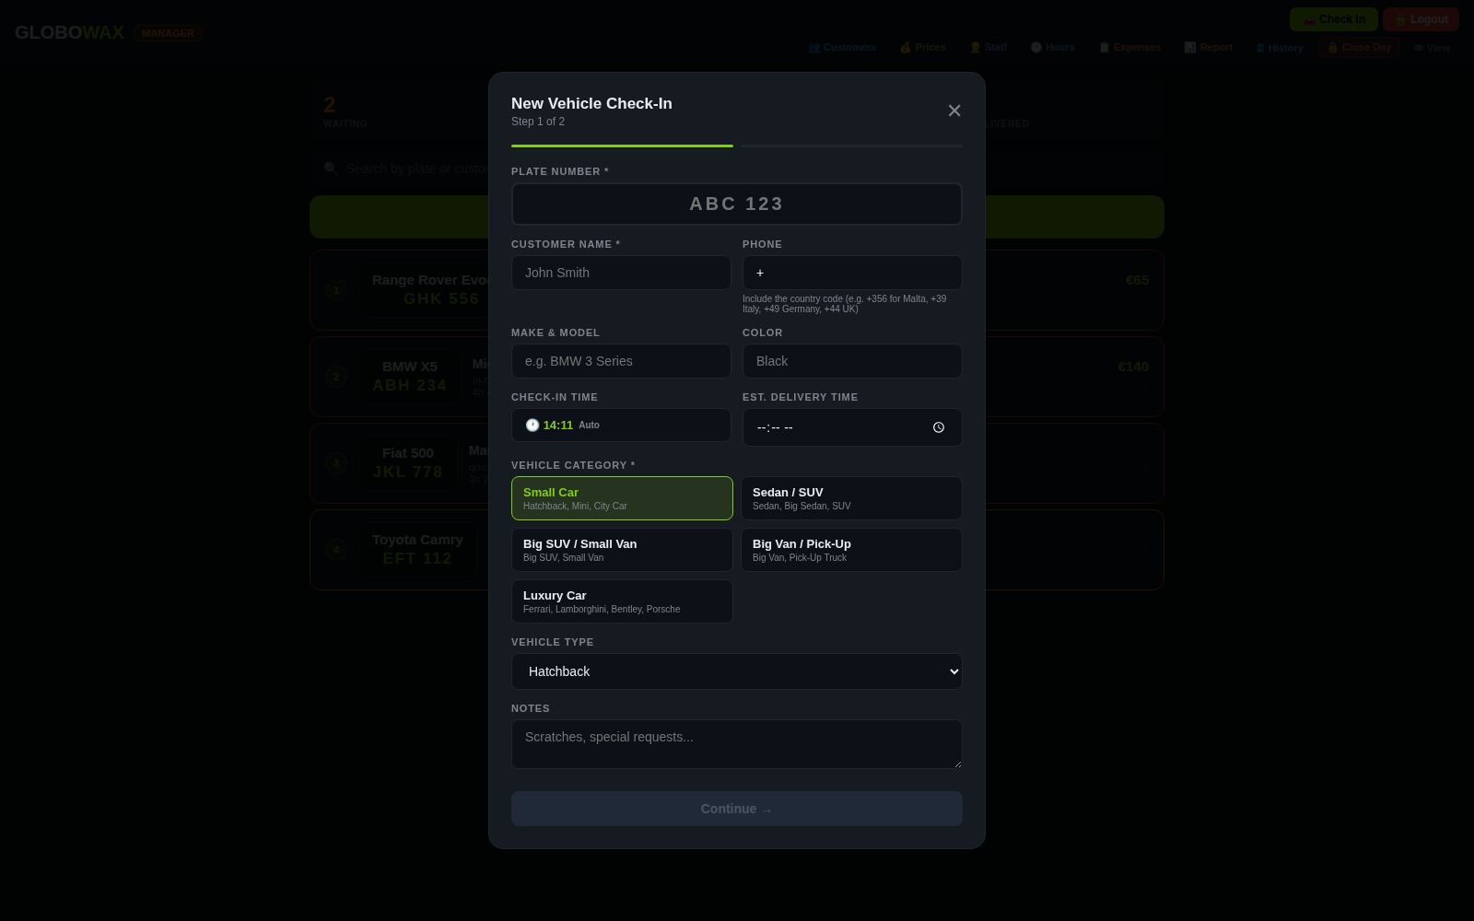

PAPER TO DIGITAL — 1
Structured data instead of a paper ticket
Customer name, phone, plate, service — now entered into a searchable system, not a piece of paper.
app.globowaxmalta.com — New Vehicle Check-In
Phone number validated with country code — blocks incomplete or incorrect data entry
Vehicle category and service selection from a standard list — no handwriting to decipher
The record lands in the system instantly, updating both operations and customer history at once
4

Slide 5
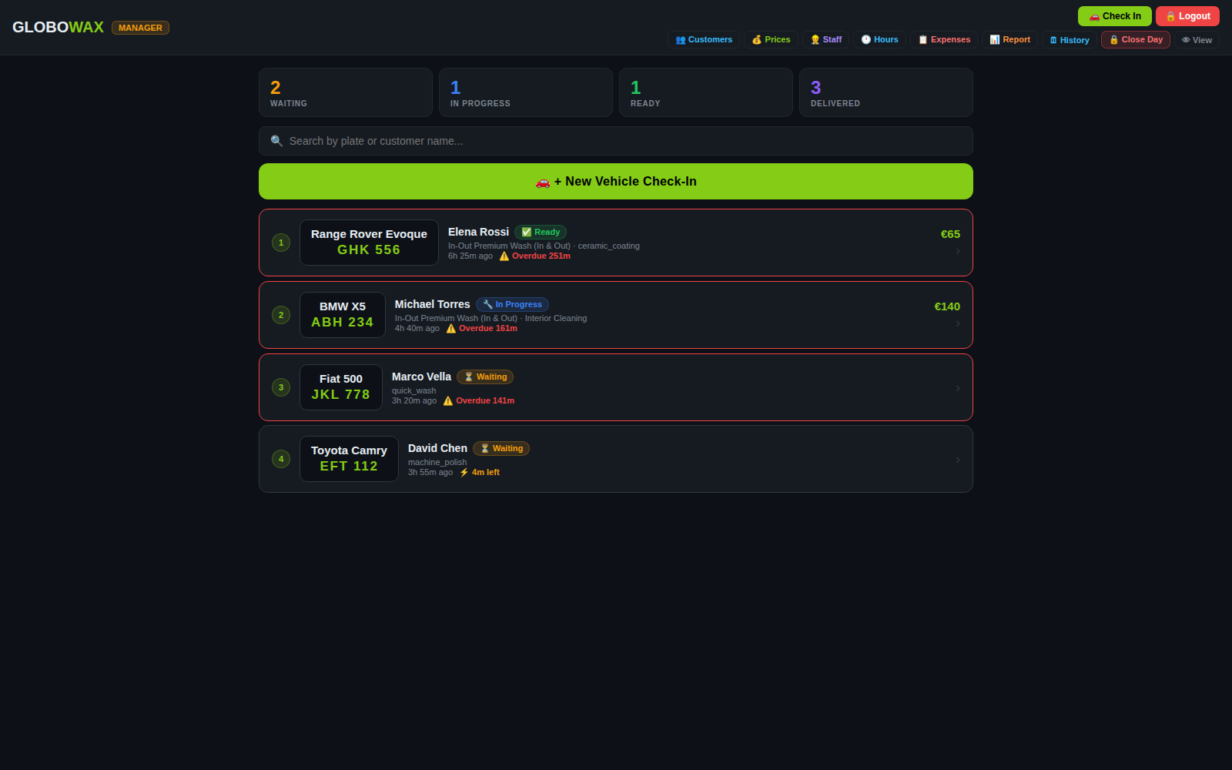
PAPER TO DIGITAL — 2
Every vehicle, at a glance, on one screen
What a paper board can't show: how long each vehicle has been waiting, and whether it's overdue.
app.globowaxmalta.com — Operations Board
5

Slide 6
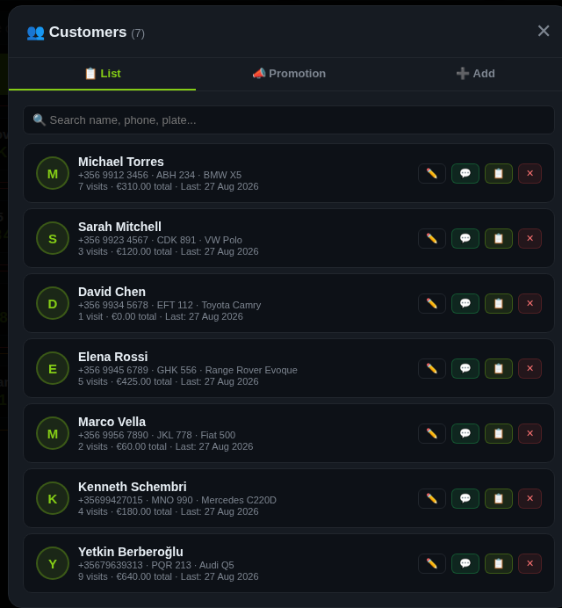
PAPER TO DIGITAL — 3
Every detail, reachable in seconds
Finding how many times a customer visited, or how much they spent, is no longer flipping through a notebook.
app.globowaxmalta.com — Customer List
6

Slide 7
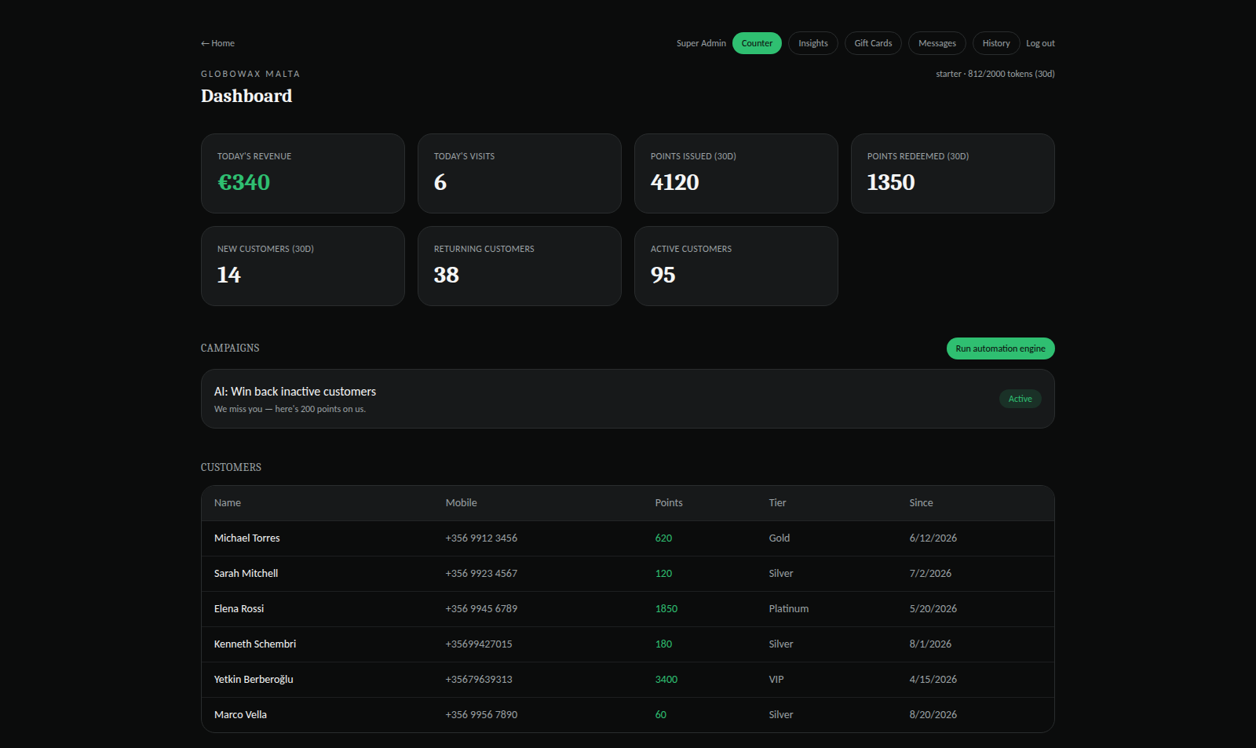
PAPER TO DIGITAL — 4
The loyalty program, in one panel
Daily revenue, points earned/redeemed, customer tiers — all at a glance.
loyalty.globowaxmalta.com/admin — Dashboard
7

Slide 8




CUSTOMER JOURNEY
The customer earns without doing anything
1
2
3
4
→
→
→
Visits
Earns automatically
Checks anytime
Redeems, returns
Gets their car washed as usual
5% of the spend is added to their account as points
No sign-up needed, just their phone number
Uses points as a discount on their next visit
No card · No app to download · No sign-up required
8

Slide 9
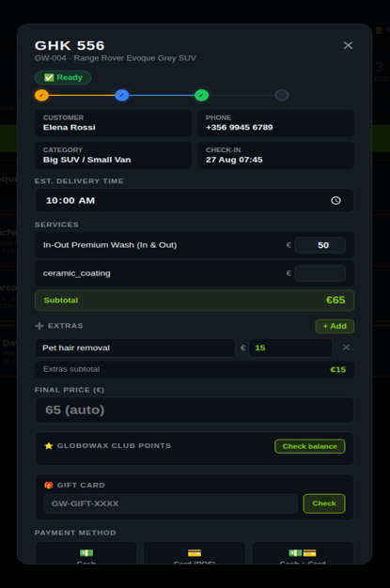
IN THE APP
Points and gift cards, right on the payment screen
Staff can apply points or a gift card from the same screen, without switching systems.
app.globowaxmalta.com — Payment Screen
9

Slide 10




FOR THE BUSINESS
Real operational advantages
Single-screen management
Automatic reporting
Check-in, payment, points, and gift card redemption all on one screen.
Daily revenue, past days, customer list — no manual tracking.
Automatic campaigns
Zero extra workload
Customers inactive for 30 days automatically get bonus points.
Staff just do their usual job — points are processed automatically.
10

Slide 11

FOR THE CUSTOMER
A frictionless experience for the customer
No card or app needed
Automatic points on every visit
Automatically tracked by phone number.
5% of the spend, with no action required.
Can check anytime
Flexible redemption
Looks it up at loyalty.globowaxmalta.com with their phone number.
Points as a cash discount, plus a gift card can be used separately.
11

Slide 12
ESTIMATED IMPACT
Example scenario: the revenue impact of retention
The figures below are an illustrative example scenario, not a measured result.
450
active customers (real)
10%
additional return rate (example)
≈ 45
extra visits / month
≈ €45
average transaction
≈ €2000
estimated extra monthly revenue
12

Slide 13
COST COMPARISON
The cost of running the system
Supabase (database)
€0–25 / mo
Netlify (hosting, 2 sites)
€0–40 / mo
Domain
≈ €1.5 / mo
WhatsApp / SMS (live integration)
€20–50 / mo
Estimated total
≈ €30–90 / mo
13

Slide 14
SUMMARY
Why we should move to this system
Not a concept — a system running in real use today
What used to be on paper is now searchable, reportable data
Requires zero effort from the customer, automates loyalty entirely
Low running cost, with potential return many times over
14

Slide 15

With this integrated Carwash Management and the CRM programme,
Globowax,
Become one of a kind professional Carwash & Detailing
loyalty.globowaxmalta.com

