Slide 1
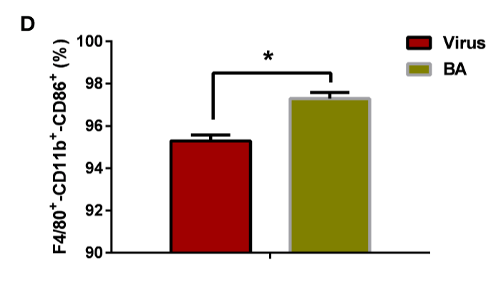
研究背景
问题
现状
对策
目标
老年人流感死亡负担
现药临床获益
植物来源候选依据
本课题研究目标
超额呼吸死亡率（例/10万人季）
症状缓解中位时间（小时）
粗提物候选价值
95%CI (例/10万人季)
<60岁
1.5 (1.1–1.9)
活性成分与NP
≥60岁
38.5 (36.8–40.2)
作用解释与转化边界
0
20
40
≥60岁死亡率较高
中国2010–15年估计
症状缓解中位时间
53.7 vs 80.2小时
非复杂流感门诊试验
黄芩苷的宿主反应
前临床，纵轴90%起
粗提物与NP候选价值
成分、效应与作用解释
1
Notes:
Topic: 植物来源天然产物的抗流感候选价值与活性成分研究
Slide title: 研究背景｜证据链
Presentation subtitle: 植物来源天然产物的抗流感候选价值与活性成分研究
Presentation scope: 研究与计划为拟议设计，未声称已取得项目结果。
Slide notice: 前三栏为已发表文献证据；目标为植物X与NP的拟议课题
老年人流感死亡负担: ≥60岁死亡率较高
中国2010–15年估计
Statement type: evidence
Evidence audit:
{
"status": "checked",
"sourceIds": [
"li2019"
],
"claimIds": [
"li2019-age-respiratory-mortality"
],
"locator": "Table1: Average annual influenza-associated excess respiratory mortality rate, All influenza column, <60 y and ≥60 y rows; Results age-specific paragraph (NCBI BioC offset15086); PubMed abstract Findings.",
"reviewed": true,
"reviewer": "Codex influenza_evidence: independent primary-source review",
"reviewNote": "2026-10-13独立核对原文Table1的All influenza列，并与Results中年龄分层段落和PubMed Findings交叉核对：<60岁点估计1.5、95%CI1.1–1.9；≥60岁点估计38.5、95%CI36.8–40.2。图中values是真实报告的平均每季超额呼吸死亡率模型点估计，不是由上下界推算的midpoint。人口为中国大陆，季节范围为2010–11至2014–15，流感A/B合计；不是A型单独死亡率，也不是当前年度统计。标题和caption仅比较原文的人群超额呼吸死亡率，不把死亡率、人数、全因死亡或天然产物临床疗效混为一谈。原文为观察性人群统计建模研究，非治疗试验。"
}
Native editable data:
{
"type": "interval",
"categories": [
"<60岁",
"≥60岁"
],
"series": [
{
"name": "超额呼吸死亡率",
"values": [
1.5,
38.5
],
"lower": [
1.1,
36.8
],
"upper": [
1.9,
40.2
]
}
],
"unit": "例/10万人季",
"intervalLabel": "95%CI",
"axis": {
"min": 0,
"max": 45,
"majorUnit": 20,
"title": "超额呼吸死亡率（例/10万人季）",
"format": "0.0"
},
"dataChecked": true,
"sourceIds": [
"li2019"
],
"locator": "Table1, All influenza column, <60 y and ≥60 y rows",
"statistic": "Reported average seasonal model point estimates with95%confidence intervals; not inferred interval midpoints",
"footnote": "中国2010–11至2014–15季；季节性A/B合计；点为模型估计，线为95%CI。非当前年度统计。"
}
现药临床获益: 症状缓解中位时间
53.7 vs 80.2小时
非复杂流感门诊试验
Statement type: evidence
Evidence audit:
{
"status": "checked",
"sourceIds": [
"hayden2018"
],
"claimIds": [
"hayden-symptom-alleviation"
],
"locator": "NEJM Results → Phase 3 Trial → Clinical and Virologic Efficacy; Figure 2 caption; Methods → Outcomes Measured; PubMed abstract Results.",
"reviewed": true,
"reviewer": "Codex influenza_evidence: independent primary-source review",
"reviewNote": "2026-10-13独立核对PubMed Results及NEJM主论文索引全文Figure 2图注：两组为53.7（95%CI 49.5–58.5）及80.2（72.6–87.1）小时，Figure 2可评价数分别455及230。首作者、题名、2018年卷期页、DOI与PubMed/Crossref匹配。主张、柱数据及caption均限于症状缓解中位时间；未以中位数重建生存曲线，未将一般健康非复杂流感门诊患者外推至重症，亦不视为植物天然产物证据。"
}
Native editable data:
{
"type": "bar",
"categories": [
"巴洛沙韦",
"安慰剂"
],
"series": [
{
"name": "症状缓解中位时间",
"values": [
53.7,
80.2
]
}
],
"unit": "小时",
"axis": {
"title": "症状缓解中位时间（小时）",
"min": 0,
"max": 100,
"majorUnit": 25,
"format": "0.0"
},
"sourceIds": [
"hayden2018"
],
"locator": "Figure 2 caption; PubMed abstract Results",
"dataChecked": true,
"statistic": "median time to symptom alleviation",
"footnote": "可评价n=455/230；门诊非复杂流感，不代表重症或天然产物疗效。",
"confidenceIntervals": {
"level": 95,
"lower": [
49.5,
72.6
],
"upper": [
58.5,
87.1
],
"unit": "小时",
"notPlotted": true
},
"nEvaluable": [
455,
230
],
"nITTInfected": [
456,
231
]
}
植物来源候选依据: 黄芩苷的宿主反应
前临床，纵轴90%起
Statement type: evidence
Evidence audit:
{
"status": "checked",
"sourceIds": [
"geng2020"
],
"claimIds": [
"geng-host-response-figure"
],
"locator": "Figure 1D and Abstract Results",
"reviewed": true,
"reviewer": "Codex primary-source figure review",
"reviewNote": "Independently checked Figure1D, its original legend and the Results. The selected panel shows M1 macrophage proportions, retaining original bars, error bars, significance markers, group labels and the90%axis baseline. It does not alone establish antiviral potency or clinical efficacy. BA denotes baicalin; this external published result is not plantX/NP project data. Original publisher figure panel is reused under CCBY4.0, with attribution; no data are redrawn or estimated from pixels."
}
Image identity and reuse:
{
"type": "image",
"path": "assets/geng2020-fig1d.png",
"role": "source",
"alt": "Geng2020 Figure1D: published macrophage phenotype result; original axis begins at90%",
"sourceIds": [
"geng2020"
],
"locator": "Figure 1D",
"license": "CC BY 4.0"
}
本课题研究目标: 粗提物与NP候选价值
成分、效应与作用解释
Statement type: proposed
Native editable proposed design:
{
"type": "diagram",
"role": "design",
"direction": "vertical",
"nodes": [
{
"id": "goal-0",
"label": "粗提物候选价值"
},
{
"id": "goal-1",
"label": "活性成分与NP"
},
{
"id": "goal-2",
"label": "作用解释与转化边界"
}
],
"edges": [
{
"from": "goal-0",
"to": "goal-1"
},
{
"from": "goal-1",
"to": "goal-2"
}
]
}
References:
[1] Influenza-associated excess respiratory mortality in China, 2010–15: a population-based study. The Lancet Public Health 2019. DOI: 10.1016/S2468-2667(19)30163-X. https://pubmed.ncbi.nlm.nih.gov/31493844/
Source license: Article: CC BY-NC-ND4.0; numeric facts independently redrawn, no original figure or table image reused
[2] Baloxavir Marboxil for Uncomplicated Influenza in Adults and Adolescents. New England Journal of Medicine 2018. DOI: 10.1056/NEJMoa1716197. https://www.nejm.org/doi/full/10.1056/NEJMoa1716197
Source license: Copyright2018 Massachusetts Medical Society; numeric facts redrawn, no source figure reused
[3] Baicalin Inhibits Influenza A Virus Infection via Promotion of M1 Macrophage Polarization. Frontiers in Pharmacology 2020. DOI: 10.3389/fphar.2020.01298. https://doi.org/10.3389/fphar.2020.01298
Source license: unknown; no source figure reused
[4] Baicalein, Ethyl Acetate, and Chloroform Extracts of Scutellaria baicalensis Inhibit the Neuraminidase Activity of Pandemic 2009 H1N1 and Seasonal Influenza A Viruses. Evidence-Based Complementary and Alternative Medicine 2013. DOI: 10.1155/2013/750803. https://doi.org/10.1155/2013/750803
Source license: unknown; no source figure reused

Slide 2
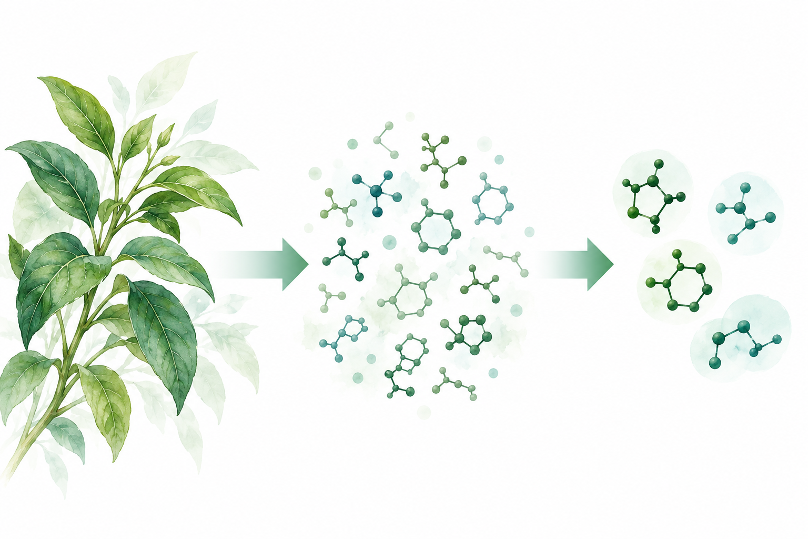
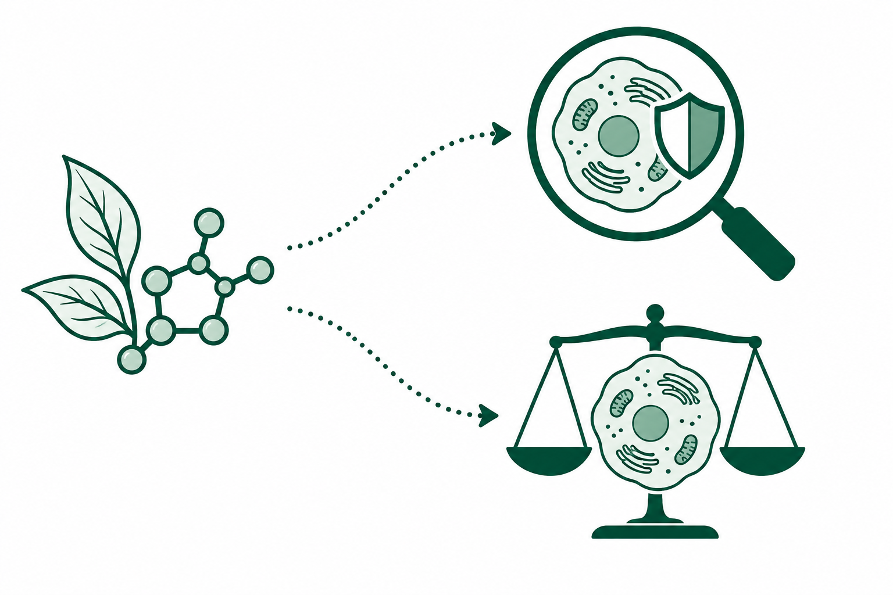
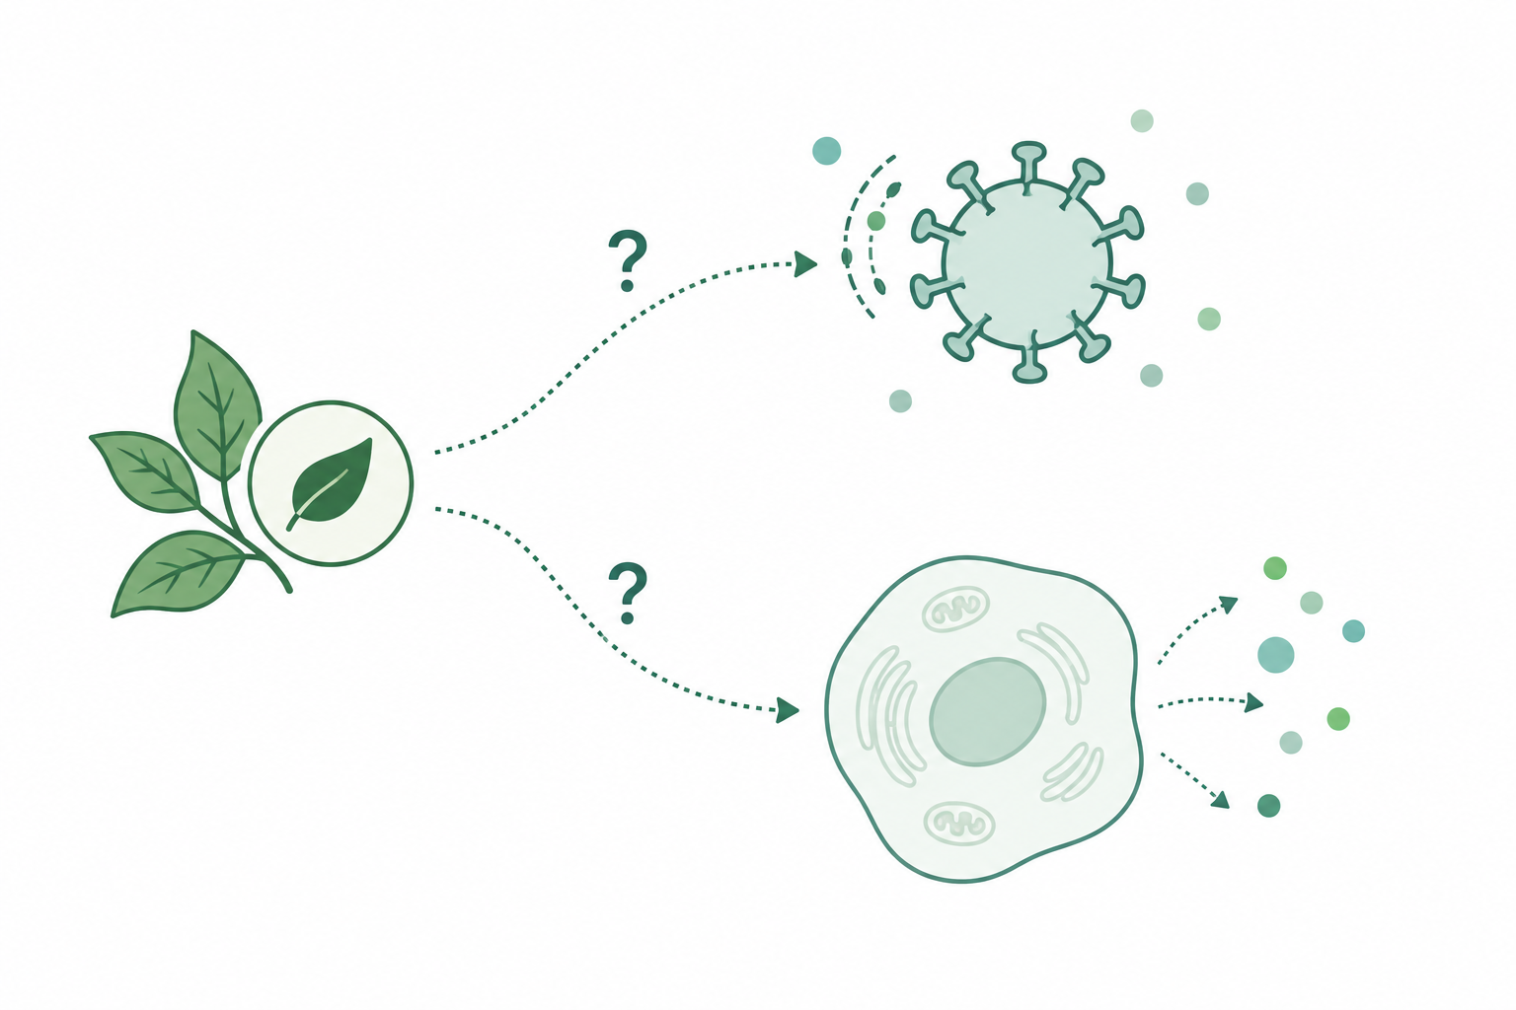
科学问题
植物 X 中哪些天然产物具有抗流感候选价值，如何解释其作用？
研究对象
核心比较
解释目标
植物 X 粗提物与候选 NP
并行解释效应与宿主安全性
连接成分、效应与作用路径
2
Notes:
Topic: 植物来源天然产物的抗流感候选价值与活性成分研究
Slide title: 科学问题｜研究假设（拟议）
Presentation subtitle: 植物来源天然产物的抗流感候选价值与活性成分研究
Presentation scope: 研究与计划为拟议设计，未声称已取得项目结果。
Slide notice: 拟议问题｜需结合项目条件确认
Main scientific question: 植物 X 中哪些天然产物具有抗流感候选价值，如何解释其作用？
研究对象: 植物 X 粗提物与候选 NP
Statement type: proposed
Image identity and reuse:
{
"type": "image",
"path": "assets/concept-0.png",
"role": "design",
"alt": "由粗提物整体效应延伸至候选成分，保留植物与化合物身份的待确认状态。",
"provenance": {
"kind": "ai-generated",
"source": "OpenAI ImageGen: original high-level proposed-research concept,2026-10-13",
"license": "LicenseRef-RSW-Noncommercial-Research-1.0",
"priorDistributionLicense": "MIT",
"licenseNote": "Provided author-owned material under the repository LICENSE for noncommercial research, teaching, and personal study. Prior valid licenses and third-party rights remain unaffected."
}
}
核心比较: 并行解释效应与宿主安全性
Statement type: proposed
Image identity and reuse:
{
"type": "image",
"path": "assets/concept-1.png",
"role": "design",
"alt": "判断效应能否与宿主损伤区分，同时识别粗提物与候选成分的证据边界。",
"provenance": {
"kind": "ai-generated",
"source": "OpenAI ImageGen: original high-level proposed-research concept,2026-10-13",
"license": "LicenseRef-RSW-Noncommercial-Research-1.0",
"priorDistributionLicense": "MIT",
"licenseNote": "Provided author-owned material under the repository LICENSE for noncommercial research, teaching, and personal study. Prior valid licenses and third-party rights remain unaffected."
}
}
解释目标: 连接成分、效应与作用路径
Statement type: proposed
Image identity and reuse:
{
"type": "image",
"path": "assets/concept-2.png",
"role": "design",
"alt": "解释哪些成分值得优先关注，以及直接作用或宿主反应各能解释哪些现象。",
"provenance": {
"kind": "ai-generated",
"source": "OpenAI ImageGen: original high-level proposed-research concept,2026-10-13",
"license": "LicenseRef-RSW-Noncommercial-Research-1.0",
"priorDistributionLicense": "MIT",
"licenseNote": "Provided author-owned material under the repository LICENSE for noncommercial research, teaching, and personal study. Prior valid licenses and third-party rights remain unaffected."
}
}
References:
[1] Influenza-associated excess respiratory mortality in China, 2010–15: a population-based study. The Lancet Public Health 2019. DOI: 10.1016/S2468-2667(19)30163-X. https://pubmed.ncbi.nlm.nih.gov/31493844/
Source license: Article: CC BY-NC-ND4.0; numeric facts independently redrawn, no original figure or table image reused
[2] Baloxavir Marboxil for Uncomplicated Influenza in Adults and Adolescents. New England Journal of Medicine 2018. DOI: 10.1056/NEJMoa1716197. https://www.nejm.org/doi/full/10.1056/NEJMoa1716197
Source license: Copyright2018 Massachusetts Medical Society; numeric facts redrawn, no source figure reused
[3] Baicalin Inhibits Influenza A Virus Infection via Promotion of M1 Macrophage Polarization. Frontiers in Pharmacology 2020. DOI: 10.3389/fphar.2020.01298. https://doi.org/10.3389/fphar.2020.01298
Source license: unknown; no source figure reused
[4] Baicalein, Ethyl Acetate, and Chloroform Extracts of Scutellaria baicalensis Inhibit the Neuraminidase Activity of Pandemic 2009 H1N1 and Seasonal Influenza A Viruses. Evidence-Based Complementary and Alternative Medicine 2013. DOI: 10.1155/2013/750803. https://doi.org/10.1155/2013/750803
Source license: unknown; no source figure reused

Slide 3
已发表研究依据：效应与毒性须同时考虑
效应必须结合毒性解释
体外选择性比值
黄芩素选择性比值
2.5与2.3
文献结果，非NP数据
3
Notes:
Topic: 植物来源天然产物的抗流感候选价值与活性成分研究
Slide title: 前期材料｜已核查来源
Presentation subtitle: 植物来源天然产物的抗流感候选价值与活性成分研究
Presentation scope: 研究与计划为拟议设计，未声称已取得项目结果。
Slide notice: 外部文献实例：黄芩素不是已确认的植物X或NP；不作为本课题前期结果
效应必须结合毒性解释: 黄芩素选择性比值
2.5与2.3
文献结果，非NP数据
Statement type: evidence
Evidence audit:
{
"status": "checked",
"sourceIds": [
"hour2013"
],
"claimIds": [
"hour-selectivity"
],
"locator": "Table 4, baicalein row, therapeutic index columns",
"reviewed": true,
"reviewer": "Codex primary-source review",
"reviewNote": "Checked Table4 baicalein row and the authors therapeutic-index definition. The reported dimensionless ratios are2.5 for seasonal2007 H1N1 and2.3 for pandemic2009 H1N1. These are different H1N1 backgrounds, not H1N1-versus-H3N2. No concentrations, operating conditions, growth parameters or per-patient results are reproduced. The ratio is a high-level preclinical selectivity measure, not a clinical therapeutic window and not userNP data."
}
Native editable data:
{
"type": "bar",
"categories": [
"季节性H1N1（2007）",
"大流行H1N1（2009）"
],
"series": [
{
"name": "选择性比值",
"values": [
2.5,
2.3
]
}
],
"unit": "无量纲比值",
"sourceIds": [
"hour2013"
],
"locator": "Table 4, baicalein row",
"dataChecked": true,
"axis": {
"min": 0,
"max": 3,
"majorUnit": 1,
"title": "体外选择性比值",
"format": "0.0"
},
"statistic": "Authors reported CC50/IC50 ratios, labelled therapeutic index",
"footnote": "研究中两类H1N1的体外选择性比值；不是临床治疗窗。数据据原文重绘。"
}
References:
[1] Influenza-associated excess respiratory mortality in China, 2010–15: a population-based study. The Lancet Public Health 2019. DOI: 10.1016/S2468-2667(19)30163-X. https://pubmed.ncbi.nlm.nih.gov/31493844/
Source license: Article: CC BY-NC-ND4.0; numeric facts independently redrawn, no original figure or table image reused
[2] Baloxavir Marboxil for Uncomplicated Influenza in Adults and Adolescents. New England Journal of Medicine 2018. DOI: 10.1056/NEJMoa1716197. https://www.nejm.org/doi/full/10.1056/NEJMoa1716197
Source license: Copyright2018 Massachusetts Medical Society; numeric facts redrawn, no source figure reused
[3] Baicalin Inhibits Influenza A Virus Infection via Promotion of M1 Macrophage Polarization. Frontiers in Pharmacology 2020. DOI: 10.3389/fphar.2020.01298. https://doi.org/10.3389/fphar.2020.01298
Source license: unknown; no source figure reused
[4] Baicalein, Ethyl Acetate, and Chloroform Extracts of Scutellaria baicalensis Inhibit the Neuraminidase Activity of Pandemic 2009 H1N1 and Seasonal Influenza A Viruses. Evidence-Based Complementary and Alternative Medicine 2013. DOI: 10.1155/2013/750803. https://doi.org/10.1155/2013/750803
Source license: unknown; no source figure reused

Slide 4
研究内容一｜粗提物候选价值（拟开展）
粗提物抗流感候选价值
效应与宿主安全性
并列呈现效应与安全性
辨别有益信号与损伤信号
标明候选价值的适用范围
评价粗提物 X 的效应与可复核性
同时关注选择性，区分效应与宿主损伤
4
Notes:
Topic: 植物来源天然产物的抗流感候选价值与活性成分研究
Slide title: 研究内容一｜粗提物候选价值
Presentation subtitle: 植物来源天然产物的抗流感候选价值与活性成分研究
Presentation scope: 研究与计划为拟议设计，未声称已取得项目结果。
Slide notice: 拟议研究内容｜需项目方确认
粗提物抗流感候选价值: 评价粗提物 X 的效应与可复核性
Statement type: proposed
Image identity and reuse:
{
"type": "image",
"path": "assets/concept-1.png",
"role": "design",
"alt": "两条平行证据带：上方为粗提物 X 的抗流感效应证据，下方为宿主状态证据；两者共同指向候选价值判断。采用无数值的关系图，避免暗示已有阳性结果。",
"provenance": {
"kind": "ai-generated",
"source": "OpenAI ImageGen high-level proposed-study concept",
"license": "LicenseRef-RSW-Noncommercial-Research-1.0",
"priorDistributionLicense": "MIT",
"licenseNote": "Provided author-owned material under the repository LICENSE for noncommercial research, teaching, and personal study. Prior valid licenses and third-party rights remain unaffected."
}
}
Proposed deliverable: 粗提物证据判断
效应与宿主安全性: 同时关注选择性，区分效应与宿主损伤
Statement type: proposed
Native editable proposed design:
{
"type": "diagram",
"role": "design",
"direction": "vertical",
"nodes": [
{
"id": "research-2-node-1",
"label": "并列呈现效应与安全性"
},
{
"id": "research-2-node-2",
"label": "辨别有益信号与损伤信号"
},
{
"id": "research-2-node-3",
"label": "标明候选价值的适用范围"
}
],
"edges": [
{
"from": "research-2-node-1",
"to": "research-2-node-2"
},
{
"from": "research-2-node-2",
"to": "research-2-node-3"
}
]
}
Proposed deliverable: 效应—安全性边界
References:
[1] Influenza-associated excess respiratory mortality in China, 2010–15: a population-based study. The Lancet Public Health 2019. DOI: 10.1016/S2468-2667(19)30163-X. https://pubmed.ncbi.nlm.nih.gov/31493844/
Source license: Article: CC BY-NC-ND4.0; numeric facts independently redrawn, no original figure or table image reused
[2] Baloxavir Marboxil for Uncomplicated Influenza in Adults and Adolescents. New England Journal of Medicine 2018. DOI: 10.1056/NEJMoa1716197. https://www.nejm.org/doi/full/10.1056/NEJMoa1716197
Source license: Copyright2018 Massachusetts Medical Society; numeric facts redrawn, no source figure reused
[3] Baicalin Inhibits Influenza A Virus Infection via Promotion of M1 Macrophage Polarization. Frontiers in Pharmacology 2020. DOI: 10.3389/fphar.2020.01298. https://doi.org/10.3389/fphar.2020.01298
Source license: unknown; no source figure reused
[4] Baicalein, Ethyl Acetate, and Chloroform Extracts of Scutellaria baicalensis Inhibit the Neuraminidase Activity of Pandemic 2009 H1N1 and Seasonal Influenza A Viruses. Evidence-Based Complementary and Alternative Medicine 2013. DOI: 10.1155/2013/750803. https://doi.org/10.1155/2013/750803
Source license: unknown; no source figure reused

Slide 5
研究内容二｜活性成分与候选评价（拟开展）
活性成分与NP
候选评价与优先级
比较成分身份的可信度
并列效应与安全性支持
形成优先级及保留理由
对应成分身份与效应，区分关联和因果
综合成分明确性、效应与安全性资料
5
Notes:
Topic: 植物来源天然产物的抗流感候选价值与活性成分研究
Slide title: 研究内容二｜活性成分与候选评价
Presentation subtitle: 植物来源天然产物的抗流感候选价值与活性成分研究
Presentation scope: 研究与计划为拟议设计，未声称已取得项目结果。
Slide notice: 拟议研究内容｜需项目方确认
活性成分与NP: 对应成分身份与效应，区分关联和因果
Statement type: proposed
Image identity and reuse:
{
"type": "image",
"path": "assets/concept-0.png",
"role": "design",
"alt": "左侧为粗提物 X 的成分资料，中间为候选成分 NP 及其他待确认成分，右侧为效应证据；关联线使用虚线，表示拟检验的关系而非已证因果。",
"provenance": {
"kind": "ai-generated",
"source": "OpenAI ImageGen high-level proposed-study concept",
"license": "LicenseRef-RSW-Noncommercial-Research-1.0",
"priorDistributionLicense": "MIT",
"licenseNote": "Provided author-owned material under the repository LICENSE for noncommercial research, teaching, and personal study. Prior valid licenses and third-party rights remain unaffected."
}
}
Proposed deliverable: 成分—效应关联图
候选评价与优先级: 综合成分明确性、效应与安全性资料
Statement type: proposed
Native editable proposed design:
{
"type": "diagram",
"role": "design",
"direction": "vertical",
"nodes": [
{
"id": "research-4-node-1",
"label": "比较成分身份的可信度"
},
{
"id": "research-4-node-2",
"label": "并列效应与安全性支持"
},
{
"id": "research-4-node-3",
"label": "形成优先级及保留理由"
}
],
"edges": [
{
"from": "research-4-node-1",
"to": "research-4-node-2"
},
{
"from": "research-4-node-2",
"to": "research-4-node-3"
}
]
}
Proposed deliverable: 候选优先级及理由
References:
[1] Influenza-associated excess respiratory mortality in China, 2010–15: a population-based study. The Lancet Public Health 2019. DOI: 10.1016/S2468-2667(19)30163-X. https://pubmed.ncbi.nlm.nih.gov/31493844/
Source license: Article: CC BY-NC-ND4.0; numeric facts independently redrawn, no original figure or table image reused
[2] Baloxavir Marboxil for Uncomplicated Influenza in Adults and Adolescents. New England Journal of Medicine 2018. DOI: 10.1056/NEJMoa1716197. https://www.nejm.org/doi/full/10.1056/NEJMoa1716197
Source license: Copyright2018 Massachusetts Medical Society; numeric facts redrawn, no source figure reused
[3] Baicalin Inhibits Influenza A Virus Infection via Promotion of M1 Macrophage Polarization. Frontiers in Pharmacology 2020. DOI: 10.3389/fphar.2020.01298. https://doi.org/10.3389/fphar.2020.01298
Source license: unknown; no source figure reused
[4] Baicalein, Ethyl Acetate, and Chloroform Extracts of Scutellaria baicalensis Inhibit the Neuraminidase Activity of Pandemic 2009 H1N1 and Seasonal Influenza A Viruses. Evidence-Based Complementary and Alternative Medicine 2013. DOI: 10.1155/2013/750803. https://doi.org/10.1155/2013/750803
Source license: unknown; no source figure reused

Slide 6
研究内容三｜作用解释与转化（拟开展）
直接作用与宿主反应
开发与转化边界
核对机制解释与效应一致性
识别选择性与成分稳定性疑问
界定后续开发与转化边界
比较两类假设，识别关键分歧与证据
核对效应与机制一致性，明确待补证据
6
Notes:
Topic: 植物来源天然产物的抗流感候选价值与活性成分研究
Slide title: 研究内容三｜作用解释与转化
Presentation subtitle: 植物来源天然产物的抗流感候选价值与活性成分研究
Presentation scope: 研究与计划为拟议设计，未声称已取得项目结果。
Slide notice: 拟议研究内容｜需项目方确认
直接作用与宿主反应: 比较两类假设，识别关键分歧与证据
Statement type: proposed
Image identity and reuse:
{
"type": "image",
"path": "assets/concept-2.png",
"role": "design",
"alt": "NP 居中，上分支连接直接作用假设，下分支连接宿主反应假设；两支各连接可解释现象与尚缺证据，末端汇合至综合机制解释。全部箭头标为待检验关系。",
"provenance": {
"kind": "ai-generated",
"source": "OpenAI ImageGen high-level proposed-study concept",
"license": "LicenseRef-RSW-Noncommercial-Research-1.0",
"priorDistributionLicense": "MIT",
"licenseNote": "Provided author-owned material under the repository LICENSE for noncommercial research, teaching, and personal study. Prior valid licenses and third-party rights remain unaffected."
}
}
Proposed deliverable: 作用假设与关键分歧
开发与转化边界: 核对效应与机制一致性，明确待补证据
Statement type: proposed
Native editable proposed design:
{
"type": "diagram",
"role": "design",
"direction": "vertical",
"nodes": [
{
"id": "research-6-node-1",
"label": "核对机制解释与效应一致性"
},
{
"id": "research-6-node-2",
"label": "识别选择性与成分稳定性疑问"
},
{
"id": "research-6-node-3",
"label": "界定后续开发与转化边界"
}
],
"edges": [
{
"from": "research-6-node-1",
"to": "research-6-node-2"
},
{
"from": "research-6-node-2",
"to": "research-6-node-3"
}
]
}
Proposed deliverable: 后续开发依据
References:
[1] Influenza-associated excess respiratory mortality in China, 2010–15: a population-based study. The Lancet Public Health 2019. DOI: 10.1016/S2468-2667(19)30163-X. https://pubmed.ncbi.nlm.nih.gov/31493844/
Source license: Article: CC BY-NC-ND4.0; numeric facts independently redrawn, no original figure or table image reused
[2] Baloxavir Marboxil for Uncomplicated Influenza in Adults and Adolescents. New England Journal of Medicine 2018. DOI: 10.1056/NEJMoa1716197. https://www.nejm.org/doi/full/10.1056/NEJMoa1716197
Source license: Copyright2018 Massachusetts Medical Society; numeric facts redrawn, no source figure reused
[3] Baicalin Inhibits Influenza A Virus Infection via Promotion of M1 Macrophage Polarization. Frontiers in Pharmacology 2020. DOI: 10.3389/fphar.2020.01298. https://doi.org/10.3389/fphar.2020.01298
Source license: unknown; no source figure reused
[4] Baicalein, Ethyl Acetate, and Chloroform Extracts of Scutellaria baicalensis Inhibit the Neuraminidase Activity of Pandemic 2009 H1N1 and Seasonal Influenza A Viruses. Evidence-Based Complementary and Alternative Medicine 2013. DOI: 10.1155/2013/750803. https://doi.org/10.1155/2013/750803
Source license: unknown; no source figure reused

Slide 7
研究计划（拟开展）
01
02
03
04
效应与边界
成分与候选
机制与分歧
复核与转化
明确研究对象
核对植物与成分资料
列出作用解释
复核关键证据
确定核心比较
对应成分与效应线索
识别关键分歧
界定可支持结论
形成解释规则
形成候选清单
整理支持与反驳证据
形成后续研究依据
形成核心问题、比较关系与结果解释规则。
区分成分确认、关联线索与待核查信息。
形成可检验假设及不同结果的解释路径。
明确可支持结论、剩余疑问与后续开发边界。
7
Notes:
Topic: 植物来源天然产物的抗流感候选价值与活性成分研究
Slide title: 后续计划｜效应、成分、机制与转化
Presentation subtitle: 植物来源天然产物的抗流感候选价值与活性成分研究
Presentation scope: 研究与计划为拟议设计，未声称已取得项目结果。
Slide notice: 拟议计划｜阶段与交付物待项目确认
效应与边界: 形成核心问题、比较关系与结果解释规则。
Statement type: proposed
Native editable proposed design:
{
"type": "diagram",
"role": "design",
"direction": "vertical",
"nodes": [
{
"id": "plan-1-node-1",
"label": "明确研究对象"
},
{
"id": "plan-1-node-2",
"label": "确定核心比较"
},
{
"id": "plan-1-node-3",
"label": "形成解释规则"
}
],
"edges": [
{
"from": "plan-1-node-1",
"to": "plan-1-node-2"
},
{
"from": "plan-1-node-2",
"to": "plan-1-node-3"
}
]
}
Proposed deliverable: 效应—安全性框架
成分与候选: 区分成分确认、关联线索与待核查信息。
Statement type: proposed
Native editable proposed design:
{
"type": "diagram",
"role": "design",
"direction": "vertical",
"nodes": [
{
"id": "plan-2-node-1",
"label": "核对植物与成分资料"
},
{
"id": "plan-2-node-2",
"label": "对应成分与效应线索"
},
{
"id": "plan-2-node-3",
"label": "形成候选清单"
}
],
"edges": [
{
"from": "plan-2-node-1",
"to": "plan-2-node-2"
},
{
"from": "plan-2-node-2",
"to": "plan-2-node-3"
}
]
}
Proposed deliverable: 成分证据与候选清单
机制与分歧: 形成可检验假设及不同结果的解释路径。
Statement type: proposed
Native editable proposed design:
{
"type": "diagram",
"role": "design",
"direction": "vertical",
"nodes": [
{
"id": "plan-3-node-1",
"label": "列出作用解释"
},
{
"id": "plan-3-node-2",
"label": "识别关键分歧"
},
{
"id": "plan-3-node-3",
"label": "整理支持与反驳证据"
}
],
"edges": [
{
"from": "plan-3-node-1",
"to": "plan-3-node-2"
},
{
"from": "plan-3-node-2",
"to": "plan-3-node-3"
}
]
}
Proposed deliverable: 作用假设与分歧图
复核与转化: 明确可支持结论、剩余疑问与后续开发边界。
Statement type: proposed
Native editable proposed design:
{
"type": "diagram",
"role": "design",
"direction": "vertical",
"nodes": [
{
"id": "plan-4-node-1",
"label": "复核关键证据"
},
{
"id": "plan-4-node-2",
"label": "界定可支持结论"
},
{
"id": "plan-4-node-3",
"label": "形成后续研究依据"
}
],
"edges": [
{
"from": "plan-4-node-1",
"to": "plan-4-node-2"
},
{
"from": "plan-4-node-2",
"to": "plan-4-node-3"
}
]
}
Proposed deliverable: 后续研究依据
References:
[1] Influenza-associated excess respiratory mortality in China, 2010–15: a population-based study. The Lancet Public Health 2019. DOI: 10.1016/S2468-2667(19)30163-X. https://pubmed.ncbi.nlm.nih.gov/31493844/
Source license: Article: CC BY-NC-ND4.0; numeric facts independently redrawn, no original figure or table image reused
[2] Baloxavir Marboxil for Uncomplicated Influenza in Adults and Adolescents. New England Journal of Medicine 2018. DOI: 10.1056/NEJMoa1716197. https://www.nejm.org/doi/full/10.1056/NEJMoa1716197
Source license: Copyright2018 Massachusetts Medical Society; numeric facts redrawn, no source figure reused
[3] Baicalin Inhibits Influenza A Virus Infection via Promotion of M1 Macrophage Polarization. Frontiers in Pharmacology 2020. DOI: 10.3389/fphar.2020.01298. https://doi.org/10.3389/fphar.2020.01298
Source license: unknown; no source figure reused
[4] Baicalein, Ethyl Acetate, and Chloroform Extracts of Scutellaria baicalensis Inhibit the Neuraminidase Activity of Pandemic 2009 H1N1 and Seasonal Influenza A Viruses. Evidence-Based Complementary and Alternative Medicine 2013. DOI: 10.1155/2013/750803. https://doi.org/10.1155/2013/750803
Source license: unknown; no source figure reused

Slide 8
参考文献
[1] Li Li et al. Influenza-associated excess respiratory mortality in China, 2010–15: a population-based study
The Lancet Public Health 2019 · DOI: 10.1016/S2468-2667(19)30163-X
https://pubmed.ncbi.nlm.nih.gov/31493844/
[2] Hayden FG et al. Baloxavir Marboxil for Uncomplicated Influenza in Adults and Adolescents
New England Journal of Medicine 2018 · DOI: 10.1056/NEJMoa1716197
https://www.nejm.org/doi/full/10.1056/NEJMoa1716197
[3] Ping Geng et al. Baicalin Inhibits Influenza A Virus Infection via Promotion of M1 Macrophage Polarization
Frontiers in Pharmacology 2020 · DOI: 10.3389/fphar.2020.01298
https://doi.org/10.3389/fphar.2020.01298
[4] Mann-Jen Hour et al. Baicalein, Ethyl Acetate, and Chloroform Extracts of Scutellaria baicalensis Inhibit the Neuraminidase Activity of Pandemic 2009 H1N1 and Seasonal Influenza A Viruses
Evidence-Based Complementary and Alternative Medicine 2013 · DOI: 10.1155/2013/750803
https://doi.org/10.1155/2013/750803
8
Notes:
Topic: 植物来源天然产物的抗流感候选价值与活性成分研究
Slide title: 参考文献｜来源与核查状态
Presentation subtitle: 植物来源天然产物的抗流感候选价值与活性成分研究
Presentation scope: 研究与计划为拟议设计，未声称已取得项目结果。
Slide notice: 题录核实与具体主张核实分别记录
References:
[1] Influenza-associated excess respiratory mortality in China, 2010–15: a population-based study. The Lancet Public Health 2019. DOI: 10.1016/S2468-2667(19)30163-X. https://pubmed.ncbi.nlm.nih.gov/31493844/
Source license: Article: CC BY-NC-ND4.0; numeric facts independently redrawn, no original figure or table image reused
[2] Baloxavir Marboxil for Uncomplicated Influenza in Adults and Adolescents. New England Journal of Medicine 2018. DOI: 10.1056/NEJMoa1716197. https://www.nejm.org/doi/full/10.1056/NEJMoa1716197
Source license: Copyright2018 Massachusetts Medical Society; numeric facts redrawn, no source figure reused
[3] Baicalin Inhibits Influenza A Virus Infection via Promotion of M1 Macrophage Polarization. Frontiers in Pharmacology 2020. DOI: 10.3389/fphar.2020.01298. https://doi.org/10.3389/fphar.2020.01298
Source license: unknown; no source figure reused
[4] Baicalein, Ethyl Acetate, and Chloroform Extracts of Scutellaria baicalensis Inhibit the Neuraminidase Activity of Pandemic 2009 H1N1 and Seasonal Influenza A Viruses. Evidence-Based Complementary and Alternative Medicine 2013. DOI: 10.1155/2013/750803. https://doi.org/10.1155/2013/750803
Source license: unknown; no source figure reused

