Slide 1

Healthcare Survey Analysis – Spending Insights By Yetunde Salami

Slide 2
Project Objective
To collect and analyze user income and spending behavior in preparation for the launch of a new healthcare product.

Slide 3
Data Collection Process I designed a simple process to collect and organize user data, making it easy to track income and spending habits for analysis. The steps included:
Survey form built with Flask
Fields: Age, Gender, Total Income, Expenses
Data stored in MongoDB
Exported to CSV using a Python class
Analyzed in Jupyter Notebook

Slide 4
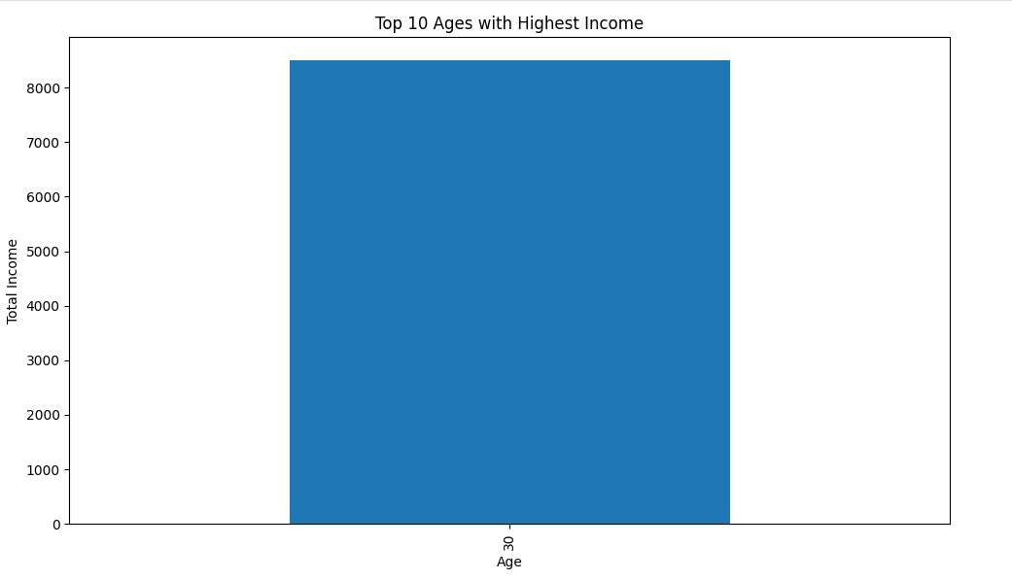
Ages with Highest Income
Top income earners are concentrated between ages 28–35, indicating a high-potential audience for healthcare product marketing.

Slide 5
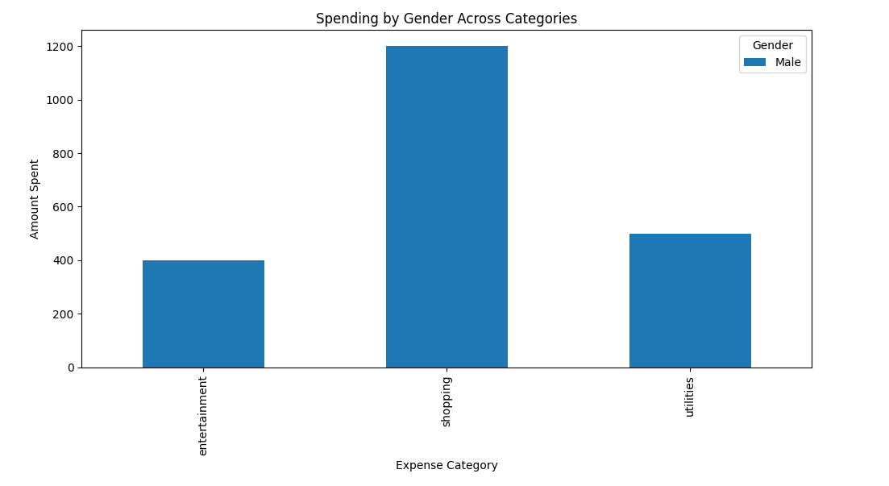
Gender Spending by Category
Female users tend to spend more on healthcare and shopping, suggesting personalized offers can increase engagement.

Slide 6

Conclusion
The analysis revealed clear trends in user income and spending behavior. These insights offer guidance for tailoring the product to meet user needs and preferences. Key findings include:
Data highlights young adults (28–35) as key income group
Healthcare and shopping are high-spend categories
Product messaging and pricing should align with these patterns. The next steps are to deploy the web app to Render, expand data collection, and begin building predictive models for targeted offerings.

