Slide 1
CSE 496 · GRADUATION PROJECT · GEBZE TECHNICAL UNIVERSITY
Video Anomaly Detection in
Production / Assembly Lines
A training-free, explainable approach using zero-shot Vision-Language Models
AUTHORS
ADVISOR
Alper Kaan Güler
Yunus Emre Türk
Asst. Prof. Habil Kalkan
Computer Engineering Dept.

Slide 2
OVERVIEW
Project Definition
We build a training-free, explainable system that watches a production / assembly line and decides whether each video clip is normal or anomalous — and explains why.
Objective
Approach
Detect line anomalies (wrong colour, orientation, missing part, belt stop, motion) without collecting or labelling any training data.
Prompt a frozen Vision-Language Model (qwen3.6-plus) with the scene description, anomaly rules and learned guiding questions.
Output
Key constraint
A clip-level verdict — normal vs anomaly — plus the anomaly type and a short, human-readable reason for the decision.
Zero training, zero fine-tuning. The model adapts only through the prompt, so it re-targets to a new product via natural language.
VAD in Production/Assembly Lines · Güler & Türk · CSE 496
2

Slide 3
PROBLEM & MOTIVATION
Why classic computer vision struggles on the factory floor
Data hunger
Retraining cost
Black box
Classic detectors need thousands of labelled defect images. In an optimised factory, real defects are rare — collecting them is slow and costly.
Every product or layout change forces a full re-train. We want a system that adapts from a natural-language spec, not new training data.
Standard models flag an anomaly but cannot say WHY. Operators need a human-readable reason before they trust and act on an alarm.
OUR APPROACH — ZERO-SHOT PROMPTING
Instead of training a detector, we prompt a frozen Vision-Language Model (qwen3.6-plus) with the scene description and the anomaly rules. Zero training, full explainability.
VAD in Production/Assembly Lines · Güler & Türk · CSE 496
3

Slide 4
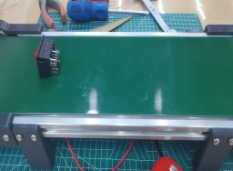
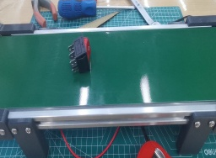
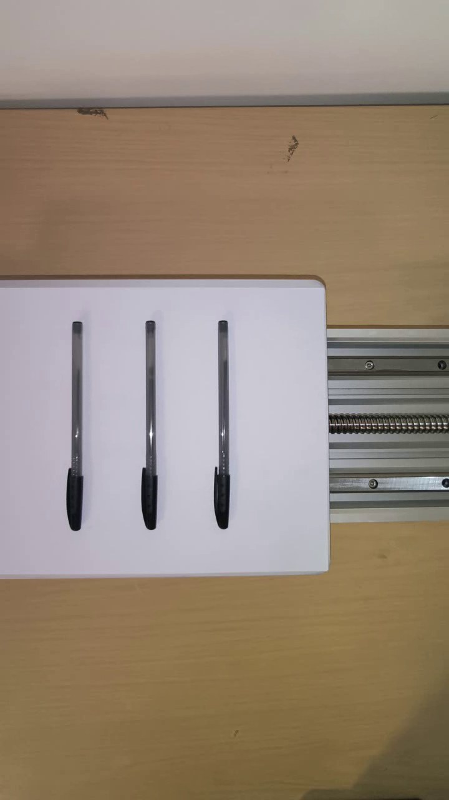
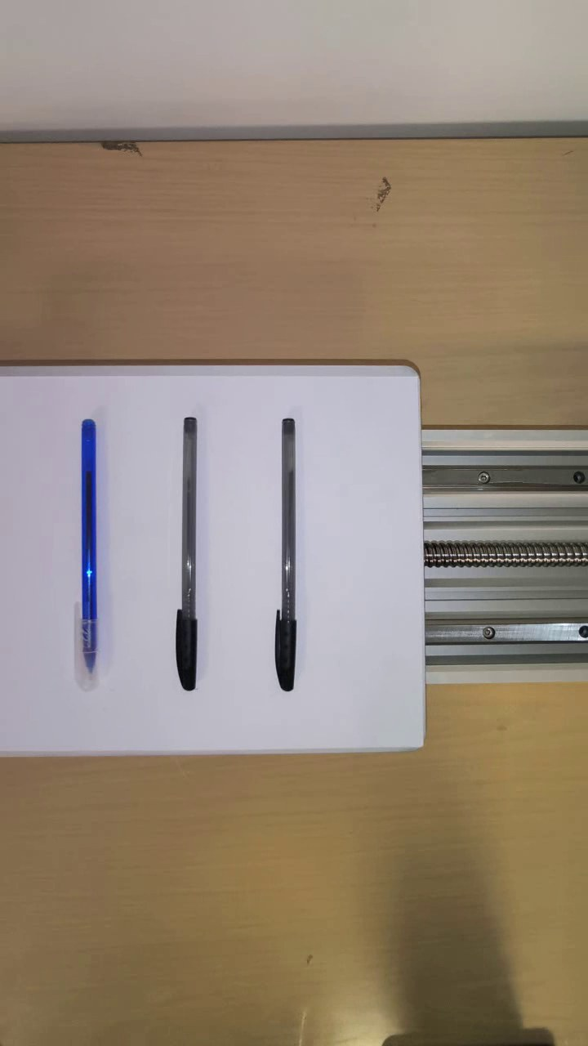
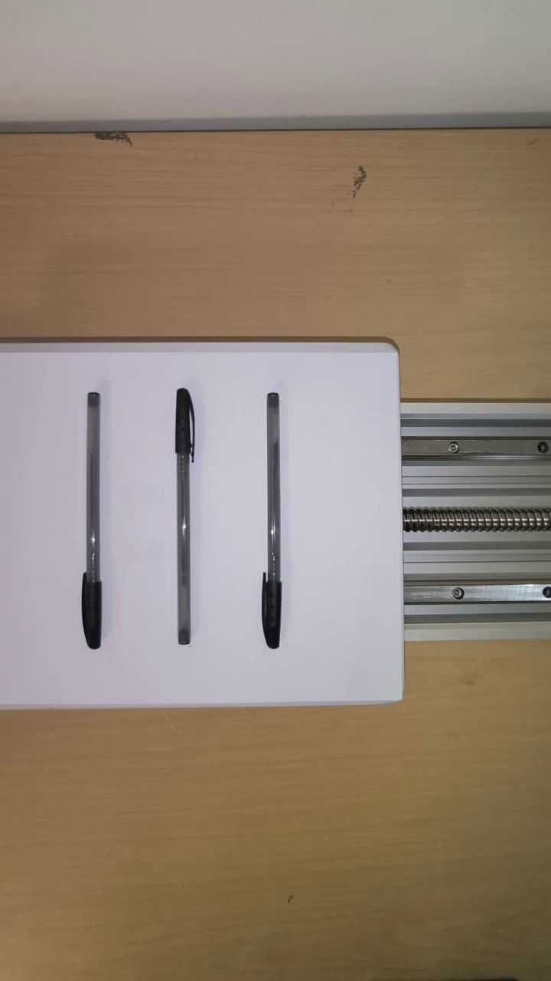
DATASET · WHY WE BUILT OUR OWN
From a public benchmark to a dataset we can trust
PHASE 1 · STARTING POINT
PHASE 2 · OUR OWN DATASET
IPAD benchmark — button conveyor
Custom pen-conveyor rig
NORMAL
COLOUR
ORIENT.
• R01 push-button & S08 sorting scenes
• Anomalies: pin angle, cap colour, sorting / clog
• Only ~256×256 — too coarse for subtle defects
too low-res to judge colour & angle
• 13 clips · recorded in 4K → 720×1280 for the API
• 7 controlled anomaly types · 3 identical pens · fixed camera
• Full control over what is normal vs anomalous
VAD in Production/Assembly Lines · Güler & Türk · CSE 496
4

Slide 5
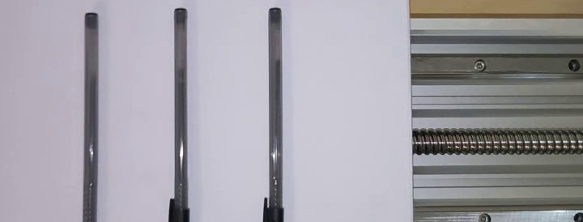
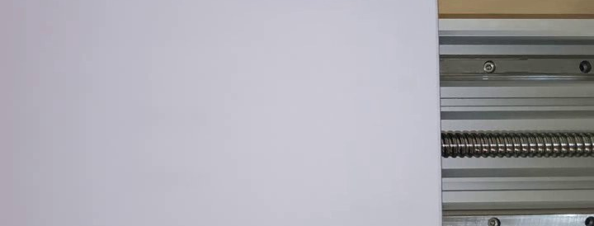
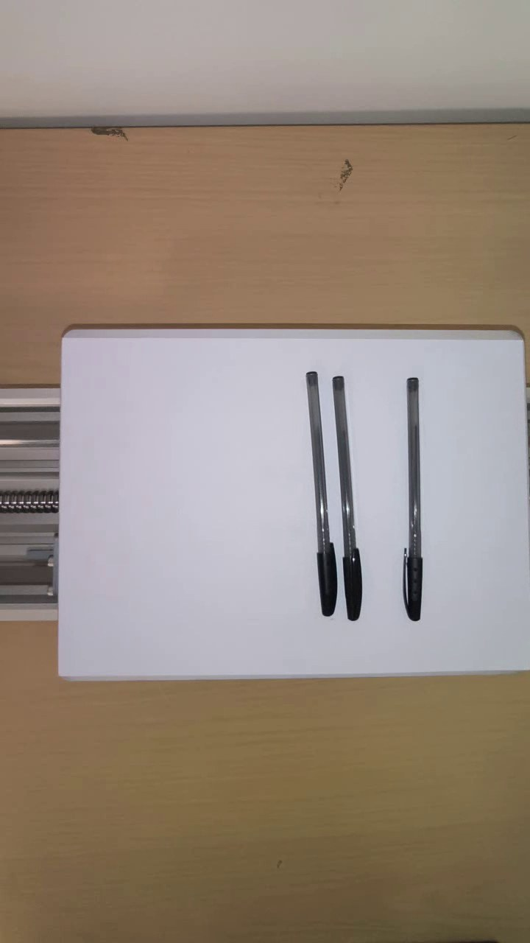
OUR DATASET
Seven controlled anomaly types on the pen line
NORMAL
WRONG COLOUR
WRONG ORIENTATION
Three identical pens, caps aligned, belt moving
One pen differs in colour from the others
A pen points the wrong way on the board
MISSING CAP
MISSING PEN
TEMPORAL / MOTION
A pen is missing its cap
Fewer than three pens are present
Pens shift mid-clip while belt looks normal
Belt-stop / freeze and a combined (orientation + missing-cap) case complete the 13 clips.
VAD in Production/Assembly Lines · Güler & Türk · CSE 496
5

Slide 6
OUR DATASET · IN MOTION
Sample clips from the pen-conveyor rig
Recorded in 4K, downscaled for the API. Click a clip to play it. Same fixed camera, three pens — only the anomaly changes.
NORMAL
COLOUR
ORIENT.
TEMPORAL
The temporal clip looks normal frame-by-frame — the anomaly is only in how the pens move over time.
VAD in Production/Assembly Lines · Güler & Türk · CSE 496
6

Slide 7
APPROACH 1 (ON IPAD BUTTONS)
First idea: robustness through multi-persona voting
A single prompt was unstable. So many synthetic "inspector" personas share the same rules but inspect the scene through a different lens, then vote — the majority decides.
Naïve operator
Mechanical engineer
Vision engineer
Majority vote
Looks at obvious visuals — cap colour, which way the pins point.
Checks how the part sits and travels on the belt.
Pixel-level cues: subtle colour shift, angle, geometry.
5 diverse voters + 1 consensus. A tie → LOW-confidence flag.
Key finding: compact YES/NO formats caused systematic false negatives. Forcing an "articulate-first" output (describe each frame, then decide) suppressed the model's bias toward "normal".
VAD in Production/Assembly Lines · Güler & Türk · CSE 496
7

Slide 8
THE ACADEMIC FOUNDATION
VERA: Verbalized Learning for VAD (CVPR 2025)
Ye, Liu & He — Explainable VAD via Verbalized Learning of VLMs. Insight: a vague prompt gives only 53–65% AUC; concrete, learned guiding questions do far better — with the model frozen.
1 · Frozen VLM
2 · Verbalized learning
3 · Coarse-to-fine
No fine-tuning, no extra reasoning module. The model is adapted only through the prompt.
Questions are learnable: a learner answers, an optimiser rewrites them from mistakes — using only coarse labels.
Segment scores → scene-context ensemble → frame scores via temporal smoothing. SOTA on UCF-Crime & XD-Violence.
→ We keep VERA's learner/optimiser question-learning core, but simplify it to clip-level verdicts for the factory setting → VERA-lite.
VAD in Production/Assembly Lines · Güler & Türk · CSE 496
8

Slide 9
APPROACH 2 · OUR ADAPTATION
The VERA-lite pipeline, step by step
1
2
3
4
Guiding questions
Learner VLM
Optimiser VLM
Blind evaluation
Start from concrete yes/no questions, one per anomaly family (count, colour, orientation, cap, belt motion, intra-object motion).
The frozen model watches the video and answers every question YES/NO with the visual evidence, then emits a structured JSON verdict.
It reads the learner's mistakes and rewrites the questions — sharper wording, no weights touched. We ran it once (v2 → v3).
The learner NEVER sees the ground-truth label. An early leak was fixed; the first honest score was 0.77, then 0.92 after v3.
Result of the loop: rewriting the questions from negative constraints to positive verification lifted blind accuracy from 0.77 → 0.92.
VAD in Production/Assembly Lines · Güler & Türk · CSE 496
9

Slide 10
INSIDE THE OPTIMISER
How the guiding questions were hardened (v2 → v3)
The optimiser noticed: "VLMs struggle with logical negation." It shifted prompts from negative constraints to positive verification.
Anomaly family | v2 (negated / weak) | v3 (positive / hardened)
Count | no missing pen and no empty gap | exactly three pens in a single row
Colour | none differing in colour | identical barrel & cap colours, no mismatch
Belt motion | without stopping, pausing, reversing | advances at every moment, never halting even briefly (1–3 s)
Positive, concrete phrasing removed the model's blind spots on count, colour and belt-stop cases.
VAD in Production/Assembly Lines · Güler & Türk · CSE 496
10

Slide 11
EXPLAINABILITY
Inside a verdict — structured, auditable JSON
For every clip the model returns structured JSON: a YES/NO answer with the visual evidence for each guiding question, then the verdict, type, score and confidence.
{
"question_answers": [
{q1 "YES" three pens in a row}
{q2 "YES" caps aligned, same way}
{q3 "NO" leftmost pen is BLUE}
{q4 "YES" all capped, similar length}
{q5 "YES" board moves, no stop}
{q6 "YES" pens fixed to the board}
],
"verdict": "ANOMALY"
"anomaly_type": "wrong_color"
"anomaly_score": 1.0
"confidence": "HIGH"
}
On the wrong-colour clip, a single "NO" on the colour question drives the decision. The per-question evidence makes the verdict auditable on the factory floor.
Verbatim learner output (blind v3 run) — abbreviated for display.
VAD in Production/Assembly Lines · Güler & Türk · CSE 496
11

Slide 12
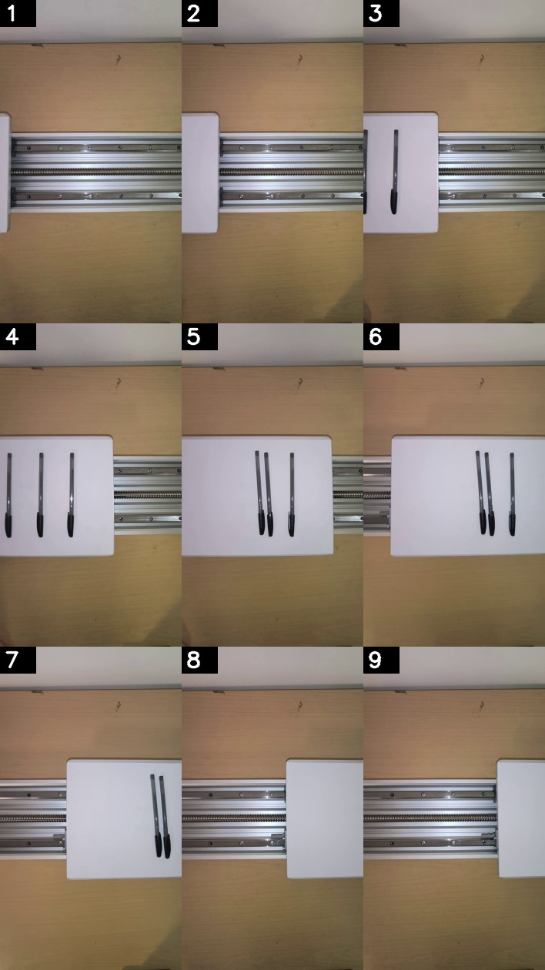
EXPERIMENTS
Three ways we fed the clip to the model
one continuous stream
N discrete frames
3×3 montage we actually sent
Continuous video
Dense frames
Temporal grid
Send the whole clip; the VLM samples a few frames internally.
Extract N evenly-spaced frames, send them as separate images.
Tile N time-ordered frames into ONE montage image, single pass.
12/13 · misses temporal
11/13 · catches temporal
negative · ≈ dense + a false positive
The trade-off is intrinsic: continuous (video) catches edges & belt-stop; discrete (frames / grid) catches intra-object motion. We confirmed it on 3 discrete variants — no single representation reaches 13/13.
VAD in Production/Assembly Lines · Güler & Türk · CSE 496
12

Slide 13
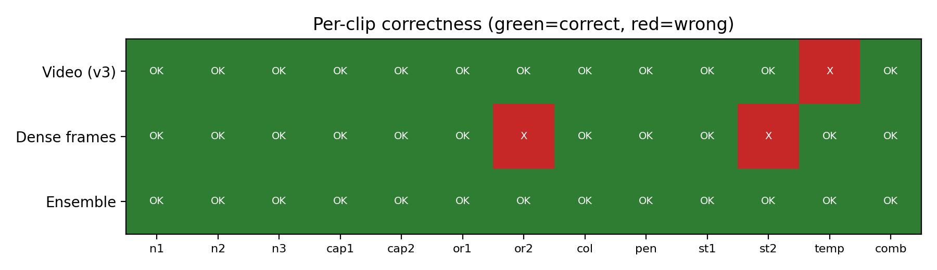
THE SOLUTION
Disjoint blind spots → combine into an ensemble
The hard case (temporal): pens shift mid-clip while the belt moves normally. Full-video input misses it — the model samples only a few internal frames. Dense frames catch it but miss some subtle cases. Their blind spots are disjoint.
Input method | Accuracy | False pos. | Temporal?
Video (continuous) | 12/13 (0.92) | 0 | No
Dense frames (16f) | 11/13 (0.85) | 0 | Yes
OR-ensemble (video ∨ dense) | 13/13 (1.00) | 0 | Yes
Two views, disjoint blind spots → the union (OR) solves every clip with zero false alarms.
Per-clip correctness: only the ensemble is fully green.
VAD in Production/Assembly Lines · Güler & Türk · CSE 496
13

Slide 14
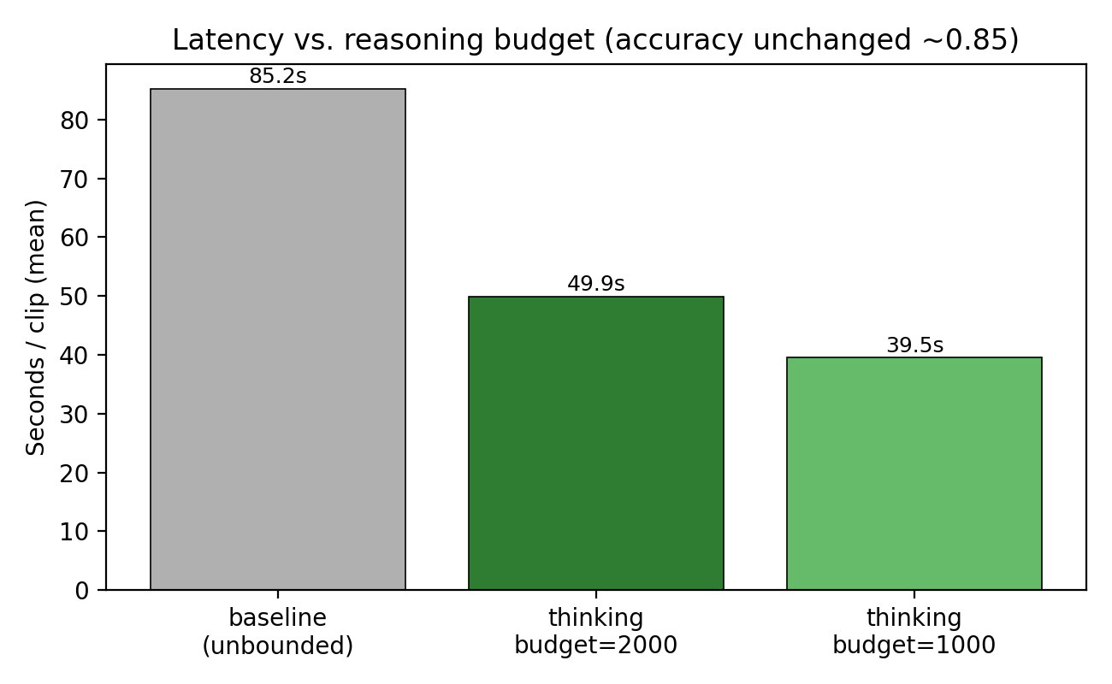
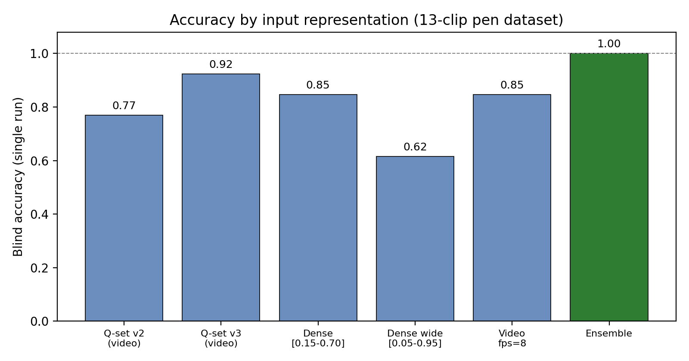
RESULTS
Accuracy, speed and determinism
13/13
0
0.846
−41%
Ensemble accuracy
False positives
Repeatable single-view
Latency after tuning
Speed & determinism
• qwen3.6-plus is a reasoning model — it once spent 15,684 reasoning tokens, spiking latency to 85.2 s/clip.
• Capping thinking_budget = 2000 → 49.9 s/clip (−41%).
• Bonus: the cap made it deterministic. Verdict flips across 3 runs dropped from 2 clips to 0.
• Honest, repeatable accuracy is 0.846 (11/13 every run) — not the lucky single-run 0.92.
VAD in Production/Assembly Lines · Güler & Türk · CSE 496
14

Slide 15
HONEST ASSESSMENT
Limitations & open problems
Small, single-scene dataset
LLM non-determinism
13 clips on one rig — results are indicative, not statistically conclusive. A larger, multi-scene set is needed.
The same input could flip the verdict; we needed a thinking-budget cap to stabilise it. True accuracy (0.846) is below the lucky 0.92.
No single view catches all
Not real-time / cloud-bound
Continuous video misses intra-object motion; dense frames miss subtle cases. The 13/13 needs an ensemble of two API calls.
~50 s per clip, depends on a paid API and internet. Raises latency, cost and data-privacy concerns for a real factory.
Limited model comparison
Question tuning sees labels
Other models were inaccessible (qwen-vl-max-latest → 403, qwen3.7 → 400); results tie to one vendor model version.
The optimiser used labels on a tiny set — risk of overfitting the questions to these specific clips.
VAD in Production/Assembly Lines · Güler & Türk · CSE 496
15

Slide 16
CONCLUSION
Explainable VAD without any labelled training data is viable for industry.
WHAT WE SHOWED
FUTURE WORK
• A frozen VLM + learned guiding questions detects fine-grained line anomalies, zero training.
• Every verdict is a human-readable, auditable JSON.
• A video∨dense ensemble reaches 13/13 with 0 false alarms.
• A thinking-budget cap makes it 41% faster and deterministic.
• Cascade: a cheap CV detector first, the VLM only on flagged segments → real-time & cheaper.
• Larger, multi-scene dataset for statistically solid numbers.
• On-prem / open VLM to remove cloud cost and privacy concerns.
• Automate the dense+video ensemble into one call.
Thank you — questions welcome.
VAD in Production/Assembly Lines · Güler & Türk · CSE 496
16

