Slide 1
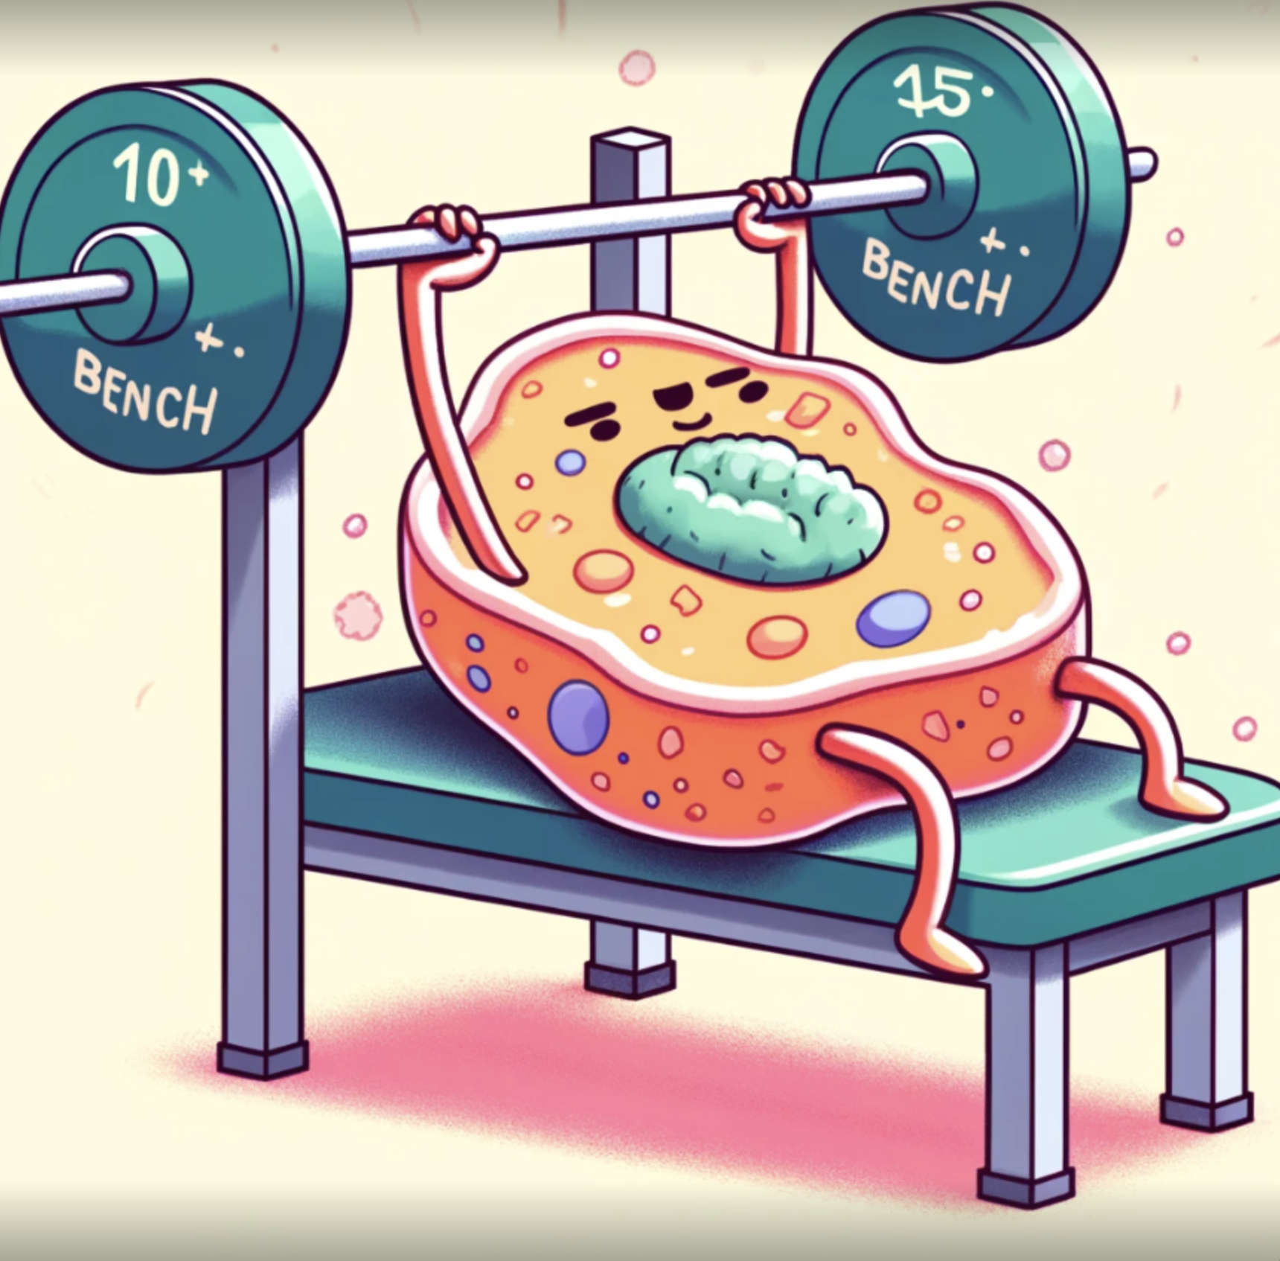

$μ$-Bench
A Vision-Language Benchmark for Microscopy Understanding

