Slide 1
VOView
Rendering VOTables using XSLT and JavaScript
Dean Hinshaw
HEASARC GSFC/NASA

Slide 2
Overview
View large tables within a Web browser
Goal 1000 to 100,000 rows
Javascript not efficient enough to handle large tables
XSLT 1.0 processing built in to all major browsers
Needed for operations that handle the entire table, e.g. sorting
Promotes/Exploits VO Table standard

Slide 3
Status
Original version written by Rick White for Hubble Legacy Archive
Code picked up and modified by several groups:
HLA version still working
HEASARC: Sview, Simple Query, Datascope (new)
NVO Directory
European HST/HLA Archive (new)

Slide 4
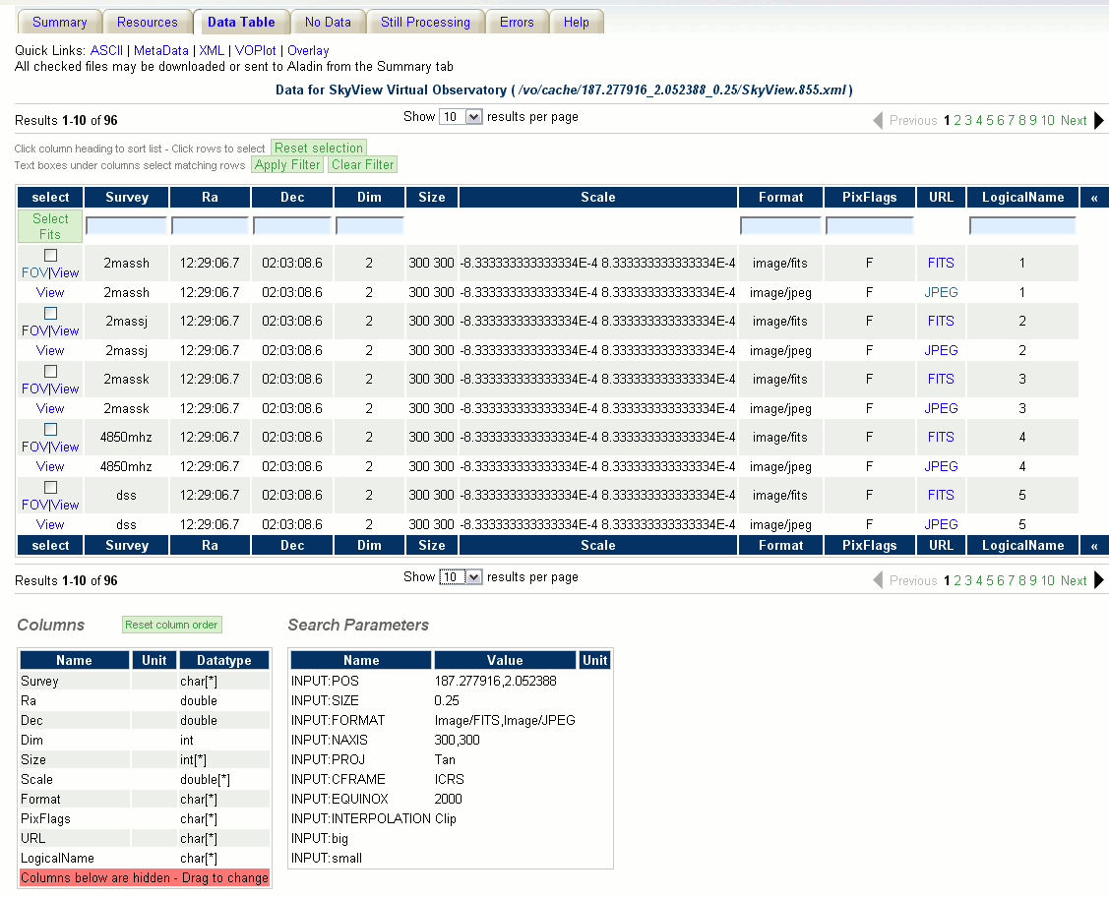
Datascope
Notes:
Show in browser if possible – Tom demoed VOView at previous interop

Slide 5
Goals
Bring development together into one project
Google Project: voview
Combine all functionality into one code base
Make VOView into a package (a la jquery)
Simple installation
Well defined external interfaces
Documentation
Design
Redesign with well-define OO structure and interfaces
Modular design allows for developer customization
Notes:
Talk about Google Project at the end

Slide 6
Design
Displayed Table (HTML)
Filter
Full VOTABLE (XML)
Filtered VOTABLE (XML)
Renderer

Slide 7
Filter Class
Takes full table as input and returns the rows of the table to be displayed
Encapsulates functionality requiring the entire table
Sorting
Column Filtering
Paging
Requires use of XSLT for efficiency
Could be implemented server-side

Slide 8
Renderer Class
Transforms XML into HTML to be displayed
Input is modest sized XML table
XSLT not required, more implementation options
XSLT could be used, but limited functionality
Jquery
Other
Most customization likely to be here

Slide 9
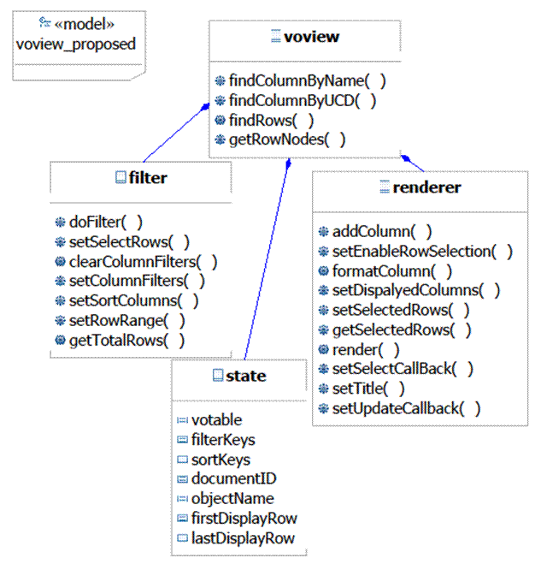
Class Diagram

Slide 10
Interface Definition
Detailed interface definition being developed using Jsdoc
Jsdoc is a javadoc-like documentation system for javascript
Inline comments generate html documentation
index.html
Notes:
Link to jsdoc only works on my PC

Slide 11
Google Project
Design and Interface still very much at proposal/discussion phase
Google Project voview
svn repository
Wiki
Issue tracker
Discussion group
http://code.google.com/p/voview/
voview@googlegroups.com

