Slide 1
Deep Neural Networks, Minecraft, and Beyond!
By: Alan Yeung

Slide 2

Overview
Neural networks = function approximator
Reinforcement learning → uses a function approximator to approximate optimal action value function
Learning → wiggling numbers so that they're closer to what they “should” be
Transfer learning → applying knowledge learned from different contexts

Slide 3
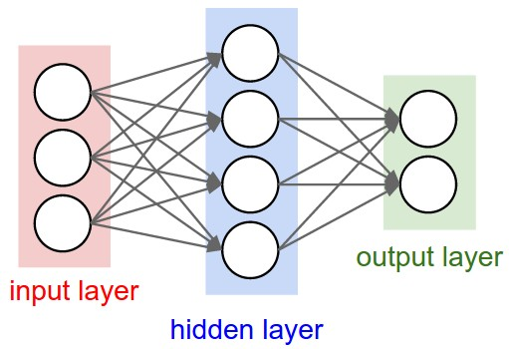
What is a Neural Network?
The answer is this
Simple neurons
  Take input
  Apply a simple function
  Pass output on
  Interconnected
A function approximator!
Black box

Slide 4
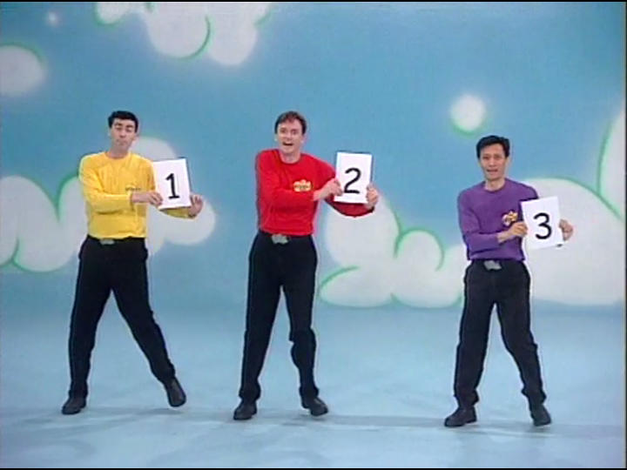
Training a Neural Network
Target-Prediction=Error
Back propagation using gradient descent
Translation:
  Wiggle numbers so that they are closer to the target

Slide 5

What makes a neural network deep?
This is a deep neural network (DNN)
What's the difference?
  An extra hidden layer!

Slide 6
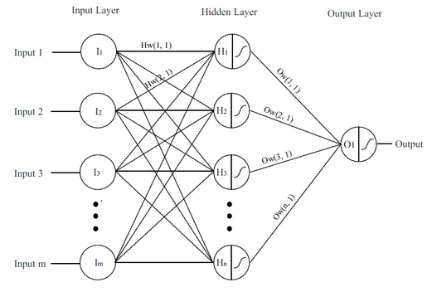
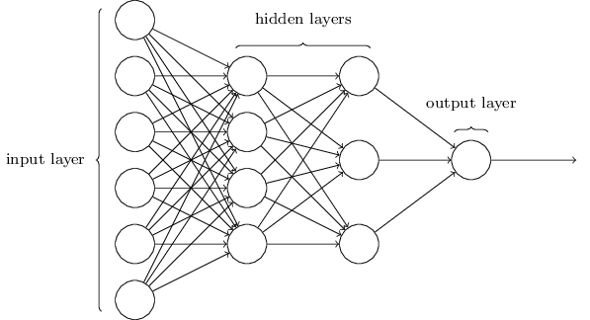
Why go deeper?
A single layer neural network can approximate any computable function
Efficiency in terms of:
  Size
  Training
  Representations

Slide 7
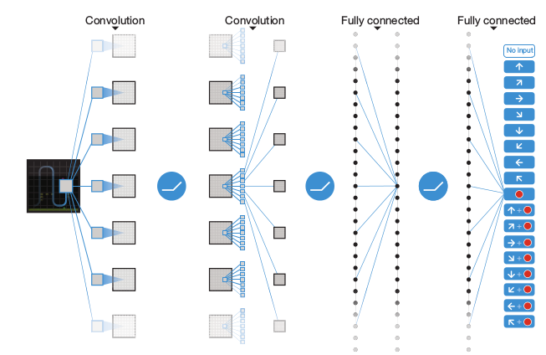
Deep Convolution Neural Network
Take pixel data and detect features
  Convolve filters around the image to detect features
Translation: Function approximators that are good with images

Slide 8
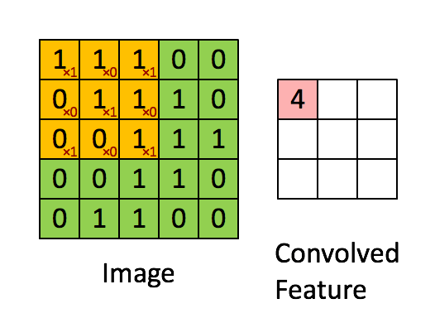
The Convolution
(feature detection)

Slide 9
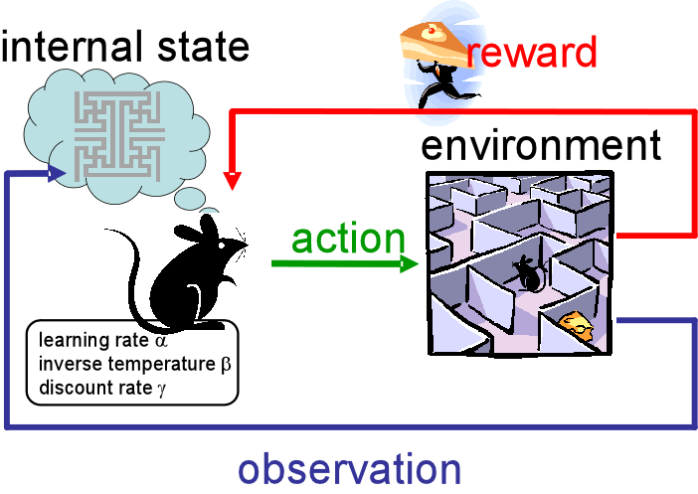
Reinforcement Learning -The Q value

Slide 10
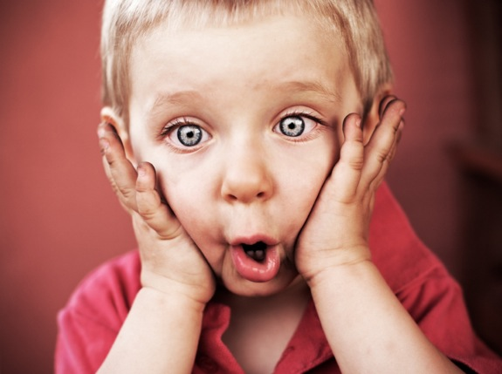
Reinforcement Learning-The Algorithm
Notes:
the learning rate, set between 0 and 1. Setting it to 0 means that the Q-values are never updated, hence nothing is learned. Setting a high value such as 0.9 means that learning can occur quickly.
discount factor, also set between 0 and 1. This models the fact that future rewards are worth less than immediate rewards. Mathematically, the discount factor needs to be set less than 0 for the algorithm to converge.
the maximum reward that is attainable in the state following the current one. i.e the reward for taking the optimal action thereafter.

Slide 11
In plain(er) English:
Initialize the Q-values table, Q(s, a).
Observe the current state, s.
Choose an action, a, for that state based on one of the action selection policies (-soft, -greedy or softmax).
Take the action, and observe the reward, r, as well as the new state, s'.
Update the Q-value for the state using the observed reward and the maximum reward possible for the next state.
Set the state to the new state, and repeat the process until a terminal state is reached.

Slide 12
Next we need a function approximator
How about we use our DCNN!
  Great idea!

Slide 13
The environment
We needed an environment to train/test our agent on a wide array of tasks
…
Minecraft!

Slide 14
Strip mining video

Slide 15
Transfer Learning (TL)
Think nature vs. nurture
Examples:
  Learning to ride a tricycle before learning to ride a bike
  Learning to code in Python (and probably Java) before learning C
TL is usually done by training an agent on a source task (or multiple source tasks) and then moving the agent onto a target task

Slide 16
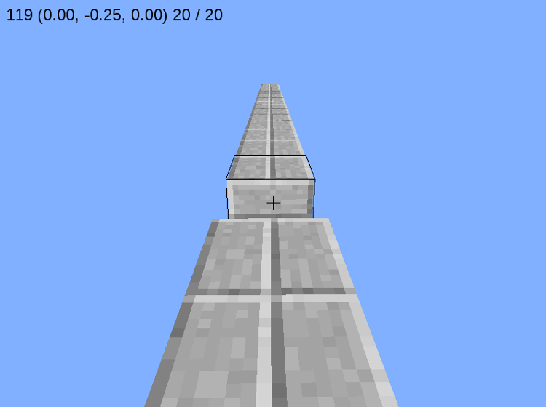
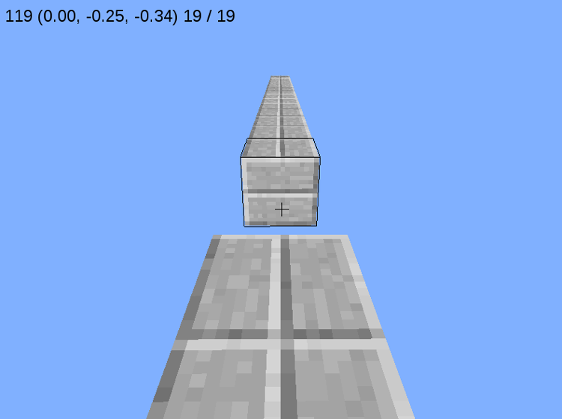
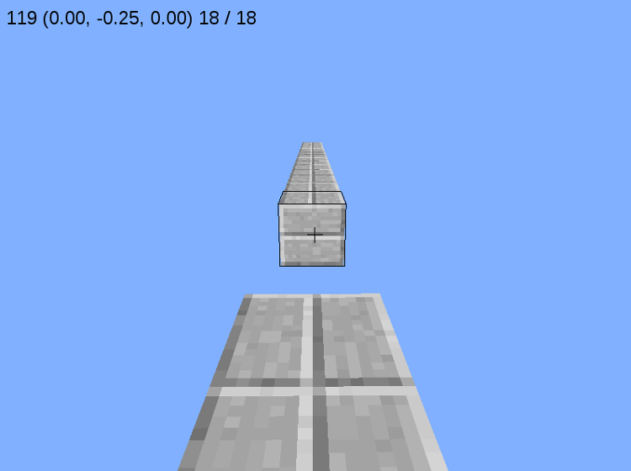
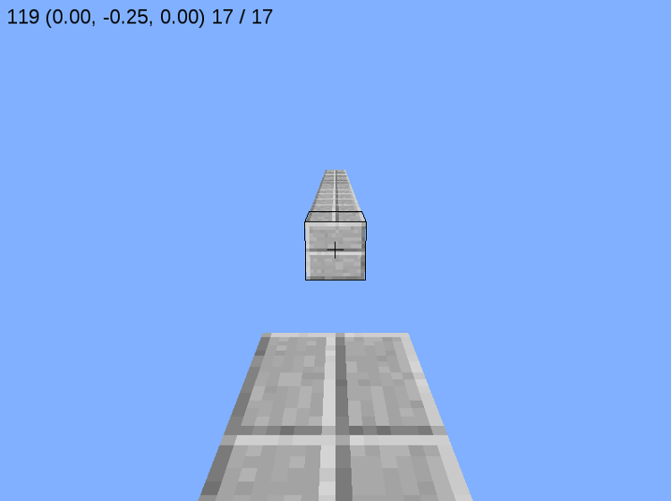
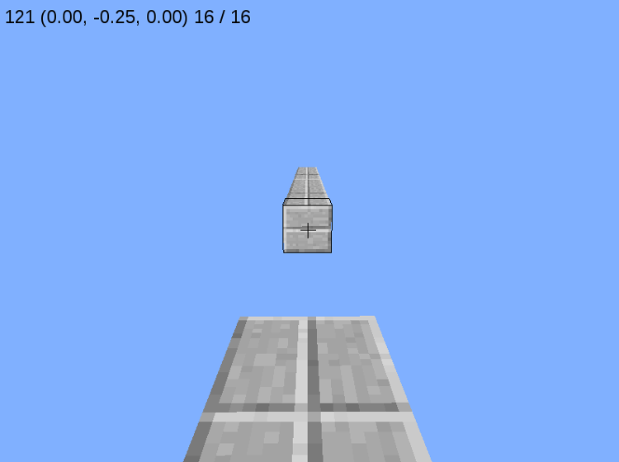
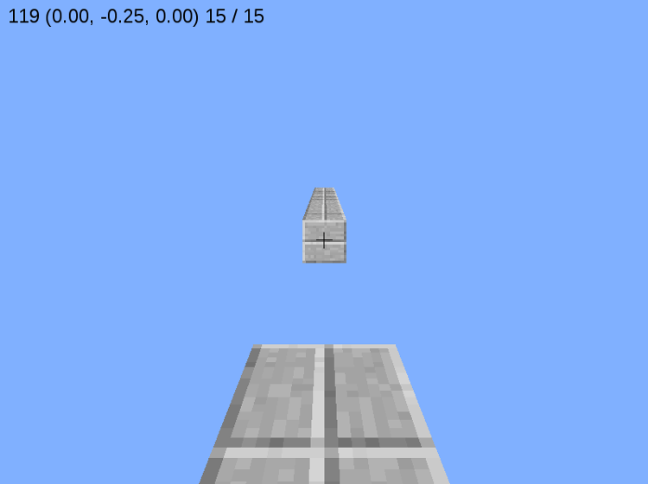
Transfer Learning – The Task
– Source Tasks
– Target Task
The agent is transferred from each source task based on a performance threshold.

Slide 17
Example of accomplished task

Slide 18
