Slide 1
Chapter 14
Exception Handling

Slide 2
Objectives (1 of 2)
In this chapter, you will:
Learn what an exception is
Learn how to handle exceptions within a program
Learn how a try/catch block is used to handle exceptions
Learn how to throw an exception
Become familiar with C++ exception classes and how to use them in a program

Slide 3
Objectives (2 of 2)
Learn how to create your own exception classes
Discover how to throw and rethrow an exception
Explore exception handling techniques
Explore stack unwinding

Slide 4
Introduction
An exception is an undesirable event detectable during program execution
Code to handle exceptions depends on the type of application being developed
May or may not want the program to terminate when an exception occurs
Can add exception-handling code at point where an error can occur

Slide 5
Handling Exceptions Within a Program
assert function:
Checks if an expression meets certain condition(s)
If conditions are not met, it terminates the program
Example: division by 0
If divisor is zero, assert terminates the program with an error message

Slide 6
C++ Mechanisms of Exception Handling
try/catch block: used to handle exceptions
Exception must be thrown in a try block and caught by a catch block
C++ provides support to handle exceptions via a hierarchy of classes

Slide 7
try/catch Block (1 of 5)
Statements that may generate an exception are placed in a try block
The try block also contains statements that should not be executed if an exception occurs
try block is followed by one or more catch blocks

Slide 8
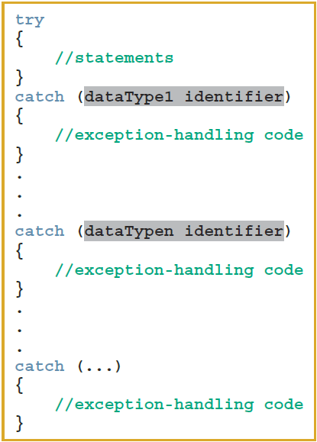
try/catch Block (2 of 5)
General syntax of the try/catch block

Slide 9
try/catch Block (3 of 5)
catch block:
Specifies the type of exception it can catch
Contains an exception handler
If the heading of a catch block contains ... (ellipses) in place of parameters:
Block can catch exceptions of all types
If no exception is thrown in a try block:
All catch blocks are ignored
Execution resumes after the last catch block

Slide 10
try/catch Block (4 of 5)
If an exception is thrown in a try block:
Remaining statements (in block) are ignored
Program searches catch blocks in order, looking for an appropriate exception handler
If the type of thrown exception matches the parameter type in one of the catch blocks:
Code of that catch block executes
Remaining catch blocks are ignored

Slide 11
try/catch Block (5 of 5)
A catch block can have at most one catch block parameter
catch block parameter becomes a placeholder for the value thrown

Slide 12

Throwing an Exception
For try/catch to work, the exception must be thrown in the try block
General syntax:
where expression is a constant value, variable, or object
Object being thrown can be a specific object or an anonymous object
In C++, an exception is a value

Slide 13
Order of catch Blocks
catch block can catch:
All exceptions of a specific type
All types of exceptions
A catch block with an ellipsis (...) catches any type of exception
If used, it should be the last catch block of that sequence
Be careful about the order in which you list catch blocks

Slide 14
Using C++ Exception Classes (1 of 2)
C++ provides support to handle exceptions via a hierarchy of classes
The class exception is the base class of the exception classes provided by C++
Function what
Contained in class exception
Returns a string containing an appropriate message
All derived classes of the class exception override the function what to issue their own error messages

Slide 15
Using C++ Exception Classes (2 of 2)
Two subclasses of exception (defined in stdexcept):
logic_error includes subclasses:
invalid_argument: for use when illegal arguments are used in a function call
out_of_range: string subscript out of range error
length_error: if a length greater than the maximum allowed for a string object is used
runtime_error includes subclasses:
overflow_error and underflow_error

Slide 16
Creating Your Own Exception Classes (1 of 2)
Can create your own exception classes to handle specific exceptions
C++ uses the same mechanism to process these exceptions
throw statement: used to throw your own exceptions
Any class can be an exception class
How you use the class makes it an exception class

Slide 17
Creating Your Own Exception Classes (2 of 2)
Exception class with member variables typically includes:
Constructors
The function what

Slide 18
Rethrowing and Throwing an Exception (1 of 3)
When an exception occurs in a try block, control immediately passes to one of the catch blocks, which either:
Handles the exception, or partially processes the exception, then rethrows the same exception
Rethrows another exception for the calling environment to handle
This allows you to provide exception-handling code all in one place

Slide 19


Rethrowing and Throwing an Exception (2 of 3)
Syntax to rethrow an exception caught by a catch block:
If the same exception is to be rethrown:
If a different exception is to be thrown
where expression is a constant value, variable, or object

Slide 20
Rethrowing and Throwing an Exception (3 of 3)
Object being thrown can be:
A specific object
An anonymous object
A function specifies the exceptions it throws in its heading using the throw clause
Example:
void expThrowExcep(int x) throw (int, string, divisionByZero)
{
.
.
.
//include the appropriate throw statements
.
.
.
}

Slide 21
Exception-Handling Techniques
When an exception occurs, the programmer usually has three choices:
Terminate the program
Include code to recover from the exception
Log the error and continue

Slide 22
Terminate the Program
In some cases, it is best to terminate the program when an exception occurs
Example: if an input file does not exist when the program executes
There is no point in continuing with the program
Program can output an appropriate error message and terminate

Slide 23
Fix the Error and Continue
In some cases, you will want to handle the exception and let the program continue
Example: a user inputs a letter instead of a number
The input stream will enter the fail state
Can include the necessary code to keep prompting the user to input a number until the entry is valid

Slide 24
Log the Error and Continue
Example: if the program is designed to run a nuclear reactor or continuously monitor a satellite
It cannot be terminated if an exception occurs
When an exception occurs:
The program should write the exception into a file and continue to run

Slide 25
Stack Unwinding (1 of 2)
When an exception is thrown in a function, the function can do the following:
Do nothing
Partially process the exception and throw the same exception or a new exception
Throw a new exception
In each case, the function-call stack is unwound so that the exception can be caught in the next try/catch block

Slide 26
Stack Unwinding (2 of 2)
When the function call stack is unwound:
The function in which the exception was not caught and/or rethrown terminates
Memory for its local variables is destroyed
Stack unwinding continues until:
A try/catch handles the exception, or
The program does not handle the exception
The function terminate is called to terminate the program

Slide 27
Quick Review (1 of 3)
An exception is an undesirable event detectable during program execution
assert checks whether an expression meets a specified condition; terminates if not met
try/catch block handles exceptions
Statements that may generate an exception are placed in a try block

Slide 28
Quick Review (2 of 3)
A catch block specifies type of exception it can catch and contains an exception handler
If no exceptions are thrown in a try block, all catch blocks for that try block are ignored
Data type of catch block parameter specifies type of exception that catch block can catch

Slide 29
Quick Review (3 of 3)
exception is the base class for exception classes
what function returns a string containing the exception object thrown by built-in exception classes
You can create your own exception classes
A function specifies the exceptions it throws in its heading with the throw clause
If the program does not handle the exception, then the function terminate terminates the program

