Slide 1
Chapter 19
Binary Trees

Slide 2
Objectives (1 of 2)
In this chapter, you will:
Learn about binary trees
Learn about the basic terminologies used in binary trees: left and right subtrees, path, height, level of a node, leaves, parent of a node
Explore various binary tree traversal algorithms
Explore how to implement the basic operations on a binary tree
Learn about binary search trees

Slide 3
Objectives (2 of 2)
Learn how to organize data in a binary search tree
Learn how to insert and delete items in a binary search tree
Explore nonrecursive binary tree traversal algorithms
Explore binary tree traversal algorithms and functions as parameters

Slide 4
Binary Trees (1 of 7)
Definition: a binary tree T is either empty or has these properties:
Has a root node
Has two sets of nodes: left subtree L_{T} and right subtree R_{T}
L_{T} and R_{T} are binary trees

Slide 5
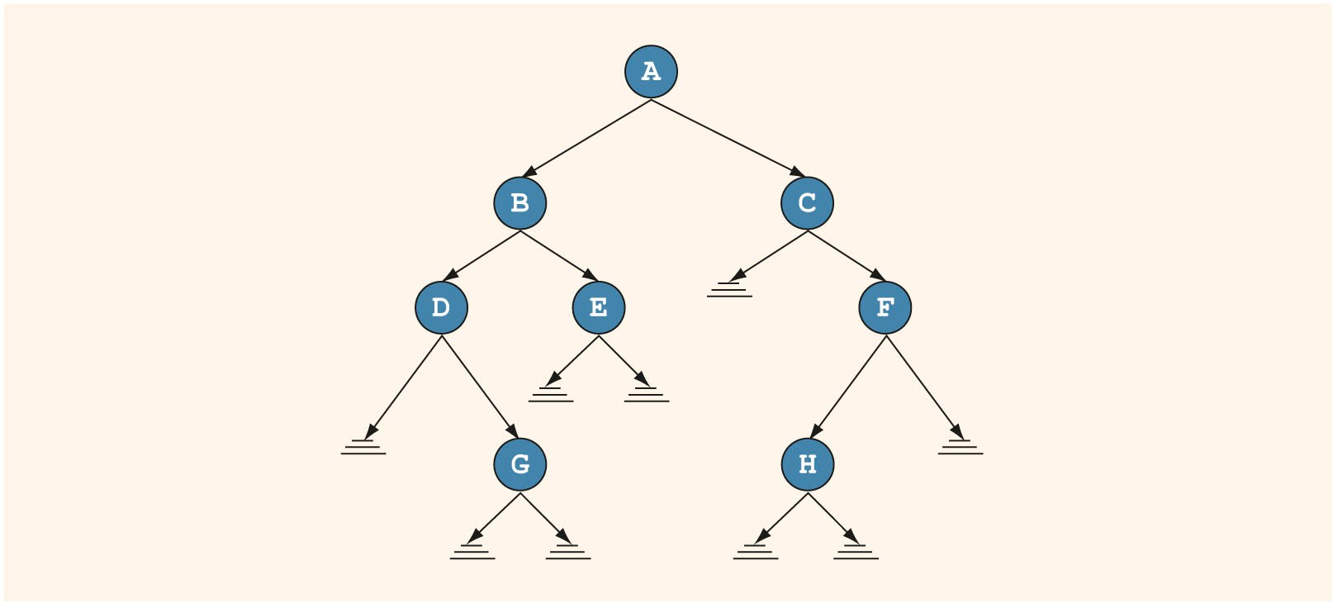
Binary Trees (2 of 7)
FIGURE 19-1 Binary tree

Slide 6
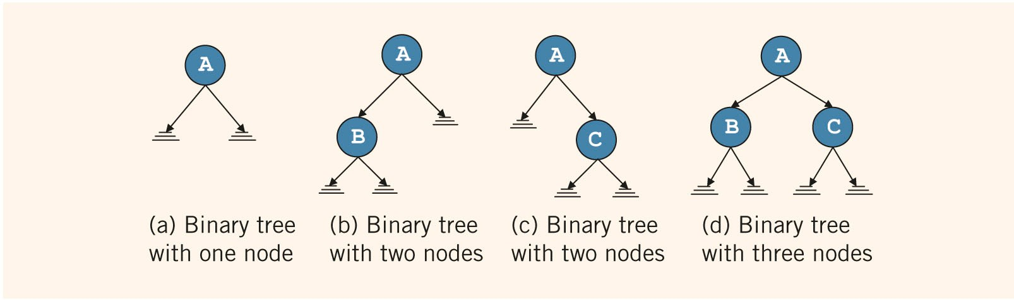
Binary Trees (3 of 7)
FIGURE 19-2 Binary tree with one, two, or three nodes

Slide 7
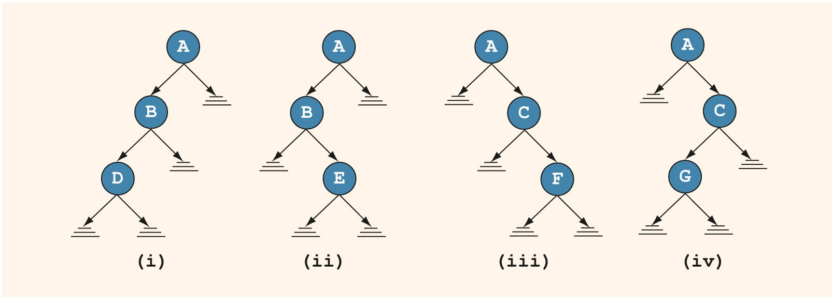
Binary Trees (4 of 7)
FIGURE 19-3 Various binary trees with three nodes

Slide 8
Binary Trees (5 of 7)
Every node has at most two children
A node:
Stores its own information
Keeps track of its left subtree and right subtree using pointers
lLink and rLink pointers

Slide 9
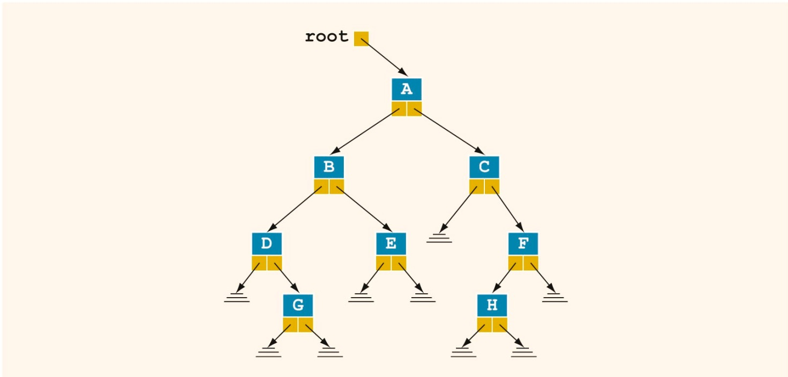
Binary Trees (6 of 7)
A pointer to the root node of the binary tree is stored outside the tree in a pointer variable
FIGURE 19-4 Binary tree

Slide 10
Binary Trees (7 of 7)
Leaf: node that has no left and right children
U is parent of V if there is a branch from U to V
There is a unique path from root to every node
Length of a path: number of branches on path
Level of a node: number of branches on the path from the root to the node
Root node level is 0
Height of a binary tree: number of nodes on the longest path from the root to a leaf

Slide 11
Copy Tree
Binary tree is a dynamic data structure
Memory is allocated/deallocated at runtime
Using just the value of the pointer of the root node makes a shallow copy of the data
To make an identical copy, must create as many nodes as are in the original tree
Use a recursive algorithm

Slide 12
Binary Tree Traversal (1 of 4)
Insertion, deletion, and lookup operations require traversal of the tree
Must start at the root node
Two choices for each node:
Visit the node first
Visit the node’s subtrees first

Slide 13
Binary Tree Traversal (2 of 4)
Inorder traversal
Traverse the left subtree
Visit the node
Traverse the right subtree
Preorder traversal
Visit the node
Traverse the left subtree
Traverse the right subtree

Slide 14
Binary Tree Traversal (3 of 4)
Postorder traversal
Traverse the left subtree
Traverse the right subtree
Visit the node
Listing of nodes produced by traversal type is called:
Inorder sequence
Preorder sequence
Postorder sequence

Slide 15
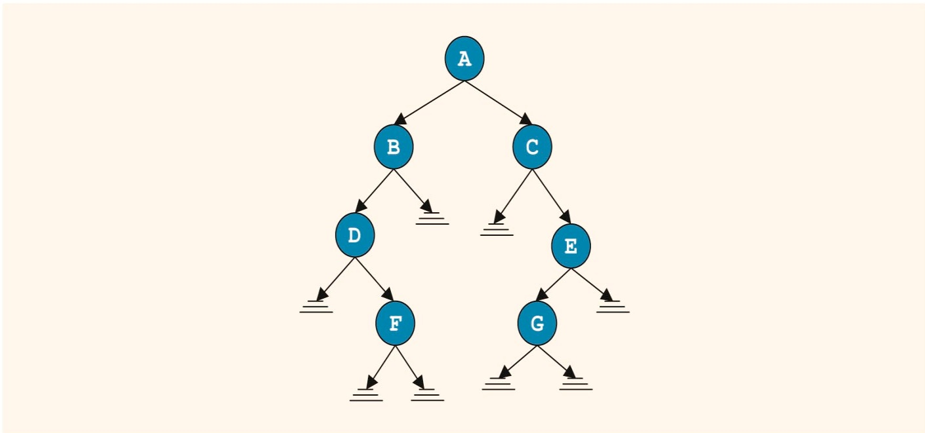
Binary Tree Traversal (4 of 4)
Inorder sequence:
DFBACGE
Preorder sequence:
ABDFCEG
Postorder sequence:
FDBGECA
FIGURE 19-6 Binary tree for an inorder traversal

Slide 16
Implementing Binary Trees (1 of 2)
Typical operations:
Determine whether the binary tree is empty
Search the binary tree for a particular item
Insert an item in the binary tree
Delete an item from the binary tree
Find the height of the binary tree

Slide 17
Implementing Binary Trees (2 of 2)
Typical operations (cont’d.):
Find the number of nodes in the binary tree
Find the number of leaves in the binary tree
Traverse the binary tree
Copy the binary tree

Slide 18
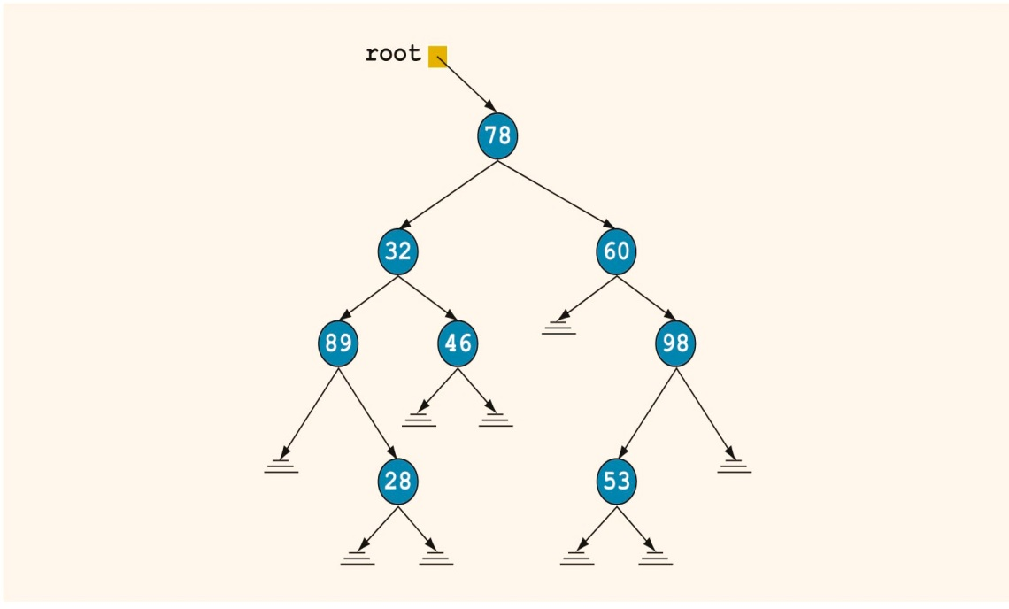
Binary Search Trees (1 of 4)
Traverse the tree to determine whether 53 is in it - this is slow
FIGURE 19-7 Arbitrary binary tree

Slide 19
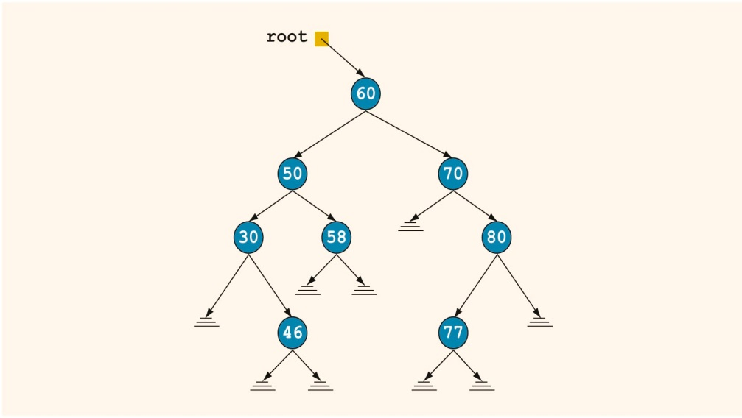
Binary Search Trees (2 of 4)
In this binary tree, data in each node is:
Larger than data in its left child
Smaller than data in its right child
FIGURE 19-8 Binary search tree

Slide 20
Binary Search Trees (3 of 4)
Definition: a binary search tree T is either empty or has these properties:
Has a root node
Has two sets of nodes: left subtree L_{T} and right subtree R_{T}
Key in root node is larger than every key in left subtree, and smaller than every key in right subtree
L_{T} and R_{T} are binary search trees

Slide 21
Binary Search Trees (4 of 4)
Typical operations on a binary search tree:
Determine if it is empty
Search for a particular item
Insert or delete an item
Find the height of the tree
Find the number of nodes and leaves in the tree
Traverse the tree
Copy the tree

Slide 22
Search
Search steps:
Start search at root node
If no match, and search item is smaller than root node, follow lLink to left subtree
Otherwise, follow rLink to right subtree
Continue these steps until item is found or search ends at an empty subtree

Slide 23
Insert
After inserting a new item, resulting binary tree must be a binary search tree
Must find location where new item should be placed
Must keep two pointers, current and parent of current, in order to insert

Slide 24
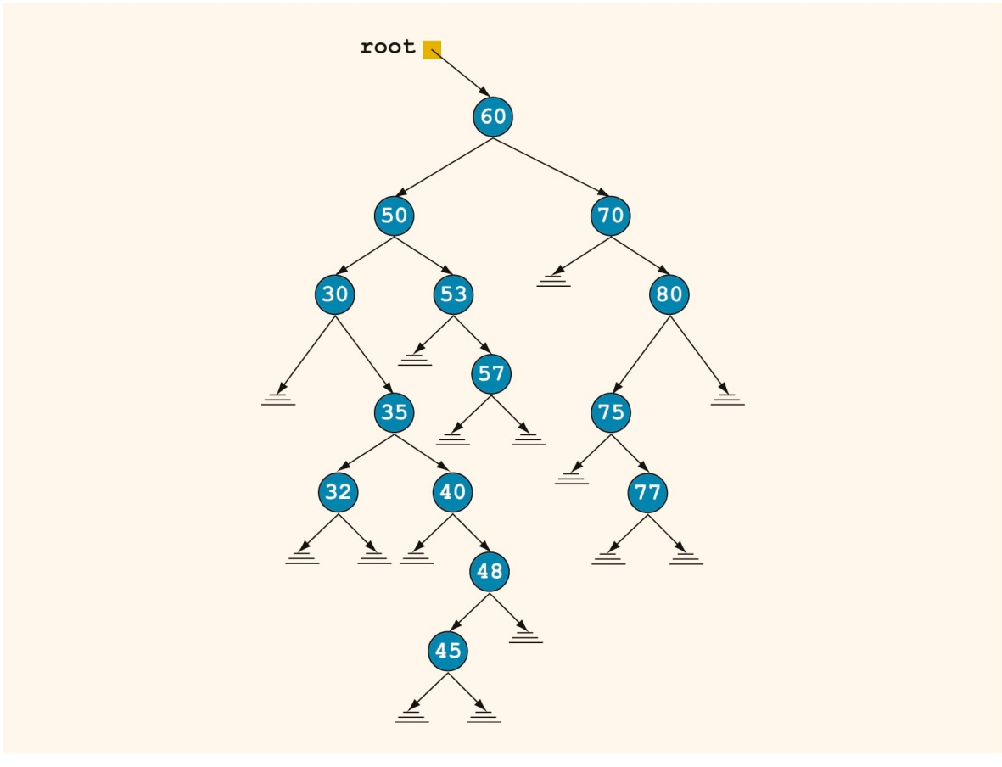
Delete (1 of 4)
FIGURE 19-9 Binary search tree before deleting a node

Slide 25
Delete (2 of 4)
The delete operation has four cases:
The node to be deleted is a leaf
The node to be deleted has no left subtree
The node to be deleted has no right subtree
The node to be deleted has nonempty left and right subtrees
Must find the node containing the item (if any) to be deleted, then delete the node

Slide 26
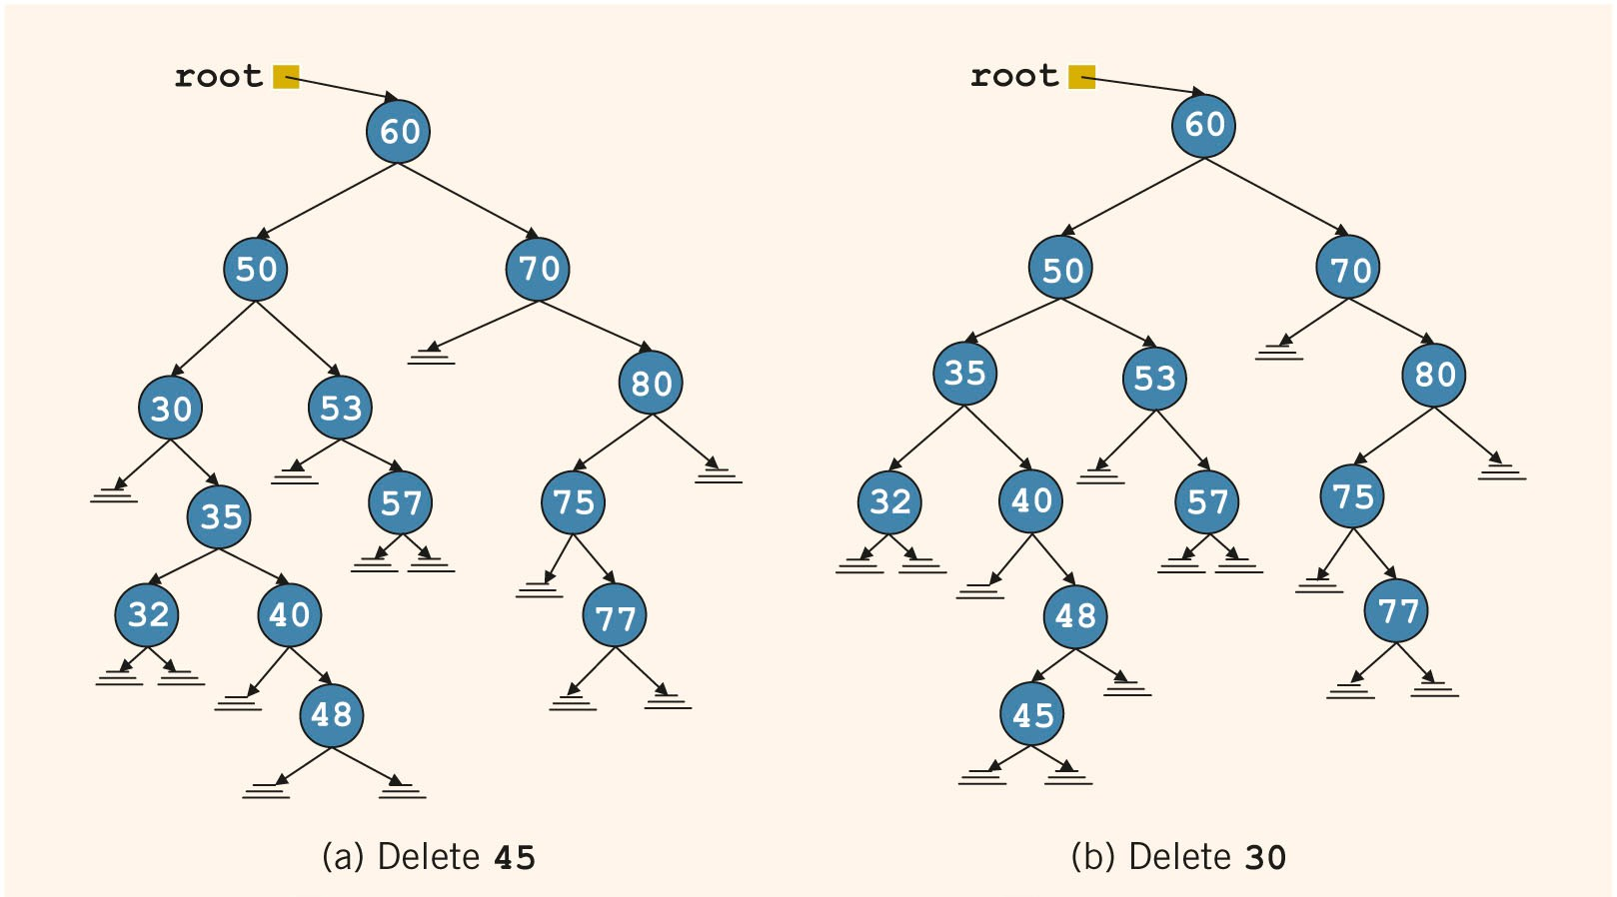
Delete (3 of 4)
FIGURE 19-10 Binary trees of Figure 19-9 after deleting various items

Slide 27
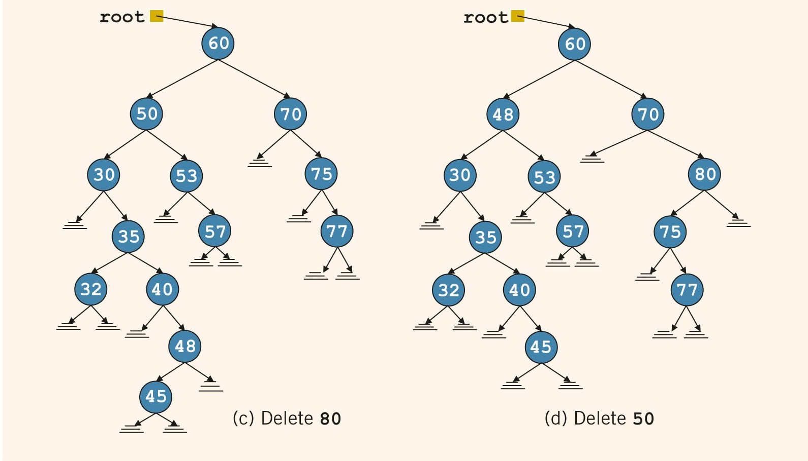
Delete (4 of 4)
FIGURE 19-10 (cont’d.) Binary trees of Figure 19-9 after deleting various items

Slide 28
Binary Search Tree: Analysis (1 of 4)
Let T be a binary search tree with n nodes, where n > 0
Suppose that we want to determine whether an item, x, is in T
The performance of the search algorithm depends on the shape of T
In the worst case, T is linear

Slide 29
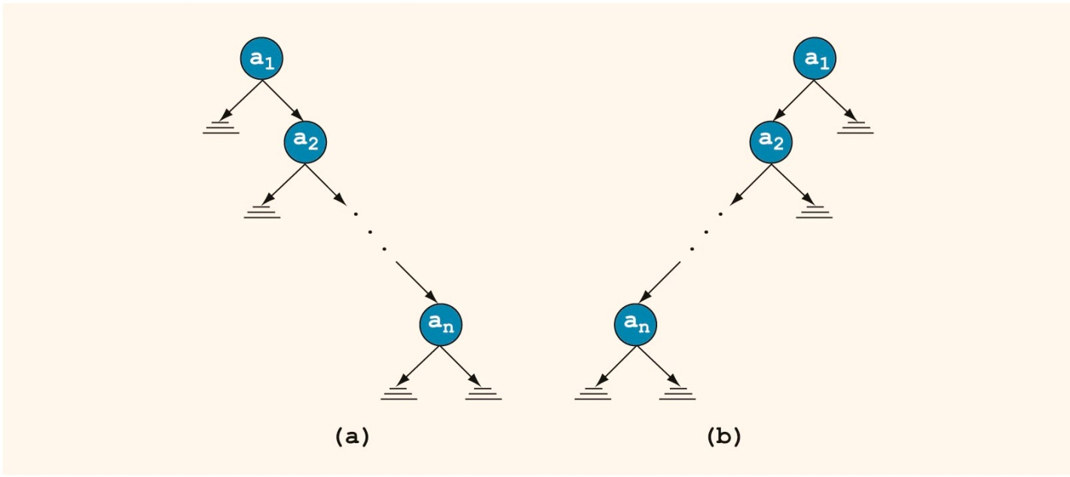
Binary Search Tree: Analysis (2 of 4)
Worst case behavior: T is linear
O(n) key comparisons
FIGURE 19-11 Linear binary search trees

Slide 30


Binary Search Tree: Analysis (3 of 4)
Average-case behavior:
There are n! possible orderings of the keys
We assume that orderings are possible
S(n) and U(n): number of comparisons in average successful and unsuccessful case, respectively

Slide 31
Binary Search Tree: Analysis (4 of 4)
Theorem: Let T be a binary search tree with n nodes, where n > 0
Average number of nodes visited in a search of T is approximately 1.39log₂n=O(log₂n)
Number of key comparisons is approximately 2.77log₂n=O(log₂n)

Slide 32
Nonrecursive Binary Tree Traversal Algorithms
The traversal algorithms discussed earlier are recursive
This section discusses the nonrecursive inorder, preorder, and postorder traversal algorithms

Slide 33
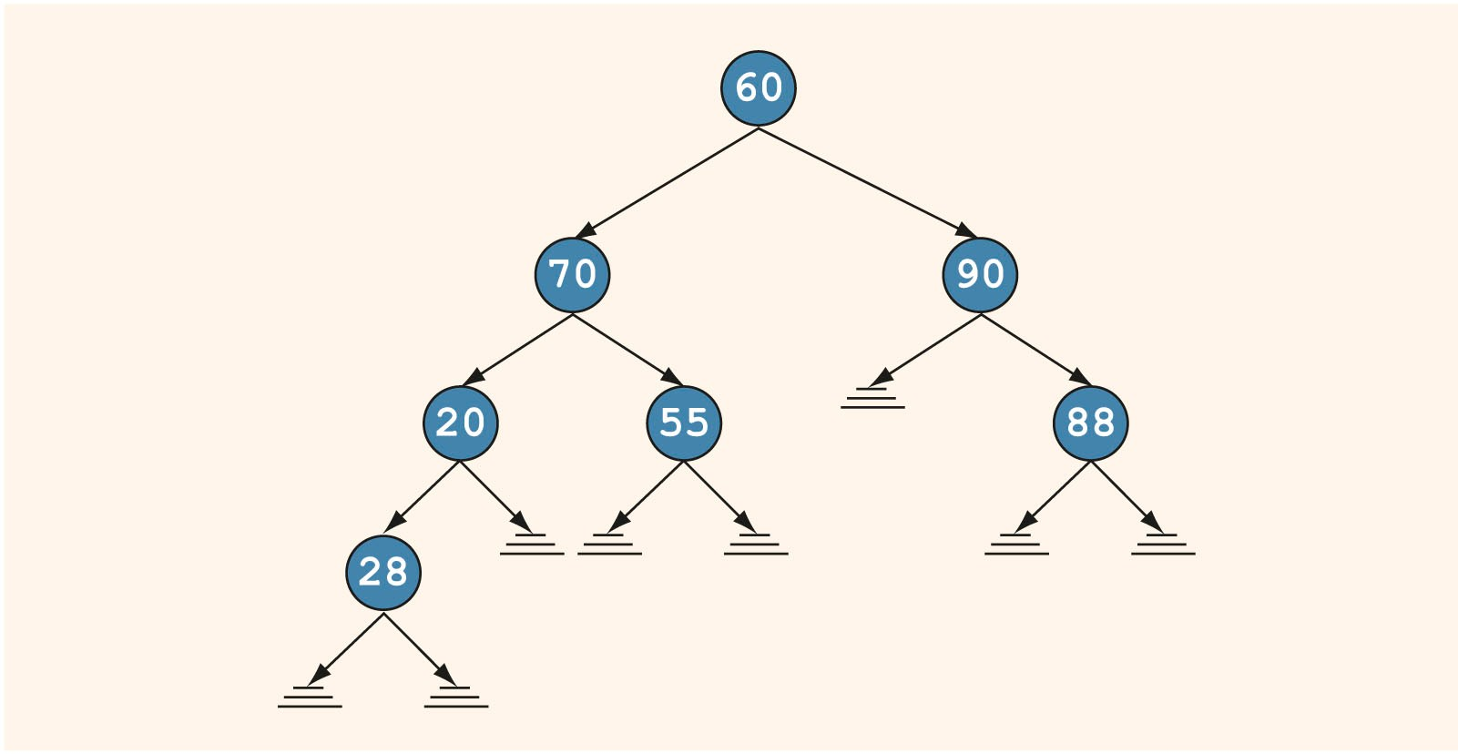
Nonrecursive Inorder Traversal
For each node, the left subtree is visited first, then the node, and then the right subtree
FIGURE 19-12 Binary tree; the leftmost node is 28

Slide 34
Nonrecursive Preorder Traversal
For each node, first the node is visited, then the left subtree, and then the right subtree
Must save a pointer to a node before visiting the left subtree, in order to visit the right subtree later

Slide 35
Nonrecursive Postorder Traversal
Visit order: left subtree, right subtree, node
Must track for the node whether the left and right subtrees have been visited
Solution: Save a pointer to the node, and also save an integer value of 1 before moving to the left subtree and value of 2 before moving to the right subtree
When the stack is popped, the integer value associated with that pointer is popped as well

Slide 36
Binary Tree Traversal and Functions as Parameters (1 of 3)
In a traversal algorithm, “visiting” may mean different things
Example: output value; update value in some way
Problem:
How do we write a generic traversal function?
Writing a specific traversal function for each type of “visit” would be cumbersome

Slide 37
Binary Tree Traversal and Functions as Parameters (2 of 3)
Solution:
Pass a function as a parameter to the traversal function
In C++, a function name without parentheses is considered a pointer to the function

Slide 38
Binary Tree Traversal and Functions as Parameters (3 of 3)
To specify a function as a formal parameter to another function:
Specify the function type, followed by name as a pointer, followed by the parameter types

Slide 39
Summary (1 of 3)
A binary tree is either empty or it has a special node called the root node
If nonempty, root node has two sets of nodes (left and right subtrees), such that the left and right subtrees are also binary trees
The node of a binary tree has two links in it
A node in the binary tree is called a leaf if it has no left and right children

Slide 40
Summary (2 of 3)
A node U is called the parent of a node V if there is a branch from U to V
Level of a node: number of branches on the path from the root to the node
The level of the root node of a binary tree is 0
The level of the children of the root is 1
Height of a binary tree: number of nodes on the longest path from the root to a leaf

Slide 41
Summary (3 of 3)
Inorder traversal
Traverse left, visit node, traverse right
Preorder traversal
Visit node, traverse left, traverse right
Postorder traversal
Traverse left, traverse right, visit node
In a binary search tree:
Root node is larger than every node in left subtree
Root node is less than every node in right subtree

