Slide 1
Special Topic: Static, Stack, Heap, and Pointers
C++ vs Java

Slide 2
Three Categories of Memory
(for Data Store)
Static: storage requirements are known prior to run time; lifetime is the entire program execution
Run-time stack: memory associated with active functions
  Structured as stack frames (activation records)
Heap: dynamically allocated storage; the least organized and most dynamic storage area

Slide 3
Static Data Memory
Simplest type of memory to manage.
Consists of anything that can be completely determined at compile time; e.g., global variables, constants (perhaps), code.
Characteristics:
  Storage requirements known prior to execution
  Size of static storage area is constant throughout execution

Slide 4
Run-Time Stack
The stack is a contiguous memory region that grows and shrinks as a program runs.
Its purpose: to support method calls
It grows (storage is allocated) when the activation record (or stack frame) is pushed on the stack at the time a method is called (activated).
It shrinks when the method terminates and storage is de-allocated.

Slide 5
Run-Time Stack
The stack frame has storage for local variables, parameters, and return linkage.
The size and structure of a stack frame is known at compile time, but actual contents and time of allocation is unknown until runtime.
How is variable lifetime affected by stack management techniques?

Slide 6
Heap Memory
Heap objects are allocated/deallocated dynamically as the program runs (not associated with specific event such as function entry/exit).
The kind of data found on the heap depends on the language
  Strings, dynamic arrays, objects, and linked structures are typically located here.
  Java and C/C++ have different policies.

Slide 7
Heap Memory
Special operations (e.g., malloc, new) may be needed to allocate heap storage.
When a program deallocates storage (free, delete) the space is returned to the heap to be re-used.
Space is allocated in variable sized blocks, so deallocation may leave “holes” in the heap (fragmentation).
  Compare to deallocation of stack storage

Slide 8
Heap Management
Some languages (e.g. C, C++) leave heap storage deallocation to the programmer
  delete
Others (e.g., Java, Perl, Python, list-processing languages) employ garbage collection to reclaim unused heap space.

Slide 9
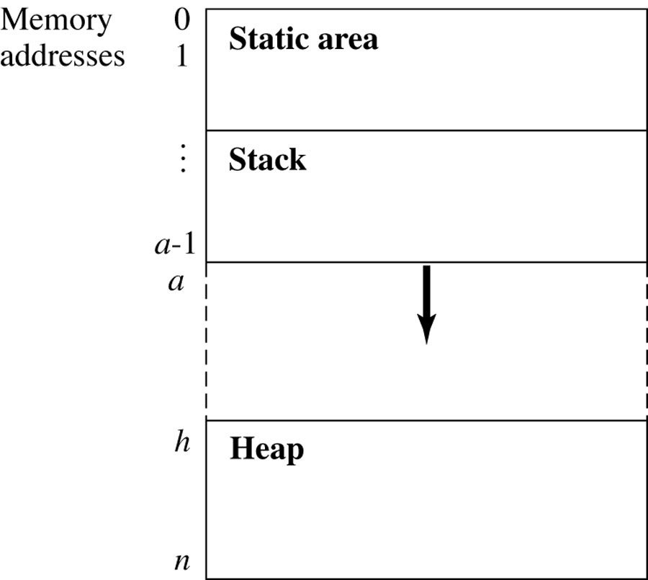
The Structure of Run-Time Memory
Figure 11.1
These two areas grow towards each other as program events require.

Slide 10
Stack Overflow
The following relation must hold:
0 ≤ a ≤ h ≤ n
In other words, if the stack top bumps into the heap, or if the beginning of the heap is greater than the end, there are problems!

Slide 11
Heap Management Functions
new returns the start address of a block of k words of unused heap storage and changes the state of the words from unused to undef.
  n ≤ k, where n is the number of words of storage needed; e.g., suppose a Java class Point has data members x,y,z which are floats.
  If floats require 4 bytes of storage, then
  Point firstCoord = new Point( )
  calls for 3 X 4 bytes (at least) to be allocated and initialized to some predetermined state.

Slide 12
Heap Overflow
Heap overflow occurs when a call to new occurs and the heap does not have a contiguous block of k unused words
So new either fails, in the case of heap overflow, or returns a pointer to the new block

Slide 13
Heap Management Functions
delete returns a block of storage to the heap
The status of the returned words are returned to unused, and are available to be allocated in response to a future new call.
One cause of heap overflow is a failure on the part of the program to return unused storage.

Slide 14
Pointers
Pointers are addresses; i.e., the value of a pointer variable is an address.
Memory that is accessed through a pointer is dynamically allocated in the heap
Java doesn’t have explicit pointers, but reference types are represented by their addresses and their storage is allocated on the heap (although the reference is on the stack).

Slide 15
Memory Allocation Java vs C++
JAVA | Stack Example | Heap Example
primitives | int a = 3; | int[] a = new int[1]; (Actually an Array Object.)
Classes | Does not exist! | String str = new String(“I am a string!”);
C++ | Stack Example | Heap Example
primitives | int a = 3; | int *a = new int;
Classes | String str(“I am a string!”) | String *str = new String(“I am a string!”);
http://www.horstmann.com/ccj2/ccjapp3.html

Slide 16
Java versus C/C++/etc.
In Java, arrays are always allocated dynamically from heap memory.
In many other languages
  Globally defined arrays - static memory.
  Local (to a function) arrays are - stack storage.
  Dynamically allocated arrays - heap storage.
Dynamically allocated arrays also have storage on the stack – a reference (pointer) to the heap block that holds the array.

Slide 17
Declaring Arrays
Typical C/C++ array declarations
  int arr[5];
  float arr1[10][15];
  int *intPtr;
  intPtr = new int[5]
Typical Java array declarations:
  int[] arr = new int[5];
  float[][] arr1 = new float [10][5];
  Object[] arr2 = new Object[100];

Slide 18
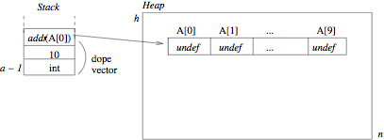
Allocation of Stack and Heap Space for Array A Figure 11.3

Slide 19
Comparing Pointers
int j = 5;
int i = 5;
int *ptrj1 = &j;
int *ptrj2 = &j;
int *ptri = &i;
True/False:
if (ptrj1 == ptrj2) ?
if (ptrj1 == ptri) ?
if (&ptrj1 == &ptrj2) ?
if (*ptrj1 == *ptri) ?
True
False
False
True

Slide 20
Assigning a value to a dereferenced pointer
A pointer must have a value before you can dereference it (follow the pointer).
int *x;
*x=3;
int foo;
int *x;
x = &foo;
*x=3;
ERROR!
Overrode the value located
in some address!
this is fine
x points to foo

Slide 21
Pointers to pointers
x
some int
int *x;
int **y;
double *z;
y
some *int
some int
z
some double

Slide 22
Pointers to pointers
Example:
  int i = 5;
  int *p_i = &i;
  int **pp_i = &p_i;
Then:
  pp_i is memory location of …
  p_i
  *pp_i is memory location of …
  i
  **pp_i equals…
  5

Slide 23
Pointers and Arrays
Array name is basically a const pointer pointing at the beginning of the array.
You can use the [] operator with pointers!
Example:
  int A[5];
  Creates a memory block of 5 integers on the stack (5x4bytes) where A (the pointer) points at the beginning of the array -> A[0]. (A = &A)
A

Slide 24
Pointers and Arrays
  int *x;
  int a[5]={-1,-2,-3,-4,-5};
  x = &a[2];
  for (int i=0;i<3;i++)
    x[i]++;
x is “the address of a[2] ”
a
x
x[i] is the same as a[i+2]
-1 | -2 | -3 | -4 | -5
x[0]
x[1]
x[2]

Slide 25
Pointer arithmetic
Integer math operations can be used with pointers: +, -, ++, --, +=, -=
If you increment a pointer, it will be increased by the size of whatever it points to.
Incrementing pointers will basically make it point to the “next” element in memory.
int *ptr = a;
*(ptr+2)
*(ptr+4)
*ptr
a[0] a[1] a[2] a[3] a[4]
int a[5];

Slide 26
Pointer Pitfalls
Assigning values to uninitialized, null, or deleted pointers:
  int *p; int *p = NULL; int *p = new int; *p = 3; *p = 4; delete p;
  *p = 5;
  All of these cases end up with segmentation fault!

Slide 27
Dangling Pointer
A pointer that points at nothing:
Example:
  int *p, *q;
  p = new int;
  q = p;
  delete q;
  *p = 3; //illegal assignment!
  p and q point to the same location, q is deleted, results with p becoming a dangling pointer!

Slide 28
Memory Leaks
Memory leak is when you remove the reference to the memory block, before deleting the block itself. Example:
  int *p = new int;
  p = NULL;//or a new other value
p points at memory location of type int.
p changed to point at null.
Result?
Must free memory block before changing reference.
Memory leak!

Slide 29
A memory leak can diminish the performance of the computer by reducing the amount of available memory.
Eventually, in the worst case, too much of the available memory may become allocated
and all or part of the system or devices stops working correctly, the application fails, or the system slows down.
Use valgrind with –leak-check=yes option if your implementation has memory leaks.
Valgrind User Manual, The Valgrind Quick Start Guide, Graphical User Interfaces
* This is why the –g flag is used when debugging!

Slide 30
11.2.1 Memory Leaks and Garbage Collection
The increasing popularity of OO programming has meant more emphasis on heap storage management.
Active objects: can be accessed through a pointer or reference.
Inactive objects: blocks that cannot be accessed; no reference exists.
(Accessible and inaccessible may be more descriptive.)

Slide 31
Review
Three types of storage
  Static
  Stack
  Heap
Problems with heap storage:
  Memory leaks (garbage): failure to free storage when pointers (references) are reassigned
  Dangling pointers: when storage is freed, but references to the storage still exist.

Slide 32
Allocation of Stack and Heap Space for Array A Figure 11.3

Slide 33
Garbage
Garbage: any block of heap memory that cannot be accessed by the program; i.e., there is no stack pointer to the block; but which the runtime system thinks is in use.
Garbage is created in several ways:
  A function ends without returning the space allocated to a local array or other dynamic variable. The pointer (dope vector) is gone.
  A node is deleted from a linked data structure, but isn’t freed
  …

Slide 34
Another Problem
A second type of problem can occur when a program assigns more than one pointer to a block of heap memory
The block may be deleted and one of the pointers set to null, but the other pointers still exist.
If the runtime system reassigns the memory to another object, the original pointers pose a danger.

Slide 35
Terminology
A dangling pointer (or dangling reference, or widow) is a pointer (reference) that still contains the address of heap space that has been deallocated (returned to the free list).
An orphan (garbage) is a block of allocated heap memory that is no longer accessible through any pointer.
A memory leak is a gradual loss of available memory due to the creation of garbage.

Slide 36
11.3 Garbage Collection
All inaccessible blocks of storage are identified and returned to the free list.
The heap may also be compacted at this time: allocated space is compressed into one end of the heap, leaving all free space in a large block at the other end.

Slide 37
Garbage Collection
C & C++ leave it to the programmer – if an unused block of storage isn’t explicitly freed by the program, it becomes garbage.
  You can get C++ garbage collectors, but they aren’t standard
Java, Python, Perl, (and other scripting languages) are examples of languages with garbage collection
  Python, etc. also automatic allocation: no need for “new” statements
Garbage collection was pioneered by languages like Lisp, which constantly creates and destroys linked lists.

