Slide 1
Chapter 16
Searching, Sorting, and the vector Type

Slide 2
Objectives
In this chapter, you will:
Learn about list processing and how to search a list using sequential search
Explore how to sort an array using the bubble sort and insertion sort algorithms
Learn how to implement the binary search algorithm
Become familiar with the vector type

Slide 3
List Processing
List: a collection of values of the same type
Array is a convenient place to store a list
Basic list operations:
Search the list for a given item
Sort the list
Insert an item in the list
Delete an item from the list
Print the list

Slide 4
Searching
Sequential search algorithm:
Not very efficient for large lists
On average, number of key comparisons is equal to half the size of the list
Does not assume that the list is sorted
If the list is sorted, the search algorithm can be improved

Slide 5
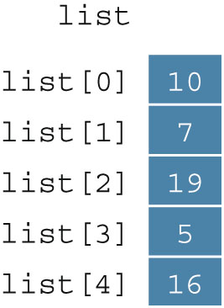
Bubble Sort (1 of 7)
list[0]...list[n - 1]
List of n elements, indexed 0 to n – 1
Example: a list of five elements (Figure 16-1)

Slide 6
Bubble Sort (2 of 7)
Series of n - 1 iterations
Successive elements list[index] and list[index + 1] of list are compared
If list[index] > list[index + 1]
Swap list[index] and list[index + 1]
Smaller elements move toward the top (beginning of the list)
Larger elements move toward the bottom (end of the list)

Slide 7
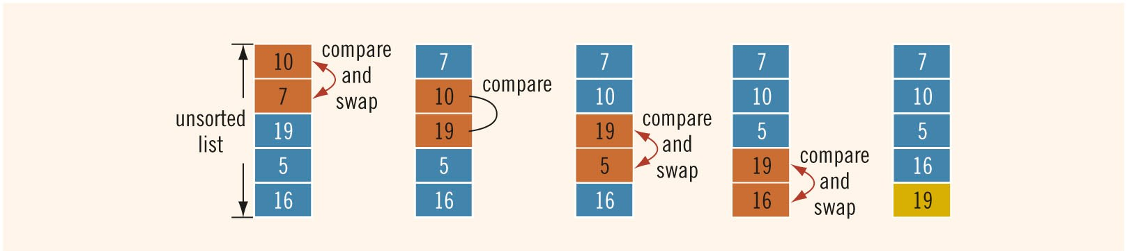
Bubble Sort (3 of 7)
FIGURE 16-2 Elements of list during the first iteration

Slide 8
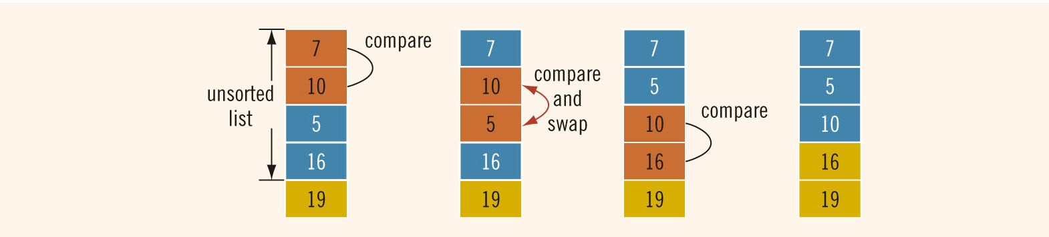
Bubble Sort (4 of 7)
FIGURE 16-3 Elements of list during the second iteration

Slide 9

Bubble Sort (5 of 7)
FIGURE 16-4 Elements of list during the third iteration

Slide 10

Bubble Sort (6 of 7)
FIGURE 16-5 Elements of list during the fourth iteration

Slide 11
Bubble Sort (7 of 7)
List of length n
Exactly n(n - 1) / 2 key comparisons
On average n(n - 1) / 4 item assignments
If n = 1000
500,000 key comparisons and 250,000 item assignments
Can improve performance if we stop the sort when no swapping occurs in an iteration

Slide 12


Insertion Sort (1 of 8)
Sorts the list by moving each element to its proper place
FIGURE 16-6 list
FIGURE 16-7 Sorted and unsorted portion of list

Slide 13
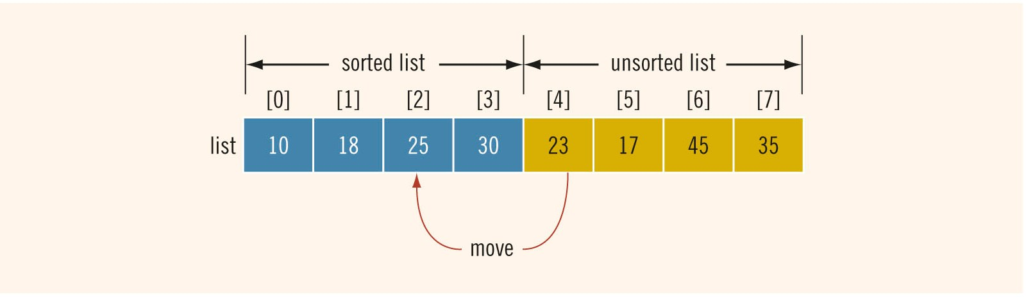
Insertion Sort (2 of 8)
Consider the element list[4]
First element of unsorted list
list[4] < list[3]
Move list[4] to proper location at list[2]
FIGURE 16-8 Move list[4] into list[2]

Slide 14
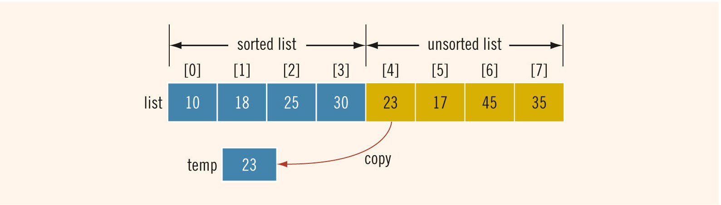
Insertion Sort (3 of 8)
FIGURE 16-9 Copy list[4] into temp

Slide 15
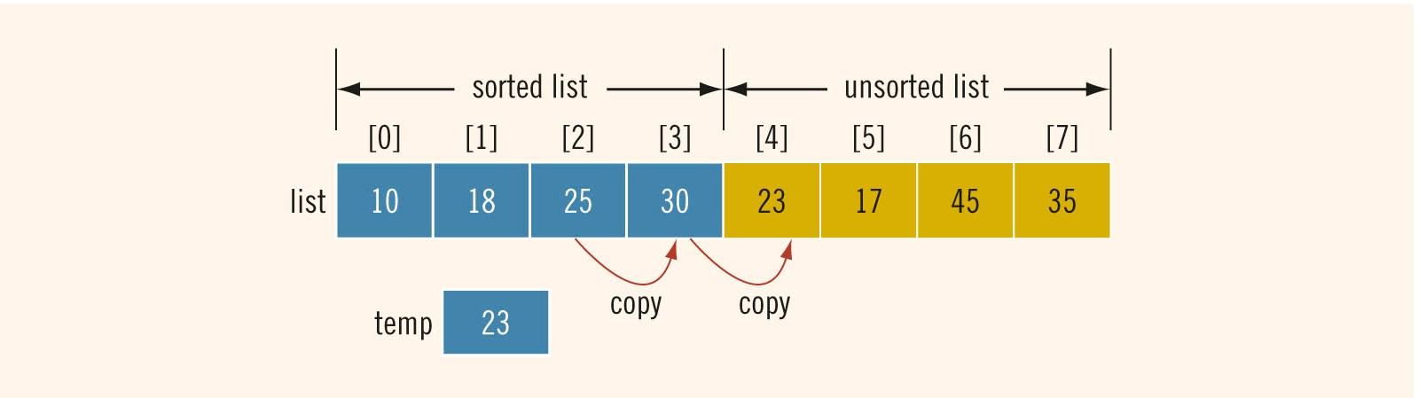
Insertion Sort (4 of 8)
FIGURE 16-10 list before copying list[3] into list[4] and then list[2] into list[3]

Slide 16
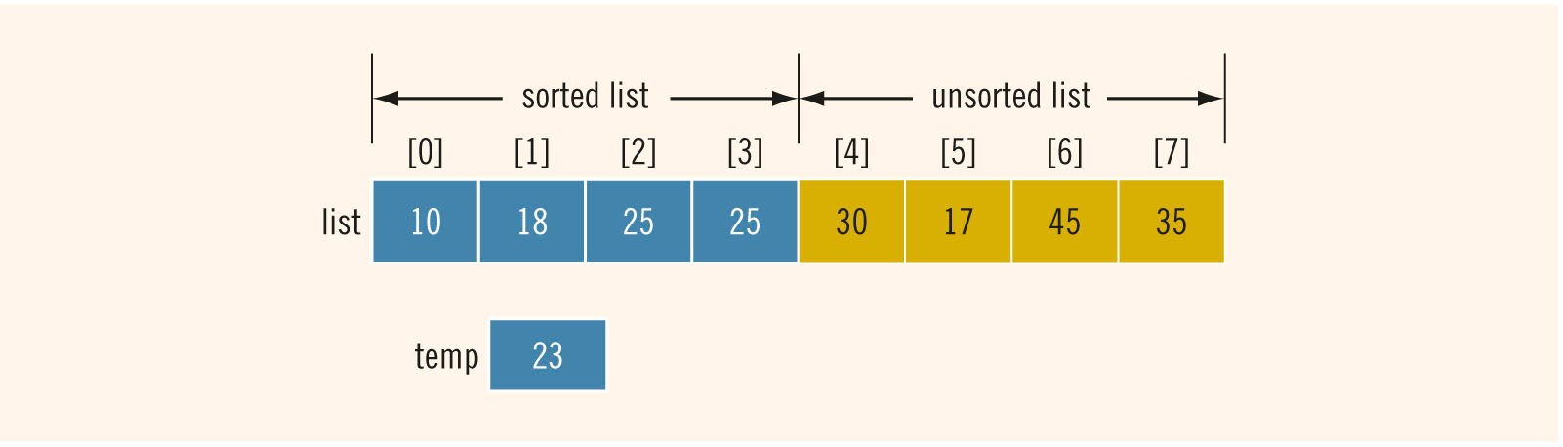
Insertion Sort (5 of 8)
FIGURE 16-11 list after copying list[3] into list[4] and then list[2] into list[3]

Slide 17
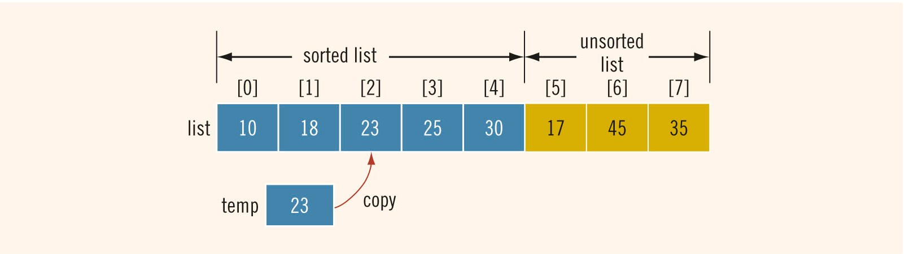
Insertion Sort (6 of 8)
FIGURE 16-12 li s t after copying t emp into li s t[ 2 ]

Slide 18
Insertion Sort (7 of 8)
During the sorting phase, the array is divided into two sublists: sorted and unsorted
Sorted sublist elements are sorted
Elements in the unsorted sublist are to be moved into their proper places in the sorted sublist, one at a time

Slide 19
Insertion Sort (8 of 8)
List of length n
About (n² + 3n – 4) / 4 key comparisons
About n(n – 1) / 4 item assignments
If n = 1000
250,000 key comparisons
250,000 item assignments

Slide 20
Binary Search (1 of 2)
Much faster than a sequential search
List must be sorted
“Divide and conquer”
Compare search item with middle element
If less than middle: search only upper half of list
If more than middle: search only lower half of list

Slide 21
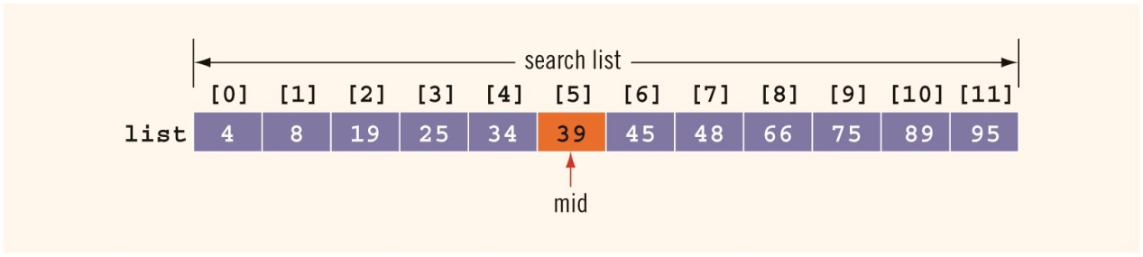
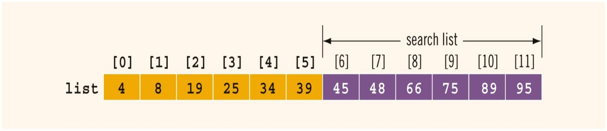
Binary Search (2 of 2)
FIGURE 16-14 Search list, list[0]...list[11]
FIGURE 16-15 Search list, list[6]...list[11]

Slide 22
Performance of Binary Search
If L is a sorted list of size 1024
Every iteration of the while loop cuts the size of the search list by half
At most, 11 iterations to determine whether x is in L
Binary search will make 22 comparisons at most
If L has1,048,576 elements
Binary search makes 42 item comparisons at most
For a sorted list of length n:
Maximum number comparisons is 2log₂n + 2

Slide 23
vector type (class) (1 of 4)
Only a fixed number of elements can be stored in an array
Inserting and removing elements causes shifting of remaining elements
vector type implements a list
vector container
vector
vector object
object

Slide 24
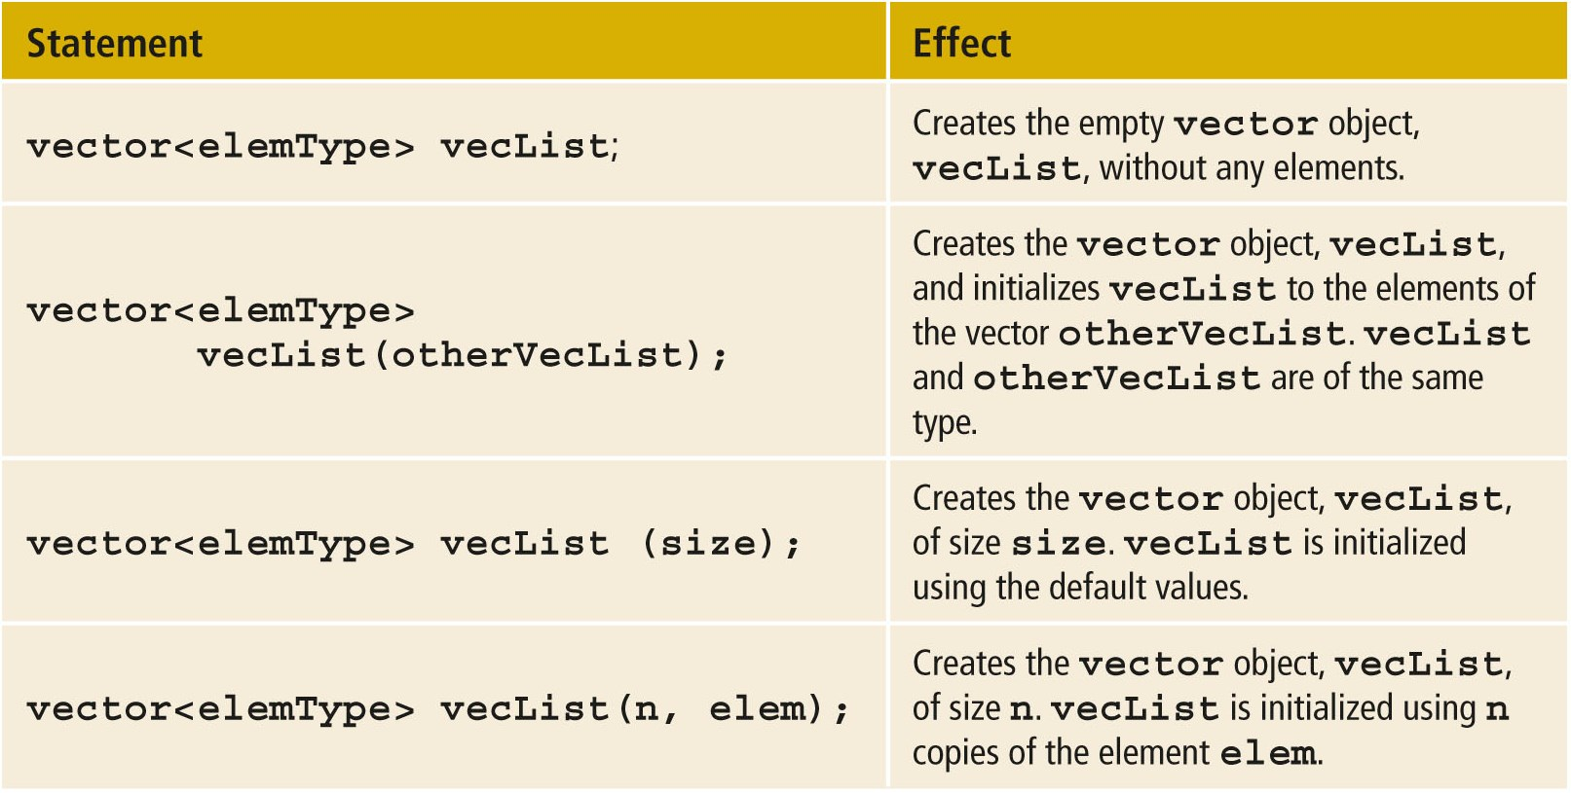
vector type (class) (2 of 4)
TABLE 16-1 Various Ways to Declare and Initialize a vector Object

Slide 25
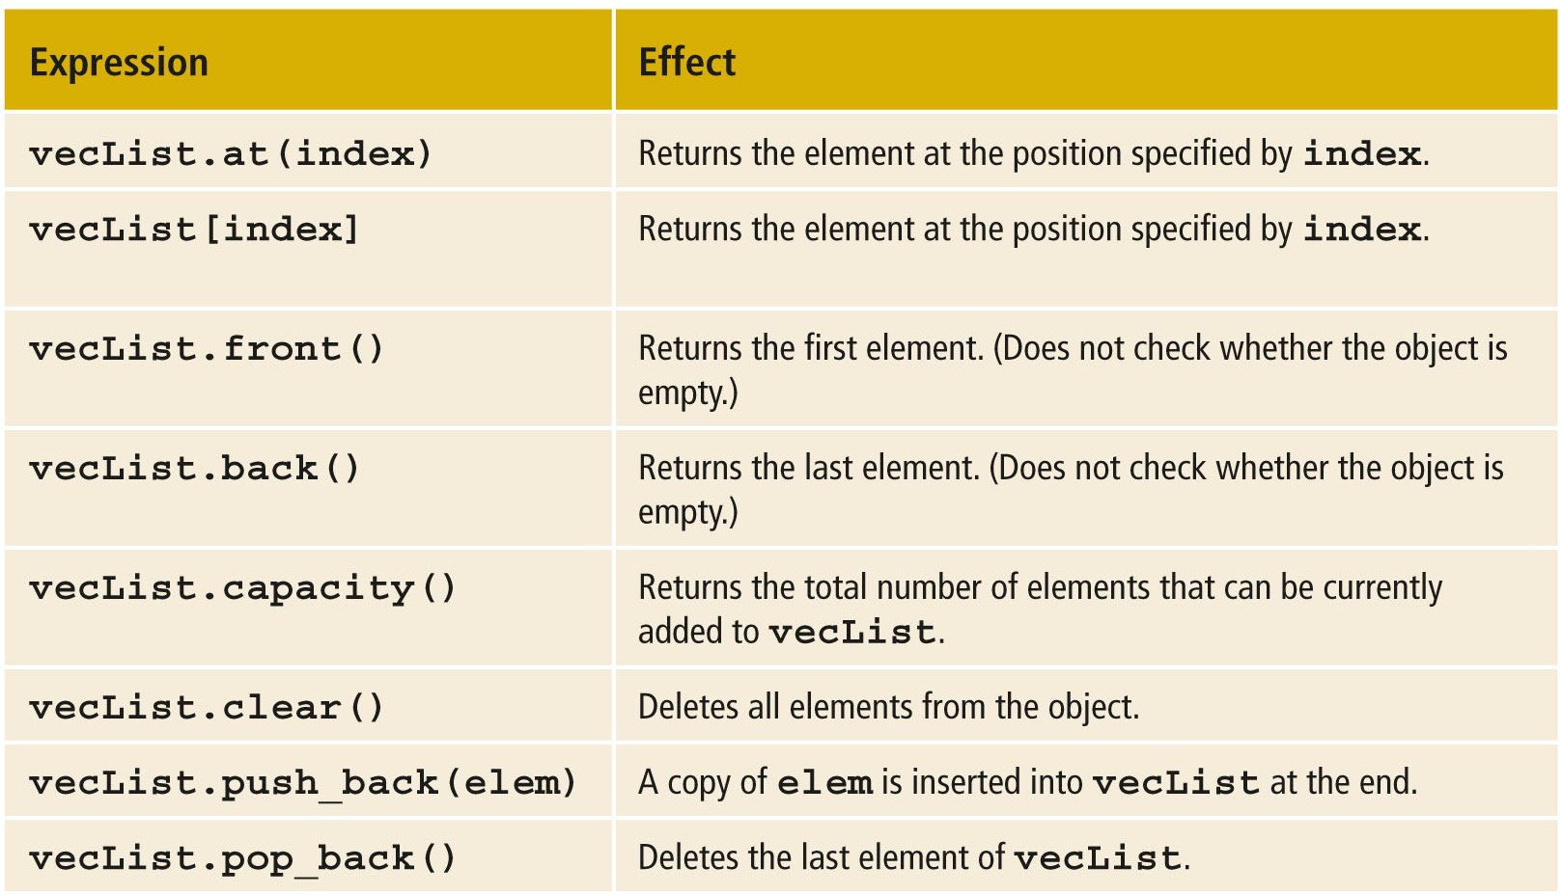
vector type (class) (3 of 4)
TABLE 16-2 Operations on a vector Object

Slide 26
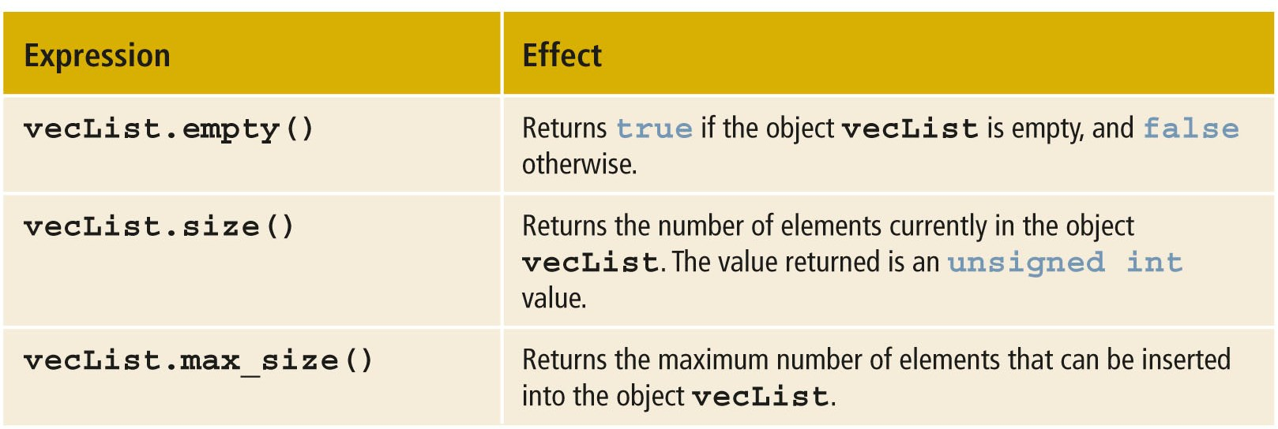
vector type (class) (4 of 4)
TABLE 16-2 Operations on a vector Object (cont’d.)

Slide 27
Vectors and Range-Based for loops
Can use range-based for loop in C++11 Standard to process vector elements
for (auto p : list) //for all p in list
cout << p << " ";
cout << endl;
Can initialize a vector object
vector<int> intList = {13, 75, 28, 35};

Slide 28
Summary (1 of 2)
List
Set of elements of the same type
Sequential search
Searches each element until item is found
Sorting algorithms
Bubble sort
Insertion sort

Slide 29
Summary (2 of 2)
Binary search
Much faster than sequential search
Requires that the list is sorted
vector type
Implements a list
Can increase/decrease in size during program execution
Must specify the type of object the vector stores

