Slide 1
Chapter 21
Standard Template Library (STL)

Slide 2
Objectives (1 of 3)
In this chapter, you will:
Learn about the Standard Template Library (STL)
Become familiar with the three basic components of the STL: containers, iterators, and algorithms
Become familiar with basic operations on vector objects
Learn about the member functions common to all containers
Learn about the member functions common to all sequence containers

Slide 3
Objectives (2 of 3)
Learn how to use the copy algorithm
Explore how to use range-based for loops
Explore how various containers, such as deque and list, are used to manipulate data in a program
Learn about various types of iterators and how they are used
Explore how to use the associative containers sets, multisets, maps and multimaps

Slide 4
Objectives (3 of 3)
Explore how to use the container adapters stacks and queues
Become familiar with the various types of STL algorithms
Learn about function objects: arithmetic and relational
Become familiar with insert iterators
Explore how to use various generic algorithms

Slide 5
Introduction
ANSI/ISO Standard C++ is equipped with a Standard Template Library (STL)
STL includes class templates to process lists, stacks, and queues
This chapter:
Discusses many important features of the STL
Shows how to use its tools

Slide 6
Components of the STL
Components of the STL
Containers
Iterators
Algorithms
Containers and iterators: class templates
Iterators: used to step through the elements of a container
Algorithms: used to manipulate data

Slide 7
Container Types
Manage objects of a given type
Three categories
Sequence (sequential) containers
Associative containers
Container adapters

Slide 8
Sequence Containers
Sequence container: every object in the container has a specific position
Three predefined sequence containers
vector
deque
list

Slide 9
Sequence Container: vector (1 of 6)
Stores and manages its objects in a dynamic array
Must use: #include <vector>
To define an object of type vector, specify the type of the object
Examples:
vector<int> intList;
vector<string> stringList;
vector contains several constructors

Slide 10
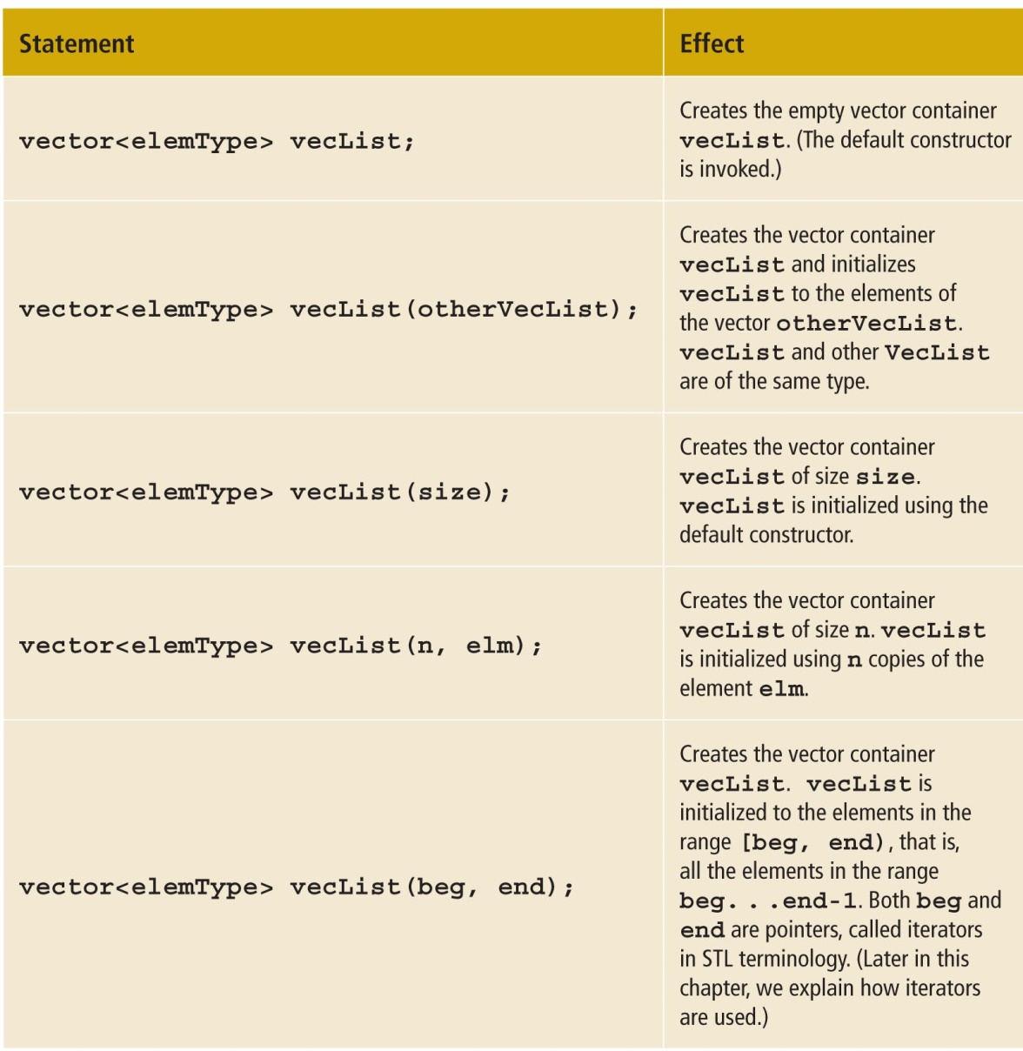
Sequence Container: vector (2 of 6)
Sequence Container: vector (cont’d.)
TABLE 21-1 Various Ways to Declare and Initialize a Vector Container

Slide 11
Sequence Container: vector (3 of 6)
Basic vector operations
Item insertion
Item deletion
Stepping through the elements
Vector elements can be processed just as they can in an array

Slide 12
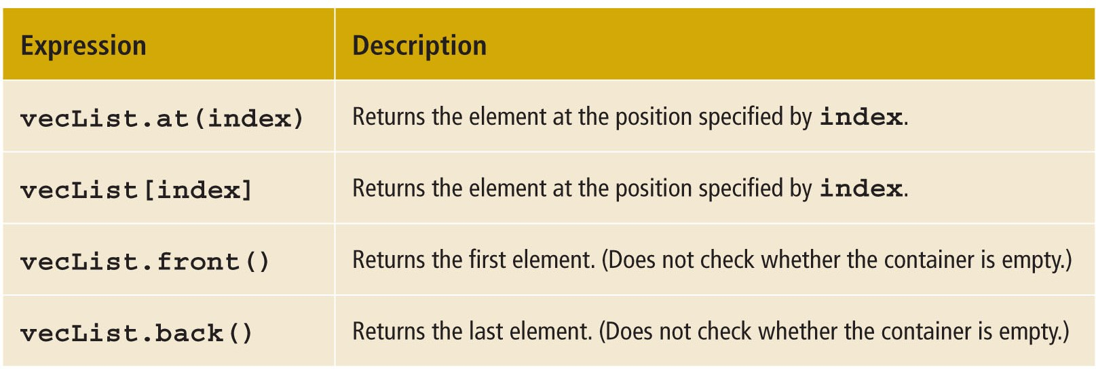
Sequence Container: vector (4 of 6)
TABLE 21-2 Operations to Access the Elements of a Vector Container

Slide 13
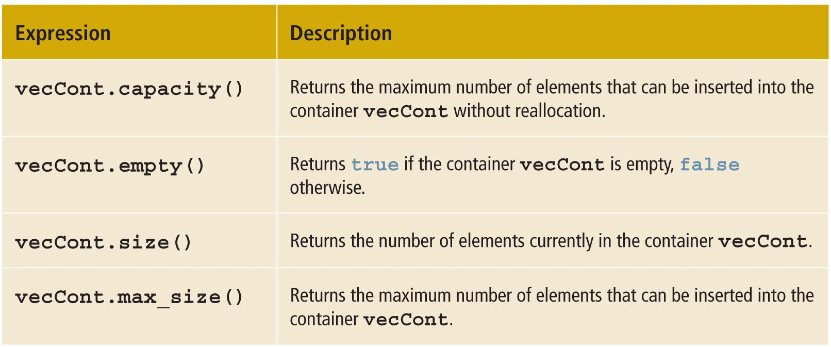
Sequence Container: vector (5 of 6)
TABLE 21-3 Operations to Determine the Size of a Vector Container

Slide 14
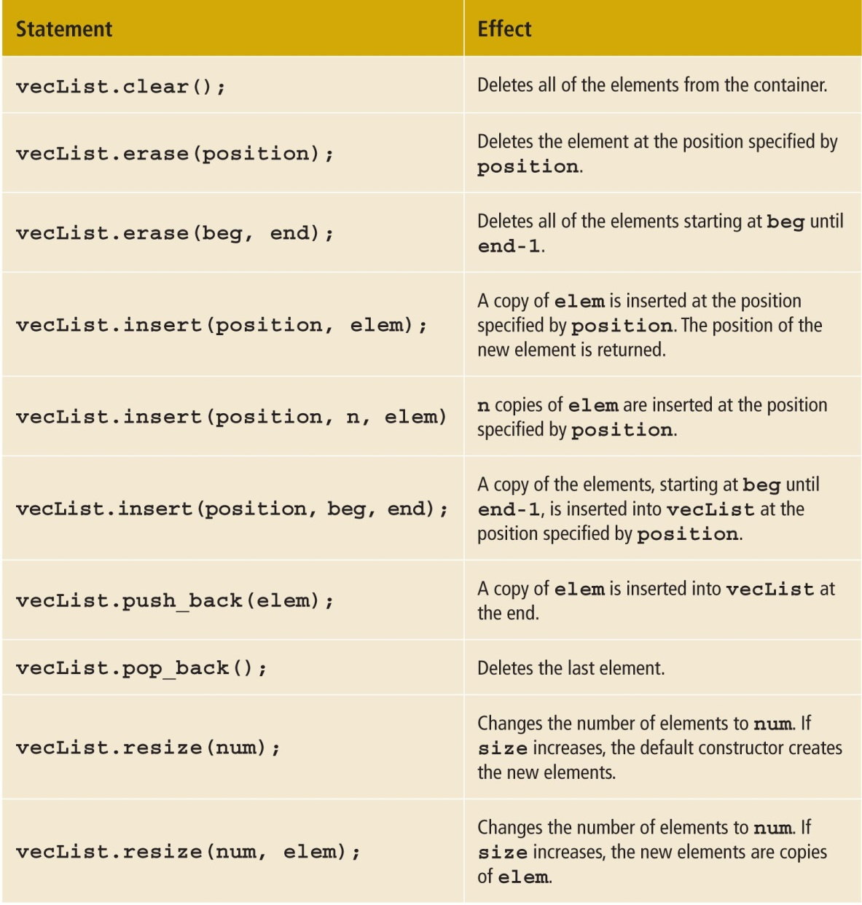
Sequence Container: vector (6 of 6)
Sequence Container: vector (cont’d.)
TABLE 21-4 Various Operations on a Vector Container

Slide 15
Declaring an iterator to a vector Container
A vector contains a typedef iterator
Examples:
vector<int>::iterator intVecIter;
Declares intVecIter to be an iterator into a vector container of type int
++intVecIter
Advances the iterator
*intVecIter
Returns element at current iterator position

Slide 16
Containers and the Functions begin and end
Every container contains member functions
begin: returns the position of the first element
end: returns the position of the last element
Both functions have no parameters

Slide 17
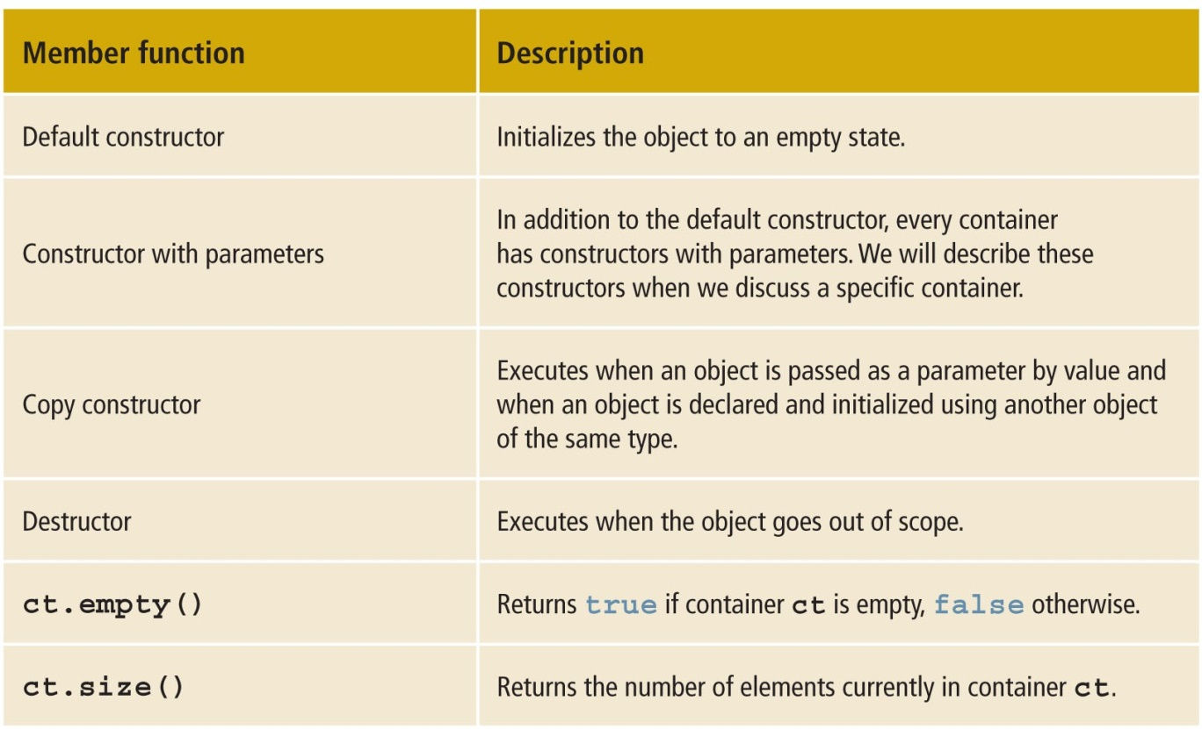
Member Functions Common to All Containers (1 of 3)
TABLE 21-5 Operations Common to All Containers (1 of 3)

Slide 18
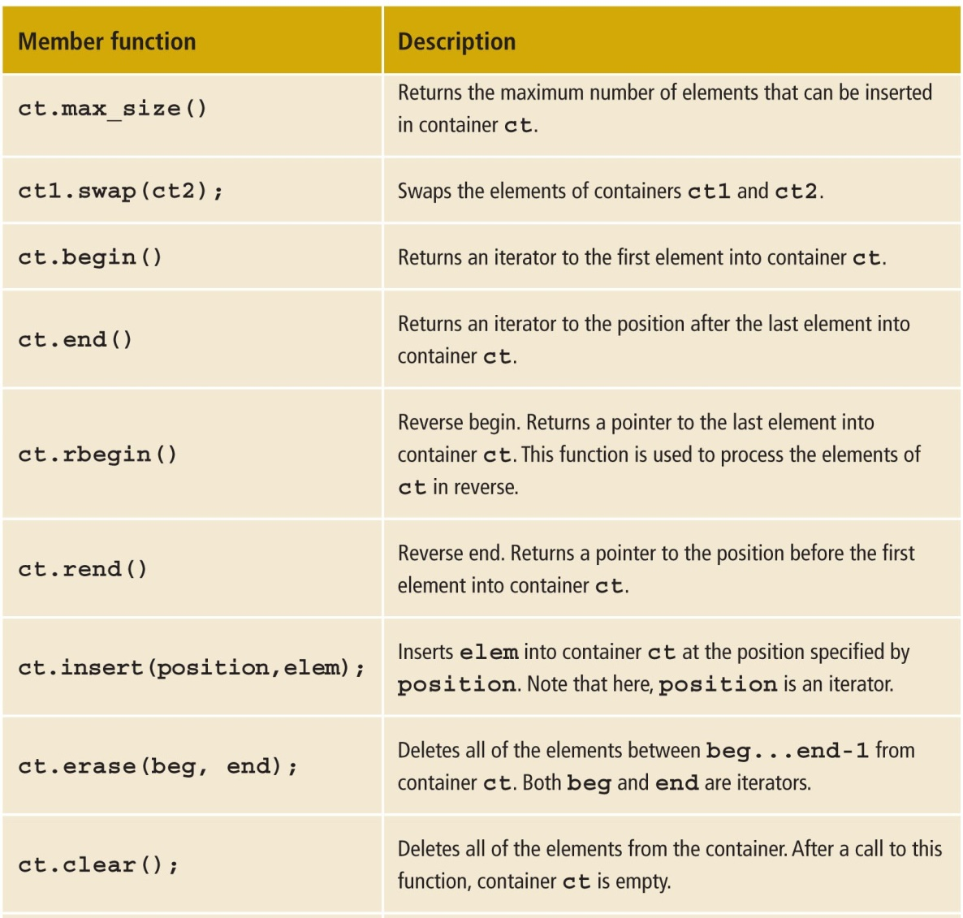
Member Functions Common to All Containers (2 of 3)
TABLE 21-5 Operations Common to All Containers (2 of 3)

Slide 19
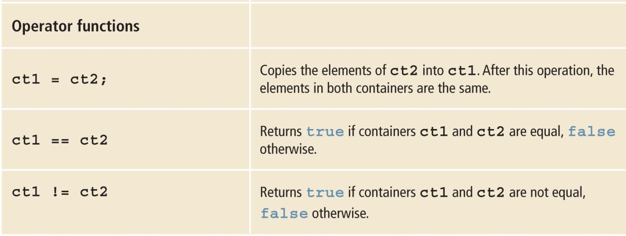
Member Functions Common to All Containers (3 of 3)
TABLE 21-5 Operations Common to All Containers (3 of 3)

Slide 20
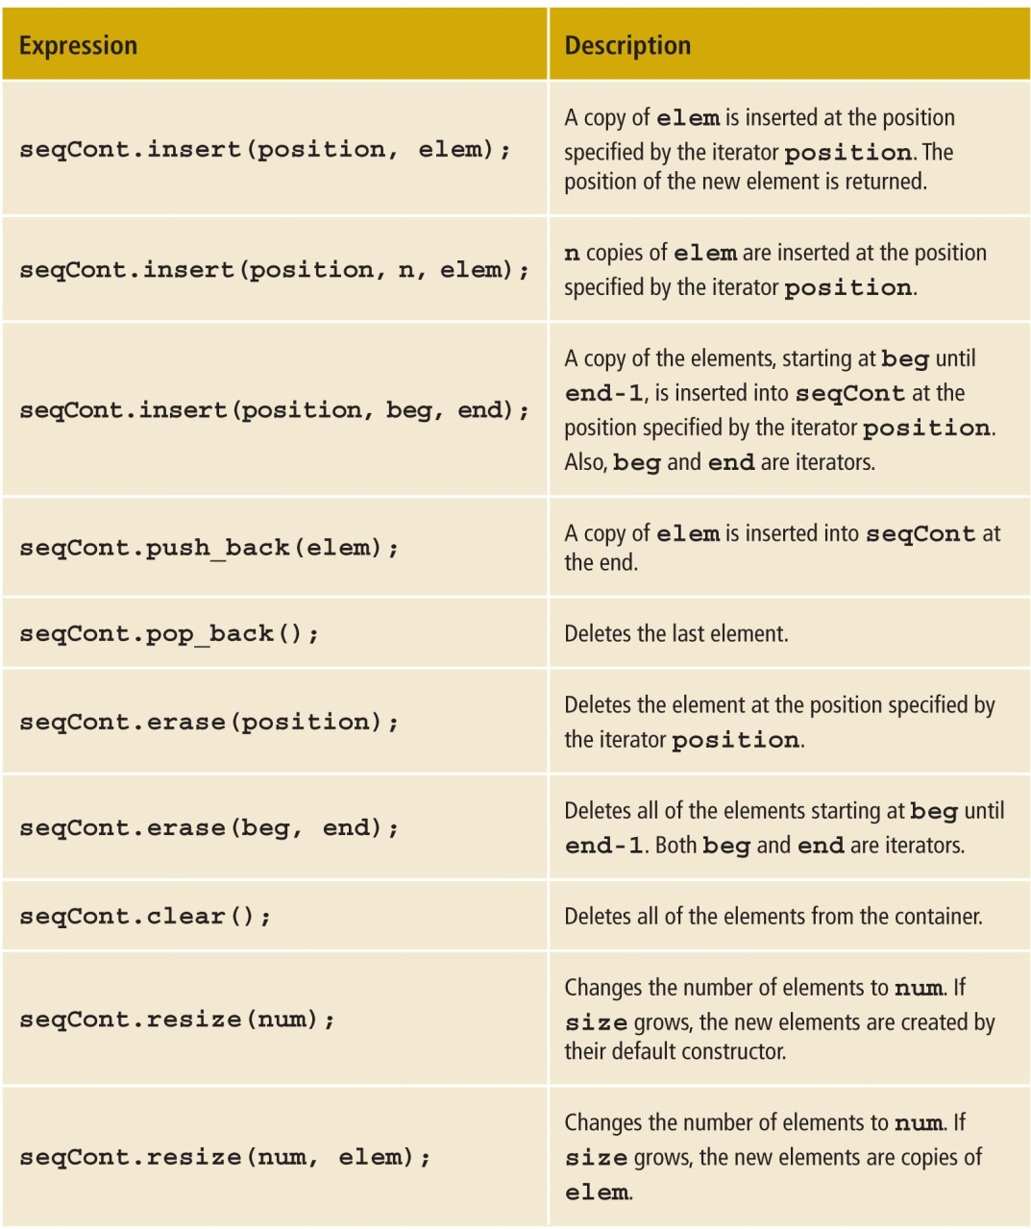
Member Functions Common to Sequence Containers
TABLE 21-6 Member Functions Common to All Sequence Containers

Slide 21
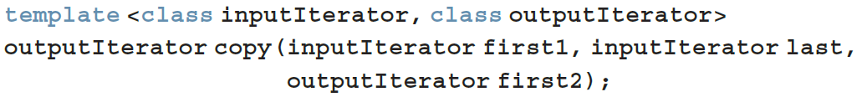
The copy Algorithm
Function copy: convenient way to output the elements of a container
Copies elements from one place to another
Can output the elements of a vector
Prototype:
Copies elements within range first1...last-1
Must use: #include <algorithm>

Slide 22
The ostream Iterator and the Function copy
copy can output a container using an iterator
Iterator of type ostream specifies destination
When creating an iterator of type ostream:
Specify the type of element that the iterator will output

Slide 23
Sequence Container: deque
deque: double-ended queue
Implemented as dynamic arrays
A deque can expand in either direction
Elements can be inserted at both ends and in the middle
Must use #include <deque>
class deque has several constructors

Slide 24
Sequence Container: list
List containers are implemented as doubly linked lists
Every element in a list points to immediate predecessor and immediate successor
Except the first and last element
Linked list is not a random access data structure
class list has several constructors

Slide 25
Iterators
Iterator: points to the elements of a container (sequence or associative)
Provides access to each element
Most common operations on iterators
++ (increment)
* (dereference)

Slide 26
Types of Iterators (1 of 2)
Input iterators:
Have read access; step forward element-by-element
Output iterators:
Have write access; step forward element-by-element
Forward iterators:
Have all functionality of input and almost all of output iterators

Slide 27
Types of Iterators (2 of 2)
Bidirectional iterators:
Can go backward
Random access iterators:
Bidirectional iterators that can randomly process the elements of a container

Slide 28
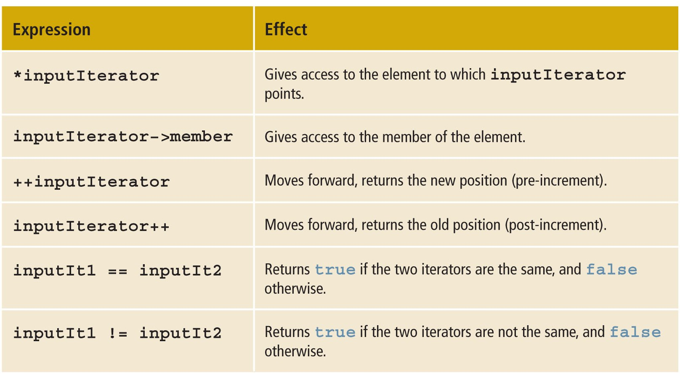
Input Iterators
TABLE 21-11 Operations on an Input Iterator

Slide 29
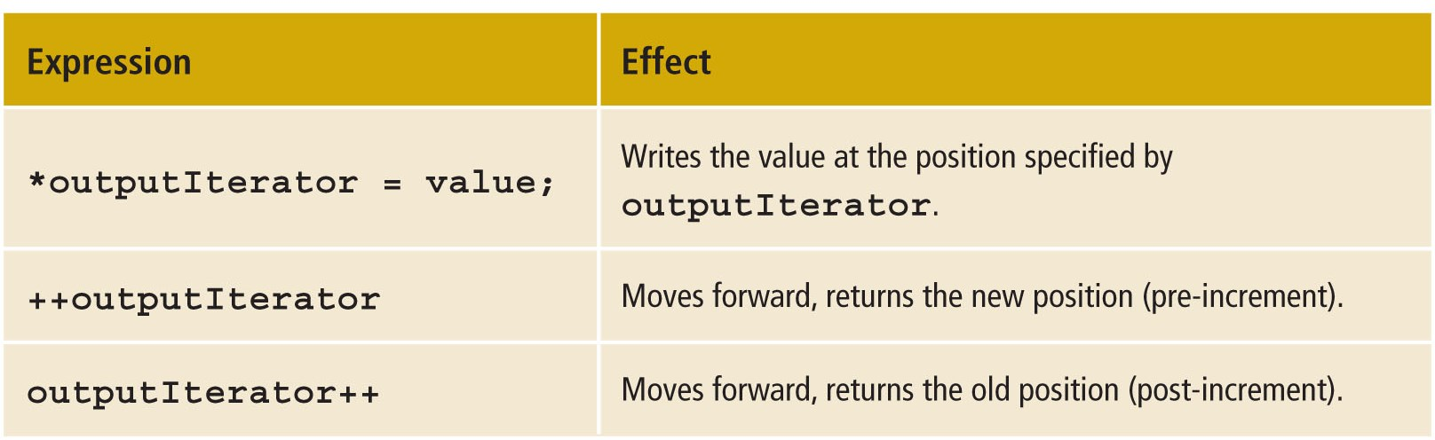
Output Iterators
Output iterators cannot be used to iterate over a range twice
TABLE 21-12 Operations on an Output Iterator

Slide 30
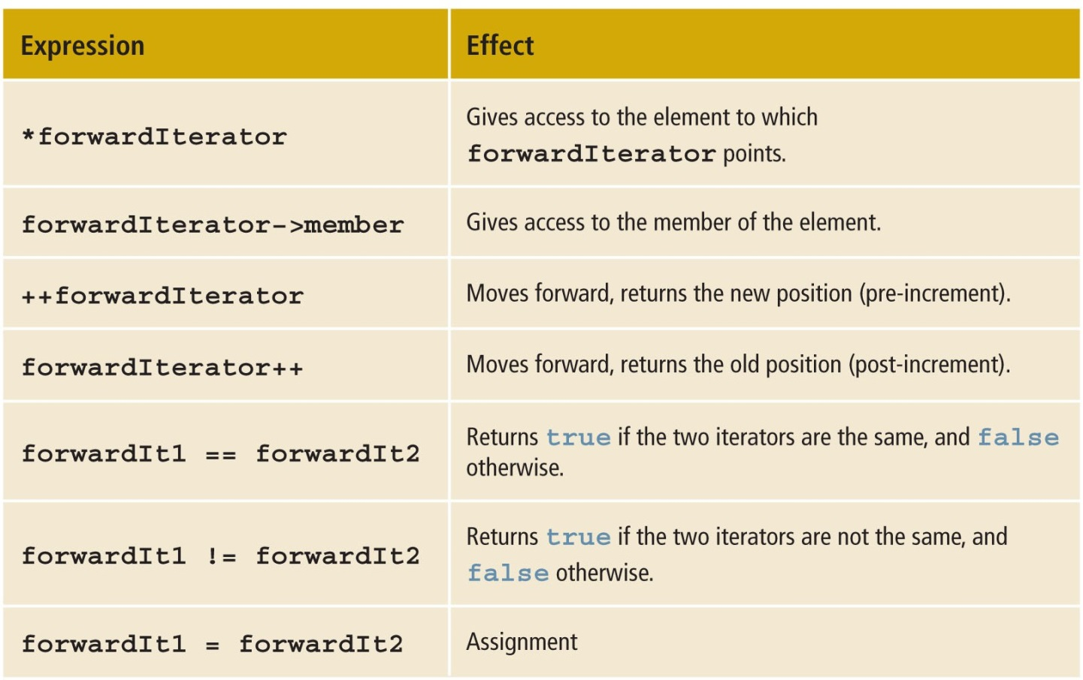
Forward Iterators
TABLE 21-13 Operations on a Forward Iterator

Slide 31
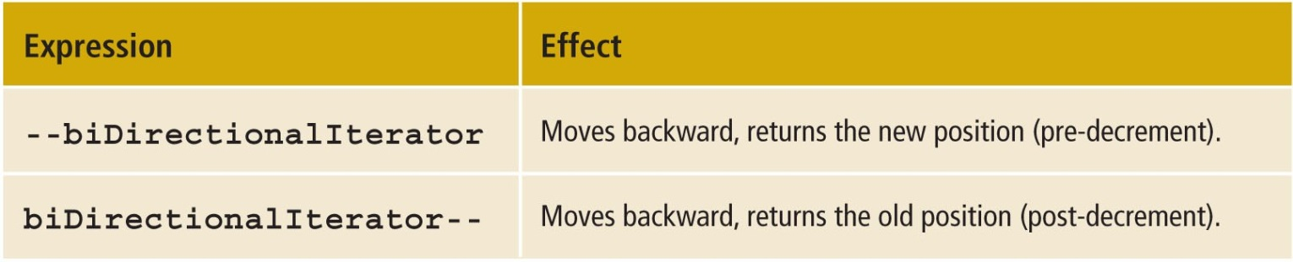
Bidirectional Iterators
Bidirectional iterator: a forward iterator that can also iterate backward over the elements
The operations defined for forward iterators apply to bidirectional iterators
Use the decrement operator to step backward
TABLE 21-14 Additional Operations on a Bidirectional Iterator

Slide 32
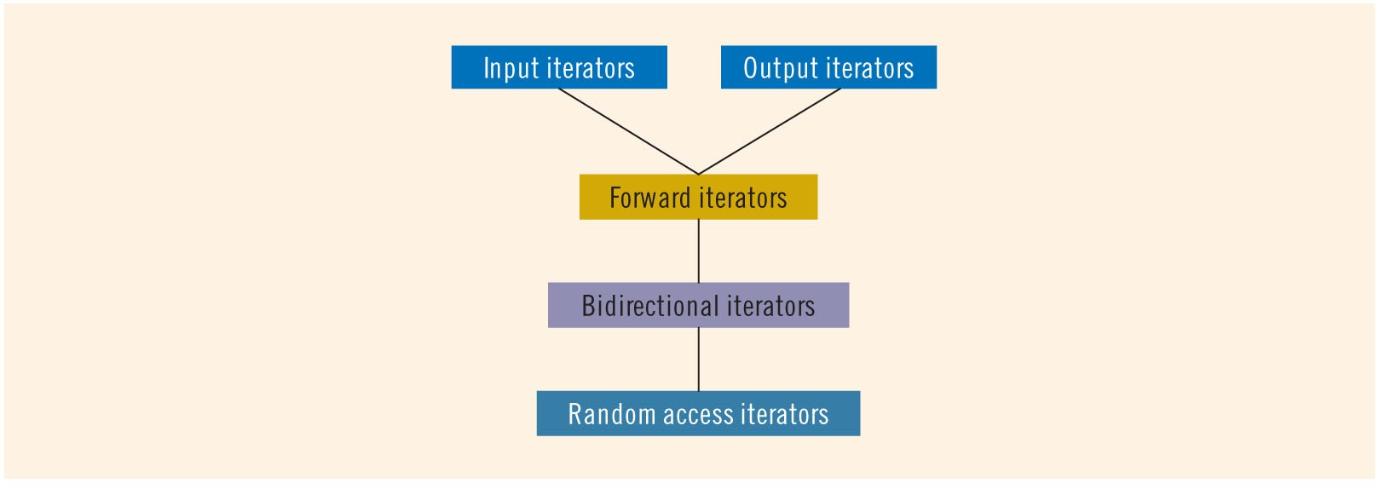
Random Access Iterators
Random access iterator: a bidirectional iterator that can randomly process elements of the container
Can be used with containers of the types vector, deque, string, as well as arrays
Operations defined for bidirectional iterators apply to random access iterators
FIGURE 21-1 Iterator hierarchy

Slide 33
typedef iterator
Every container contains a typedef iterator
Used to declare the iterator
Example:
vector<int>::iterator intVecIter;
declares intVecIter to be an iterator into a vector container of the type int

Slide 34
typedef const_iterator
Use an iterator and the dereference operator, *, to modify the elements of the container
Every container also contains typedef const_iterator to prevent the iterator from modifying the elements of a const container

Slide 35
typedef reverse_iterator
Every container also contains the typedef reverse_iterator
Used to iterate through the elements of a container in reverse

Slide 36
typedef const_reverse_iterator
Read-only iterator
Used to iterate through the elements of a container in reverse
Required if the container is declared as const, and iteration through the elements of the container in reverse is needed

Slide 37
Stream Iterators
istream_iterator
Used to input data into a program from an input stream
ostream_iterator
Used to output data into an output stream
or

Slide 38
Associative Containers
Associative container: stores elements automatically sorted according to some ordering criteria
Default criteria: < (less than)
Predefined associative containers in the STL
Sets
Multisets
Maps
Multimaps

Slide 39
Associative Containers: set and multiset
Associative containers set and multiset automatically sort elements in ascending order
multiset allows duplicates; set does not
Default sorting criterion is < (less than)
Ascending order
Must use #include <set>
See Tables 21-17 and 21-18 in text

Slide 40
Container Adapters
Container adapters: containers to accommodate special situations
Three container adapters
Stacks
Queues
Priority Queues
Do not support any type of iterator

Slide 41
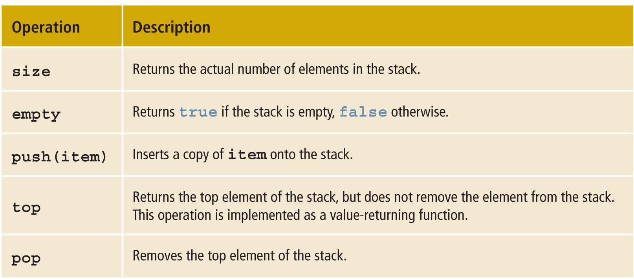
Stack
The STL provides a stack class
TABLE 21-19 Various Operations on a stack Object

Slide 42
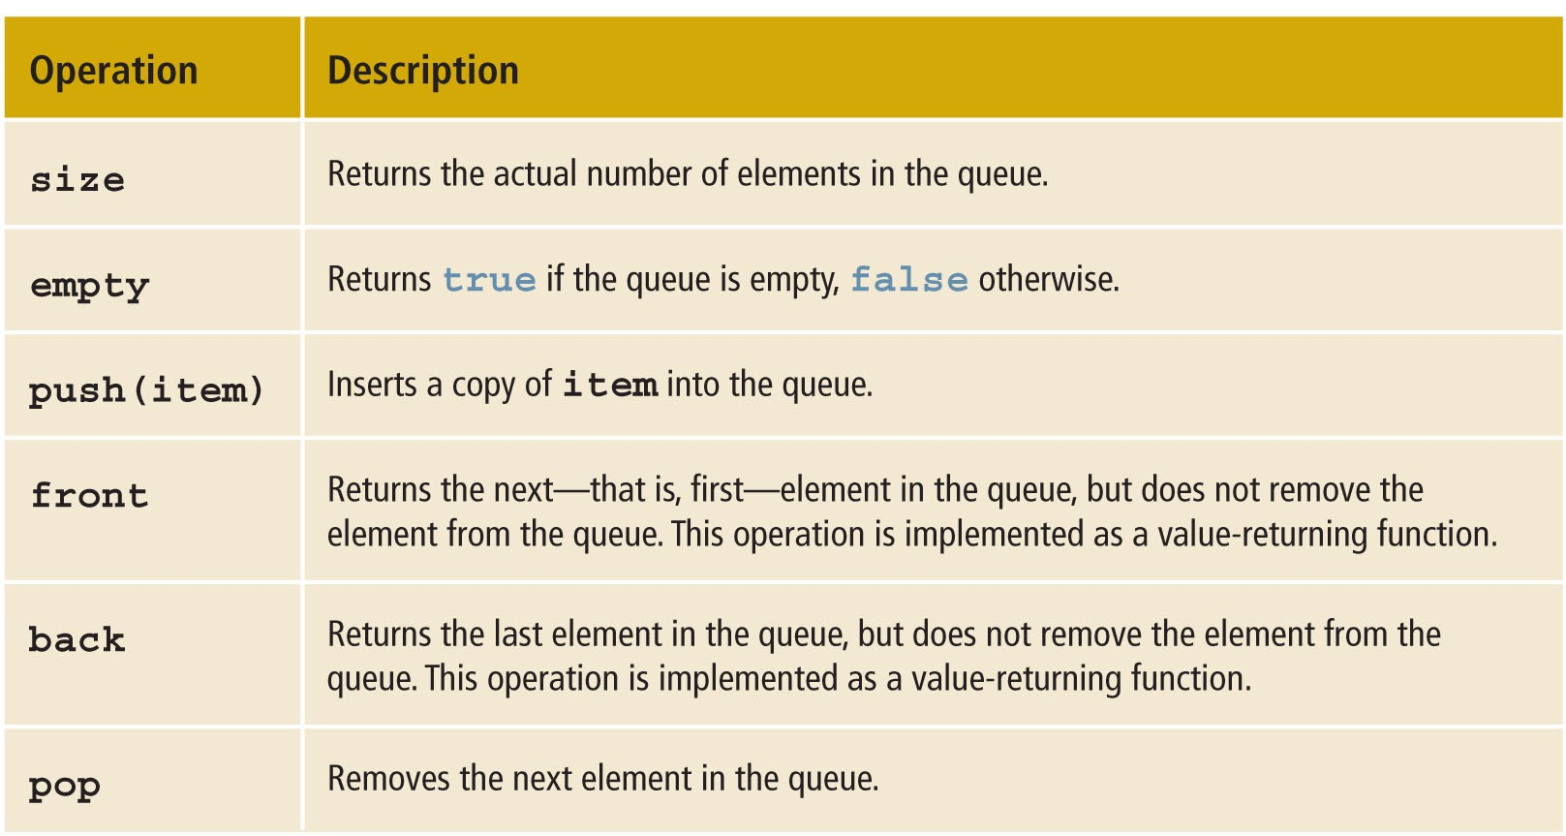
Queue
TABLE 21-20 Various Operations on a queue Object

Slide 43
Containers, Associated Header Files, and Iterator Support (1 of 2)
Every container is a class
Definition of the class implementing a specific container is contained in the header file

Slide 44
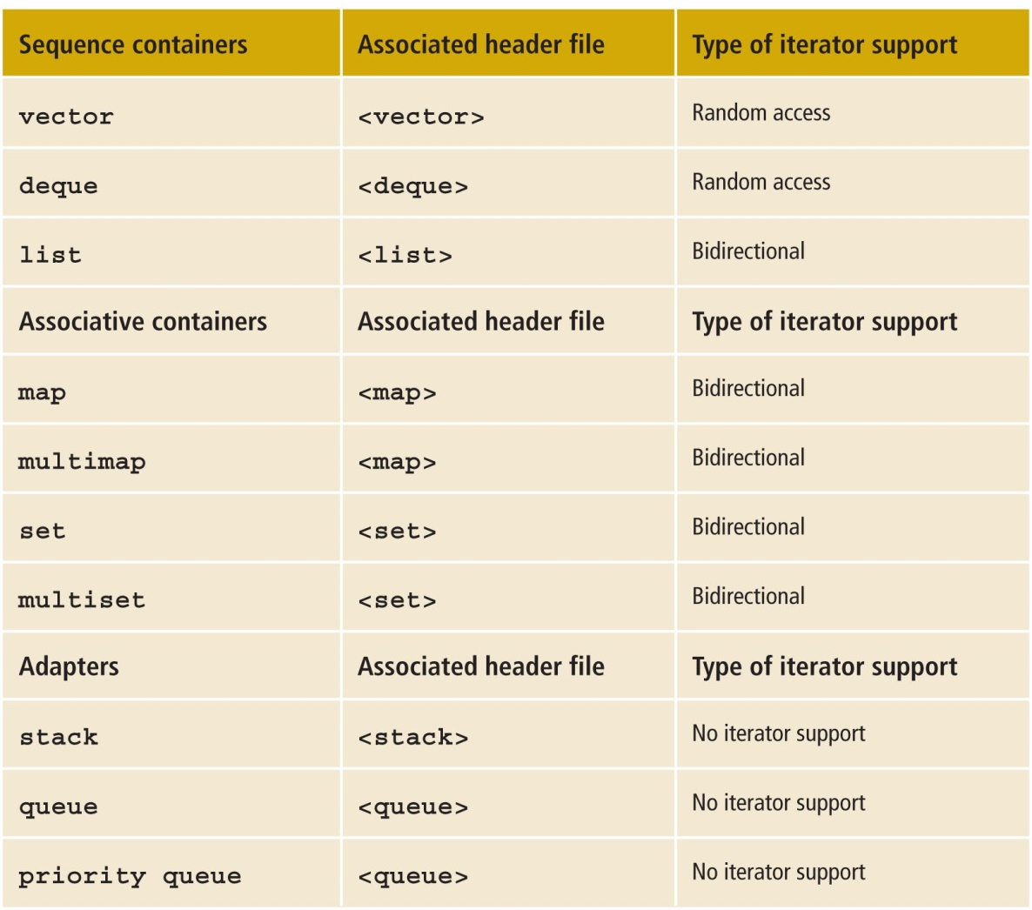
Containers, Associated Header Files, and Iterator Support (2 of 2)
TABLE 21-21 Containers, Their Associated Header Files, and the Type of Iterator Supported by Each Container

Slide 45
Algorithms
Several operations can be defined for a container
Some are very specific to a container – provided as part of the container definition
Other operations are common to all containers
Generic algorithms contained in the header file algorithm

Slide 46
STL Algorithm Classification
Operations such as clear, sort, and merge are common to all containers
Provided as generic algorithms
STL algorithm classifications
Nonmodifying algorithms
Modifying algorithms
Numeric algorithms
Heap algorithms

Slide 47
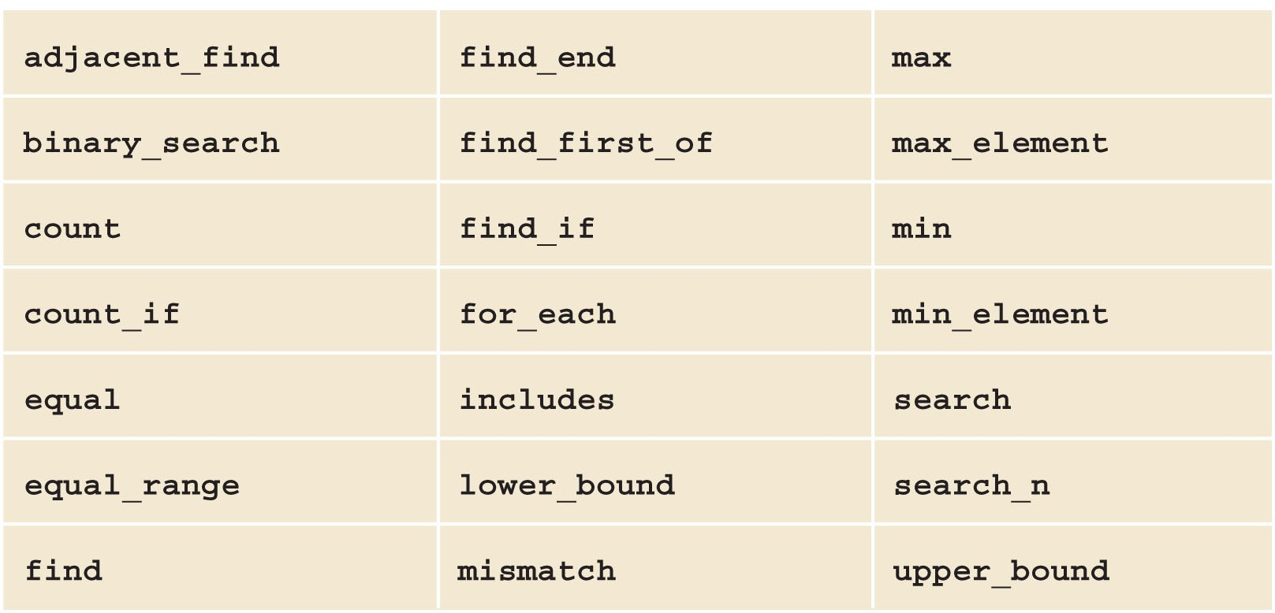
Nonmodifying Algorithms
Nonmodifying algorithms: do not modify the elements of the container
TABLE 21-22 Nonmodifying Algorithms

Slide 48
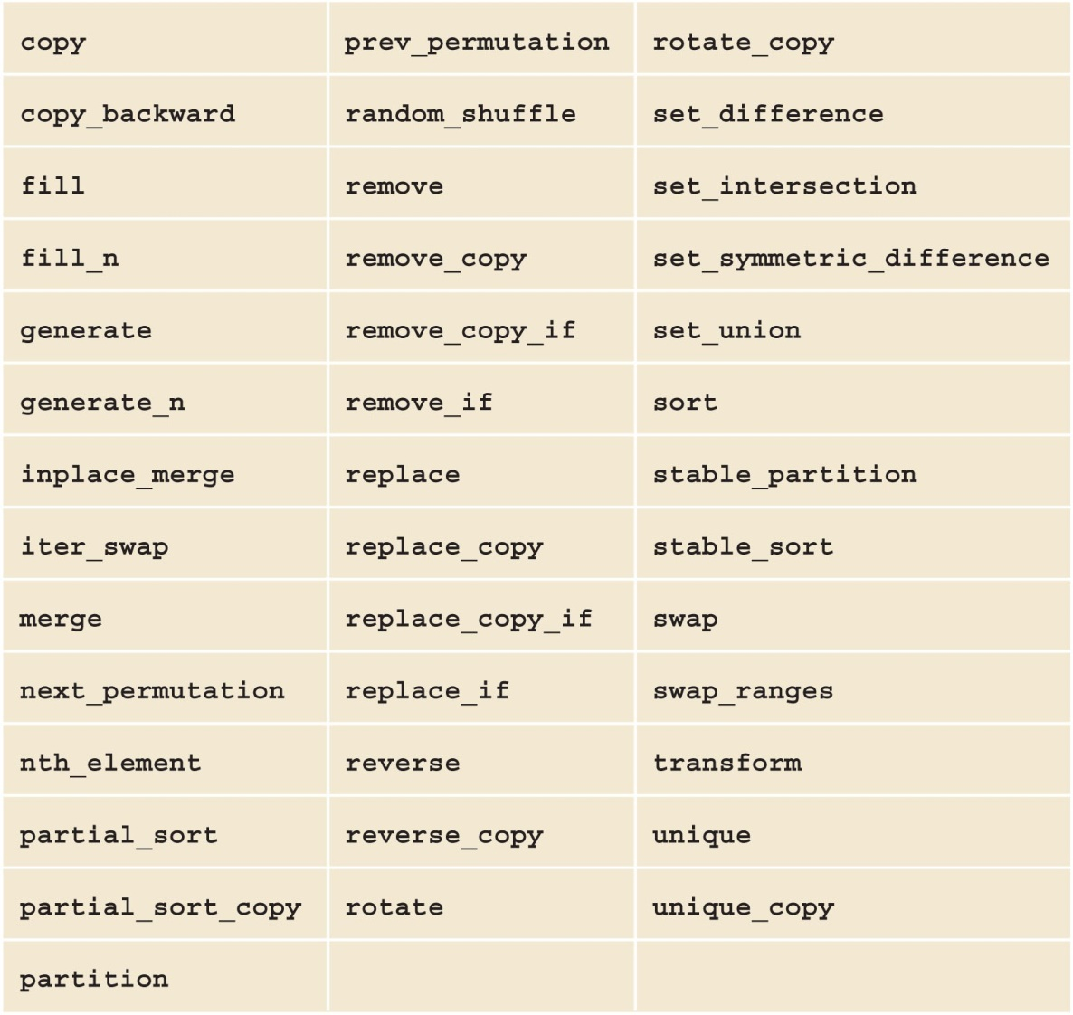
Modifying Algorithms
Modifying algorithms: modify the elements of the container
TABLE 21-23 Modifying Algorithms

Slide 49
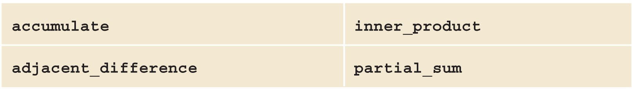
Numeric Algorithms
Perform numeric calculations on elements of a container
TABLE 21-24 Numeric Algorithms

Slide 50
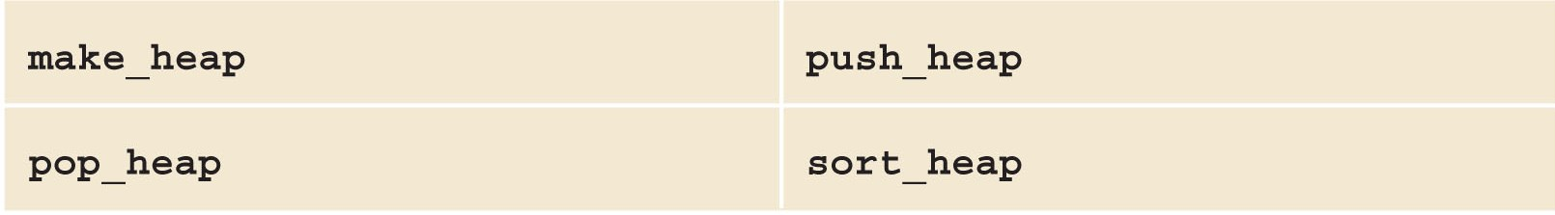
Heap Algorithms
Heap sort algorithm sorts array data
Array containing the data is viewed as a binary tree
TABLE 21-25 Heap Algorithms

Slide 51
Function Objects (1 of 2)
To make a generic algorithm flexible, the STL usually provides two forms
Use the natural operation to accomplish the goal
Specify criteria based on which algorithm processes the elements
Criteria are passed as a function object

Slide 52
Function Objects (2 of 2)
Function object: contains a function that can be treated as such using the operator()
Class template that overloads the function call operator
STL provides arithmetic, relational, and logical function objects
Contained in the header file functional
See Tables 21-26 through 21-28 in the text
Can also create your own

Slide 53
Predicates
Predicates: special types of function objects that return Boolean values
Two types
Unary: check a property for a single argument
Binary: check a specific property for a pair
Predicate must always return the same result for the same value
Functions that modify their internal states cannot be considered predicates

Slide 54
Insert Iterator
STL provides 3 insert iterators to insert elements at the desired destination
back_inserter: uses push_back in place of = operator; the argument is the container
front_inserter: uses push_front; argument is the container itself
Cannot be used for the vector container
inserter: uses insert operation; must pass container and an iterator specifying the position at which the insertion should begin

Slide 55
STL Algorithms
STL algorithms include documentation with the function prototypes
The parameter types indicate for which type of container the algorithm is applicable

Slide 56
The Functions fill and fill_n
Fill functions
fill: fills a container with elements
fill_n: fills in the next n elements
filling element is passed as a parameter
Defined in header file algorithm

Slide 57
The Functions generate and generate_n
Generate functions
generate: fills a sequence
generate_n: fills a sequence in a range
Defined in header file algorithm

Slide 58
The Functions find, find_if, find_end, and find_first_of
Find functions
find: searches for searchValue
find_if: searched for element for which op(rangeElement) is true
find_end: searches for last occurrence
find_first_of: searches for first occurrence

Slide 59
The Functions remove, remove_if, remove_copy, and remove_copy_if
Remove functions
remove: removes certain elements from a sequence
remove_if: removes elements from a sequence by using some criteria
remove_copy: copies all elements except those specified by value
remove_copy_if: copies all elements except those for which op(element) is true

Slide 60
The Functions replace, replace_if, replace_copy, and replace_copy_if
Replace and copy functions
replace: replaces all occurrences with given range
replace_if: replaces all occurrences with given range satisfying some criteria
replace_copy: combination of replace and copy
replace_copy_if: combination of replace_if and copy_if

Slide 61
The Functions swap, iter_swap, and swap_ranges
Swap functions
swap: swaps values of object1 and object2
iter_swap: swaps values to which iterators first and second point
swap_ranges: swaps one range of elements with another range of elements

Slide 62
The Functions search, search_n, sort, and binary_search
Search and sort functions
search: searches for a subrange
search_n: searches count consecutive occurrences of value
sort: reorders elements in a range in ascending order
binary_search: returns true if searchValue is found in the range

Slide 63
The Functions adjacent_find, merge, and inplace_merge
adjacent_find: finds the first occurrence of consecutive elements that meet criteria
merge: merges sorted lists
inplace_merge: combines sorted consecutive sequences

Slide 64
The Functions reverse, reverse_copy, rotate, and rotate_copy
Reverse and rotate functions
reverse: reverses element order in given range
reverse_copy: reverses elements of a given range while copying into a destination range; the source is not modified
rotate: rotates elements of a given range
rotate_copy: combination of rotate and copy; elements of the source are copied at the destination in a rotated order

Slide 65
The Functions count, count_if, max, max_element, min, min_element, and random_shuffle (1 of 2)
Count functions
count: counts occurrence of a given item in a given range
count_if: counts occurrences of a given value in a given range satisfying a certain criterion

Slide 66
The Functions count, count_if, max, max_element, min, min_element, and random_shuffle (2 of 2)
Min/Max functions
min: determines the minimum of two values
max: determines the maximum of two values
max_element: determines the largest element in a given range
min_element: determines the smallest element in a given range
Shuffle function
random_shuffle: randomly orders elements

Slide 67
The Functions for_each and transform
for_each: accesses and processes each element in a given range by applying a function
transform: creates a sequence of elements at the destination by applying the unary operation to each element in the range

Slide 68
The Functions includes, set_intersection, set_union, set_difference, and set_symmetric_difference
Set functions
includes: determines if elements in one range appear in another range
set_intersection: finds elements that are common to two ranges
set_union: finds elements that are contained in two ranges of elements
set_difference: finds elements in one range that are not in the other range
set_symmetric_difference: creates a sequence of sorted elements that are in one range but not the other, in both directions

Slide 69
The Functions accumulate, adjacent_difference, inner_product, and partial_sum
Numerical functions
accumulate: finds the sum of all elements in a given range
adjacent_difference: creates a sequence in which the first element is the same, and all other elements are the differences of the current and previous elements
inner_product: multiplies corresponding elements of two ranges
partial_sum: creates a sequence in which each element is the sum of all previous elements in the range

Slide 70
Summary (1 of 2)
STL consists of
Containers: class templates
Iterators: step through the elements of a container
Algorithms: manipulate the elements in a container
Containers
Sequence: vector, deque, and list
Associative: sets, multisets, maps, and multimaps
Container adapters: stacks, queues, and priority queues

Slide 71
Summary (2 of 2)
Iterators: input, output, forward, bidirectional, and random access iterator
Predicates: Boolean function objects
Algorithms: nonmodifying, modifying, numerical, and heap
Algorithms are overloaded for flexibility

