Slide 1
Chapter 13
Overloading and Templates

Slide 2
Objectives (1 of 2)
In this chapter, you will:
Learn about overloading
Become familiar with the restrictions on operator overloading
Examine the pointer this
Learn about friend functions
Learn how to overload operators as members and nonmembers of a class

Slide 3
Objectives (2 of 2)
Discover how to overload various operators
Become familiar with the requirements for classes with pointer member variables
Learn about templates
Explore how to construct function templates and class templates
Become aware of C++11 random number generators

Slide 4
Introduction
Templates enable you to write generic code for related functions and classes
Function templates simplify function overloading

Slide 5
Why Operator Overloading Is Needed (1 of 2)
Consider the following statements:
clockType myClock(8, 23, 34);
clockType yourClock(4, 5, 30);
Which version of C++ statements would you prefer?
myClock.printTime();
myClock.incrementSeconds();
if (myClock.equalTime(yourClock))
.
.
.
cout << myClock;
myClock++;
if (myClock == yourClock)
.
.
.

Slide 6
Why Operator Overloading Is Needed (2 of 2)
Assignment and member selection are the only built-in operations on classes
Other operators cannot be applied directly to class objects
Operator overloading extends the definition of an operator to work with a user-defined data type
C++ allows you to extend the definitions of most of the operators to work with classes

Slide 7
Operator Overloading
Most existing C++ operators can be overloaded to manipulate class objects
New operators cannot be created
An operator function is a function that overloads an operator
Use reserved word operator followed by the operator as the function name

Slide 8
Syntax for Operator Functions
Syntax of an operator function heading:
It is a value-returning function
operator is a reserved word
To overload an operator for a class:
Include the operator function declaration in the class definition
Write the definition of the operator function

Slide 9
Overloading an Operator: Some Restrictions
Cannot change the precedence of an operator
Associativity cannot be changed
Default parameters cannot be used
Cannot change number of parameters
Cannot create new operators
Cannot overload: . .* :: ?: sizeof
How the operator works with built-in types remains the same
Can overload for user-defined objects or for a combination of user-defined and built-in objects

Slide 10
Pointer this
Every object of a class maintains a (hidden) pointer to itself called this
When an object invokes a member function
this is referenced by the member function

Slide 11
Friend Functions of Classes
A friend function (of a class) is a nonmember function of the class that has access to all the members of the class
Use the reserved word friend in the function prototype in the class definition
Friendship is always given by the class
class classIllusFriend
{
friend void two(/*parameters*/);
.
.
.
};

Slide 12
Definition of a friend Function
friend does not appear in the heading of the function’s definition
When writing the friend function’s definition
The name of the class and the scope resolution operator are not used
void two(/*parameters*/)
{
.
.
.
}

Slide 13
Operator Functions as Member and Nonmember Functions
To overload (), [], ->, or = for a class, the function must be a member of the class
Suppose op is overloaded for opOverClass:
If the leftmost operand of op is an object of a different type, the overloading function must be a nonmember (friend) of the class
If the overloading function for op is a member of opOverClass, then when applying op on objects of type opOverClass, the leftmost operand must be of type opOverClass

Slide 14
Overloading Binary Operators
If # represents a binary operator (e.g., + or ==) that is to be overloaded for rectangleType
It can be overloaded as either a member function of the class or as a friend function

Slide 15
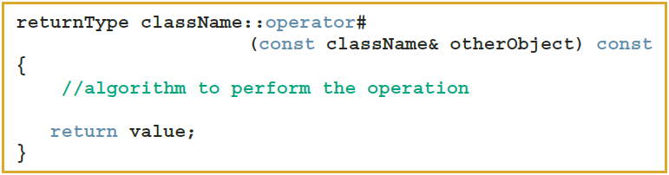
Overloading the Binary Operators as Member Functions
Function prototype (included in the class definition):
Function definition:

Slide 16

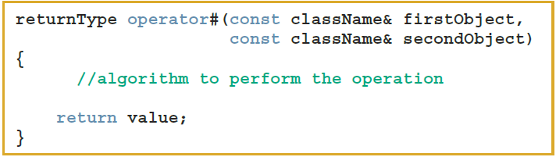
Overloading the Binary Operators (Arithmetic or Relational) as Nonmember Functions
Function prototype (included in class definition):
Function definition:

Slide 17
Overloading the Stream Insertion (<<) and Extraction (>>) Operators
Consider the expression:
cout << myRectangle;
Leftmost operand is an ostream object, not a rectangleType object
Thus, the operator function that overloads << for rectangleType must be a nonmember function of the class
The same applies to the function that overloads >>

Slide 18
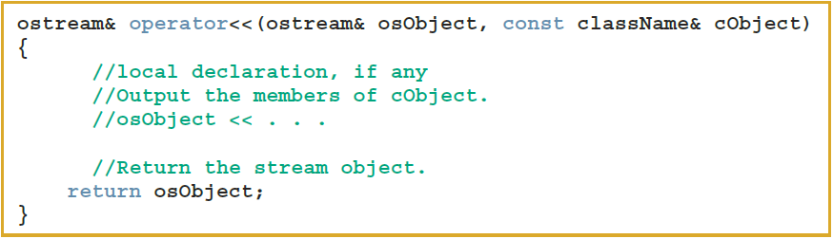
Overloading the Stream Insertion Operator (<<)
Function prototype:
Function definition:

Slide 19
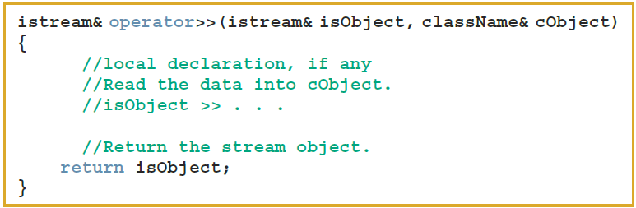
Overloading the Stream Extraction Operator (>>)
Function prototype:
Function definition:

Slide 20
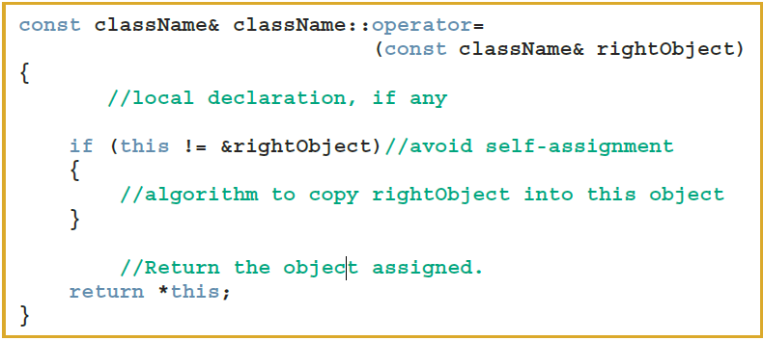
Overloading the Assignment Operator (=)
Function prototype:
Function definition:

Slide 21
Overloading Unary Operators
To overload a unary operator for a class:
If the operator function is a member of the class, it has no parameters
If the operator function is a nonmember (i.e., a friend function), it has one parameter

Slide 22

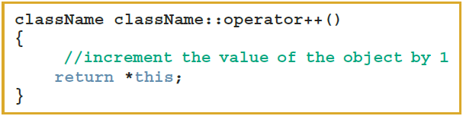
Overloading the Increment (++) and Decrement (--) Operators (1 of 4)
General syntax to overload the pre-increment operator ++ as a member function
Function prototype:
Function definition:

Slide 23
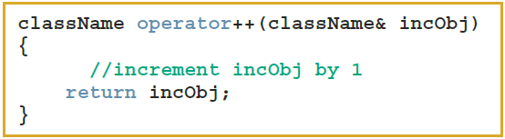
Overloading the Increment (++) and Decrement (--) Operators (2 of 4)
General syntax to overload the pre-increment operator ++ as a nonmember function
Function prototype:
Function definition:

Slide 24

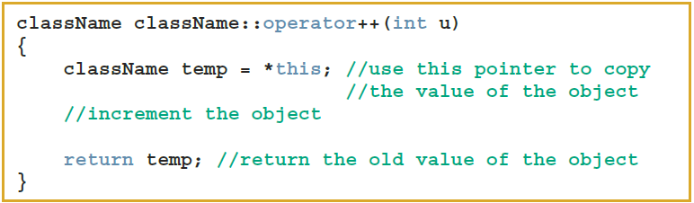
Overloading the Increment (++) and Decrement (--) Operators (3 of 4)
General syntax to overload the post-increment operator ++ as a member function:
Function prototype:
Function definition:

Slide 25
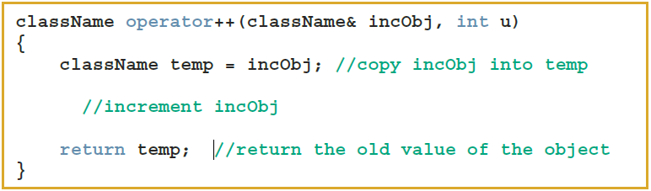
Overloading the Increment (++) and Decrement (--) Operators (4 of 4)
General syntax to overload the post-increment operator ++ as a nonmember function:
Function prototype:
Function definition:

Slide 26
Operator Overloading: Member versus Nonmember (1 of 2)
Some operators must be overloaded as member functions and some must be overloaded as nonmember (friend) functions
Binary arithmetic operator + can be overloaded either way
As a member function, operator + has direct access to data members of one of the objects
Need to pass only one object as a parameter

Slide 27
Operator Overloading: Member versus Nonmember (2 of 2)
Overload + as a nonmember function
Must pass both objects as parameters
Code may be somewhat clearer this way

Slide 28
Classes and Pointer Member Variables (Revisited)
Recall that the assignment operator copies member variables from one object to another of the same type
Does not work well with pointer member variables
Classes with pointer member variables must:
Explicitly overload the assignment operator
Include the copy constructor
Include the destructor

Slide 29
Operator Overloading: One Final Word
If an operator op is overloaded for a class, e.g., rectangleType
When you use op on objects of type rectangleType, the body of the function that overloads the operator op for the class rectangleType executes
Therefore, whatever code you put in the body of the function executes

Slide 30

Overloading the Array Index (Subscript) Operator ([])
Syntax to declare operator[] as a member of a class for nonconstant arrays:
Syntax to declare operator[] as a member of a class for constant arrays:

Slide 31
Function Overloading
Overloading a function refers to having several functions with the same name, but different parameters
The parameter list determines which function will execute
Must provide the definition of each function

Slide 32

Templates (1 of 2)
Template: a single code body for a set of related functions (function template) and related classes (class template)
Syntax:
Type is the data type
declaration is either a function declaration or a class declaration

Slide 33
Templates (2 of 2)
class in the heading refers to any user-defined type or built-in type
Type is a formal parameter to the template
Just as variables are parameters to functions, data types are parameters to templates

Slide 34

Function Templates
Syntax of the function template:
Type is a formal parameter of the template used to:
Specify type of parameters to the function
Specify return type of the function
Declare variables within the function

Slide 35

Class Templates
Class template: a single code segment for a set of related classes
Called parameterized types
Syntax:
A template instantiation can be created with either a built-in or user-defined type
The function members of a class template are considered to be function templates

Slide 36
Header File and Implementation File of a Class Template (1 of 2)
Passing a parameter to a function takes effect at run time
Passing a parameter to a class template takes effect at compile time
Cannot compile the implementation file independently of the client code
Can put class definition and definitions of the function templates directly in the client code
Can put class definition and the definitions of the function templates in the same header file

Slide 37
Header File and Implementation File of a Class Template (2 of 2)
Another alternative is to put class definition and function definitions in separate files
Include directive to the implementation file at the end of the header file
In either case, function definitions and client code are compiled together

Slide 38
C++11 Random Number Generator
To use C++ 11 random number generator functions we use an engine and a distributor
An engine returns unpredictable (random) bits
A distribution returns random numbers whose likelihoods correspond to a specific shape such as a uniform or normal distribution
The C++11 standard library provides 25 distribution types in five categories
uniform_int_distribution and uniform_real_distribution fall in the category of uniform distributions

Slide 39
Quick Review (1 of 3)
An operator that has different meanings with different data types is said to be overloaded
Operator function: a function that overloads an operator
operator is a reserved word
Operator functions are value-returning
Operator overloading provides the same concise notation for user-defined data types as for built-in data types

Slide 40
Quick Review (2 of 3)
Only existing operators can be overloaded
The pointer this refers to the object
A friend function is a nonmember of a class
If an operator function is a member of a class
The leftmost operand of the operator must be a class object (or a reference to a class object) of that operator’s class

Slide 41
Quick Review (3 of 3)
Classes with pointer variables must overload the assignment operator, and include both the copy constructor and the destructor
In C++, template is a reserved word
Function template: a single code segment for a set of related functions
Class template: a single code segment for a set of related classes
Are called parameterized types
C++11 provides many functions to implement random number generator.

