Slide 1
Chapter 20
Graphs

Slide 2
Objectives
In this chapter, you will:
Learn about graphs
Become familiar with the basic terminology of graph theory
Discover how to represent graphs in computer memory
Explore graphs as ADTs
Examine and implement various graph traversal algorithms
Learn how to implement the shortest path algorithm
Examine and implement the minimal spanning tree algorithm

Slide 3
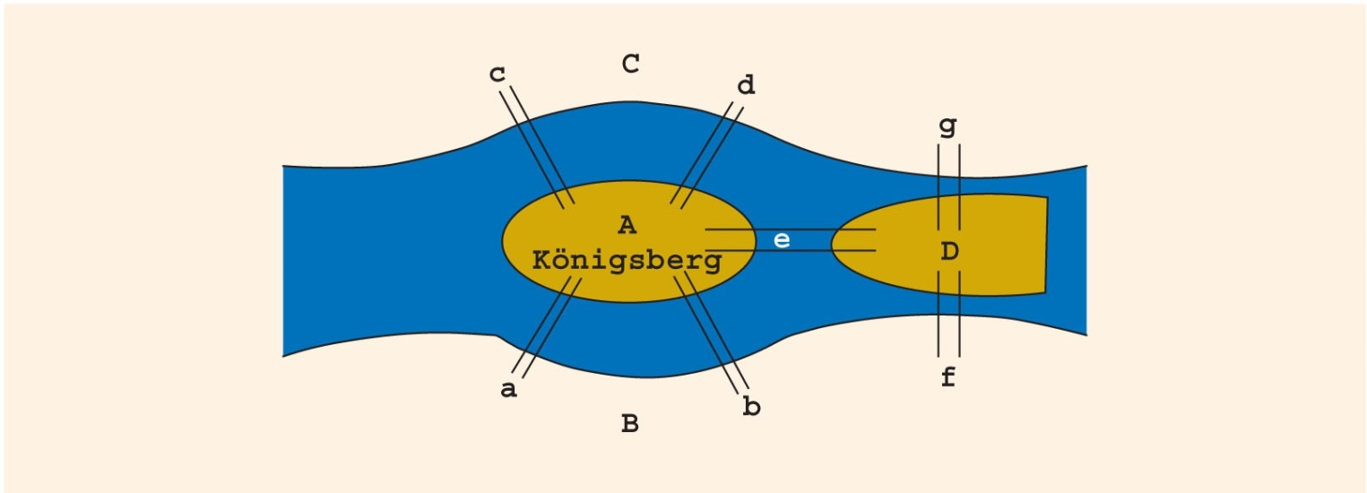
Introduction (1 of 3)
Königsberg bridge problem
The river Pregel flows around the island Kneiphof and then divides into two branches
FIGURE 20-1 Königsberg bridge problem

Slide 4

Introduction (2 of 3)
Starting at one land area, can you cross all bridges exactly once and return to the start?
In 1736, Euler represented the problem as a graph and answered the question: No
FIGURE 20-2 Graph representation of Königsberg bridge problem

Slide 5
Introduction (3 of 3)
Over the past 200 years, graph theory has been applied to a variety of problems, including:
Model electrical circuits, chemical compounds, highway maps, etc.
Analysis of electrical circuits, finding the shortest route, project planning, linguistics, genetics, social science, etc.

Slide 6
Graph Definitions and Notations (1 of 8)
a ∈ X: a is an element of the set X
Subset (Y ⊆ X): every element of Y is also an element of X
Intersection (A ∩ B): contains all the elements in A and B
A ∩ B = {x | x ∈ A and x ∈ B}
Union (A ∪ B): set of all the elements that are in A or in B
A ∪ B = {x | x ∈ A or x ∈ B}

Slide 7
Graph Definitions and Notations (2 of 8)
A × B: set of all the ordered pairs of elements of A and B
A × B = {(a, b) | a ∈ A, b ∈ B}
Graph G: G = (V, E)
V is a finite nonempty set of vertices of G
E ⊆ V × V
Elements in E are the pairs of elements of V
E is called set of edges

Slide 8
Graph Definitions and Notations (3 of 8)
Directed graph or digraph: elements of E(G) are ordered pairs
Undirected graph: elements not ordered pairs
If (u, v) is an edge in a directed graph
Origin: u
Destination: v
Subgraph H of G: if V(H) ⊆ V(G) and E(H) ⊆ E(G)
Every vertex and edge of V is in G

Slide 9
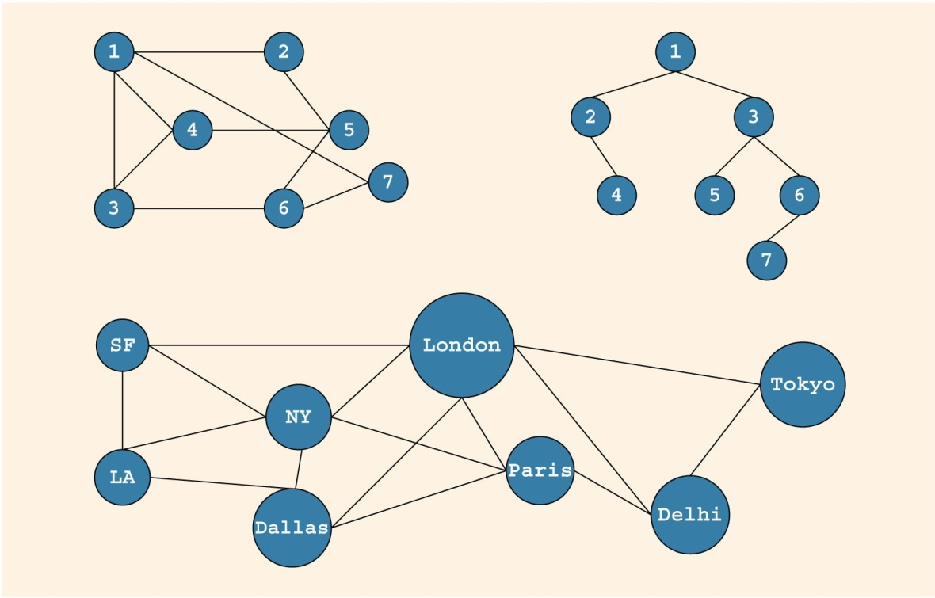
Graph Definitions and Notations (4 of 8)
FIGURE 20-3 Various undirected graphs

Slide 10
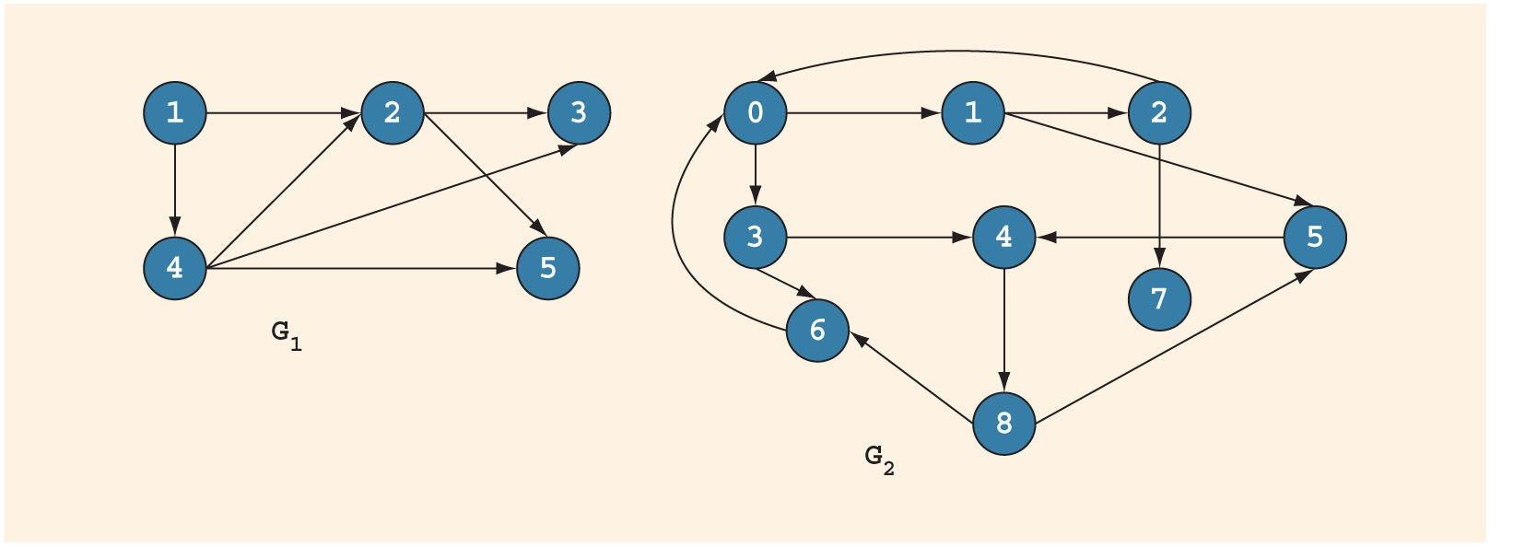
Graph Definitions and Notations (5 of 8)
FIGURE 20-4 Various directed graphs

Slide 11
Graph Definitions and Notations (6 of 8)
Adjacent: there is an edge from one vertex to the other; i.e., (u, v) ∈ E(G)
Incident: if edge e = (u, v), then e is incident on u and v
Loop: edge incident on a single vertex
Parallel edges: associated with the same pair of vertices
Simple graph: has no loops or parallel edges

Slide 12
Graph Definitions and Notations (7 of 8)
Path: sequence of vertices u₁, u₂, ..., u_{n} such that u = u₁, u_{n} = v, and (u_{i}, u_{i + 1}) is an edge for all i = 1, 2, ..., n − 1
Connected vertices: there is a path from u to v
Simple path: path in which all vertices, except possibly the first and last, are distinct
Cycle: simple path in which the first and last vertices are the same

Slide 13
Graph Definitions and Notations (8 of 8)
Connected: path exists from any vertex to any other vertex
Component: maximal subset of connected vertices
In a connected graph G, if there is an edge from u to v, i.e., (u, v) ∈ E(G), then u is adjacent to v and v is adjacent from u
Strongly connected: any two vertices in G are connected

Slide 14
Graph Representation
To write programs that process and manipulate graphs:
Must store graphs in computer memory
A graph can be represented in several ways:
Adjacency matrices
Adjacency lists

Slide 15
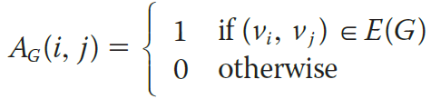
Adjacency Matrix
G: graph with n vertices (n > 0)
V(G) = {v₁, v₂, ..., v_{n}}
Adjacency matrix (A_{G} of G): two-dimensional n × n matrix such that:
Adjacency matrix of an undirected graph is symmetric

Slide 16
Adjacency Lists (1 of 2)
G: graph with n vertices (n > 0)
V(G) = {v₁, v₂, ..., v_{n}}
Linked list corresponding to each vertex, v,
Each node of linked list contains the vertex, u, such that (u,v) ∈ E(G)
Each node has two components, such as vertex and link

Slide 17
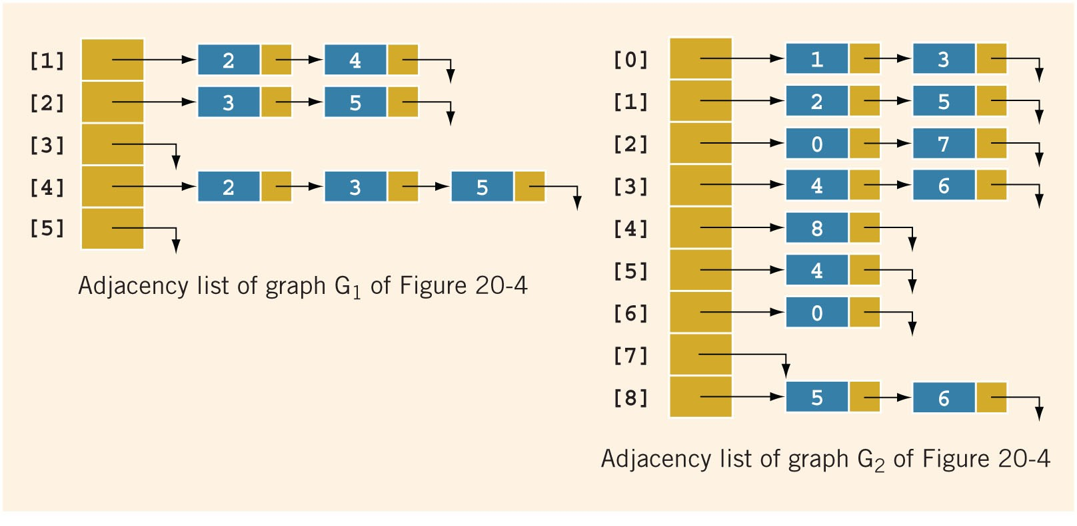
Adjacency Lists (2 of 2)
FIGURE 20-5 Adjacency list of graphs of Figure 20-4

Slide 18
Operations on Graphs (1 of 2)
Operations commonly performed on a graph
Create the graph
Clear the graph
Makes the graph empty
Determine whether the graph is empty
Traverse the graph
Print the graph

Slide 19
Operations on Graphs (2 of 2)
The adjacency list (linked list) representation
For each vertex, v, vertices adjacent to v are stored in linked list associated with v
In a directed graph, vertices adjacent to v are called immediate successors
To manage data in a linked list, use class unorderedLinkedList

Slide 20
Graphs as ADTs
We implement graphs as an abstract data type (ADT), including functions to:
Create/clear the graph
Print the graph
Traverse the graph
Determine the graph’s size

Slide 21
Graph Traversals
Traversing a graph is similar to traversing a binary tree, except that:
A graph might have cycles
Might not be able to traverse the entire graph from a single vertex
Most common graph traversal algorithms
Depth first traversal
Breadth first traversal

Slide 22
Depth First Traversal (1 of 2)
Depth first traversal at a given node, v
Mark node v as visited
Visit the node
for each vertex u adjacent to v
if u is not visited
start the depth first traversal at u
This is a recursive algorithm

Slide 23

Depth First Traversal (2 of 2)
Depth-first ordering of vertices:
0, 1, 4, 3, 2, 5, 7, 8, 6, 9
Breadth-first ordering of vertices:
0, 1, 3, 4, 2, 5, 7, 8, 6, 9
FIGURE 20-6 Directed graph G

Slide 24
Breadth First Traversal
Breadth first traversal of a graph
Similar to traversing a binary tree level by level
Nodes at each level are visited from left to right
Starting at the first vertex, the graph is traversed as much as possible
Then go to next vertex not yet visited
Use a queue to implement the breadth first search algorithm

Slide 25
Shortest Path Algorithm (1 of 9)
Weight of the edge: nonnegative real number assigned to the edges connecting two vertices
Weighted graph: every edge has a nonnegative weight
Weight of the path P
Sum of the weights of all edges on the path P
Also called the weight of v from u via P
Source: starting vertex in the path

Slide 26
Shortest Path Algorithm (2 of 9)
Shortest path: path with the smallest weight
Shortest path algorithm
Called the greedy algorithm, developed by Dijkstra
G: graph with n vertices, where n ≥ 0
V(G) = {v₁, v₂, ..., v_{n}}
W: two-dimensional n × n matrix

Slide 27
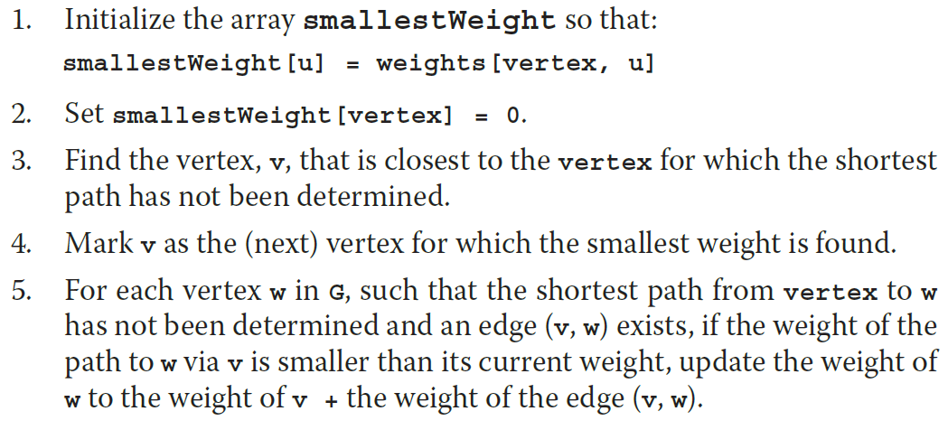
Shortest Path Algorithm (3 of 9)
Shortest path algorithm
For n vertices, repeat Steps 3 through 5, n – 1 times.

Slide 28

Shortest Path Algorithm (4 of 9)
FIGURE 20-7 Weighted graph G

Slide 29
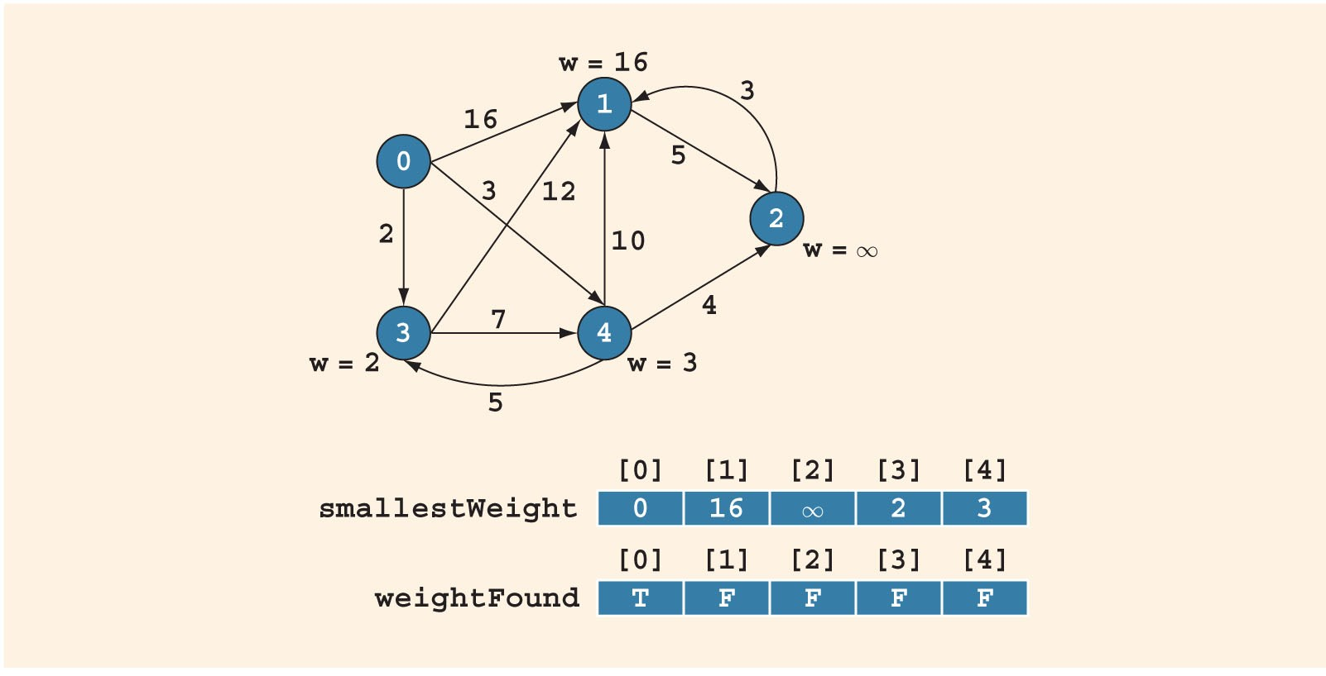
Shortest Path Algorithm (5 of 9)
FIGURE 20-8 Graph after Steps 1 and 2 execute

Slide 30
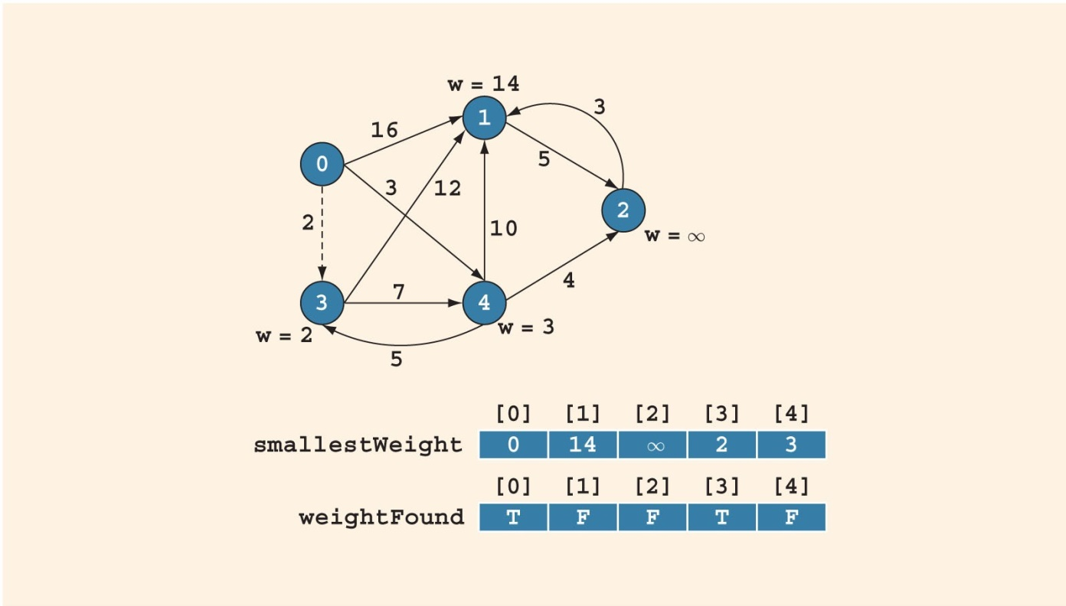
Shortest Path Algorithm (6 of 9)
Graph after first iteration of Steps 3, 4, and 5
FIGURE 20-9 Graph after the first iteration of Steps 3 to 5

Slide 31
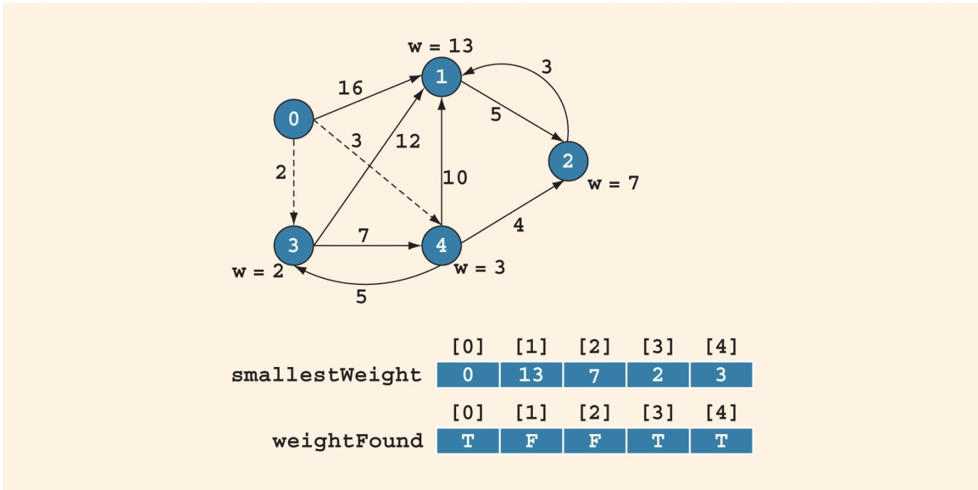
Shortest Path Algorithm (7 of 9)
Graph after second iteration of Steps 3, 4, and 5
FIGURE 20-10 Graph after the second iteration of Steps 3 to 5

Slide 32

Shortest Path Algorithm (8 of 9)
Graph after third iteration of Steps 3, 4, and 5
FIGURE 20-11 Graph after the third iteration of Steps 3 to 5

Slide 33
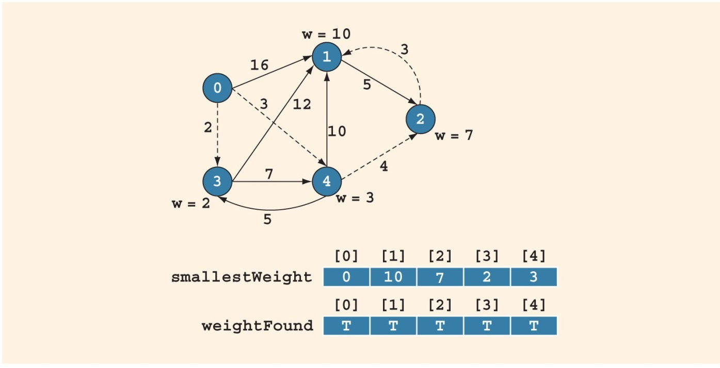
Shortest Path Algorithm (9 of 9)
Graph after fourth iteration of Steps 3, 4, and 5
FIGURE 20-12 Graph after the fourth iteration of Steps 3 to 5

Slide 34
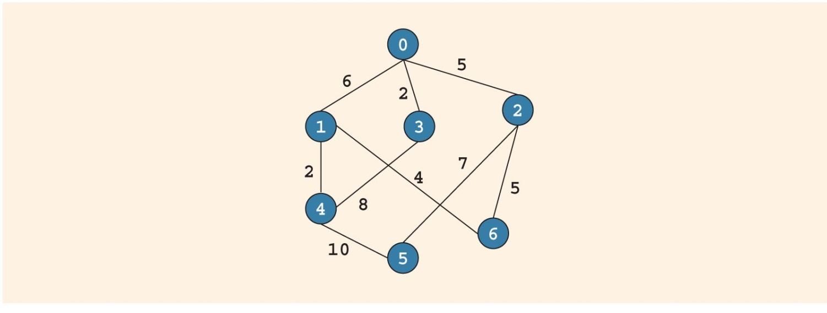
Minimal Spanning Tree (1 of 6)
Company needs to shut down a maximum number of connections and still be able to fly from one city to another
FIGURE 20-13 Airline connections between cities and the cost factor of maintaining the connections

Slide 35
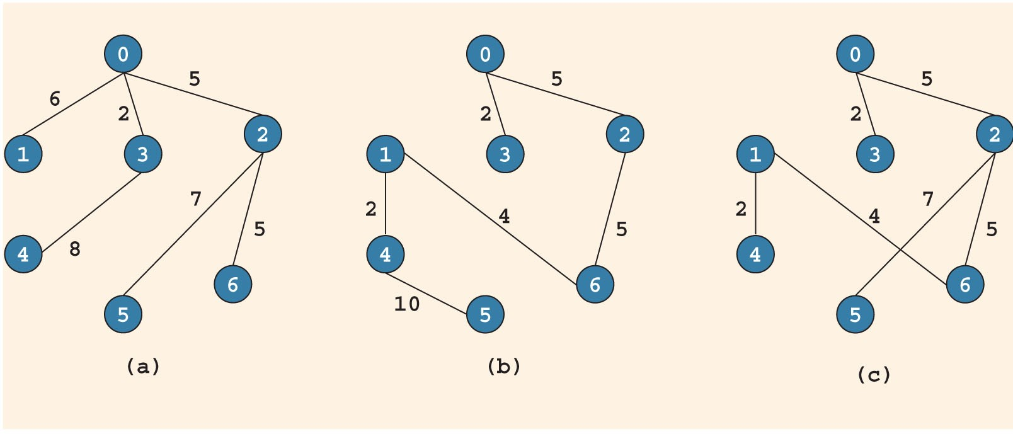
Minimal Spanning Tree (2 of 6)
FIGURE 20-14 Possible solutions to the graph of Figure 20-13

Slide 36
Minimal Spanning Tree (3 of 6)
(Free) tree: simple graph such that if u and v are two vertices in T, then there is a unique path from u to v
Rooted tree: tree in which a particular vertex is designated as a root
Weighted tree: tree in which a weight is assigned to the edges
Weight of T: sum of the weights of all the edges in T, denoted by W(T)

Slide 37
Minimal Spanning Tree (4 of 6)
Spanning tree of graph G: if T is a subgraph of G such that V(T) = V(G)
All the vertices of G are in T
Figure 20-14 shows three spanning trees of the graph shown in Figure 20-13
Theorem: a graph G has a spanning tree if and only if G is connected
Minimal spanning tree: spanning tree in a weighted graph with the minimum weight

Slide 38
Minimal Spanning Tree (5 of 6)
Two well-known algorithms to find a minimal spanning tree
Kruskal’s algorithm
Prim’s algorithm
Builds the tree iteratively by adding edges until a minimal spanning tree is obtained
Start with a designated vertex, called the source vertex
At each iteration, a new edge that does not complete a cycle is added to the tree

Slide 39
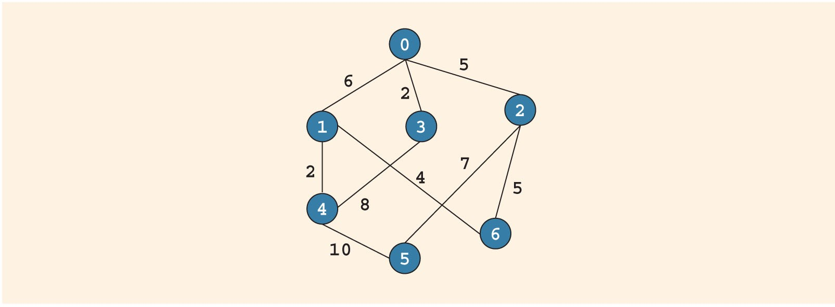
Minimal Spanning Tree (6 of 6)
FIGURE 20-15 Weighted graph G

Slide 40
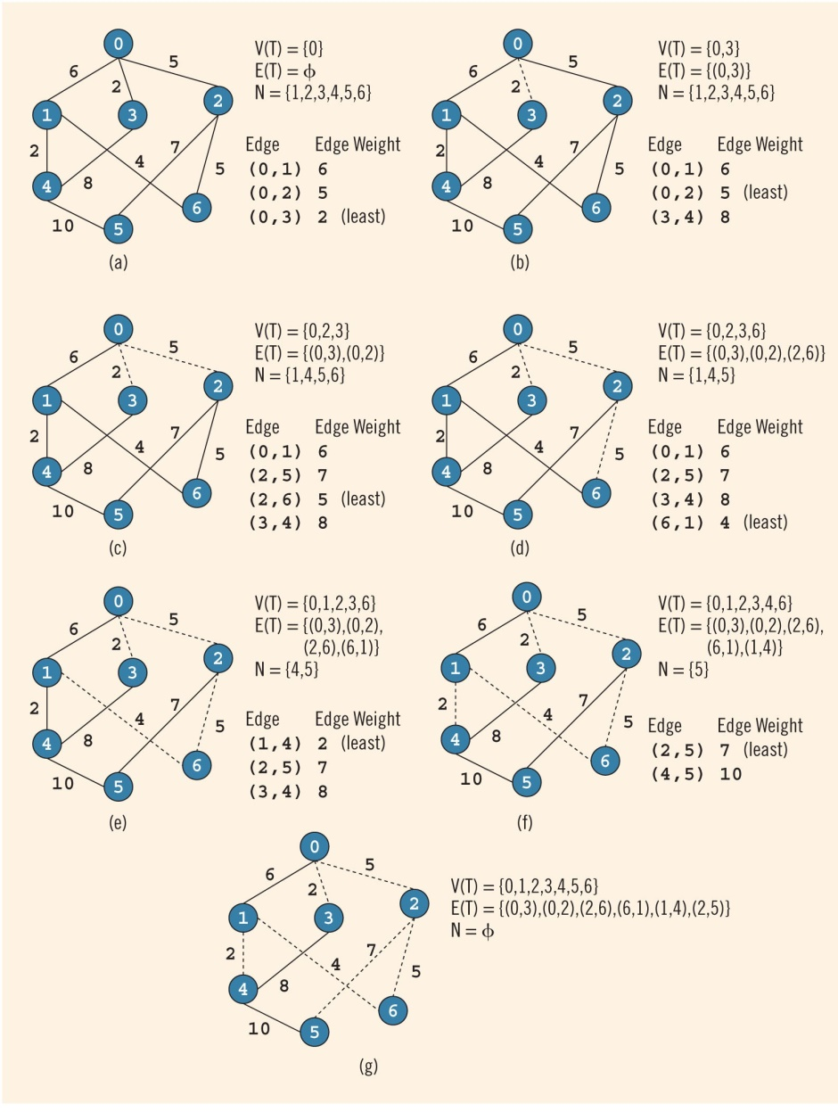
Prim’s Algorithm to Find a Minimal Spanning Tree
FIGURE 20-16 Prim’s algorithm to find a minimal spanning tree

Slide 41
Summary (1 of 3)
A graph G is a pair, G = (V, E)
In an undirected graph G = (V, E), the elements of E are unordered pairs
In a directed graph G = (V, E), the elements of E are ordered pairs
H is a subgraph of G if every vertex of H is a vertex of G and every edge is an edge in G
Two vertices in an undirected graph are adjacent if there is an edge between them

Slide 42
Summary (2 of 3)
Loop: an edge incident on a single vertex
Simple graph: no loops and no parallel edges
Simple path: all the vertices, except possibly the first and last vertices, are distinct
Cycle: a simple path in which the first and last vertices are the same
An undirected graph is connected if there is a path from any vertex to any other vertex

Slide 43
Summary (3 of 3)
Shortest path algorithm gives the shortest distance for a given node to every other node in the graph
In a weighted graph, every edge has a nonnegative weight
A tree in which a particular vertex is designated as a root is called a rooted tree
A tree T is called a spanning tree of graph G if T is a subgraph of G such that V(T) = V(G)

