Slide 1
Sleep Health and Lifestyle
John Little & Yeva Kramarova

Slide 2
Introduction
The dataset was found on Kaggle, and can be accessed here.
This dataset contains sleep information and covers a wide range of variables related to sleep and health habits. It contains data on sleep duration quality, basic health and fitness information, and information on the study’s participants (age and gender). We will be using logistic regression to predict whether an individual has a sleep disorder based on given information. We will then be using linear regression to predict the sleep quality of an individual. The variables are as follows:

Slide 3
Variable Descriptions
-Person ID: An identifier for each individual participant.
-Gender: The gender of each person (Male or Female).
-Age: The age of each person in years.
-Occupation: The occupation of each person.
-Sleep Duration: The number of hours the person sleeps per day.
-Quality of Sleep: A subjective rating of the quality of sleep, from 1 to 10.
-Physical Activity Level: The number of minutes each person engages in physical activity daily.
-Stress Level: A subjective rating of the stress level experienced by the person, from 1 to 10.
-BMI Category: The BMI category of the person (Underweight, Normal, Overweight, Obese)
-Blood Pressure: The blood pressure of the person (systolic/diastolic)
-Heart Rate: The resting heart rate of the person in beats per minute (bpm)
-Daily Steps: The number of steps the person takes per day.
-Sleep Disorder: What sleep disorder the person has (No Disorder, Insomnia, Sleep Apnea)

Slide 4
Background
The data is synthetic and made only for illustrative purposes by the author. The author is a machine learning engineer, and this dataset was only created to demonstrate machine learning techniques. Therefore, there was no particular question that the author was trying to answer.

Slide 5
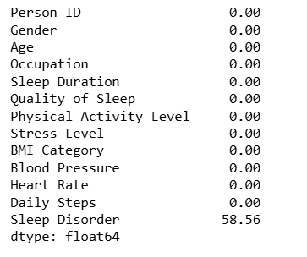
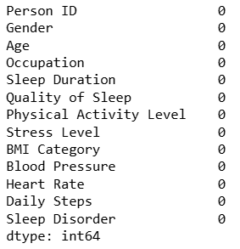
Data Preparation
Determined where the missing data is
Investigated missing data rows
Used imputation dictionary to replace missing “Sleep Disorder” data with “No Disorder”

Slide 6
Exploratory Data Analysis
This dataset contains 374 rows and 13 columns with various data types.

Slide 7
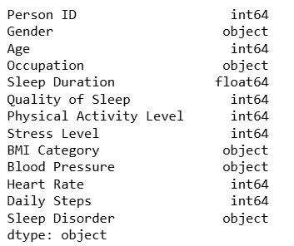
Data Types

Slide 8
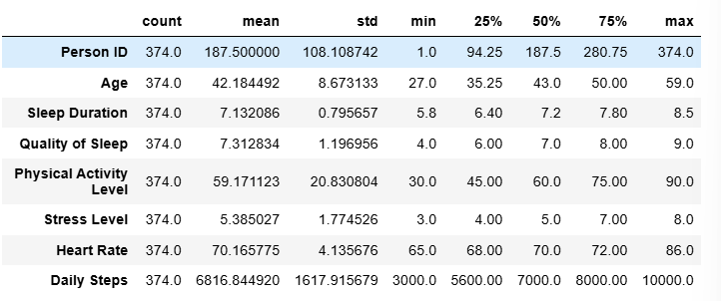
Data Statistics

Slide 9
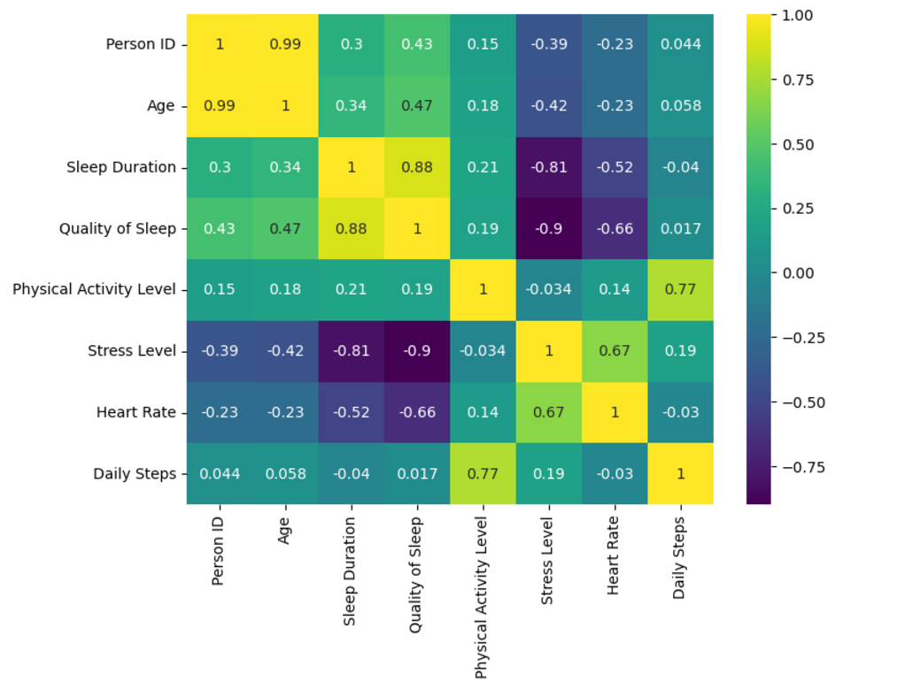
Correlation Heatmap

Slide 10
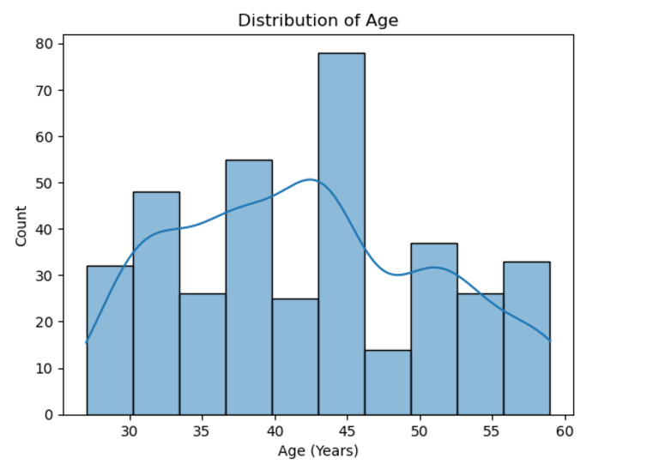

Slide 11
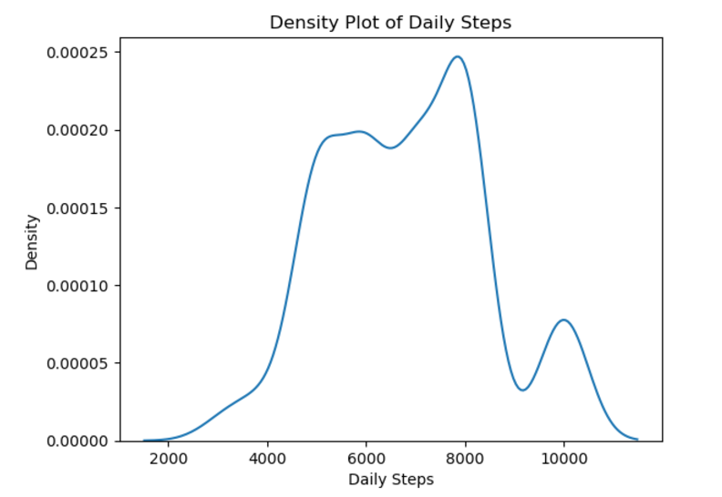

Slide 12
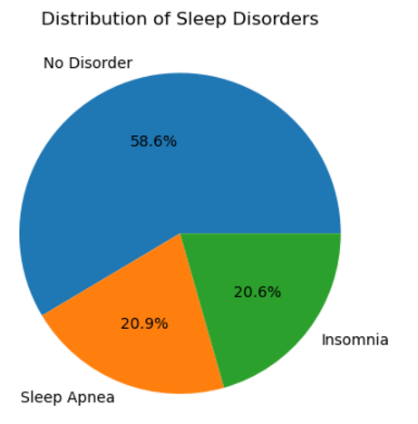

Slide 13
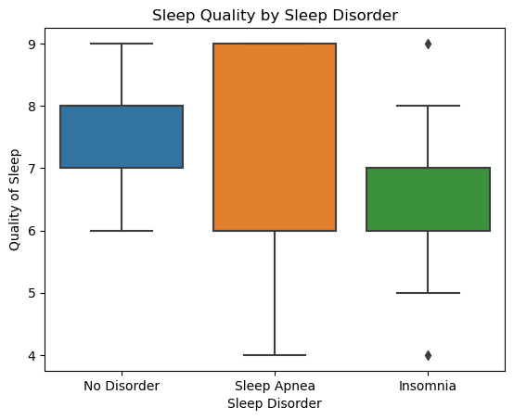
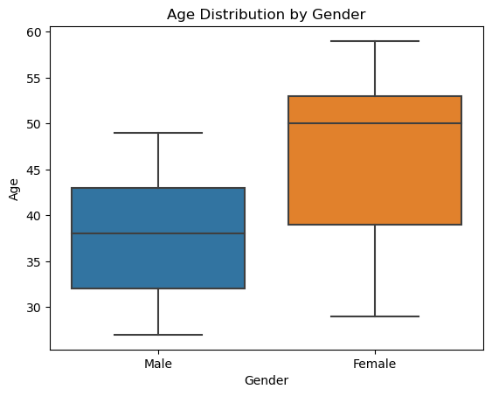

Slide 14
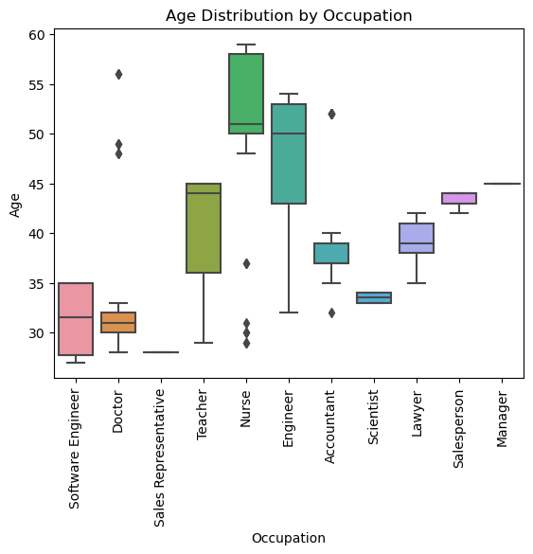

Slide 15
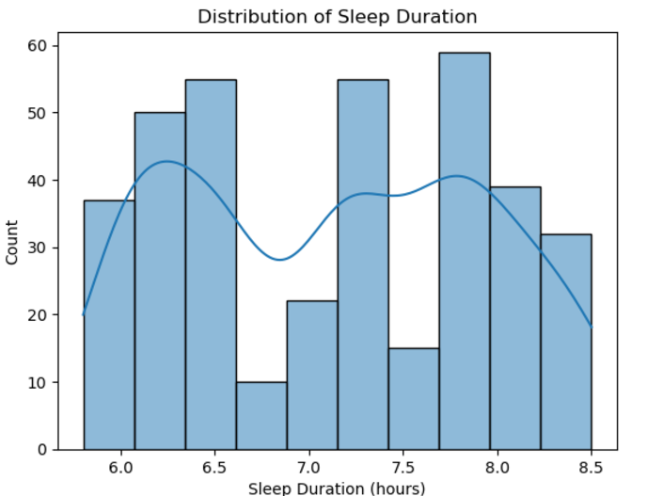
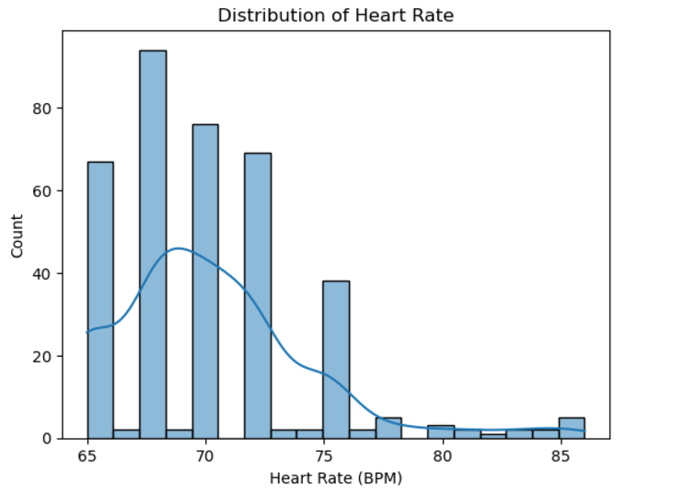

Slide 16
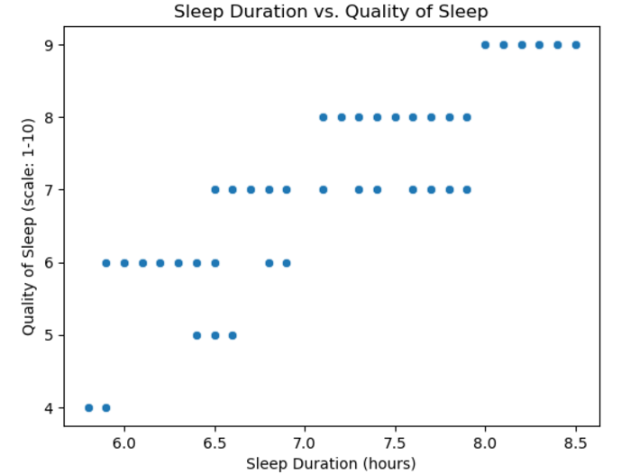
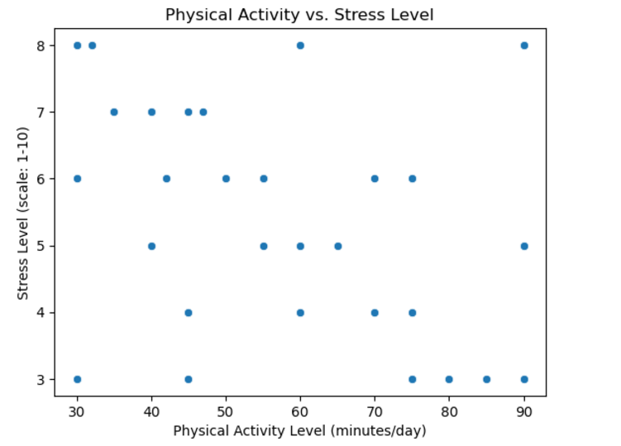

Slide 17
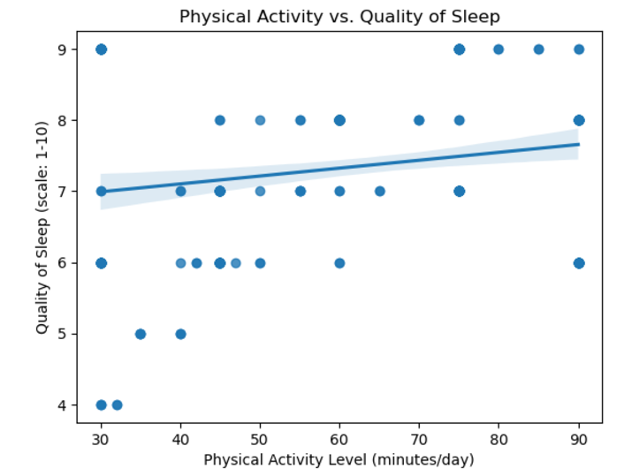
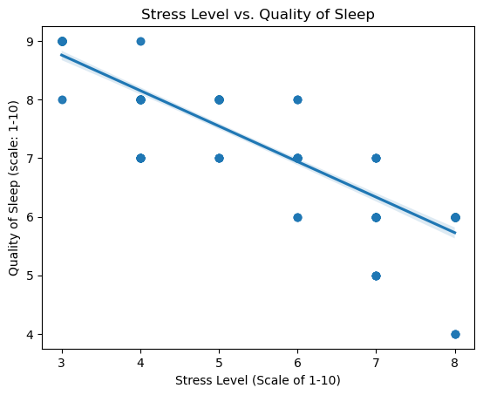

Slide 18
Machine Learning

Slide 19
Method Used for Linear Regression
First, coded the dummies by One-Hot Encode tool (Gender, BMI, Sleep Disorder)
Trained the model on 80/20 split. Metrics:
- MSE: 0.0654; RMSE: 0.2558; R-squared: 0.9567.
Trained the model on 70/30 split: Metrics:
- MSE: 0.0731; RMSE: 0.2703; R-squared: 0.7048.
To predict the quality of sleep (on a scale from 1-10):
- independent variables: Age, Stress Level, Physical Activity Level, Sleep Duration, Daily Steps, Gender, BMI Category, Sleep Disorder (10).

Slide 20
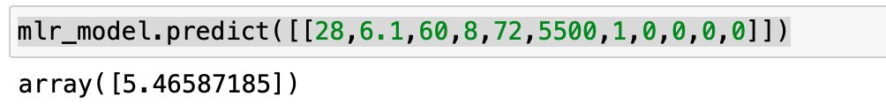
Results
The quality of sleep score for:
- 28 years old
- male
- sleep duration of 6 hours
- physical activity level of 60
- stress level of 8
- heart rate of 72
- daily steps of 5500
- normal weight
- no sleeping disorder
Our model predicts a quality of score
of 5.46 / 10.

Slide 21
Method Used for Logistic Regression
Same One-Hot Encoding for Gender and BMI
Combining "Sleep Apnea" and "Insomnia" and replacing with "Has No Sleeping Disorder"
Metrics:
- Accuracy: 92% (29 out of 32 instances of "Has a Disorder"
- Both Precision and Recall: 93% (accurate predicting "Has No Disorder")
- F1: 90% (overall a good balance between precision and recall)
To predict whether an individual has a sleeping disorder:
- independent variables: Age, Stress Level, Physical Activity Level, Sleep Duration, Daily Steps, Gender, BMI Category (9).

Slide 22
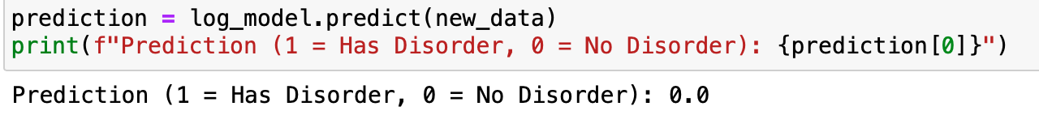
Results
To predict whether an individual has a sleeping disorder if:
- 28 years old
- male
- sleep duration of 6 hours
- physical activity level of 60
- stress level of 8
- heart rate of 72
- daily steps of 5500
- normal weight
- no sleeping disorder
Our model predicts that this individual has no sleeping disorder.

Slide 23
Problems, Limitations, and Improvements
Overall, no big problems with the dataset
One-Hot Encoding sometimes was problematic, requiring data imputation beforehand
Could be improved if more variables took place: such as food habits, smoking habits etc.

Slide 24
Conclusion
Stress seems to be strongly correlated to sleep duration and sleep quality.
As stress levels increase, sleep quality decreases.
As sleep duration increases, so does sleep quality.
People without a sleep disorder generally have better quality of sleep than people with insomnia.
Both the linear and logistic regression models of machine learning seems to work as intended.
According to all important metrics, the predictions are accurate and reliable.

